Slide 1
Communications
IGTF RAT Comms Challenge 3 Fall 2015
All work by Ursula Epting, SCC-KIT
Work by: Ursula Epting, SCC-KIT
Karlsruhe, DE

Slide 2
Interacting with the IGTF ID providers
Today
Every 1-6 hours: CRL retrieval
Every 24 hours: CRL Availability/Reliability check
Every ~2 years: RAT Communications challenge
Did we progress between 2013 and 2015 in response?
Can we answer some basic status questions as well?

Slide 3
RAT challenge results from 2013
In a strict interpretation we can say that ~30 % missed out on the requirement to react within one business day – only 70% were compliant
.. and 13% did not reply at all – and the rechallenge only marginally improved it ☹
Results communication test 2013: 76 % fullfilled the requirement - 24 % failed.
Data: Ursula Epting, KIT

Slide 4
Suspension guidance
IGTF 2015 All Hands meeting (Taipei) consensus:
"Sustained engagement of accredited authorities and timely response to policy and operational issues is essential to maintain the trust fabric. Consistent and long-term lack of communications, or persistent long-term operational issues, may lead to automatic or reviewed suspension and subsequent withdrawal of the trust anchor(s) of the authority from the IGTF trust anchor distribution.
An authority may be suspended without further review for operational reasons if after 30 days of commencement of an operational failure condition the issue cannot be resolved, and no remediation has been communicated to the PMA within this period.
An authority may be suspended without further review when failing to respond to a designated Communications Challenge for more than 30 days.
An authority may be suspended subject to peer review in case of policy compliance issues.
At any time an authority suffering compliance issues may communicate with the PMA, provide a remediation plan addressing the issues, and request the suspension to be reviewed, deferred, or annulled. Such communication shall in itself cause automatic suspension to be deferred.“

Slide 5
RATCC3 – Fall 2013
Results of the communications challenge 3
Results on the SHA-1 to SHA-2 migration questionnaire

Slide 6
The intention of the test was to check whether the registered email addresses of accredited IGTF-CA's are correct and how good communication works.
correct email addresses are the basis for all communication
effective communication is essential in an infrastructure providing elementary security, like the IGTF PKI
Why should we care?
In case of a security incident or compromised certificate it is very important that a CA quickly processes revocation requests, i.e. revoke a certificate and issue a new CRL – which uses the registered email address of the CA in the distribution

Slide 7
Comms Challenge 3 description
The test started with the announcement that a communication test will be executed within the next 3 weeks. This information went to all accredited CA's, included in the IGTF-Release 1.69.
These CA's then received an email and have been requested to answer within one business day. If no replies arrived reminders were sent to that CA's. Additionally they were asked two questions which could be answered within one week. (Part two of this talk)
The number of CA's in the IGTF-release at the time of testing: 96
Notice: 'A CA' refers again to one CA-certificate. If there is a hierarchical structure with e.g. root-, server-, user-CA this will count as three CA's while in fact it is only one CA-structure.

Slide 8
Time line
6th November, Announcement of the test
25th November, 12.00 h, Start of the test
26th November, 12.05 h, Reminder for non-replying CAs
27th November, 13.00 h, 2nd Reminder
28th November, End of the test
Notice 1: The specified test times refer to UTC/GMT +2, CEST +1
Notice 2: no reminders were sent for the two additional questions

Slide 9
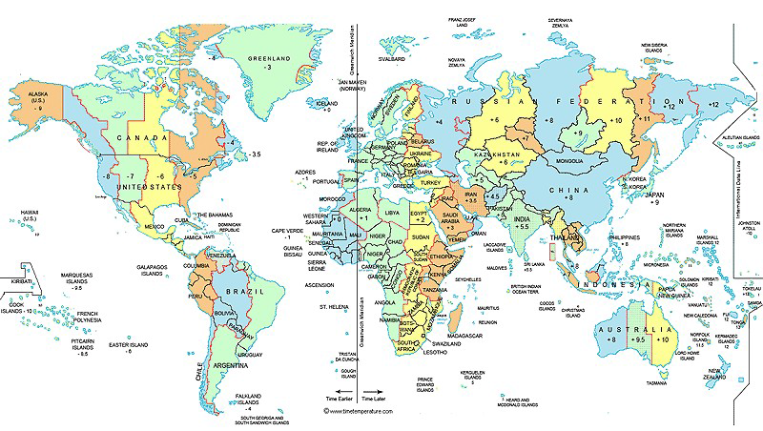
Time measurement
As the test victims are spread all over the world and therefore live in different time zones, the target response time 'within one business day' was interpreted as 24 h referring to the location of the test sender.
Response times were also measured in this sense. All emails received by the test sender within 1 hour after the start of the test, count for 'CA replied within 1 hour' regardless of the timezone of the CA.

Slide 10
Detailed time view
42 % of the CA's have replied within the first hour (last time 30%), which shows that there was again a very high motivation to contribute to a successful test result!
IGTF communication challenge Nov 2015
number of responses received →
hours after challenge start →

Slide 11
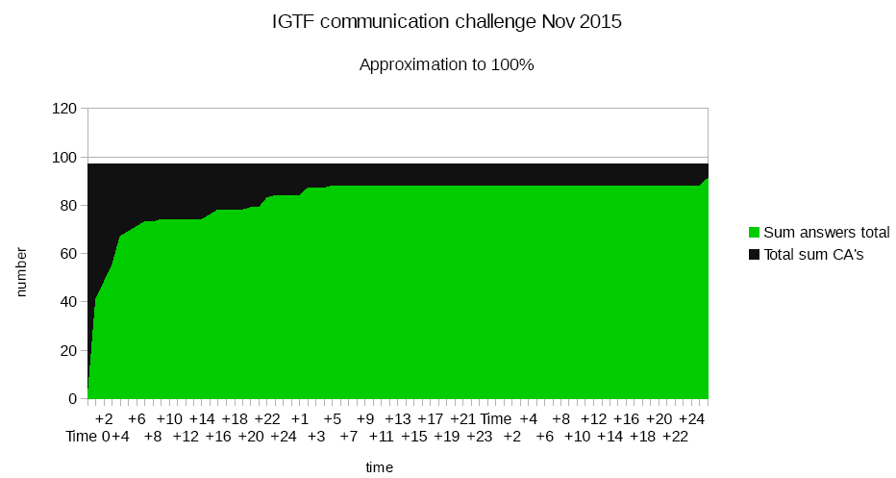
Results cumulative view
So answers from 100 % of all CA's has not been reached, but 88 % (hard) or 92 % (soft) or 95 % (very soft) have been responsive.

Slide 12
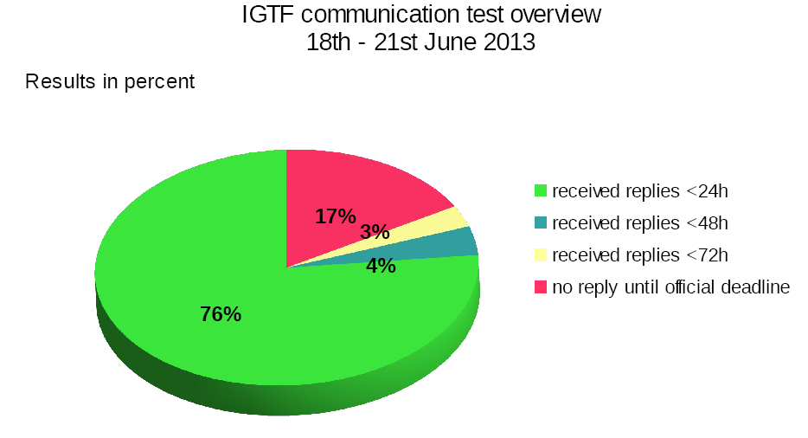
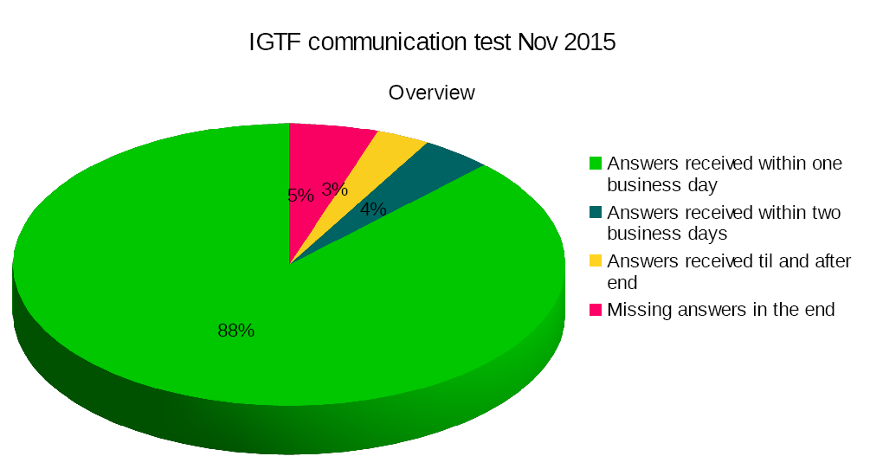
Results complete view (2015 & 2013)
The big majority of 88 % replied within 24 hours/one business day. Additionally 4% replied within 48 hours and 3 % replied later 5 % did not reply at all.
Notice: automatic replies of e.g. ticket systems were not counted

Slide 13
Interpretation
In a strict interpretation we can say that 88 % (76 % in 2013) fullfilled the requirement to react within one business day - while 12 % (24 % in 2013) failed.
So we did better this time! But is it good enough?
In a softer interpretation we can say that 95 % (83 % in 2013) are responsive while 5 % (17 % in 2013) are not.
So we have won 12 % ;) How to deal with the last 5 %?

Slide 14
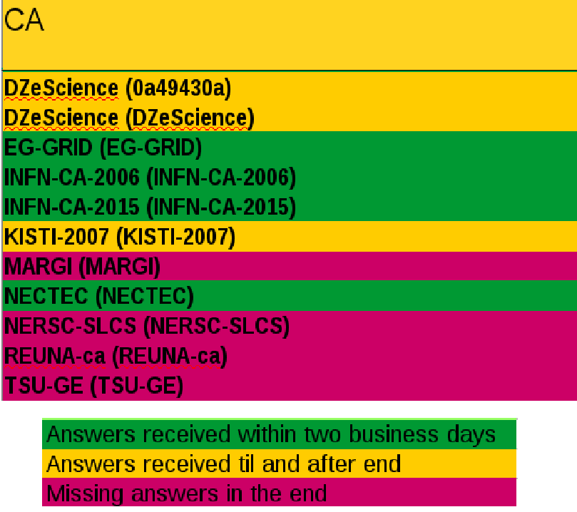
Specific cases
Challenge identified mail configuration issues (as usual)
Really troublesome ones will be contacted again via Chairs

Slide 15
Part 2: on SHA-1, -2, and so on
Do you issue sha2 signed certificates by default?
When is the last sha1 signed certificate going to expire?

Slide 16
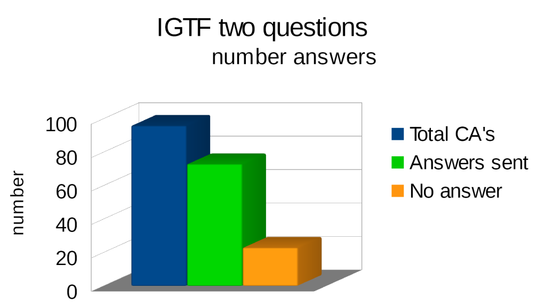
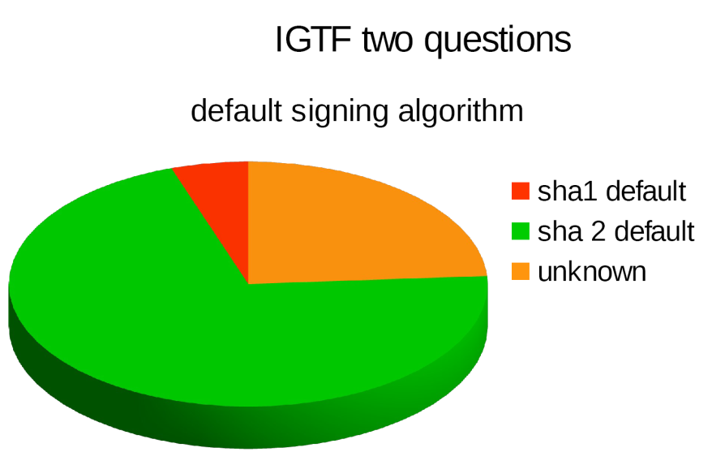
73 CA's did kindly answer the questions (76 %)
5 of them still issue sha1-signed certificates, the other
68 issue sha2 (sha256/sha512) by default
23 CA's did not sent answers (24 %)

Slide 17
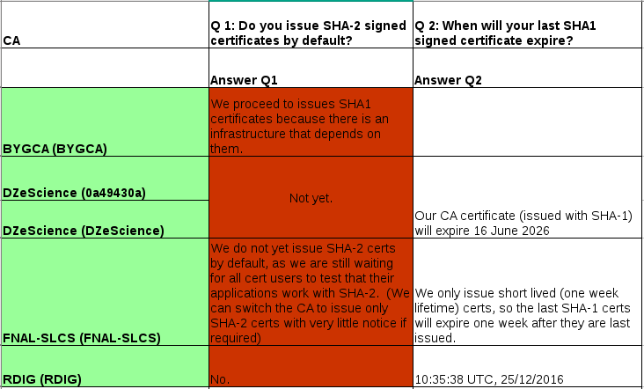
The SHA-1 CAs response summary

Slide 18
Why to stick to SHA-1?
Several CA's have some sha1-signed certs which will all expire within 2016
In Germany we have a special community for climate research which is not able to use sha2 and whishes to ‘use sha1 forever’…

Slide 19
Building a global trust fabric
Questions?

