Slide 1

Building Trust for Research and Collaboration
I2GS 2017 v01
bridging technology
and policy divides
David Groep
I2GS 2017
Image by Cristian Bortes, May 2011, CC-BY - https://flic.kr/p/9Uvwng

Slide 2
Putting the Policy Puzzle Together
IGTF
research and collaboration across
highly distributed communities
with bottom-up collaboration needs
ongoing global efforts
towards a common goal
Interoperation with global impact
FIM4R
REFEDS
WISE
GN4
AARC
. . .
SIRTFI

Slide 3
IGTF – Interoperable Global Trust Federation supporting distributed IT infrastructures for research
IGTF, started in 2000 as the EU DataGrid CA Coordination Group, brings together
  e-Infrastructure resource providers, user communities and identity authorities
  to agree on
  global, shared minimum requirements and assurance levels
  inspired and coordinated by the needs of relying parties
Trust is technology-agnostic
  focus on global, coordinated identity across communities and across service providers for cooperative services
  define ‘best practices’ for assurance levels, attribute authority operations, credential management, auditing and reviewing

Slide 4
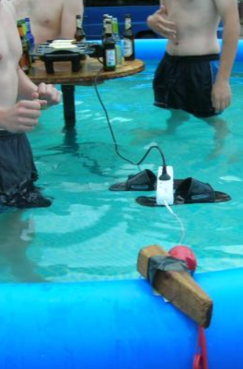
Relying Parties as a Key Stakeholder
Service providers (‘relying parties’) absorb almost all of the residual risk – as they host and manage resources under threat
Sources of ‘subject authority’ should
align with RP interests to be useful
RP must have policy controls to
compose sources of authority
RP must be equipped with
effective controls to mitigate risks
source: NorthWood LAN party 7 - http://www.linuxno.de/

Slide 5
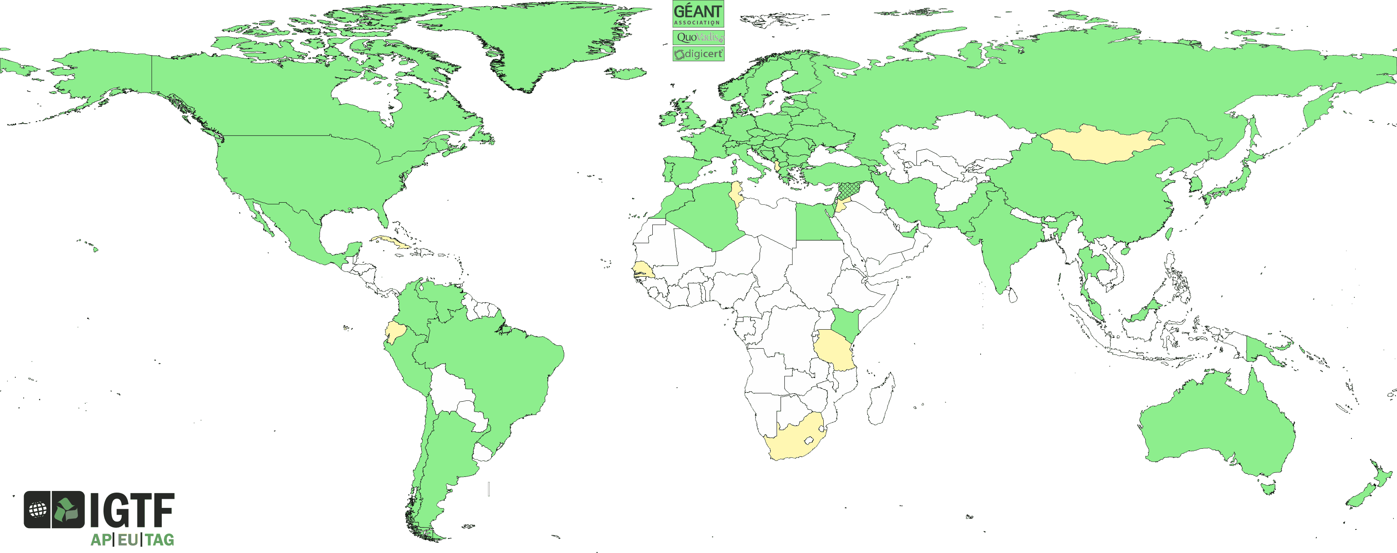
Coverage: users and providers
~100 000 users and resources
89 national and regional identity authorities: R&E and commercial
>1000 different user communities: small and large, national and global
Major relying parties: EGI, PRACE, XSEDE, Open Science Grid, HPCI, wLCG, OGF, …
IGTF is a coordinating body, and not a legal entity in itself – although its members may be
Premise is end-user (researcher) oriented
https://www.igtf.net/

Slide 6
Minimum Requirements & Peer Review
Federation imposes minimum requirements
on identity provider participants
  Reflect operational and security needs of resource providers
  Differentiated LoA support
    classic user-based subscriber services: serve all users
    identity services leveraging federations with ID vetting
    Identifier-Only Trust Assurance
    – if relying party has other ways to vet its users,
    leveraging identifier uniqueness and incident response
  Research-inspired verification process: self-audits,
  peer-review, transparent open policies and processes
  ‘meet or exceed’ required minimum standards
‘BIRCH’ , ‘Capuccino’
‘DOGWOOD’ , ‘Baseline’

Slide 7
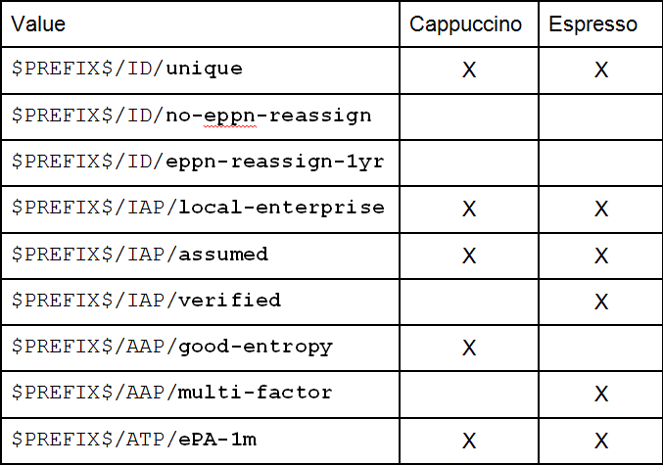
Differentiated Assurance Profile – in eduGAIN, REFEDS, and beyond
Specific definitive guidance to IdPs and federations
Logical grouping and profiles for the Infrastructures
Uniqueness at least ePUID or ePTID/NameID
extra: ePPN non-reassigned or 1-year-hiatus
ID proofing: ‘local enterprise’, ‘assumed’ (Kantara LoA2, IGTF BIRCH, eIDAS low), or ‘verified (LoA3, eIDAS substantial)
Authenticator: follow REFEDS MFA ‘good-entropy’ or ‘multi-factor’
Freshness: ePA/ePSA reflect departure
within 30 days
All: organisational-level authority, also used locally for ‘real work’, good security practices
… and simplicity for all
https://wiki.refeds.org/display/CON/Consultation%3A+REFEDS+Assurance+Framework

Slide 8
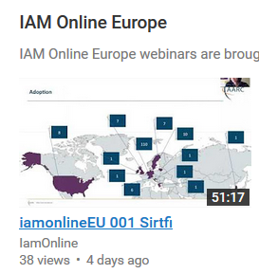
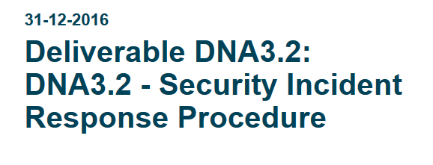
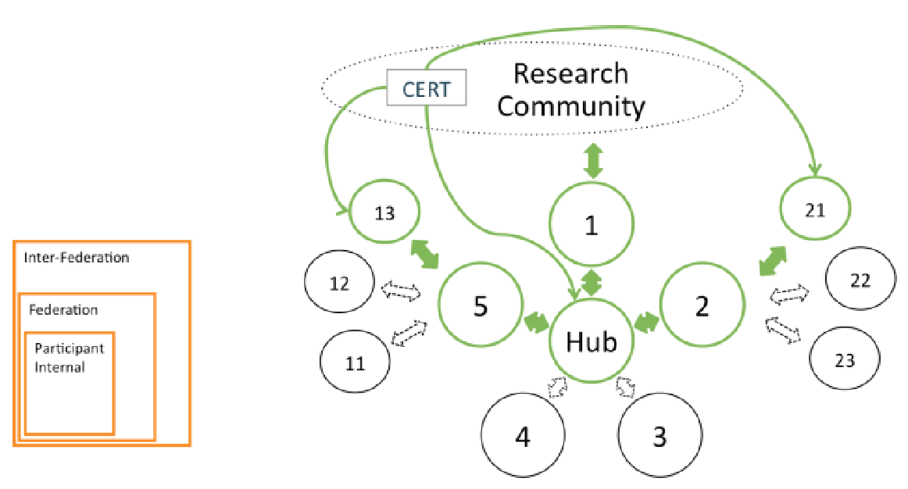
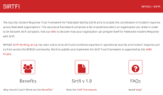

Fed Security Operational Procedures
‘A Very Timely Activity’
Incident response capabilities at IdPs and SPs:
Sirtfi v1 brings these to light
Beyond v1: establish proper channels,
expectations, and the operational capability
Establish ‘homogeneous’ Incident Response Procedure
with central operational capability
and information sharing
✓
Mar 17th 137 entities (+23) that support Sirtfi
Apr 23rd 160 entities (+23)
https://aarc-project.eu/wp-content/uploads/2017/02/DNA3.2-Security-Incident-Response-Procedure-v1.0.pdf

Slide 9
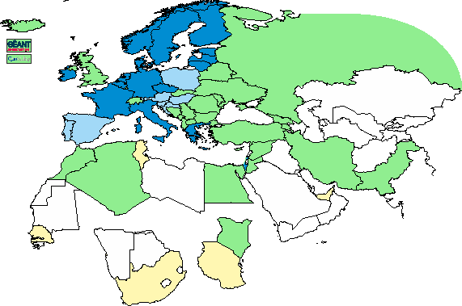
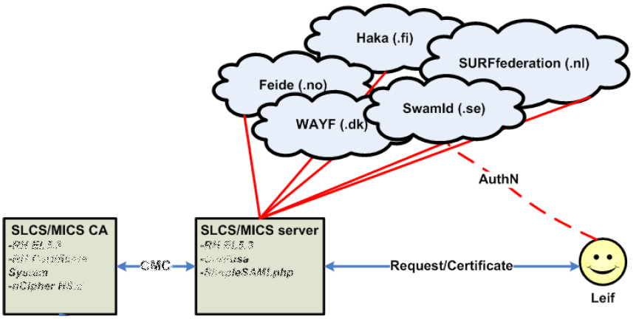
Trust is technology agnostic
SAML to PKIX
GEANT TCS
DFN AAI SLCS
CILogon
RCauth.eu
PKIX to SAML
IGTF Certificate Proxy @ GRNET
SLCS/MICS graphic: Jan Meijer, UNINETT

Slide 10
Seamless (eduGAIN) Access via the CILogon-like TTS Pilot: aims
Ability to serve a large pan-European user base without national restrictions
  without having to rely on specific national participation exclusively for this service
  serving the needs of cross-national user communities that have a large but sparsely distributed user base
Use existing resources and e-Infrastructure services
  without the needs for security model changes at the resource centre or national level
Allow integration of this system in science gateways and portals with minimal effort
  only light-weight industry-standard protocols, limit security expertise (and exposure)
Permit the use of the VOMS community membership service
  attributes for group and role management in attribute certificates
  also for portals and science gateways access the e-Infrastructure
Concentrate service elements that require significant operational expertise
  not burden research communities with the need to care for security-sensitive service components
  keep a secure credential management model
  coordinate compliance and accreditation – and help meet EU privacy stuff in just one place to ease adoption
Optional elements: ability to obtain CLI tokens (via web flow or ssh); implicit AuthZ

Slide 11
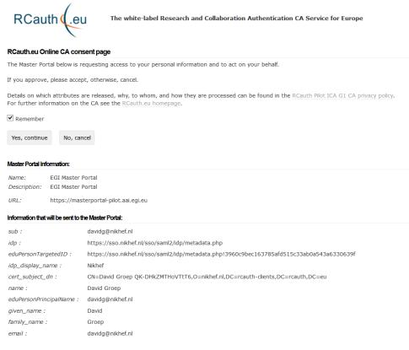
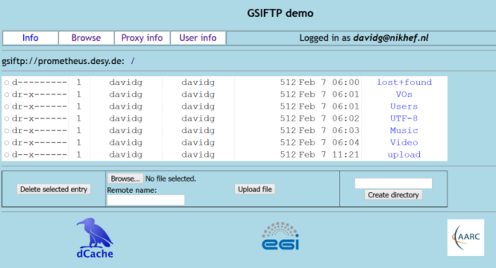
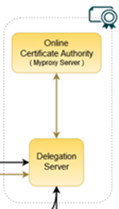
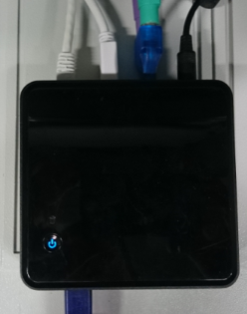

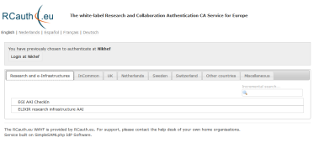


Flow for RCauth-like scenarios
Community Science Portal
Accredited
PKIX Authority
Infrastructure Master
Portal Credential Store
REFEDS R&S
Sirtfi Trust
User Home Org
or Infrastructure IdP
Policy Filtering WAYF / eduGAIN
Built on CILogon and MyProxy!
www.cilogon.org
11
see also https://rcdemo.nikhef.nl/
Notes:
VO portal can be anything even a simple shell
Certs stored only for 11 days
Master portal can add attributes via VOMS (or others in the future)

Slide 12
The Reverse: the IGTF-to-eduGAIN bridge
“the ultimate assured-identity IdP of last resort”
authenticate with any IGTF accredited client cert
known to the (SAML2int, R&E) eduGAIN community via GRnet
with assurance information in ePAss (and 2FA set in ACCR)
asserts REFEDS R&S and Sirtfi (based on IGTF qualification)
will appear as https://edugain-proxy.igtf.net/
R&S + Sirtfi tags should enable many research SPs to trust you
work by Ioannis Kakavas (GRNET) and Christos Kanellopoulos –
see github for implementation of SimpleSAMLphp module

Slide 13
davidg@nikhef.nl

