Slide 1
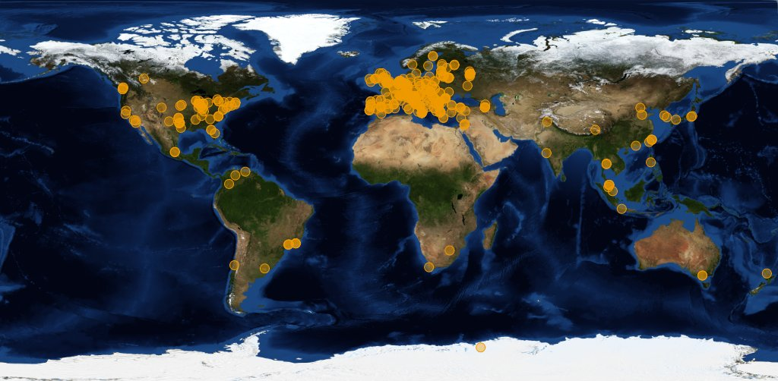




Image source: joint CERN (wLCG) and EGI
Organisations participating in the global collaboration of e-Infrastructures
Even just for wLCG, supporting the CERN LHC programme
More than 200 independent institutes with end-users
More than 50 countries & regions
More than 300 service centres
Handful regional ‘service coordination organisations’
300 000 CPU cores, 200+PByte storage
One independent ‘policy-bridge’ PKI

Slide 2
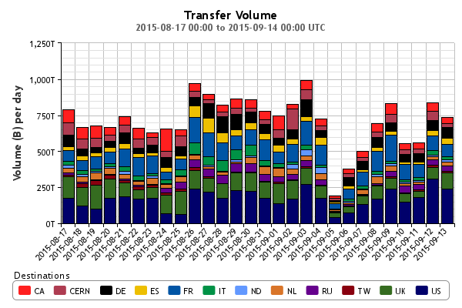
Big ‘as in Large’ Data
Atlas only
http://dashb-atlas-ddm.cern.ch/ddm2

Slide 3
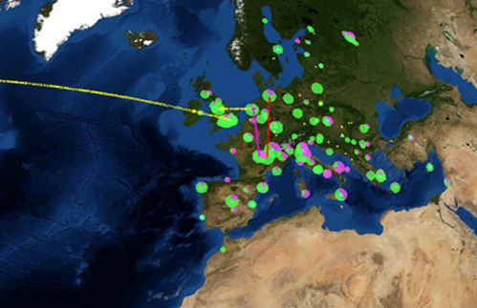
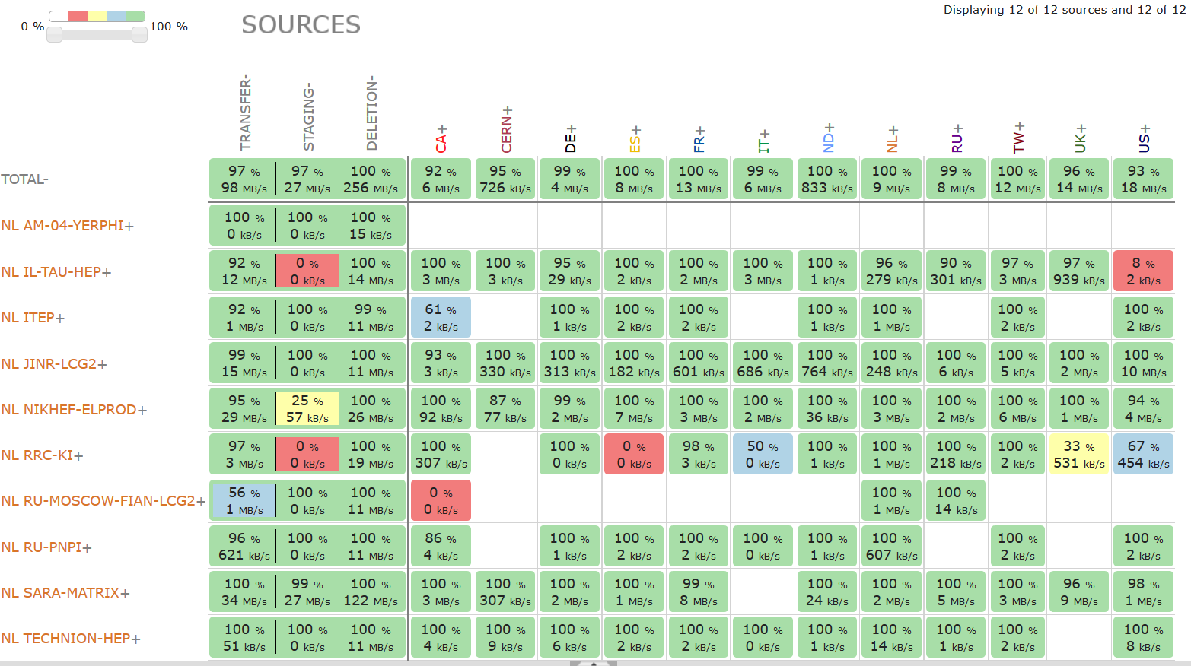
Distributed analysis – ‘Atlas neighbours’
http://dashb-atlas-ddm.cern.ch/ddm2

Slide 4
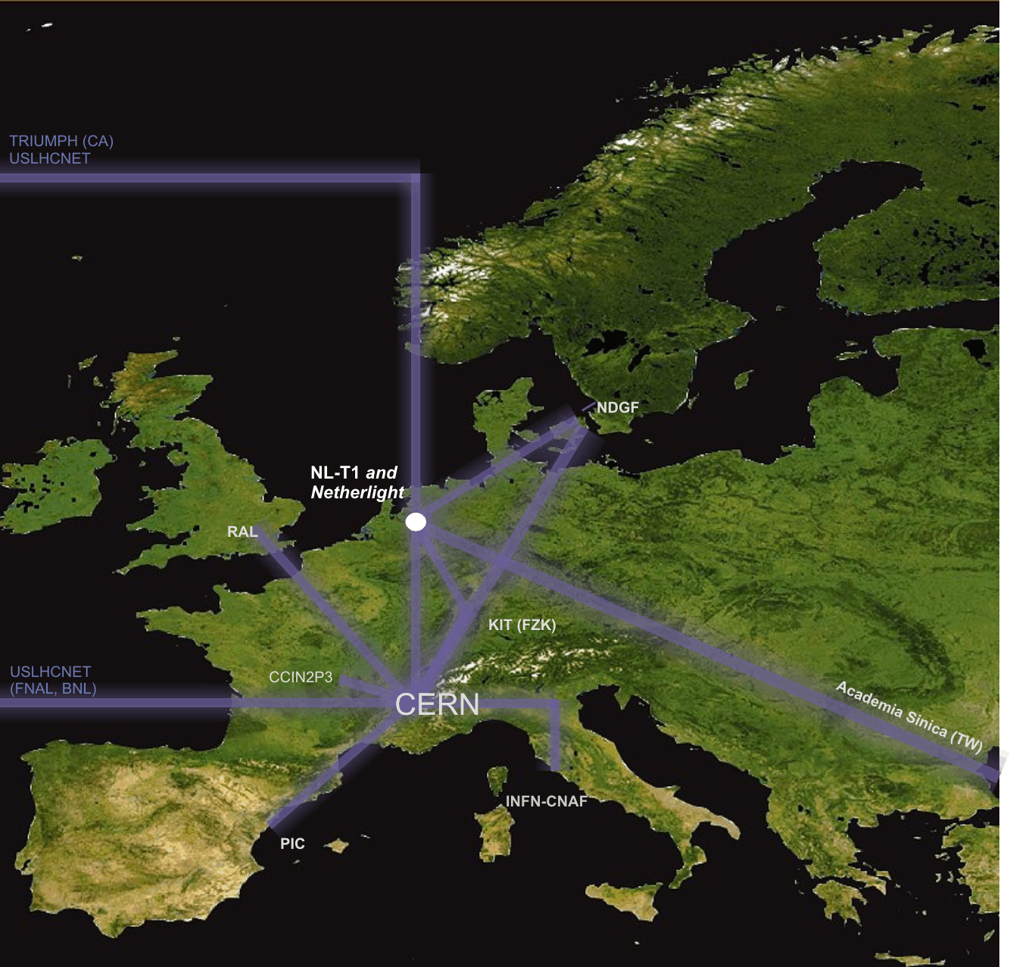
Interconnecting the Grid – the LHCOPN/LHCOne network
LHC Optical Private Network
10 – 100 Gbps dedicated
global networks
Scaled to T0-T1 data transfers

Slide 5
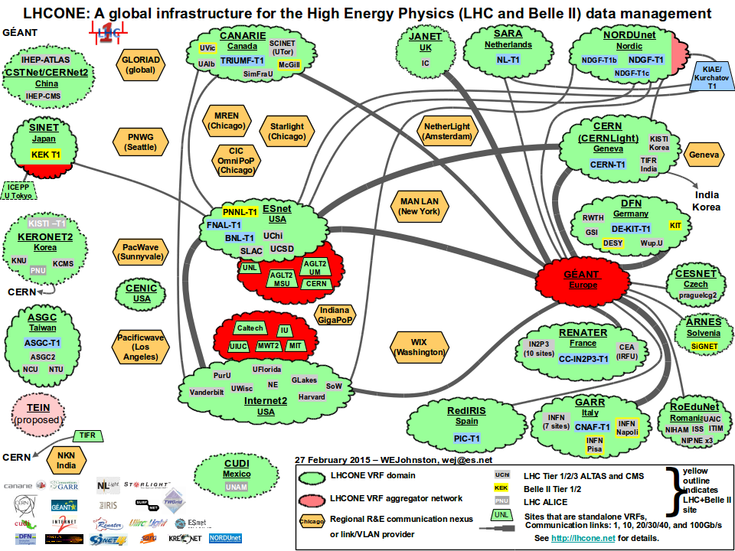
LHC OPN and LHCOne

Slide 6
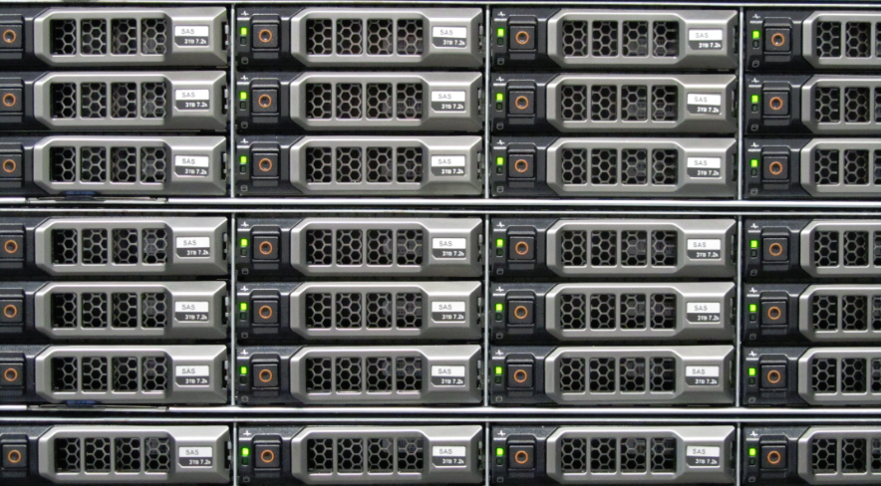
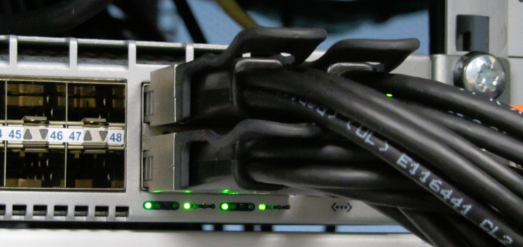
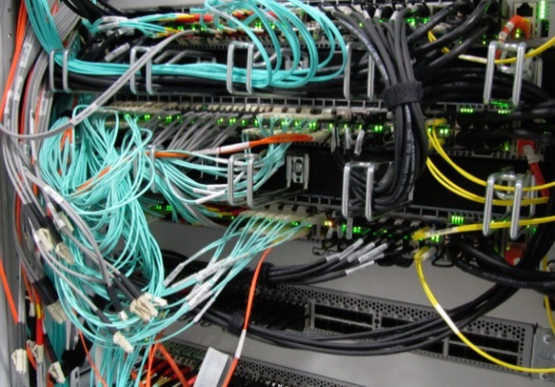
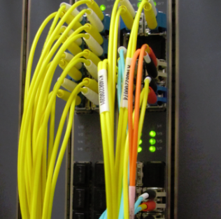

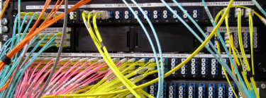
The Flow of Data at Nikhef
10 – 40 Gbps per server
240 Gbps interconnect
44 disk servers
~3 PiB (~3000 TByte)
2 control & DB nodes
Peerings: SURFnet, SURFsara,
Kurchatov, AMOLF, CWI,
LHCOPN, LHCOne via SARA
>200 Gbps uplinks

Slide 7
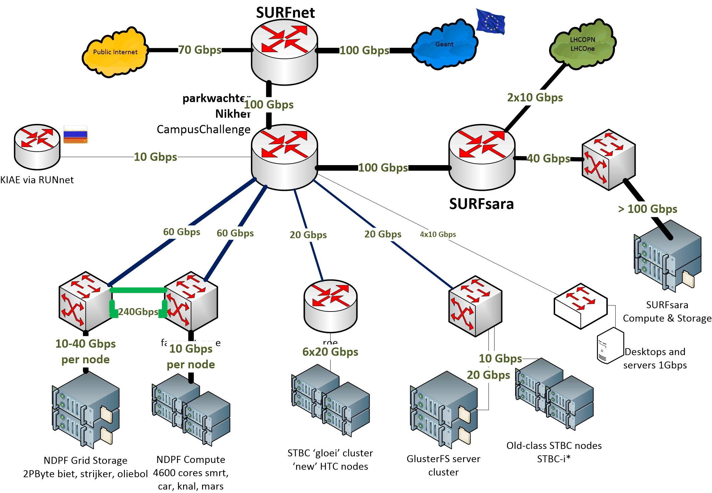

Nikhef Data Processing network

Slide 8
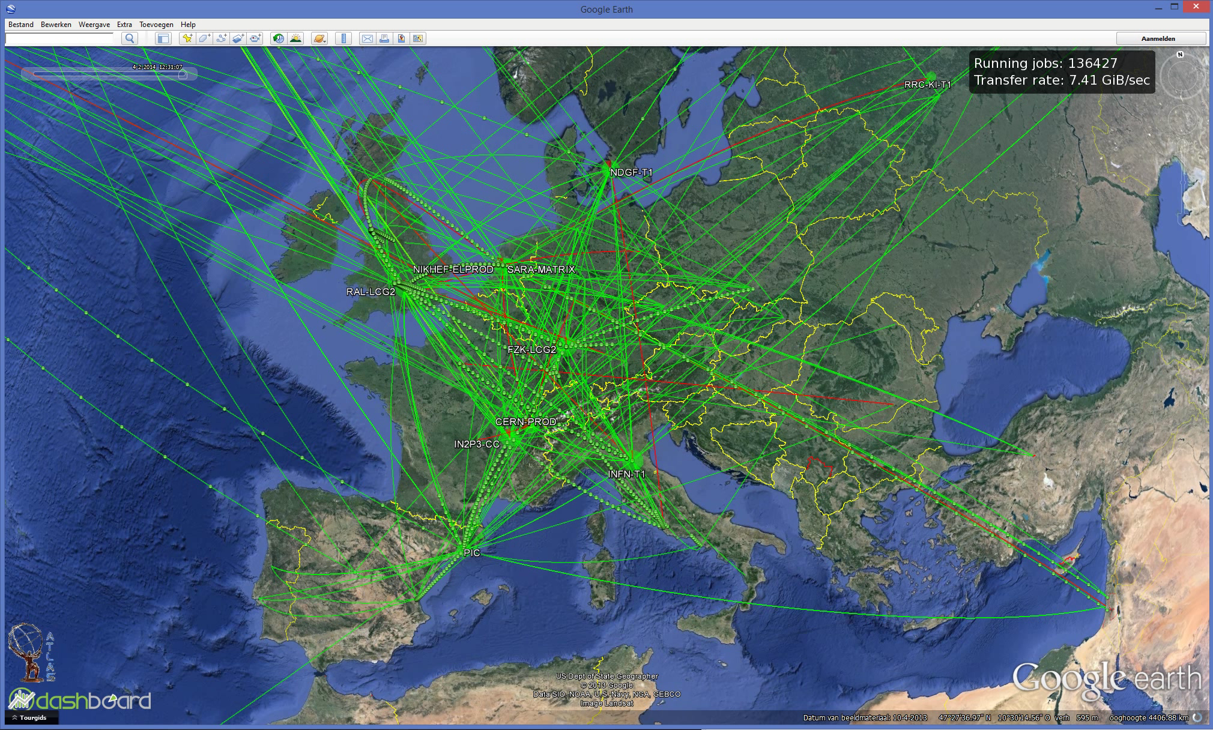
Data Flows in the LHC Computing Grid

Slide 9
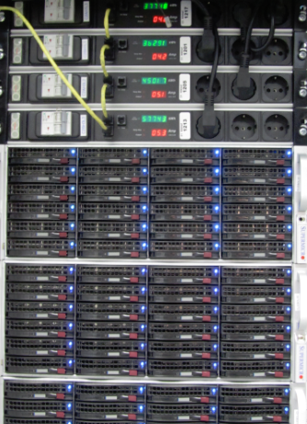
But that’s only a small subset
LCG “FTS” visualisation sees but part of the data
only shows the centrally managed data transfers
sees only traffic from Atlas, CMS, and LHCb
cannot show the quality, nor bandwidth used
But each of our nodes sees all
its transfers
server logging is in itself data
we collect it all

Slide 10
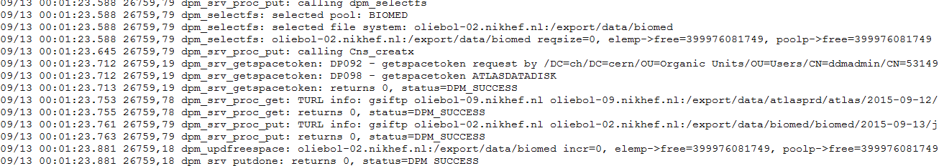
One day worth of logs … ~12GB/day
tbn18.nikhef.nl:/var/log/
631M dpm/log.1
1.1G dpns/log.1
639M srmv2.2/log.1
plus 44 disk server nodes @250 Mbyte/day
And then our storage manager is still ‘decent’ …

Slide 11
Big Data Analytics for log analysis
Analysis of log data is typical ‘big data’ problem
  CERN tried Hadoop (‘map-reduce’)
  RAL went with … ELK*
For logs specifically, it’s mostly efficient search
  ElasticSearch (www.elastic.co)
  LogStash (collect and parse logs, import to ES)
  Kibana – analysis based on Apache Lucene + graphing
Integrated into a single ‘stack’: ELK
*Appleyard et al., http://pos.sissa.it/archive/conferences/239/027/ISGC2015_027.pdf

Slide 12
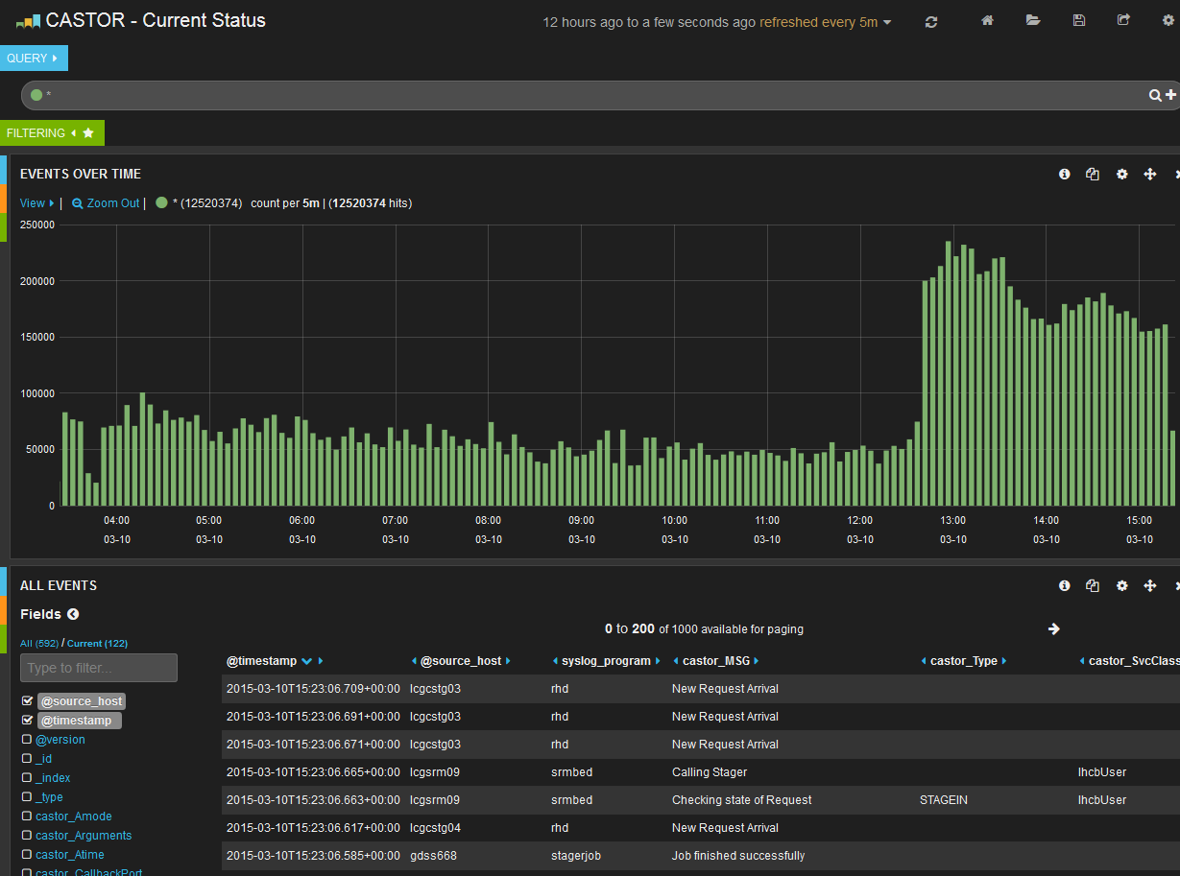
Analyse ‘by hand’: Kibana & Lucene
Graphic from Rob Appleyard, RTFC RAL – at ISGC 2015

Slide 13
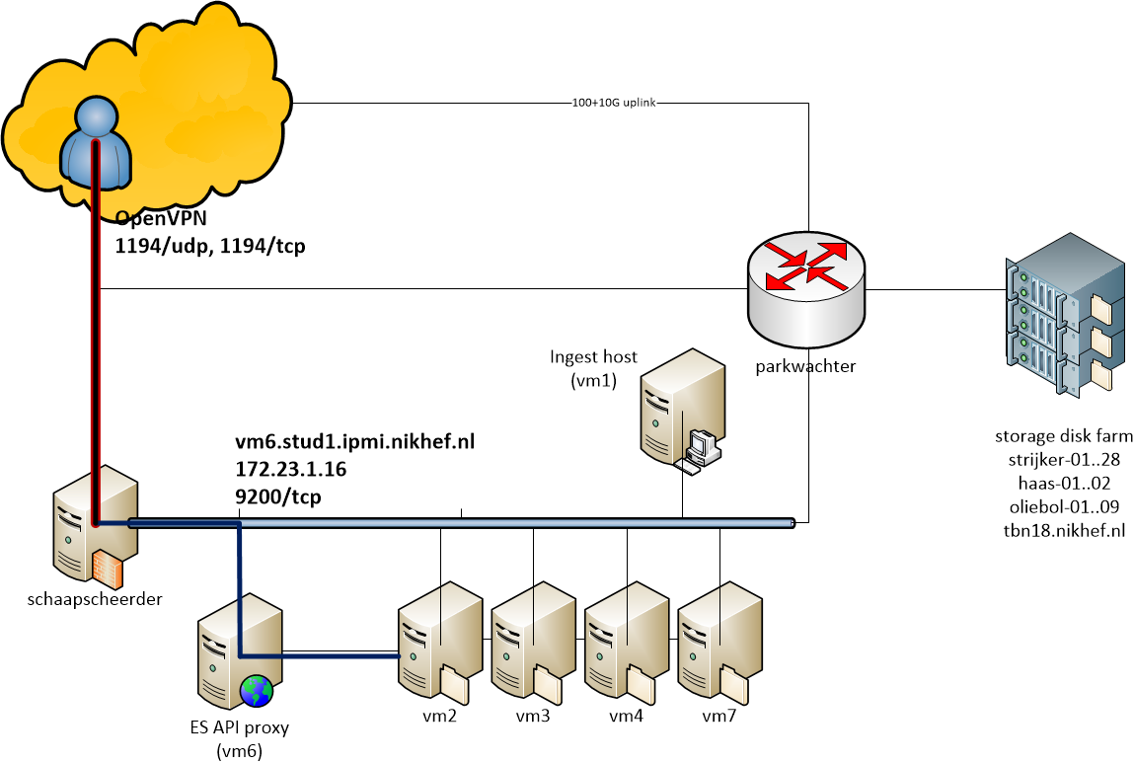
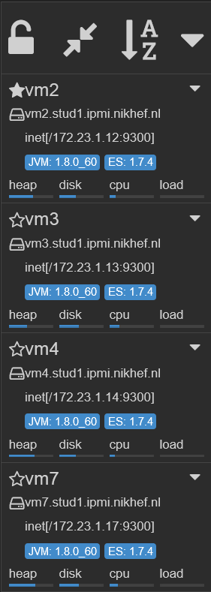
ELK Cluster and Interface

Slide 14
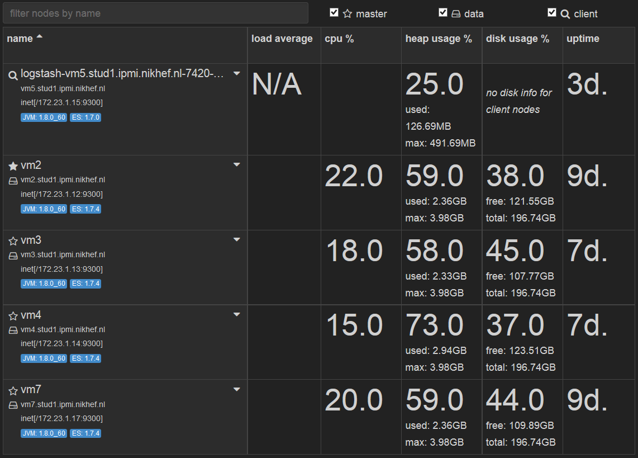
Filled with data

Slide 15
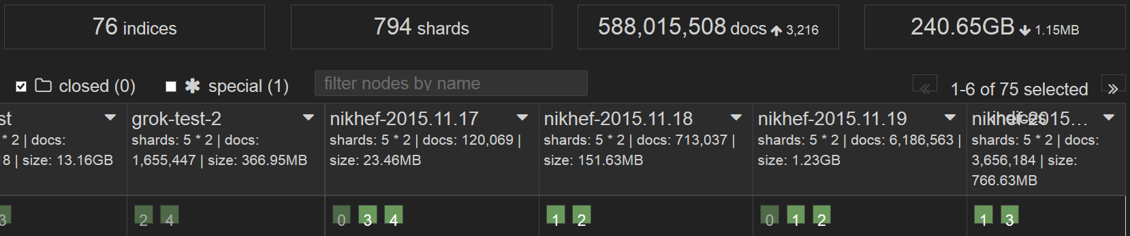
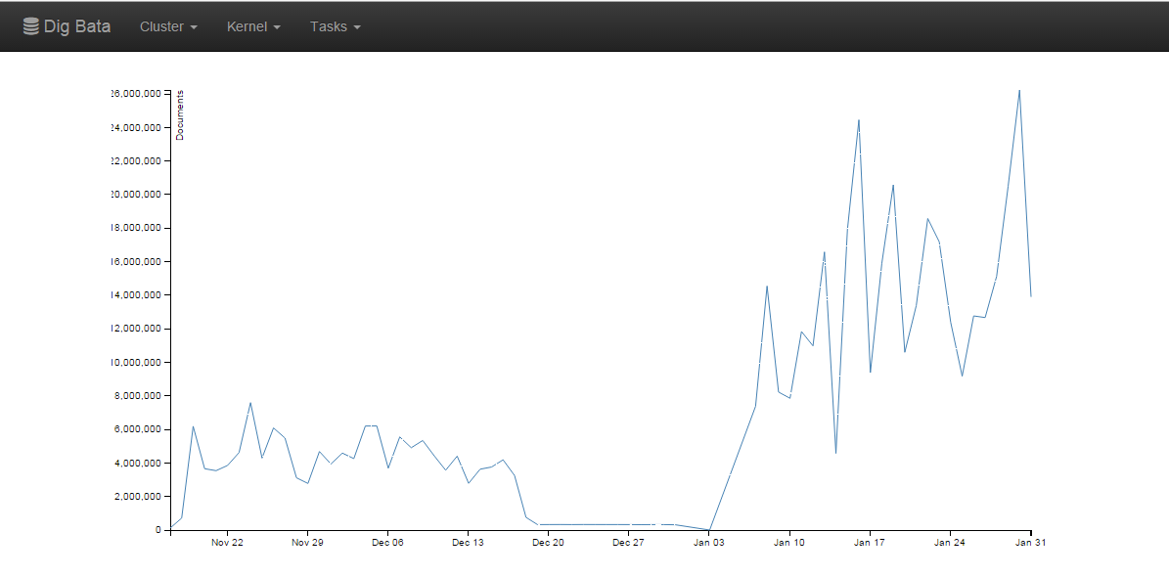
Filling it up: from 0 to ~ 500 million
16 M records/day
Graphics courtesy Jouke Roorda, Olivier Verbeek, Rens Visser

Slide 16
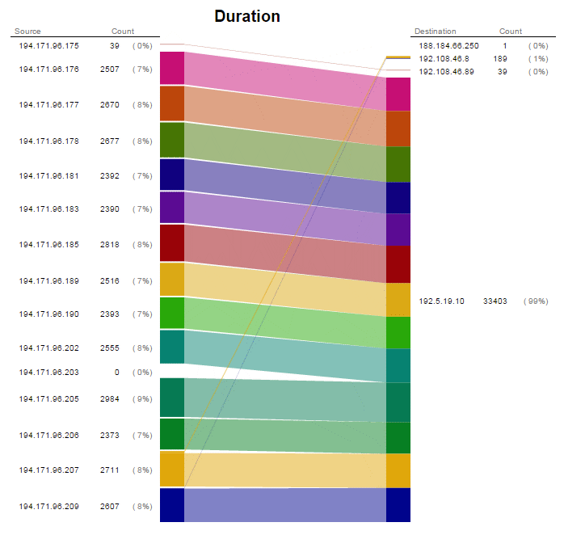
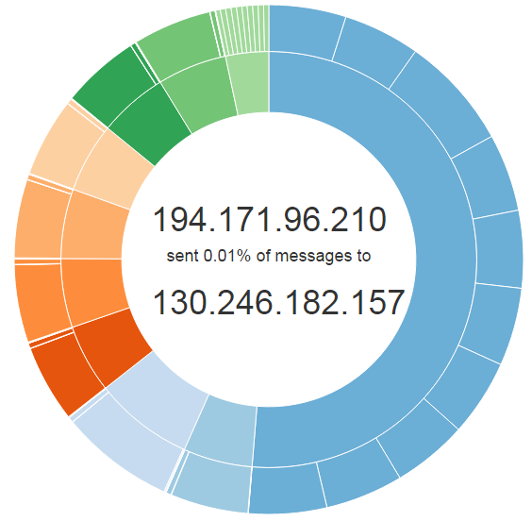
Data flows: a user at UC Irvine
reading a data set from Nikhef,
with some background from CERN
and KIT Karlsruhe
Graphics courtesy Jouke Roorda, Olivier Verbeek, Rens Visser

Slide 17
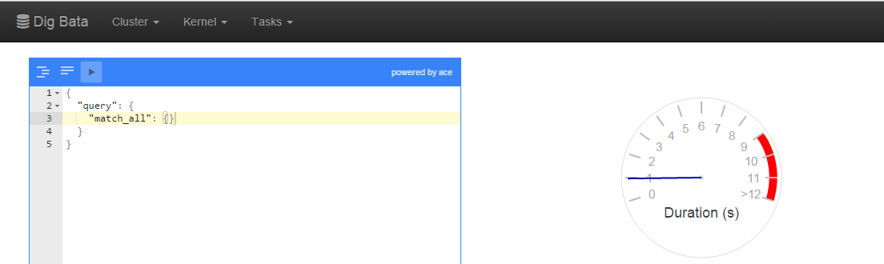
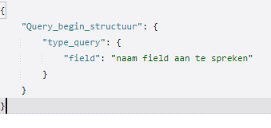
Queries and responses
Graphics courtesy Jouke Roorda, Olivier Verbeek, Rens Visser

Slide 18
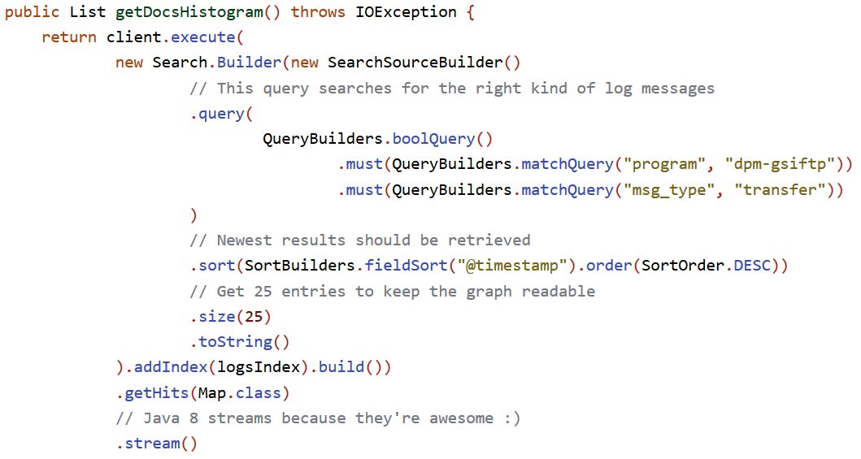
Code sample: Jouke Roorda, PDP-sample-app

