Slide 1
Showing More Big Data
Towards visualisation of compute clusters
in a mixed-purpose ELK Analytics Cluster
HvA induction session September 2016
David Groep, Nikhef

Slide 2
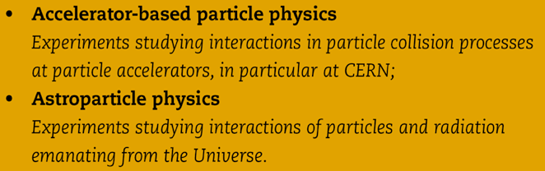
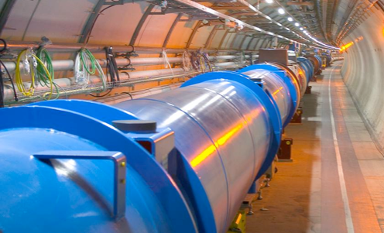
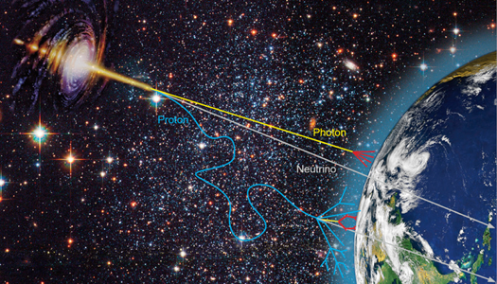


Nationaal instituut voor subatomaire fysica
Verleggen van de grenzen van onze kennis
Phenomenology
Collider physics
Astroparticle physics
8 september 2015
Orientatie Nikhef
Notes:
not on slide but important: concentrates all NL HEP infrastructure
machine shop, designers, ICT

Slide 3
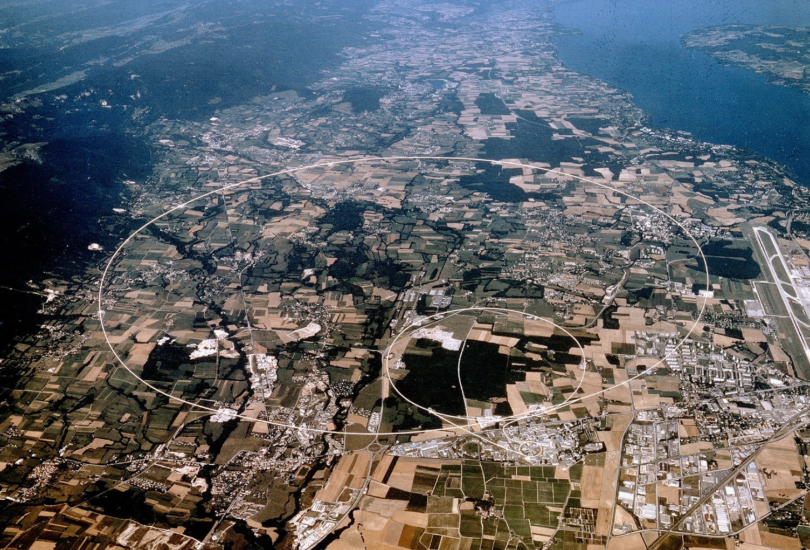


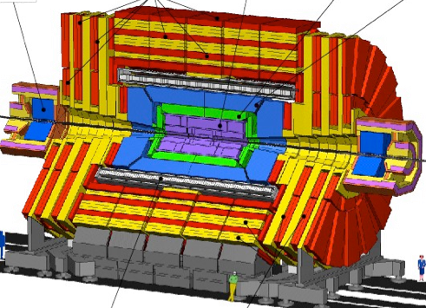




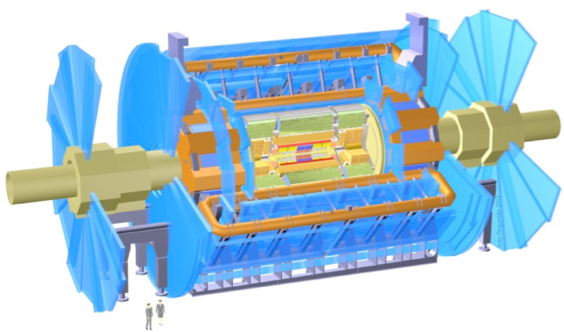

CMS
LHCb
ALICE
ATLAS
Atlas
protons
Haarlemse Chemische Kring

Slide 4
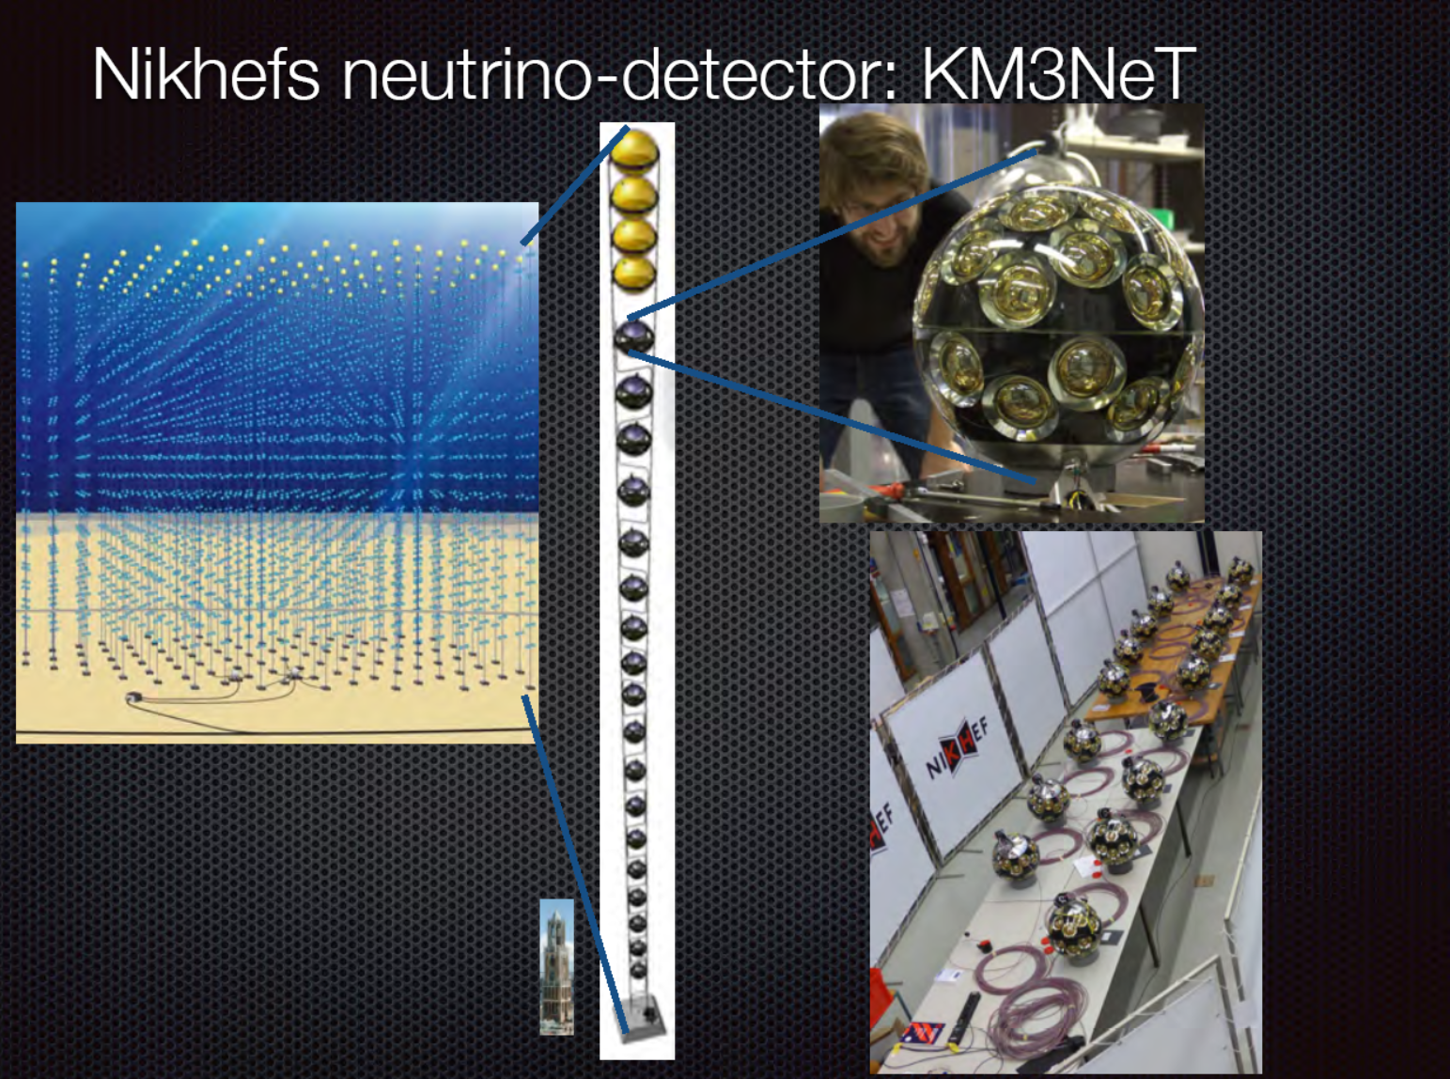

Slide 5
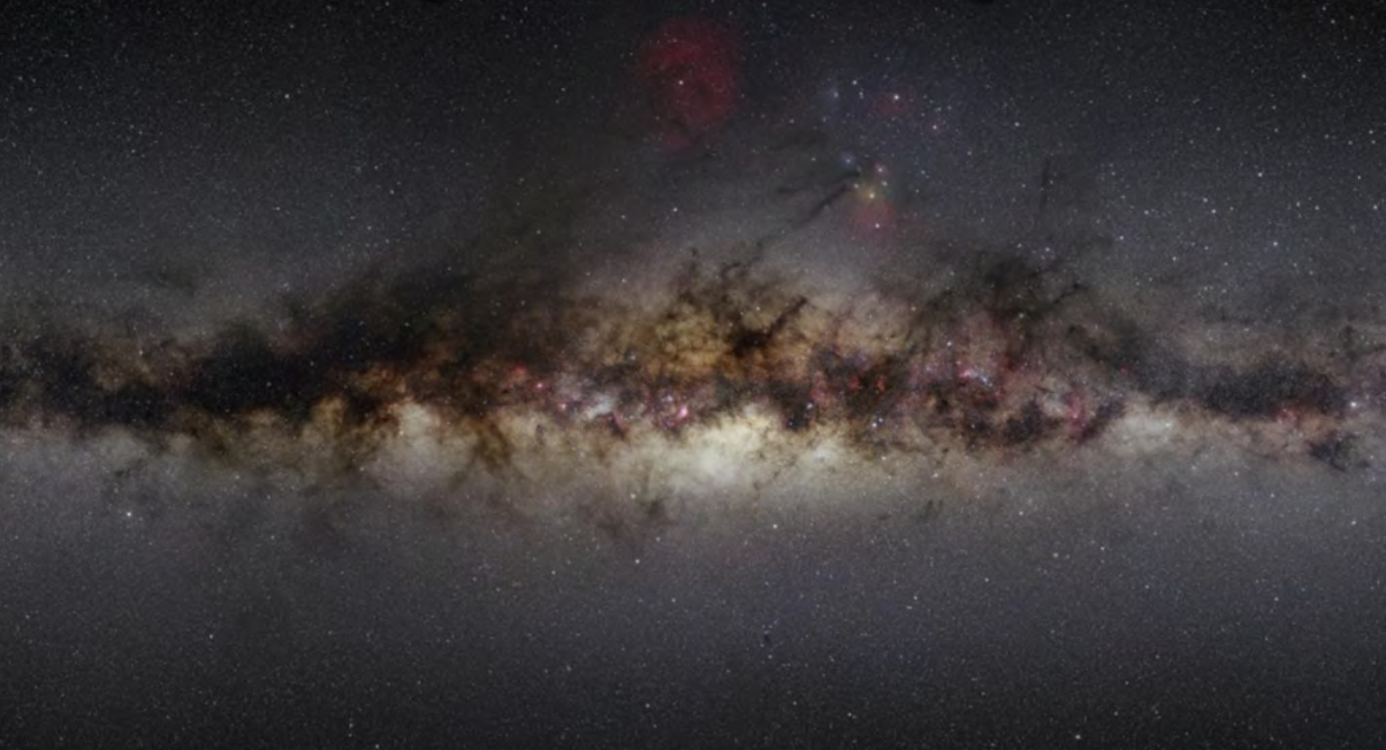
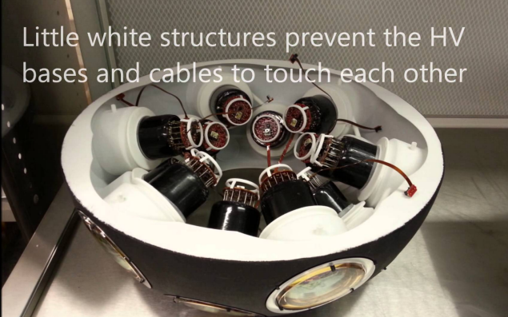
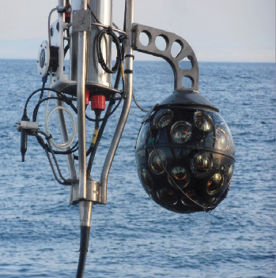
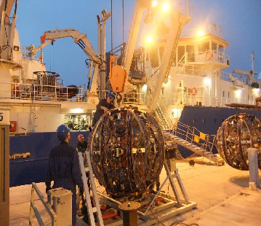
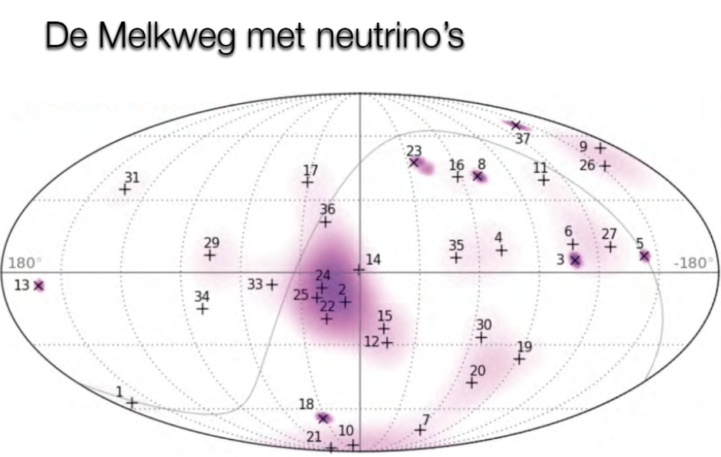

Slide 6
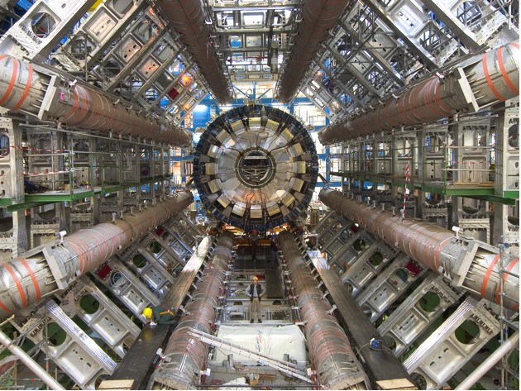

Slide 7
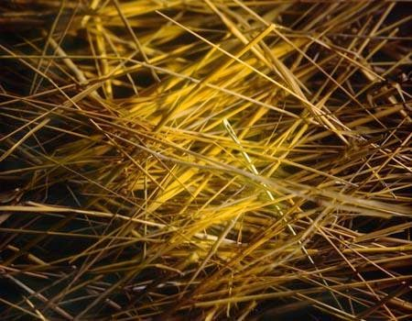
Kans Higgs deeltje:
1 op de 1.000.000.000.000 bostingen
- Dit is equivalent met zoeken van 1 persoon op 1000 wereldpopulaties
- Oftewel één naald in 20 miljoen hooibergen

Slide 8
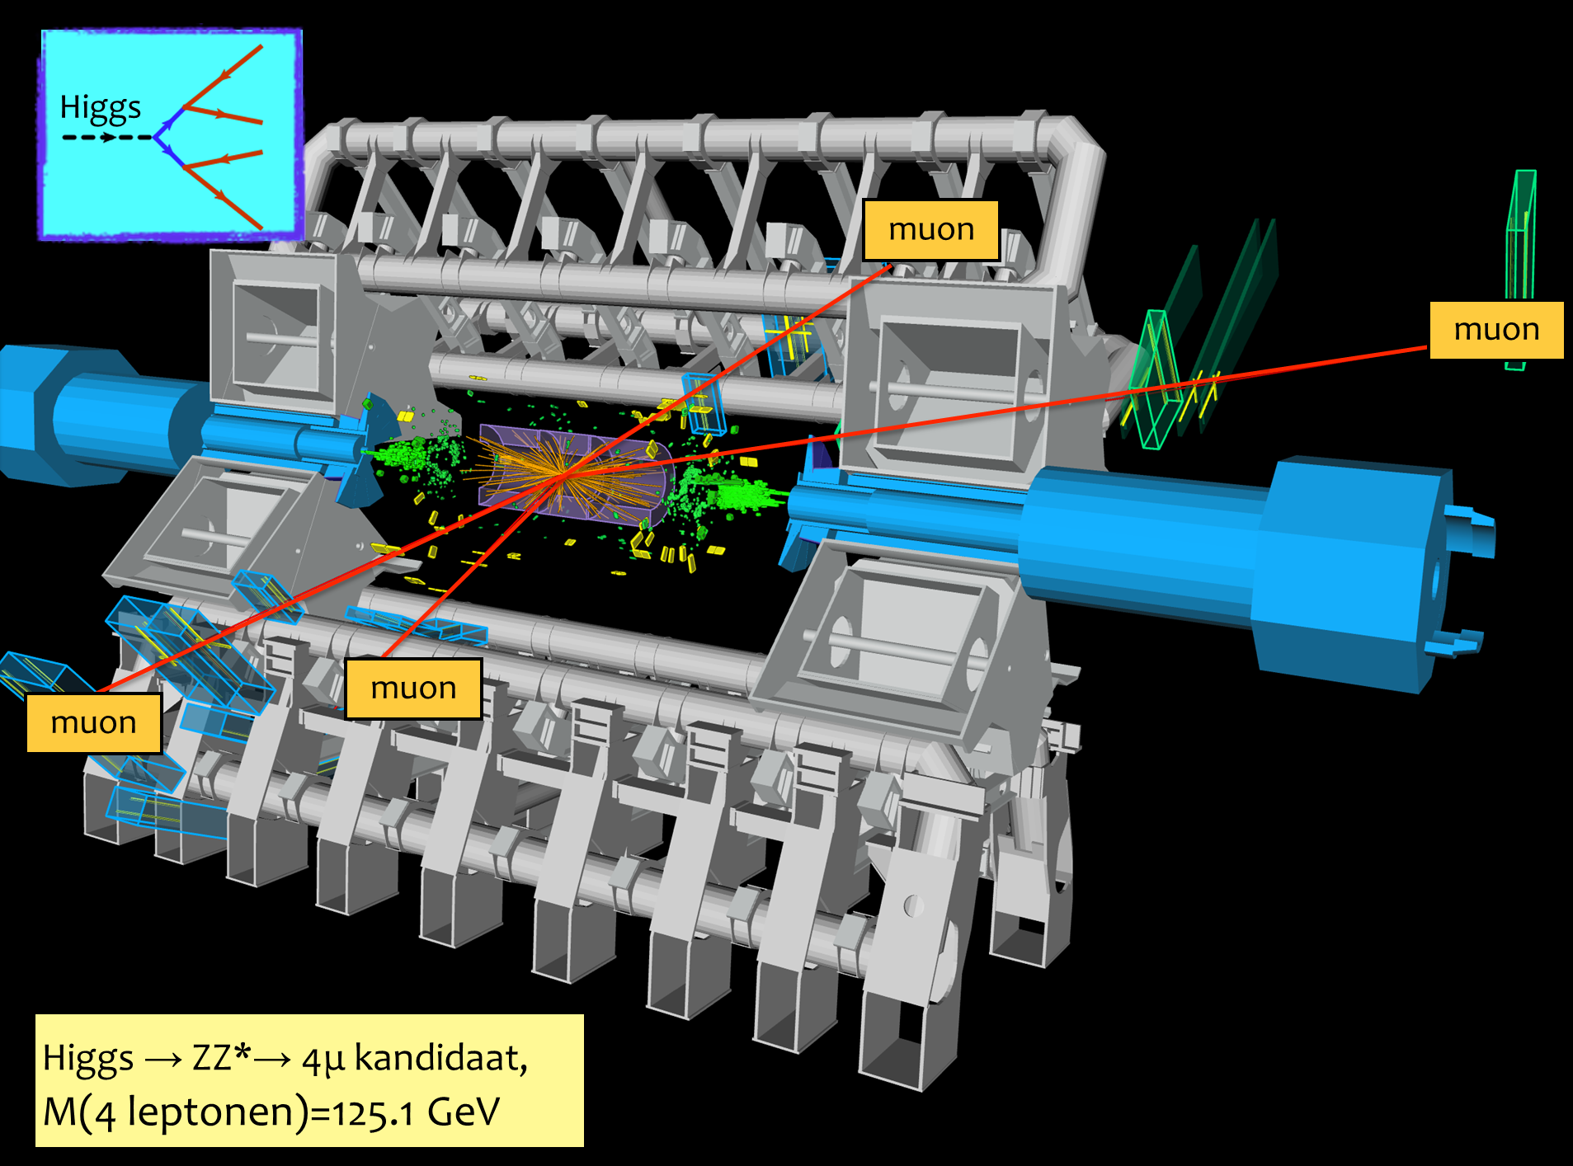

Slide 9
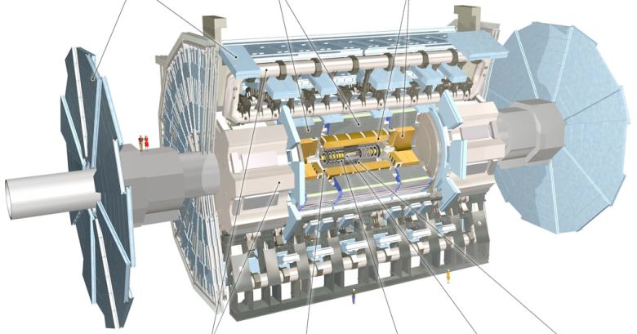
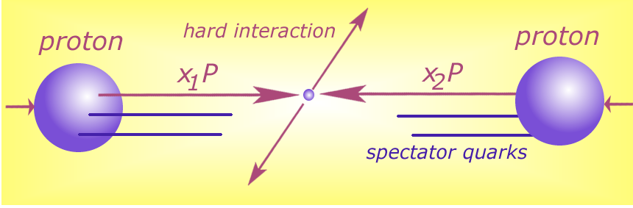





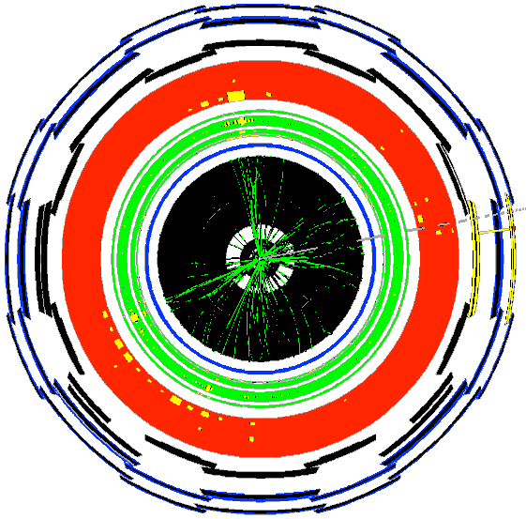




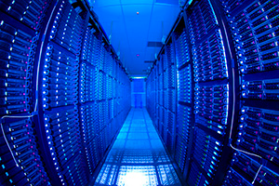


Detector to doctor ...
40 miljoen / seconde
Analyse van botsingen door promovendi
Trigger systeem selecteert 600 Hz
~ 1 GB/s data
and processing
Data distributie met
GRID computers
Collisions characterised by event signature:
  - electronen
  - muonen
  - jets
  -...

Slide 10
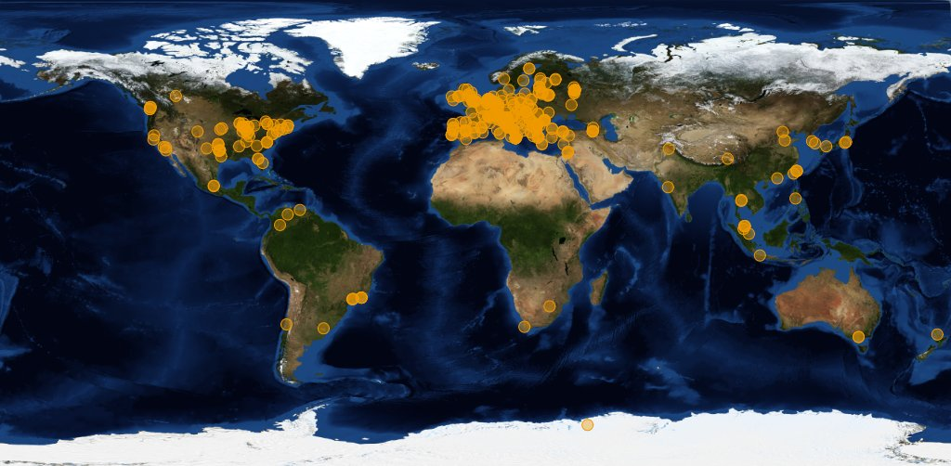




Image source: joint CERN (wLCG) and EGI
Organisations participating in the global collaboration of e-Infrastructures
Even just for wLCG, supporting the CERN LHC programme
More than 200 independent institutes with end-users
More than 50 countries & regions
More than 300 service centres
Handful regional ‘service coordination organisations’
500 000 CPU cores, 200+PByte storage
One independent ‘policy-bridge’ PKI

Slide 11
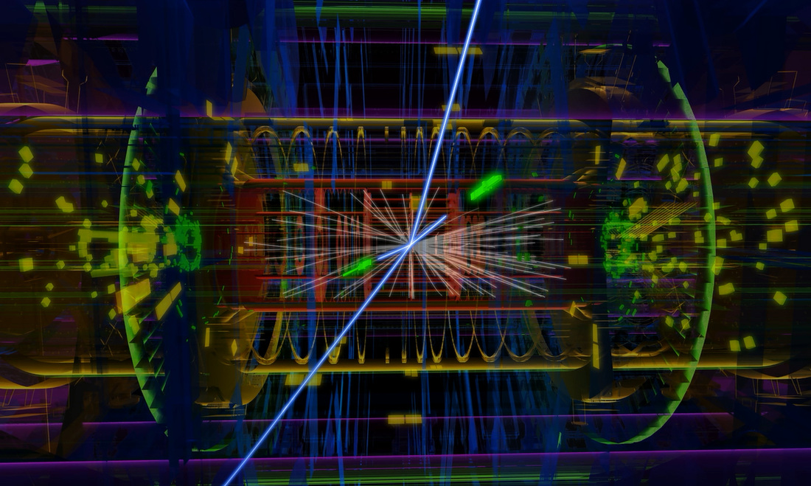
Atlas: ~50 TByte/day raw data to tape; 1000 TByte/day processed data transfers
Image source: CERN, Atlas

Slide 12
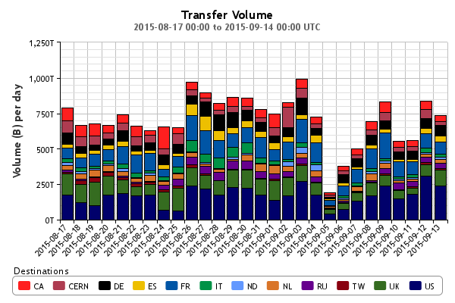
Big ‘as in Large’ Data
Atlas only
http://dashb-atlas-ddm.cern.ch/ddm2

Slide 13
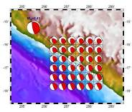


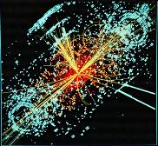
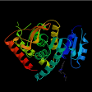
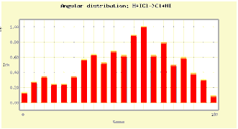
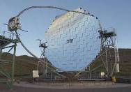
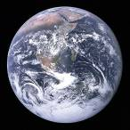
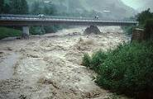
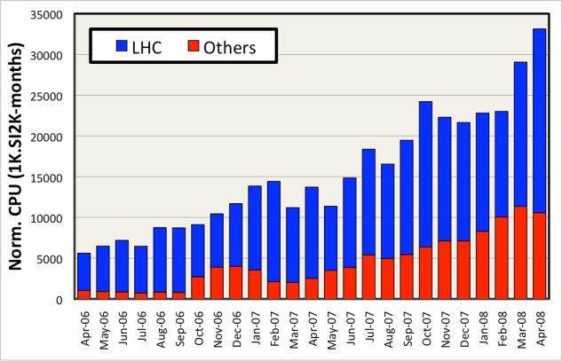
Shared e-Infrastructure
>270 communities
from many different domains
  Astronomy & Astrophysics
  Civil Protection
  Computational Chemistry
  Comp. Fluid Dynamics
  Computer Science/Tools
  Condensed Matter Physics
  Earth Sciences
  Fusion
  High Energy Physics
  Life Sciences
  …
Applications have moved from
testing to routine and daily usage
~80-95% efficiency

Slide 14
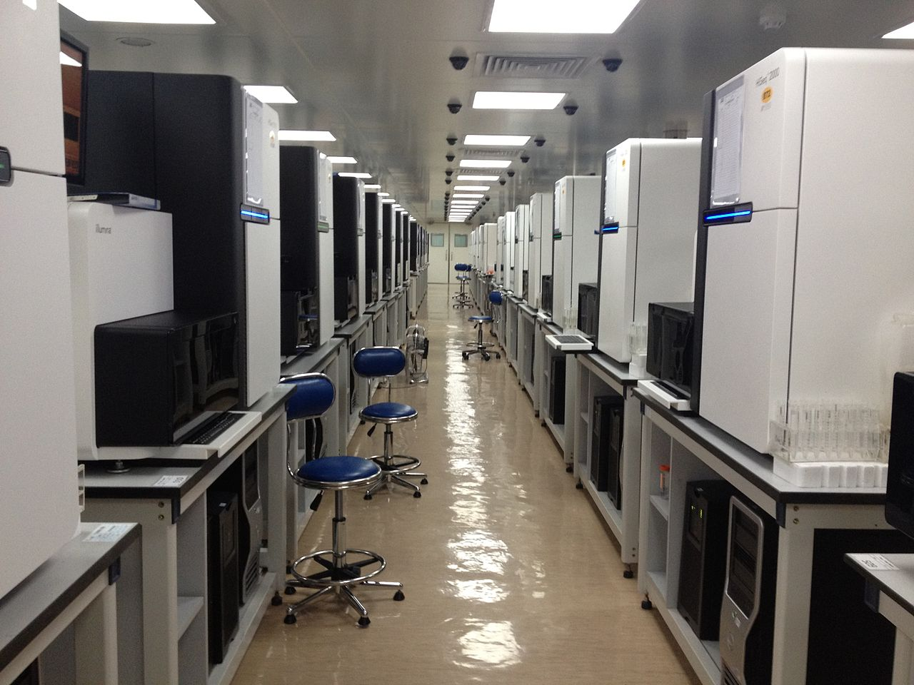
Global data flows
~150GByte, 12hrs
per (human) genome
per sequencer
But 1000+ sequencers…
Genome sequencing at the Beijing Genomics Institute BGI
Photo: Scotted400, CC-BY-3.0

Slide 15
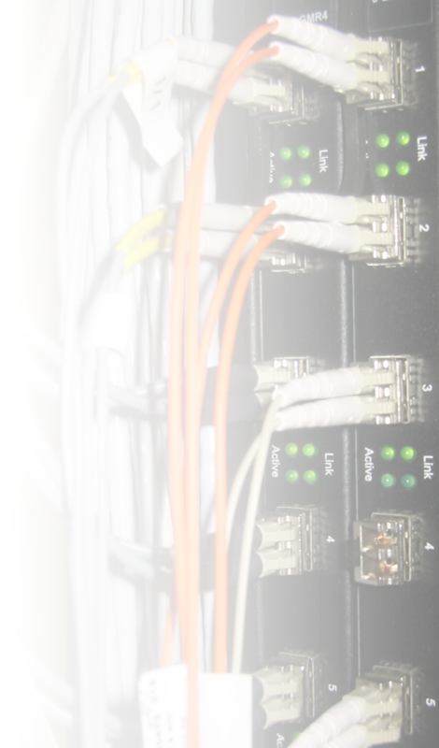


There’s always a network close to you
Doubling Time
(months)
Optical Fibre
(bits per second)
Gilder’s Law
(32X in 4 yrs)
9 12 18
Data Storage
(bits per sq. inch)
Storage Law
(16X in 4yrs)
Performance per Dollar Spent
Chip capacity
(# transistors)
Moore’s Law
(5X in 4yrs)
0 1 2 3 4 5
Number of Years
SURFnet pioneered ‘lambda’ and hybrid networks in the world
and likely contributed to the creation of
a market for ‘dark fibre’ in the Netherlands
There’s always fibre within 2 miles from you – where ever you are!
(it’s just that last mile to your home that’s missing
– and the business model of your telecom provider…)

Slide 16
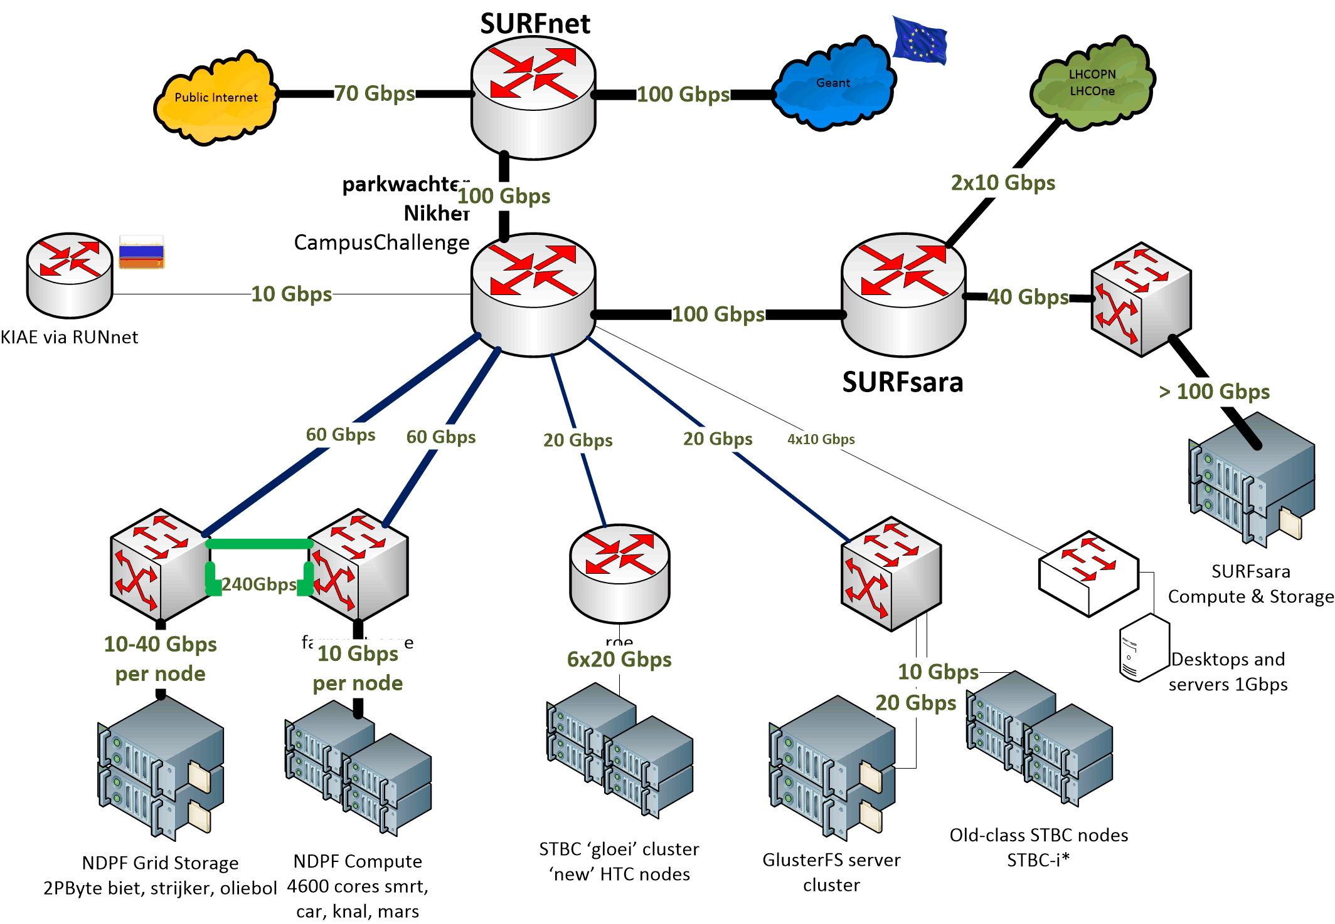

Nikhef Data Processing network

Slide 17
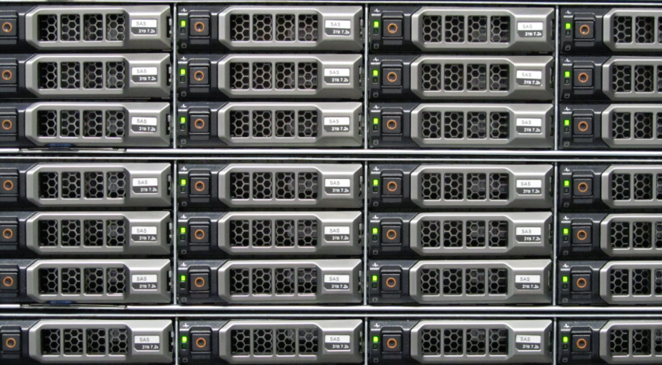
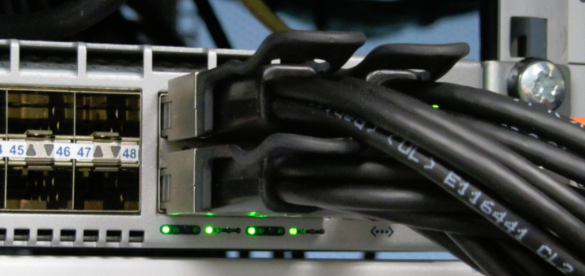
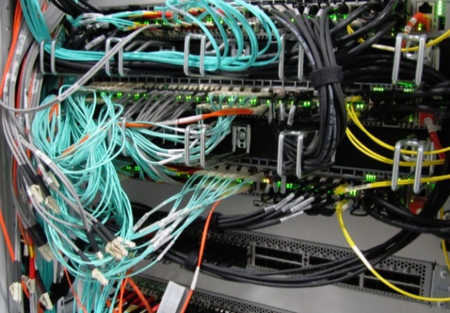
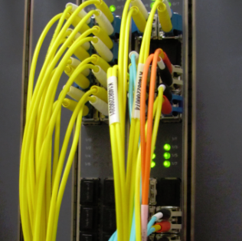

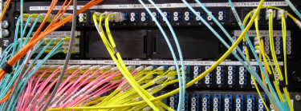
The Flow of Data at Nikhef
10 – 40 Gbps per server
240 Gbps interconnect
44 disk servers
~3 PiB (~3000 TByte)
2 control & DB nodes
Peerings: SURFnet, SURFsara,
Kurchatov, AMOLF, CWI,
LHCOPN, LHCOne via SARA
>200 Gbps uplinks

Slide 18
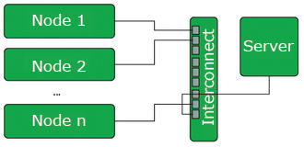
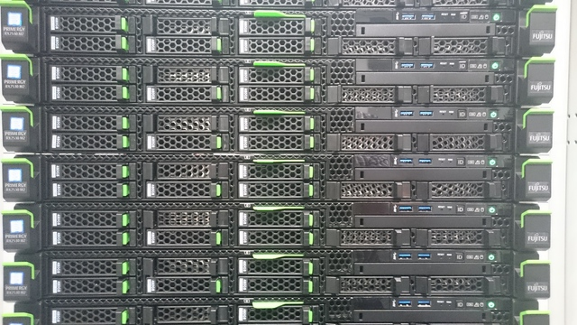
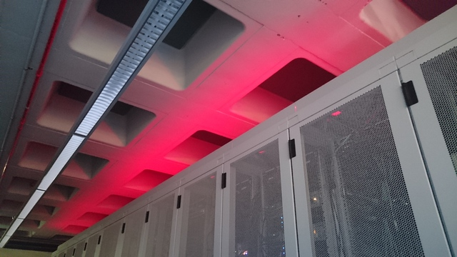
Batch processing – cluster setup

Slide 19
Big Data Analytics for log analysis
Analysis of log data is typical ‘big data’ problem
  CERN tried Hadoop (‘map-reduce’)
  RAL went with … ELK*
For logs specifically, it’s mostly efficient search
  ElasticSearch (www.elastic.co)
  LogStash (collect and parse logs, import to ES)
  Kibana – analysis based on Apache Lucene + graphing
Integrated into a single ‘stack’: ELK
*Appleyard et al., http://pos.sissa.it/archive/conferences/239/027/ISGC2015_027.pdf

Slide 20
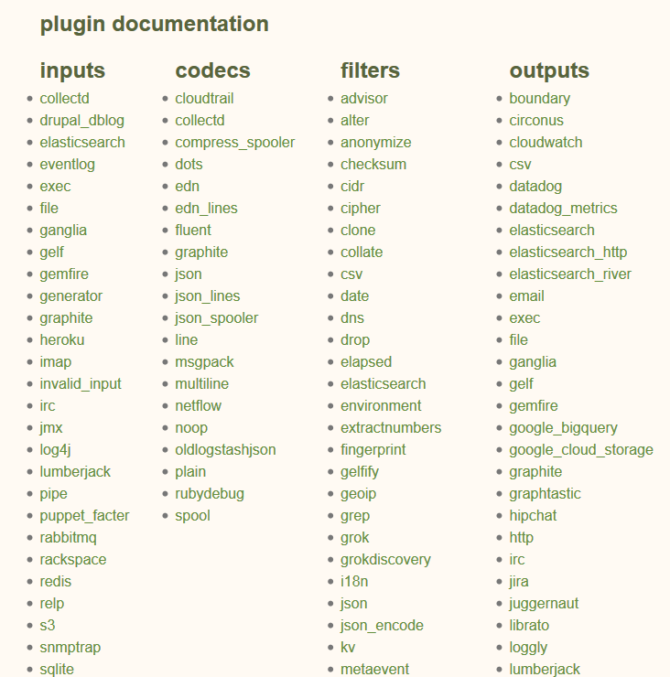
LogStash
Data arrives in format A…
…process B occurs…
…data out in format C
e.g. convert syslog into json

Slide 21
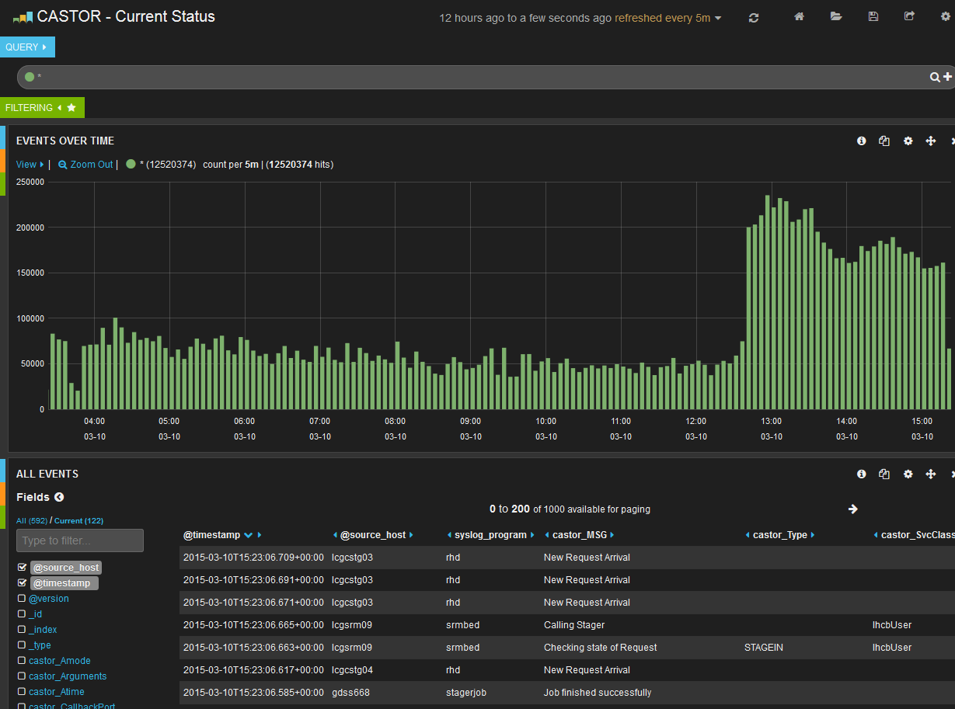
Analyse ‘by hand’: Kibana & Lucene
Graphic from Rob Appleyard, RTFC RAL – at ISGC 2015

Slide 22
Challenges ahead!
At the start
  ~500 difference data sources, 5500 CPU cores
  5000+ users, working 24x7
Your colleagues in 2015-2016 added
setup of a big data analytics cluster (ELK)
define queries and find some global anomalies ☺
Focus on data transfers, but no compute …

Slide 23
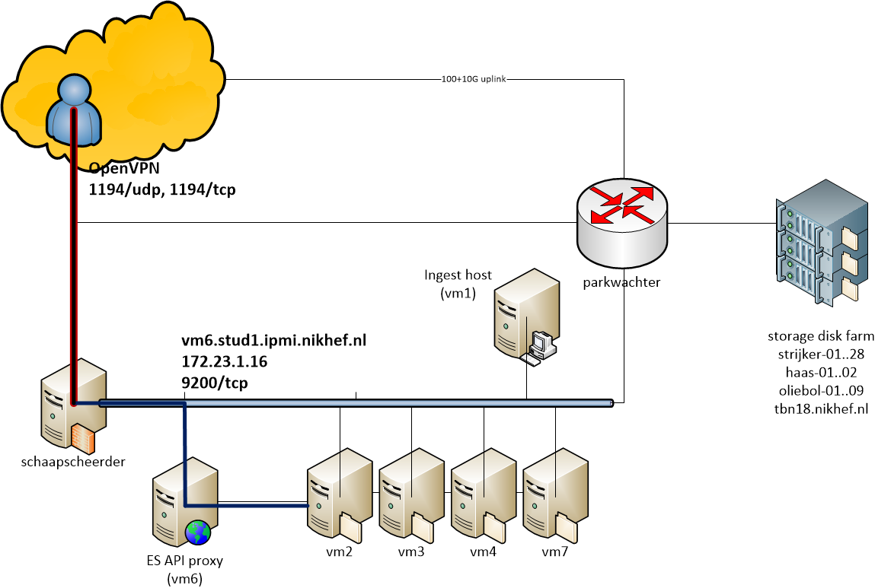
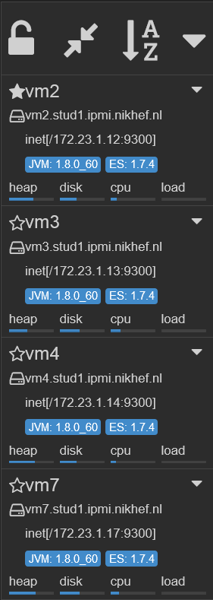
ELK Cluster and Interface

Slide 24
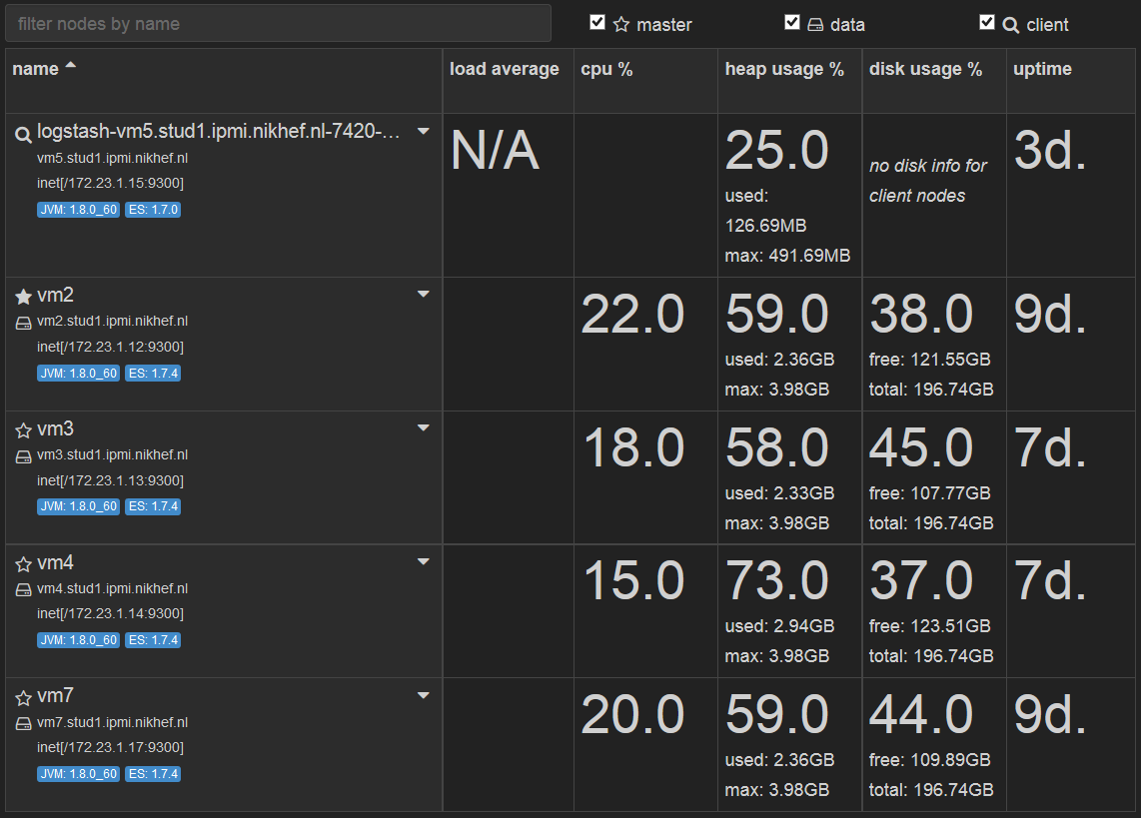
Filled with data

Slide 25
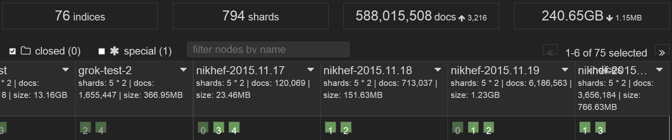
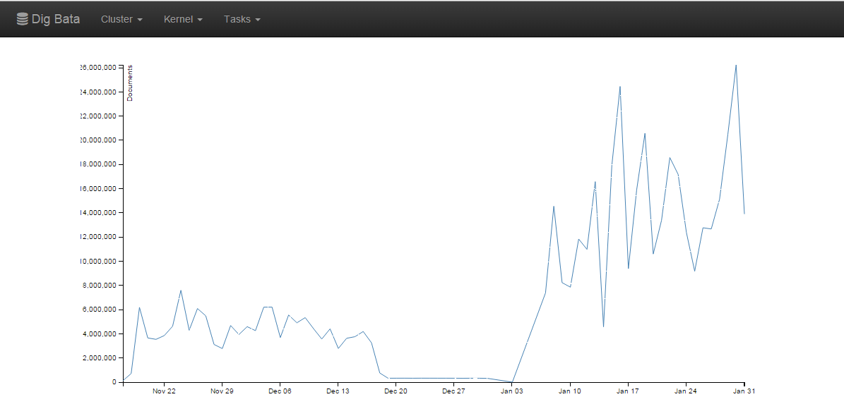
Filling it up: from 0 to ~ 500 million
16 M records/day
Graphics courtesy Jouke Roorda, Olivier Verbeek, Rens Visser

Slide 26
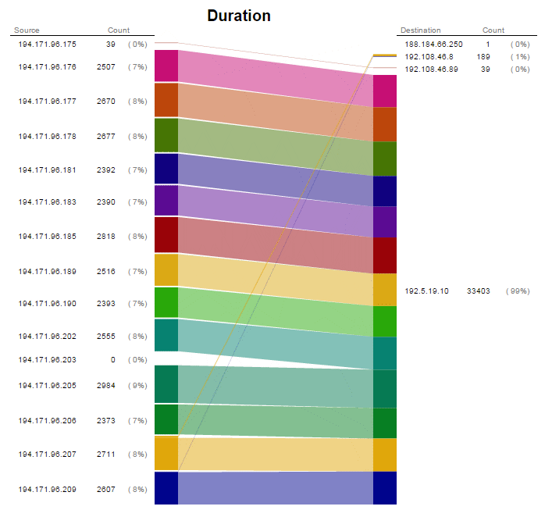
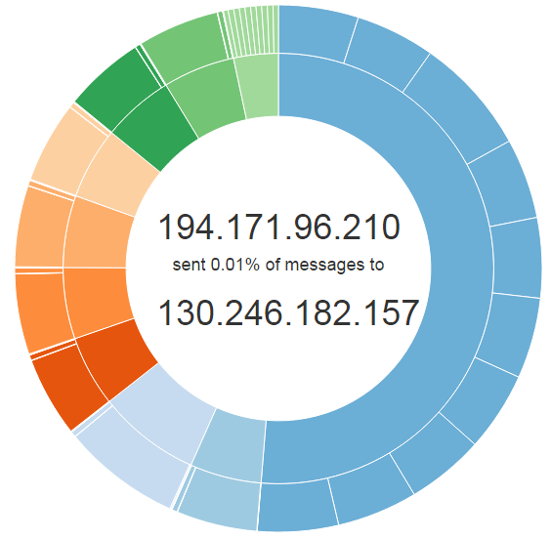
Data flows: a user at UC Irvine
reading a data set from Nikhef,
with some background from CERN
and KIT Karlsruhe
Graphics courtesy Jouke Roorda, Olivier Verbeek, Rens Visser

Slide 27


Queries and responses
Graphics courtesy Jouke Roorda, Olivier Verbeek, Rens Visser

Slide 28
Processing batch logs
Log file format is different (different service) so you’ll need to parse, extract, and identify elements
The ‘grok’ filter is used to process logs
vm4.stud1.ipmi.nikhef.nl runs grok now
‘/grok/ls_config’
If and when you need write access there, ask …

Slide 29
Access services
https://wiki.nikhef.nl/grid/HvABigDataVisualisation
OpenVPN configuration
Access to full ES search API
Don’t kill the cluster just yet …
Do not redistribute or copy records with PII
Kindly observe the Nikhef AUP as well –
and report any incidents to security@nikhef.nl

Slide 30

Your call!
Questions?
Code sample: Jouke Roorda, PDP-sample-app

