Slide 1
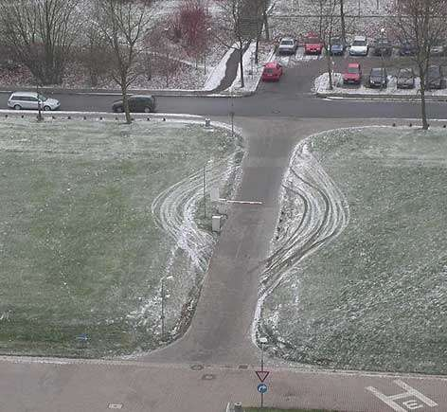
\

Slide 2
Grid Security and Authentication
David Groep
Physics Data Processing group Nikhef

Slide 3
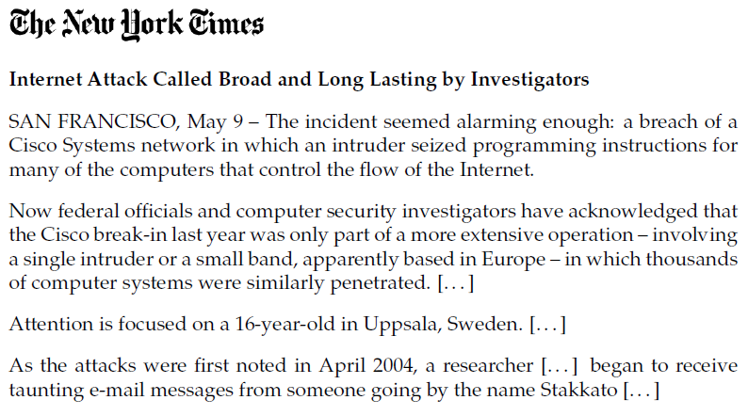
Stakkato
Slide and info: Leif Nixon, NSC, Linköping – CCGrid06 key note “The Stakkato Intrusions”

Slide 4
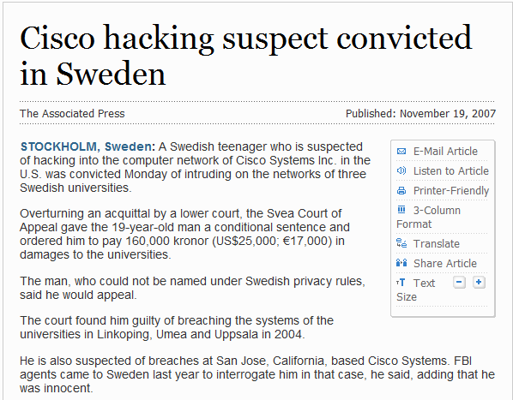
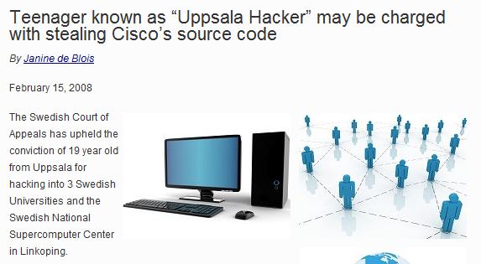
Then, in 2007 and February …

Slide 5
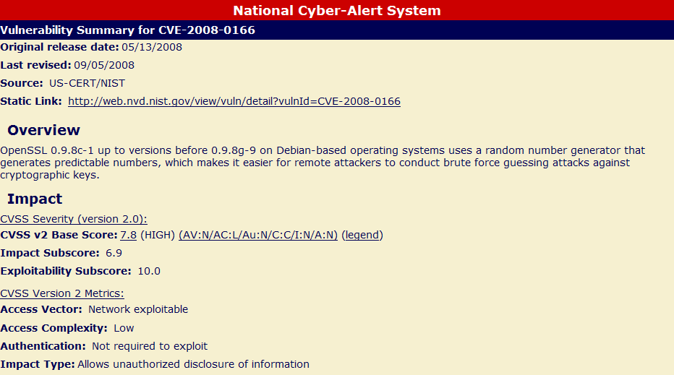
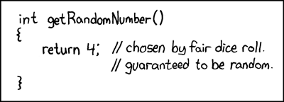
Is It Random: 3, 3, 3, 3, 3, 3, 3, 3, 3, 3, 3
Only 163840 possible ssh keys!
http://xkcd.com/221/

Slide 6
More ssh
‘XXXX-CERT-20080805’

Slide 7
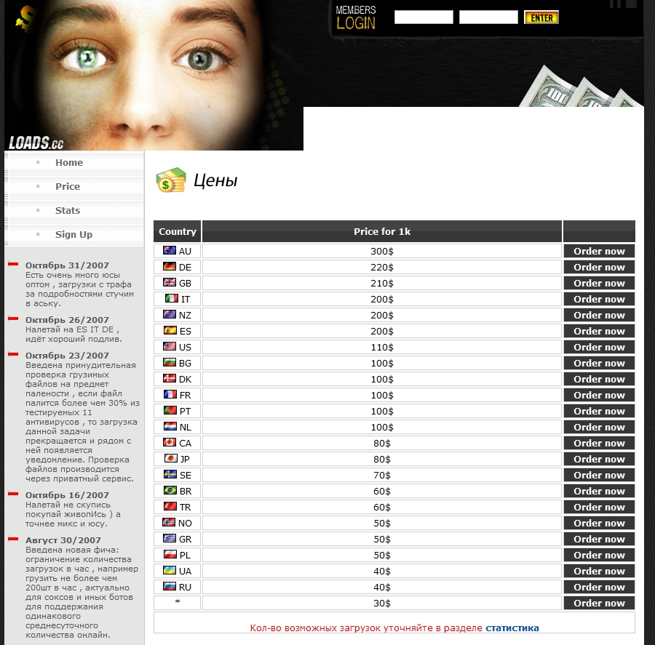
Zombies for Sale
Price for 1000 infected consumer computers:
AU: US$ 300
US: US$ 110
NL: US$ 100
And grid systems are better connected than xDSL systems, so …
http://rbnexploit.blogspot.com/2007/11/rbn-76-service-team-loads-cc-and-their.html

Slide 8
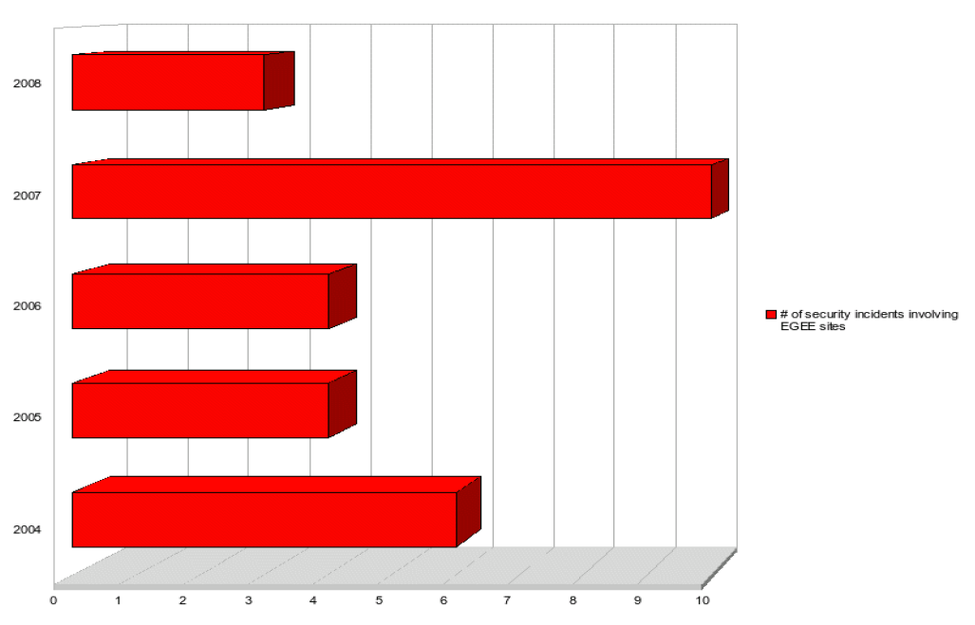

Incidents involving EGEE sites
(per 3/2008 and extrapolated)
Most incidents are not malicious users, but
stolen credentials
plus a local exploit
remote exploits
Romain Wartel, CERN and OSCT; http://romain.wartel.net/talks/20080409Wartel-short.pdf

Slide 9
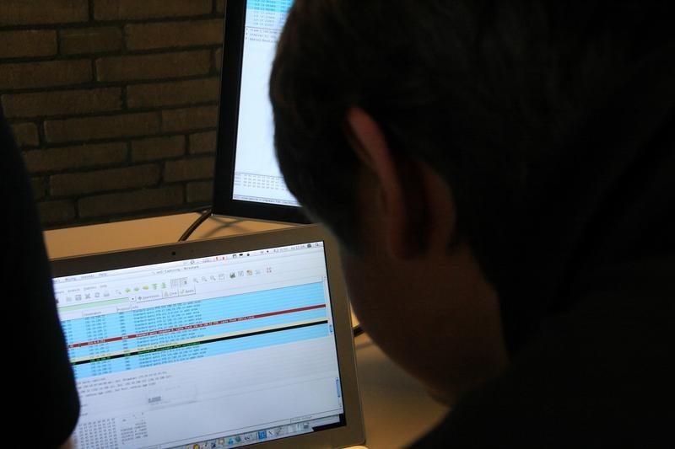
Weakness
But What About Containment?
Oops … ssh keys
do not expire
cannot be revoked

Slide 10
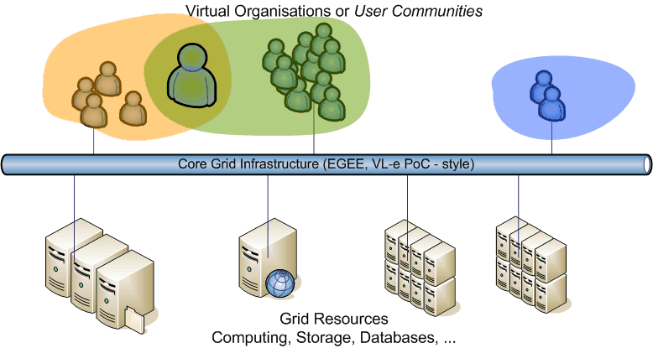
Security And Availability For All Involved
Who are playing in the Grid Space, and thus: who get attacked?
Virtual Organisations or Communities: you and your colleagues
Resource Centres and Grid Services:
CPU, Storage, Data base and service providers
central services and coordination

Slide 11
Security and Availability
‘Security means more than merely preventing unauthorised access.
It is pro-actively concerned with maximising the availability and integrity of all the services and data that might be required by authorised users.
This Policy accordingly addresses the protection, confidentiality, integrity and availability of Resources and the Services running on them.’
From: LCG Security and Availability Policy version 4.0c

Slide 12
Security Policies
Incident
Response
Certification
Authorities
Audit
Requirements
Site & VO
Policies
Security and Availability Policy
Grid & VO
AUPs
User Registration
& VO Management
Application Development
& Network Admin Guide
Site Oper.
Procedures

Slide 13
Grid Acceptable Use Policy
Certification
Authorities
Incident
Response
Audit
Requirements
Protecting the Grid and Resource Centres
and tells you what you consent to:
Don’t do anything nasty
Your work stays within the scope of your VO
Report (potential) abuse or suspected account compromise
The Grid is not a guaranteed resource
Registration and logged information is used only for
administrative, operational, accounting, monitoring and security purposes
may be disclosed to other organizations anywhere in the world for these purposes
You’re liable for the consequences of violating the AUP
Site & VO
Policies
Security and Availability Policy
Grid & VO
AUPs
User Registration
& VO Management
Application Development
& Network Admin Guide
Site Oper.
Procedures

Slide 14
But Who Are You, and Why?
You already got a ‘digital certificate’
A digital passport: it says who you are, not where you can go
Technically called ‘X.509 identity certificate’
Digitally signed by a ‘certification authority’
Contains: your name, and a unique name in the world
An X.509 Certificate contains:
  owner’s public key;
  identity of the owner;
  info on the CA;
  time of validity;
  Serial number;
  digital signature of the CA
Public key
You prove possession by a ‘private key’ that only you know to sign transactions
Subject:C=CH, O=CERN, OU=GRID, CN=Andrea Sciaba 8968
Issuer: C=CH, O=CERN, OU=GRID, CN=CERN CA
Expiration date: Aug 26 08:08:14 2005 GMT
Serial number: 625 (0x271)
CA Digital signature

Slide 15
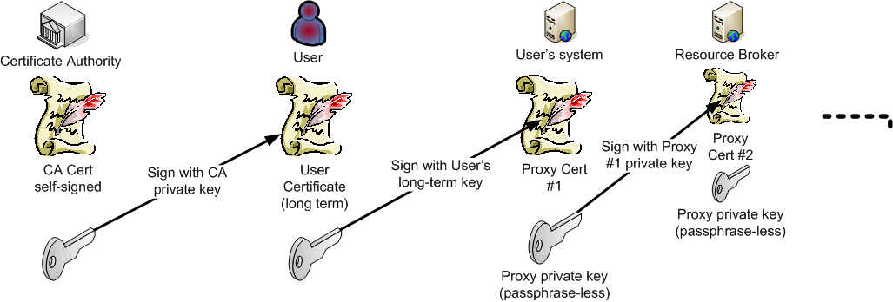
Grid By Proxy
Your private key MUST be protected by a pass phrase
  Like ‘gRatJESolleSB&E’, or ‘o~gemds!oniE’
But
  You don’t want to type that every few seconds
  The broker has to work on your behalf
  Password-less, short-lived, proxy certificates:

Slide 16
Attached to your passport are ‘Visa’
Grid ‘visa’ are issues by your community (VO)
Technically called ‘VOMS Attribute Certificates’
Digitally signed by the community server
Contains: your roles and group memberships
Bound to your passport (“X.509”) distinguished name
Embedded in your temporary proxy certificate
Authentication
Request
C=IT/O=INFN
/L=CNAF
/CN=Pinco Palla
/CN=proxy
user
VOMS
Pinco’s
VO attributes
VOMS
pseudo-cert
Query
OK
C=IT/O=INFN
/L=CNAF
/CN=Pinco Palla
/CN=proxy
VOMS
pseudo-cert
Auth
DB
OK

Slide 17
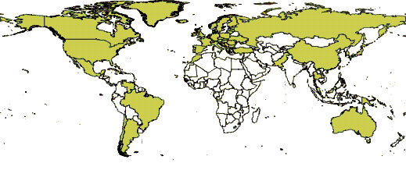
Acceptable Credentials on the Grid
‘Let’s not make the SSH mistake again’
All Credentials Have A Life Time
  Long lived credentials must be revocable
  Short lived (< 100ks) credentials may be left to expire
So we get
X.509 identity certificates: 1 year
Proxy credentials: between 12 and ~24 hours
VOMS attributes: ~ 24 hours
Proxies in a trusted credential store MyProxy: 1Ms, ~11 days
It seems horribly complicated, but …
… but you get global trust, instead of signing up at 250 sites!

Slide 18

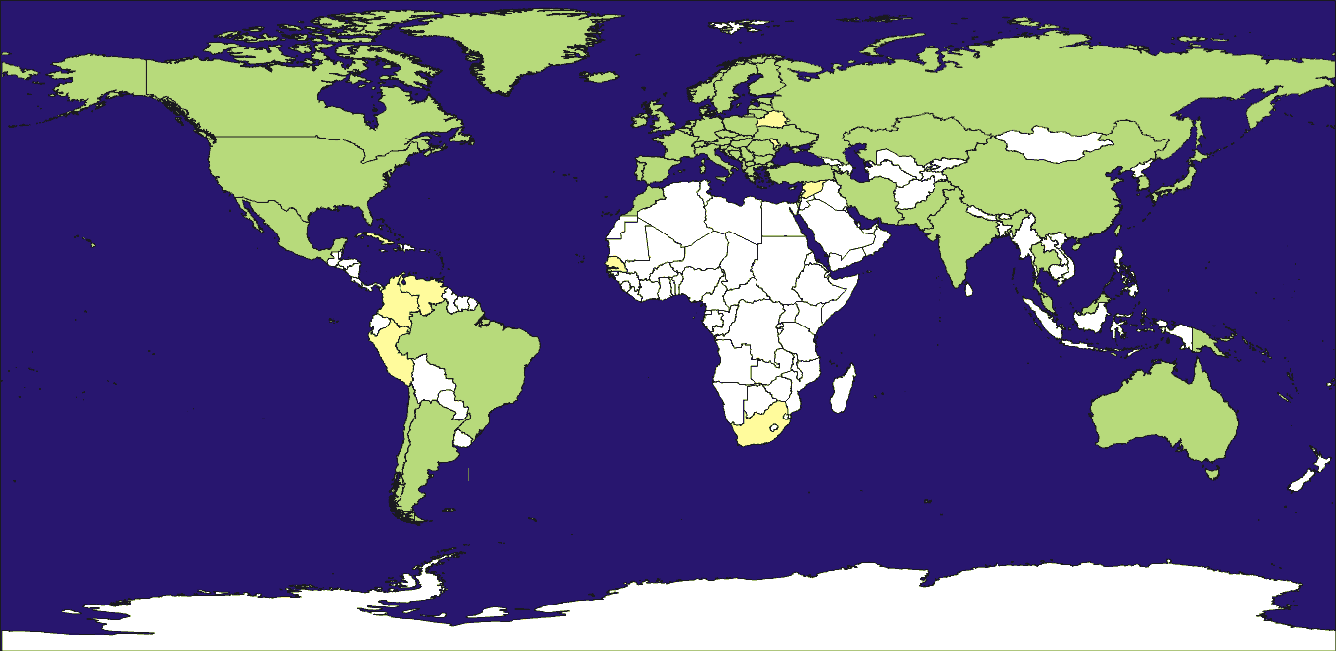
How do the sites know me (and I them)?
International Grid Trust Federation
All research grid infrastructures share
the same base set of trusted third parties (‘CAs’)
There is typically one in each country
The credentials they issue are comparable in quality

Slide 19
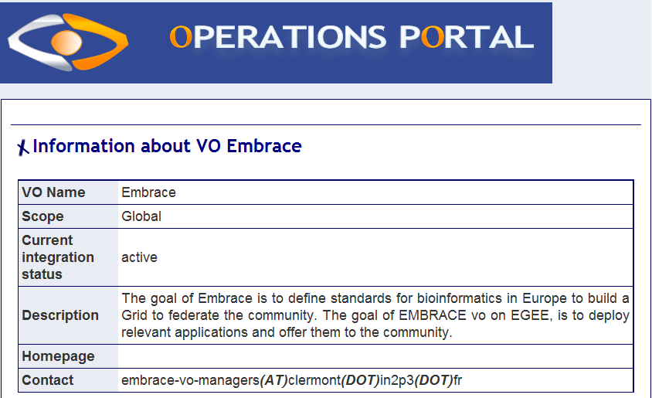
VOs that comply with the Policy
Sites supporting the VO trust the ‘visa’ issued
Trust anchor available to all sites from the trusted source
VO manager is responsible for adding and removing users
subject to the VO management policy
EGEE Operations Portal: http://cic.gridops.org/

Slide 20
So, where does that leave us?
Is the grid safe? You never know …
  Strong authentication of users and resources by certificates
  Exposure is time-limited and revocable
  Community membership via secured ‘visa’
  Encrypted and integrity-protected communications
  Grid and sites subject to policies, with data protection taken seriously,
  commensurate with the open, scientific nature of the infrastructure
  A vulnerability and risk assessment process to work on the software
  Auditing and incident response teams across Europe and the Grids
  And you now know more-or-less how this works
But, as always, it remains a matter of trust …

