Slide 1


Getting Real about Virtual Collaboration on the Grid
Technologies for AAI in non-web e-Infrastructures
TNC 2011
David Groep

Slide 2
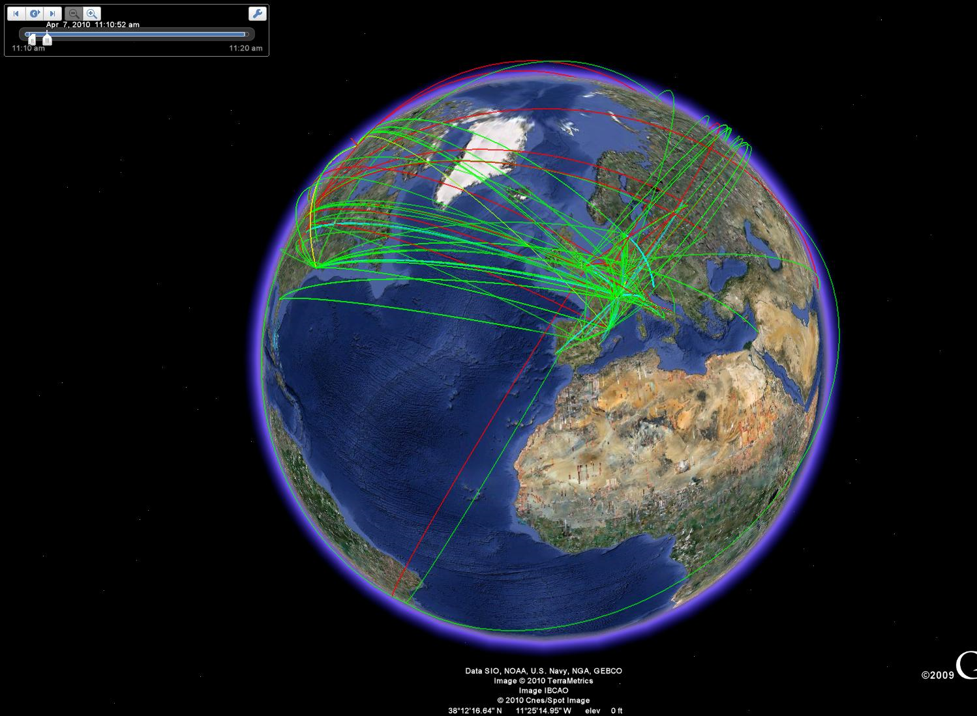
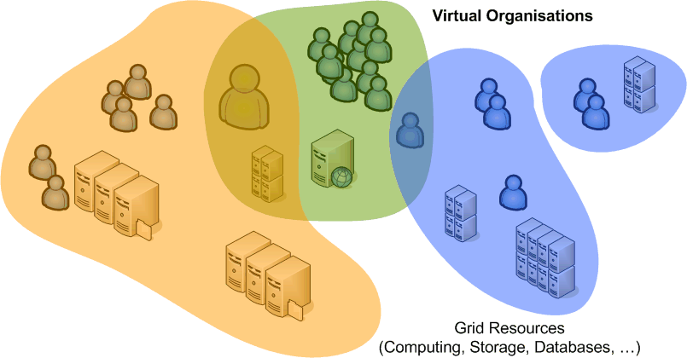
our e-Infrastructure is global
based around (dynamic)
user communities
not around their home organisations
that may live long or be over quickly
deal with compute, data, visualisation, services, and more
and users consist of research staff, students, technicians, …

Slide 3
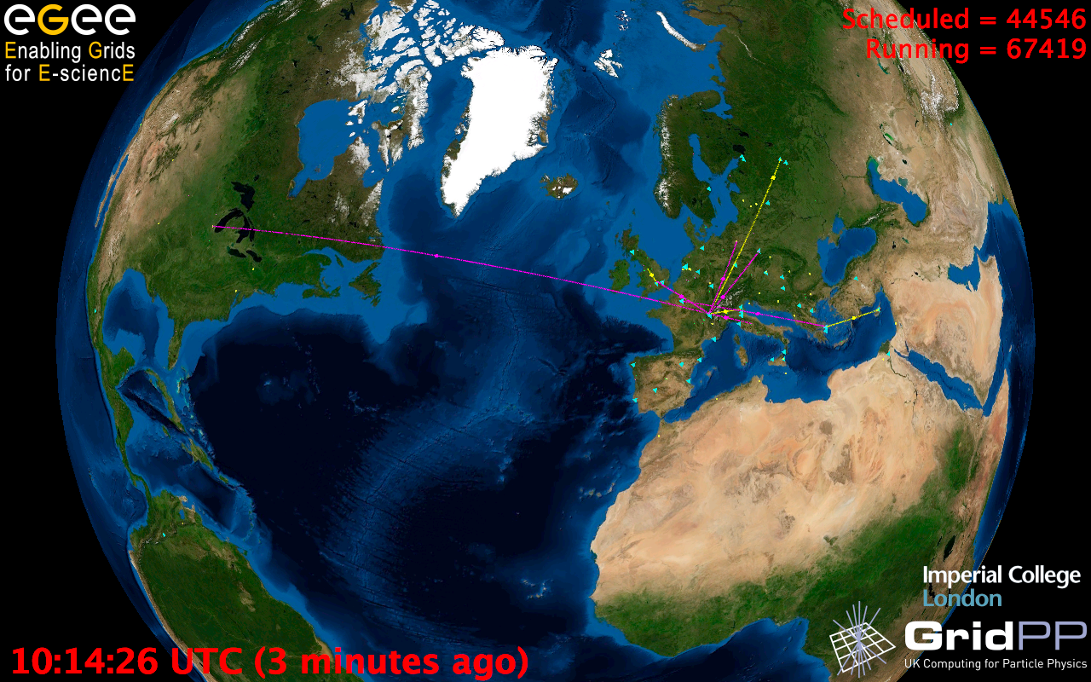
A typical infrastructure in Europe
  Archeology
  Astronomy
  Astrophysics
  Civil Protection
  Comp. Chemistry
  Earth Sciences
  Finance
  Fusion
  Geophysics
  High Energy Physics
  Life Sciences
  Multimedia
  Material Sciences
  …
186 VOs
320 sites
58 countries
Logical CPUs (cores)
  207,200 EGI
  308,500 All
101 PB disk
80 PB tape
25.7 million jobs/month
  933,000 jobs/day

Slide 4
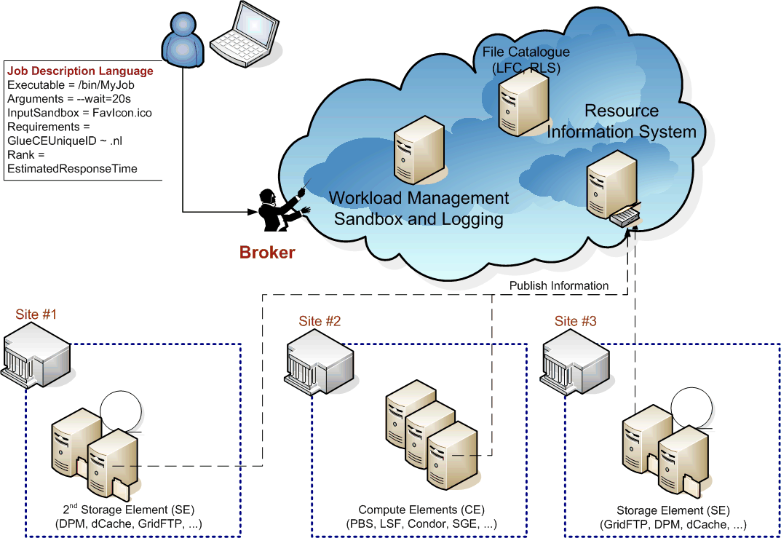
Typical Grid scenarios

Slide 5
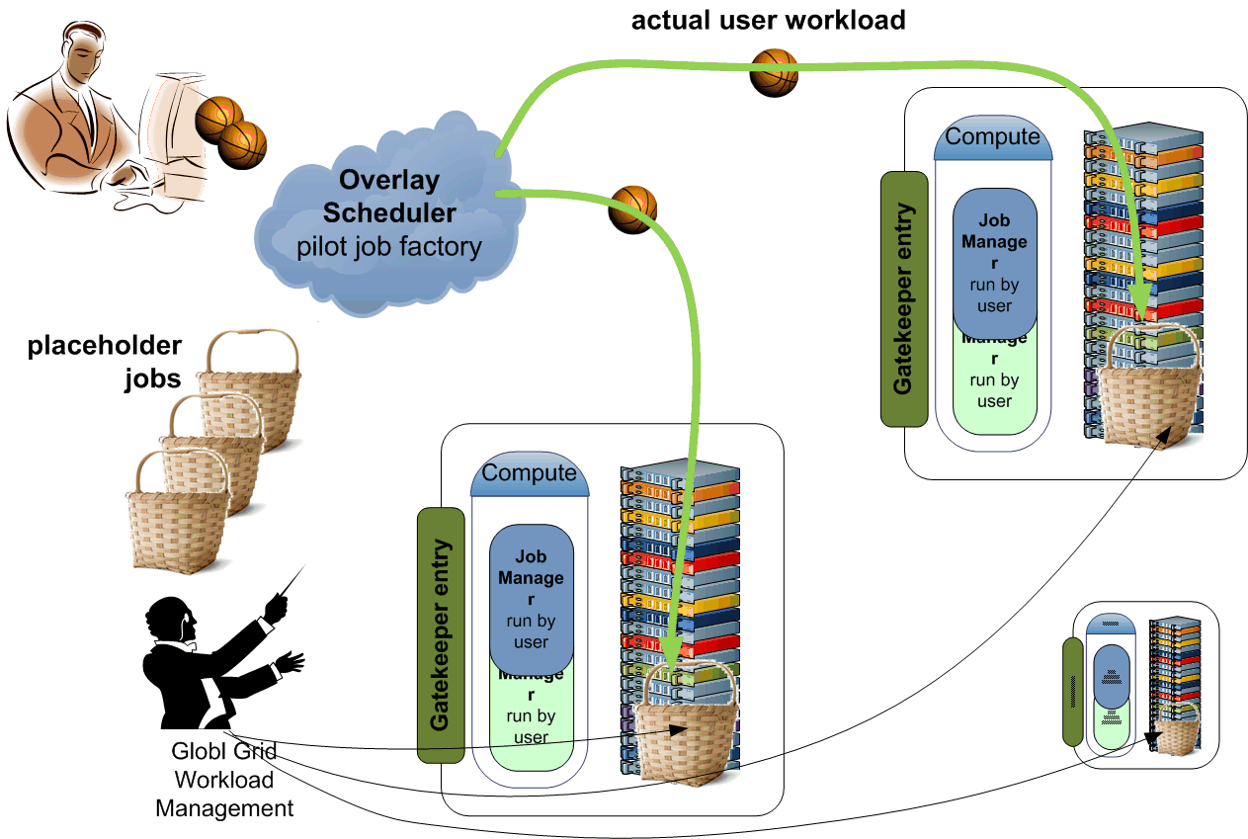
‘Private Cluster’ via overlay scheduling

Slide 6
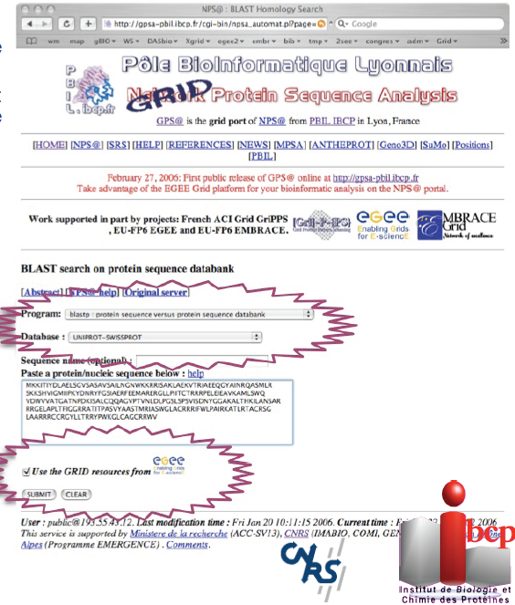
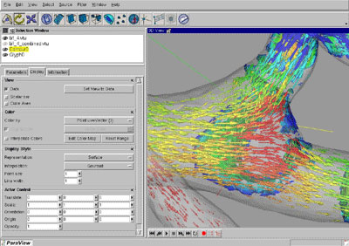
Or via portals
Portals acting
on behalf of the user,
work-flow portals with canned applications
turn-around: min~hours
Graphic: Christophe Blanchet, CNRS/IBCP

Slide 7
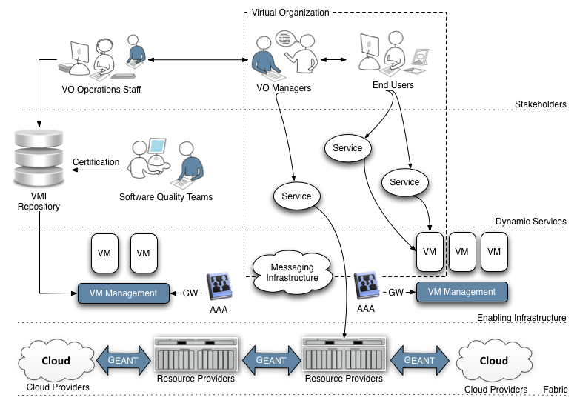
Or in a cloud …
Graphic: Steven Newhouse, EGI.eu

Slide 8

more than one ...
More than one administrative domain
More than one service provider
participates in a single transaction
More than one user
in a single transaction
More than one authority
influences effective policy
Single interoperating instance
across the entire world

Slide 9
What drove the Grid AAI model
Accommodate multiple sources for assertions
  collective policies linked by a common trusted identity (AuthN)
  one or more sources of VO centric ‘AuthZ’ attributes
Accommodate delegation (disconnected work)
  Many entities (services & systems) act on behalf of a user
  Service providers do not know, and cannot fully trust, each other
  conversely: ensure commensurate impact of resource compromise
Accommodate individual, independent researchers
  collaborate without necessity to involve home org. bureaucracy
Sufficient LoA & Trust as needed by resource providers
  allow ‘auto-provisioning’ access to systems
  without pre-registration of individual users

Slide 10
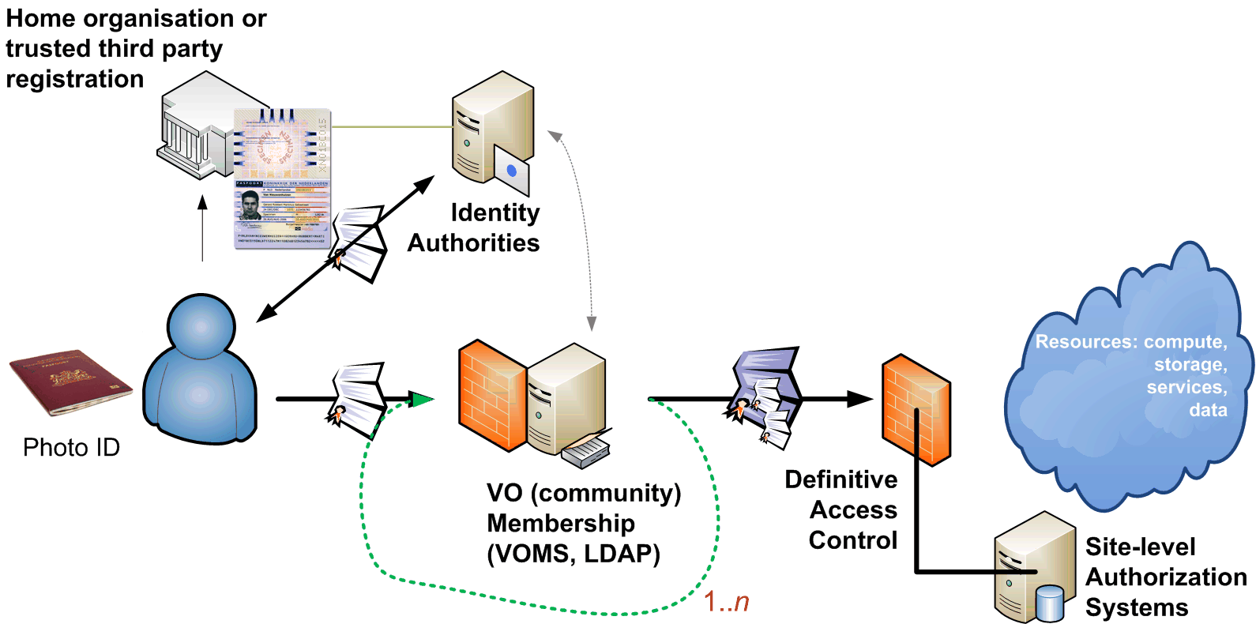
The Canonical Grid Scenario

Slide 11
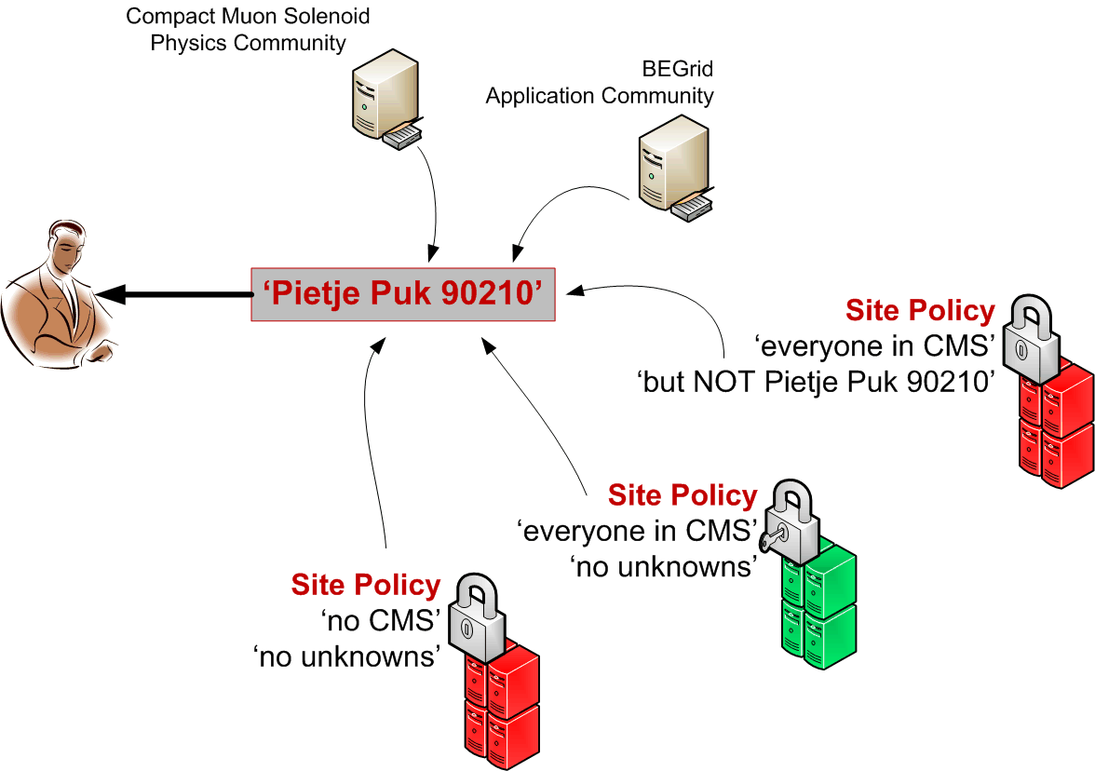
Coordinated Identity

Slide 12
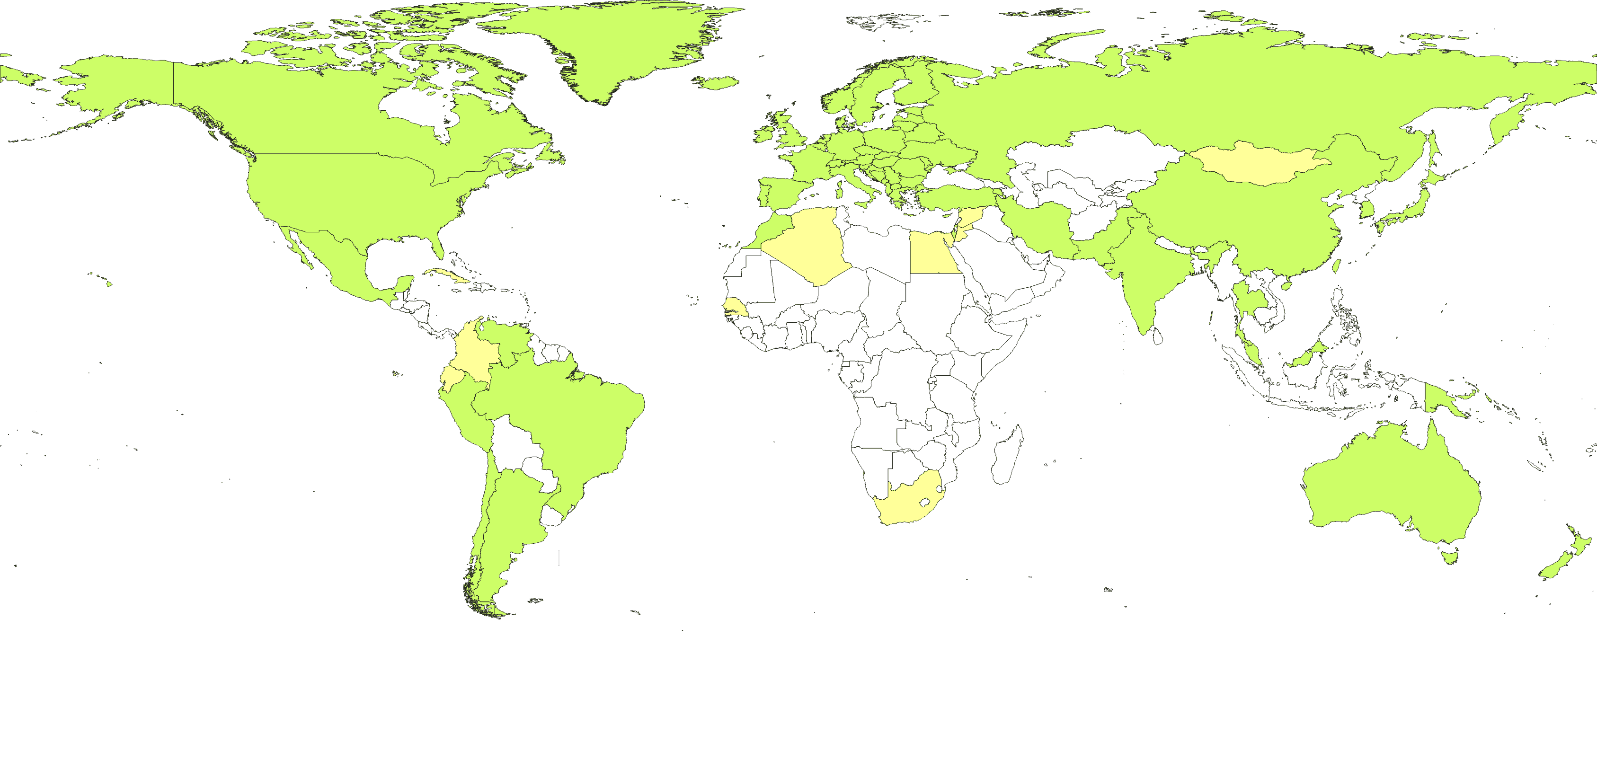

coordinated identity - IGTF
‘policy bridge’ infrastructure for authentication:
86 accredited authorities, 54 countries & economic regions
direct relying party (customer) representation (LoA!)
from countries and major cross-national organisations
  EGI, DEISA/PRACE-RI, wLCG, TERENA, PRAGMA (APGridPMA), Teragrid (TAGPMA), Open Science Grid (TAGPMA)
common trust from all production infrastructures

Slide 13
Authentication Policy Guidelines
IGTF established a single trust fabric, incorporating authorities using different techniques & comparable LoA
Common Elements
Unique Subject Naming
scoped naming
Identifier Association
Publication & IPR
Contact and
incident response
Auditability
Profiles
Classic PKI
  Real-time vetting
  (F2F or TTP)
  13 months life time
SLCS
  Existing IdM databases
  100k – 1Ms life time
MICS
  IdM Federation with F2F
  managed, revocable, identity
  13 months max
https://www.eugridpma.org/guidelines/

Slide 14

A Bunch Of Assertions is Not Enough
Example
file transfer services using managed third-party copy via the SRM protocol
3. Register
(via RRS)
Replica
Catalog
Replica
Manager
SRM-Client
SRM-Client
Users
1.DATA
Creation
2. SRM-PUT
Network transfer
of DATA
SRM-Client
4.SRM-COPY
Tier0 to Tier1
7.SRM-COPY
Tier1 to
Tier2
Retrieve data
for analysis
10.SRM-GET
8.SRM-PUT
SRM
Network transfer
of DATA
SRM
5.SRM-GET
SRM
Network transfer
Network transfer
CASTOR
cache
dCache
Tier2
Storage
archive files
archive files
stage files
Tier 2
Center
CERN
Tier 0
FNAL
Tier 1
SRM graphic: Timur Perelmutov and Don Petravick, Fermilab, US
Example
automatic workload distribution across many sites in a Grid

Slide 15
Delegation – why break a recursion?
Mechanism to have someone,
or some-thing – a program – act on your behalf
  with a (sub)set of your rights
  allowing resource providers to apply policies based on your own
Fundamental to the grid model
  since the grid is highly dynamic and
  resources do not necessarily know about each other
  only the user (and VO) can ‘grasp’ the current view of their grid
  resource owners need long-lasting assertions and traceability (independent of the community or its short life time)
  higher LoA and declaration of ID requires for high value resources!

Slide 16
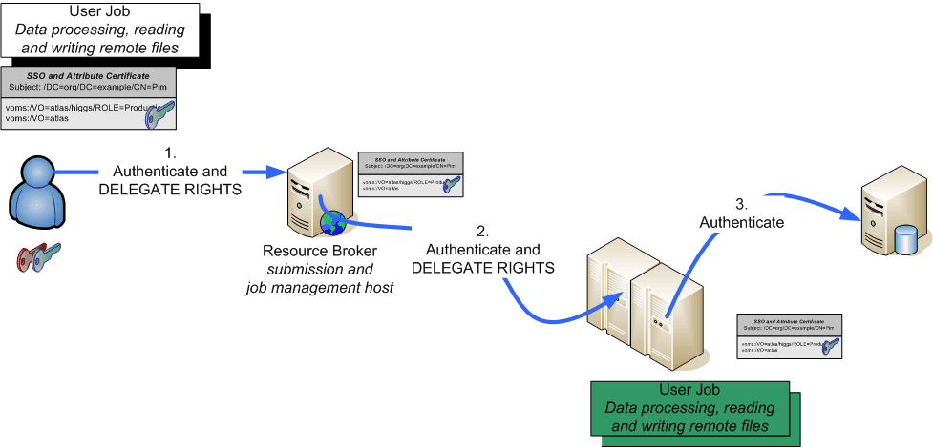
Delegating rights and privileges
GSI-PKI ... and now also some recent SAML specs
  GSI (PKI) through ‘proxy’ certificates (see RFC3820)
  SAML: Subject Confirmation, linking to at least one key or name
RFC3820 supported in OpenSSL and as add-in to many suites

Slide 17
Authorization: VO representations
VO*: directory of members, groups, roles, attributes
Membership information conveyed to services
  configured statically, out of band
  usually with pre-provisioning of local user accounts
  in advance, by periodically pulling lists
  VO (LDAP) directories
  VO Membership Service (VOMS)
  signed assertions pushed
  with the request in proxies
  push or pull assertions via SAML
* this is the ‘EGI’ or e-Infrastructure sense of VO, representing users. Other definitions may include resources providers in a more vertically oriented ‘silo’ model

Slide 18
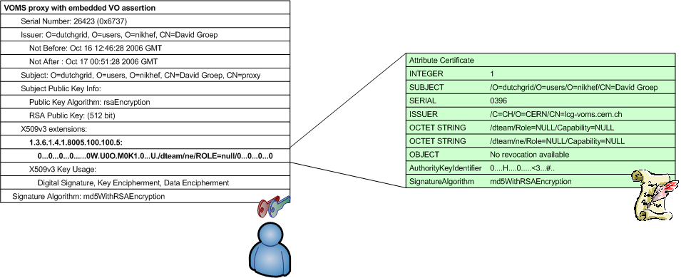
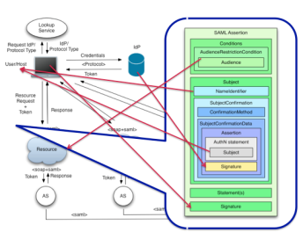
VOMS: the ‘proxy’ as a container
Virtual Organisation Management System (VOMS)
push-model signed VO membership tokens
  using the traditional X.509 ‘proxy’ certificate for trans-shipment,
  backward-compatible with only-identity-based mechanisms
  supplying SAML tokens (typically in a push scenario as well)
Similar concept as use of embedded SAML as SubjectConfirmation
in the GEMBus token format ...
GEMBus graphic from: Diego R. Lopez, RedIRIS and GEANT3

Slide 19
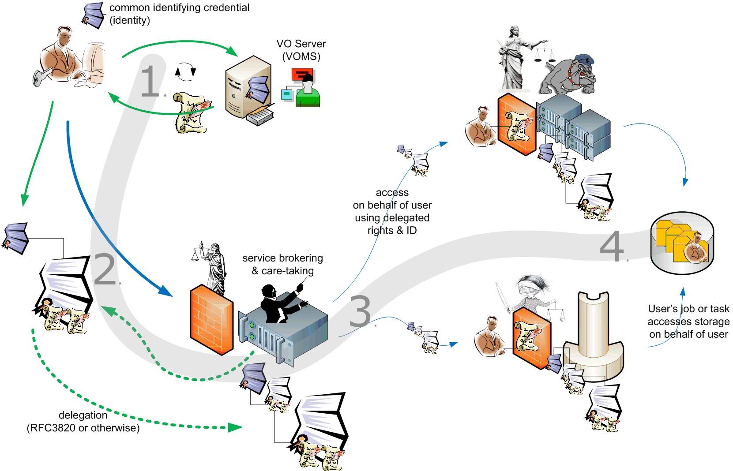

Slide 20
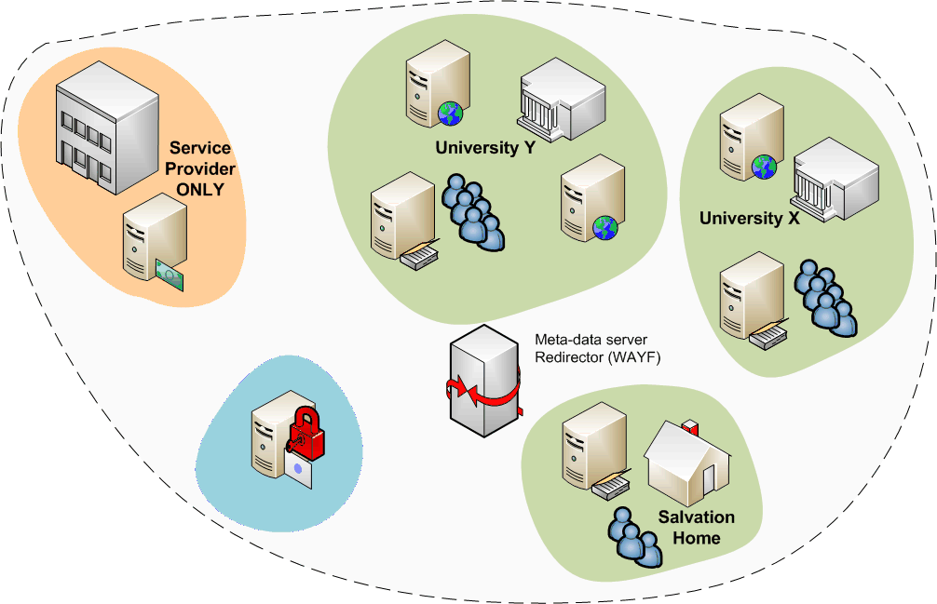
Attributes from many sources
In ‘conventional’ grids, all attributes assigned by VO
but there are many more attributes, and
some of these may be very useful for grid
grid structure was not
too much different!

Slide 21
Towards a multi-authority world
Interlinking of technologies can be done at various points
Authentication: linking (federations of) identity providers to the existing grid AuthN systems
  (Short-Lived) Credential Services translation: e.g. TCS eSc Personal
Populate VO databases with UHO Attributes
Equip resource providers to also inspect UHO attributes
Expressing VO attributes as function of UHO attributes
and many other options as well …
Leads to assertions with multiple LoAs in the same token
  thus all assertions ought carry to their LoA
  expressed in a way that’s recognisable
  and the LoA attested to by a trusted (third?) party (e.g. a federation)
  e.g. in ‘meta-data distribution’ and bound by a chain signatures

Slide 22
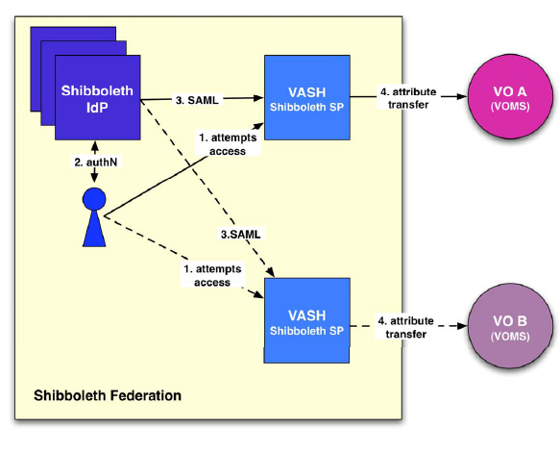
Attributes from multi-authority world
Linking two worlds example –
VASH
‘VOMS Attributes
from Shibboleth’
  Populate VOMS with
  generic attributes
  Part of gLite (SWITCH)
http://www.switch.ch/grid/vash/

Slide 23
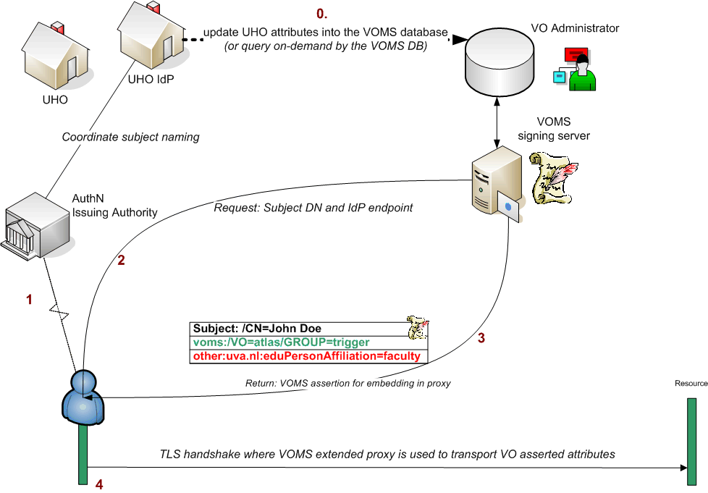
Putting home attributes in the VO
Characteristics
  The VO will know the source of the attributes
  Resource can make a decision on combined VO and UHO attributes
  but for the outside world, the VO now has asserted to the validity of the UHO attributes – over which the VO has hardly any control

Slide 24
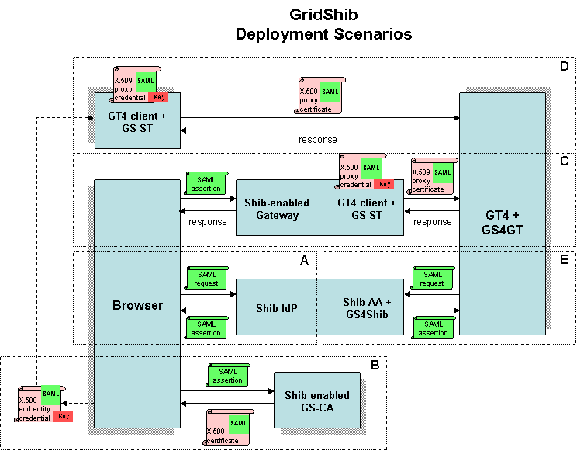
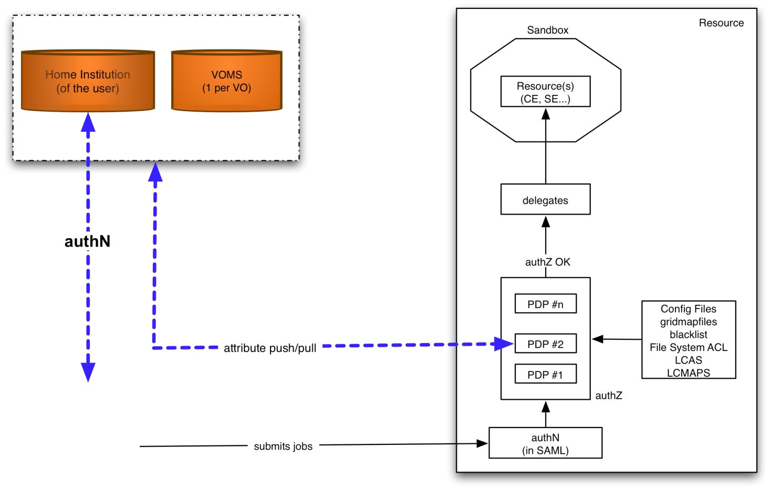
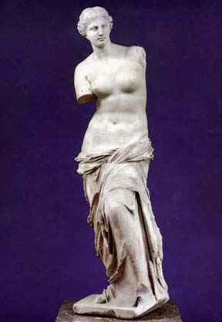
Attribute collection ‘at the resource’
graphic from:
Chistoph Witzig, SWITCH, GGF16
Graphic: the GridShib project (NCSA)
http://gridshib.globus.org/docs/gridshib/deploy-scenarios.html
Characteristics
  The RP (at the decision point) knows the source of all attributes
  but has to combine these and make the ‘informed decision’
  is suddenly faced with a decision on quality from different assertions
  needs to push a kind of ‘session identifier’ to select a role at the target resource

Slide 25
What to Do with a Bunch of Attributes...

Slide 26
Make a Decision ...
Permit Atlas users (FQAN) to execute job on worker node (WN)
  resource "http://grid.switch.ch/wn" {
  action "http://glite.org/xacml/action/execute" {
  rule permit { fqan="/atlas" }
  }
  }
Ban a particular user by DN
  resource ".*" {
  action ".*" {
  rule deny {
  subject="/C=CH/O=SWITCH/CN=Valery Tschopp" }
  }
  }
Example: Argus Authorization Service. Argus translates this to XACML2.
Source: Valery Tschopp, SWITCH and EMI

Slide 27
A basic yes-no doesn’t get you far
If yes, what are you allowed to do?
  Credential mapping via obligations, e.g. unix user accounts,
  to limit what a user can do or disambiguate users
  ‘Intended’ side effects
  allocating or creating accounts ... or virtual machines, or
  limit access to specific (batch) queues, or specific systems, or ...
Additional software needed
  Interpreting policy and constraints
  Handling ‘obligations’ conveyed with a decision
  e.g. LCMAPS: account mappings, AFS tokens, Argus call-out
  Argus: pluggable obligation handlers per application
    and interpret (pre-provisioned) policies applicable to a transaction/credential

Slide 28
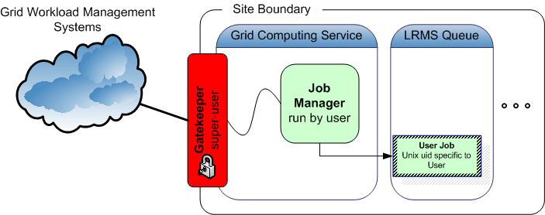
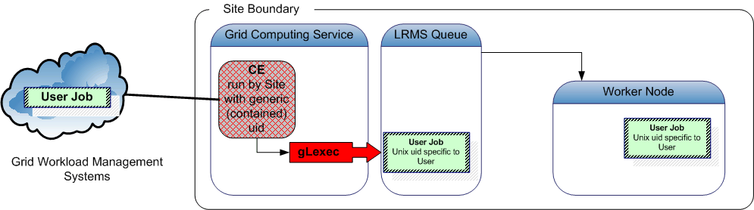
Job Submission Today
User submits the jobs to a resource through a ‘cloud’ of intermediaries
Direct binding of payload and submitted grid job
job contains all the user’s business
access control is done at the site’s edge
inside the site, the user job should get a specific, site-local, system identity

Slide 29
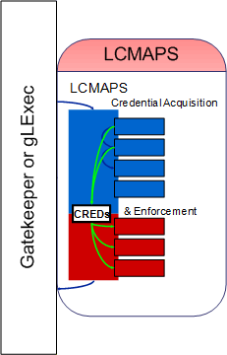
Auto-provisioning as a core feature
– e.g. to the Unix world
C=IT/O=INFN
/L=CNAF
/CN=Pinco Palla
/CN=proxy
Identity Proxy
VOMS
pseudo-cert
VOMS + other attributes
translate
pvier001:x:43401:2029:PoolAccount VL-e P4 no.1:/home/pvier001:/bin/sh
run as root
credential: …/CN=Pietje Puk
Unix does not talk Grid, so
translation is needed between
grid and local identity
translation has to happen somewhere
something needs to do that
without knowing the users in advance!
run as target user
uid: ppuk001
uidNumber: 96201
www.nikhef.nl/grid/lcaslcmaps/

Slide 30
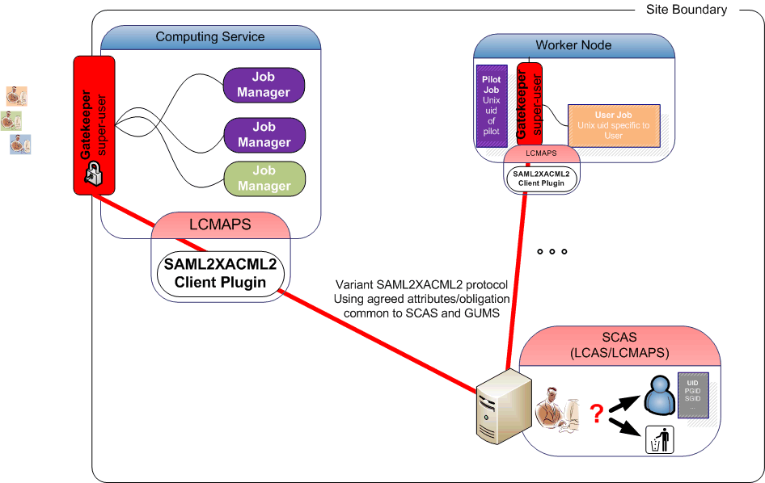
Many access control points …
off-site
policy
site-central service
* of course, central policy and distributed
per-WN mapping also possible!

Slide 31
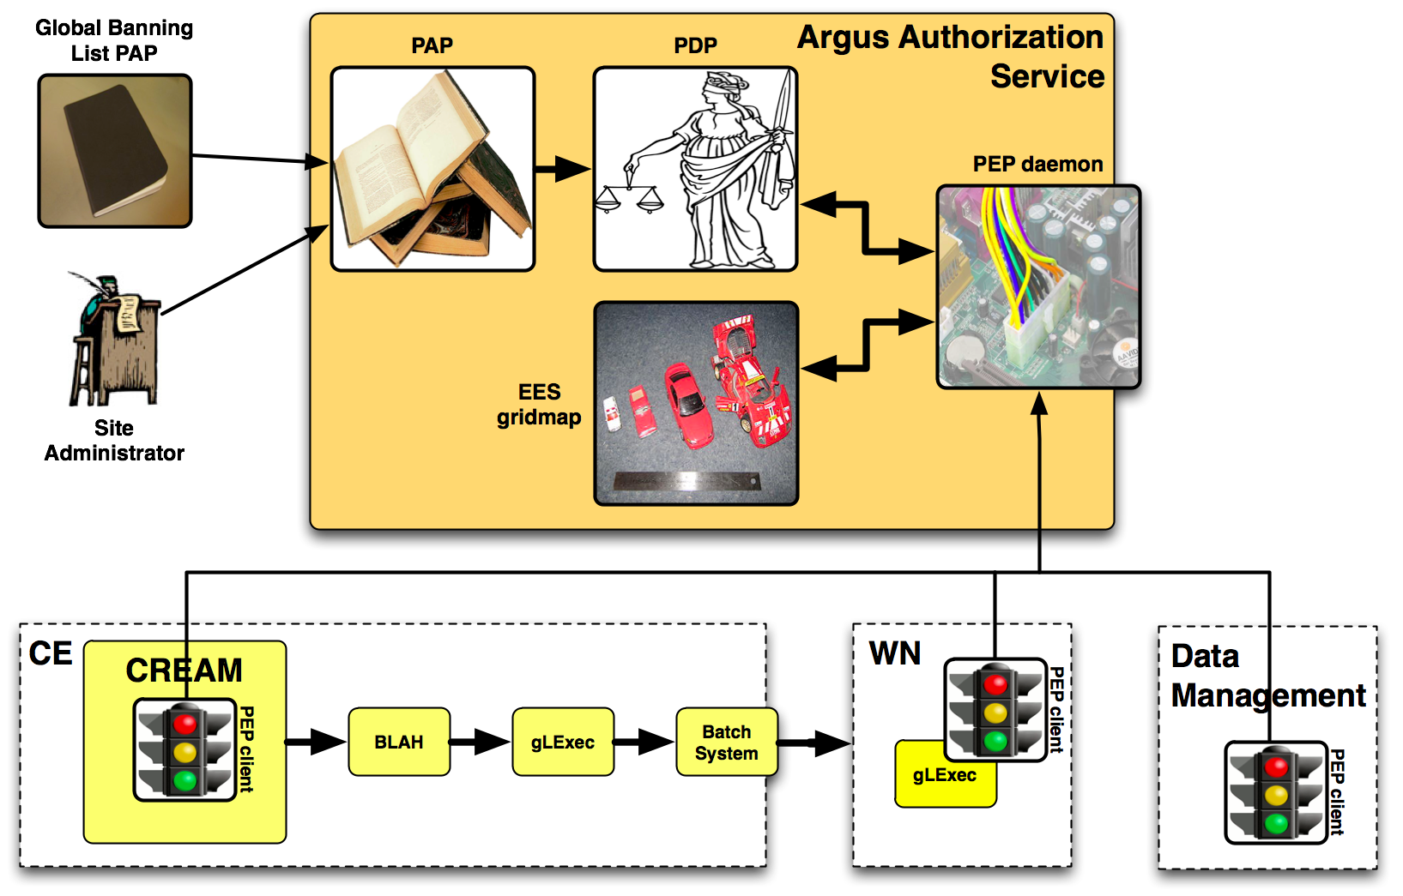
Argus – consistent authorization
graphic: Valery Tschopp, SWITCH and EMI
https://twiki.cern.ch/twiki/bin/view/EGEE/AuthorizationFramework

Slide 32
Key Elements for interop
Common communications profile
  Agreed on use of SAML2-XACML2
  http://www.switch.ch/grid/support/documents/xacmlsaml.pdf
Common attributes and obligations profile
  List and semantics of attributes sent and obligations received between a ‘PEP’ and ‘PDP’
  http://cd-docdb.fnal.gov/cgi-bin/ShowDocument?docid=2952
  http://edms.cern.ch/document/929867
Graphic: Gabriele Garzoglio, FNAL
  Subject S requests to perform Action A on Resource R within Environment E
CE / SE / WN
XACML Request
Site Services
Gateway
PDP
PEP
XACML Response
Grid Site
  Decision Permit, but must fulfill Obligation O
EGI-TF10 NREN-Grids workshop
Sept. 2009
32
http://www.authz-interop.org/

Slide 33
Capabilities (Argus as an example)
Enable various common authorization tasks
  Banning of users (VO, WMS, site, or grid wide)
Composition of policies
  e.g. Site Owner policy + experiment policy + CE policy +
  EGI CSIRT policy + NGI policy=> Effective policy
  Argus uses composeability of XACML policies and policy sets
Support authorization based on information
about the job, action, and execution environment
  Support for authorization based on attributes other than FQAN
  Support for multiple credential formats (not just X.509)
  ‘Procurement’ of multiple types of execution environments
  Virtual machines, workspaces, …
https://twiki.cern.ch/twiki/bin/view/EGEE/AuthorizationFramework

Slide 34
Beyond a single policy
Attribute interpretation is more than mere mapping
  what do the attributes mean, and do all VOs mean similar things with the same kinds of attributes?
  Is the order in which the attributes are presented important?
  Can the same bag of attributes (or same priority) be used for both compute and data access?
  How do changing attributes reflect access rights on persistent storage, if the VO evolves its attribute set?
needs interaction between attribute source and RPs/SPs,
that goes beyond just policy languages, SAML or XACML
  harmonization only makes sense when driven by relying parties
  explicitly include RPs in setting standards for LoA and semantics

Slide 35
What Grid-AA Does for you Today
Grid is built around multiple sources of authority
  ID vetting, persistent identification, attribute sourcing and policy come under distinct domains, but leveraging a common authentication ID
  With the ‘PKI bits’ being ever more cleverly hidden from the user
Accommodate delegation of rights bound to an ID
  allows software and other users to act on your behalf
  with transparency via MyProxy and on-line service like TCS and SLCS-es
Accommodate also individual, independent researchers
  even though federations will aid 95+% percent, full coverage will not be …
EGI demonstrates that grid mechanisms and associated policies and standards convinced 300+ resource providers grid is trustworthy enough
Users actually see a single interface (VO), and no longer need to register at 100s of different sites and fill in 100+ AUP statements … since 2002!

Slide 36
Questions?

