Slide 1
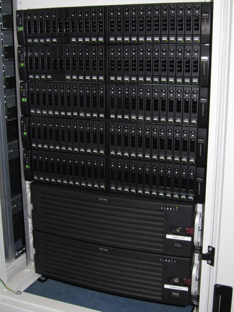
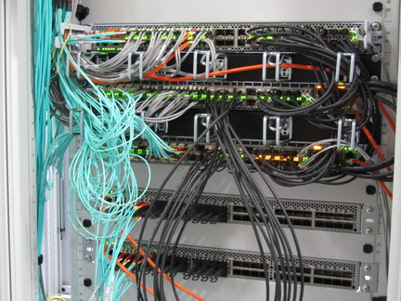
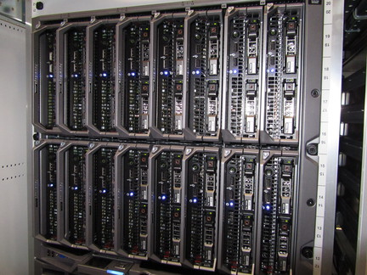
Getting Started with Sint & Piet
Status as per 4 April 2012

Slide 2
Elements of NDPF Service Cluster
GSP Piet “MTDR24”: 16 blade servers
Sint SAN storage “MTDR23”:50 TByte
Existing set of Generics 2008/A
few of these will become a security VM cluster
1-2 others become test systems
Existing blades “bl0”
1-5, 13,14 will be upgraded to dual FC SAN
10G stacked switches replace pass-through (Thu.)
Installnet switch (still now: deelmlx)
Seperate installation network ve11 @1+10G
IPMI management LAN ve4 for managementonly

Slide 3
Storage
Dell Compellent Storage Center (6.0.3)
sint.ipmi.nikhef.nl collective management
username: Admin
78 TByte gross capacity
auto-tiering ESSD, 10kRPMSAS, 7k2RPM N/L-SAS
Default RAID 6-6 on Tier 2&3
Default RAID-10 and 5-5 on Tier 1
Effective capacity ~ 50 TByte

Slide 4
Auto-tiering effect on used storage

Slide 5
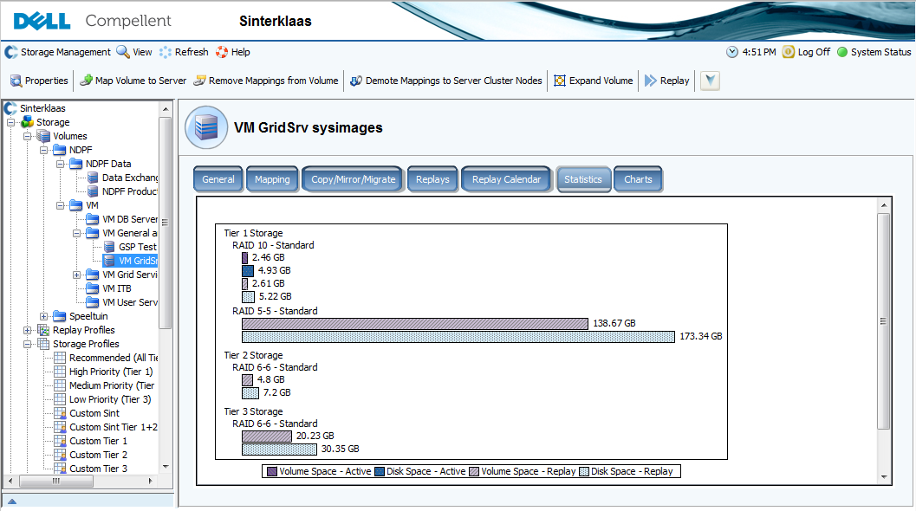

Slide 6
Caveats
Tier migration only works on replay volumes
If you do not configure replay, data stays in primary storage most, usually on Tier-1
Choose a ‘custom’ template for all volumes
for most volumes ‘Custom Sint’ is OK
databases and high-IOPS: ‘Custom Sint Tier 1+2 HS’

Slide 7
LUNs for VM hosting
You can (and should) host more than one VM system disk on a LUN
But not too many since performance (IO queues) are per-LUN
Allocation is sparse, so ‘0’s take no space
On re-writing old VM images, space is not reclaimed
Put transient VMs in a dedicated pool LUN
LUN can be removed after completion
Guideline: 10-15 VMs per LUN
Separate LUNs for Data, databases and $HOME

Slide 8
Assigning LUNs to hosts
Xen clusters are Server Clusters which share use of each LUN
this ‘server cluster’ must be defined as such on the Compellent, or Sint will warn for inconsistencies
XCP/XenServer “Piet” with the dual FC paths uses EL5/Xen5.x multi-path “MP” IO
Generics 2008/A iSCSI only has a single path, so uses XenServer 5.x IO
You cannot attach LUNs to a single server in a XCP cluster
You cannot share LUNs without using LVM

Slide 9
Linking storage and compute
We have a dual-redundant FC mash-up
Key FC concepts:
“WWN”: world-wide name, identifies an FC end-point or port on a FC card
“zone”: a group of server end-points that can see eachother
‘soft zoning’: a zone based on WWNs
‘hard zoning’: zone based on physical ports
“alias”: a friendly name for a WWN
license: everything is licensed!
FC: switches v.s. ‘access gateways’

Slide 10
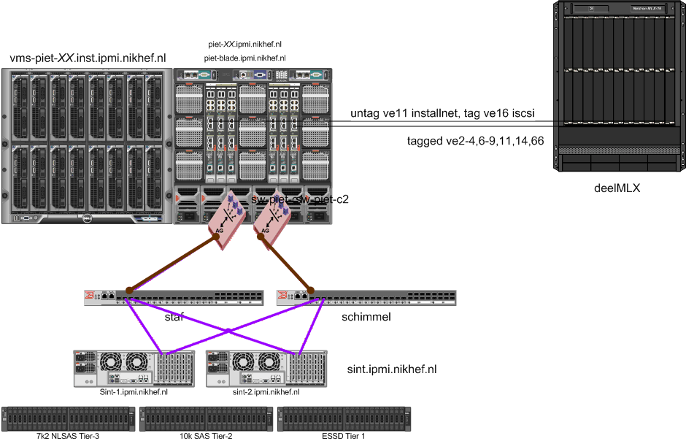

Slide 11
Staf and Schimmel
Brocase SAN switches containing zone def
two independent switches for each path
cross-connect to the Compellent
server ports (and AGw’s) connect to one of them, and servers have two FC ports for MPIO
effectively, each host sees a LUN 4 times
Zones:
Z_Sint_Piet01: contains both “Sint”s and all Piet’s
Z_Sint_R710: contains both “Sint”s and Achtbaan

Slide 12
Useful commands
alicreate "aliName","member[; member...]“
name aliases after hostname and switch fabric
alicreate “A_Piet03_C1” “20:01:24:b6:fd:be:23:e3” on switch staf.ipmi.nikhef.nl
zoneadd "zoneName", "member[; member]“
add named aliases (please!) to a zone
zoneadd “Z_Sint_Piet01”, “A_Piet03_C1; A_Piet_04_C1” on switch staf
on schimmel it would look like
zoneadd “Z_Sint_Piet01”, “A_Piet03_C2”

Slide 13
FC Configurations
changes in the CLI are the defined configuration, not yet the effective configuration settings
Save the configured settings
cfgsave
Enable the configured settings
cfgenable “C_Staf”
There can be multiple configuration, but for the time being that would just be confusing
Note that a single WWN can be a member of many zones

Slide 14
iSCSI – for Generics and more

Slide 15
GSP Piet
16 M610 blades,
96 GByte RAM, 2x600 GB SAS disk in RAID-1 config
2x6 cores with HT
eth0+1: 1 Gbps, switch fabric A
eth2+3: 10 Gbps, switch fabric B
dual FC: 8 Gbps, switch fabric C
Enclosure: piet-blade.ipmi.nikhef.nl
Switches: sw-piet-<fabric><1|2>.ipmi.nikhef.nl
Blade DRAC: piet-<01..16>.ipmi.nikhef.nl

Slide 16
Recommended BIOS
CPU: virtualisation enabled ☺
no memory checking on boot
boot order: disk, <rest>
To install
mount the virtual CD-ROM via DRAC, via Java applet or ActiveX control
press F11 during boot
select ‘Virtual CD-ROM’
Proceed with installation

Slide 17
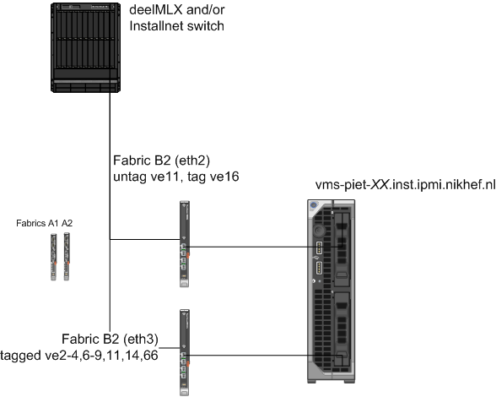
Ethernet Networking Piet

Slide 18
Installation
Follow install guidance XCP1.5beta (1.4.90)
Hostnames
vms-piet-XX.inst.ipmi.nikhef.nl, vms-gen-XX.inst....
Cluster master (via CNAME)
pool-piet.inst.ipmi.nikhef.nl CNAME vms-piet-16...
static IP address (see Wiki or DNS)
dedicated installnet “ve11” 172.22.64.0/18
untagged over eth2 (eth0 for Generics 2008/A)
DNS: boer, stal, dwalin
NTP: stal, salado.inst (172.22.64.2), dwalin

Slide 19
XenServer
XCP 1.5 looks like XenServer 6 w/o HA,WBS
Local configuration resembles CentOS5
Installed via CD-ROM
Install image ISO on stal, or download from xen.org
to make it look like XenServer, follow Wiki tweaks
Fit in local ‘GridSRV’-like management system
run xcp-config.sh post-install script
installs ssh keys of nDPFPrivilegedUsers for root
configure bridged networking & txqueue performance
https://wiki.nikhef.nl/grid/GSP_Virtualisation_with_Xen

Slide 20
Pool Constraints
All hosts in the pool must have
the same network configuration (devices, vlans)
the same FC configuration for MPIO
be in the same server pool on Sint
You can’t
copy VDIs between SRs on different pools
migrate VMs between pools
mount the same storage r/w on different pools
copy VDIs with the GUI (but you can with a CLI)

Slide 21
XenCenter
Works best under Windows (sorry)
CLI anyway needed for advanced configuration
The CLI command is xe (see also: xe help --all)
Configuration
connect to pool-piet.inst.ipmi.nikhef.nl, username: root
Caveats:
no HA, so failing hardware will kill VMs
Live migration: right-click to move VMs
Maintenance mode: automatically moves VMs
Maintenance on pool master: trigger alternate master (and remember to update DNS CNAME please)

Slide 22
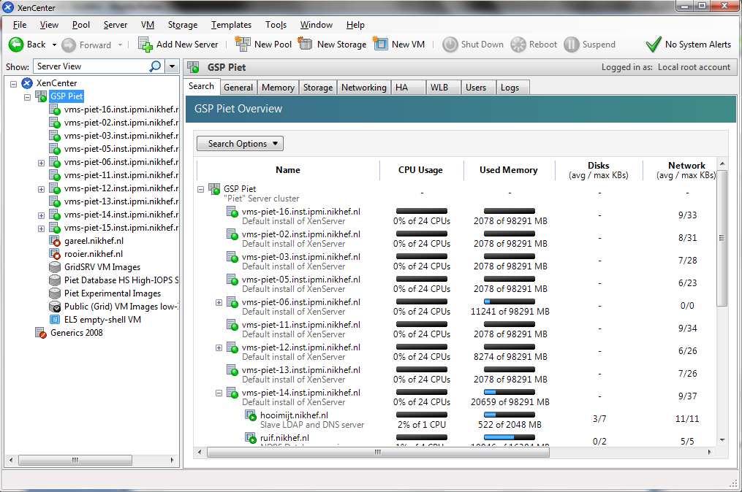

Slide 23
AII VM provisioning
Configure a machine with quattor
make sure the hardware spec is really what you want
compile the profile (the new biggerish-XML works)
aii-shellfe --configure <hostname>
aii-provision-vm --n “<hostname”> -a
After install: fixup XenTools version as per Wiki
network configuration is in .xapirc of ndpfmgr
stal:~:1030$ aii-provision-vm -n "boslook.nikhef.nl" -a
Parsing XML data from CDB, please wait ... Done.
Password:
Connecting to https://pool-piet.inst.ipmi.nikhef.nl/ as root ...
Creating new VM boslook.nikhef.nl on pool.
SR will be Public (Grid) VM Images low-IOPS series 1
Template used OpaqueRef:94142f41-6744-76da-881c-45570ae1938d
OS Repository http://stal.nikhef.nl/centos/5.7/os/x86_64/
Autoboot set to 1
Start on ready set to no
Creating NIC eth0 in Public Grid (194.171.97.0)

Slide 24
Non-AII
Create host from template (“New VM”)
the install URL is like http://spiegel.nikhef.nl/mirror/centos/6/os/x86_64
boot options: ks=<url> graphical utf8
When the install fails first time
login to pool master
reset the boot loader to “eliloader”

Slide 25
Tuning the VM and more
Memory balooning can be set through the GUI
only after VM tools are installed
and fixed to proper version
Live migration
again easiest from GUI
only within a pool
only to same hardware
Across pools?
you cannot live migrate across pools
you cannot sanely share LUNs across pools

Slide 26
About disks and images
VM disk images are stored in Storage Repositories
One LUN contains one SR
One SR can contain many disk images
An SR is always LVM volume, even on local disk
The default XCP disk image type is now VHD inside LVs, no longer raw LVM volumes
in you copy in disk images, create the VDI yourself with type RAW
when copying VDIs between SRs, they become VHD
you cannot copy out VHDs to raw LVs

Slide 27
Finding your SR
An SR is hosted on a LUN and reached via
a local HBA for FC connected systems
an iSCSI HBA for Generics 2008/A
On FC, your LUN is visible immediately once you add the server to the server group on Sint
On iSCSI, you need to trigger a discover on both sides at the same time (<30sec)
Provision the LUN on the Compellent first
For aii-provision-vm: making the desired SR the default SR eases creation of new VMs

Slide 28
Import existing VM from EL5
Create a RAW LVM xe vdi-create \ sm-config:type=raw sr-uuid={SR_UUID} \ name-label="My Raw LVM VDI" \ virtual-size={size}GiB type=user
mount this LVM in the Dom0
a lot safer than tweaking with lvchange –ay!
vbd-create and vbd-plug
Copy the contents into it (may take a while!)
you can try it with a live VM if the FS is stable
unplug please VDI from the dom0 VBD
destroy the left-over vbd in the dom0
create a VM which boots pygrub (not eliloader)

Slide 29
Backups and restore
SRs can be detaches and attached without trouble
DO NOT FORMAT AN SR if you think there’s useful data on it
Attach an SR only to one pool in RW mode

Slide 30
Oops
If all is hosed recover from database dump (wiki!)
Or, if worst comes to worst:
detach all SRs
wipe all VM hosts (“enter maintenance mode” -> “remove server from pool”, or reinstall
create a new pool
re-attach the SRs, but do not format
create a bootable template
create VMs based on existing VDI disk images

Slide 31
En Nu Zelf ...

