Slide 1
Evolving the EGI trust fabric using distributed responsibility
David Groep
EGI IGTF Liaison
orcid.org/0000-0003-1026-6606

Slide 2
EGI trust policy space
EGI Security Policy
top-level framework
Accepted Certification Authorities policy
IGTF Classic
IGTF MICS
Virtual Organisation
Membership Policy
Registration Practices
IGTF SLCS
EGI (based on earlier joint JSPG work) puts user traceability on the IGTF providers
accepting a set of IGTF assurance profiles: MICS, SLCS, Classic
with peer-reviewed self-audits and transparency
VO registration process is fairly light-weight: no audits, no documented procedures
but a few VOs are different and do have such processes (mainly wLCG)

Slide 3
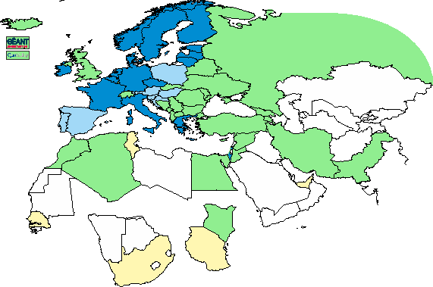
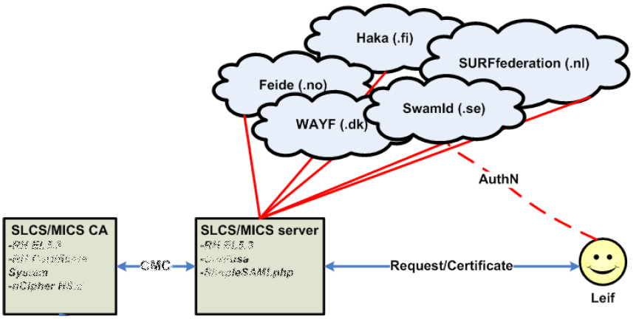
Federated Authentication
Performing reasonable identity vetting of users and providing traceability is non-trivial
Authorities set of a distributed Registration Authority network
Or leverage an existing one, based on ‘FedAuth’ with quality assurance
e.g. through services like DFN-AAI and Trusted Certificate Service TCS
Graphic: IGTF 2015
Graphic from: Jan Meijer, UNINETT

Slide 4

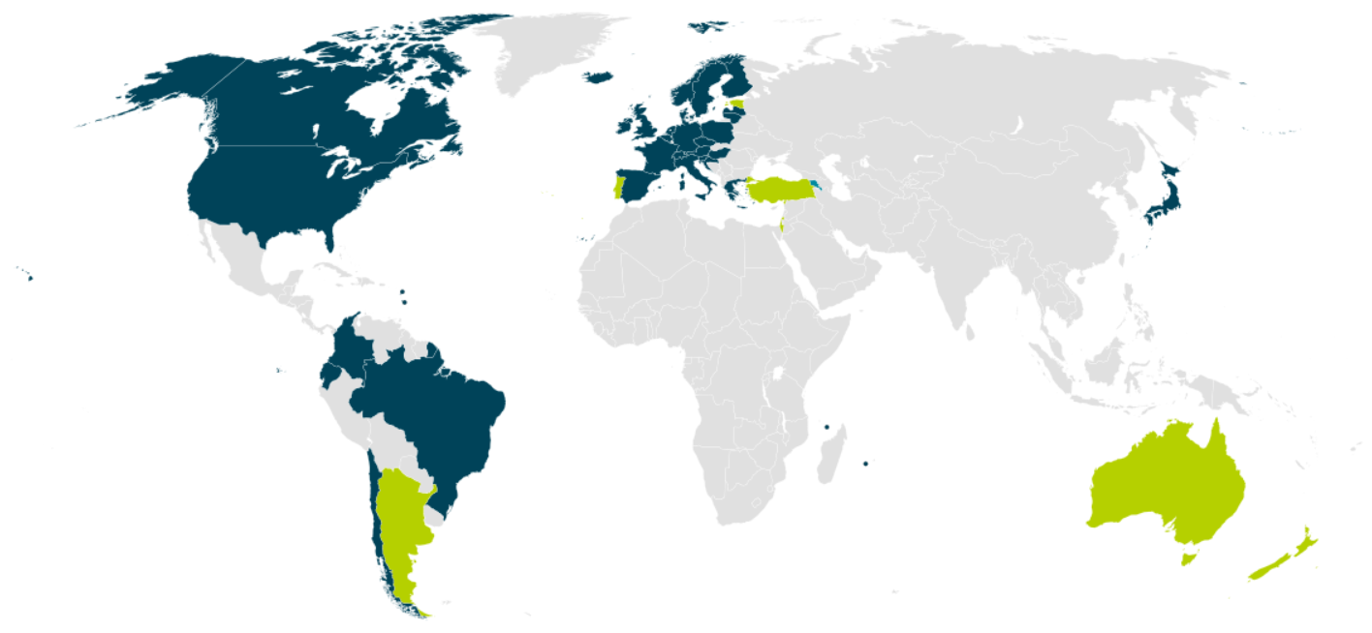

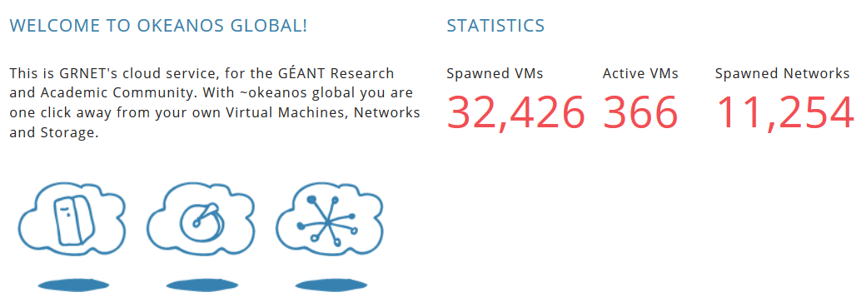
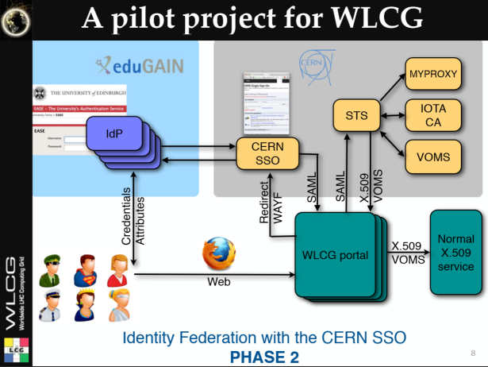
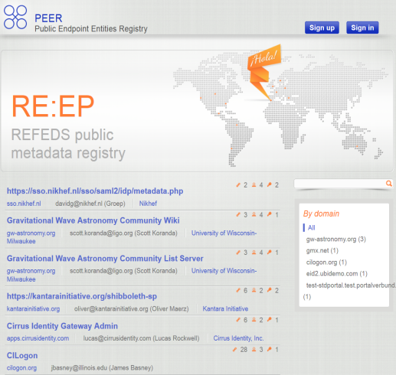

‘Federated Authentication’ for a myriad of services
But SSO single password & federation also means:
instant abuse in case it gets compromised
(WebSSO, imap, smtp, ssh, eduroam, TCS, …)
And unknown qualities of identity in each federation and each IdP ☹
‘free VMs 4 ALL’
wLCG FIM4R pilot
background: eduGAIN connected federations as of November 2014 – Brooke Schofield, TERENA

Slide 5
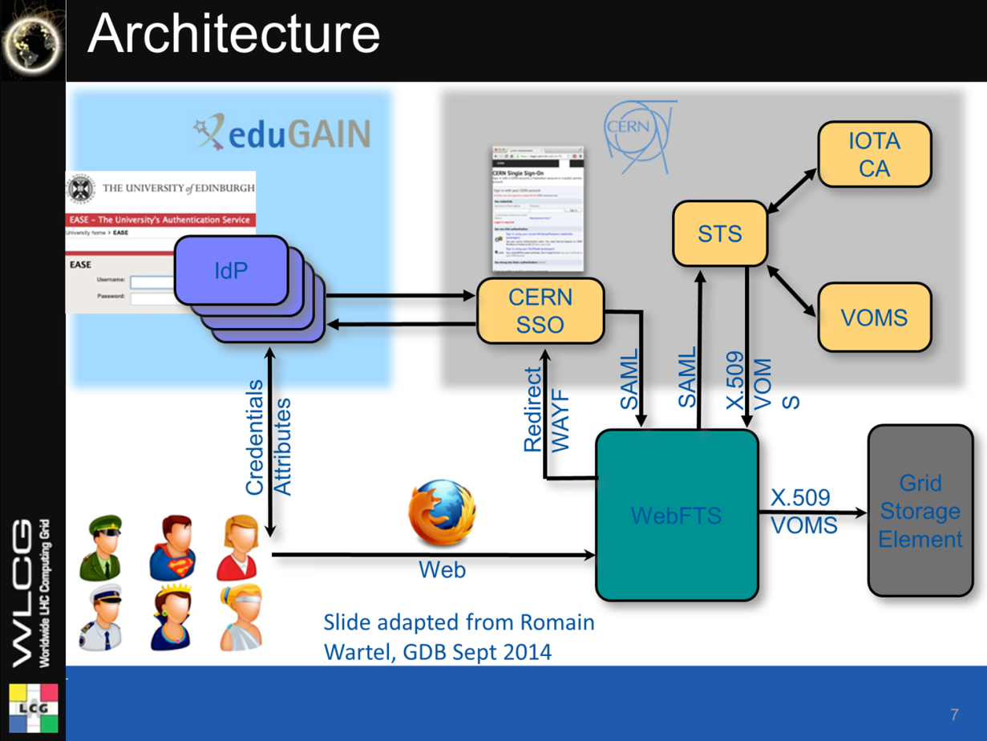
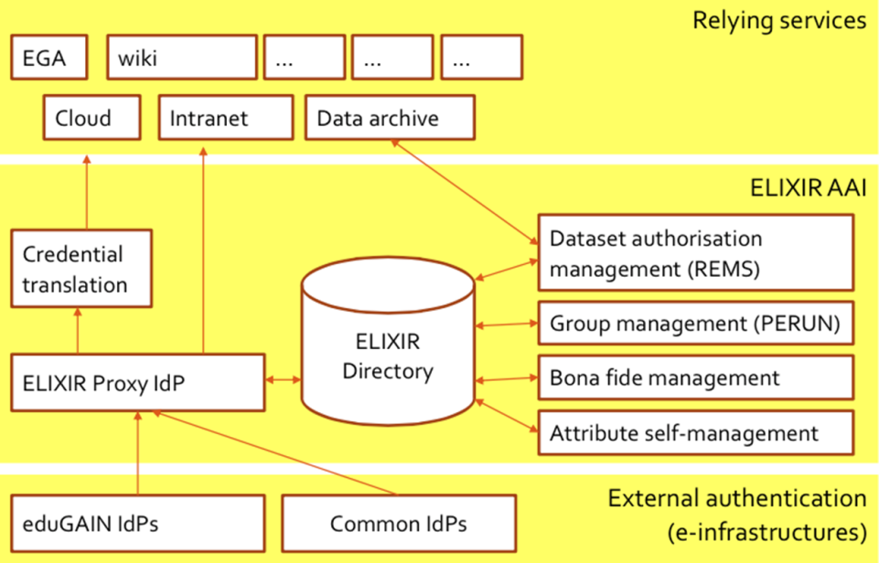
Federated use of the eInfra
WebFTS ‘FIM4R’ in wLCG
Romain Wartel
ELIXIR reference architecture
Mikael Linden et al.

Slide 6
Why the move to FedAuth
Cross-national federated access progressed tremendously
eduGAIN: more federations, with technical interop across countries
Increased awareness of research & scholarship use cases
‘the will to make it happen’: demonstrated by SirTFi, AARC, VOPaaS, …
A great promise for easier collaboration
Move to authenticators ‘closer’ to the user understanding – mainly home organization credentials
Ability to ‘hide’ end-user PKIX technology – and offer simpler authentication for web-based services through ‘OpenID Connect’ and ‘SAML’
And there are bridges – since for non-Web, command-line and brokerage
‘SAML2Int WebSSO’ does not work
STS, CILogon, TCS, SSH-to-MyProxy tokens, Moonshot, …

Slide 7
Issues hindering the adoption of FedAuth
Although many production federations are pretty good, and
quite a few IdPs have good processes …
public documentation, self-assessment and peer-review are missing
it’s not consistent across IdPs
and processes are not designed for collaboration use cases
re-use of identifiers is common (also an issue for social IdPs)
the identity providers provide no identity … or it’s non-consistent
identifiers generated are specific to each SP
and may not provide traceability needed for valuable resources
some allow users to change their own data (including e.g. their email address and all contact data), or do not collaborate in case of issues

Slide 8
Assurance profiles as charted by the IGTF
So many production federations and IdPs are pretty good, but …
they are all different, and the lowest common denominator is quite low
… so IGTF for ‘conventional’ assurances requires additional per-user controls
… and the (‘uniqueified’) AP ‘DOGWOOD’ (IOTA) leaves an assurance gap
…3,4
LoA 2: 1, 2-factor vetting, verified traceability, externally audited as matter of course
2
Assurance profiles BIRCH, CEDAR (MICS, Classic):
identified naming, traceability, longer-term, limited auditing
Kantara-like
Assurance
Scale
ASPEN (SLCS): identified naming, point-in-time traceability, time-limited
RP task
DOGWOOD (IOTA): unique identification, no identity , limited traceability
1
LoA 1: verified email address with mail-back
* somewhat
my personal
view …
sorry for bias
LoA 0: ‘like conventional unsigned email’

Slide 9
Redistributing responsibilities with IOTA
Who can absorb the responsibilities, if not the identity providers?
Requirements:
End-to-end traceability must remain the same
Changing or documenting federation and IdP processes is a ‘lengthy’ process – but adding some requirements does work (e.g. SiRTFi on incident response)
… so who can absorb the responsibility?
The resource centres – and go back to 1995 with per-site vetting ☹
The Infrastructure or funding agencies, through a rigorous registration process – PRACE ‘home sites’, or XSEDE registration + NSF granting
EGI UMP – that’s what’s happening partially in the LToS service
Or the communities?

Slide 10
Moving the bar towards differentiated assurance
http://igtf.net/ap/iota (part of http://igtf.net/ap/loa)
IOTA AP assurance level ‘DOGWOOD’ is different, and remainder of the elements
must be taken up by
somebody else – the VO or the sites
Only thing you get is an opaque ID
Consider questions about
  Real names and pseudonyms
  Enrolling users in a community
  Keeping audit records
  Auditability and tracing
  Incident response
Identity elements
identifier management
re-binding and revocation
binding to entities
traceability of entities
emergency communications
regular communications
‘rich’ attribute assertions
correlating identifiers
access control

Slide 11
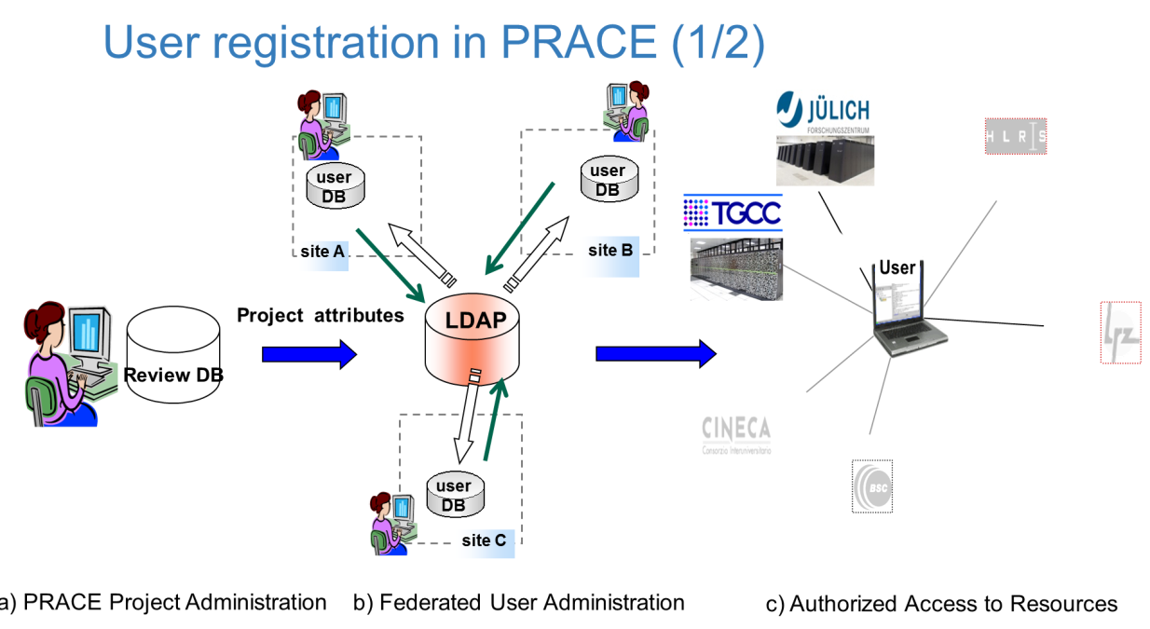
Specific Delegated Responsibilities
Need for proper traceability does not go away, so …
who holds that information need not only be a traditional CA
but can be another entity with similarly rigorous processes
Some communities have an
existing registration system
that is very robust
PRACE – in-person links
at the home sites
XSEDE – NSF grant
approval process
wLCG –CERN Users Office
and HR Database

Slide 12
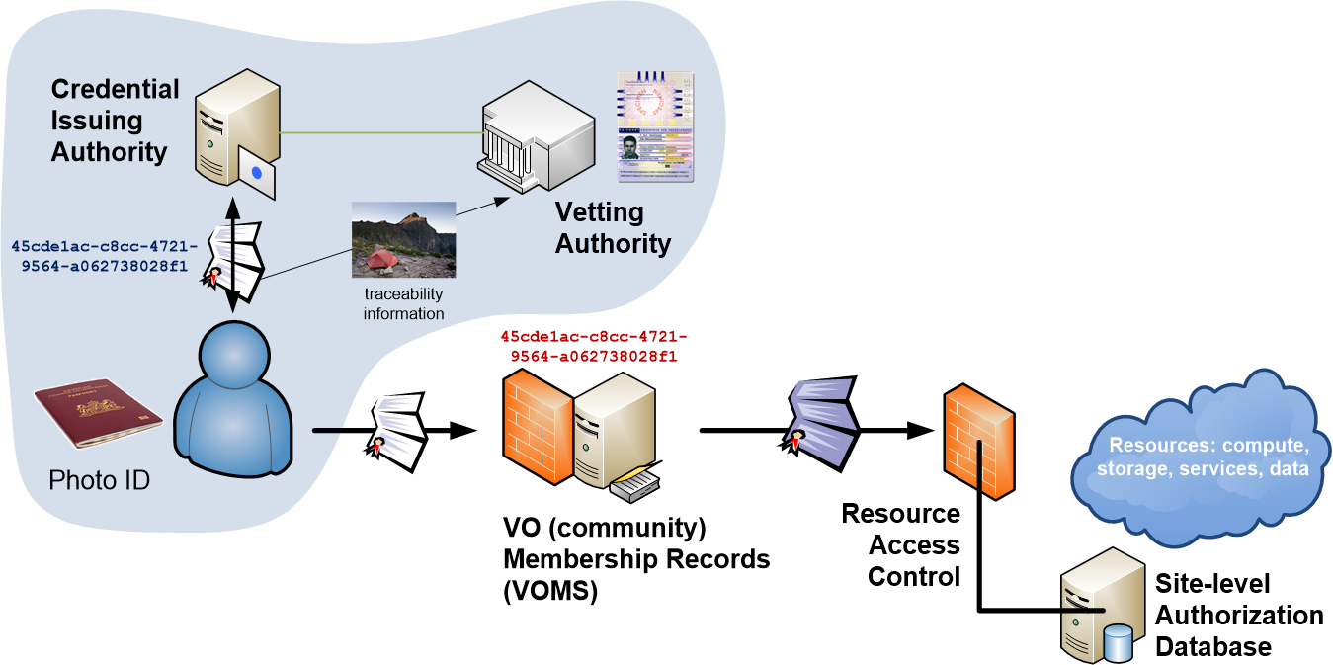
Distributed Responsibilities I:
Trusted Third Party

Slide 13
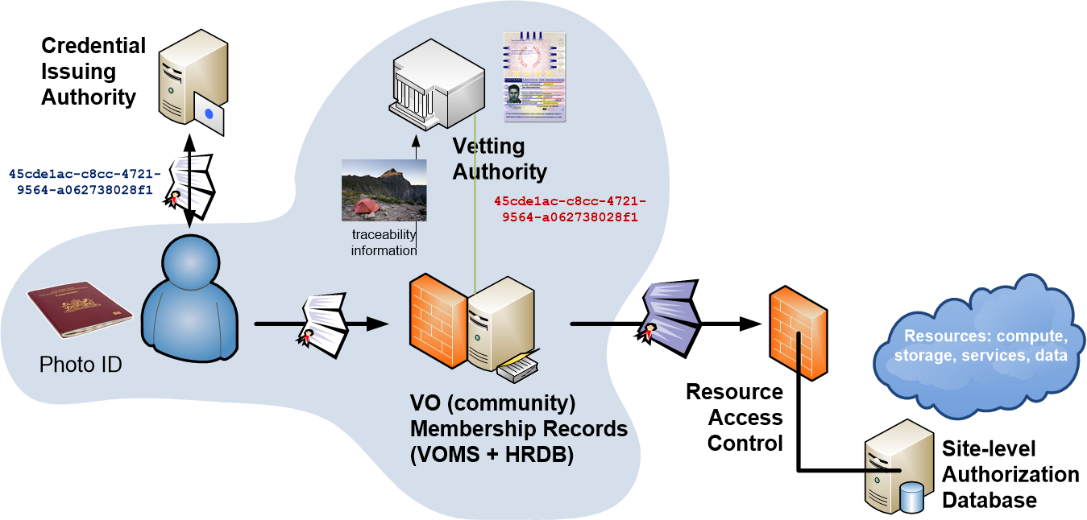
Distributed Responsibilities II:
Collaborative Assurance & Traceability

Slide 14
IOTA in the EGI context
EGI – by design - supports loose and flexible user collaboration
300+ communities
Many established ‘bottom-up’ with fairly light-weight processes
Membership management policy* is deliberately light-weight
Most VO managers rely on naming in credentials to enroll colleagues
Only a few VOs are ‘special’
LHC VOs: enrolment is based on the users’ entry in a special (CERN-managed) HR database, based on a separate face-to-face vetting process and eligibility checks, including government photo ID + institutional attestations
Only properly registered and active people can be listed in VOMS
*) https://documents.egi.eu/document/79

Slide 15
Software support for DiffLoA
What is needed it for the infrastructures (resource centres) to differentiate between ‘light-weight VOs’ and ‘heavily-managed VOs’
Preferably on a per-VO basis
Allowing IdPs with a lower assurance profile to be used for heavily-managed VOs’
Whilst ensuring light-weight VOs can continue to enjoy airiness since they’re combined with higher-assurance IdPs (CAs)
# Example VO-CA-AP-file, please adapt according to requirements
# First the VOMS entries
/pvier "/C=NL/O=NIKHEF/CN=NIKHEF medium-security certification auth",\
file:TERENAeSciencePersonalCA.info, file:TERENAeSciencePersonalCA-2.info, \
file:TERENAeSciencePersonalCA-3.info
/dteam file:policy-igtf-mics.info,file:policy-igtf-classic.info

Slide 16
Software capabilities today
‘For site-controlled redistribution to work, all software in the infrastructure faces with redistributed responsibility must support it’
Key components
Argus Authorization System
Site access control suite for C ‘LCMAPS’
… embedded ACL systems in (storage) software
For some it’s there (like LCMAPS on next slide), for others its ‘fairly trivial’ to implement (Argus), but all needs to be deployed and used as well
way to feed CA policy information to Argus decision engine is needed
i.e., a “PIP” in AUthZ lingo speak, or it will not scale, but this is planned
For service-specific authorization systems an inventory is needed

Slide 17
LCMAPS example implementation
# Example VO-CA-AP-file, please adapt according to requirements
# First the VOMS entries
/pvier "/C=NL/O=NIKHEF/CN=NIKHEF medium-security certification auth",\
file:TERENAeSciencePersonalCA.info, \
file:TERENAeSciencePersonalCA-3.info
/dteam file:policy-igtf-mics.info,file:policy-igtf-classic.info
For each VO (FQAN), list the set of
acceptable CAs and (IGTF) Assurance Profiles
Relying parties can easily add their own bundles (in info files)
Under control of the resource centres – who have to take the risks
For Argus
Read “CA” and “Profile” information in a Policy Information Point
The decision in the Argus policy is then a simple “AND” of VO+CA/AP

Slide 18
A Generic (CERN or EGI) IOTA CA
But this software is not there quite yet
Needs at least Argus (and a PIP)
Deployment
Ubiquitous adoption
Meanwhile, we do want to experiment with FedAuth in production
Solution: implement the VO requirements in the IOTA CA,
making it a special IOTA CA scoped to VOs that do their own tracing
Accept that special CA in the infra with specific policy controls
Which wLCG in this case can safely do
  because it satisfies the requirements
  and the policy (also EGI’s) already allows for exceptions
  And it’s deployed only as needed – so now only for wLCG

Slide 19
‘Twee geloven op één kussen, daar slaapt de duivel tussen’*
* old Dutch saying: two religions sleeping on one cushion? The Devil sleeps in between!
Can you combine two policies within the same infrastructure?
Can been done if new policy does not negatively affect the other one
Which in this case is OK, since the specific new CERN IOTA CA
  In itself implements all the policy requirements of a traditional CA by insisting on LHC membership
  the same requirement that already governs the Classic CERN CA
But note that is does not generally hold for arbitrary IOTA CAs
Have to wait for “VO+CA-authZ” before adding e.g. InCommon Basic
Technically it is a relatively easy change

Slide 20
Dependencies in policy installation
For EGI-only sites: nothing changes!
For EGI sites also under wLCG policy and installed post-EGEE:
just install both policy packages “egi-core” and “lcg”
lcg-CA
ca-policy-egi-core
IGTF Classic
ca-AEGIS
…
IGTF MICS
ca-TCS
…
IGTF SLCS
ca-DFN-AAI
…
ca-policy-lcg
IGTF Classic
ca-AEGIS
…
IGTF MICS
ca-TCS
…
IGTF SLCS
ca-DFN-AAI
…
ca-CERN-LCG-IOTA

Slide 21
Changes to the trust fabric
EGI sites continue installing the egi-core
whilst preparing for a future of differentiated assurance
wLCG sites (also the EGI ones) also install the wlcg policy
Net result is that the EGI+wLCG sites add one CA:
the special, circumscribed, CERN LHC IOTA CA
This does not compromise the integrity of the trust fabric at any site, since the VO (actually CERN) takes care of traceability through additional policy constraints
“WLCG-CERN-IOTA-statement-MB-20151028”
http://www.nikhef.nl/grid/tmp/WLCG-CERN-IOTA-statement-MB-20151028.pdf

Slide 22
Document on the Agenda Page
Read it: it contains specific safeguards that are essential
This does not open a door to arbitrary IOTA CAs: this cannot be done since we want to support loose collaborations – until we get VO+CA decision support in all middleware
  foreseen in Argus&there in LCMAPS, needs bit more development
  should also be deployed and honoured at all EGI sites
But does open the way to innovative use of FedAuth and many new use cases – including support for federated research and scholarship!
For EGI-only sites: nothing changes … yet
For EGI+wLCG sites: install the “ca-policy-lcg” package in addition to “ca-policy-egi-core” when so requested
Both packages are contained in both yum/apt repositories
- so it does not matter whether you use the EGI or LCG repository

Slide 23
… and join the AARC session on Thursday!

