Slide 1
Evolving Assurance – IGTF LoA generalisation
David Groep
Interoperable Global Trust Federation IGTF
Documents at http://wiki.eugridpma.org/Main/IGTFLoAGeneralisation

Slide 2
The LoA generalization process aims to extract those elements from the IGTF APs that are of general value to the community.
This is not always clear from the IGTF AP documents, since they have LoA elements and implementation requirements combined in a single document.
But the APs, and now these LoAs, actually encode the consensus of acceptable levels for our major relying parties, and are designed such that they also balance the 'cost' or 'do-ability' of our identity providers.

Slide 3
IGTF building trust: an exercise in scaling
Accreditation process
Extensively documented public practices (CP/CPS, RFC3647)
Interviewing and scrutiny by peer group (the PMA)
Assessment against standards (LoA and APs)
Technical compliance checks (dependent on credential type)
Periodic, peer-reviewed, self-audits
Based on Authentication Profiles, standard reference: GFD169
inspired by APs, LoA, and NIST SP800-53/ISO:IEC 27002
Federated assessment methodology by region (IGTF)
keeps it scalable by ‘divide & conquer’
https://www.eugridpma.org/guidelines/accreditation

Slide 4
IGTF LoA Generalisation
http://wiki.eugridpma.org/Main/IGTFLoAGeneralisation
Federation of major Relying Parties (RPs) and identity providers that jointly agree on achievable and sufficient assurance
RPs like PRACE, EGI, EUDAT, XSEDE, OSG, TERENA/ GÉANT, HPCI, … and many national representatives
Identity providers, both from R&E and beyond
About 2-3 distinct levels (not the Kantara ones)
And a R&E ‘unique’ verification mechanism: peer reviewed and open documentation

Slide 5
IGTF Trust Structure
Common criteria and model
globally unique and persistent identifier provisioning
not fully normative, but based on minimum requirements
Trust is technology agnostic
technology and assurance ‘profiles’ in the same trust fabric
‘classic’ traditional public key infrastructure with near-realtime identity betting
‘MICS’ dynamic ID provisioning leveraging federations
‘SLCS’ on-demand short-lived token generation a basis for ‘arbitrary token’ services
‘IOTA’ collaborative assurance (Identifier-Only Trust)
For your interest: IGTF Authentication Profiles http://ww.igtf.net/

Slide 6
Different assurance levels – for different cases

Slide 7
Generalised LoA
IGTF ‘levels’ are useful classifying IdP assurance levels for distributed infrastructures
There is not exactly a hierarchy (so we used opaque names)
Is technology agnostic (PKI, SAML, OpenID/OAuth)
http://wiki.eugridpma.org/Main/IGTFLoAGeneralisation
ASPEN, BIRCH, CEDAR, DOGWOOD
Reflect trust level of SLCS, MICS, Classic, IOTA
Many IdPs are actually ‘good enough’ (certainly for DOGWOOD), but just forget or are afraid to express their (usually rather good) practices!

Slide 8
LoA Alignment & Comparison
ASPEN compensates for issuance-time only tracablity by limiting credential life time to approximately 11 days (1 million seconds)
BIRCH and CIDER are materially equivalent – and may be merged – have extended tracability, and follow typical employment and study cylces with expected credential verification every year (400 days), e.g re-issuance or password aging
DOGWOOD has issuance-time only assurance and provides very limited ID information – and really should be complemented by trusted attributes and assurance from complementary sources. It’s expected validity is up to 1 year

Slide 9
Making LoA useful
For LoA to be useful, it needs to consider risk and e.g. incident response capability when all assertions are combined for a final AuthZ decision
Any source of attributes has an LoA (even if it is not yet expressed in readable form)
The end-to-end system collaboratively needs to address risk: identifiers, attributes, resource data
Example IGTF LoAs: The IGTF itself deals in identifiers, but the LoA framework could be applied to more attributes
Decision based on attributes from multiple sources
Need to make the LoA more ‘visible’ to authZ software
But you should not just force higher LoA for all, but
Allow for ‘collaborative’ assurance from many sources

Slide 11
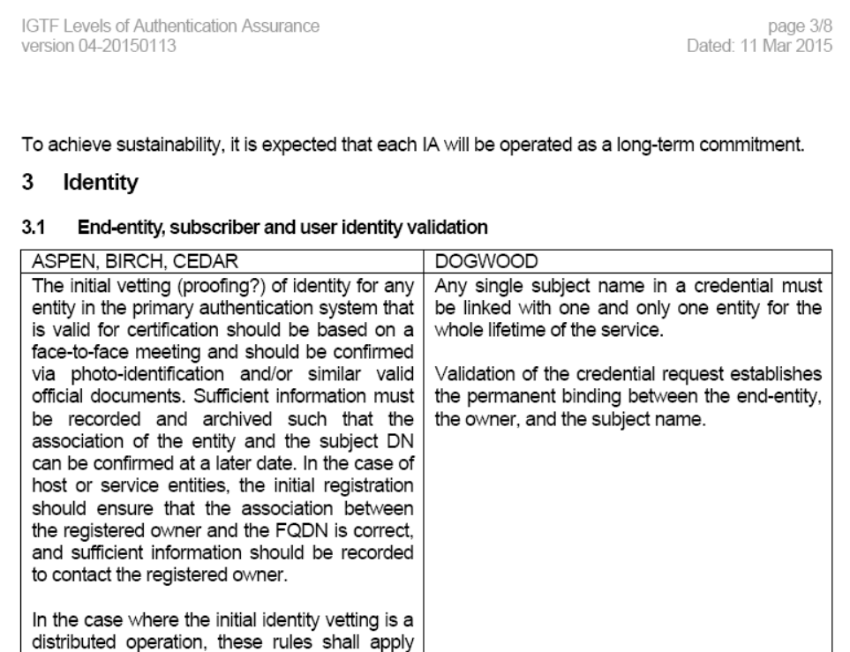
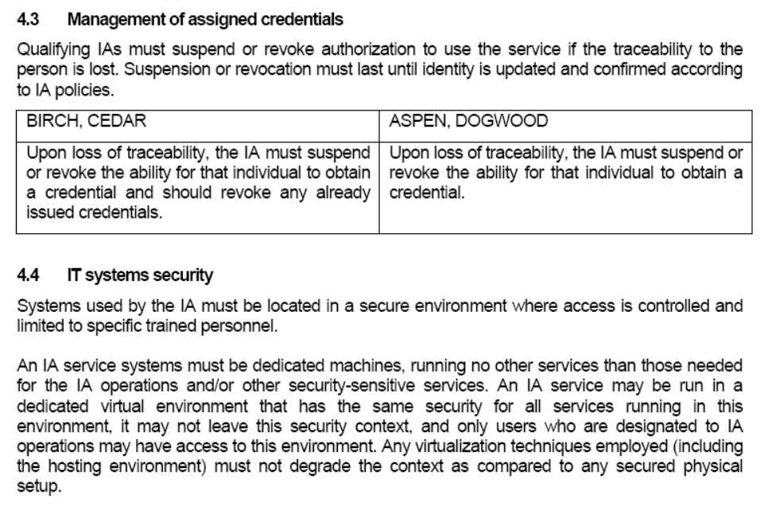

Slide 12
Further work needed
a section on incident response (like sec 5.1 in IOTA) should also be added to the Classic, MICS and SLCS profiles
for MICS and SLCS, the line from IOTA needs to be added to the profiles: "The authority must not knowingly continue to rely on data from third parties that provide inaccurate or fraudulent information. It is strongly recommended that any third party on which the issuing authority relies has an incident response capability and is willing to participate in resolving such incidents"
"well documented" really means "well documented and maintained"
a good description of the face-to-face requirements (including the models where it is supported by attestations by notary publics and video conf, for example) still needs to be written [now marked in yellow in the document]

