Slide 1
EUGridPMA
Status and Current Trends and some IGTF & AARC topics
December 2019
TAGPMA New Orleans
David Groep, Nikhef & EUGridPMA

Slide 2
Recent EUGridPMA topics
PMA membership and evolution of authorities
Communications Challenges and the ‘WISE SCCC JWG’
OIDCfed
See also the EUGridPMA47 summary: https://www.eugridpma.org/meetings/2019-09/

Slide 3
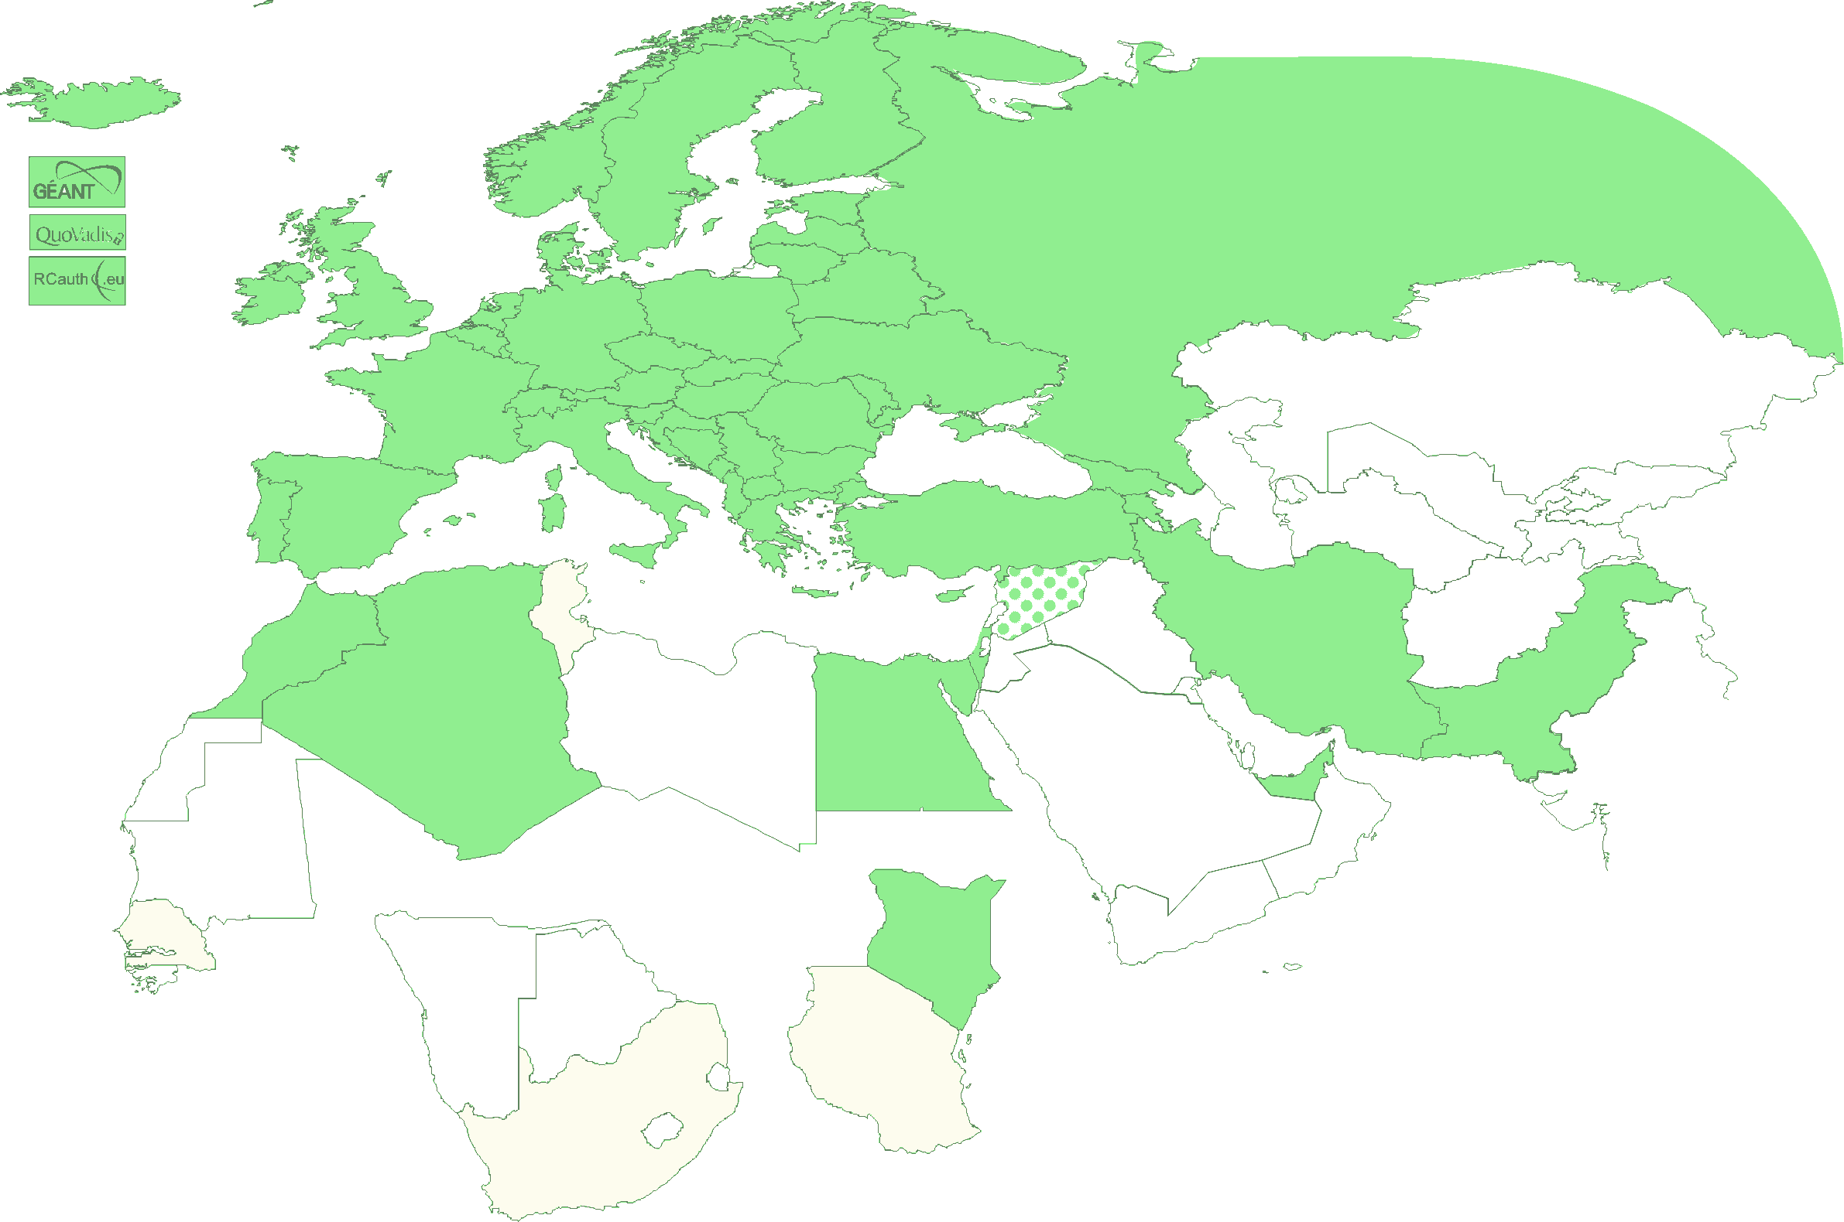
Authority coverage in EMEA
Europe: AT, CY, CZ, DE, DK, ES, FI, FR, GR, HR, HU, IT, NL, PL, PT, RO, SE, SI, SK, UK; AM, GE, IS, MD, ME, MK, NO, RS, RU, TR, UA and
the GEANT TCS
Middle East: AE, IR, PK
Africa: DZ, EG, MA, KE
Multinational:
CERN, RCauth.eu,
QuoVadis (BM)

Slide 4
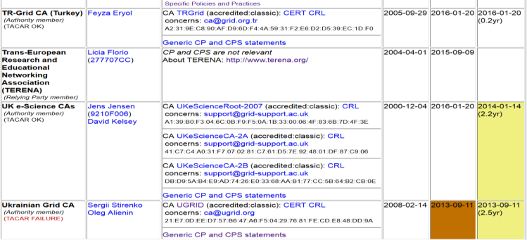
Membership and other changes
Responsiveness challenges for some members
  PLEASE take care to renew your trust anchors in time, as well as your CRLs
  EG-EUN now temporarily withdrawn for availability reasons
Identity providers: both reduction and growth
  RCauth.eu distributed operations (GRNET, STFC, Nikhef)
  using a shared key (and some smart border-guard-proof distribution)
  governance board + PMA + technical team
Self-audit review
  Cosmin Nistor as review coordinator
  Self-audits progressing
  on schedule for most CAs

Slide 5
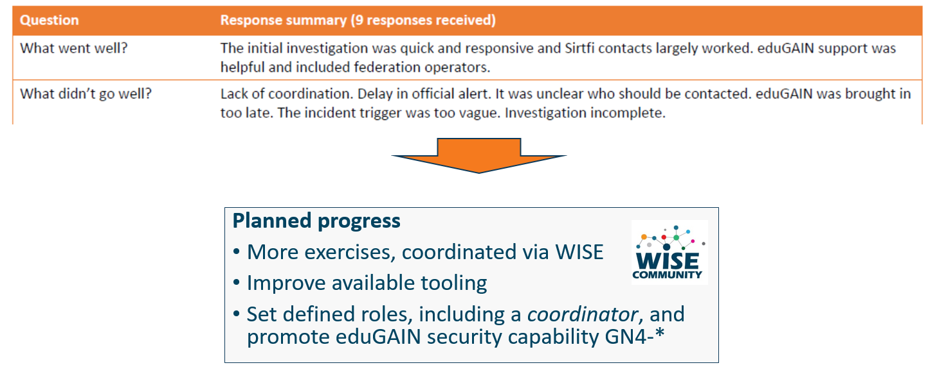
Communications Challenges
Based on Sirtfi incident role play of AARC in eduGAIN:
testing communications channels identified as high-prio target
Initial model might be along the IGTF RAT CC challenges – can be extended later

Slide 6
Proper OpSec needs to be exercized!
Like the IGTF RAT Communications Challenges, and TF-CSIRT processes, opsec really needs to be exercised often and in-depth to ensure readiness
Logical candidates that could all run the test against IdPs, CAs, SPs, RPs …
… and ‘legitimately’ claim an interest in their results
eduGAIN
IGTF
GEANT.org
EOSC-HUB ops, or EGI CSIRT
each of the e-Infrastructures XSEDE, EGI, EUDAT, PRACE, HPCI, …
every research infra with an interest: WLCG, LSAAI, BBMRI, ELIXIR, …
any institution (or person) with access to https://mds.edugain.org/
so soon: all the email in the world will be about Sirtfi Incident Response tests??

Slide 7
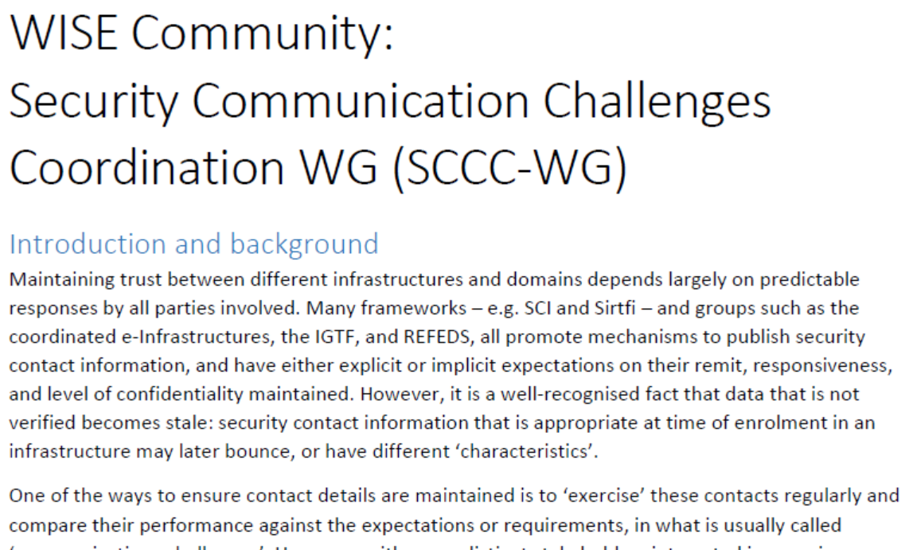
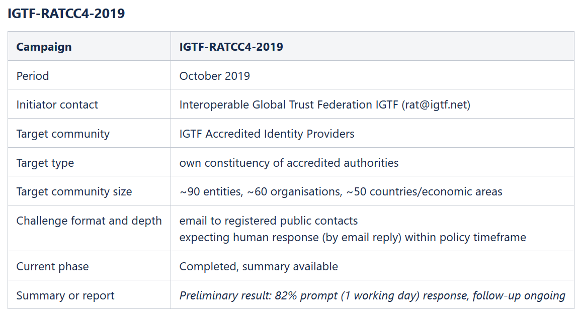
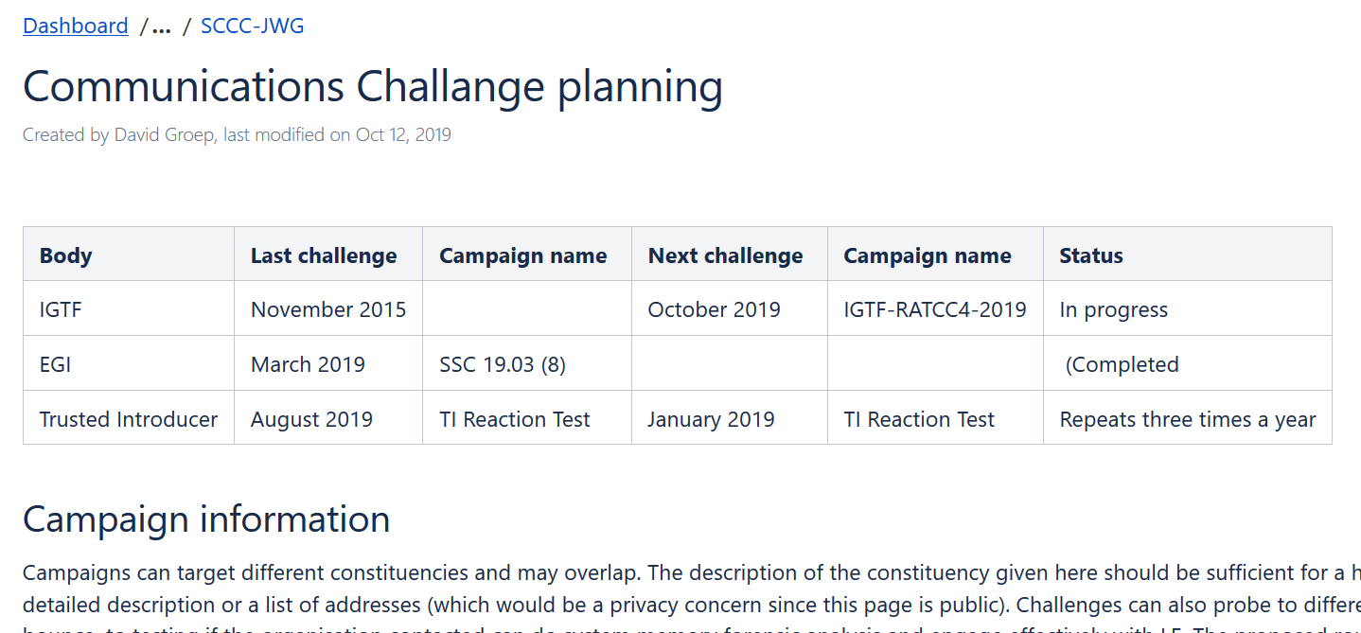
WISE SCCC-WG – participate!
WISE, SIGISM, REFEDS, TI joint working group
see wise-community.org and join!
https://wiki.geant.org/display/WISE/SCCC-JWG

Slide 8
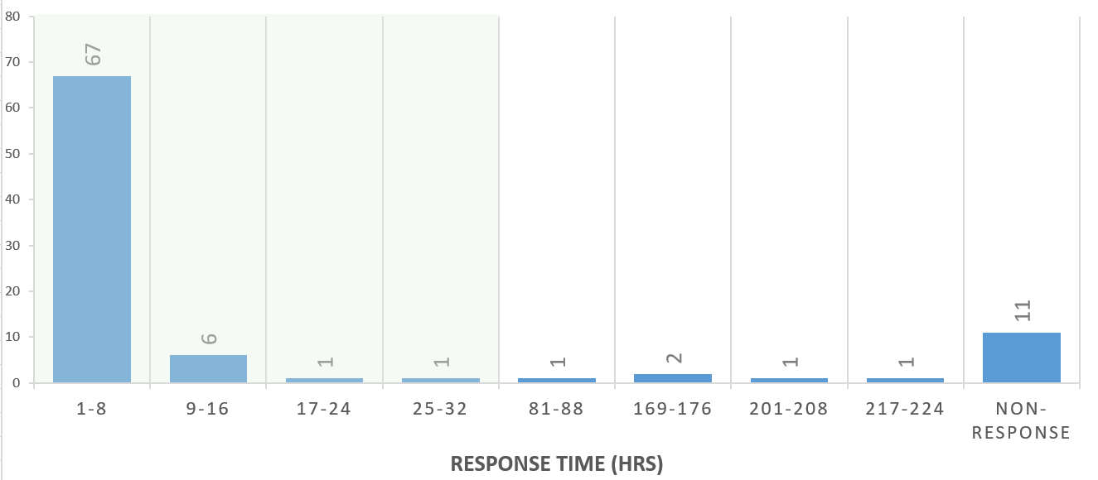
IGTF RATCC4 Results
In total there are 91 trust anchors (root, intermediate, and issuing authorities) currently in the accredited bundle,
managed by 60 organisations.
Of the 60 organisations, 49 responded within one working day (82%), representing (incidentally) also 82% of the trust anchors.
Within a few days more, 3 additional ones came in, and 4 more responded after a reminder.
In total, 90% of the organisations responded to the challenge, representing 88% of the trust anchors.

Slide 9
oidcfed.igtf.net
And now for something completely different …

Slide 10
OIDC Federation use cases for communities
Why did we embark on OIDC Fed for global e-Science?
EOSC-HUB registration of clients
goal for EGI and EUDAT is a scalable and trusted form of OIDC usage.
Today < O(50) clients; next year maybe O(100-1000)?
cloud-based services (containers, microservices) could push that to millions
CILogon (and XSEDE) use cases see need for a set of policies and practices
that support a 'trust anchor distribution'-like service targeting OIDC OPs and RPs
and where RPs that are ‘in the community’ can be identified as such
ELIXIR (and the Life Sciences) AAI expect growth in # OIDC RPs as AAI extends beyond just ELIXIR and into other biomedical RIs – potentially dynamically created
All of these need a policy framework, on both the (infrastructure) OPs and on the RPs
This is the community that traditionally also relied on the IGTF trust anchor distribution

Slide 11
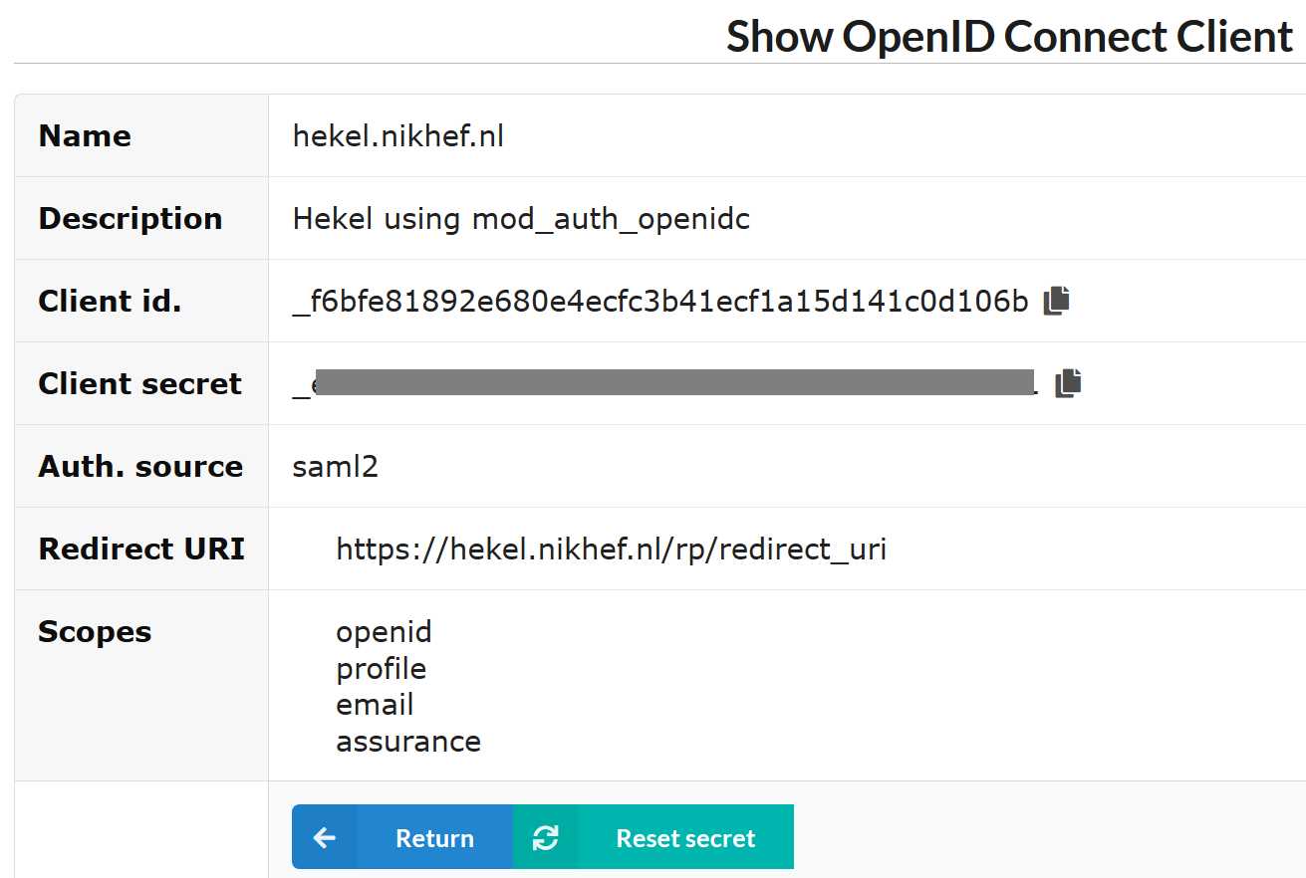
And registering clients does not scale…
configuration of a (test) client on the Nikhef institutional OP sso.nikhef.nl

Slide 12
OIDC Fed ‘policy’
IGTF “RP oriented” OIDC Fed can leverage existing framework
connect RPs from infrastructures that are IGTF members
(EGI, HPCI, OSG, WLCG, GEANT, PRAGMA, PRACE, XSEDE, …)
and new IGTF RP members can join of course!
Accreditation process and membership guidelines in place
OPs in the federation (RI/EI IdP-SP-Proxies) use IGTF APs
and Snctfi framework where needed
RPs in the federation become the responsibility of their member representatives
regional (‘national’) RP groups via their existing authority member
for RP trust (more than today) re-use Sirtfi, WISE, and trust groups

Slide 13
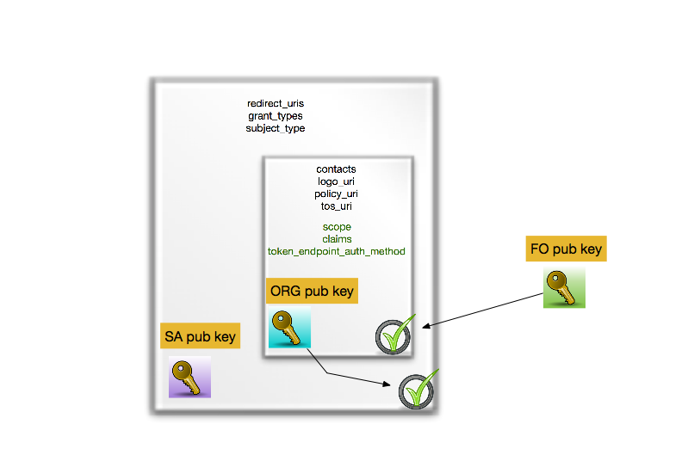
OIDCfed is basically signing a tree of entities with extensions
we kind-of know building trees and meshed of signed entities work – is this ‘just recast it JSON’ ?

Slide 14
Or can we do without a single one to rule them all?
today the RIs and EIs trust the IGTF trust anchors and
may (but do rarely) add their own
Can the ‘federation’ be the community and import a commonly trusted set?
Can the IGTF allow devolved registration provided that the trusted organisations implement the same policy controls Snctfi and the proper Assurance Profiles?

Slide 15
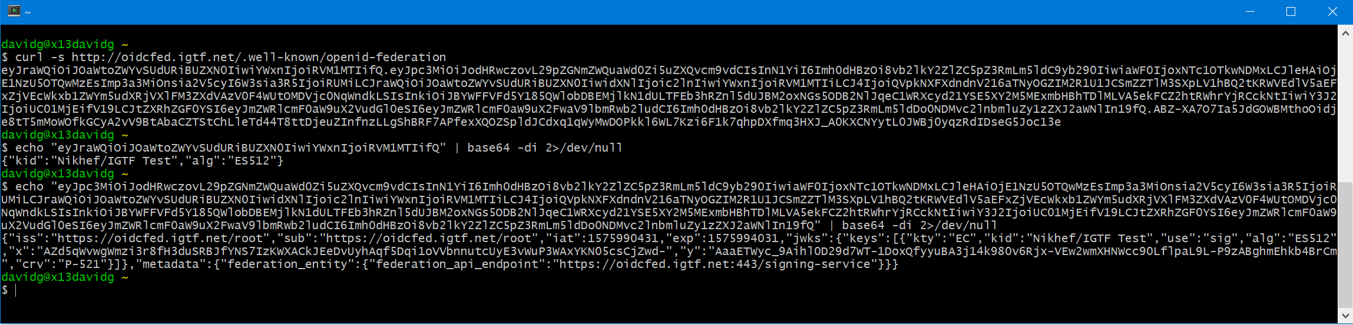
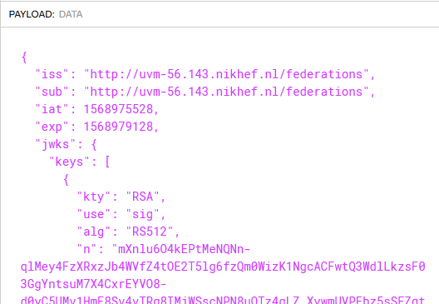
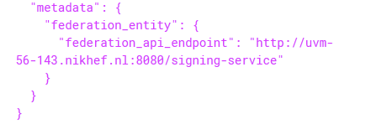
and this works now: oidcfed.igtf.net
translating with jwt.io into
Ask Jouke Roorda!

Slide 16
Next meetings
EUGridPMA 48 Prague, CZ 22-24 January 2020
APGridPMA 2020 Taipei, TW March 9, 2020
EUGridPMA 49 May 2020
IGTF All Hands (& EUGridPMA50?) Pittsburg, PA, USA September 2020

