Slide 1
EUGridPMA
Status and Current Trends and some IGTF topics
August 2018
APGridPMA Auckland Meeting
David Groep, Nikhef & EUGridPMA

Slide 2
Recent EUGridPMA topics
PMA membership and reviews
Infrastructure Policy Alignment & AARC
  assurance frameworks – evolution and components
  Joint Infrastructure policies
  Acceptable Use and Conditions of Use
  Policy Development Kit
  Attribute Authority Operations
  Incident response and communications challenges
See also the EUGridPMA43 summary: https://www.eugridpma.org/meetings/2018-05/

Slide 3
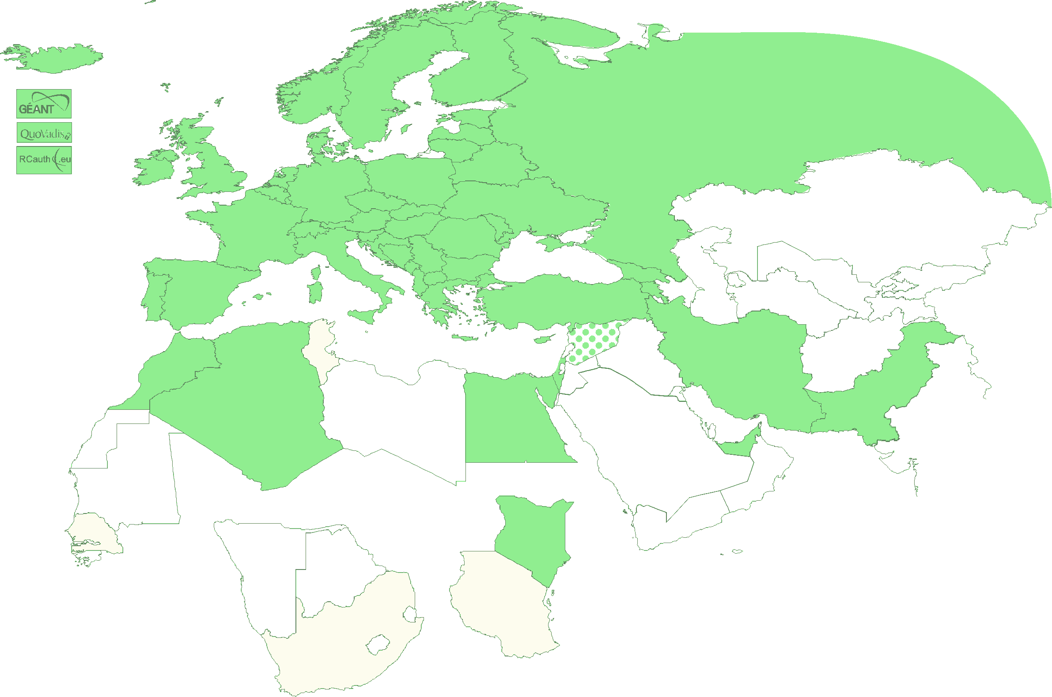
Authority coverage in EMEA
Europe: AT, CY, CZ, DE, DK, ES, FI, FR, GR, HR, HU, IT, NL, PL, PT, RO, SE, SI, SK, UK; AM, GE, IS, MD, ME, MK, NO, RS, RU, TR, UA and
the GEANT TCS
and EGI catch-all
Middle East: AE, IR, PK
Africa: DZ, EG, MA, KE
Multinational:
CERN, RCauth.eu,
QuoVadis (BM)
47+4

Slide 4
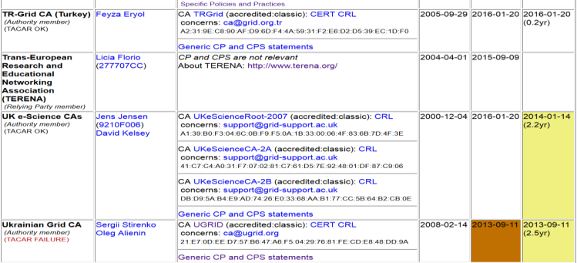
Membership and other changes
Responsiveness challenges for some members
  PLEASE take care to renew your trust anchors in time, as well as your CRLs
Identity providers: both reduction and growth
  RCauth.eu distributed operations (GRNET, STFC, Nikhef)
Self-audit review
  Cosmin Nistor as review coordinator
  Self-audits progressing
  on schedule for most CAs

Slide 5
AAI in a wider context
IGTF traditionally well-linked to research and e-Infrastructures
support for research use cases
user-centric authentication based on a ‘bottom-up’ approach
In Europe, the AARC project supports evolution of ‘traditional’ R&E federations towards this research and collaboration use
common Blueprint Architecture promoting SP-IdP Proxies
harmonised policy supporting production use of federations (Sirtfi and “R&S”, non-reassigned identifiers and assurance)
help communities express ‘common’ qualities through Snctfi
allow newer technologies (OIDC) on the Infrastructure side

Slide 6
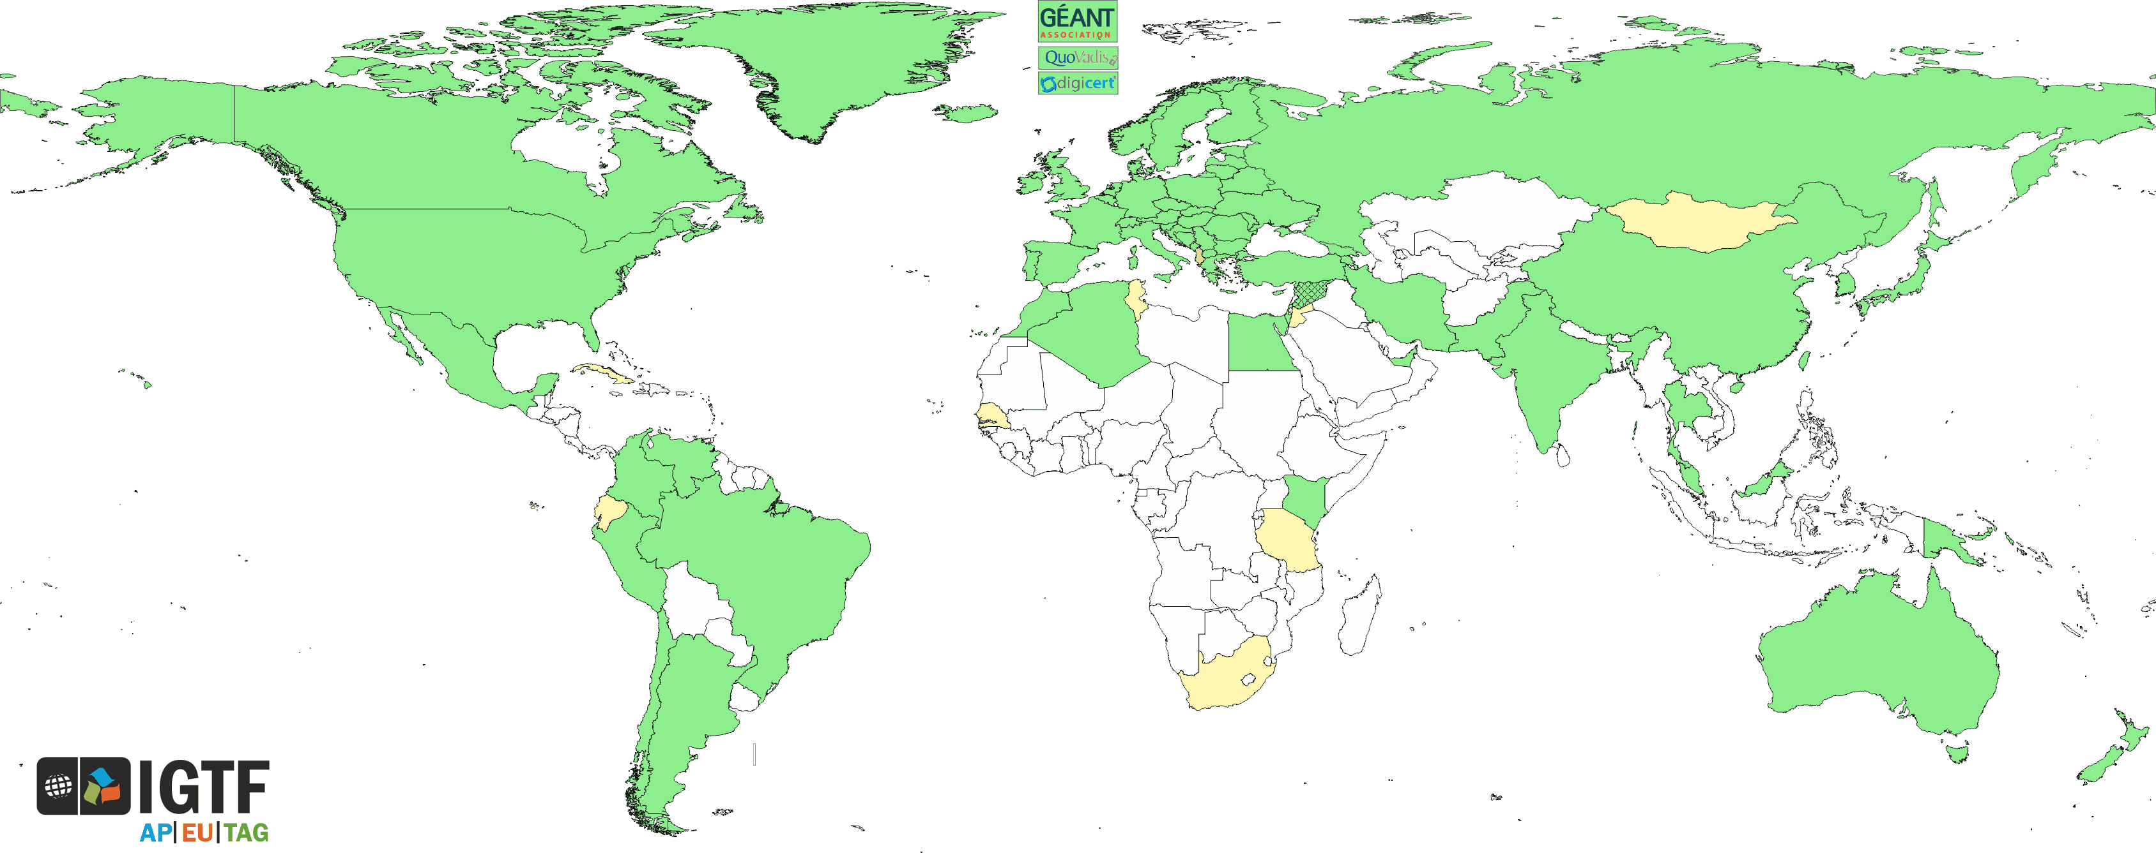
Trust for global e-Science infrastructures
“establish common policies and guidelines that enable interoperable, global trust relations between providers of e-Infrastructures and cyber-infrastructures, identity providers,
and relying parties”
EGI
PRACE
GEANT WLCG
XSEDE
OSG
HPCI
PRAGMA
RedCLARA
. . .

Slide 7
Selected topics from EUGridPMA & AARC
Assurance frameworks – evolution and components
Joint Infrastructure policies
Acceptable Use and Conditions of Use
Policy Development Kit
Attribute Authority Operations
Incident response and communications challenges

Slide 8
Assurance and trust frameworks
Identity Assurance Profiles for Infrastructure risk scenarios https://igtf.net/ap/loa/
BIRCH - good quality (federated) identity,
DOGWOOD - identifier-only with traceability (R&S+Sirtfi+a few bits)
RFC 6711 Registry: https://iana.org/assignments/loa-profiles
technology-specific ‘trust anchor’ distribution services
Assurance landscape is becoming more complex again
‘components of trust’ in SP800-63v3, IETF VoT, and in REFEDS RAF
for Research and collaboration use case use profiles,
for home organization IdPs use components and REFEDS RAF + [MS]FA

Slide 9
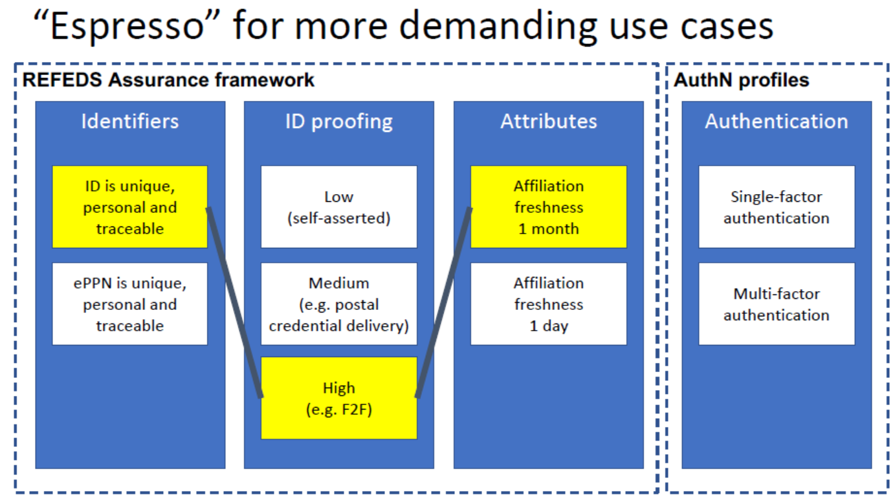

Example: “Espresso” profile for demanding use cases
‘goes well with’
alignment with REFEDS SFA/MFA WG is part of the work programme of AARC2

Slide 10




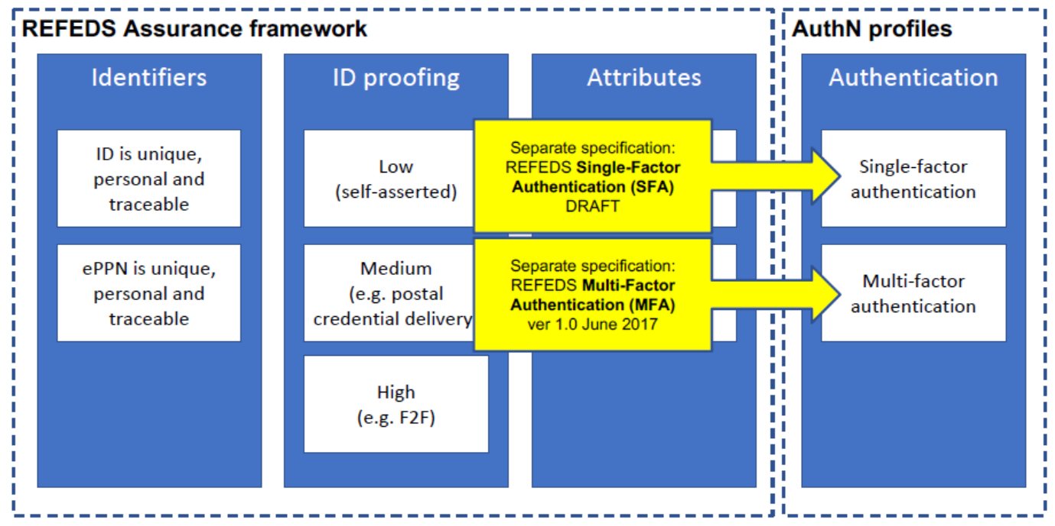



Using the REFEDS Assurance Framework in practice: the RAF Pilot ☺
Goal: gain practical experience with Assurance framework and REFEDS Single-factor authentication (SFA) profile, both on specification and in deploying existing SAML products
Today: both IdP software (now mostly Shibboleth) can express components and profiles, and use cases can leverage REFEDS assurance profiles (Cappuccino, Espresso) directly
https://wiki.refeds.org/display/GROUPS/Pilot+on+RAF+and+SFA
https://wiki.refeds.org/display/GROUPS/Pilot+resources

Slide 11
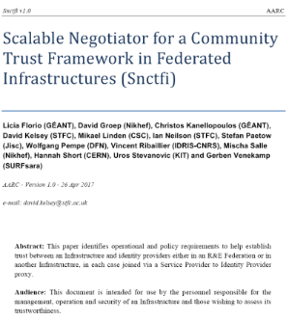

Snctfi: aiding Infrastructures achieve policy coherency
✓
allow SP-IdP-Proxies to assert ‘qualities’, based on assessable trust
✓
Develop recommendations for an Infrastructure’s coherent policy set
Snctfi
Scalable Negotiator for a Community Trust Framework in Federated Infrastructures
Complements Sirtfi with requirements on internal consistent policy sets for Infrastructures
Aids Infrastructures assert existing categories R&S, Sirtfi, CoCo
Support communities and infrastructures with
a policy kit and Acceptable Use Policy alignment
Graphics inset: Ann Harding and Lukas Hammerle, GEANT and SWITCH
https://igtf.net/snctfi

Slide 12
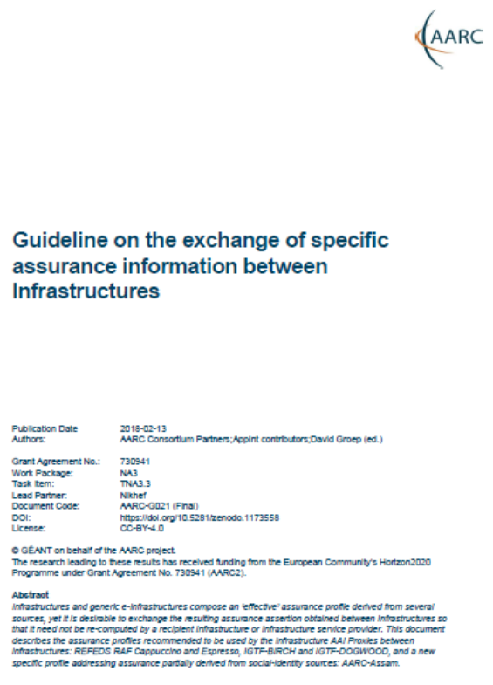
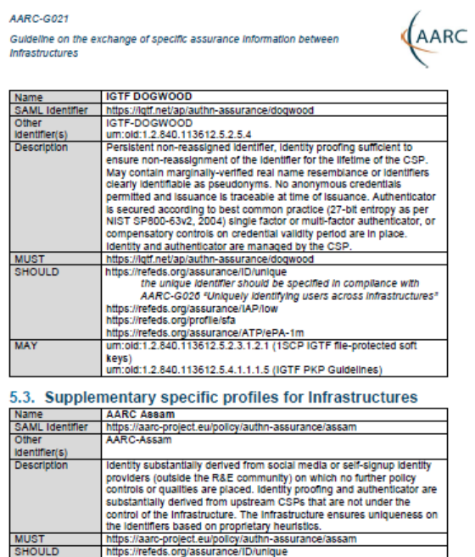
Re-usable Assurance between Infrastructures
BPA (community) proxy constructs identity based on multiple sources: home organisation, attributes, linked identities, authenticators
– and process these with (community-specific) heuristics
resulting assurance level may be different from one in home organization – and may depend on intelligence (components) that are
not ‘passable’ to the next (infrastructure) proxy
luckily: number of proxies in an exchange limited, and there’s explicit trust
AARC-G021
each BPA IdP-SP proxy should convey its ‘established assurance’
use a limited number of profiles targeted
at Infrastructure and Services risk levels (not in IdP capabilities)
re-use existing profiles as much as reasonable
AARC-G021: https://doi.org/10.5281/zenodo.1173558

Slide 13
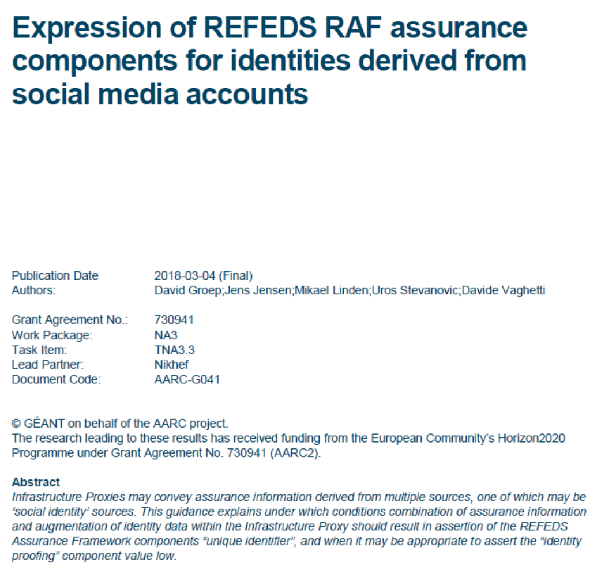
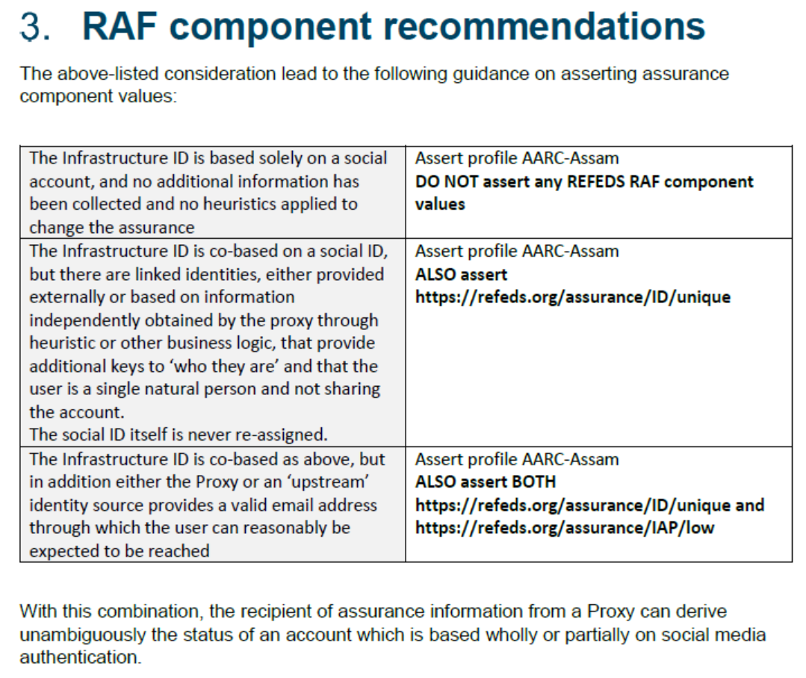
Specific assurance information BETWEEN Infrastructures
from REFEDS Assurance Framework: Cappuccino, Espresso
from IGTF Assurance Profiles: BIRCH, DOGWOOD (https://iana.org/assignments/loa-profiles)
from the AARC JRA1 use case analysis: Assam – derived from a user-held social identity
Can be extended to social ID
between the e-Infrastructures
from assessment:
this level is below DOGWOOD
unless specifically augmented by
an Infrastructure proxy and registry
AARC-G041
https://aarc-project.eu/guidelines/aarc-g041/

Slide 14

Divergence and convergence – the AUP Alignment Study
Image: Mozes en de tafelen der Wet, Rembrandt van Rijn, 1659

Slide 15
Scaling Acceptable Use Policy and data release
impractical to present user ‘click-through’ screens on each individual service
Community conditions
Community specific terms & conditions
Community specific terms & conditions
RI Cluster-specific terms & conditions
Common baseline AUP
for e-Infrastructures and Research Communities
(current draft: JSPG Evolved AUP –
leveraging comparison study and joint e-Infrastructure work)
Modular approach:
applicable to Snctfi proxies
(also) on behalf of a community
https://wiki.geant.org/x/P4bWBQ

Slide 16
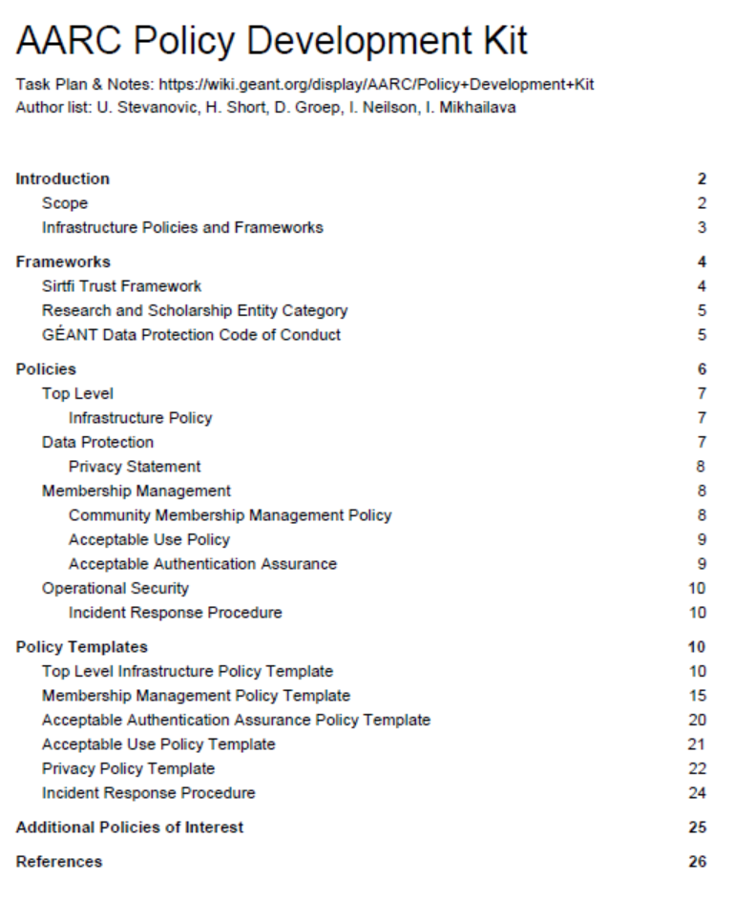
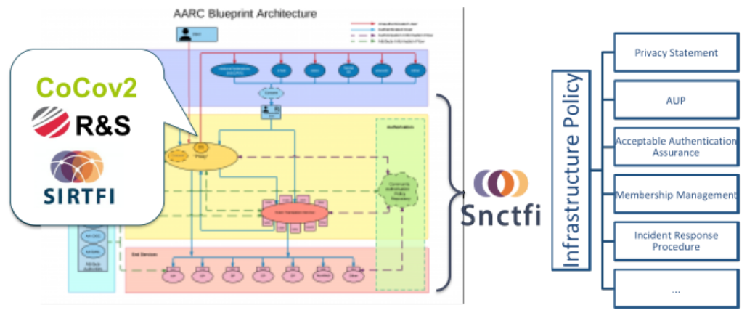
Policy Development Kit
Bring together a consistent suite
based on e-Infrastructure best practices
in particular EGI, WLCG, and the JSPG

Slide 17
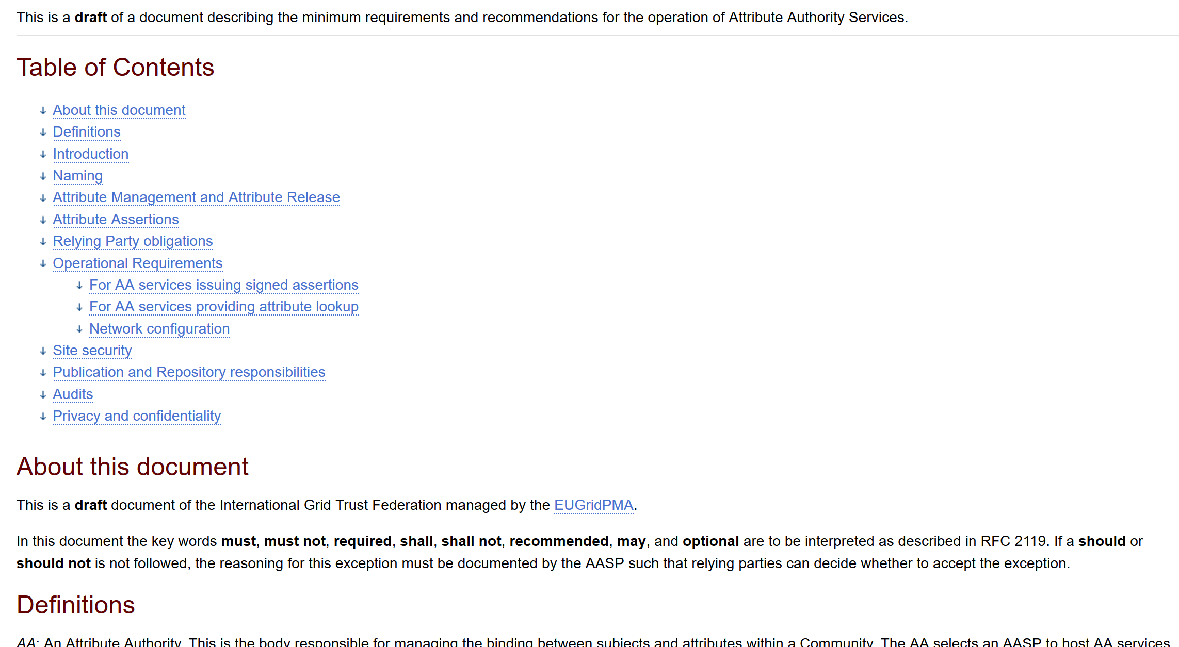
Attribute Authority Operations
Extending OpSec and trust capability in the authorization space
Based on initial IGTF work in 2012, which can now be put on a Snctfi basis
https://www.igtf.net/guidelines/aaops/
AAOPS as basis
for Infrastructure Proxies
Extend scope of ‘proper secure authorities’ to the community membership services at the Snctfi Proxy
Bring best practice of Sirtfi operational security for infrastructure proxies to
same level as for identity authorities

Slide 18
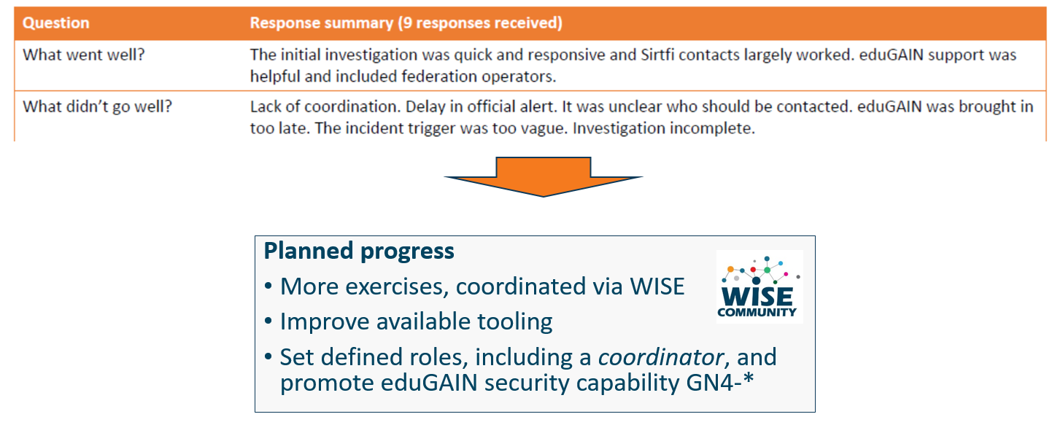
Communications Challenges
Based on Sirtfi incident role play of AARC in eduGAIN:
testing communications channels identified as high-prio target
Initial model might be along the IGTF RAT CC challenges – can be extended later

Slide 19
Proper OpSec needs to be exercized!
Like the IGTF RAT Communications Challenges, and TF-CSIRT processes, opsec really needs to be exercised often and in-depth to ensure readiness
Logical candidates that could all run the test against IdPs, CAs, SPs, RPs …
… and ‘legitimately’ claim an interest in their results
eduGAIN
IGTF
GEANT.org
EOSC-HUB ops, or EGI CSIRT
each of the e-Infrastructures XSEDE, EGI, EUDAT, PRACE, HPCI, …
every research infra with an interest: WLCG, LSAAI, BBMRI, ELIXIR, …
any institution (or person) with access to https://mds.edugain.org/
so soon: all the email in the world will be about Sirtfi Incident Response tests??

Slide 20
Frequency of challenges and tests - examples
Trusted Introducer and TF-CSIRT
2-3 Reaction Tests per year
supported by web click infrastructure, but requires (team) authentication
SURFcert challenges
annual response challenges, just reply to email to a (traceable) ticket
IGTF RAT Communications Challenges
every 1-2 years
in parallel with continuous operational monitoring
yet we already listed 14 entities that have a real interest in running tests,
5000+ entities can claim the same

Slide 21
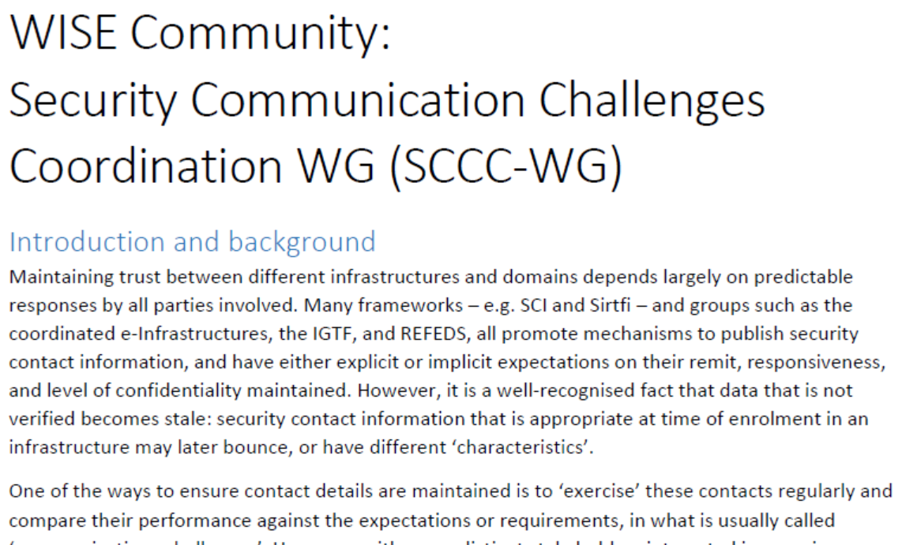
WISE SCCC-WG proposal – participate!
Proposed working group to WISE SC – see wise-community.org and join!

Slide 22
Upcoming PMA events
EUGridPMA 44,
Toulouse September 24 – 26, 2018
TechEx Oct 15-18, Orlando, FL, USA
TNC19 June 16-20 2019, Tallinn, EE

