Slide 1
EUGridPMA
Status and Current Trends and some IGTF topics
April 2017
TAGPMA I2GS April Meeting
David Groep, Nikhef & EUGridPMA

Slide 2
EUGridPMA Topics
EUGridPMA (membership) status
  New CAs: RCauth.eu/AARC CILogon-like TTS; DarkMatter
  AARC
IGTF-to-eduGAIN bridge
Related activities: Sirtfi, Snctfi, REFEDS Assurance WG, and AARC2
Model implementations for video-supported vetting
GFD.225 Certificate Profile completed
IPv6, SHA-1 collisions, CA web server freshness, and more
See also the EUGridPMA39 summary: https://www.eugridpma.org/meetings/2017-01/

Slide 3
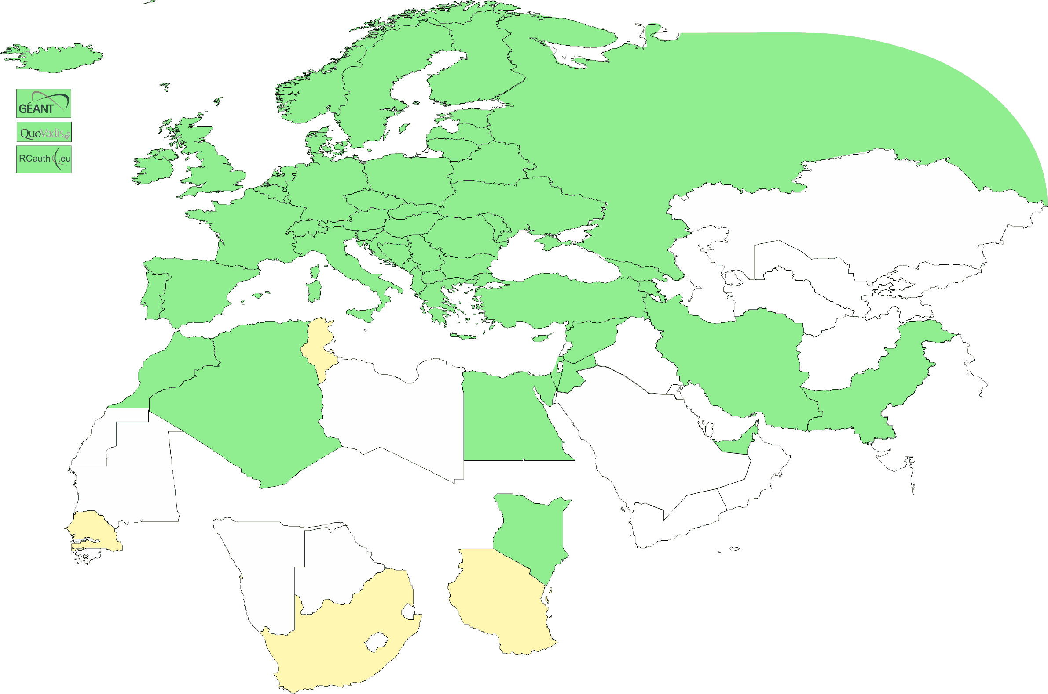
Geographical coverage of the EUGridPMA
26 of 28 EU member states (all except LU, MT)
+ AE, AM, CH, DZ, EG, GE, IR, IS, JO, MA, MD, ME, MK, NO, KE, PK, RS,
RU, SY, TR, UA,
CERN (int),
TCS (EU),
RCauth.eu (EU/NL),
QV (BM)
47+4
In progress
ZA, TZ

Slide 4
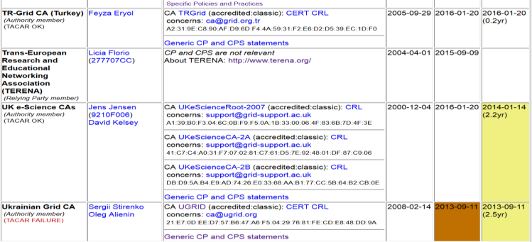
Membership and other changes
Responsiveness challenges for some members
  JUNET CA – removed from membership
  HIAST CA – suspended for operational reasons
Identity providers: both reduction and growth
  New CA for e-Infras: RCauth.eu IOTA CA (“for those who cannot use TCS”)
  New CA for UAE: DarkMatter (phase 1 of 2)
  Upcoming in UK: adding SLCS
Self-audit review
  Cosmin Nistor as review coordinator
  Self-audits progressing
  on schedule for most CAs

Slide 5
RCauth.eu white-label CA for the AARC CILogon-like TTS Pilot
Ability to serve a large pan-European user base without national restrictions
  without having to rely on specific national participation exclusively for this service
  serving the needs of cross-national user communities that have a large but sparsely distributed user base
Use existing resources and e-Infrastructure services
  without the needs for security model changes at the resource centre or national level
Allow integration of this system in science gateways & portals with minimal effort
  only light-weight industry-standard protocols, limit security expertise (and exposure)
Permit the use of the VOMS community membership service
  attributes for group and role management in attribute certificates
  also for portals and science gateways access the e-Infrastructure
Concentrate service elements that require significant operational expertise
  not burden research communities with the need to care for security-sensitive service components
  keep a secure credential management model
  coordinate compliance and accreditation – and help meet EU privacy stuff in just one place to ease adoption
Optional elements: ability to obtain CLI tokens (via ssh agent or even U/P); implicit AuthZ

Slide 6
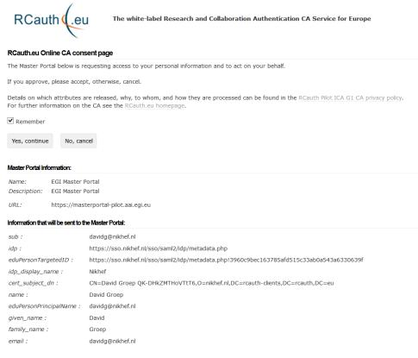
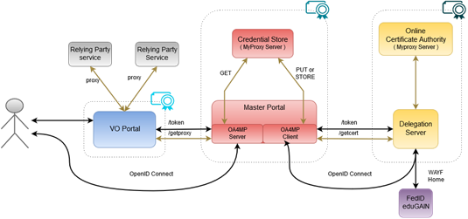

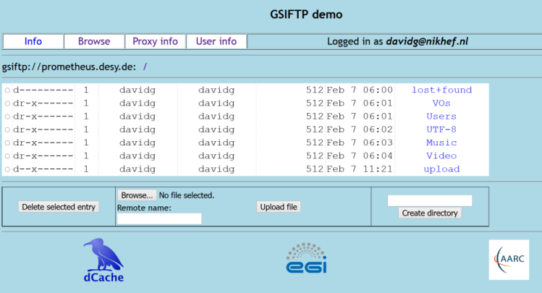
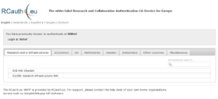
Flow for RCauth-like scenarios
Sirtfi
REFEDS “R&S”
Built on CILogon and MyProxy!
www.cilogon.org
6
see also https://rcdemo.nikhef.nl/
Notes:
VO portal can be anything even a simple shell
Certs stored only for 11 days
Master portal can add attributes via VOMS (or others in the future)

Slide 7
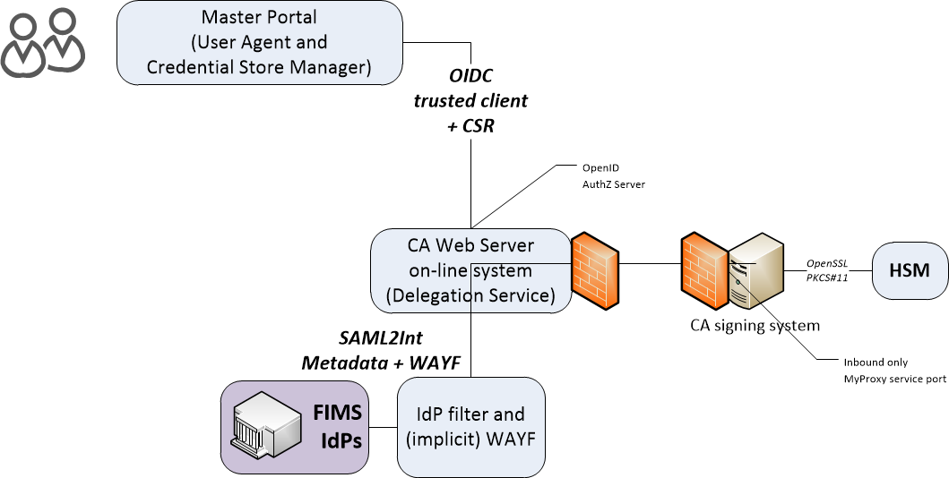
Enrolment and issuance [4.2]
Users could enroll directly, but are in practice using a Master Portal/Credential Manager
The credential manager is explicitly trusted by the RCauth CA service
  exchange of OIDC client secret to authenticate
  ‘need to know’: (master) portals will hold user credentials, and we need to protect users per the PKP Guidelines
CA web server checks the incoming assertions from the IdP filter
  Uses CILogon/OAuth4MP software based on the Shibboleth SAML implementation over server-side TLS
  Connected for now to the SURFconext WAYF
  … and yes, we check the SAML signature ;-)
When moving to wider support of eduGAIN
WAYF IdP filter check the incoming SAML2Int
  Use multi-domain WAYF over server-side TLS
  Based on SimpleSAMLphp implemenation with custom filters
  … and yes, also here we’ll check the SAML signature
FIMS IdPs: leverage existing infrastructures

Slide 8









Potential RCauth.eu management model
shared governance through a
Policy Management Authority
non-discriminatory policy and practices
joint PMA authoritative
for policy and operations
Stakeholders
EGI, EUDAT, SURF,
GÉANT, ELIXIR, …
in-kind or explicit contributions
of services, kit, and operators
trust by any and all
global relying parties
Infrastructure-specific Master Portals
and Credential Repository
user contact service by
specific stakeholder

Slide 9
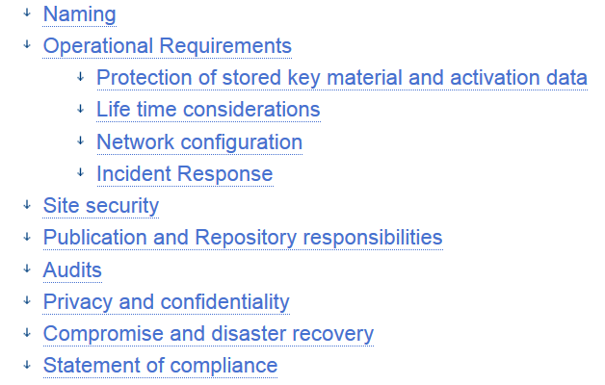
Trusted Credential Stores
In easing access to e-Infrastructures incrasingly
credential management systems appear:
UnityIDM, MyProxy hosting, AARC’s Master Portals, …
Issuing Authorities promoting PKP guidelines (e.g. RCauth.eu) need framework to assess explicitly-connected portals
Guidance on what constitutes an
‘acceptable’ credential store
Guidance for operators on
‘community best practice’
https://wiki.eugridpma.org/Main/CredStoreOperationsGuideline

Slide 10
RCauth sustainability
Somewhat amazingly, many of the e-Infrastructures in Europe all want to ‘have a share’ in running the service
Support for now ensured by the Dutch National e-Infrastructure (Nikhef, SURF) – will likely transition to a collaborative entity with own separate PMA and redundant distributed infrastructure - details to be worked

Slide 11
The Reverse: the IGTF-to-eduGAIN bridge
“the ultimate assured-identity IdP of last resort”
authenticate with any IGTF accredited client cert
known to the (SAML2int, R&E) eduGAIN community via GRnet
with assurance information in ePAss (and 2FA set in ACCR)
asserts REFEDS R&S and Sirtfi (based on IGTF qualification)
will appear as https://edugain-proxy.igtf.net/
R&S + Sirtfi tags should enable many research SPs to trust you
work by Ioannis Kakavas (GRNET) and Christos Kanellopoulos –
see github for implementation of SimpleSAMLphp module

Slide 12
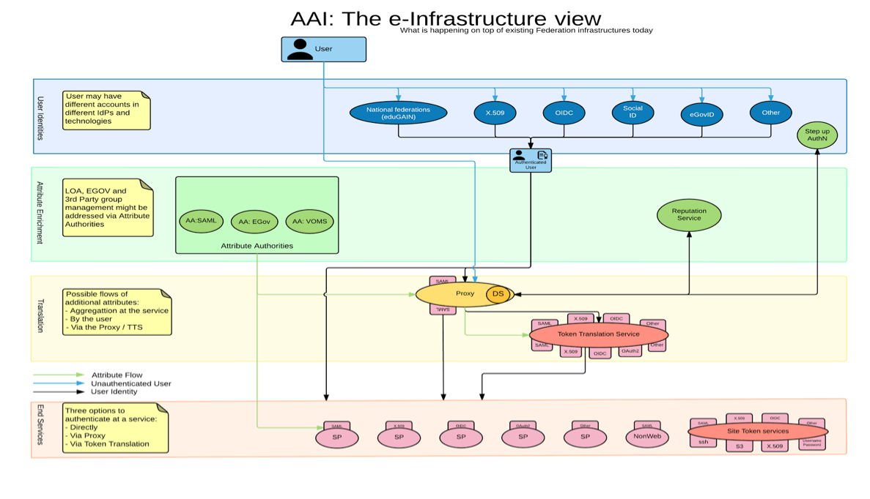

AARC Blueprint Architecture & eduGAIN
Research & e-Infrastructures
  Implement the AARC blueprint
AARC
  set of building blocks - both technical and policy,
  leveraging eduGAIN,
  for International Research Collaboration
eduGAIN and the Identity Federations
  A solid foundation for federated
  access in R&E

Slide 13
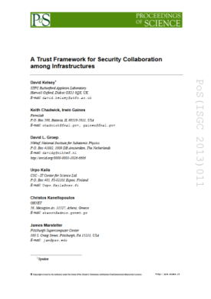

Developing scalable policy models in light of the Blueprint: Snctfi
✓
allow proxy operators to assert ‘trust marks’ based on known SP properties
✓
Develop framework recommendations for RIs for coherent policy sets
evaluate with the SP-IdP-Proxies in pilots
based on the Blueprint Architecture
Collaborate in WISE, IGTF &
FIM4R to get endorsement
Many SPs are alike
Policy frameworks for collective service providers Shared use of and collaboration on reputation services, together in FIM4R
Complementary work:
Accounting Data Exchange Protection for Infrastructures
Graphics inset: Ann Harding, SWITCH
Proxying IdPs to SPs is part of the BPA, with e.g. the RCauth CPS as policy example

Slide 14

More policy harmonisation and development in AARC2
Reflected in updated AARC2 structure
Operational security capabilities and Incident response in federations – beyond Sirtfi v1
Service-centric policies: traceability & accounting, privacy, gateway operations & proxies
e-Researcher-centric policies: alignment of AUPs and templates,
authentication assurance, community attribute management models
and provisioning
Policy Engagement and Coordination:
contributes to Community Engagement, provision of
policy expertise to the Competence Centre, promotion of
best practices globally (WISE, FIM4R, IGTF, REFEDS),
easing end-to-end coordination across the chain
Structuring the exchange of information amongst SP groups

Slide 15

Sirtfi and R&E federation assurance
Federation 2
SP
Federation 1
SP
IdP
IdP
SP
SP
SP
SP
SP
All I need is one identity…
IdP
Federation 3
SP
IdP
SP

SP
IdP
Clearly an inviting vector of attack… luckily, this was noticed several years ago!

Slide 16
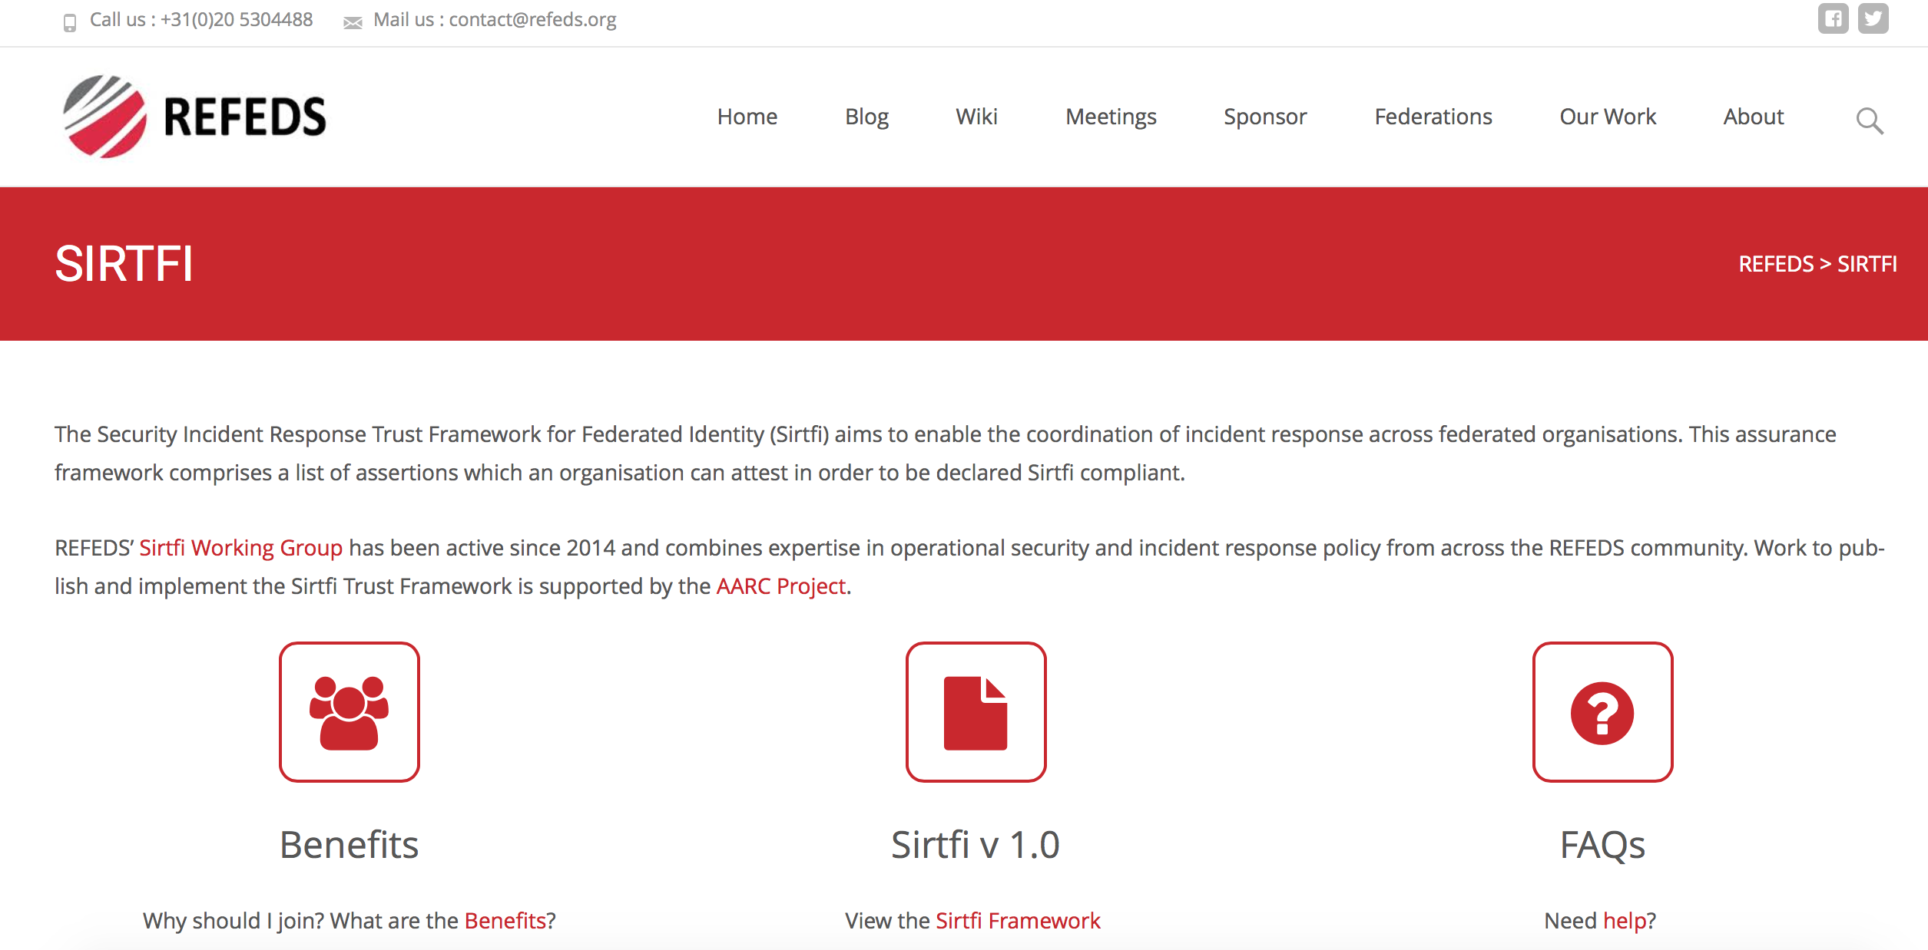
Find out more on Sirtfi
https://refeds.org/sirtfi

Slide 17
More R&E developments on assurance
REFEDS Assurance WG
  Baseline comes out of Mikael’s AARC work
  https://docs.google.com/document/d/15v65wJvRwTSQKViep_gGuEvxLl3UJbaOX5o9eLtsyBI
  beyond the baseline: “Cappucino” (BIRCH), “Espresso” (EIDAS substantial, KI LoA 3)
EGI ad-hoc assurance evolution
  Use cases identified for several levels – needs alignment
  There is a noted difference between ‘open guest IdPs’ and controlled university IdPs, but these cannot be identified now
  UKAMS publishes UnitedID to edugain: ‘edugain’ is not enough
  But hardly any need for >>BIRCH LoA (only some biomed cases)

Slide 18
Video-supported vetting
“[Vetting] should be based on a face-to-face meeting and should be confirmed via photo-identification and/or similar valid official documents.” (BIRCH and CEDAR APs)
Many support explicit F2F only, yet designate RAs in different ways
Video-supported and notary-public postal mail & video: BR, TR
Government records: some TCS subscribers (universities with access to these databases)
Kantara LoA 2: some TCS countries (SE) for some of their applicants

Slide 19
Evolution of guidance
“The aim should be to stay within the 'bandwidth of trust' described in the current text: between the (possibly worthless) notary-public attestations, and the more trusted real in-person hand-shake vetting.”
“If appropriate compensatory controls are in place and we can protect same-person continuity (non-reassignment) as well as traceability, it should be viable. Compensatory controls have some 'hard' requirements in the model process described in the Wiki:”
http://wiki.eugridpma.org/Main/VettingModelGuidelines
It is important that this be described and reviewed in each case, so the proposal is that "The following is also considered to be an acceptable process for implementing method 2 - if so acceptably documented in the CP/CPS and endorsed by the accrediting PMA”

Slide 20
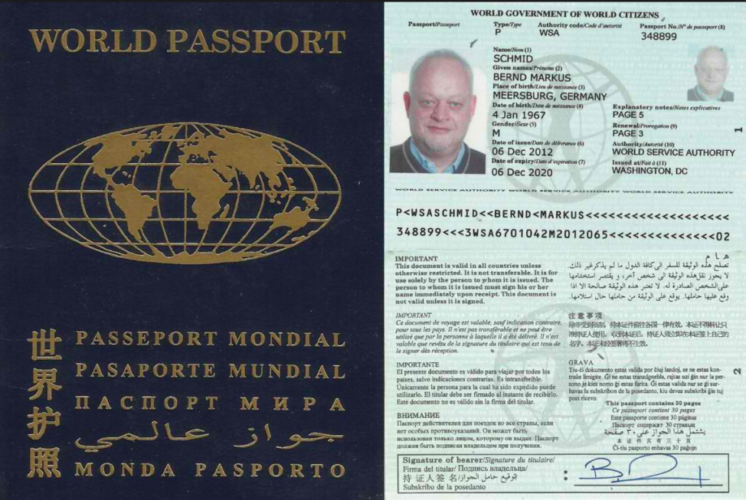
Evaluation leads to mixed results …
Realistic test by CESNET
(who really wanted to use it)
resulted in “unable to decide
on validity” over skype
Test by German bank (using
trained verificators and with
flashlight on smartphone) was
successful
Really depends on training,
knowledge of valid documents, and some specific tests
Photo Credit: Sonnenstaatland
For examples see also e.g.: National Document Fraud Unit, UK Home Office
Guidance_on_examining_identity_documents_v._June_2016

Slide 21
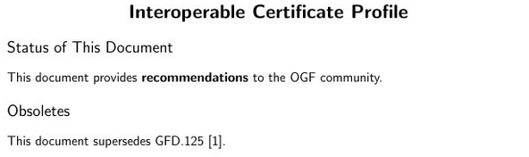
GFD.225
Now done – Jens also picked the last nits:
published now: http://www.ogf.org/documents/GFD.225.pdf
Also there the reviews should probably check compliance
Ursula Epting re-wrote the auditing spreadsheets
see www.eugridpma.org/agenda/39/
How to progress with future updates?
https://www.overleaf.com/646373kvfmwn

Slide 22
IPv6 status
New continuous v6 CRL monitor
http://cvmfs-6.ndgf.org/ipv6/overview.php
41 CAs offer working v6 CRL (down from 43 in Oct 2016 ☹)
  but: also 1-2 CAs that give AAAA record but the GET fails …
  Still 52 broken endpoints support only legacy IP
  the ClouldFlare cache solution is trivial, so please either …
  dl.igtf.net can act as v6 source-of-last-resort for RPs that need it

Slide 23
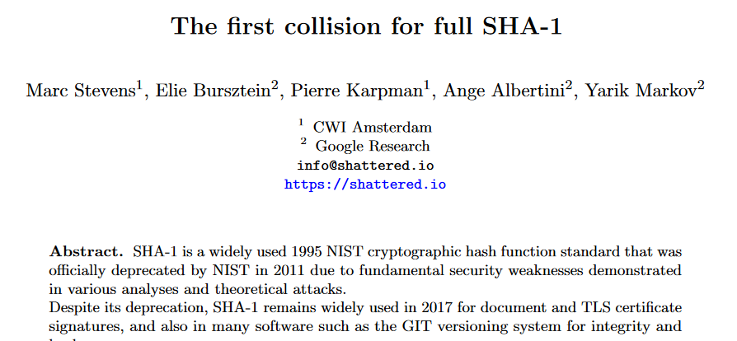
And really: get rid of SHA-1 – it’s broken!
Do we still have SHA-1 EECs??
FNAL KCA
REUNA?
…?
https://shattered.io/static/shattered.pdf

Slide 24
CA CRL web server status – explain or fix!
A party known and friendly to us surveyed system status
“Running critical infrastructure on software
that is 13 years old is just not funny.”
EUGridPMA sent notices to its own authorities, and trigger the IGTF RAT process (but that’s really quiet – why?)
Pending for TAGPMA:
LACGridCA, Apache/2.2.3 (CentOS)
= Centos/SL 5
REUNA-ca, Apache/2.0.53 (Fedora)
= Fedora Core 3 (2004)
UNAMgrid-ca, Apache-Coyote/1.1
= Fedora 4 (2005) (Tomcat 5.0.x)

Slide 25
Upcoming meetings
For more details,
see https://www.eugridpma.org/meetings/,
but meanwhile:

Slide 26
Upcoming events
EUGridPMA 40, Ljubljana May 22 – 24
TNC2017, Linz, AT May 29 – June 2 (REFEDS: Monday!)
EUGridPMA41 September 2017
APGridPMA Spring meeting March 19, 2018

