Slide 1
EUGridPMA
Status and Current Trends and some IGTF topics
March 2016
Miami, FL, USA
David Groep, Nikhef & EUGridPMA

Slide 2
EUGridPMA Topics
EUGridPMA (membership) status
  New & coming CAs: RCauth.eu/AARC CILogon-like TTS; DarkMatter
Assurance Profiles:
  IOTA update, implementation of Generalised Assurance Profiles & PKI Guidelines
  New AP structure and GFD.169/review sheets
GFD.225 OGF Certificate Profile and OGF News
Model implementations for video-supported vetting
Guidelines on Trusted Credential Stores & (finally) on-line CAs
Disaster Recovery and Business Continuity development
Dissemination and impact
See the Abingdon summary: https://www.eugridpma.org/meetings/2016-05/

Slide 3
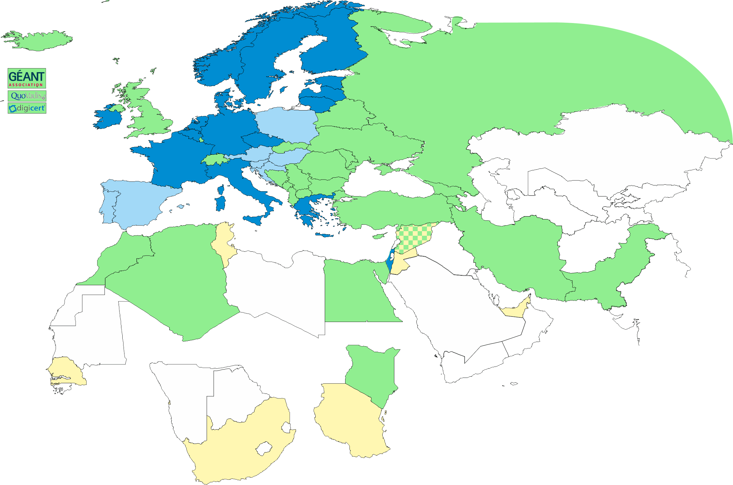
Geographical coverage of the EUGridPMA
26 of 28 EU member states (all except LU, MT)
+ AM, CH, DZ, EG, GE, IL, IR, IS, JO, MA, MD, ME, MK, NO, PK,
RS, RU, SY, TR, UA, CERN (int) + TCS (EU)
Pending or in progress
ZA, TZ, AE

Slide 4
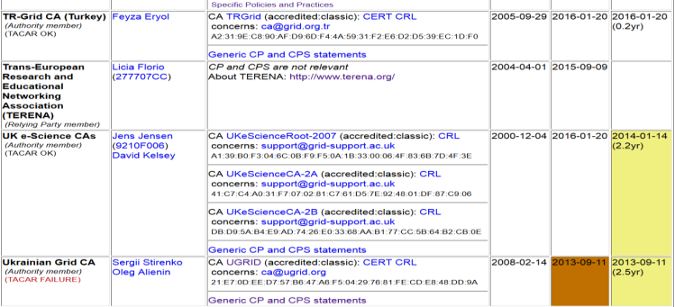
Membership and other changes
Responsiveness challenges for some members
  JUNET CA – suspended
  HIAST CA – temporarily withdrawn for operational reasons
Identity providers: both reduction and growth
  New CA in Kenya (by the NREN KENET) classic on-line CA
  New CA from CERN: IOTA (scoped) CA
  New CA for e-Infras: RCauth.eu IOTA CA
Self-audit review
  Cosmin Nistor replaced Kaspars as
  review process coordinator
  Self-audits progressing on schedule
  for most CAs

Slide 5
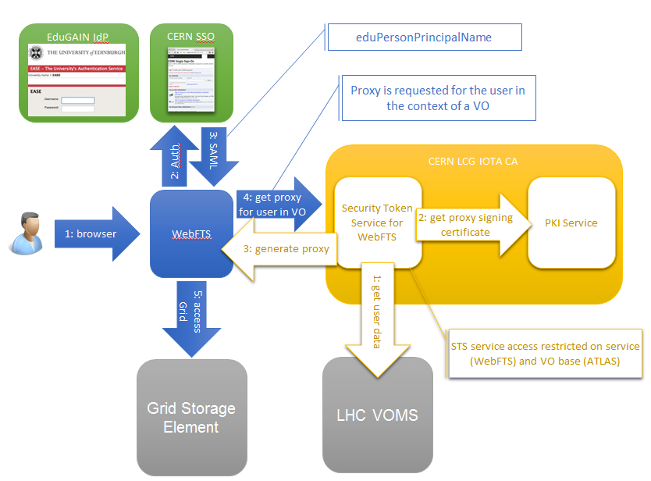
CERN LCG IOTA CA
Specific Identifier Only Trust Assurance CA – adds ‘VO membership’ constraints internally to fit with current state of e-Infrastructures and wLCG sites*
* http://lcg-ca.web.cern.ch/lcg-ca/doc/WLCG-CERN-IOTA-statement-MB.pdf

Slide 6
RCauth.eu white-label CA for the AARC CILogon-like TTS Pilot
Ability to serve a large pan-European user base without national restrictions
  without having to rely on specific national participation exclusively for this service
  serving the needs of cross-national user communities that have a large but sparsely distributed user base
Use existing resources and e-Infrastructure services
  without the needs for security model changes at the resource centre or national level
Allow integration of this system in science gateways and portals with minimal effort
  only light-weight industry-standard protocols, limit security expertise (and exposure)
Permit the use of the VOMS community membership service
  attributes for group and role management in attribute certificates
  also for portals and science gateways access the e-Infrastructure
Concentrate service elements that require significant operational expertise
  not burden research communities with the need to care for security-sensitive service components
  keep a secure credential management model
  coordinate compliance and accreditation – and help meet EU privacy stuff in just one place to ease adoption
Optional elements: ability to obtain CLI tokens (via ssh agent or even U/P); implicit AuthZ

Slide 7
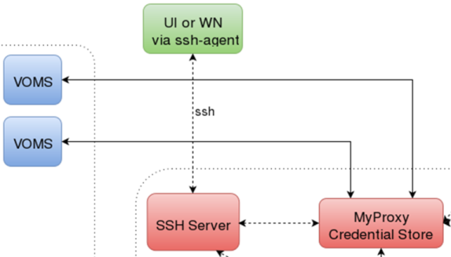
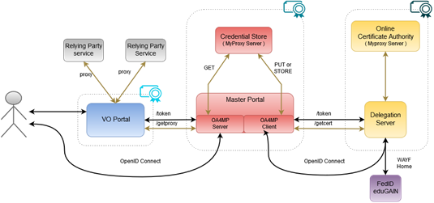
CILogon-like TTS Pilot - distributable elements

Slide 8
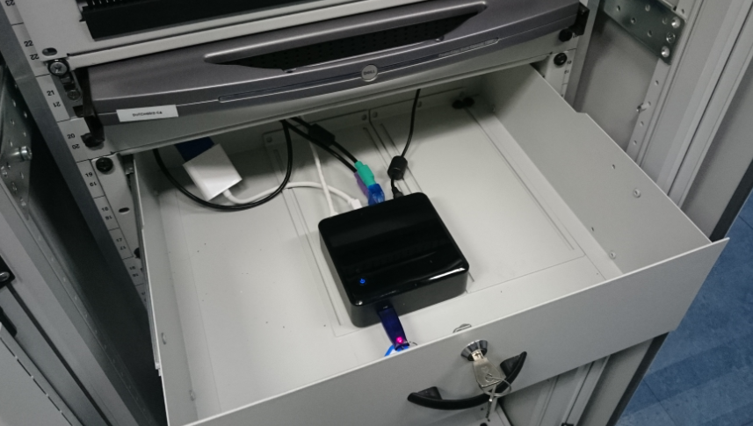
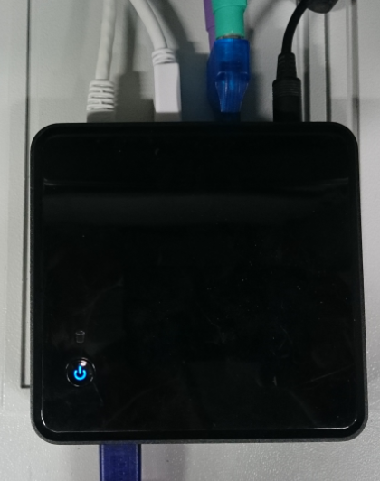
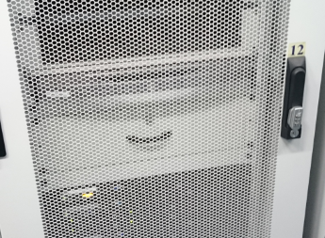
More pretty pictures

Slide 9
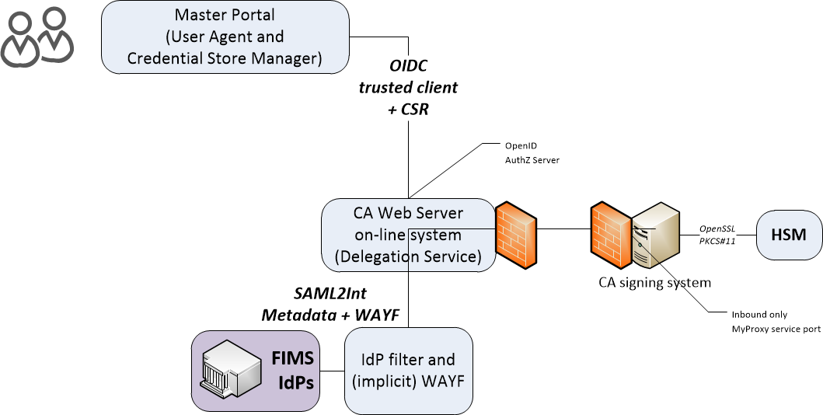
Enrolment and issuance [4.2]
Users could enroll directly, but are in practice using a Master Portal/Credential Manager
The credential manager is explicitly trusted by the RCauth CA service
  exchange of OIDC client secret to authenticate
  ‘need to know’: (master) portals will hold user credentials, and we need to protect users per the PKP Guidelines
CA web server checks the incoming assertions from the IdP filter
  Uses CILogon/OAuth4MP software based on the Shibboleth SAML implementation over server-side TLS
  Connected for now to the SURFconext WAYF
  … and yes, we check the SAML signature ;-)
When moving to wider support of eduGAIN
WAYF IdP filter check the incoming SAML2Int
  Use multi-domain WAYF over server-side TLS
  Based on SimpleSAMLphp implemenation with custom filters
  … and yes, also here we’ll check the SAML signature
FIMS IdPs: leverage existing infrastructures

Slide 10
Broader issues from the Abingdon meeting

Slide 11
Assurance Profile
Both Assurance Profile + PKI Technology Guidelines complete
https://www.eugridpma.org/guidelines/authn-assurance/
https://www.eugridpma.org/guidelines/pkitech/
now Classic and IOTA profile updated as well
“We hereby agree that the version 5.0 of the Classic profile is equivalent to version 4.4, and that version 2.0 of the IOTA profile is equivalent to version 1.1a.
There is thus no need for CAs that are currently accredited to review or revise their own policies and practices”

Slide 12
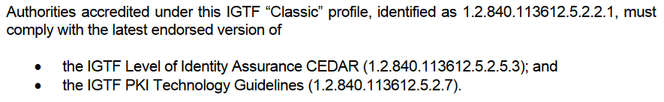
And now what?
The profiles themselves are now ‘rather short’
There are no self-audit template sheets for new structure
Nor is there any guidance for reviewers (if so needed)
Work to do - for the first reviews and self-audits that come
GFD.169 appendix: item mapping for APs and PKI Tech
Review spreadsheets: two sheets for each review?

Slide 13
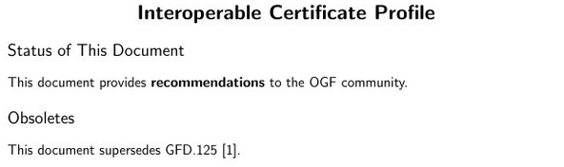
GFD.225
Now ‘really’ almost done – Jens also picked the last nits:
About to be published soon now …
and Jens is now anyway the OGF VP of Standards …
Also there the reviews should probably check compliance
https://www.overleaf.com/646373kvfmwn

Slide 14
Video-supported vetting
“[Vetting] should be based on a face-to-face meeting and should be confirmed via photo-identification and/or similar valid official documents.” (BIRCH and CEDAR APs)
Many support explicit F2F only, yet designate RAs in different ways
Video-supported and notary-public postal mail & video: BR, TR
Government records: some TCS subscribers (universities with access to these databases)
Kantara LoA 2: some TCS countries (SE) for some of their applicants

Slide 15
On the notary public & govt. databases
In many countries, notaries are rather exclusive, and rather expensive to attest to documents (think ~€25 + half a day & travel for the appointment)
Access to databases to rather complex for most orgs
So e.g. HPCI and others are looking for alternatives
By ‘chance’, I was exposed to another, quite interesting and rigorous process – which was easier – if you’re allowed to keep photographs …
… and which some CAs (specifically HPCI, but I expect many others) would seriously want to consider!

Slide 16
Evolution of guidance
Ongoing work item
“The aim should be to stay within the 'bandwidth of trust' described in the current text: between the (possibly worthless) notary-public attestations, and the more trusted real in-person hand-shake vetting.”
“If appropriate compensatory controls are in place and we can protect same-person continuity (non-reassignment) as well as traceability, it should be viable. Compensatory controls have some 'hard' requirements in the model process described in the Wiki:”
http://wiki.eugridpma.org/Main/VettingModelGuidelines
It is important that this be described and reviewed in each case, so the proposal is that "The following is also considered to be an acceptable process for implementing method 2 - if so acceptably documented in the CP/CPS and endorsed by the accrediting PMA”

Slide 17
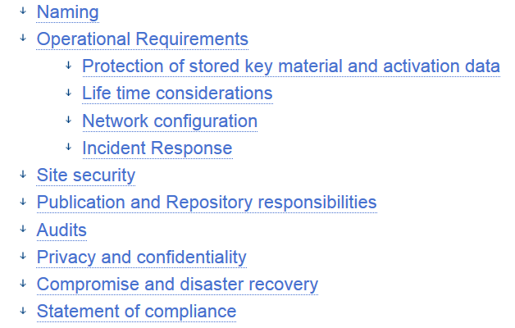
Trusted Credential Stores
In easing access to e-Infrastructures incrasingly
credential management systems appear:
UnityIDM, MyProxy hosting, AARC’s Master Portals, …
Issuing Authorities promoting PKP guidelines (e.g. RCauth.eu) need framework to assess explicitly-connected portals
Guidance on what constitutes an
‘acceptable’ credential store
Guidance for operators on
‘community best practice’

Slide 18
We have also documented on-line CA Guidance now
The on-line CA guidelines document available at
https://wiki.eugridpma.org/Main/GuidelinesForOnLineCAs
Codifies current requirements from Classic AP and current best practice – and permits more explicitly the key generation ceremony
Follows AP structure:
Operational requirements
Network controls
Key generation
Key storage
Key Activation
Key Deactivation
Key End of Life
Procedural Controls
Site Security
Publication and repository responsibilities
Audits
Compromise and disaster recovery

Slide 19
Which one to pick if you want it ‘just done’
On-line CA architectures must ensure that only legitimate traffic related to certificate issuing operations will ever reach the on-line CA issuing system. This can be ensured in various ways:
(A) an authentication/request server, suitably protected and connected to the public network, and a separate signing system, connected to the front-end via a private link, that only processes approved signing requests and logs all certificate issuance;
(B) an authentication/request server containing also the HSM hardware, connected to a dedicated network that only carries traffic destined for the CA and is actively monitored for intrusions and is protected via a packet-inspecting stateful firewall;
where it is noted that model A type designs are more readily secured and usually need less components and effort to maintain and operate and therefore preferred.

Slide 20
Best practice now documented
“To further protect the issuing CA and permit revocation thereof, it is strongly advised that all on-line issuing CAs be a subordinate of an off-line root or higher-level CA, where the off-line root may have a long-lived (one year or longer) CRL.”
“Any on-line CA shall have a disaster recovery and business continuity plan. For CAs where the key material has been generated inside the HSM, this plan should include regular tests of the capability to recover the key in the HSM from archival material.”
And a bit more, just read the doc …

Slide 21
Contribution sought: Disaster WG
“Develop guidelines for the structure and for topics to be addressed by the disaster recovery section of both the CP/CPS and in private specific plans.”
Some guidance exists, but it is scattered and not shared
Many CP/CPS “section 5” text gives hits, but no best practice
For now:
JensJ, JanC, ScottR, ReimerKM, DavidG, UrsulaE & ShahinR
Volunteers welcome!

Slide 22
IPv6 status
New continuous v6 CRL monitor
http://cvmfs-6.ndgf.org/ipv6/overview.php
39 CAs offer working v6 CRL
  but: also 2-4 CAs that give AAAA record but the GET fails …
  Still 54 broken endpoints support only legacy IP
  dl.igtf.net can act as v6 source-of-last-resort
fetch-crlv3 v3.0.10+ has an explicit mode to force-enable IPv6 also for older perl versions
  Added option "--inet6glue" and "inet6glue" config setting to load the Net::INET6Glue perl module (if it is available) to use IPv6 connections in LWP to download CRLs

Slide 23
Upcoming meetings

Slide 24
IGTF+ Meeting Agenda
IGTF All Hands meeting &
EUGridPMA 38, 19-21 Sept 2016, Geneva
https://www.eugridpma.org/meetings/2016-09/
EUGridPMA 39, Jan 30th – Feb 1st 2017, Florence
EUGridPMA 40, May 2017, Ljubljana

