Slide 1
EUGridPMA
Status and Current Trends and some IGTF topics
March 2015
Taipei, TW
David Groep, Nikhef & EUGridPMA

Slide 2
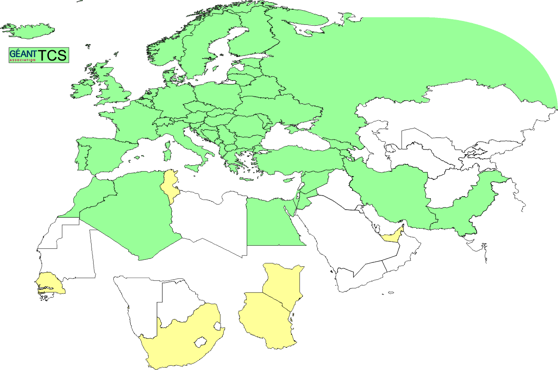
Geographical coverage of the EUGridPMA
26 of 28 EU member states (all except LU, MT)
+ AM, CH, DZ, EG, GE, IL, IR, IS, JO, MA, MD, ME, MK, NO, PK,
RS, RU, SY, TR, UA, CERN (int) + TCS (EU)
Pending or in progress
ZA, KE, TZ, AE

Slide 3
EUGridPMA Topics
EUGridPMA (membership) status
New and updated CAs
IPv6 readiness and fetch-crl
Private Key Protection Guidelines v2.0
On-line CA Architectures Guideline document
Wildcard naming
Also see the Berlin summary at
https://www.eugridpma.org/meetings/2015-01/

Slide 4
Membership and other changes
Responsiveness challenges for some members
  JUNET CA – suspended
  HIAST CA – temporarily withdrawn for operational reasons
Identity providers: reduction and growth
  New CA in Georgia (Tblisi) accredited
  New “G3” Trusted Certificate Service by the GÉANT Ass.
  operated by DigiCert of Lehi, Utah.
Self-audit review
  Cosmin Nistor replaced Kaspars as review process coordinator
  Self-audits progressing on schedule for most CAs

Slide 5
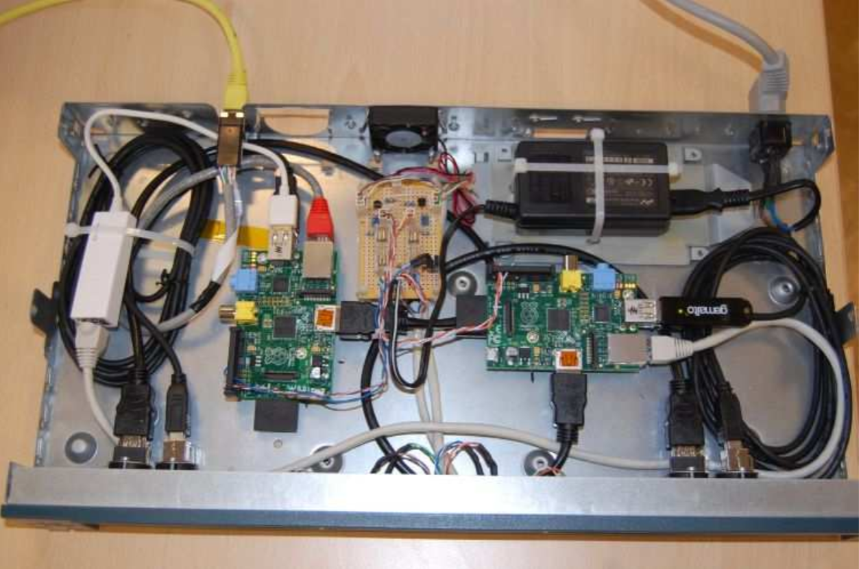
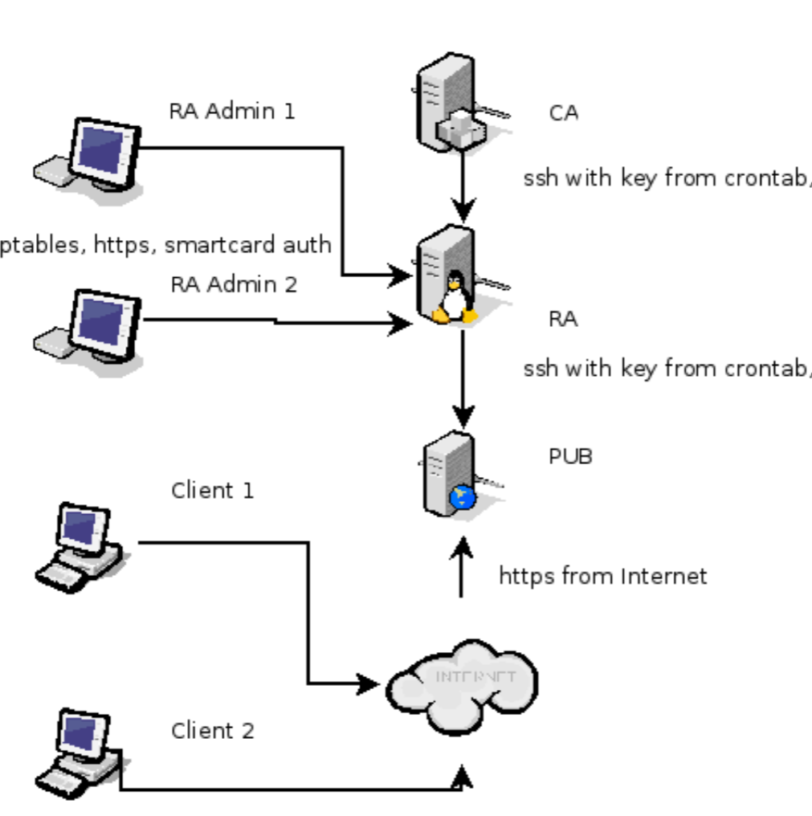
New CAs in the 1.62 release I: NIIF
Graphic: Tamas Maray, NIIF, Hungary

Slide 6
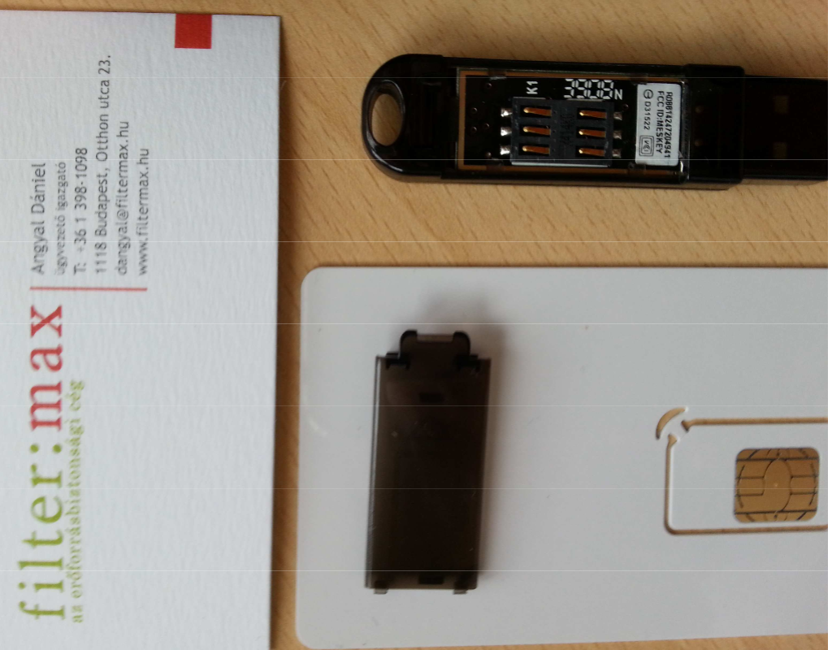
Gemalto token: FIPS-140 L3
Graphic:
Tamas Maray, NIIF, Hungary
But even if you have a L3 token, doing a documented key generation ceremony outside the token is still good to prevent vendor lock-in

Slide 7
Now we have also documented Guidance
The on-line CA guidelines document available at
https://wiki.eugridpma.org/Main/GuidelinesForOnLineCAs
Codifies current requirements from Classic AP and current best practice – and permits more explicitly the key generation ceremony
Follows AP structure:
Operational requirements
Network controls
Key generation
Key storage
Key Activation
Key Deactivation
Key End of Life
Procedural Controls
Site Security
Publication and repository responsibilities
Audits
Compromise and disaster recovery

Slide 8
Which one to pick if you want it ‘just done’
On-line CA architectures must ensure that only legitimate traffic related to certificate issuing operations will ever reach the on-line CA issuing system. This can be ensured in various ways:
(A) an authentication/request server, suitably protected and connected to the public network, and a separate signing system, connected to the front-end via a private link, that only processes approved signing requests and logs all certificate issuance;
(B) an authentication/request server containing also the HSM hardware, connected to a dedicated network that only carries traffic destined for the CA and is actively monitored for intrusions and is protected via a packet-inspecting stateful firewall;
where it is noted that model A type designs are more readily secured and usually need less components and effort to maintain and operate and therefore preferred.

Slide 9
Best practice now documented
“To further protect the issuing CA and permit revocation thereof, it is strongly advised that all on-line issuing CAs be a subordinate of an off-line root or higher-level CA, where the off-line root may have a long-lived (one year or longer) CRL.”
“Any on-line CA shall have a disaster recovery and business continuity plan. For CAs where the key material has been generated inside the HSM, this plan should include regular tests of the capability to recover the key in the HSM from archival material.”
And a bit more, just read the doc …

Slide 10
new GEANT TCS Trusted Certificate Service

Slide 11
A long (but rather successful) road
2nd CfP
DigiCert selected
as TCS partner
contract signed
with GlobalSign
contract signed
with Comodo
Start of SCS
IDEA
Start of TCS
CfP
3rd CfP
Contract
renewed
Start TCS
eScience
Start of
new TCS
Contract
renewed
2004
2005
2006
2007
2008
2009
2010
2011
2012
2013
2014
2015
End of SCS
End of Comodo
TCS service

Slide 12
The TCS structure
GEANT Ass. (TERENA) is the ‘owner’ of the certificate services, which is procures on behalf of the participating NRENs (members)
It sources the issuing service from a commercial CA service provider and sets the requirements
  Via the tender/RfP requirements
  Via updates to the CP/CPS
NRENs then act as the user-facing end of the service
  They may co-brand the service
  They can (or could) define some of the processes
  All have to agree to the same CP/CPS and contract(s)
  The TCS PMA controlling the CP/CPS is comprised
  of experts from across the community

Slide 13
Interesting elements
By its intention, the TCS CAs should
  Be publicly trusted in all major (mobile) systems
  Use mechanisms that scale to the European R&E community
  Don’t burden the subscribers (institutions) too much – in particular for auditing
  Preserve under GEANT’s control key elements that ensure continuity (no vendor lock-in) –
  for eScience, this means e.g. the subject namespace
but of course not everything is under our control
  Changes to baseline requirements affect us
  The way the CA interprets those changes affects us even more – which is how we ‘lost’ usable OV certs
  Server certs are more tightly controlled than personal

Slide 14

TCS G3 – 10 years of TCS
Selected DigiCert, Inc. of Lehi, Utah, USA
in August 2014
Signed contract in November 2014
Already TAGPMA accredited with ‘general-purpose’ grid CAs
GEANT TCS service uses (6) dedicated ICAs
  Of which 2 are IGTF accredited
  Others: regular OV SSL, regular Client, EV, and CS

Slide 15
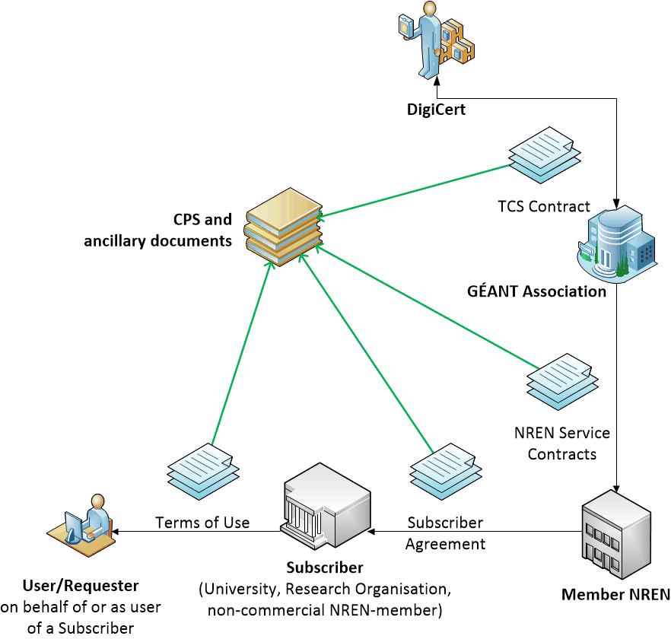
Built using contracts
scales well to large numbers of organisations and users
assurance requirements on subscribers ensure quality ID
bound through legal contracts
listed in specific document and in the CPS

Slide 16
Document set
Leverage largely as much existing accreditation
Instead of a single CPS, we have
  DigiCert CP
  DigiCert CPS
  GEANT TCS CPS
  Subscriber Agreement (“Terms of Use”)
  Consolidated Required Contractual Terms (CRCT)
Only GEANT TCS CPS and CRCT are TCS specific
  Describe authentication, vetting, uniqueness, etc.
  Refer back to upstream CPS and CP for everything else

Slide 17
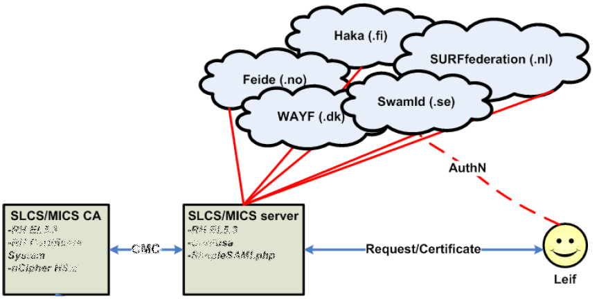
Linking federations to Grid AuthN
Use your federation ID
... to authenticate to a service
... that issues a certificate
... recognised by the Grid today
Graphic from:
Jan Meijer, UNINETT

Slide 18
Introduction of the TCS G3 in IGTF
New CP/CPS
  Attempted to leverage existing TAGPMA accreditation
  Mixed result: it seemed easier to write the CPS, but then the reviewer still read all documents, and cross-dependencies were complex to track
Self-audit as per GDF.169
  Had been overdue for some time
  The new CPS implementing any recommendations was ready at the same time
  Review of new CPS and self-audit combined – reviewers:
  Reimer Karlsen-Masur (DFN-CERT), Dave Kelsey (RAL & wLCG),
  Jules Wolfrat (SURFsara & PRACE), and Urpo Kaila (CSC, EUDAT)

Slide 19
The new ‘G3’ TCS
Roll-out via staged pilots
  Phase I: expert testing and debugging (almost done)
  Phase II: NREN-level testing and customization options
  Phase III: Customer (Subscriber) testing and roll-out
Deployed in IGTF 1.62 on Feb 23
Federation integration pending (so now mostly server-only)
Full production everywhere before June 2015
✓
✓
⇨

Slide 20
The RPS model
(as first introduced by Scott in TAGPMA)
The RPS outlines the procedures that the community members follow to comply with the CA Profile. It allows communications with a defined set of registration practices to move between issuing CAs.
worked on by both TAGPMA and EUGridPMA, and evolved and refined in Berlin, with particular attention to sections 1, 3, and 9.
latest version can be found at
https://wiki.eugridpma.org/Main/RPS
The concept of the RPS very much aligns with the new TCSG3 CPS, although in that specific case the precedence is reversed (there TCS managed its own CPS with details the same elements as the RPS would, but then incorporates the CA Operators CPS by references, whereas the RPS model would do that the other way round).

Slide 21
Miscellaneous topics
IPv6
Private Key Protection Guidelines v2.0
On-line CA Architectures Guideline document

Slide 22
IPv6 status
FZU runs a continuous v6 CRL monitor
http://www.particle.cz/farm/admin/IPv6EuGridPMACrlChecker/
23 CAs offer working v6 CRL
  but there are also 4 CAs that give an AAAA record but where the GET fails …
  Still 71 endpoints to go (but they go in bulk)
  dist.eugridpma.info can act as v6 source-of-last-resort
fetch-crlv3 v3.0.10+ has an explicit mode to force-enable IPv6 also for older perl versions
  Added option "--inet6glue" and "inet6glue" config setting to load the Net::INET6Glue perl module (if it is available) to use IPv6 connections in LWP to download CRLs

Slide 23
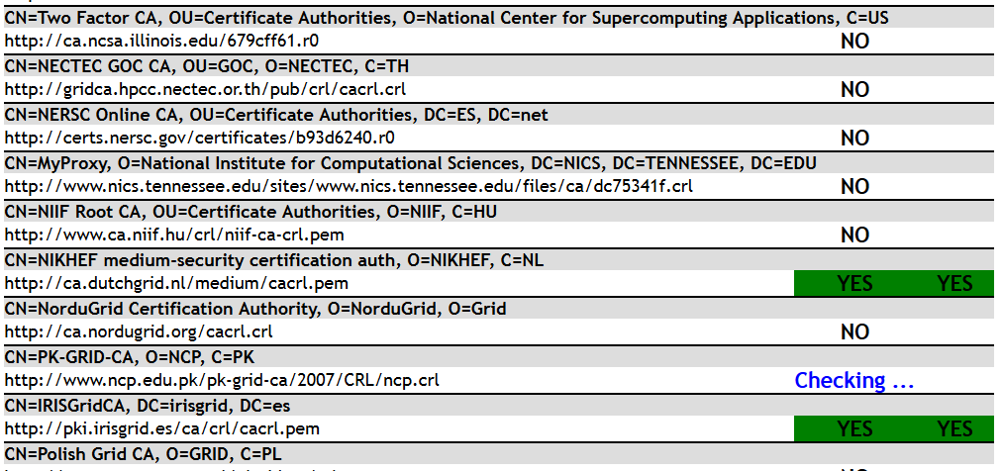
http://www.particle.cz/farm/admin/IPv6EuGridPMACrlChecker/

Slide 24
Private Key Protection Life Cycle
The (last) final changes were made to the private key protection guidelines document
http://wiki.eugridpma.org/Main/PrivateKeyProtectionLifeCycle
It supports all the use cases currently permitted under the PKP guidelines version 1.1, but it is better reflecting the key life cycles and clarifies the roles of the participants.

Slide 25
Wildcard naming
Although some TLS RFCs have defined a syntax for including wild cards in the subject (and subject alternative) names, only a few syntaxes actually work
CABforum guidance also limits what clients should consider acceptable
EUGridPMA Guidance on WIldcard naming
a single "*" wildcard character is allowed, only in the left-most subdomain element of an FQDN
each node (systems) must have its own key pair, although the same (wildcard) name may be associated with multiple certs based on those distinct key pairs
it is recommended to have a specific subdomain to which a responsible person is assigned

Slide 26
Naming and authority
There are also conceptual issues in validation (determining 'ownership‘ of the names)
This means that for e.g. a set of web load balancers, a subdomain
"web.example.org"
is created and a responsible person assigned thereto.
wild card certificates *.web.example.org" are then controlled by said responsible.
guidance on the permissible location of the "*" character should be added to GFD.225 (in progress)

Slide 27
Upcoming meetings

Slide 28
EUGridPMA Agenda
34th PMA meeting
11-13 May 2015 in Copenhagen, DK
EGI Engage conference: May 18-22, Lisbon, PT
REFEDS + TNC2015: June 14-18, Porto, PT
35th PMA meeting
open to co-hosting with AARC
otherwise: likely 7-9 September 2015
place tbd

