Slide 1
EUGridPMA
Status and Current Trends and some IGTF topics
June 2014
Lehi, UT, US
David Groep, Nikhef & EUGridPMA

Slide 2
EUGridPMA Topics
EUGridPMA (membership) status
Towards an African presence in the IGTF
Risk Assessment Team status
IPv6 readiness and fetch-crl
IGTF Repositioning
See summary at
https://www.eugridpma.org/meetings/2014-05/

Slide 3
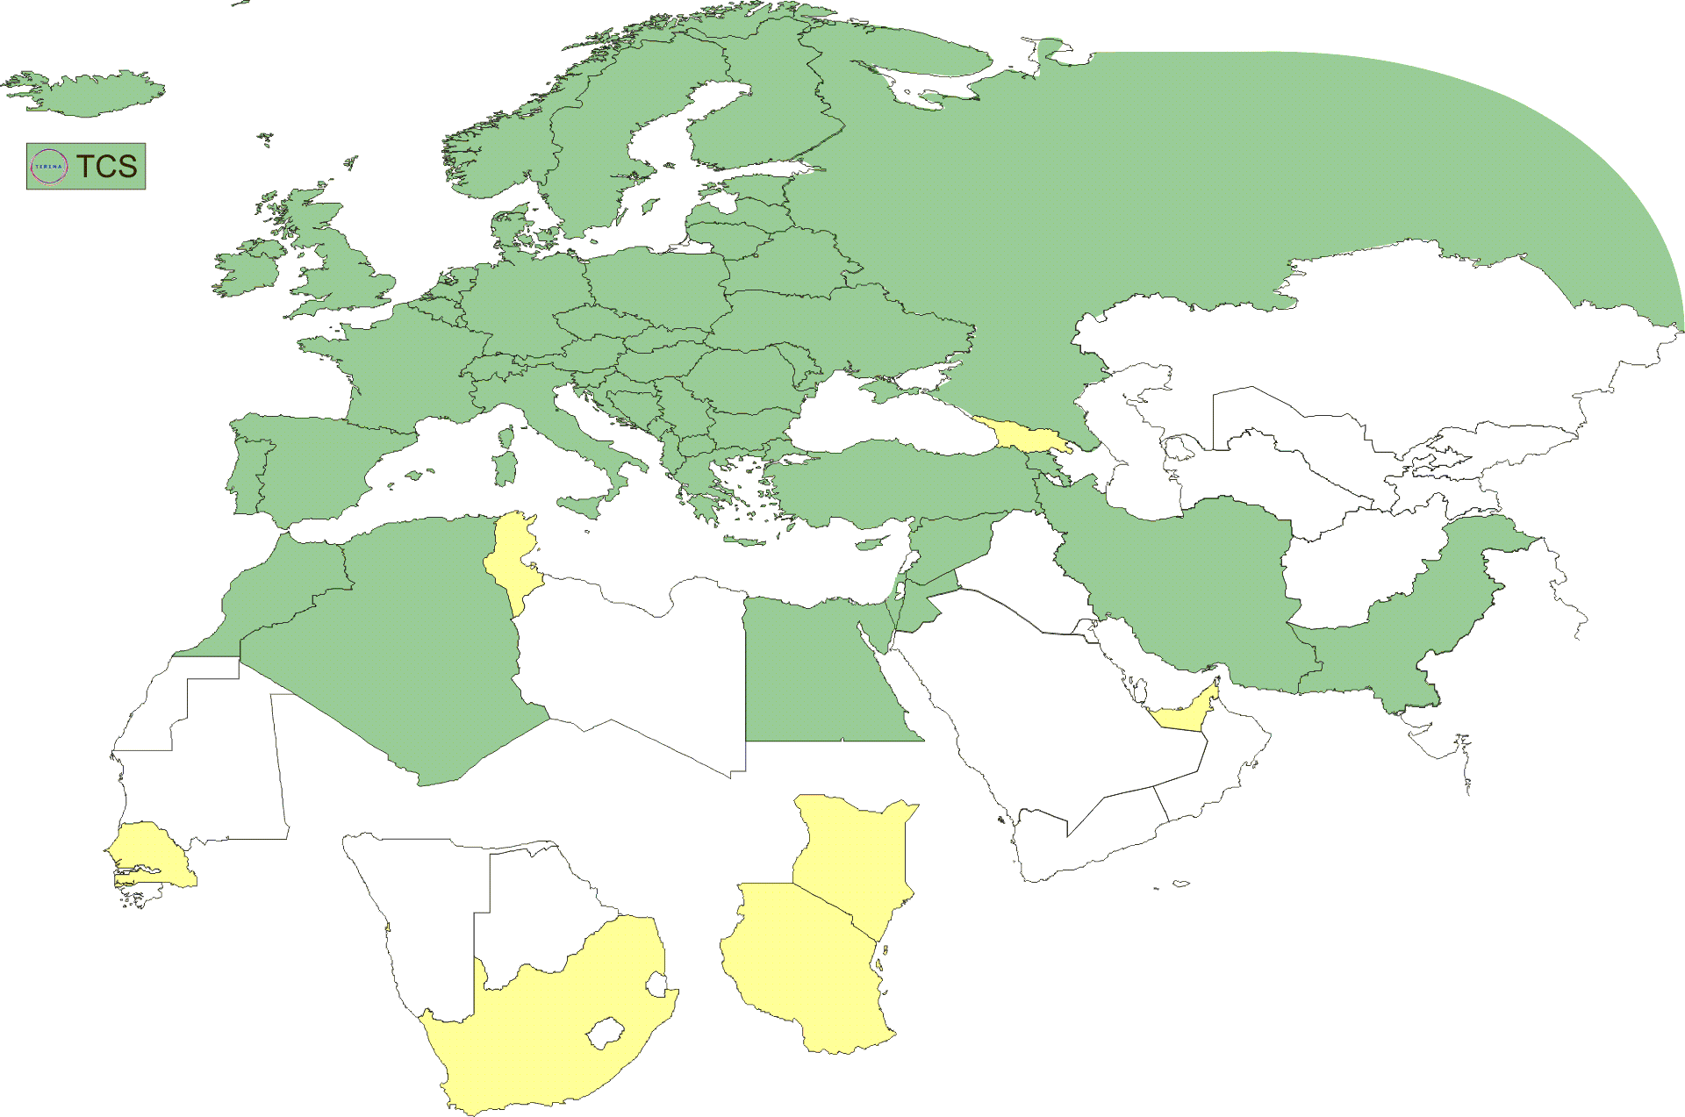
Geographical coverage of the EUGridPMA
25 of 27 EU member states (all except LU, MT)
+ AM, CH, DZ, EG, HR, IL, IR, IS, JO, MA, MD, ME, MK, NO, PK, RO,
RS, RU, SY, TR, UA, CERN (int), DoEGrids(US)* + TCS (EU)
Pending or in progress
ZA, KE, TZ, SN, TN, AE, GE

Slide 4
Membership and other changes
Responsiveness challenges for some members
  JUNET CA – suspended
  HIAST CA – keeps running (albeit with some connectivity issues)
CA reduction and growth
  More countries moved to TCS: IUCC IL, IE, …
  DoEGrids & ESnet decommissioned (as of 1.56 release)
  TCS tender ongoing, target start of overlap period summer 2014
  New CA in Georgia (Tblisi), many from UbuntuNet &c
Self-audit review
  Kaspars Krampis as dedicated review process coordinator
  Self-audits progressing on schedule for most CAs
  biggest challenge in getting peer reviewers to actually review

Slide 5
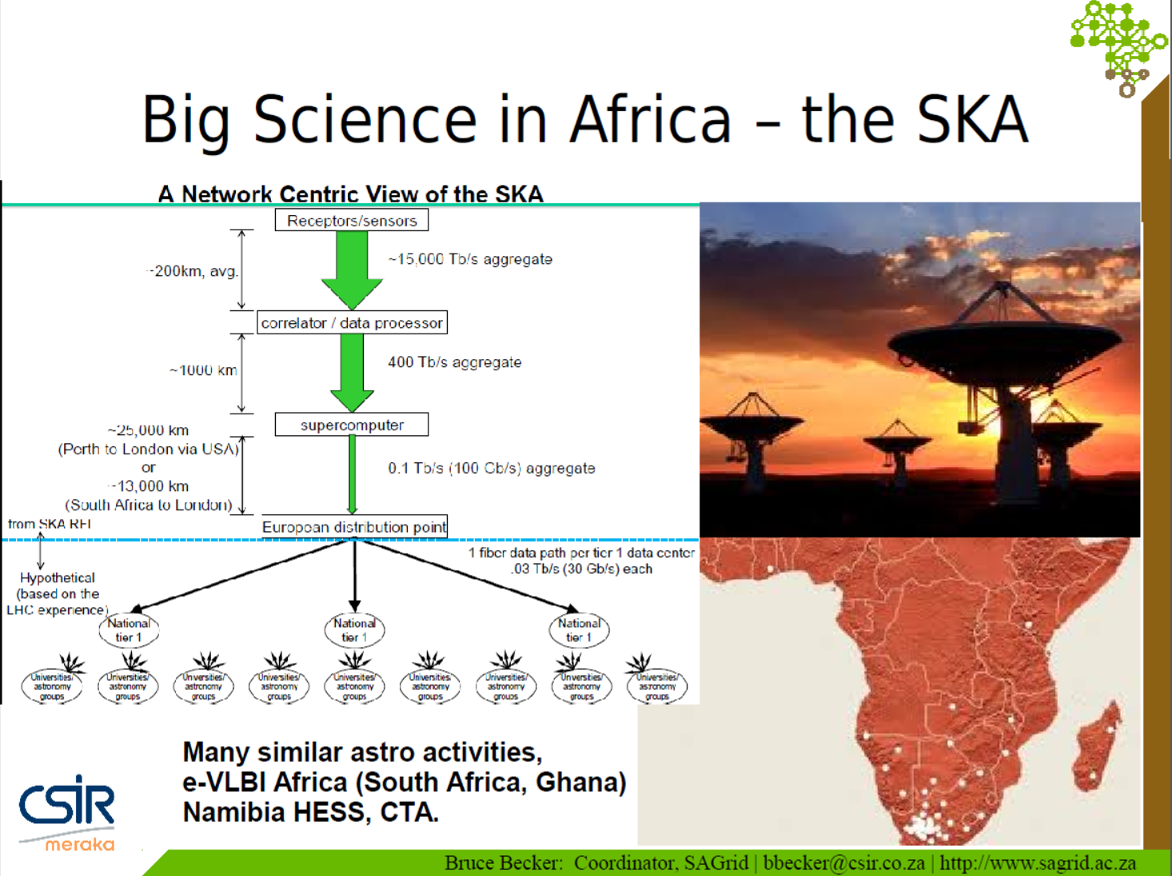
Activities in Africa

Slide 6
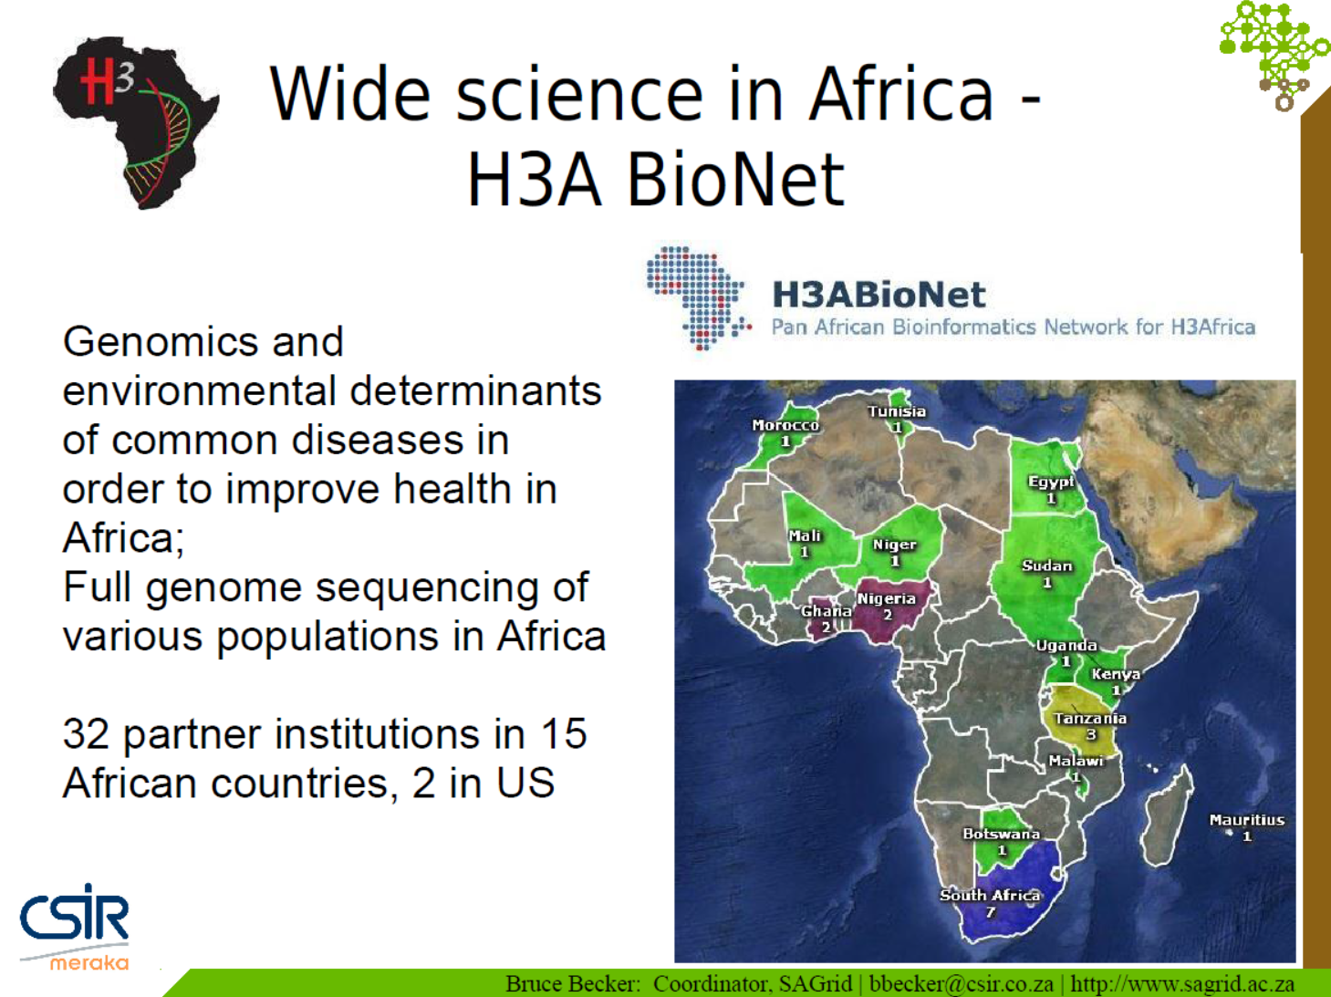

Slide 7
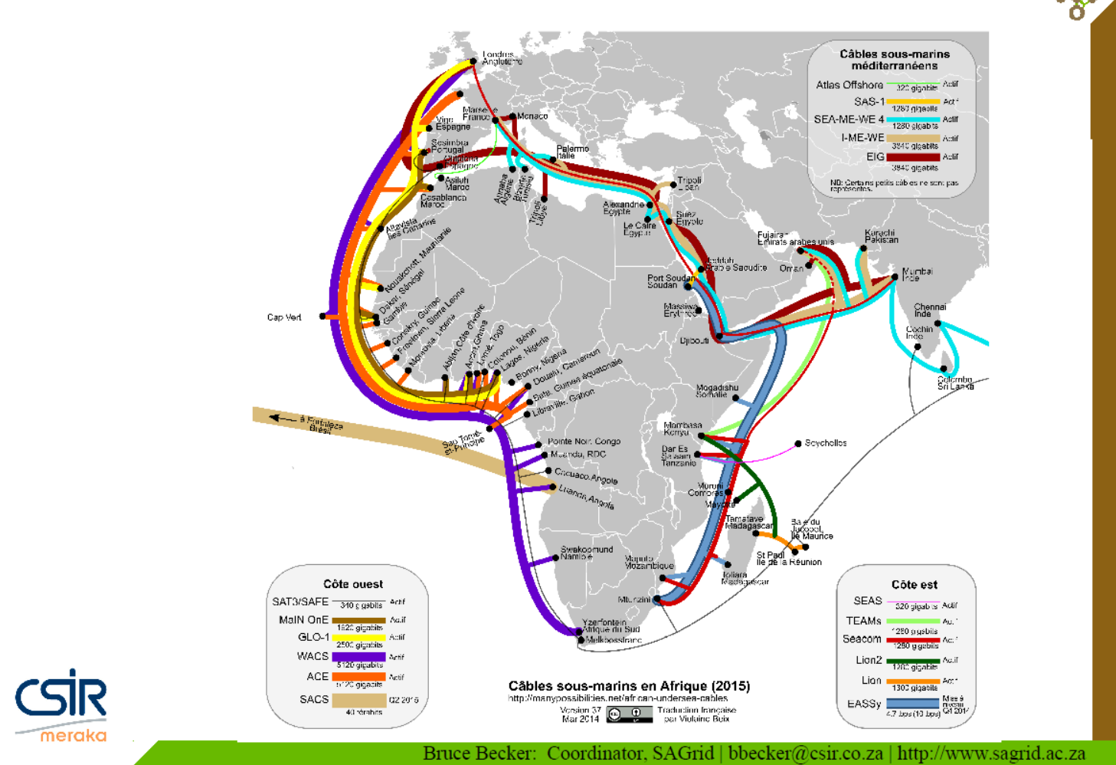

Slide 8
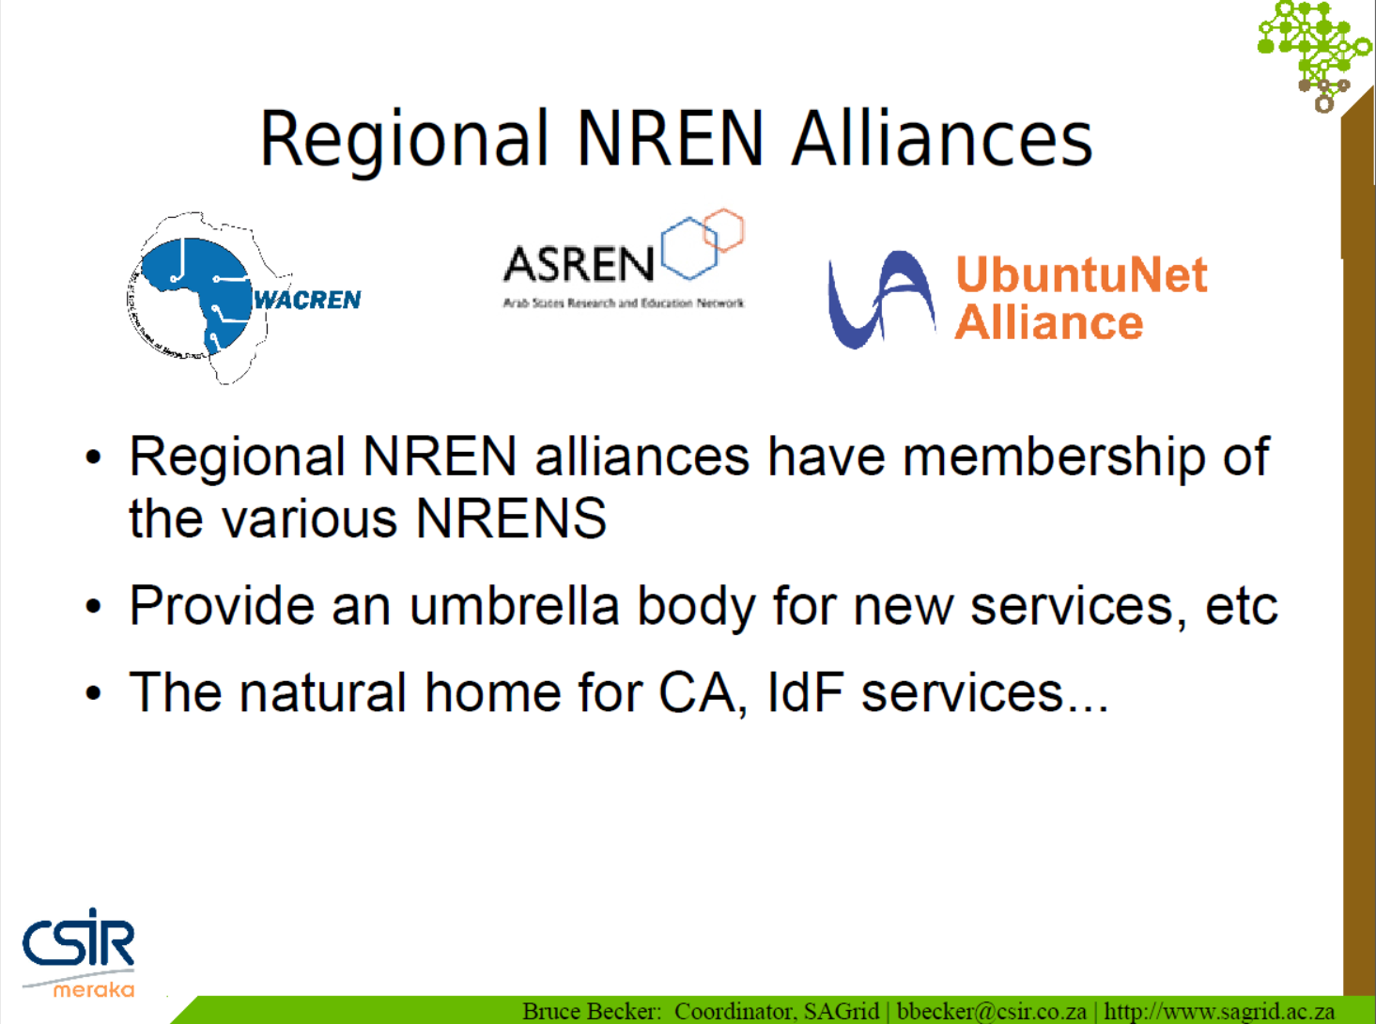

Slide 9
Current and upcoming CAs in Africa
In North-Africa and ASREN region already
Morocco, Algeria, Egypt
Coming soon
South-Africa, Kenya, Tanzania,
Senegal, Ghana, Nigeria, …
With e-Infrastructure help from incubator projects like CHAIN-REDS, eI4Africa, &c

Slide 10
Tartu summary on an ‘African PMA’
‘This activity (and the size of the continent and number of prospective authorities and projects in Africa) in itself merits the thought of establishing a dedicated PMA for Africa in the future, with preliminary actions to that effect mirroring the developments in the Americas with a dedicated 'chapter' ’
‘There is in the PMA quite wide support for an African PMA after the activities have been 'bootstrapped' and sufficient experience built up in the region to sustain the (effort intensive) review and accreditation processes. ’
‘The concept of having in the future (2 years or so) a identifiable African presence in the IGTF is supported by the EUGridPMA.’

Slide 11
Miscellaneous topics
RAT communications challenge
IPv6
Generalised MICS profile
Private Key Protection Guidelines v2.0
Heartbleed
On-line CA Architectures Guideline document
IGTF repositioning and new byline

Slide 12
RAT Challenge

Slide 13
RAT challange
Ursula Epting to conduct early June against all CAs
Timeline taking into account time zones
  4th June, Announcement of the test
  18th June, 10.20 h, Start of the test
  20th June, 14.50 h, Reminder for not replying CA's
  21th June, 10.20 h, End of the test
Request for
  Acknowledge receipt
  for each trust anchor

Slide 14
Results (2)
Furthermore 4 CA's replied later, after the official deadline
So in the very end 13 % did not reply at all.
This comes down to 11 CA's (with 'one CA' as 'one structure')

Slide 15
Results
Notice: automatic replies of e.g. ticket systems were not counted

Slide 16
Interpretation of the results
In a strict interpretation we can say that only 36 % fullfilled
the requirement to react within one business day –
while 74 % failed.
(Results communication test 2013:
76 % fullfilled the requirement - 24 % failed.
In a softer interpretation we can say that 57 % are responsive
while 43 % are not.

Slide 17
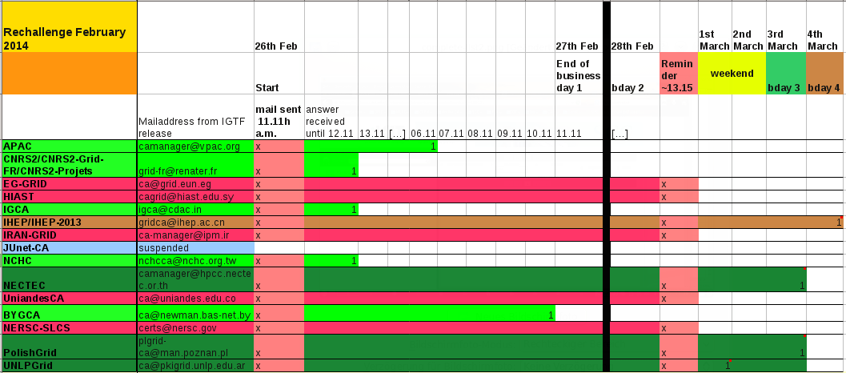
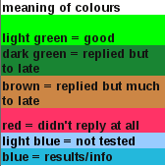
Complete List

Slide 18
Suggestion for improvement
The CA's not replying at all to the test should be contacted by their PMA-chairs.
An explanation about the failing should be provided to IGTF-RAT team
The reasons for failing should be eliminated.
~~~~~~~~~~
The communication test should be repeated - for all CA's – at the end of this year, so we get used to have a challenge once a year.
Notes:
Hier nochmal DG's mail pruefen und anregungen aufnehmen

Slide 19
IPv6

Slide 20
IPv6 status
FZU runs a continuous v6 CRL monitor
http://www.particle.cz/farm/admin/IPv6EuGridPMACrlChecker/
23 CAs offer working v6 CRL
  but there are also 4 CAs that give an AAAA record but where the GET fails …
  Still 71 endpoints to go (but they go in bulk)
  dist.eugridpma.info can act as v6 source-of-last-resort
fetch-crlv3 v3.0.10+ has an explicit mode to force-enable IPv6 also for older perl versions
  Added option "--inet6glue" and "inet6glue" config setting to load the Net::INET6Glue perl module (if it is available) to use IPv6 connections in LWP to download CRLs

Slide 21
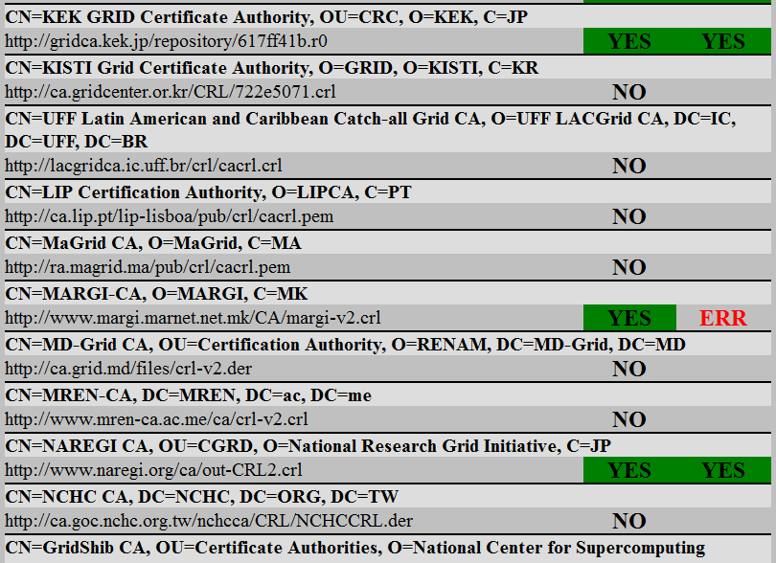
http://www.particle.cz/farm/admin/IPv6EuGridPMACrlChecker/

Slide 22
On-line CA architecture - guidelines
EUGridPMA will (finally) draft the "On line CA Guidelines”
based on current wording in the Classic profile
keep the network separation (models A or B, where A with a private link between RA and signing system preferred)
Allow import of a key pair into a token (taking it out of FIPS L3 mode) as long as there is a well-documented key generation and import ceremony
L2 HSMs allowed if compensatory controls are in place Keeping tokens and their systems in a solid safe-box and in a closed and locked cabinet in a monitored machine room is considered adequate
Keys are permanently activated anyway, so L3 mode (separate usage functions like generation or use) is not used for our purposes
Activation on boot should be manual (so the operator must be required to be present)

Slide 23
Generalized MICS profile?
In line with the new IGTF byline, it would be beneficial to 'generalise‘ the current MICS profile and turn it into a pure LoA document describing the requirements on identity authorities (IdPs or CAs) given needs of the relying parties and SPs. Since the MICS is the closest one to the current federation model, it is the appropriate starting place.
Unfortunately, the PMA meeting at this point ran out of time, so the details are deferred to the next meeting. In particular, we would like to ask the TAGPMA (the 'hosts' of the MICS profile) to consider this discussion for the next TAGPMA meeting in Lehi.
The generalisation would imply:
- removal of the PKI specific bits of the text
- recast it as a 'Level of identity Assurance' text, representing the coordinated (harmonized) consensus of the relying party expectations and requirements
- be complementary (and not overlap with) the SCI requirements
This will then complement the (lower) IOTA level, which is already almost technology-agnostic.

Slide 24
Private Key Protection Life Cycle
The (last) final changes were made to the private key protection guidelines document
http://wiki.eugridpma.org/Main/PrivateKeyProtectionLifeCycle
It supports all the use cases currently permitted under the PKP guidelines version 1.1, but it is better reflecting the key life cycles and clarifies the roles of the participants.

Slide 25
Heartbleed
Surprisingly few revocations! Why??
The operational readiness of the CAs was increased once the vulnerability was known and the RPs were happy with the quick service received.
The OpenSSL disclosure process has improved

Slide 26
In the future …
quiet consensus that the authorities are willing to work operationally with the CSIRT teams to get issues resolved quickly (the IGTF typically sees a 'different side' of the issue, and has other ways to contact the subscribers)
sharing testing tools proactively on the mailing lists is encouraged.
These will not be publicly shared but remain within the IGTF trust circle.
We will use the Wiki (PMA member access only!) to share such tools and restricted information
the IGTF can also scan itself – some infrastructures (EUDAT) may never have scanner from the RP side
message templates for subscribers can also be shared (again on the Wiki)

Slide 27
On-line CA Architecture Doc
The on-line CA guidelines document was not discussed due to lack of time, but everyone is encouraged to review the draft available at
https://wiki.eugridpma.org/Main/GuidelinesForOnLineCAs
If access to the Wiki is not possible, please send your DN to the EUGridPMA operations folk (info@eugridpma.org) to get your account activated on the Wiki. Read-only access (through plain http) is open to the whole world.

Slide 28
IGTF Repositioning

Slide 29
IGTF in 10 years from now …
Attributes and authorization becoming more important
mere identity authentication is likely to become commonplace in the years to come (academic federations, commercial ID providers, etc.)
But authorization, (community) assured attributes, and attribute composition are unsolved for research:
the IGTF can reposition itself to address these new challenges
anyway consolidation of federations in the research and academic space means that there need be less emphasis on the classical CA work

Slide 30
Already ongoing …
AA Operations Guideline
Guideline on Trusted Credential Stores
IOTA as a basis for community-provided assurance

Slide 31
Beyond the current framing:
IGTF as a brand, not an acronym
Proposal
IGTF be no longer considered an acronym, but be treated as a word where we can associate it with a more appropriate byline.
Based on an extensive discussion by those present, it was concluded that a proposal be circulated to the other PMAs with a new 'byline':
IGTF: Interoperable Global Trust Federation
supporting distributed IT infrastructures for research

Slide 32
A new motto and mission …
"The IGTF –through its members– develops guidance, coordinates requirements, and harmonizes assurance levels, for the purpose for supporting trust between distributed IT infrastructures for research.
This goal is accomplished by the members of the IGTF through coordination of providers of trust information (authorities) and consumers thereof (relying parties) and by adoption of common standards, minimum requirements, and best practices for policy, technical security, and operational trust.“
Needs a revised charter - draft done in EUGridPMA, can we converge here this week?
https://wiki.eugridpma.org/Members/IGTFFederationDocument

Slide 33
If you concur …
Update IGTF Federation Document (Charter)
Revise IGTF logo and web site – done
Encourage wider participation in the IGTF, in particular by relying parties and infrastructures, with an emphasis on those having operational (security) aspects and/or representing relying user communities
  role to play for 'catch-all' cases as well? – many of the current organisations and authorities also work 'bottom-up’ serving limited numbers of researchers across a large number of institutions (with a few people each) –
  this is not traditional use case for Refederations … but it is for commercial IdPs

Slide 34
IGTF Web Site
Ongoing, some changes already done. Proposed
public-facing (RP, general public) function should be separated from any internal use
  primary audience is RPs and 'general' public
  it should include a section for 'our own' integral IGTF use with links, agenda, &c
add an introduction for 'humans'
  links to interviews and (iSGTW-like) articles about IGTF
  everyone to send these to <webmaster@igtf.net>
  add a 'news' box with current information (to change monthly or so).
Make map more prominent
  The mini-map should link to a PMA page with a click-able map or membership list
  encourage TAGPMA and APGridPMA to maintain a list of their meeting that can be linked to

Slide 35
Review the draft charter this week …

Slide 36
Upcoming meetings

Slide 37
EUGridPMA Agenda
32nd PMA meeting
8-10 September 2014 (Poznan, PL)
33rd PMA meeting
12-14 January 2015, Berlin, DE (offered by DFN)

