Slide 1
Information Security Management in the EOSC Future SMS evolution
January 2023

Slide 2
Goal of Information Security Management (ISM)
“ensure confidentiality, integrity and availability”
“protecting sensitive data from threats and vulnerabilities”
In our heterogeneous EOSC at large, founded on subsidiarity, this translates to
primum non nocere: do no harm to interests & assets of users
not expose other service providers in the EOSC ecosystem to enlarged risk
as a result of their participation in EOSC
be transparent about infosec maturity and risk to its customers and suppliers

Slide 3
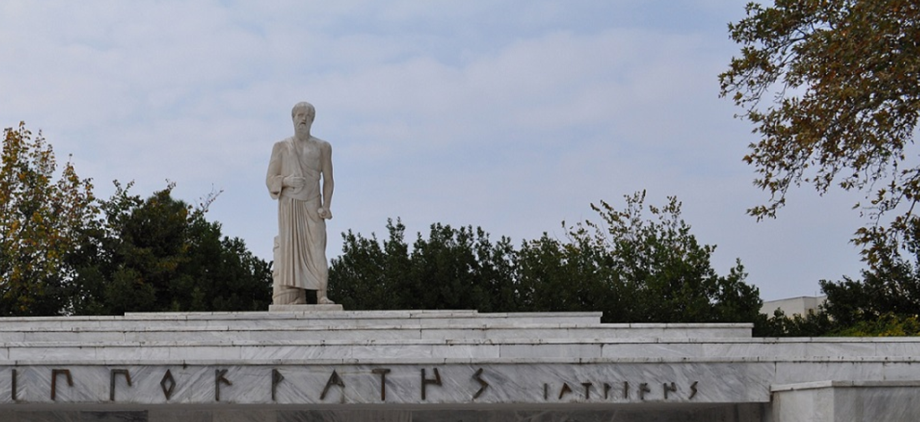
The basic tenets for EOSC ecosystem security
A service provider should
do no harm to interests & assets of users
not expose other service providers
in the EOSC ecosystem to enlarged risk
as a result of their participation in EOSC
be transparent about its infosec maturity and risk to its customers and suppliers
From promoting and monitoring capabilities
to managing core risk
Photo Hippokrates tomb: Melania Stubos, CC-BY-SA-3.0
http://himetop.wikidot.com/hippocrates-funeral-monument
this means some minimum requirements in the EOSC Core … and Exchange

Slide 4
How the security coodination team supports a trusted EOSC
Risk-centric self-assessment framework
Baselining security policies & common assurance
An incident coordination hub and a trust posture
Actionable operational response to incidents
AARC, REFEDS, IGTF, PDK & practical implementation measures
EOSC core expertise to support resolution of cross-provider issues
spanning providers and core, based on experience & exercises
based on federated InfoSec guidance including WISE SCI
Fostering trust through a known skills programme
so that your peers may have confidence in service provider abilities
WISE SCI: wise-community.org/sci
AARC&c: aarc-community.org, refeds.org, igtf.net
PDK: aarc-community.org/policies/policy-development-kit

Slide 5
How the Information Security Process helps
EOSC ISM differentiates between Core and Exchange
Core: mandatory adherence (and pro-active support from the security team)
since the security of the Core services underpins the whole EOSC ecosystem
Exchange: based on Interoperability Framework (& ‘RFC2119 RECOMMENDED’)
Participants are autonomous
but subscribe to shared commitment of maintaining trustworthy & secure EOSC
We need everyone’s help in incident response and ‘drills’ (that also a lot of fun!)
for the Core services, expert forensics support is provided for if desired
in the Exchange, coordination and liaison are the primary tasks of the CSIRT
but the EOSC CSIRT will of course help where it can!

Slide 6
Structuring security for the EOSC
Information security risk assessment framework based on SCI and a maturity model – targeting connected services as well as data, and correlated risks
Coordinate security policies for a baseline aligned with the Rules of Participation of the EOSC, and the EOSC AAI federation – ensuring transparency for the ‘risk appetite’ of the participants
Mechanisms for coordination and resolution of incidents through Information Security Management (ISM) processes – leveraging WISE community and Sirtfi, and enabling the (tested) framework for information sharing
Security operations and incident response capabilities related to or affecting the EOSC Core (in relatively broad sense) - with content and service providers

Slide 7
Information Assets in the EOSC
Subsidiarity
core service providers are subject to the EOSC Core Agreement, but the operating entities are the primary responsible for their own services
exchange service providers bring their own (existing) services, and join based on the EOSC Rules of Participation, the On-boarding Agreement, and the AAI
Hence the assets that the EOSC Security sees are services,
including the data and digital objects they manage, but
not their hardware, service components, middleware, or people
this provides the touchstone for the ISM policies, following the EOSChub model

Slide 8
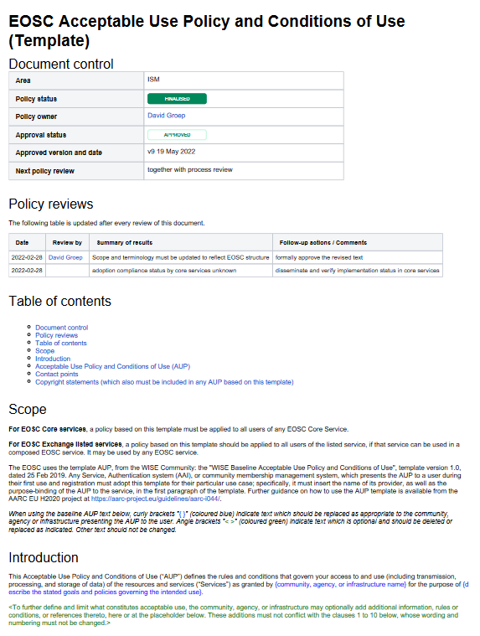
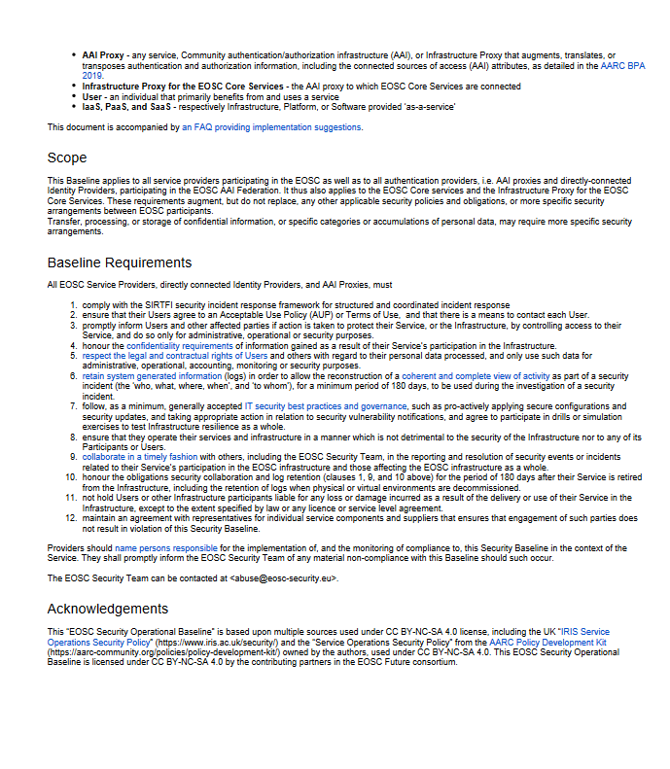
Policy – a baselining approach for AUP and Operations
Users don’t like to click! So show a common baseline AUP for most services - only once
Common AUP (based on WISE AUP) – required for core services to ensure consistency, strongly recommended for all services and for community AAI proxies
EOSC Security Operational Baseline
a mere 12 points that make you a trustworthy provider organisation towards your peers and the EOSC

Slide 9

EOSC Security Operational Baseline
Co-development of EOSC Future & AARC Policy Community
version based on UK-IRIS evolution of the AARC PDK
specifically geared towards the looser EOSC ecosystem
mindful of urgent need for collective coherent response
EOSC consultation together with AEGIS, AARC, and GEANT EnCo
complemented by an ‘FAQ’ with guidance and references, but
no new standards: ‘there is enough good stuff out there’
leverages Sirtfi framework
part of the EOSC SMS, endorsed by TCB, in Core Participation Agreement
submitted as part of the EOSC I/F
Joint input to the new WISE AARC Service Operational Policy work in SCI?

Slide 10
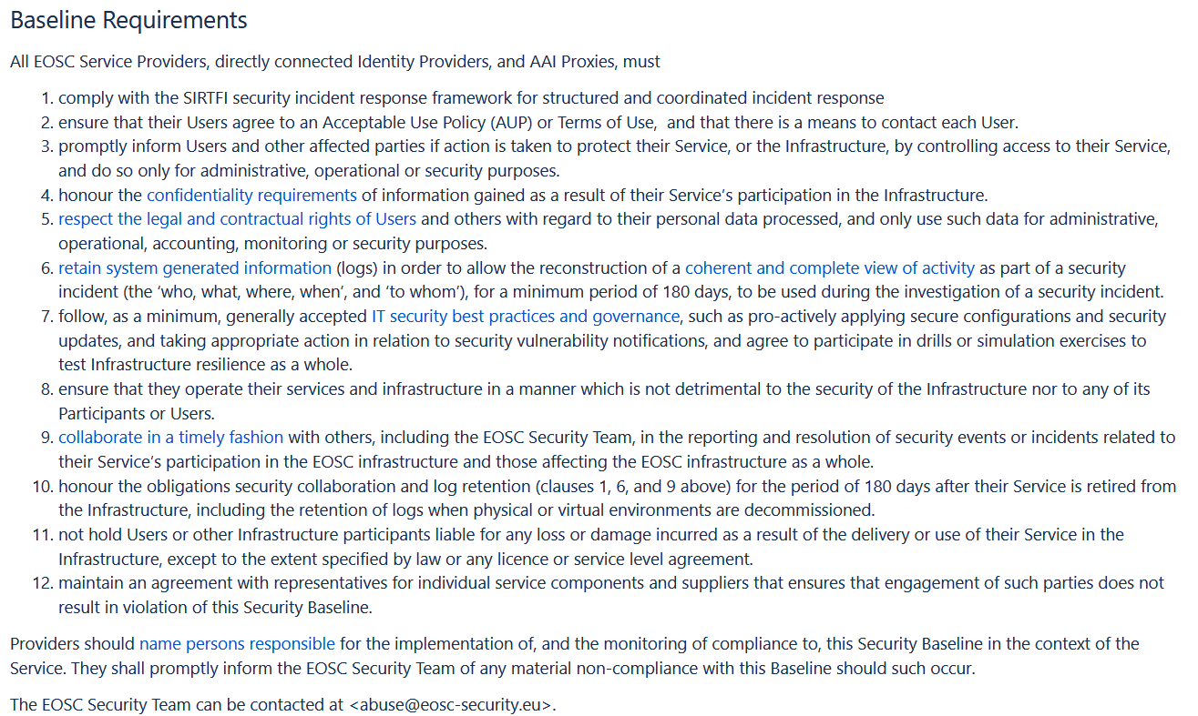
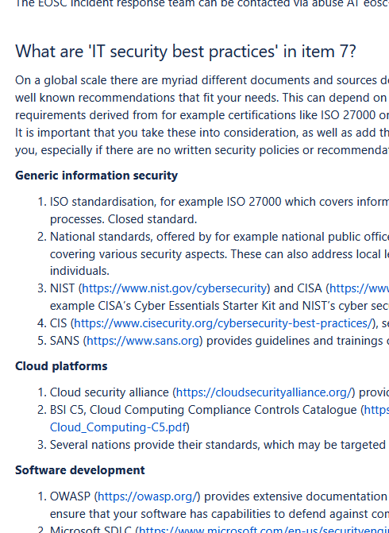
EOSCSMS – EOSC Security Operational Baseline & FAQ
https://wiki.eoscfuture.eu/display/PUBLIC/EOSC+Security+Operational+Baseline

Slide 11
FitSM SMS ISM Audit
December 19th, 2022

Slide 12
FitSM ISM - identified roles
The key role is the CSIRT at abuse@eosc-security.eu
Of course there are real people, but for long-term stability and tracking only generic addresses should be used for communication
CSIRT central team: Pau, Daniel, DavidC
ISM processes and (public) procedures: Alf, DaveK, SvenG, DavidG
ISM Policies: DavidG, DaveK, Ralph, Alf, IanN,
ISM Risk Assessment process: Urpo, Linda, DaveK, IanN, JoukeR

Slide 13
FitSM ISM Requirements
PR6.1: two information security policies defined, following initial suitability assessment
PR6.2: security controls defined at asset level through the Security Operational Baseline, as included in the Core Service provider agreement, the EOSC AAI federation requirements, and (to be) the EOSC I/F
PR6.3: annual review foreseen together with process review
PR6.4: both general security events (ISM.6) and emergency incidents (under ISM.1) are treated with appropriate priority.
PR6.5: consistency is delegated to the (core) service providers, subject to the EOSC AAI and the risk assessment. Risk assessment methodology defined but procedures not implemented yet.

Slide 14
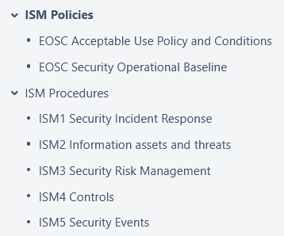
ISM SMS structure
start with just 2 policies
and 5 procedures
Supported by
a ‘comms challenge’ as a KPI
that we can track (~2x per year)
standing CSIRT response team
security ‘events’ monitoring & triage
(to align with FitSM)

Slide 15
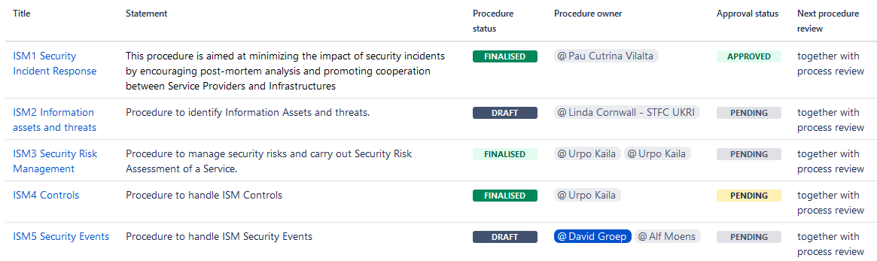
ISM Procedures – at various stages of maturity

Slide 16
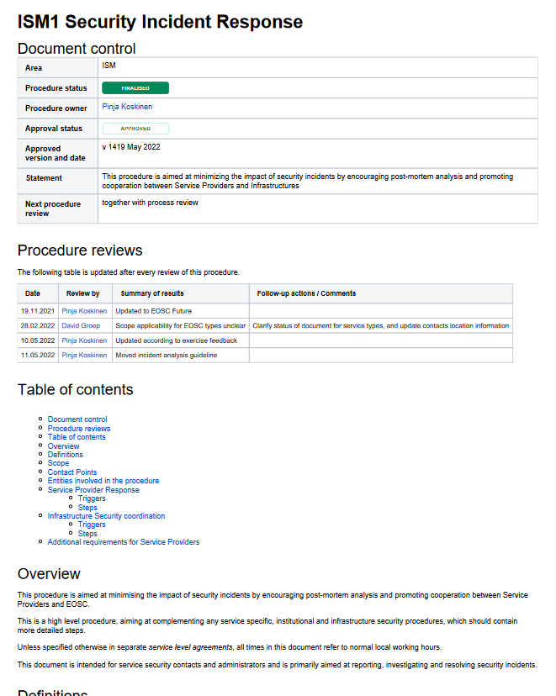
Procedures for incident response
Two parts to the incident process
This (public) ISM1 response procedure
Focussing on interaction between central CSIRT and the provider organisation
Ingress from Zammad and by mail
There is a 2nd element …
an internal detailed technical note, focussing on the team interaction within the CSIRT (how to use RT, mail templates)
The internal note is private, as it contains quite a lot of confidential address information

Slide 17
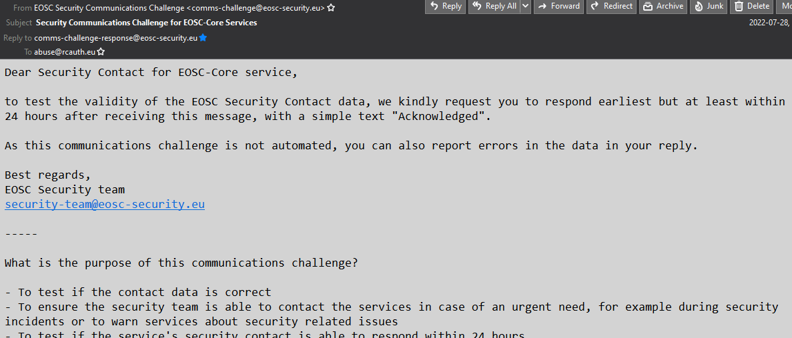
Communications challenges (~ 2x per year)
You already got the mail with the simple question for contact data fixes
response can be done by email
verifies the security contacts
(and proved useful already)
The request to join as a “volunteer for
tabletop exercises ” will come
– a great way to get prepared for the future multiplayer RPGs
Participation in drills or simulation exercises to test Infrastructure resilience as a whole is necessary (and part of the Baseline …)

Slide 18
KPIs
ISM.1 | Average number of actions, per incident, taken during incident handling not following procedures (exceptional actions):Actions not covered by any procedure Procedure covering actions incorrect | By the debriefing at quarterly F2F meeting, which reviews all the records registered in our ticket tracker: - Number of actions is counted during the debriefing on each incident | Incidents are reviewed at each F2F meeting of the Security Operations Team (3 or 4 times per year). | NA | January 2023 | greater than 3
ISM.2 | Time, accumulated over sites, between EOSC Security Team being notified and affected service providers taking actionMeasures delay introduced by EOSC Security Team procedures Measures clarity of messages sent (broadcast or targetted) to sites | By the debriefing at quarterly F2F meeting, which reviews all the records registered in our ticket tracker: - Time is the difference between each update from user and following response from us (unless it was pending information from someone else) and between when we get information and we create other tickets | Incidents are reviewed at each F2F meeting of the Security Operations Team (3 or 4 times per year). | NA | January 2023 | not applicable
ISM.3 | Number of communications challenges run against the EOSC-Core providers | Counting runs | 2 per year | 2 | October 2023 | less than 1

Slide 19
Maturity & actions – now @level 2: partially complete
Action | Person responsible | Due date | Status
Rename file with process abbreviation and review date (e.g. CSI-2022-09-07.docx) and attach to SMS Process Reviews page | [Process Manager] | 2022-12-20 | Done, 2022-12-13
Review by process owner | [Process Owner] | 2022-12-19 | Done, 2022-12-14
Risk management procedure will be revised and registry established based on the self-assessment/questionnaire model following WISE RAW-WG methodology Includes tracking assets (i.e. services) through the registry. | @Urpo Kaila | 2023-08-31 | Ongoing
Security Event procedure (ISM.5) will be validated and exercised | [Security Incident Coordinator], @Alf Moens | 2023-02-01 | Ongoing
Security Controls review – following risk assessment | @Urpo Kaila, [Security Incident Coordinator] | 2023-08-31 | Ongoing
Security Incident Response weekly coordination meetings will resume once staff returns | [Security Incident Coordinator] | 2023-01-01 | Ongoing

Slide 20
Known action items
Complete procedures 2 .. 5!
Risk assessment for the ticketing system itself
Risk assessment for the security ticketing system has identified relevant risks, but these have not yet been rated (or mitigations been assessed)
Coordination meetings had been suspended
Weekly update meetings have been suspended from August 2022 until January 2023 until new staff commences. Operational activity continued as scheduled.
SMS Report at https://wiki.eoscfuture.eu/display/EOSCSMS/ISM+Reports

Slide 21
Audit process itself
4.8. Information Security Management
(FitSM-1, PR6)
Audit evidence:
(EV) SIRTIFI framework
(EV) EOSC Security Operational Baseline (Confluence)
(EV) ISM3 Security Risk Management (Confluence)
(EV) WISE Risk Assessment framework
(EV) IR maptable exercise
(EV) ISM1 Security Incident Response (Confluence)
(EV) ISM5 Security Events (Confluence)
(EV) ISM KPI (Confluence)

Slide 22
Audit findings
Classification Finding
(SR) The development of a risk management approach (and tooling) to be applied as part of the information security management process is still work in progress and should be further promoted.
(H) It could be considered to add another KPI, based on KPI ISM.3, to report on the results of the communication challenges (e.g. number of challenges where the security contact did not respond within the required period of time).
(H) It could be reviewed, to which extent additional Information security aspects and requirements can or should be added to the EOSC interoperability framework and the provider / service onboarding process.

Slide 23
Risk Assessment Methodology
Audit Finding ISM#3

Slide 24
Security Frameworks
There are many of these out there:
NIST Cyberframework (https://www.nist.gov/cyberframework),
mapping to ISO27k2, NIST SP800-53, and others
ISO27k10 (multi-domain messaging and information exchange)
builds strongly on 27k2, so is not quite the ‘light weight’ option we look for

Slide 25
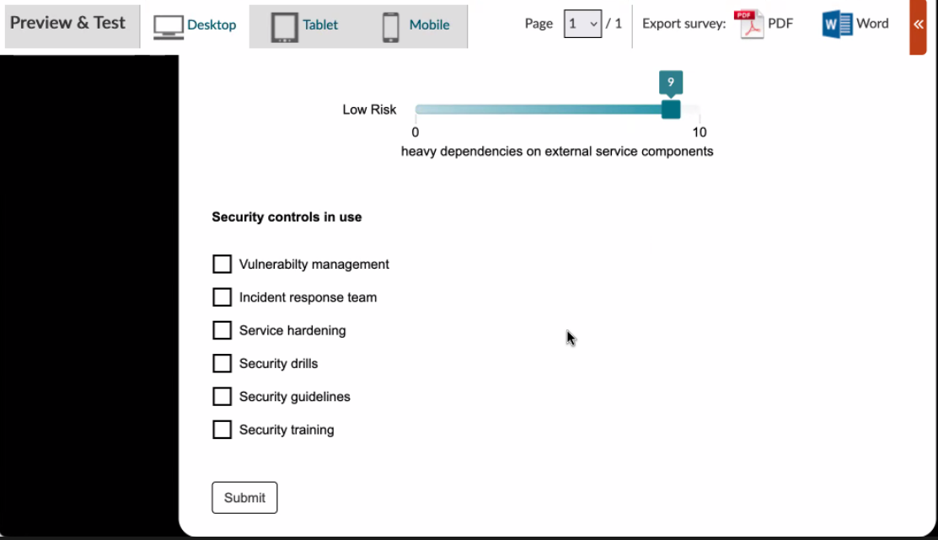
Risk Management Framework
We do have the framework based on SCIv2 and the Risk Assessment WG
Simple risk assessment questionnaire almost complete (on webropol), and
core service providers will be requested to answer (and discuss) the questions
We will use a reference community to evaluate the risk-assessment approach for the EOSC Exchange (using SKA as a ‘fresh’ example community)

Slide 26
Planning the rest of EOSCF
For D7.5b in M27 (June 2023)

Slide 27
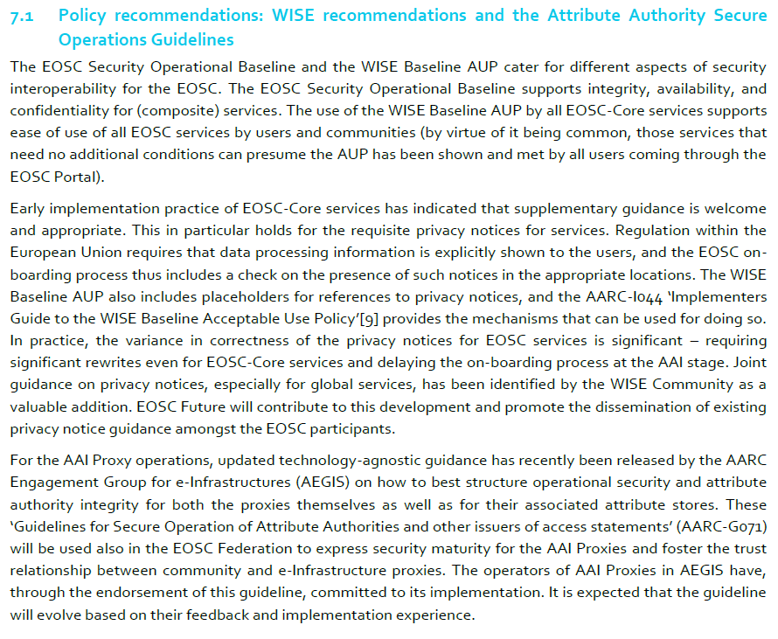

Slide 28
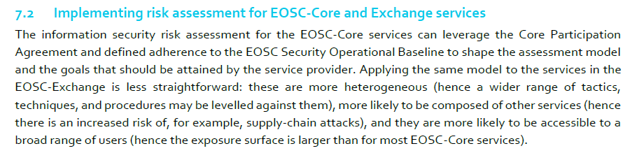
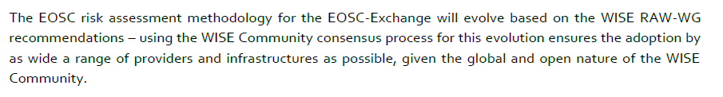
Risk …

Slide 29
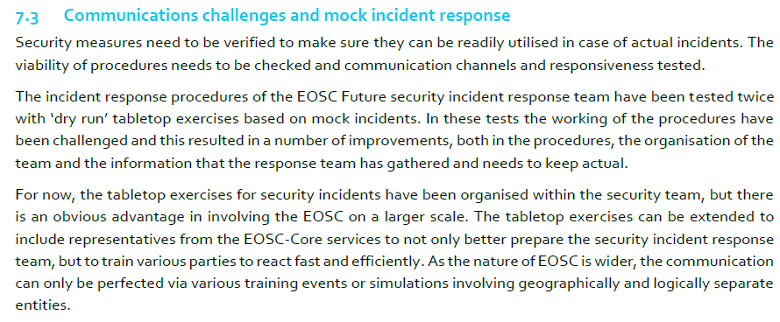
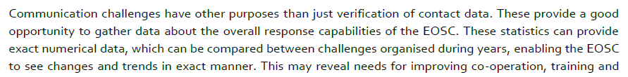
Processes and exercises

Slide 30
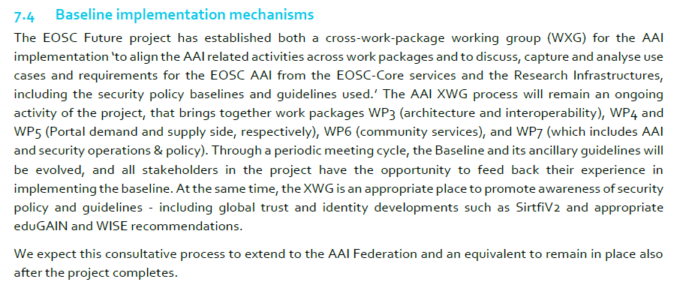
Baselines

Slide 31
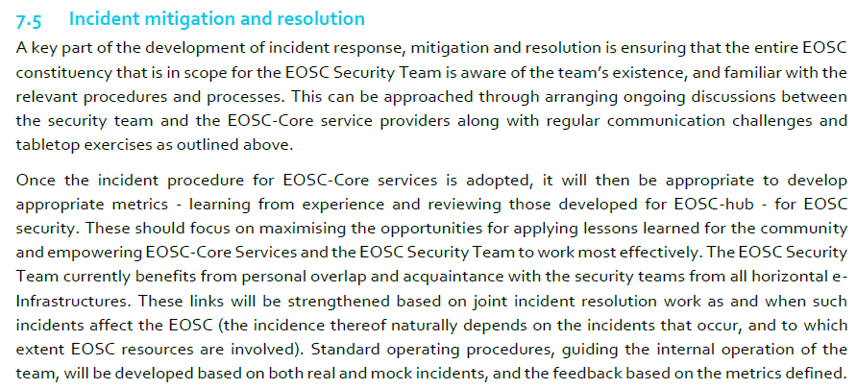
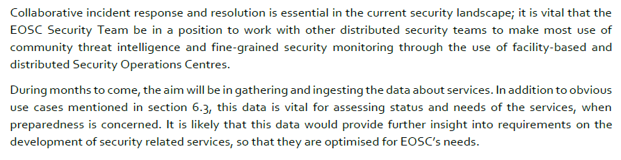

Slide 32
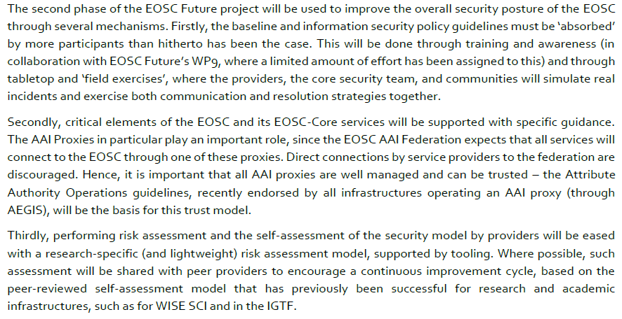
What we anticipated in D7.5a

Slide 33

Discussion time!
Thanks to the EOSC Future WP7.5 collaborators: Alf Moens, Daniel Kouřil, Baptise Grenier, David Crooks, David Groep, David Kelsey, Ian Neilson, Linda Cornwall, Matt Viljoen, Pau Cutrina Vilalta, Ralph Niederberger, Romain Wartel, Sven Gabriel, and Urpo Kaila.
eoscfuture.eu

Slide 34
Evolving Security and Trust for attribute sources & proxies
Beyond the baseline:
supporting interoperable trust for the EOSC Federation
Community membership management directories and attribute authorities
integrity of membership
identification, naming and traceability
site and service security
protection on the network
assertion integrity
Image source: AARC Community
https://aarc-community.org/architecture/

Slide 35
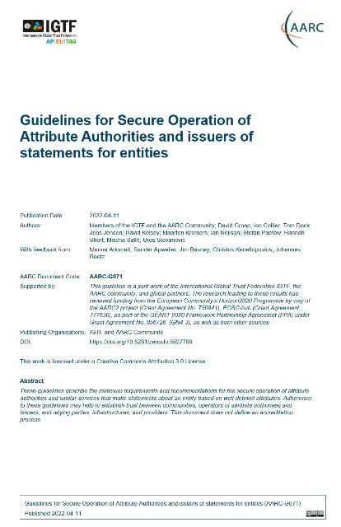
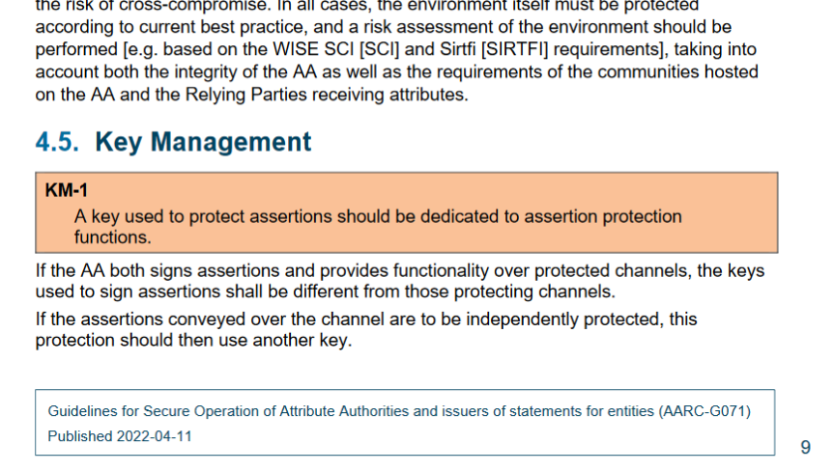
Specific guidance and implementation recommendations
Following the IGTF “Annotated Requirements” model, each statement is accompanied by implementation guidance.
Technology neutral, i.e. both push and pull* models are in scope
aarc-community.org/guidelines/aarc-g071
https://doi.org/10.5281/zenodo.5927799
* see RFC2904 for the model descriptions

Slide 36
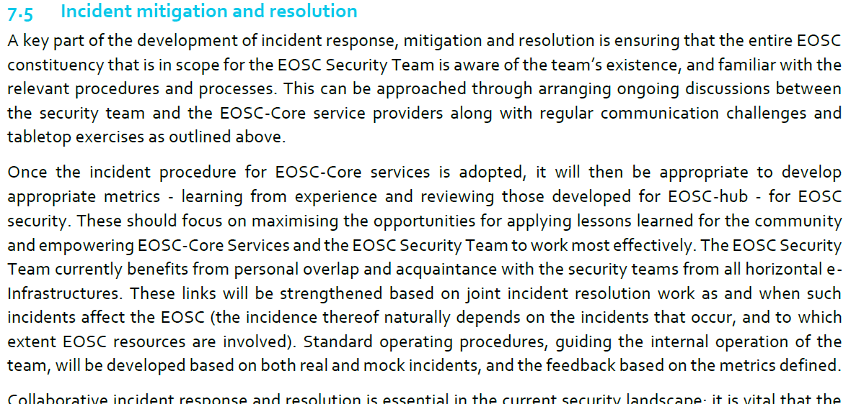
For incident response
https://wiki.eoscfuture.eu/display/EOSCF/D7.5a+Evaluation+of+EOSC+Security+Baseline

