Slide 1
EOSC: a secure and trusted place to reside
EOSC Symposium, November 2022
David Groep – WP7.5 Security Operations and Policy lead Nikhef Physics Data Processing programme
UM Department of Advanced Computing Sciences, Faculty of Science and Engineering

Slide 2
Security is a means – a way to support the EOSC mission
“ensure confidentiality, integrity and availability”
“protecting our data and services from threats and vulnerabilities”
and in our interconnected EOSC, also security is a collective responsibility
and also an opportunity to collaborate and improve our posture together

Slide 3
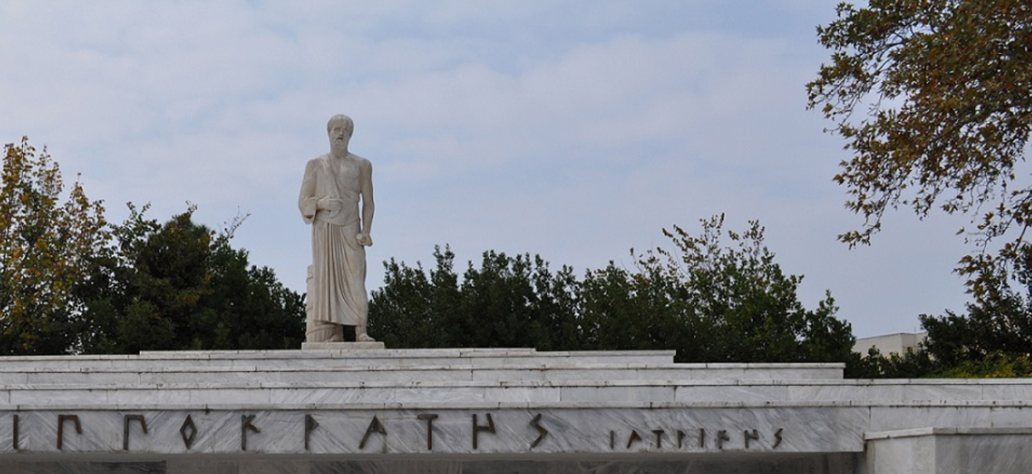
The basic tenets for EOSC ecosystem security
A service provider should
do no harm to interests & assets of users
not expose other service providers in the EOSC ecosystem to enlarged risk as a result of their participation in EOSC
be transparent about its infosec maturity and risk to its customers and suppliers
From promoting and monitoring capabilities to managing core risk
Photo Hippokrates tomb: Melania Stubos, CC-BY-SA-3.0 http://himetop.wikidot.com/hippocrates-funeral-monument
this means some minimum requirements in the EOSC Core … and Exchange

Slide 4
Keeping the EOSC secure
baselining is a true & tried approach to improve collective security posture
minimum requirements to ensure a collective response and to prevent miscreants to hide in unmanaged corners of the system
leverage collective knowledge and capabilities that each provider already has ‘baseline’ is just that – only the provider really knows the inner sensitivities of each service or data set
supported by expert fall-back in case incidents happen (and they do happen!)

Slide 5
How the security coodination team supports a trusted EOSC
Risk-centric self-assessment framework
Baselining security policies & common assurance
An incident coordination hub and a trust posture
Actionable operational response to incidents
AARC, REFEDS, IGTF, PDK & practical implementation measures
EOSC core expertise to support resolution of cross-provider issues
spanning providers and core, based on experience & exercises
based on federated InfoSec guidance including WISE SCI
Fostering trust through a known skills programme
so that your peers may have confidence in service provider abilities
WISE SCI: wise-community.org/sci AARC&c: aarc-community.org, refeds.org, igtf.net PDK: aarc-community.org/policies/policy-development-kit

Slide 6
How the Information Security Process helps
EOSC ISM differentiates between Core and Exchange
Core: mandatory adherence (and pro-active support from the security team) since the security of the Core services underpins the whole EOSC ecosystem
Exchange: based on Interoperability Framework (& ‘RFC2119 RECOMMENDED’)
Participants are autonomous
but subscribe to shared commitment of maintaining trustworthy & secure EOSC
We need everyone’s help in incident response and ‘drills’ (that also a lot of fun!)
for the Core services, expert forensics support is provided for if desired
in the Exchange, coordination and liaison are the primary tasks of the CSIRT but the EOSC CSIRT will of course help where it can!

Slide 7
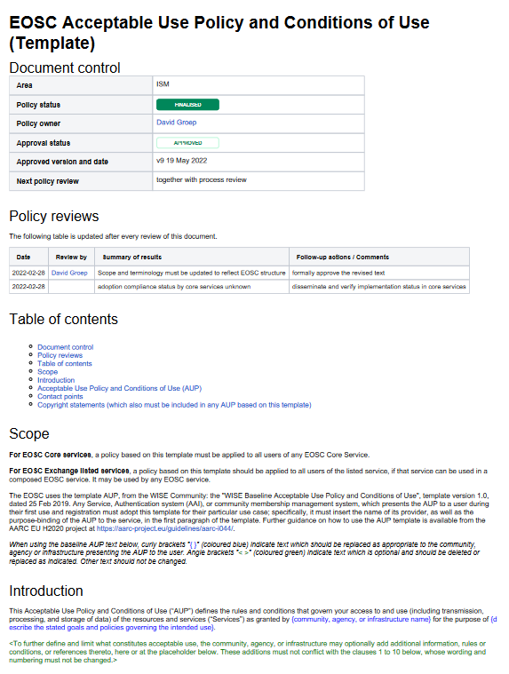
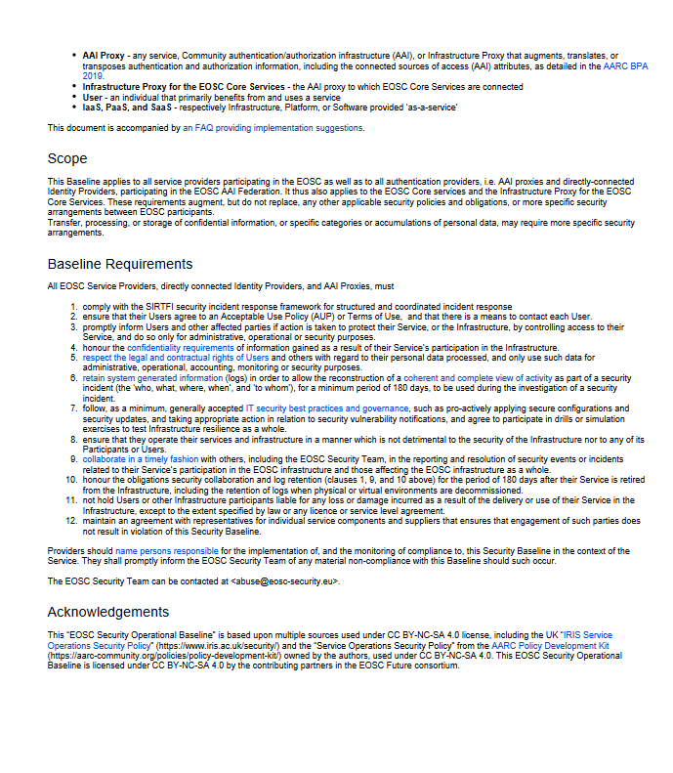
Policy – a baselining approach for AUP and Operations
Users don’t like to click! So show a common baseline AUP for most services - only once
Common AUP (based on WISE AUP) – required for core services to ensure consistency, strongly recommended for all services and for community AAI proxies
EOSC Security Operational Baseline
a mere 12 points that make you a trustworthy provider organisation towards your peers and the EOSC

Slide 8
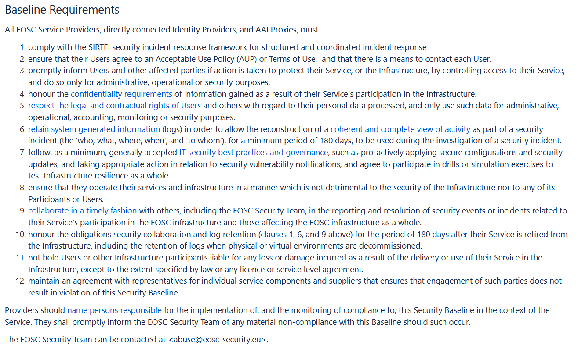
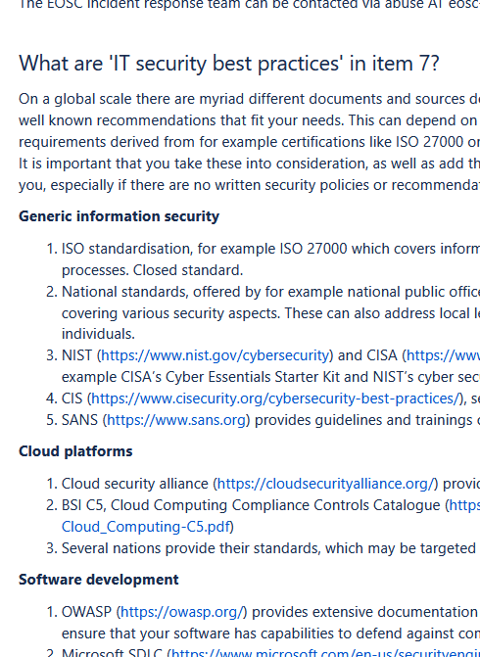
EOSCSMS – EOSC Security Operational Baseline & FAQ
https://wiki.eoscfuture.eu/display/PUBLIC/EOSC+Security+Operational+Baseline

Slide 9
Who you gonna call?
If there's something weird, and it don't look good?
abuse@eosc-security.eu
or select the EOSC Security group in the helpdesk
And of course there are real people there – your friendly CSIRT central team is: Pau Cutrina, Daniel Kouřil, and David Crooks

Slide 10
Thanks to the EOSC Future WP7.5 collaborators: Alf Moens, Daniel Kouřil, Baptiste Grenier, David Crooks, David Groep, David Kelsey, Ian Neilson, Linda Cornwall, Jouke Roorda, Matt Viljoen, Pau Cutrina, Ralph Niederberger, Romain Wartel, Sven Gabriel, and Urpo Kaila.
eoscfuture.eu

