Slide 1
Information Security Management in the EOSC Future
EOSCF Security Updates for the IRTF, September 2022

Slide 2


A challenging landscape
Entities of all kinds – diversity in the EOSC range
from data sets to storage to computing to publications & digital objects
An open ecosystem – rules of participation will favour low barrier to
entry regarding operational maturity, service management quality, &c
A diverse ecosystem – providers will come from e-Infrastructures,
from member states, from research infrastructures, and private sector
An interdependent ecosystem – aiming for composability
and collective service design through an open, core AAI federation

Slide 3
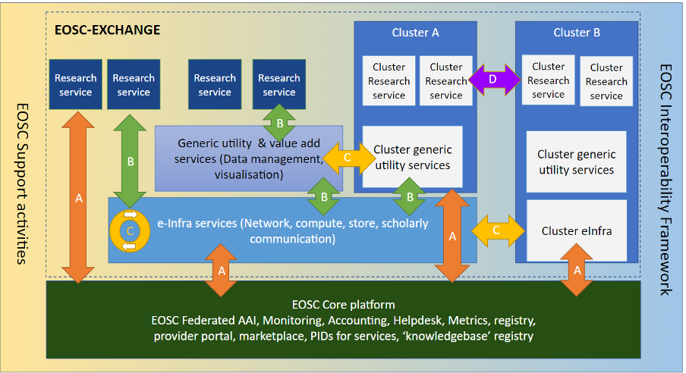

Slide 4
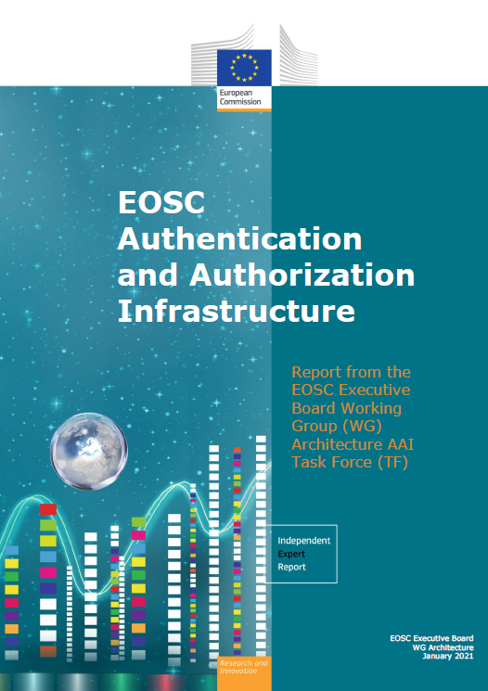
The EOSC AAI /Federation
In order to outline a globally viable, scalable and secure EOSC AAI, the group defined the following three core principles, on which to base their work:
User experience is the only touchstone.
All trust flows from communities.
There is no centre in a distributed system.
“The human element was the starting point of our exploration. We believe that providing a good user experience and making use of the existing trust relations that users already have within their research communities are the key factors for delivering a successful EOSC AAI.” [Klaas Wieringa, EOSC AAI TF chair]
doi:10.2777/8702 – ISBN 978-92-76-28113-9

Slide 5
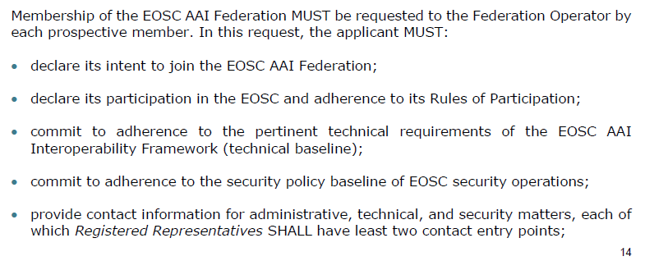
Why is the EOSC AAI important here?
… the new ‘EOSC’ federation gets policies and a base line at ‘onboarding’ time
leveraging existing trust frameworks
not repeat earlier mistakes: so implement a baseline at the ‘start’

Slide 6
Goal of Information Security Management (ISM)
“ensure confidentiality, integrity and availability”
“protecting sensitive data from threats and vulnerabilities”
In our heterogeneous EOSC at large, founded on subsidiarity, this translates to
primum non nocere: do no harm to interests & assets of users
not expose other service providers in the EOSC ecosystem to enlarged risk
as a result of their participation in EOSC
be transparent about infosec maturity and risk to its customers and suppliers

Slide 7
Structuring security for the EOSC
Information security risk assessment framework based on SCI and a maturity model – targeting connected services as well as data, and correlated risks
Coordinate security policies for a baseline aligned with the Rules of Participation of the EOSC, and the EOSC AAI federation – ensuring transparency for the ‘risk appetite’ of the participants
Mechanisms for coordination and resolution of incidents through Information Security Management (ISM) processes – leveraging WISE community and Sirtfi, and enabling the (tested) framework for information sharing
Security operations and incident response capabilities related to or affecting the EOSC Core (in relatively broad sense) - with content and service providers

Slide 8
Information Assets in the EOSC
Subsidiarity
core service providers are subject to the EOSC Core Agreement, but the operating entities are the primary responsible for their own services
exchange service providers bring their own (existing) services, and join based on the EOSC Rules of Participation, the On-boarding Agreement, and the AAI
Hence the assets that the EOSC Security sees are services,
including the data and digital objects they manage, but
not their hardware, service components, middleware, or people
this provides the touchstone for the ISM policies, following the EOSChub model

Slide 9
The ISM policies and processes
EOSC ISM differentiates between Core and Exchange
both are in scope for all security policies
Core: mandatory adherence (and pro-active support from the security team)
Exchange: based on Interoperability Framework and the AAI
(and ‘RFC2119-RECOMMENDED’ pressure)
Participants are autonomous
but subscribe to shared commitment of maintaining trustworthy & secure EOSC
With everyone expected to participate in incident response and ‘drills’
for the Core services, expert forensics support is provided for if desired
in the Exchange, coordination and liaison are the primary tasks of the CSIRT

Slide 10
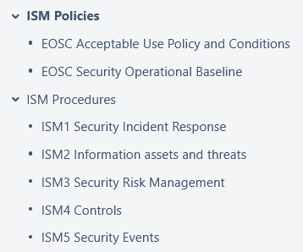
ISM SMS structure
start with just 2 policies
and 5 procedures
Supported by
a ‘comms challenge’ as a KPI
that we can track (~2x per year)
standing CSIRT response team
security ‘events’ monitoring & triage
(to align with FitSM)

Slide 11
Important roles
The key role is the CSIRT at abuse@eosc-security.eu
Of course there are real people, but for long-term stability and tracking only generic addresses should be used for communication
CSIRT central team: Pau, Daniel, DavidC
ISM processes and (public) procedures: Alf, DaveK, SvenG, DavidG
ISM Policies: DavidG, DaveK, Ralph, Alf, IanN,
ISM Risk Assessment process: Urpo, Linda, DaveK, IanN, JoukeR

Slide 12
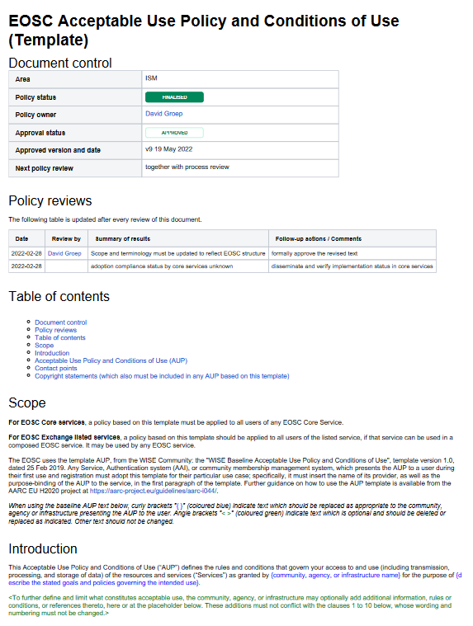
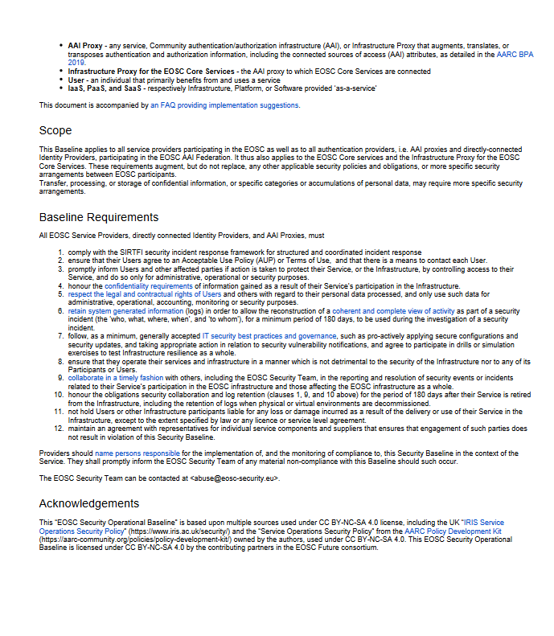
Policy – a baselining approach
Common AUP (based on WISE AUP) – required for core services to ensure consistency, strongly recommended for all services and for community AAI proxies
EOSC Security Operational Baseline
a mere 12 points that make you a trustworthy provider organisation towards your peers and the EOSC

Slide 13

EOSC Security Operational Baseline
Co-development of EOSC Future & AARC Policy Community
version based on UK-IRIS evolution of the AARC PDK
specifically geared towards the looser EOSC ecosystem
mindful of urgent need for collective coherent response
EOSC consultation together with AEGIS, AARC, and GEANT EnCo
complemented by an ‘FAQ’ with guidance and references, but
no new standards: ‘there is enough good stuff out there’
leverages Sirtfi framework
connects to the Core Security Team
part of the EOSC SMS and Core Participation Agreement
Joint input to the new WISE AARC Service Operational Policy work in SCI

Slide 14
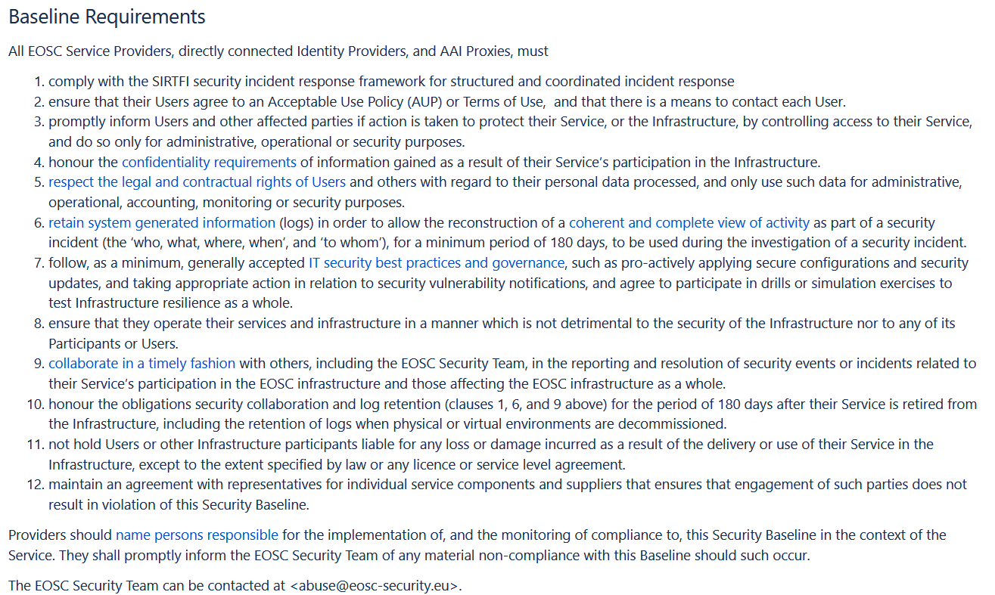
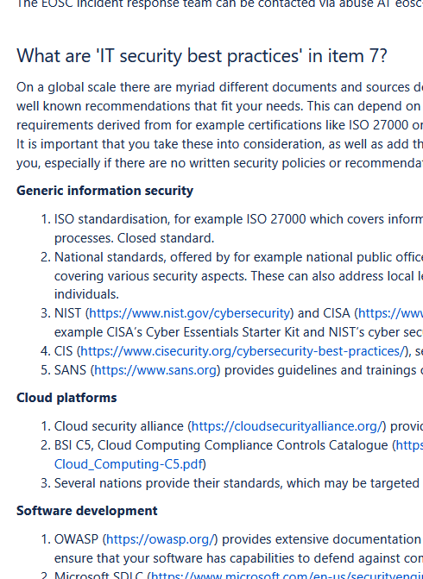
EOSCSMS – EOSC Security Operational Baseline & FAQ
https://wiki.eoscfuture.eu/display/EOSCSMS/EOSC+Security+Operational+Baseline

Slide 15
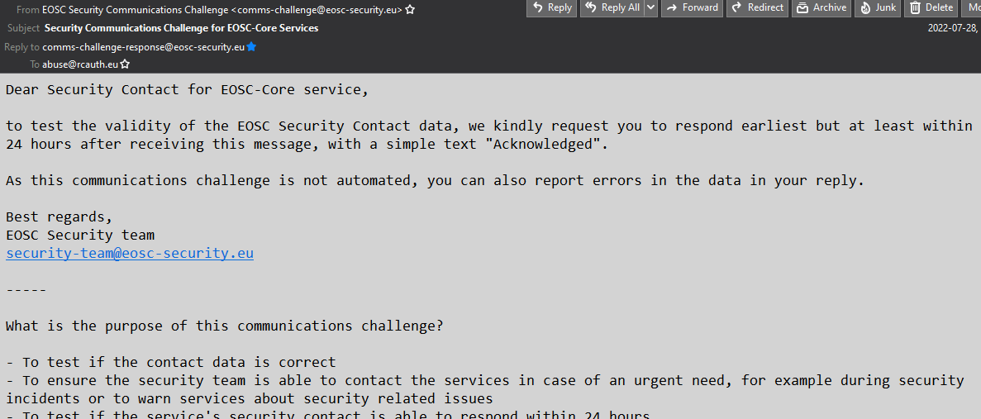
Communications challenges (~ 2x per year)
You already got the mail with the simple question for contact data fixes
response can be done by email
verifies the security contacts
(and proved useful already)
The request to join as a “volunteer for
tabletop exercises ” will come
– a great way to get prepared for the future multiplayer RPGs
Participation in drills or simulation exercises to test Infrastructure resilience as a whole is necessary (and part of the Baseline …)

Slide 16
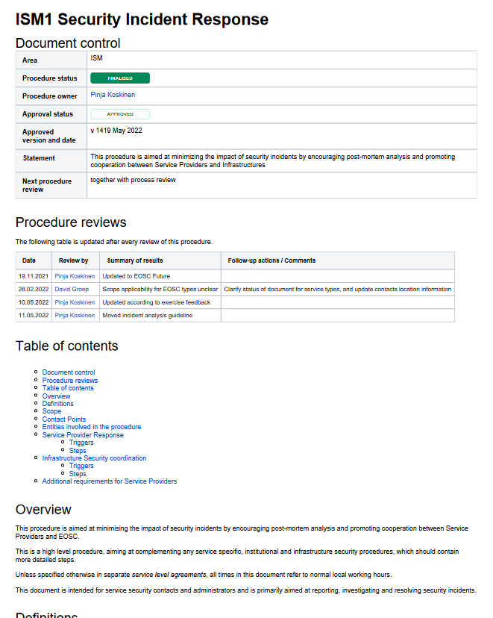
Procedures for incident response
Two parts to the incident process
This (public) ISM1 response procedure
Focussing on interaction between central CSIRT and the provider organisation
Ingress from Zammad and by mail
There is a 2nd element …
an internal detailed technical note, focussing on the team interaction within the CSIRT (how to use RT, mail templates)
The internal note is private, as it contains quite a lot of confidential address information

Slide 17
Security Frameworks
There are many of these out there:
NIST Cyberframework (https://www.nist.gov/cyberframework),
mapping to ISO27k2, NIST SP800-53, and others
ISO27k10 (multi-domain messaging and information exchange)
builds strongly on 27k2, so is not quite the ‘light weight’ option we look for

Slide 18
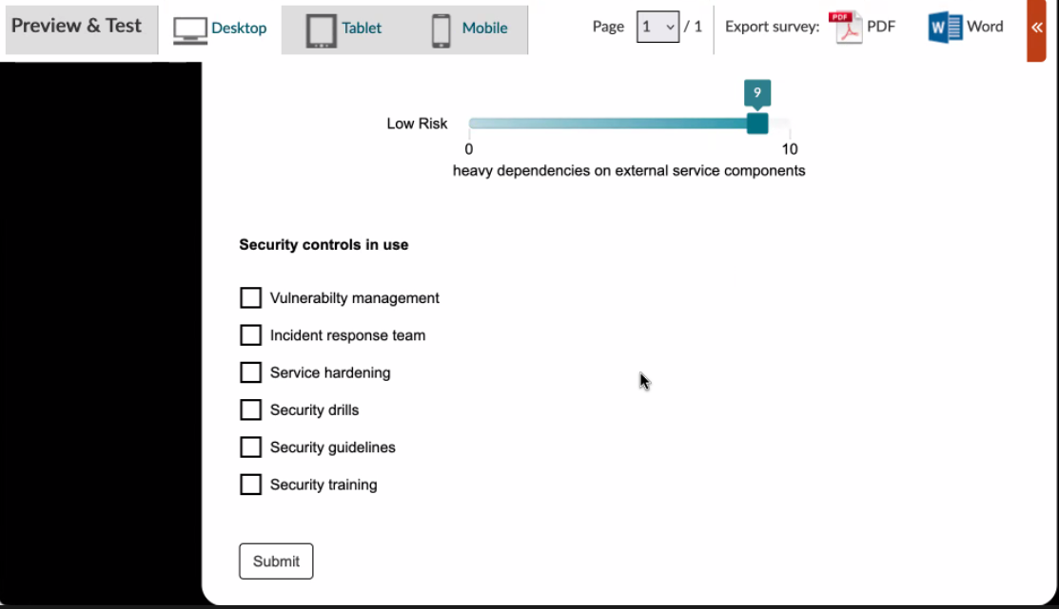
Risk Management Framework
We do have the framework based on SCIv2 and the Risk Assessment WG
Simple risk assessment questionnaire almost complete (on webropol), and
core service providers will be requested to answer (and discuss) the questions
We will use a reference community to evaluate the risk-assessment approach for the EOSC Exchange (using SKA as a ‘fresh’ example community)

Slide 19
Evolving Security and Trust for attribute sources & proxies
Beyond the baseline:
supporting interoperable trust for the EOSC Federation
Community membership management directories and attribute authorities
integrity of membership
identification, naming and traceability
site and service security
protection on the network
assertion integrity
Image source: AARC Community
https://aarc-community.org/architecture/

Slide 20
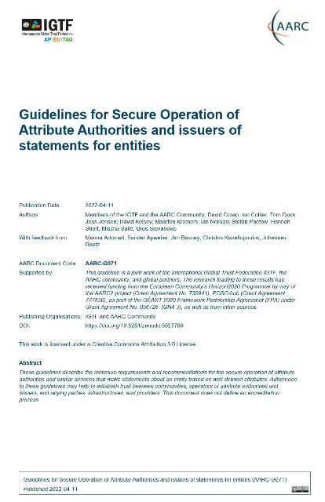
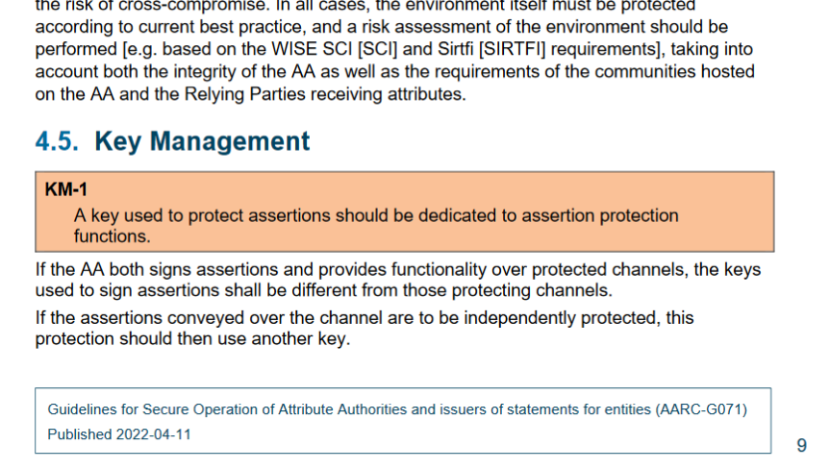
Specific guidance and implementation recommendations
Following the IGTF “Annotated Requirements” model, each statement is accompanied by implementation guidance.
Technology neutral, i.e. both push and pull* models are in scope
aarc-community.org/guidelines/aarc-g071
https://doi.org/10.5281/zenodo.5927799
* see RFC2904 for the model descriptions

Slide 21
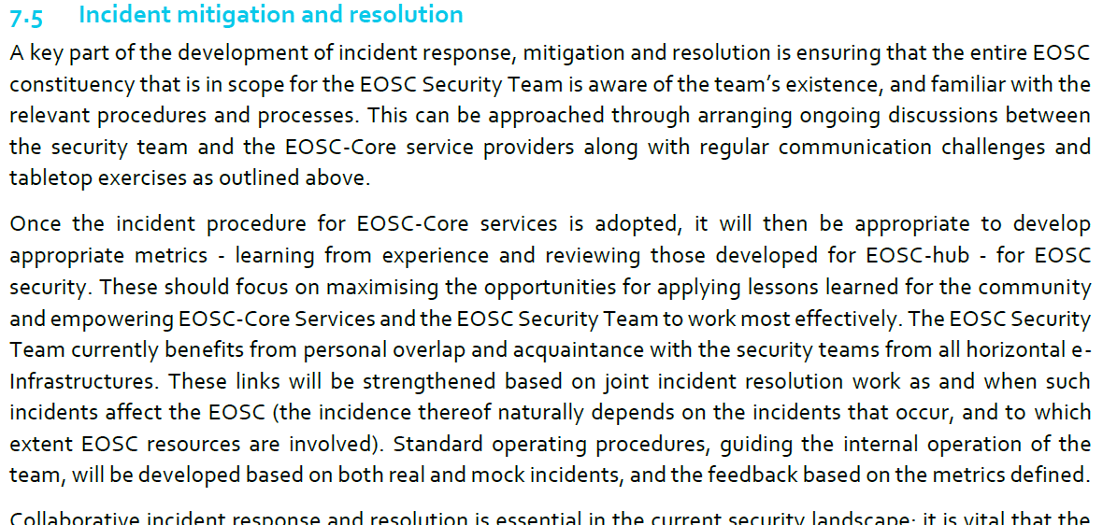
For incident response
https://wiki.eoscfuture.eu/display/EOSCF/D7.5a+Evaluation+of+EOSC+Security+Baseline

Slide 22

Discussion time!
Thanks to the EOSC Future WP7.5 collaborators: Alf Moens, Daniel Kouřil, Baptise Grenier, David Crooks, David Groep, David Kelsey, Ian Neilson, Linda Cornwall, Matt Viljoen, Pinja Koskinen, Ralph Niederberger, Romain Wartel, Sven Gabriel, and Urpo Kaila.
eoscfuture.eu

