Slide 1

Security in the Future of the European Open Science Cloud
WISE workshop, April 2022

Slide 2

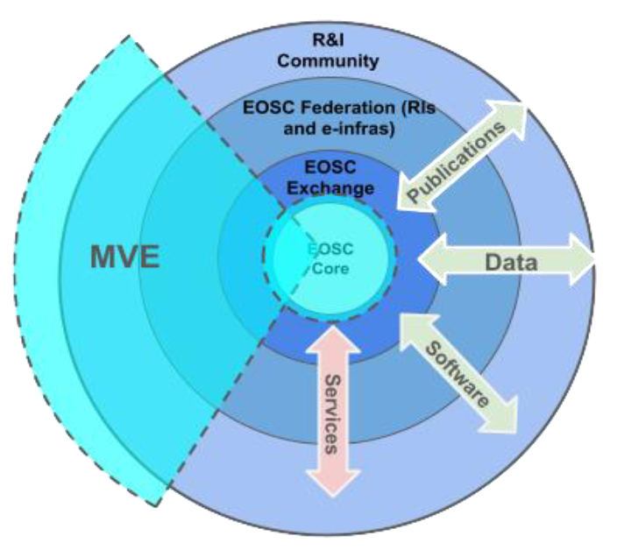
Enabling an Interoperable & FAIR Research Ecosystem
Built as a sustainable ecosystem of FAIR research services,
data, publications, and software for research:
based on the principle of openness
aligned with FAIR principles
interoperable architecture
based on ethical research integrity
users contribute to the ‘federation’
subject to guidelines and policies
users properly reference all resources
built in an incremental way (“Minimum Viable EOSC”) way around common core
Image from: Licia Florio et al. Draft EOSC Architecture and Interoperability Framework, https://eosc-portal.eu/eosc-interoperability-framework-consultation

Slide 3



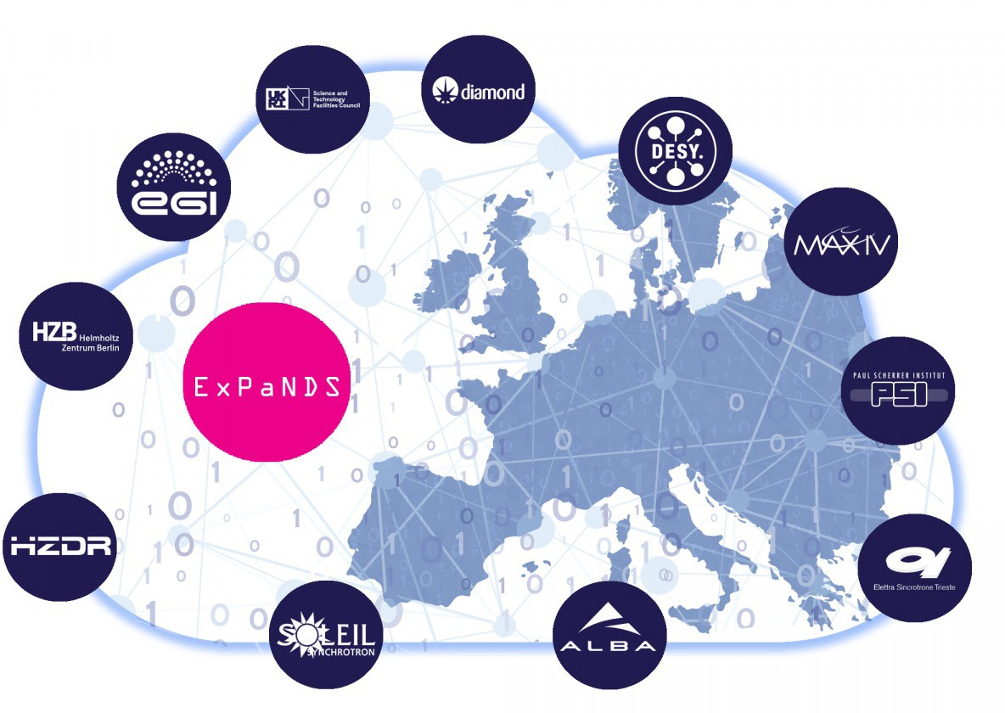











Research and e-Infrastructures from all research areas
Images: logos of the ESFRI cluster projects, INFRAEOSC-07 awarded infrastructure projects, and the national and regional EOSC service development projects – retrieved from EOSC Future Open Day 1, https://eoscfuture.eu/library

Slide 4
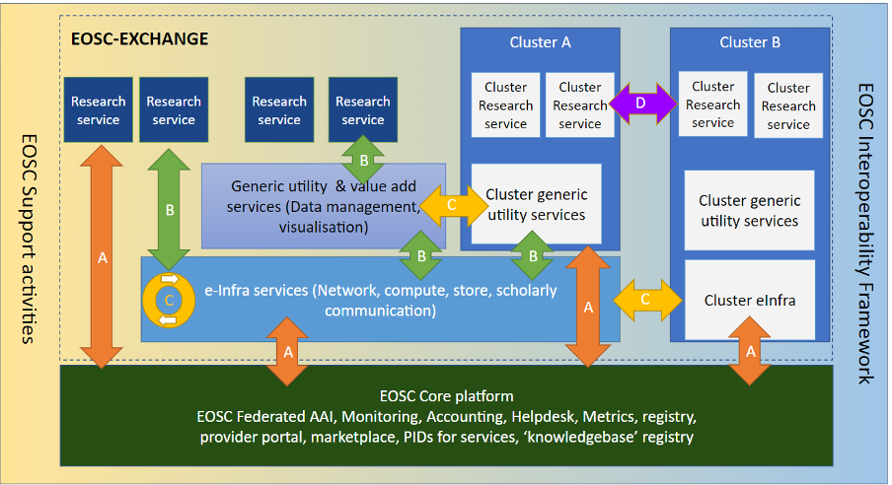
Core, Exchange, and composite services
Image: EOSC Architecture WG

Slide 5


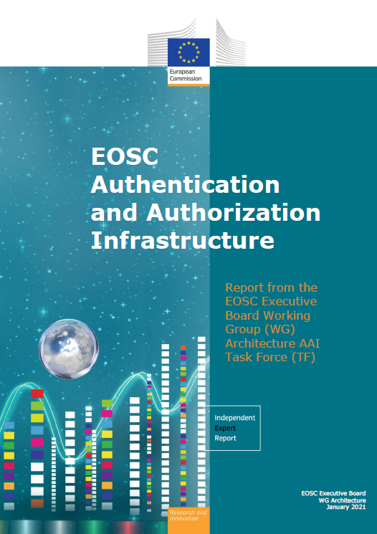

A challenging landscape ahead!
doi:10.2777/8702 – ISBN 978-92-76-28113-9
Entities of all kinds – EOSC spans from data sets to storage
from computing to publications & digital objects
Open diverse ecosystem – user-driven, research and
e-Infra services, favouring low entry barrier
Interoperable ecosystem – common frameworks
An interdependent ecosystem – with composability,
collective service design, and a federated approach to AAI
User experience is the only touchstone
All trust flows from communities
There is no centre in a distributed system

Slide 6
Translating to security operations and security policy
clarity on assets and their service management
with Core services are more ‘tightly controlled’ than assets in the Exchange
participants are autonomous, yet subscribe to shared commitment of trust
security policies follow a baselining approach + good practice guidance
risk-based on the Hippocratic principle of “primum non nocere”
security incident response is coordinated, with support from the central team
which for the Core services also has actionable responsibility

Slide 7
Information Assets in the EOSC
Subsidiarity
core service providers are subject to the EOSC Core Agreement, but the operating entities are the primary responsible for their own services
exchange service providers bring their own (existing) services, and join based on the EOSC Rules of Participation and the On-boarding Agreement
Hence the assets that the EOSC sees are services,
including the data and digital objects they manage, but
not their hardware, service components, middleware, or people
this provides the touchstone for the ISM policies, following the EOSChub model

Slide 8
Live and let die (in the policy world)
EOSC ISM Policies that will live
Security Operational Baseline
WISE Baseline AUP
Policies and processes relegated to service providers and infrastructures
top-level security policy: for EOSC, their substance goes into agreements
software vulnerability management: software used in services is matter for SP
Much more invigorated processes in the EOSC
risk assessments, their methods, and their self-assessment and transparency
multi-stakeholder coordination of incident response

Slide 9
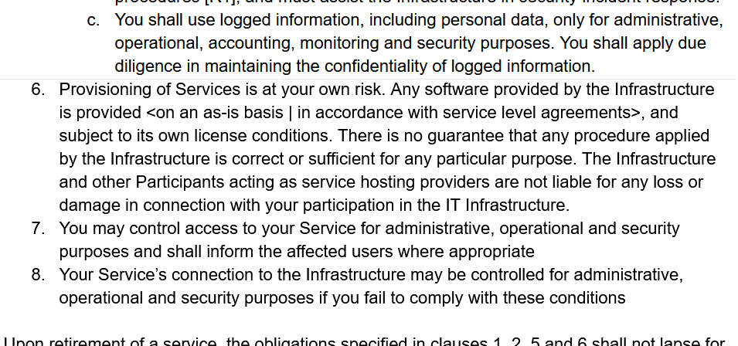
Evolving the Service Security Policy
AARC ‘rev 1’ PDK version of “Service Operations” was, purposefully, specific
includes ‘service-internal’
operations and software
embedded in the PDK
document suite:
does not work well as
a ‘stand-alone’ document
has built-in assumption of
coherent and coordinated
single infrastructure
Evolved by UK-IRIS addressing many of these concerns

Slide 10
EOSC Security Operational Baseline
Co-development of EOSC Future & AARC Policy Community
version based on UK-IRIS evolution of the AARC PDK
specifically geared towards the looser EOSC ecosystem
mindful of urgent need for collective coherent response
EOSC consultation together with AEGIS, AARC, and GEANT EnCo
complemented by an ‘FAQ’ with guidance and references, but
no new standards: ‘there is enough good stuff out there’
leverages Sirtfi framework
connects to the Core Security Team
part of the EOSC SMS and Core Participation Agreement
Joint input to the new WISE AARC Service Operational Policy work in SCI

Slide 11
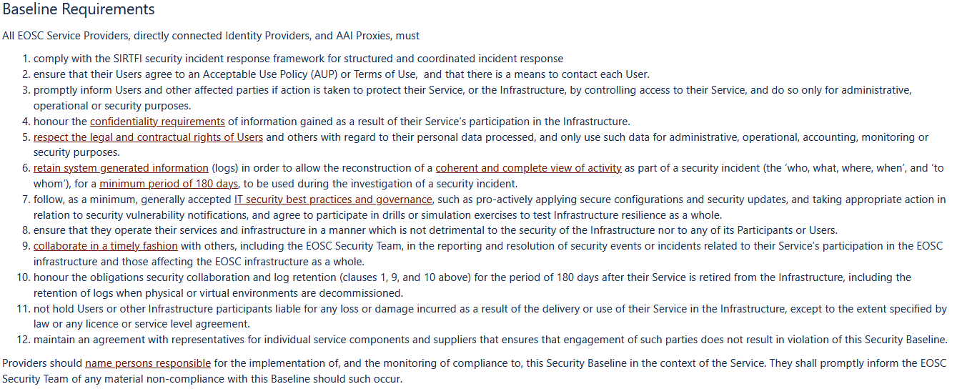
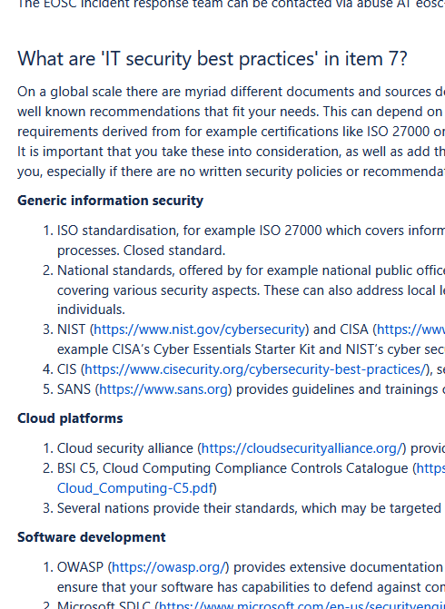
EOSCSMS – EOSC Security Operational Baseline & FAQ
https://wiki.eoscfuture.eu/display/EOSCSMS/EOSC+Security+Operational+Baseline

Slide 12
Evolving Security and Trust for attribute sources & proxies
Beyond the baseline:
supporting interoperable trust for the EOSC Federation
Community membership management directories and attribute authorities
integrity of membership
identification, naming and traceability
site and service security
protection on the network
assertion integrity
Image source: AARC Community
https://aarc-community.org/architecture/

Slide 13
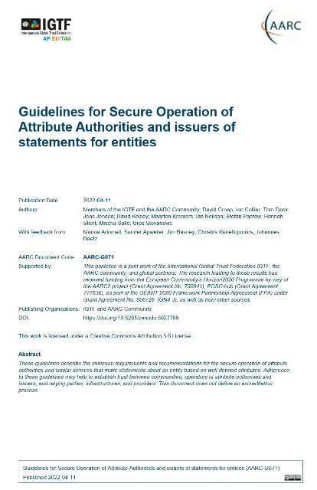
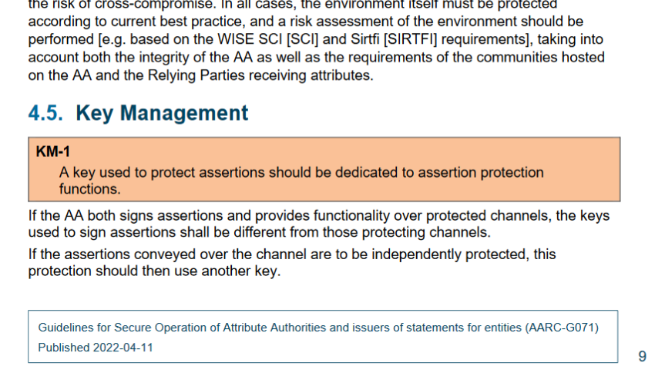
Specific guidance and implementation recommendations
Following the IGTF “Annotated Requirements” model, each statement is accompanies with implementation guidance.
Technology neutral, i.e. both push and pull* models are in scope
aarc-community.org/guidelines/aarc-g071
https://doi.org/10.5281/zenodo.5927799
see RFC2904 for the model descriptions

Slide 14
Risk assessment
Scalability and ‘ease of assessment’ by providers driving a new risk model
usual ‘ISO-style’ risk frameworks need expert assessors to
identify risks, appropriate controls, and assign risk ownership
daunting task, and expertise is scarce
Use ‘well-known-risks’ driven model, focussing on services, data, liability & trust
‘data breach’, ‘systems compromise’, ‘unattended vulnerability’,
‘weak configuration’, ‘DoS’, ‘composite dependencies on external services’
provide tooling to facility self-assessment: sheet-based approach does not scale
prepare the ground with a dry-run to generate example assessments
start with the most critical components in EOSC (such as proxies, web-based tools like a marketplace,

Slide 15
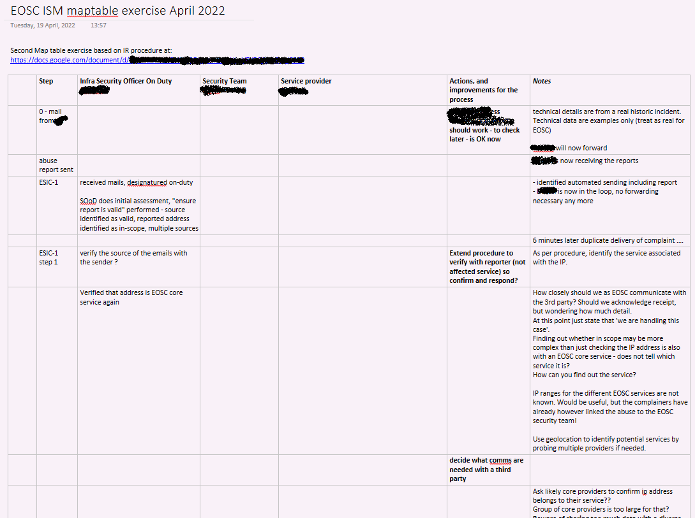
Is ‘the EOSC’ now ready to respond?
Distance between operational security
and (exchange) services remains large
not having face-to-face meetings is
a hindrance for ‘conveying the message’
a large and diverse community anyway
Core services easier to identify
security contact are in place
service management system is known
on-boarding process being rolled out
and the security team is in place!
see subsequent talk by Pinja!
Communicate, exercise … and exercise again!

Slide 16

Securing our EOSC web of FAIR data and services together!
Thanks to the EOSC Future WP7.5 collaborators: Alf Moens, Daniel Kouřil, Baptise Grenier, David Crooks, David Groep, David Kelsey, Ian Neilson, Linda Cornwall, Matt Viljoen, Pinja Koskinen, Ralph Niederberger, Romain Wartel, Sven Gabriel, and Urpo Kaila.
eoscfuture.eu

