Slide 1
Update - Security Policies
David Groep (Nikhef)
EGI OMB 24 November 2016

Slide 2
Refreshing the security policy suite
Finalised earlier this year
Formal adoption – Oct 2016: LTOS AUP, LTOS Security policy, VMI Endorsement and operations (V4), Revised AUP (V2)
Personal Data Protection Policy
OMB meeting: presented March 2016
Almost ready – and now used as basis for EGI CheckIn Privacy privacy template appendix should evolve taking this into account
https://documents.egi.eu/document/2732
Acceptable Authentication Assurance
Approved OMB: July and Sep 2016
https://documents.egi.eu/document/2930
Awaiting formal approval and adoption

Slide 3
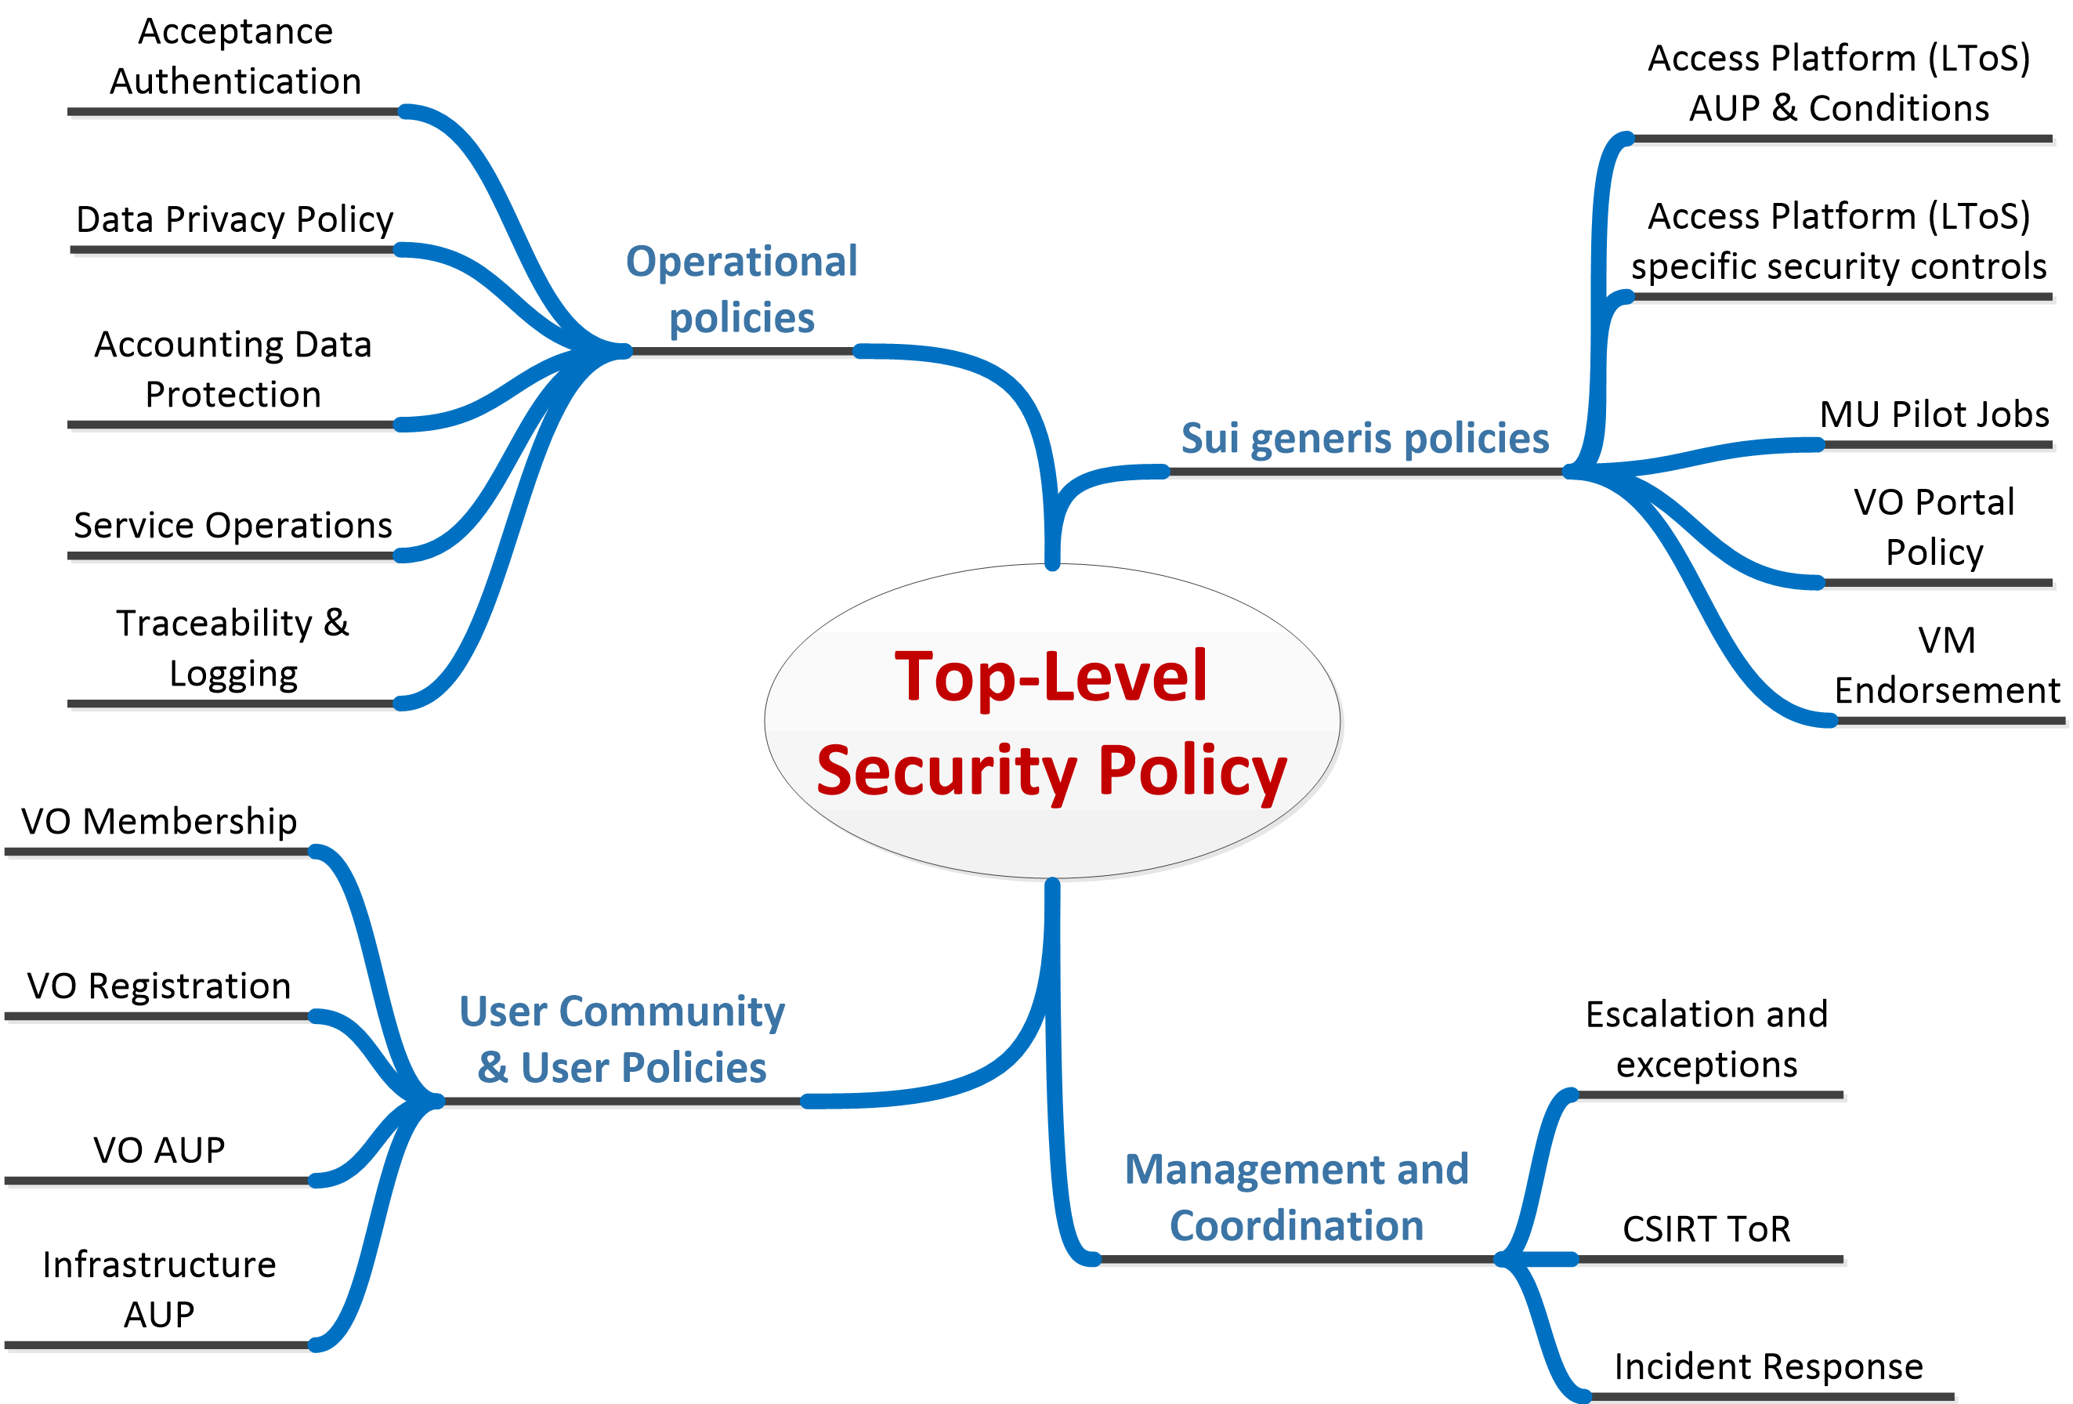
Security Policy Suite
to be revised before end of EGI-ENGAGE

Slide 4
Top-Level Security Policy
Current version (doc #86) is ‘well matured’, dating July 2010, and wording does not immediately indicate its relevance to new infrastructure concepts (although it obvious does apply)
Reword in technology-agnostic way
Minimal changes, as the previous policy worked well
Keeps subsidiarity principle that characterizes our current security model
Clarify applicability to each constituency ( “participants”)
Points to common processes as much as possible
Use existing policies from our suite to assign responsibilities and give mandates

Slide 5
Structure
Introduction and Definitions
Roles and Responsibilities
The Management
The e-Infrastructure Security Officer and the CSIRT
User Community Management
Users
Resource Centre Management
Physical Security
Network Security
Exceptions to Compliance
Sanctions

Slide 6
Example: User Community Management
The User Community Management must designate a Security contact point […]
The User Community Management should abide by the e-Infrastructure policies in the areas of Acceptable Use, User Registration and Membership Management and all other applicable policies. Exceptions to this must be handled as in section Exceptions to Compliance. They must ensure that only individuals who have agreed to abide by the e-Infrastructure AUP and the User Community AUP are registered as members of the User Community.
User Community Management and Users that provide and/or operate resources or services must abide by the Service Operations Security Policy, the Traceability and Logging Policy and all other applicable policies.
For services requiring authentication of entities the User Community Management must abide by the policy on Acceptable Authentication Assurance.
User Community Management is responsible for promptly investigating reports of Users failing to comply with the policies and for taking appropriate action to limit the risk to the e-Infrastructure and ensure compliance in the future, as defined in section Sanctions.

Slide 7
Exceptions to compliance
Wherever possible, e-Infrastructure policies and procedures are designed to apply uniformly to all participants.
If this is not possible, for example due to legal or contractual obligations, exceptions may be made.
Such exceptions should be time-limited and must be documented and authorised by the e-Infrastructure Security Officer and, if required, approved at the appropriate level of management.
…

Slide 8
EGI CheckIn – Data Privacy Policy
Builds on the – previously OMB-endorsed – Data Protection policy and the Privacy Template
Having a privacy policy is a necessary prerequisite
For running a service handling personal data
For registering the service in eduGAIN with the GEANT DP CoCo “Code of Conduct” trust mark
To have all users be well informed on how we process their personal data in the portal and in EGI services

Slide 9
A data privacy policy answers questions!
What Personal Data do We process?
Purposes of Processing?
Stored where?
Accessed by whom?
Retained for how long?
If so: how is your data shared with others?
Name and Contact details of Data Processor
Name and Contact details of the EGI CheckIn Service Data Protection Officer

Slide 10
But: EGI CheckIn in a just a front!
EGI CheckIn itself conveyed attributes to others that the entire purpose of it ☺
All services that connect to CheckIn, must be part of the same policy framework
Data protection model for sharing is inspired by the GDPR “Binding Corporate Rules” (BCR) model, that leverages our comprehensive policy set
Only entities that comply with all the policies, and where we have viable enforcement mechanisms, may have access to the data

Slide 11
10.4 Policy
By their activity in the Infrastructure, Participants:
Declare that they have read, understood and will abide by the Principles of Personal Data Processing as set out below.
Declare their acknowledgment that failure to abide by these Principles may result in exclusion from the Infrastructure, and that if such failure is thought to be the result of an unlawful act or results in unlawful information disclosure, they may be reported to the relevant legal authorities.

Slide 12
A first step: getting this to work … ASAP!
The draft data privacy policy for EGI CheckIn https://wiki.egi.eu/wiki/SPG:Drafts:Data_Privacy_EGI_CheckIn
Addresses all basic 8 questions
Has the service-specific “EGI Policy on the Processing of Personal Data”
Is really needed, real soon, like, “yesterday”
Can be evolved by updating EGI CheckIn website unless we make user-impacting changes

Slide 13
Future work items
User-community related security policies
Today there are three policies for “VOs”: registration, membership management, and the AUP – which is too many, are to vague, and inadvertently suggests some technology. But they are tech-agnostic!
Policy documents govern relationships, and communities relate
with their constituent users, for which we can provide a reference templates (it says “should abide” in the top-level policy, i.e. uses a “comply or explain” model)
with the infrastructure, for which we are authoritative (“must abide”)
SPG will propose revised community policies before the end of ENGAGE
Continue collaboration with other Infrastructures via WISE and SCIV2-WG
Policy and trust issues
To identify potential further gaps and inconsistencies

Slide 14
Requests to the OMB
To endorse the new top-level security policy https://wiki.egi.eu/wiki/SPG:Drafts:Security_Policy
To endorse the first version of the AAI CheckIn Data Privacy Policy – so that it can be used as of now for informing the users on the processing https://wiki.egi.eu/wiki/SPG:Drafts:Data_Privacy_EGI_CheckIn
To (re-)confirm the CSIRT ToR https://documents.egi.eu/secure/ShowDocument?docid=385&version=11

