Slide 1

Information Security 3:
Who you gonna call?
David Groep
Security Coordination Group
AARC Policy & Best Practice coordination, EOSCHUB ISM, GN4 EnCo, SURF DNI
Nikhef Physics Data Processing group
In collaboration with & co-supported
by AARC – aarc-project.eu

Slide 2
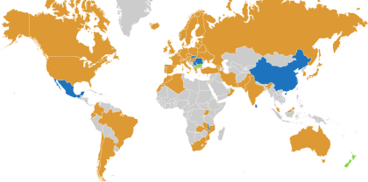
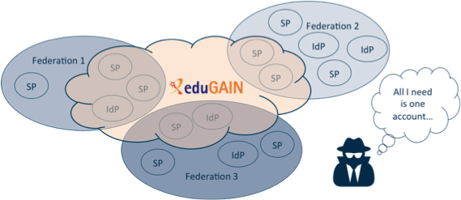














R&E federation and eduGAIN – and the wonderful world of this session
eduGAIN – many countries & economic regions with an R&E identity federation
… yet incident response has to be global (since the miscreants certainly are ☹) …
full of valuable resources (data, network, services)
graphics sources: map technical.edugain.org; federation drawing: Hannah Short, CERN; Infrastructure logos: AARC Pilot use cases

Slide 3
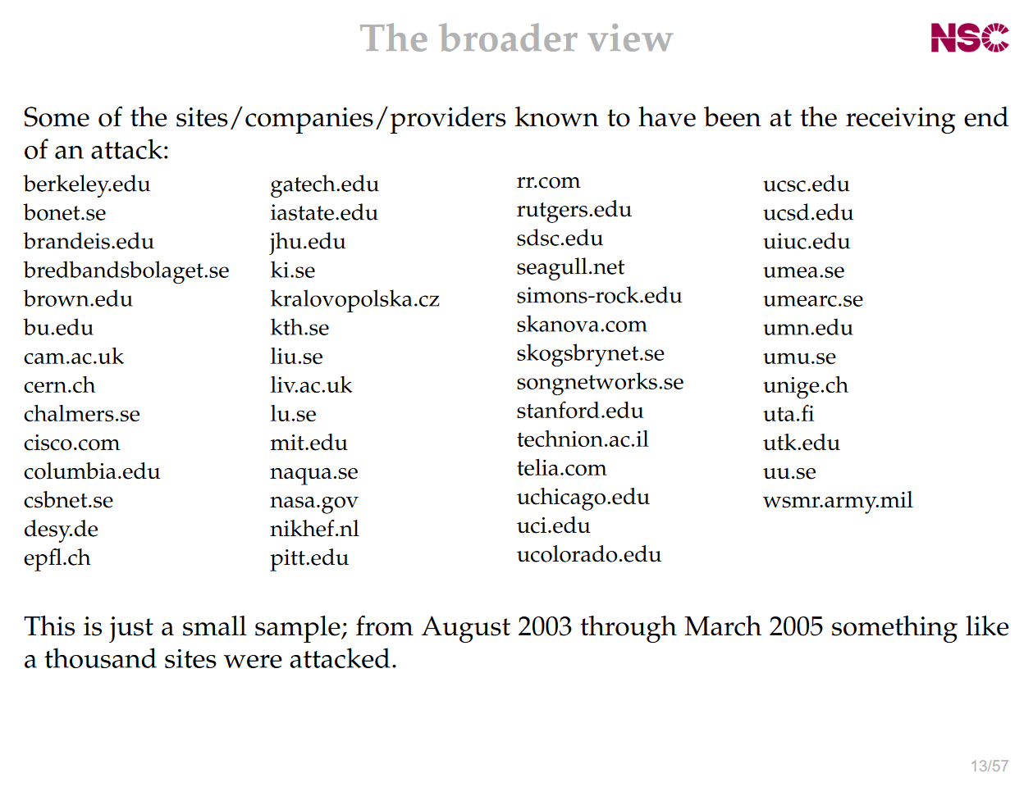
Incidents spread through the community
We live & breath federation!
communities have access to services in many sites, in countries across the globe,
which is anyway better than before federated login, where users had accounts (all with the same password) everywhere,
but the spread of incidents, and finding good targets, remains as easy as it ever was!
slide with site names: Stakkato incident – investigation by Leif Nixon

Slide 4
But what appears trivial
SP
IdP
SP notices suspicious jobs executed by a handful of users from an IdP
Notifies IdP
IdP identifies over 1000 compromised identities
IdP identifies all SPs accessed
Notifies SPs
SP
SP
SP
graphics source: Hannah Short, CERN

Slide 5
… may not be so …
SP
Small IdP may not have capability to block users, or trace their usage
IdP
SP notices suspicious jobs executed by a handful of users from an IdP
Notifies IdP
X
IdP identifies over 1000 compromised identities
!
IdP identifies all SPs accessed
!
Large SP does not share details of compromise, for fear of damage to reputation
X
X
Notifies SPs
X
SPs are not bound to abide by confidentiality protocol and disclose sensitive information
SP
SP
No security contact details!
!
!
SP
graphics source: Hannah Short, CERN

Slide 6
So who do you call?
Do you follow only the network?
  whois data, abuse contacts in RIPEDB, and … pray
Or: do you follow the community?
  look at authorization log and find the community contact in the VOID card
  community will have to look for the user, meanwhile the incident goes on
and do you contact your peers?
  call EGI CSIRT (always a good idea) and share IoCs to protect likely victims
and do you contact the identity provider mitigate issue at source?
  use federation meta-data to find a trusted contact point with Sirtfi
  involve the eduGAIN support desk security function to get global reach

Slide 7

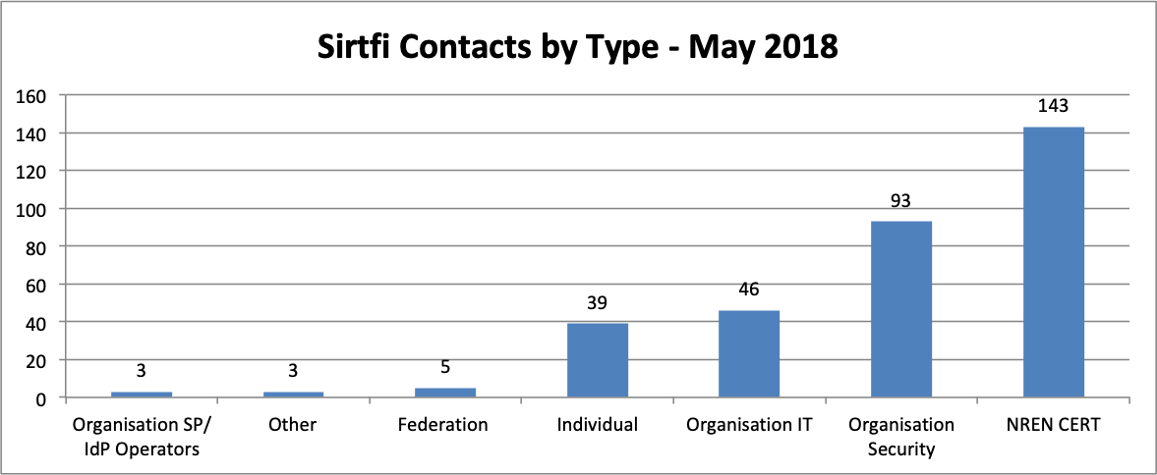
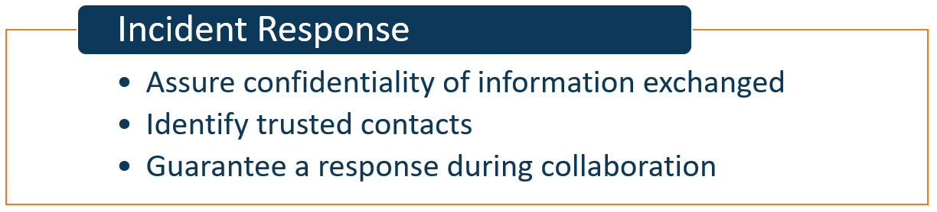
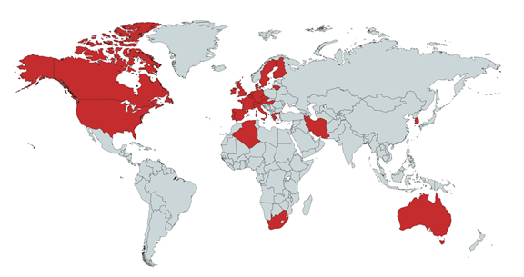
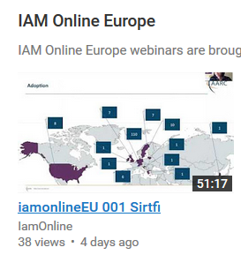
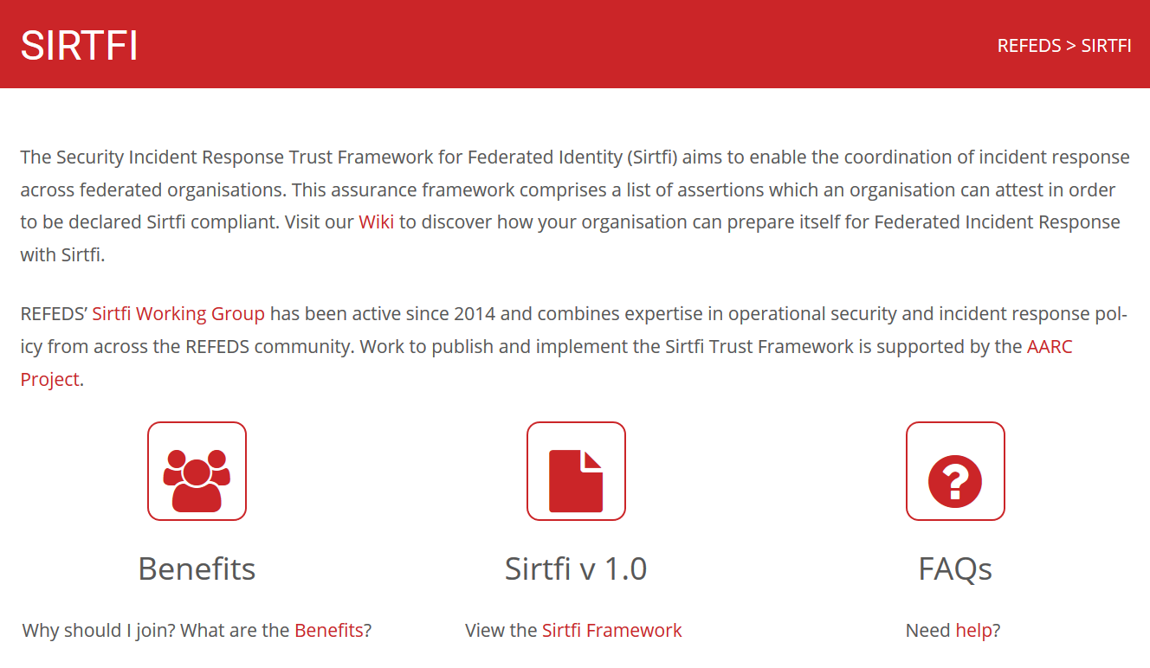
Sirtfi is there today – 561 parties joined, in 28 federations
https://refeds.org/SIRTFI
countries with at least one Sirtfi entity
graphics source: AARC2 DNA3.2 Report on Incident Response in FIM; data: technical.edugain.org

Slide 8
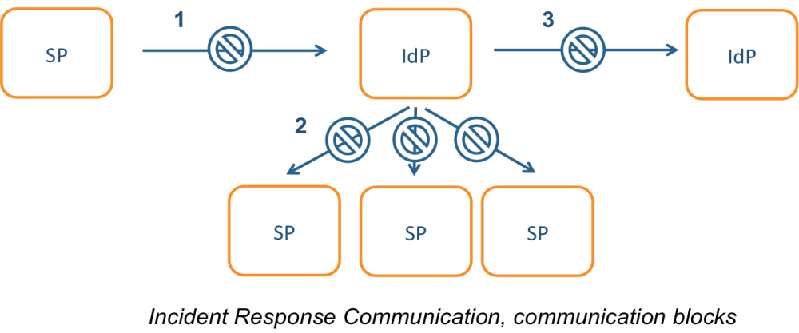
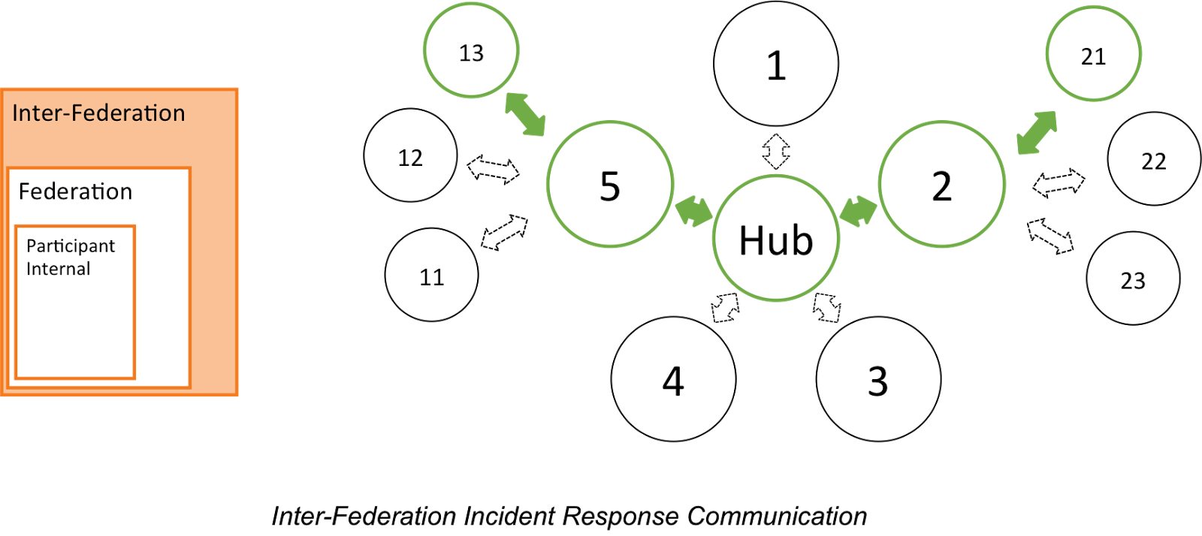
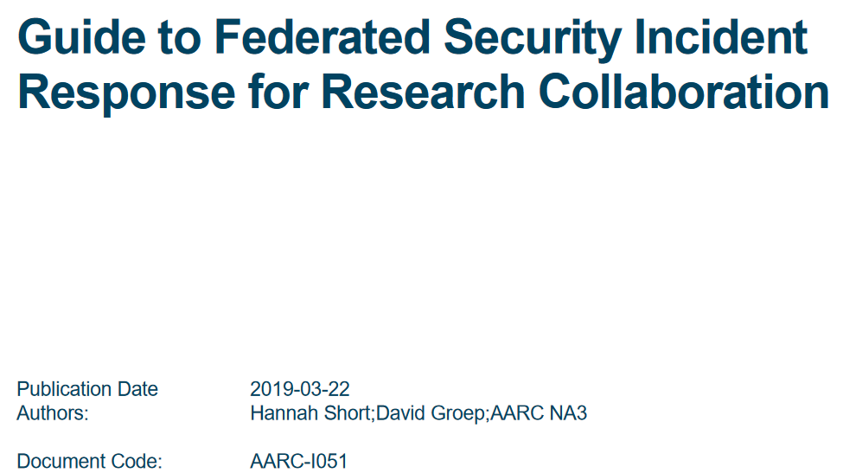

Incident response process evolution in federations
Proposed solutions
Stronger role for federation operators, as
they are known to both SPs and IdPs
Add hub capability centrally (@ eduGAIN)
https://aarc-project.eu/guidelines/aarc-i051/

Slide 9
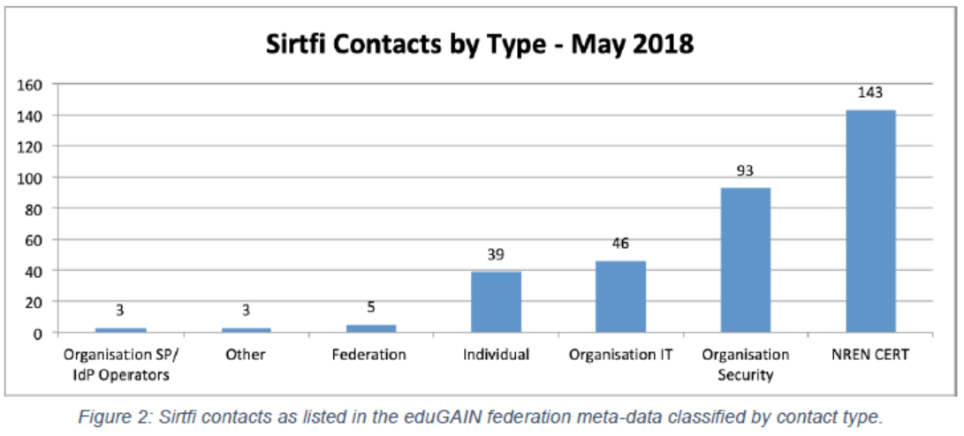
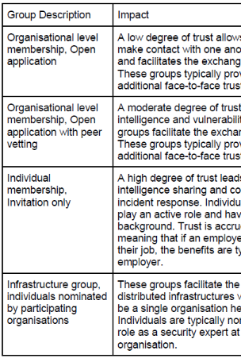
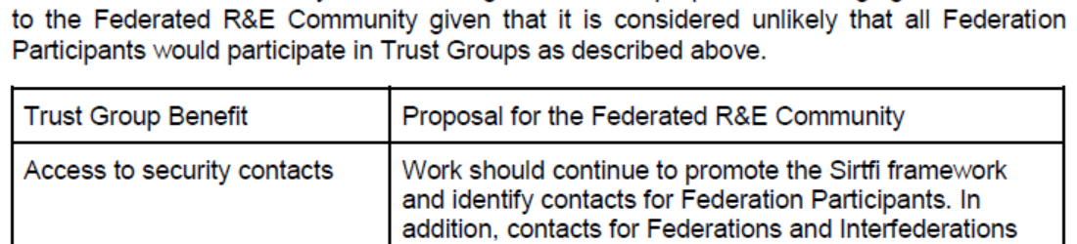
Responding to incidents – sharing relevant information
Sirtfi take-up at proper organizational level
Beyond basic Sirtfi
federation-level engagement in process
Sirtfi+ registry broadens global base
engagement in trust groups valuable
for federated collective response
from DNA3.2 Report on Security Incident Response and Cybersecurity in Federated Authentication Scenarios

Slide 10
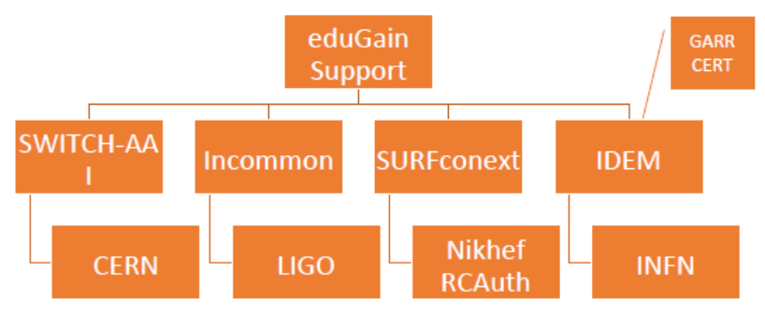
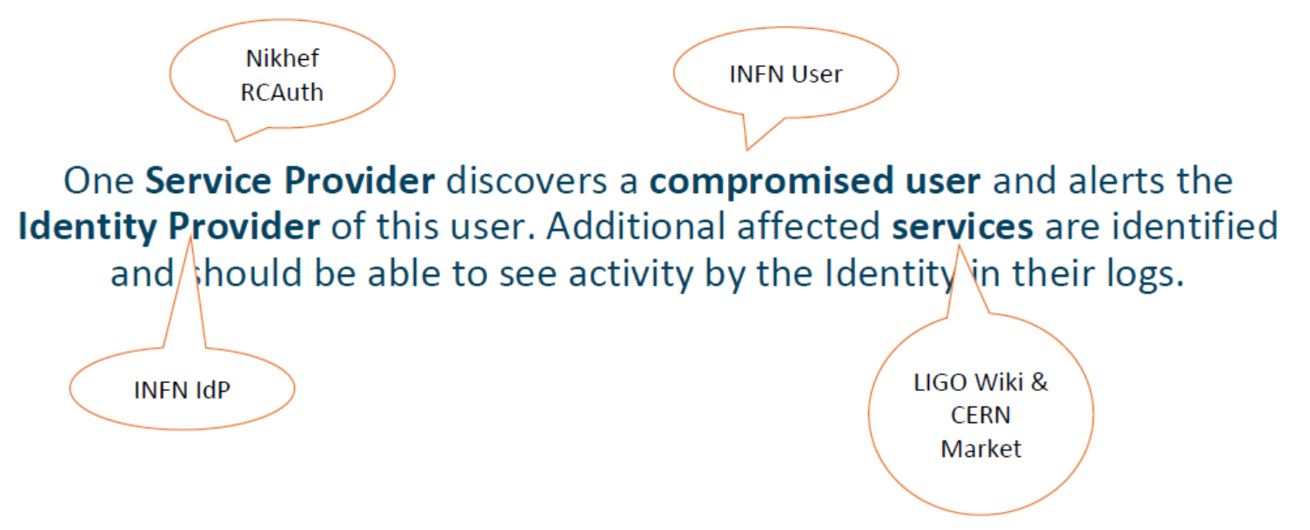


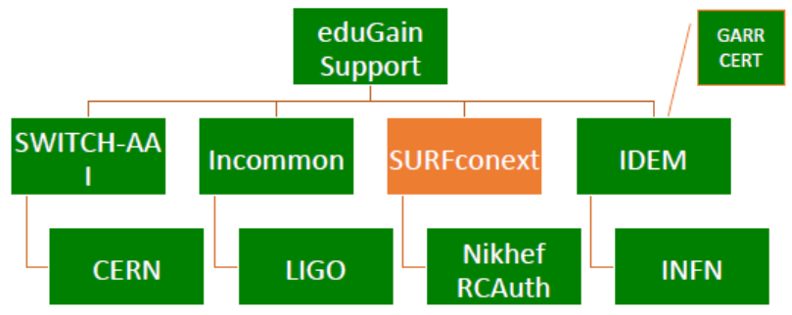



Test model for federated incident response
defines the model actors in a global test incident
include eduGAIN Support Desk
exercise the attack scenario!
and learn: the result is AARC-I051 with a reference process
parties involved in response challenge
Report-out see https://wiki.geant.org/display/AARC/Incident+Response+Test+Model+for+Organizations

Slide 11
Communicate – who picks up the phone on time?
Communications challenges build ‘confidence’ and trust
– an important social aspect
but unless you run every test yourself, or get full insight in the results of a challenge, you may not trust it as you ought to do
to get a ‘warm and fuzzy feeling of trust’, results (responsiveness data) should be shared – but in confidence
but a single test can answer the questions of many:
if the challenge measures responsiveness and the data are available,
each infrastructure can set its own level of expectancy
yet other trust bits needs different probes (and may be more intensive)
responsiveness vs. ability to take action or forensics/traceability capacity

Slide 12
Let’s share test results
Trusted Introducer and TF-CSIRT
2-3 Reaction Tests per year
supported by web click infrastructure, but requires (team) authentication
Nationally, e.g. the SURFcert challenges
annual response challenges, just reply to email to a (traceable) ticket
IGTF RAT Communications Challenges
every 1-2 years
in parallel with continuous operational monitoring
EGI CSIRT: both comms challenges and security service challenges
are the contacts in GOCDB correct and responsive?
do the service providers know what to do if a real incident strikes?

Slide 13
Communication Challenge 2018 Results
23/272 clicks within 1 minute (8%)
101/272 clicks within 10 minutes (37%)
179/272 clicks within 1 hour (66%)
214/272 clicks within 4 hours (79%)
234/272 clicks within 1 day (86%)
252/272 clicks within 4 days (93%)
261/272 clicks within 7+ days (96%)
2 clicks at 39 days...
9 without direct clicks
Working-hour wise, these numbers are even better!
data and imagery: Sven Gabriel, EGI CSIRT presentation ISGC 2019

Slide 14
Can a coordinated service provider federation do better?
Go to the Tuesday morning security session to find out!

Slide 15

Sharing trust –
WISE Security Communications Challenge Coordination Joint WG
Coordination of ‘CCs recipient groups’ among participating infrastructures
ensure targets are not overloaded by coinciding or overlapping challenges, for example by designating lead agency
Transitivity of trust in CC results between infrastructures
for example by specifying the level of disclosure detail for CCs between trusted infrastructures, by using an SCI evaluation framework approach to it, or by coordination of testing and success criteria.
how can requests for CCs between infrastructures be handled, e.g. in response to changing needs or a changed risk assessments; or as remediation after an incident in which communications did not meet expectation.
Definition of CC models and classification
‘depth’ of the CC testing is a balance between the level of trust gained (more profound testing and good results gives more trust) and expediency (asking the recipient to respond to a mail or click a link consumes less resources than requesting forensic investigation of a simulated incident of deliberately unknown nature).
Frequency of CCs
simple communications challenges are often performed one or several times per year (e.g. for TF-CSIRT, by SURFcert for the SURFconext federation, EGI Operations on their sites).
complex challenges are less frequent (e.g. ‘black-box traceability’ trials in EGI take place once every 1-2 years).
following a CC model classification, propose an appropriate frequency for each class.

Slide 16
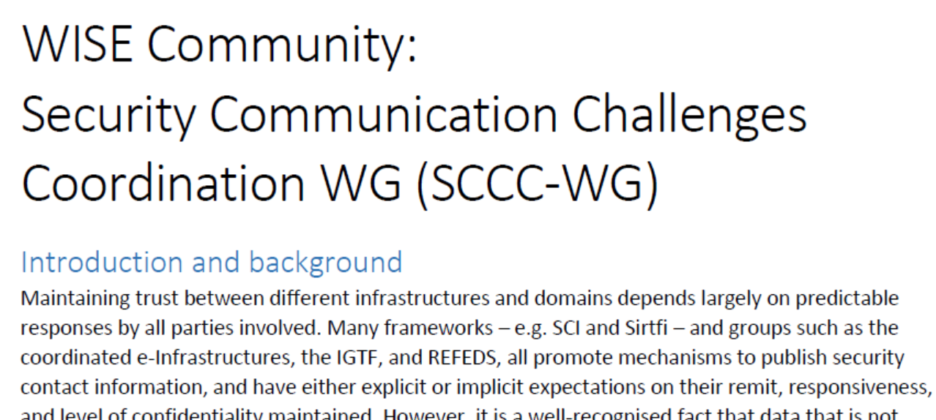
will be a joint working group by WISE, SIG-ISM, REFEDS, and the IGTF

Slide 17

Let’s communicate!
wise-community.org
aarc-project.eu
csirt.egi.eu
technical.edugain.org
David Groep
davidg@nikhef.nl
https://www.nikhef.nl/~davidg/presentations/
https://orcid.org/0000-0003-1026-6606
AARC elements © GÉANT on behalf of the AARC project. AARC material licensed under a Creative Common Attribution 4.0 (CC-BY) License.
The work leading to these results has received funding from the European Union’s Horizon 2020 research and innovation programme under Grant Agreement No. 730941 (AARC2).

