Slide 1
Evolving the trust fabric for research and collaboration
enabling pragmatic credentialing in a multi-domain world
May 2015
David Groep, Nikhef

Slide 2
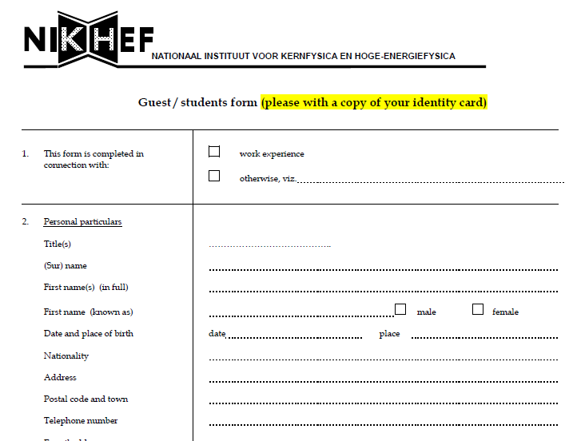
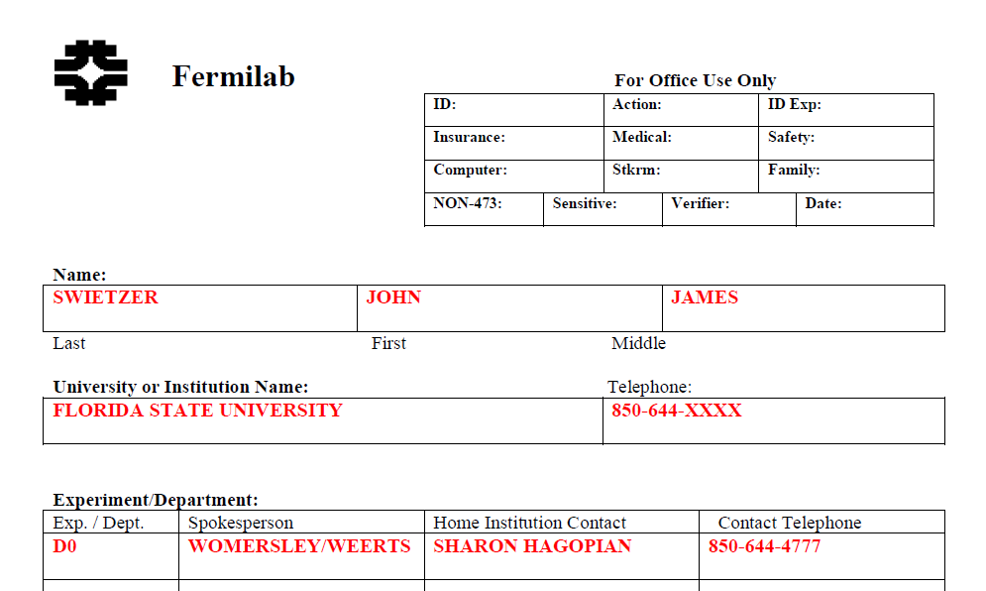
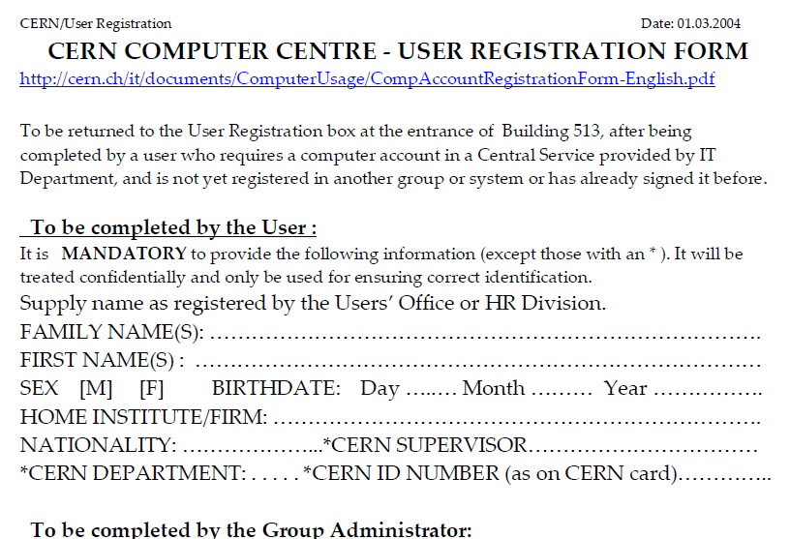
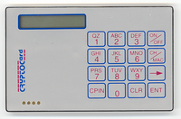
Anyone remember these days?

Slide 3
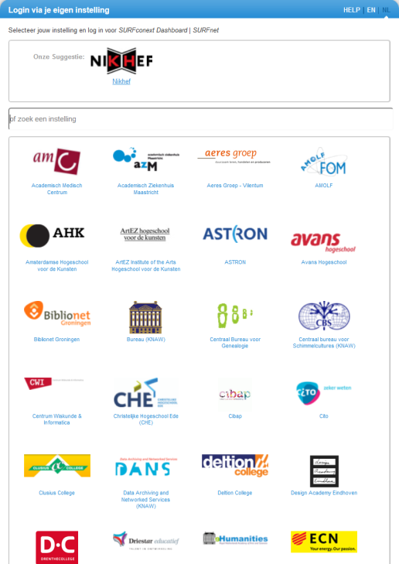
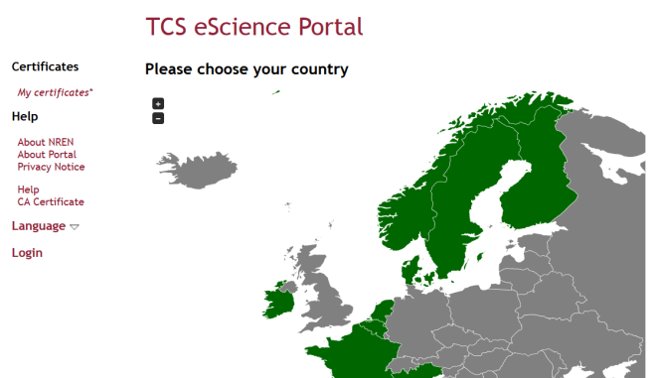
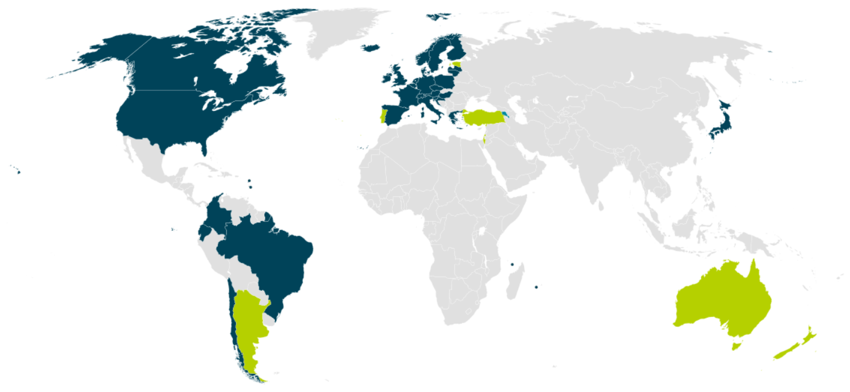


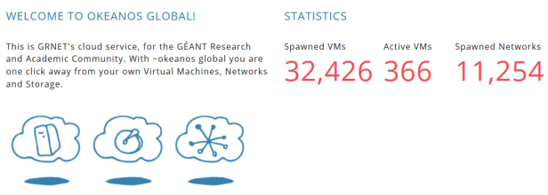

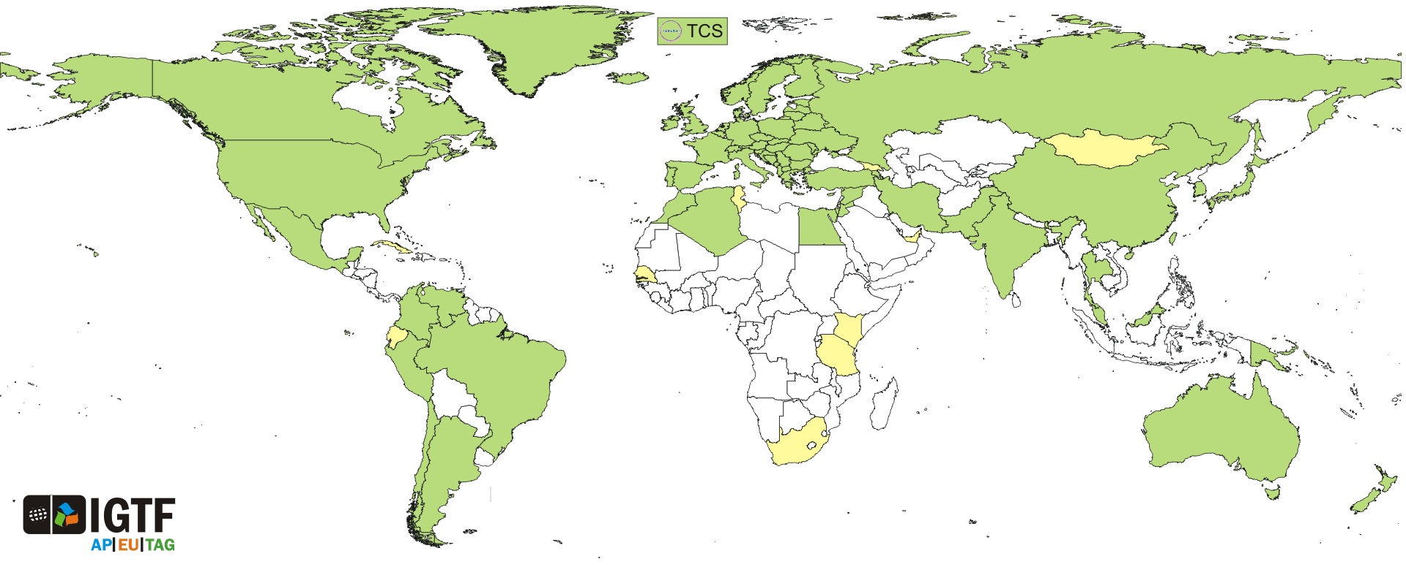
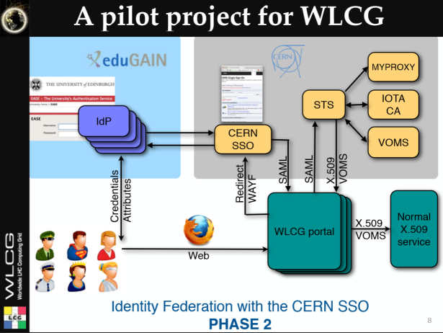
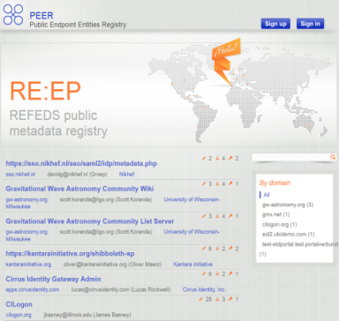

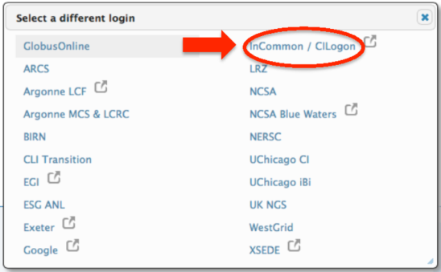
And now we have this!
wLCG FIM4R pilot

Slide 4
Something happened in the last 15 years!
research workflows: a global collaborative endeavour
distributing responsibility in an interconnected world
… and ‘just’ some technical glue

Slide 5
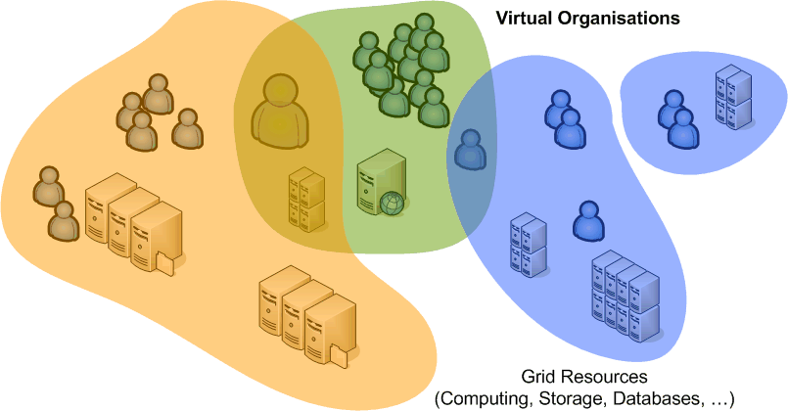
Overlapping Communities - Common Trust
Reduce policy burden
for providers and users
by adhering to common criteria
Goals
multiple sources of authority: User, Institute, Community
acknowledge long-term and ad-hoc community structures
enable security incident response and containment
balance data protection and right to privacy

Slide 6
Entities making up the trust framework
each has given up some autonomy
and flexibility in order to collaborate
‘quite often, user collaboration outlives any single employment, so the ‘home IdP’ the most transient entity of them all …’
Who suffers if trust breaks down? That’s today most often the resource provider (and of course the victims of cybercrime!) and maybe some community processing sensitive data … so the ‘Service Provider’ should drive requirements on trust, acceptable risk, and permissible methods

Slide 7
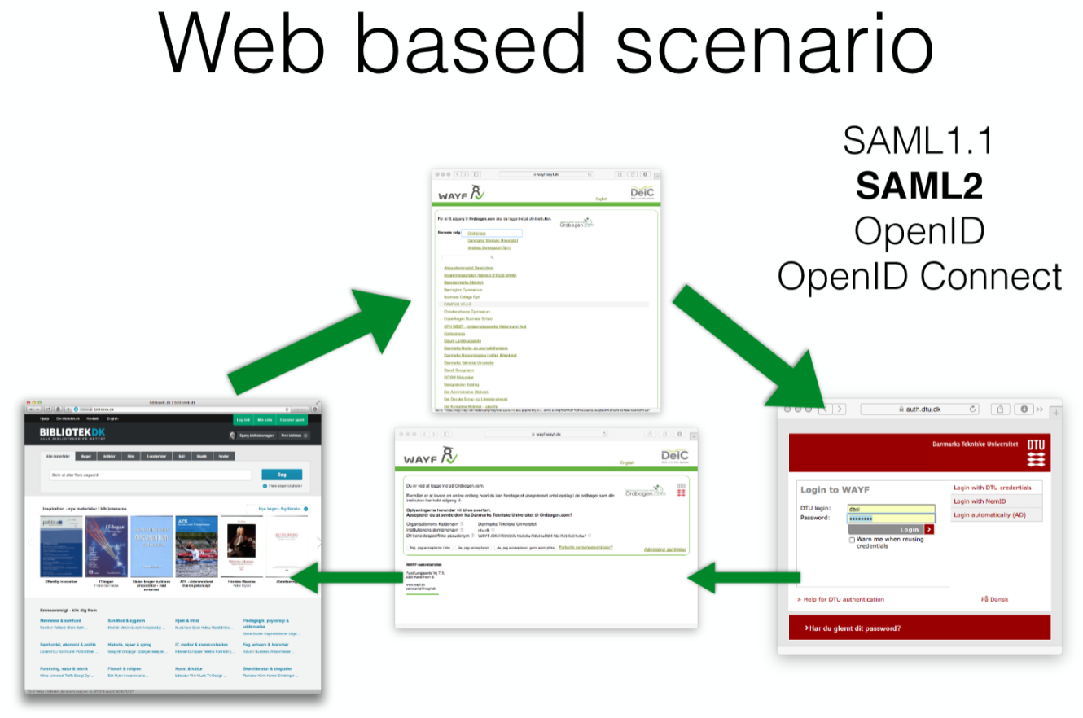
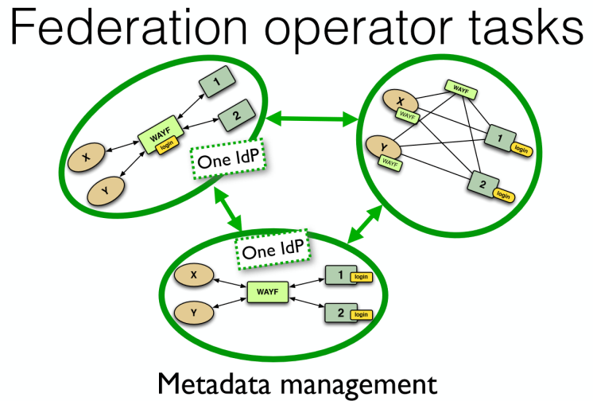
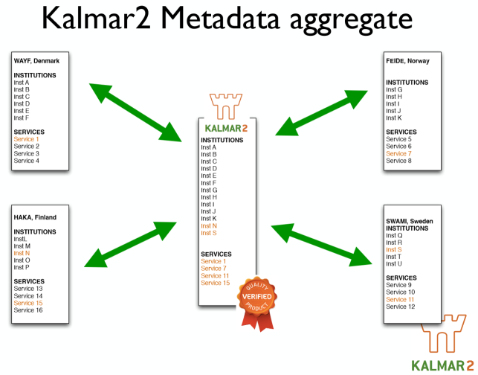
Intermezzo on Federation …
Graphics by David Simonsen, WAYF.dk http://neic2015.nordforsk.org/display/NeIC2015/AAI

Slide 8


On Risk
‘acceptable risk envelope’
Subject (ID, Attribute) based
Defined assurance level
Ensure services are provided to intended users, and not abused by or data disclosed to miscreants
Includes LoA from multiple sources and attributes
Subject (ID, Attribute) based
Defined assurance level
Ensure services are provided to intended users, and not abused by or data disclosed to miscreants
Includes LoA from multiple sources and attributes
Action (application) based
More constraint actions can
lower the risk (which is absorbed by the app provider)
(J)SPG VO Portal policy
does that with 4 ‘levels of action’
Resource (value) based
e.g. access to wireless network does not pose huge risks,
so can live with a lower identity LoA (eduroam)
well connected systems, HPC, and e.g. low-latency are high-value
Residual Risk:
Insurance, larger CSIRT, more PR people, bunch of lawyers, …

Slide 9
Parties to subject and ID in the R&E space
User self-assertions (GoogleID, FB, LinkedIn, …)
Trusted Third Parties assertions (’IGTF PKI’) - user-managed
User’s home organisation (when relevant attribs are there)
Research collaboration consortia and user communities
User self-managed groups and ‘reputation management’
Resource providers own or peer registry (‘home site’)
and authenticators from any of above or e.g. e-Gov/eIDAS
To be useful to collaborative risk assessment, a provider must have a defined and disclosed (or audited) process and assurance level – as a whole, or at least per-entity

Slide 10
Distributing responsibility for subject and identity attributes
Technical elements
integrity of the roots of trust
integrity of issuance process
process incident response
revocation capabilities
key management
credential management
incident response
‘Identity’ elements
identifier management
re-binding and revocation
binding to entities
traceability of entities
emergency communications
regular communications
‘rich’ attribute assertions
correlating identifiers
access control
IGTF Classic, MICS, SLCS
‘typical’ elements
RP, Community
Single Level IGTF sufficed for long
Peer-reviewed self-assertions
Long-term non-reassigned identifier
Traceability/mitigation of last resort
Verifiability & Response, mitigation, recovery

Slide 11
Generalised IGTF LoA
IGTF ‘levels’ useful assurance levels for distributed
e-infrastructures as trust is technology agnostic
http://wiki.eugridpma.org/Main/IGTFLoAGeneralisation
Extract and emphasise generic global trust elements
  2 identifiable levels reflecting distribution of assurance between ‘IdP’ and additional trusted providers
  (like strong, long-lived communities like the LHC collaborations)
  Reflects trustlevel Classic, MICS, SLCS vs. IOTA (‘DOGWOOD’)
  Many R&E federation IdPs are actually ‘good enough’
    - for an identifiable subset of their users, or even for all
    - but forget or are afraid to express their (usually quite good) practices

Slide 12
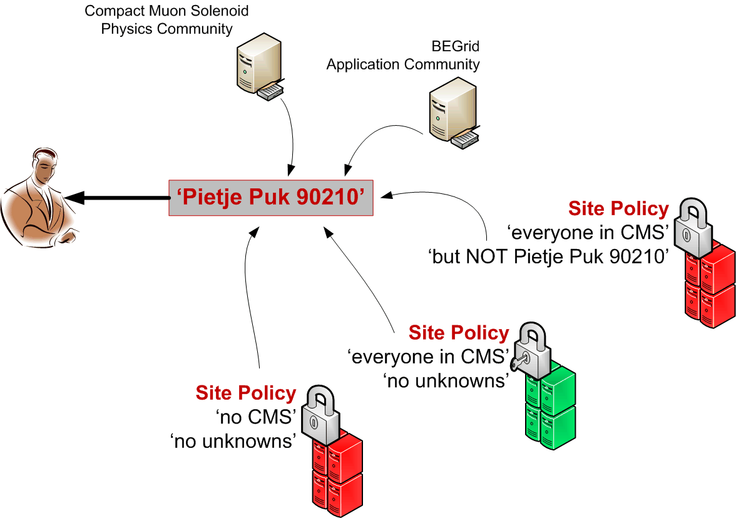
Providing subject ID services together
Having distributed the responsibilities,
participants have to collaborate to jointly provide
  end-to-end traceabilty and assurance
  collectively provide assurance and trust for manageable residual risk
  assurance must be acceptable to party absorbing the residual risk …
And work together to ‘anchor’ the relevant attributes together
  Linkage across domains is essential for collaborative model to work
  Who (one or many) will provide long-term non-reassigned ID, across multiple SPs?
  SPs will (should) also have a ‘local ID’, but that is not enough
‘Subject Distinguished Name’
‘(eduPerson)PrincipalName’
... at least something common

Slide 13
Sharing attributes is not as logical as it should be ...
For collaborative cases to work, attributes and (some personal) data must be shared
  Access control based on community or organisational roles, identity, etc.
  Data ownership & storage linked to long-term non-reassigned identifiers
  For accounting/metering releasing this is not ‘free choice’ (not ‘consent’)
Who decides who gets or may use the attributes?
  ‘R&E Federation’ space: the IdP has subsumed this role
  ‘we decide what is good for you’
  ‘your use case is really, truly, very important to us, but just hang in there. We’ll get to you … after all that student enrolment work is done’ yeah…
  most current e-Infrastructures managed by the end-user: that’s one unexpected advantage of end-user PKI, alongside the inherent uniqueID
  communities and consortia will likely share – if only they could participate
  and who remembers InfoCard (MS CardSpace), the ultimate user control?

Slide 14
Who is the ‘owner’ of the user’s attributes?
A thought: should IdP & federation not be there to empower the user?
Compare to STORK/eIDAS (system for cross-natl. eID)
  end-user designated as the responsible party
  leverages user consent (and to them DLA Piper said that was fine!)
Release more freely by differentiating ‘consent’ vs. ‘necessary’
    Internal services – release without asking
    Necessary services – minimal release, based on ‘legitimate interest’
    Optional external services – based on consent + information about status of service (ToU’s, DPCoCo, trust marks, or even none at all)
Some IdPs are just cooperative, and/or honour R&S/DPCoC
But many (DE,UK) are just afraid and don’t give anything ☹
or regard federation solely as a cost-saving measure …

Slide 15

Assurance in R&E federations
Most of the work till now has been to get good-quality SPs
and give IdPs sufficient trust in the service providers
  Data Protection Code of Conduct
  SPs having a developed Privacy Policy
  And justification for the attribute(s) requested
  https://wiki.edugain.org/Recipe_for_a_Service_Provider
For SPs ‘reciprocal’ mechanisms will also be needed,
and guidance to IdPs on what constitutes ‘useful’ interaction
  release at least some identifiers that are ‘useful’ and ‘true’
  given that many IdPs are run as a business case,
  this will need a sustainable logic behind it (“show the benefits”)
  what IdPs can’t provide must come from elsewhere: the community

Slide 16
Collaboration to reduce our joint residual risk
So can SPs trust what is sent by the IdP, and: can we expect IdP and community attribute providers to ‘do the right thing’?
some SP typical concerns
  Incident response, traceability, emergency suspension
  collaboration, sharing, follow-up: current-ness of all registered info
    but traceability and incident response are not ‘primary goals’ of community attribute providers – and they may even have wrong short-term ‘incentives’!
and even federations are not all ‘operational’ entities … yet
  meta-data in e.g. eduGAIN may be stale, missing, out-of-spec,
  or simply not defined – depends on country again ☹
  there is no good place to get ‘all IdPs’ for transnational services
  not always well-connected to national or NREN CSIRTs
Unfortunately, solving this in one or a few countries doesn’t help
For collaboration, things need to work everywhere and consistently
Notes:
Research communities have the wrong incentive because their aim to to get papers out now, and work together, and they will not bear the burden of incident response since the risk rests with the resource owners and RPs, not with the individual researchers that will grant access to write their software frameworks.

Slide 17
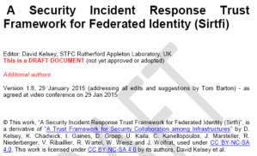
SirTFi – incident response coordination since many IdPs are actually better than advertised!
‘enable a coordinated response to a security incident in a federated context that does not depend on a centralised authority or governance structure to assign roles and responsibilities for doing so’. … example (self-asserted )items:
provide security incident response contact information
able and willing to collaborate in the management of a security incident with affected organisations that participate in the Sirtfi trust framework
Mechanisms are deployed to detect possible intrusions
Users and Service Owners within the organisation can be contacted
security incident response capability exists within the organisation with sufficient authority,
But realise: SAML meta-data does not even have a field for a security contact!
https://wiki.refeds.org/display/GROUPS/SIRTFI

Slide 18





Trust in the SP, IdP, and in the ‘broker’
Moving towards a world of ‘trust marks’?
Well known in meatspace
Convey both ‘trust’, ‘qualities’ & some review process
Emerging in federations for SPs as ‘entity categories’
GEANT Data Protection Code of Conduct
Research & Scholarship Entity Category, …
And we should have some for IdPs as well
‘SirTFi compatible’? ‘IGTF BIRCH’ ID name quality? …
(as an EntCat, or convey SirTFi-ready even per user using ePAssurance or a SAMLAuthenticatonContextClassRef)
and for attribute providers use e.g. IGTF AA Operations Guidelines
plus a defined membership enrolment and de-provisioning process?

Slide 19
Adding technical glue
‘We are not there just yet … please hold!’
Technologies for changing trust models?
Attribute composition and merger
Beyond the Web

Slide 20
Collecting attributes
What technology is there to
express trust relationships and trust marks?
compose attributes from many sources?
separate authenticators from attributes?
support long-running distributed workflows?
a lot, but no integrated solution that users understand ☹
And some aggregation and standards would be welcome:
  SAML, EE-PKI/GSI, OAuth, OpenID Connect, Moonshot, Unity,
  X-realm KRB, FACIUS, LDAP, …
  HEXAA, REMS, PERUN, VOMS, Co-manage, OpenConext Teams, … plain-old LDAP, …

Slide 21
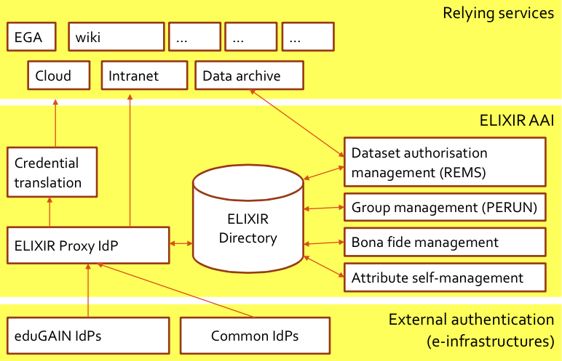
Working ‘around’ the limitations: proxying!
Elixir Setup (draft)
Graphic sourced from Paul van Dijk, SURFnet

Slide 22
Beyond the web and interactive use
Most currently deployed R&E services are web-only
but:
many research and e-Infra cases are non-web
collective services need to perform certain tasks on behalf of the user (delegation)
credential token must be renewed (for long-running jobs) without the user being present
  since revocation in a distributed system is too complex
  For instance: in the grid today the only effective control on run-away jobs is by the identity-credential source (CA) revoking the entire identity ☹

Slide 23
Many solutions for non-web AuthN
‘CILogin’ – MyProxy + OpenID + SAML
  A credential management suite using short-lived tokens and PKI
Direct end-user PKI, e.g. via TCS* bridging to all R&E IdPs
  Both web and non-web, delegation & long-running workflow support
  works really great, also for delegation, if only the users would understand it - and be able to securely manage a key pair
SAML ECP – seems to just never get there …
STS Security Token Service – SAML<>PKI&more on demand
OpenID Connect, FACIUS, Unity-IdM, X-realm KRB, GSI
Moonshot
  Authentication-only for non-web, based on existing GSSAPI standards, but it requires a parallel non-trivial infrastructure
*or TCS equivalents, like the InCommon Silver CA, AusCERT, DFN SLCS, …

Slide 24

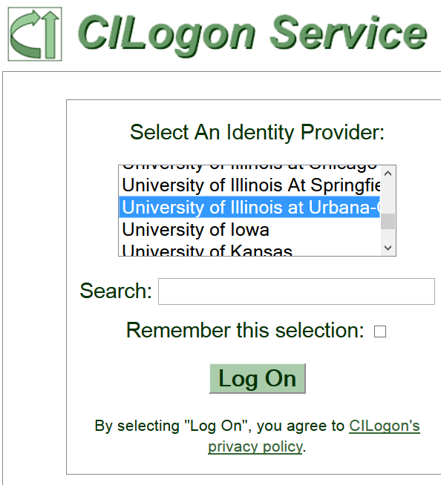
Proxying, credential stores, and user management
Example – one of many
CILogon/MyProxy could act as a ‘credential hub’,
as well as the many ‘community proxy’ solutions
SAML, OpenID Connect, &PKI in and out
  TCS backing a credential store?!
  Yes, it’s allowed …
  TCS G3 “Grid Client” governed by
  IGTF Private Key Protection
  supporting credential stores
A trusted ‘credential manager’ for user e-Infra credentials?
  Takes care of automatic refresh for long-running workflows, of revocation, and of RFC3820 delegation

Slide 25
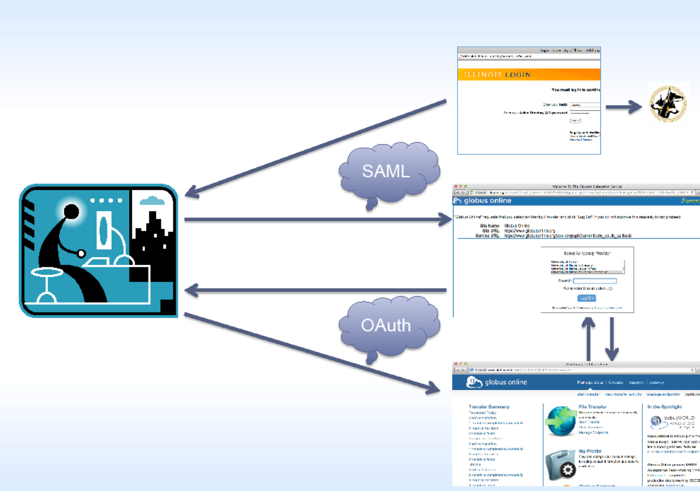
CILogon translations and GlobusOnline
Graphic from “CILogon and OAuth for MyProxy”, Jim Basney, NCSA
http://myproxy.ncsa.uiuc.edu/ and https://cilogon.org/

Slide 26
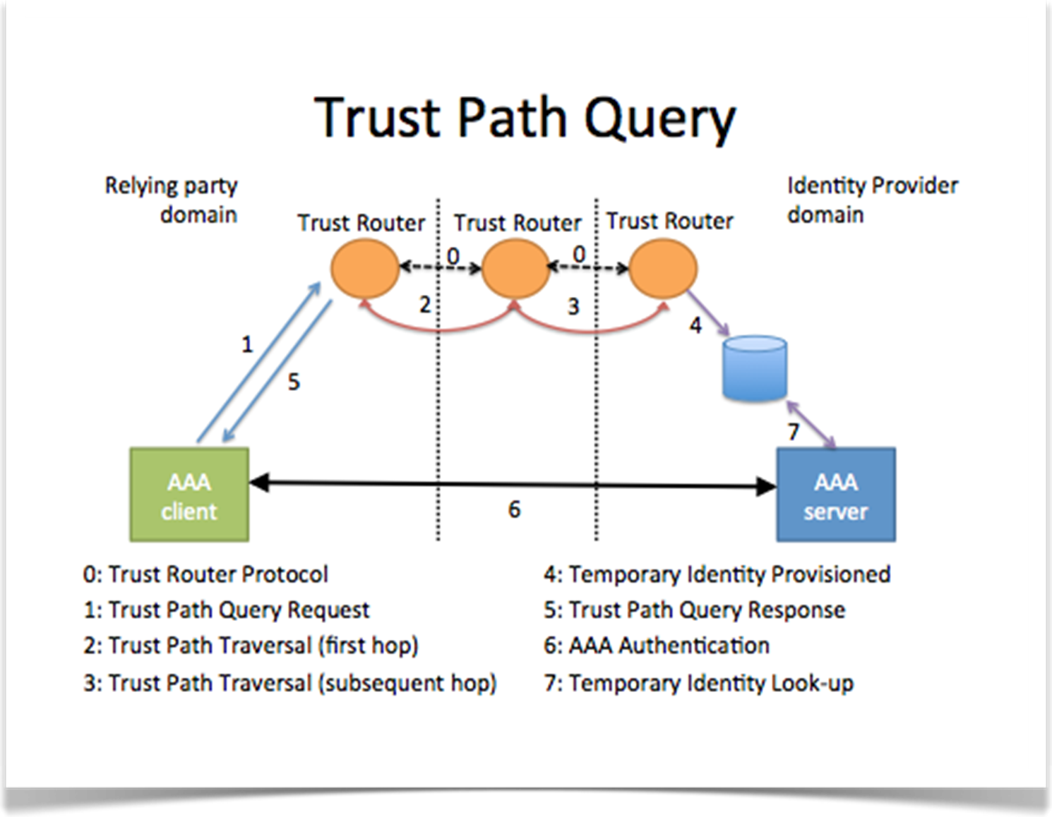
Moonshot
Example – one of many
‘inspired by RADIUS and eduroam’
authN over an inner tunnel, and the resulting attributes travel on the ‘outside’ back to the client
TR is a relying party like any other: it mediates trust (and does that through a quasi-DH key exchange
Eventually will have routing tables across the whole network
For now, default peers can be configured.
The trust router instead acts as an introduction service - once a trusted path is found, it provides the end client and server with a temporary credential.
This temporary credential is used to create a RadSec connection directly between the client and server.
Graphics from Janet and JISC presentations on Moonshot … see wiki.moonshot.ja.net!

Slide 27
Moonshot applicability
Basically anything that does GSSAPI/SASL – provided it is not ‘kerberish’ – and it’s still early days here
including again Firefox GSS to Apache httpd ☺
ssh (but beware of lack of authZ & provisioning support)
also NFSv4 shown to work (again with some tweaks, since the Linux kernel thinks the GSS world is only Krb ☹)
MyProxy, for proxies and in PKI CA mode
and more demos like iRODS, CIFS, OpenLDAP, OpenLDAP-to-ActiveDirectory/SSPI, IIS+SSPI, Jabberd, console login

Slide 28
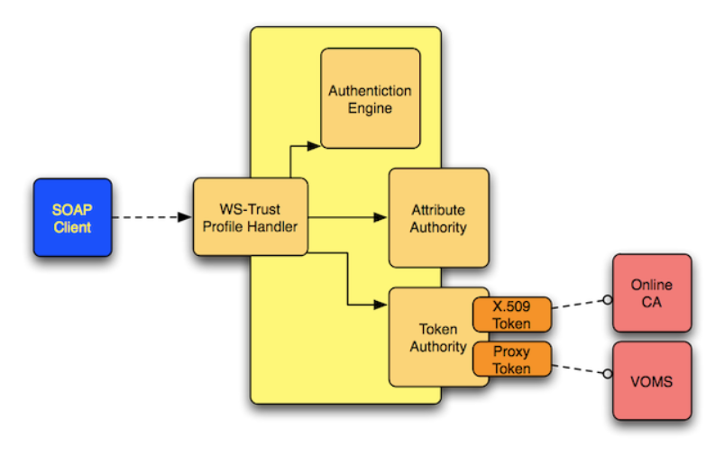
Security Token Service ‘STS’
Example – one of many
WS-Trust compliant translation from any-to-any
Including hooks to attach attribute authorities
With access control to the service, so it can
implement distributed controls
support & info henri.mikkonen@nimbleidm.com
see also https://twiki.cern.ch/twiki/bin/view/EMI/EMISTSDocumentation

Slide 29
WebFTS3: wLCG FIM4R pilot and STS
X509 delegation is needed to let WebFTS access the grid storage on the users’ behalf
Users can use their private key within the browser, but
it is not available via a browser API
wLCG FIM4R: trying to replace user certificate delegation with transparent access via Identity Federation
(a pilot project for WLCG)
Same technology may be used for other types of services, e.g. job submission.
Slides content taken from Romain Wartel, CERN and wLCG

Slide 30
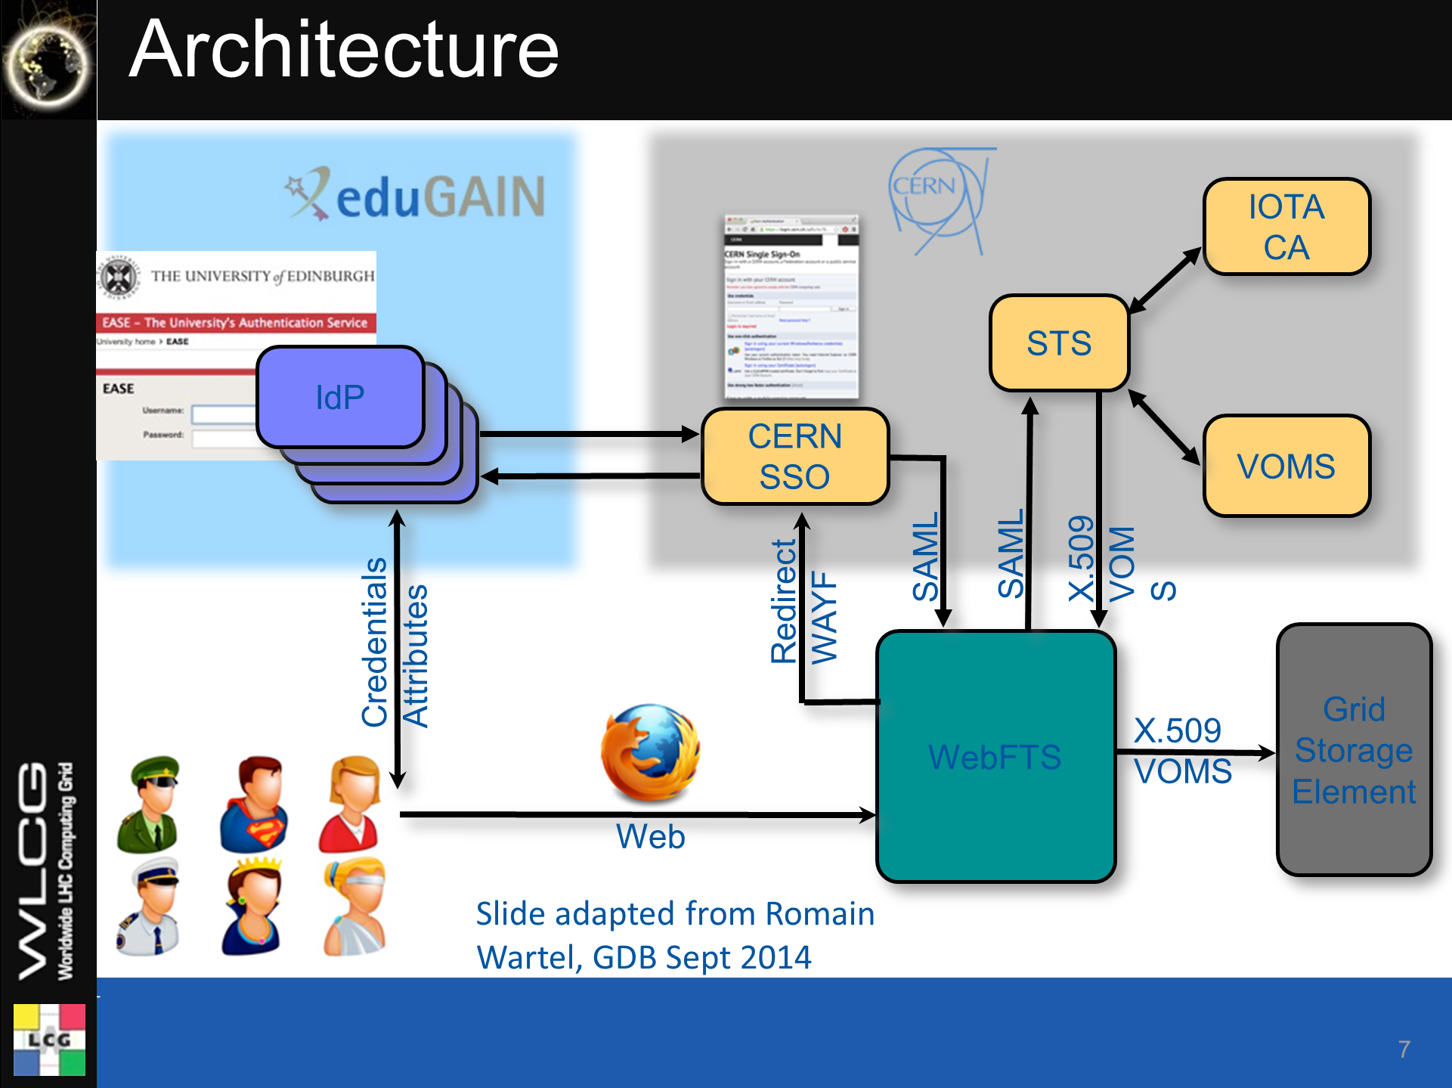
STS Security Token Service supported by Henri Mikkonen of NimbleIDM.com
For wLCG FIM4R pilot romain.wartel@cern.ch

Slide 31
Remember: … not too different!
Elixir Setup (draft)
Graphic sourced from Paul van Dijk, SURFnet

Slide 32




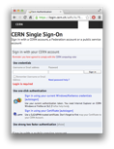
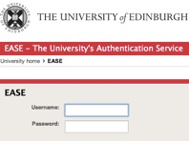

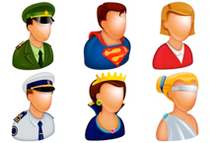
thinking beyond just WebFTS …
Wider accessibility & public use status of eduGAIN?
IOTA
CA
Add TCSG3?
STS, CILogon, …
STS
IdP
IdP
IdP
Trust
Mark
Filter?
+Govt eID
+DiffLoA Guest IdP?
IdP
Community WAYF?
Other community AA services?
CERN SSO
VOMS
SAML
SAML
X.509
VOMS
Redirect
WAYF
Credentials
Attributes
WebFTS
Grid
Storage
Element
Web
GSI/PKI
SASL
IMAP/SMTP
SSH
…
National or Community Credential Management?
X.509
VOMS
Web
+ direct credential provisioning client?
A CILogon clone here?
Just some random thoughts – let’s discuss where this could all go in the next 2 years!

Slide 33
A selective summary
“We have plenty of elements, just little glue”
Trust fabric are evolving and converging rapidly
for both e-Infrastructures and ‘traditional R&E’ federations
Focus must now be on enabling use
not be overly legalistic or we will be by-passed by closed-silo commercials that are less scrupulous than R&E IdPs have been...

Slide 34

Aiming for coherency and pragmatic solutions
Authentication and Authorization for Research and Collaboration
with materials gratefully provided by Licia Florio (GÉANT),
Paul van Dijk (SURFnet), and other AARC collaborators

Slide 35
AARC?
Authentication and Authorisation
for Research and Collaboration
support the collaboration model across institutional and sector borders
advance mechanisms that will improve the experience for users
guarantee their privacy and security
build on the very many existing and evolving components
ESFRI clusters, eduGAIN, national AAI fed’s, NGIs, IGTF, SCI, SirTFi, …
design, test and pilot any missing components
integrate them with existing working flows

Slide 36
AARC - Goals
OUTREACH and TRAINING
  To lower entry barriers for organisations to join national federations
  To improve penetration of federated access
TECHNICAL and POLICY Work
  To develop an integrated AAI built on production services (i.e. eduGAIN)
  To define an incident response framework to work in a federated context
  To agree on a LoA baseline for the R&E community
  To pilot new components and best practices guidelines in existing production services

Slide 37





IdPs – extend coverage
National IdPs
  All SAML, national policies and formats
  Any issues? perhaps promote opt-out approach
VU
eduGAIN IdPs
  All SAML but differences in attribute management
  need policies and formats
TC
“External” access
  Lower barriers for non academia (“externals”)
  Use of Gov e-ID, social IDs, linking accounts
  Support scalable LoA for “externals” accounts
  Deal with “library walk-in users”
TC
graphic: Paul van Dijk, SURFnet
Notes:
Some outlines visible wrt guest access.

Slide 38
Training Activities
Training for IdPs
  Directly focusing on research use cases, engaging their local researchers and their requirements
  Encourage them to harmonize through best practices
  Expand coverage of national identity federations, supporting institutions with low levels of technical or organisational preparedness
Architectures for integrated/interoperable AAI
  technical elements needed for the integrated AAI: attribute frameworks and deployable web & non-web technologies
  Support for guest IdPs
  Integration of multiple sources within and outside R&E
GÉANT,
Alessandra Scicchitano
GRNET,
Christos Kanellopoulos

Slide 39
There are lots of components out there!
Non-Web Authentication
...but no workable global solution ☹
CI-Logon &
Client PKI
Unity-IdM
FACIUS
SAML ECP
GSI over GSSAPI
X-realm KRB
Moonshot*
OpenID Connect
*lacks AuthZ system support
Delegation support - needed for broker scenarios & long-running workflows – mostly missing
PKI/GSI + RFC3820 does it
KRB TGT
SAML ECP could,
but with re-usable ‘golden’ token
OpenID Connect
promising, but not yet there …
Credential repositories + STS can
Attribute&Community management
VOMS &
VOMS-SAML
PERUN
REMS
HEXAA
Conext
LDAP queries
Co-manage

Slide 40
Technical pilots
Pilots on integrated R&E AAI
  Introduction of attribute management services
  Access to R&E + commercial services
  Guest services, also for SME/R&D collaborators
  Build PoCs together with the community
  Demonstrate ‘production-worthy’ pilots that
  have a sustainability model
  e.g. adoption by the GEANT services activity, run by the research community, or by the e-Infrastructures
  Facilitate researchers to collaborate in a secure and trusted virtual research environment
SURFnet,
Paul van Dijk

Slide 41

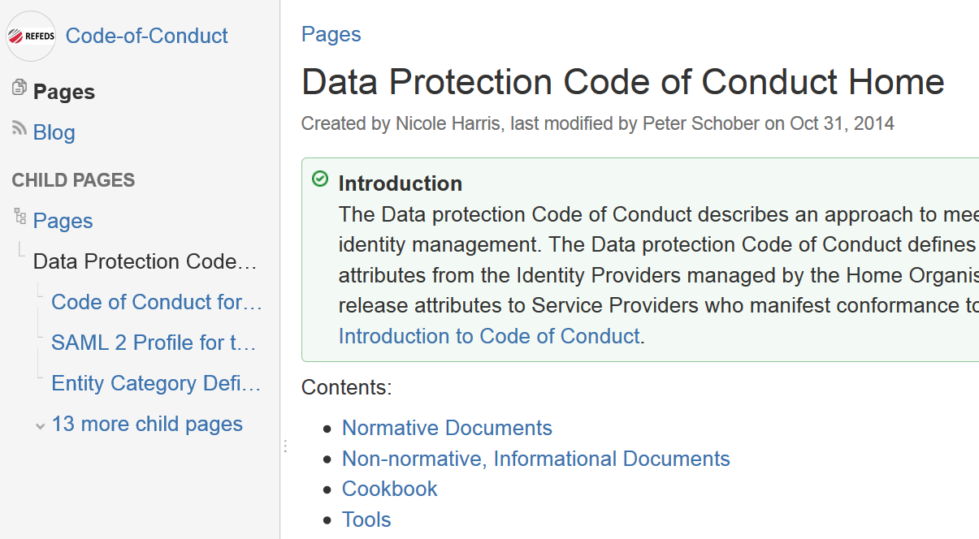
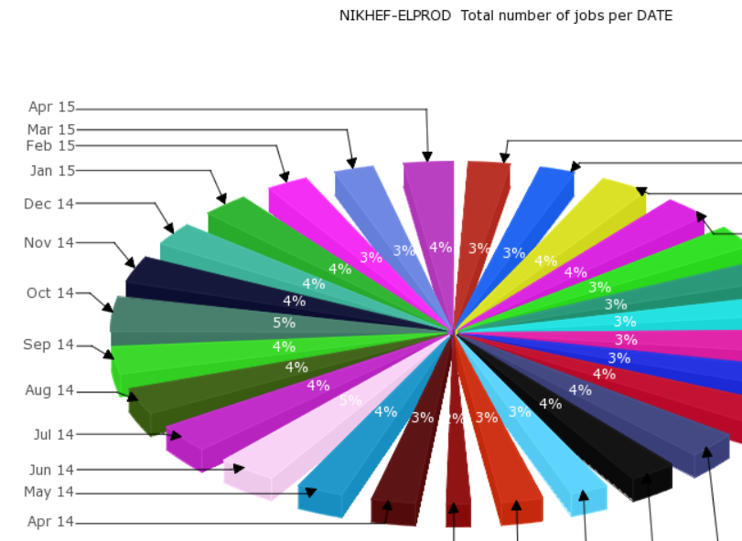
Policy challenges
‘What does assurance mean?
Who needs to say so?
Can we have ‘mixed quality’ attributes?
What’s a sustainable distribution of
responsibilities amongst AAI participants?
How can we share necessary accounting?

Slide 42
Policy and best practice harmonization
Policy and Best Practices harmonisation
  collate a level of assurance framework
    for SPs: where we already have DP CoC, R&S EC
    for IdPs: express reasonably achievable assurances
    for AAs and communities: a ‘new’ domain
  consistent handling of security incidents (in eduGAIN &c)
  scalable policy expression and negotiation
    identify policies needed for attribute aggregation
    policy & security to enable the integration of attribute providers and of credential translation services
  support models for (inter)federated access (i.e. how are we going to sustain something scalable once AARC is over?
  guidelines to enable exchange of accounting data
Nikhef,
DavidG

Slide 43
Liaisons with other groups

Slide 44
Where are we now
Started on May 1st
Open kick-off meeting
June 3+4, Amsterdam, NL
  Theme sessions around cross-activity topics, e.g.
  ‘how to enable access for guests and non-academic users’, crossing topics such as technical IdPs of last resort, access policies, LoA for guests, engagement with industrial R&D, support for library walk-in users in a digital content world’
  ‘enabling expression of SCIRT collaboration by IdPs through federation through to resource providers’

Slide 45










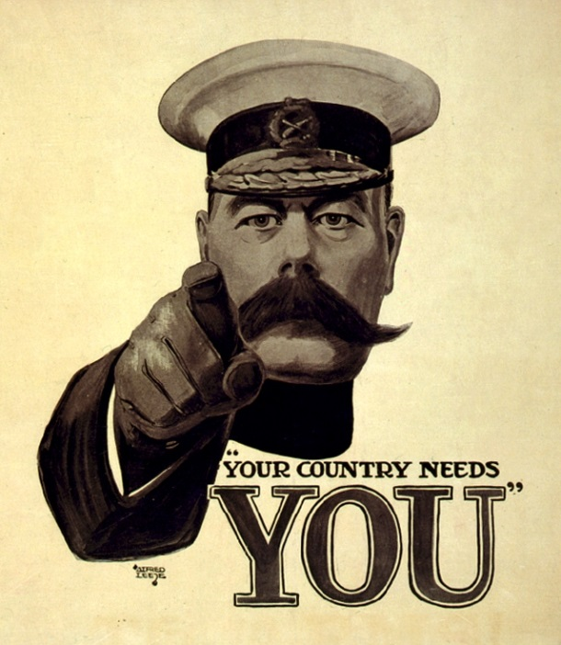







AARC needs you – please engage
http://aarc-project.eu/

