Slide 1


The International Grid
Trust Federation
enabling an interoperable
global trust fabric
also supported by EGI.eu
EGI-InSPIRE RI-261323, and
BiG Grid, the Dutch eScience Grid

Slide 2
The Need for a Global Trust Fabric
More than one administrative organisation
More than one service provider
participates in a single transaction
More than one user
in a single transaction
More than one authority
influences effective policy
Single interoperating instance
at the global level

Slide 3
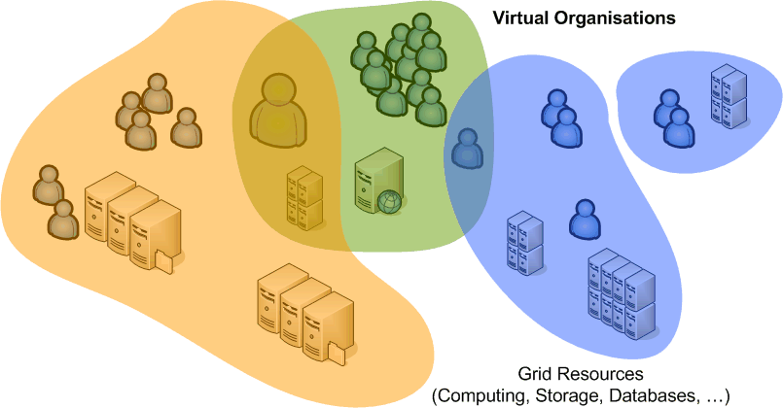
Overlapping Communities –
Common Trust
Reduce over-all policy burden
by adhering to common criteria
Goals
allow multiple sources of authority: User, Institute, Community
acknowledge both long- and short-term community structures
enable security incident response and containment
balance data protection and right to privacy
to
provide basis for access control decisions by resources and communities

Slide 4
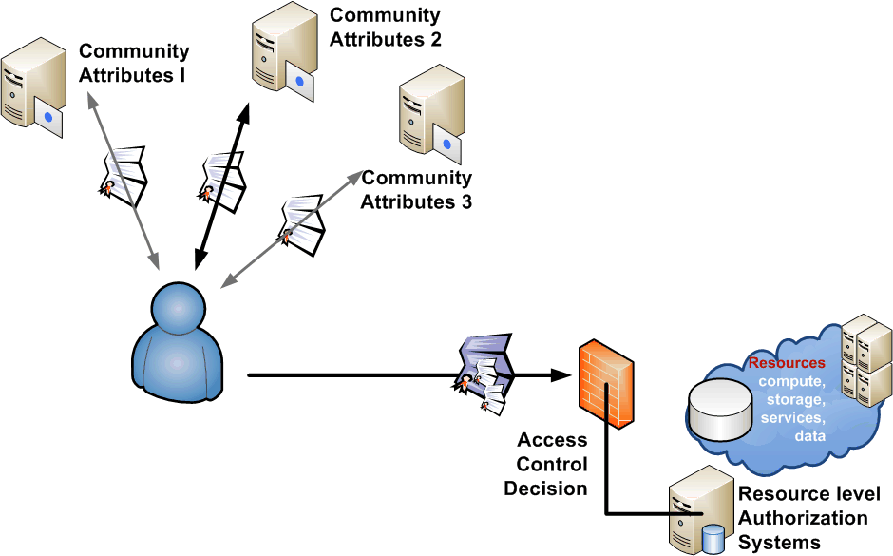
Attributes and Access Control
Several communities have complementary information for a user
Access control based on policy expressed in these attributes, including the ID
attributes will need to be linked
link identifier to provide persistency

Slide 5




Requirements on a trusted source
Privacy and data
protection
important ‘unalienable
right’ for research
correlation of PII among
service providers could allow profiling
exchange of PII often fraught with issues
Access Control Attribute handle
unique binding
never re-assigned
Measurement and
Accounting
publication metrics
usage metering, billing
auditing and compliance monitoring
Incident Response
long-term* traceable
independent from
short-lived community
must be revocable
correlate with other information sources
banning and containment handle
A common ID must live
in a policy ecosystem to protect participants
and to limit its use to specific purposes

Slide 6
Elements of Trusted Identity
Vetting and assurance – for identity and attributes
  vetting rules and data quality
  expiration and renewal
  revocation and incident containment
Operational requirements for identity providers
  operating environment and site security
  staff qualification and control
Publication and audits
  openness of policy, practices and meta-data
  review and auditing
Privacy and confidentiality guarantees
Compromise, disaster recovery and business continuity
OGF CAOPS-WG: Authentication Profile Structure, WG draft

Slide 7
Assurance levels
Trust in the assertions
by resource and service providers is key
Until now, our e-Infrastructure used a single ‘level’
  there are well-known ‘government’ standards for LoA
  (US: OMB M-04-04 & NIST SP800-63)
  but 95/46/EC and 1999/93/EC are not of much use to us
  and the Nice treaty states that identity is a national matter …
  there is rough but not 1:1 correspondence between balanced needs of the providers and users and the NIST LoA levels

Slide 8
Authentication Assurance – SP800-63
Remote authentication over a network
LoA | ID vetting | Technical controls
1 | - none | no plaintext transmission
2 | inperson: photo-ID and address remote: two independent factors (photo-ID & finances) which is checked at the source, and confirmed to address on record | password, pin or better, but verified directly & only with the credential issuer
3 | inperson: photo-ID and address that is checked against its authoritative source remote: like LoA2, but stronger consistency | two-factor from private key, one-time password, or secure hardware token
4 | inperson: two photo-ID documents and taking of a new biometric remote: - not allowed | two-factor, with at least a qualified secure hardware token at FIPS-140 L2+
LoA2 ‘in person’ is usually strong enough, but auditing is commonly done based on a well-understood principles in the world of scholarly research: peer review and scrutiny

Slide 9
IGTF Assurance Levels
Type and classification of e-Infrastructure services
drives the level of assurance required
Security and assurance level set to be commensurate
  not overly high for ‘commodity’ resources
  not too low, as providers otherwise start implementing additional controls on top of and over the common criteria
  defined in collaboration with resource providers
  using transparency and a peer review processes
  leveraging our own community organisation mechanisms

Slide 10
Establishing the IGTF – EU AP TAG
EU DataGrid established Coordination Group in 2000
Global need resulted in the 2003 Tokyo Accord
With start of production e-Infrastructures
  EUGridPMA established with DEISA, EGEE, SEE-GRID, and TERENA (TACAR) as relying parties and national identity providers in 2004, with e-IRG endorsement
  APGrid and PRAGMA establish the APGridPMA
  Canada, EELA-countries and USA IdPs establish TAGPMA
Consistent guidelines and service provider involvement

Slide 11
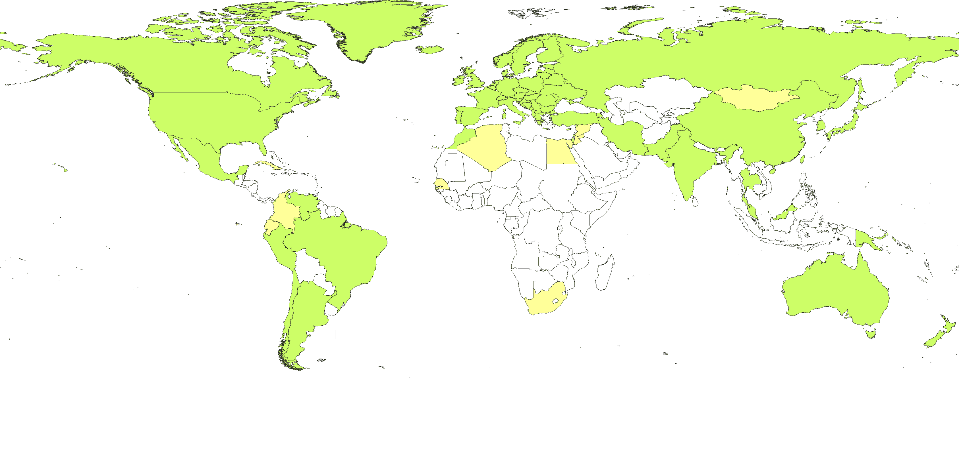



Global Trust
86 accredited authorities from 53 countries and economic regions

Slide 12
Structure of Trust
Common criteria and model
  globally unique and persistent identifier provisioning
  not fully normative, but based on minimum requirements
Trust is technology agnostic
  technology and assurance ‘profiles’ in the same trust fabric
  ‘classic’ traditional public key infrastructure
  ‘MICS’ dynamic ID provisioning leveraging federations
  ‘SLCS’ on-demand short-lived token generation
  a basis for ‘arbitrary token’ services
  new profiles

Slide 13
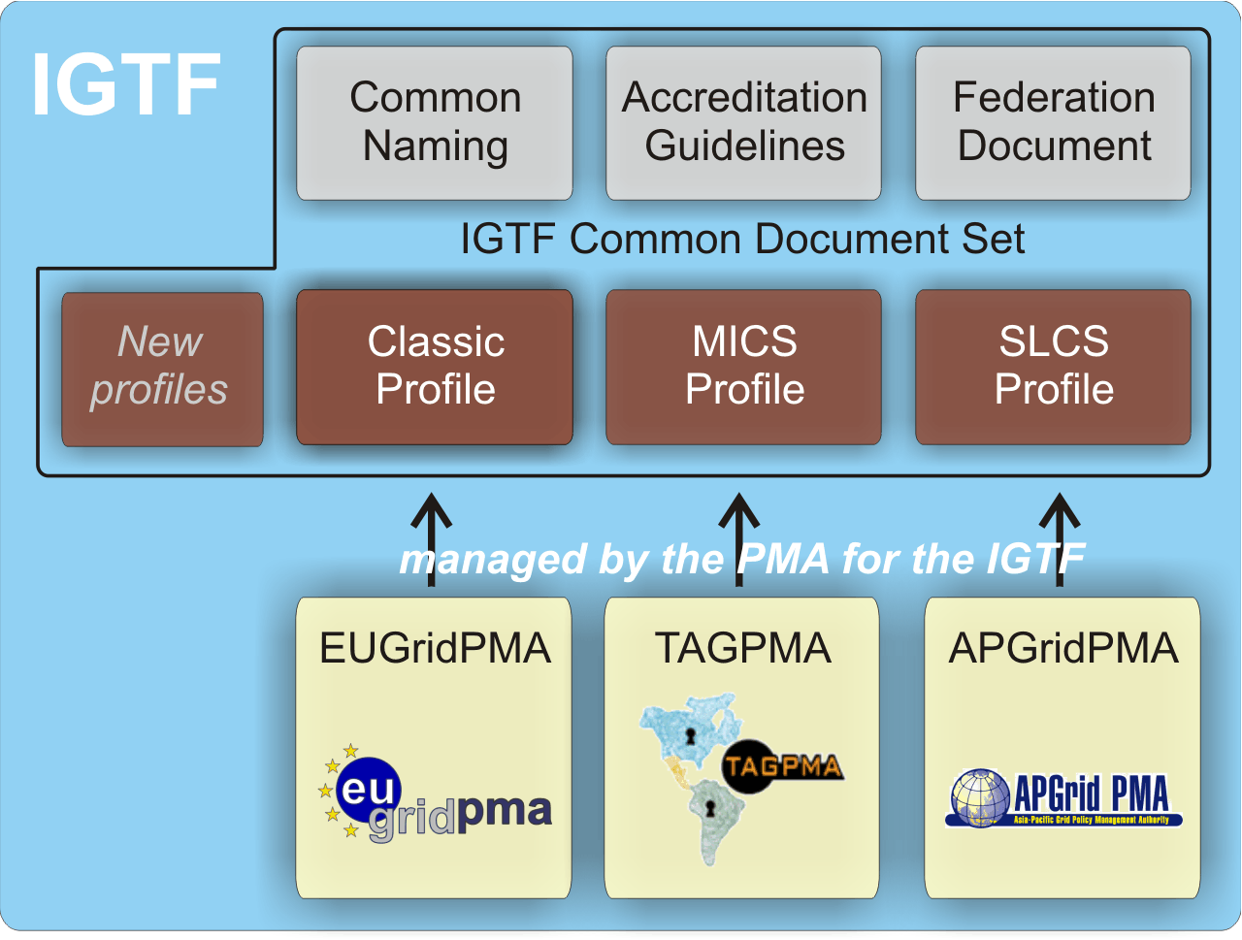
IGTF Common Criteria

Slide 14
Assurance levels in the IGTF
Technical and operational controls
Authorities come in two basic flavours
  off-line (only used in ‘traditional’ PKI): human controls and air-gap security provide protection against attacks
  on-line infrastructure (federation-backed, SLCS and classic): valuable security material is network connected need compensatory controls:
    secure hardware, compliant to FIPS 140-2 level 3
    additional layered network security
Technical requirements apply to any attribute source
  such as community registries like ‘VOMS’

Slide 15
Vetting Assurance Levels
Identity controls and vetting
long-term traceable assurance (classic, MICS)
  based on in-person checking of (nationally defined) official identity documents
  recorded identity persists beyond the moment of issuance
  assertions can live for a long time (over a year) to facilitate long-term use
  but compromise may happen, so is revocable
momentary assurance (SLCS)
  traceability to a physical person for at least one year
  may use any vetting mechanism that assures that traceability
  but assertions are limited in time to 24 hours (unless revocable, in which case: 11 days)
https://www.eugridpma.org/guidelines/{classic,mics,slcs}

Slide 16
Building trust – an exercise in scaling
Accreditation process
  Extensively documented public practices (CP/CPS, RFC3647)
  Interviewing and scrutiny by peer group (the PMA)
  Assessment against the Authentication Profiles
  Technical compliance checks (RFC5280 and GFD.125)
Periodic, peer-reviewed, self-audits
  Based on Authentication Profiles, standard reference: GFD.169
  OGF & IGTF, inspired by NIST SP800-53/ISO:IEC 27002
Federated assessment methodology by region (IGTF)
https://www.eugridpma.org/guidelines/accreditation

Slide 17
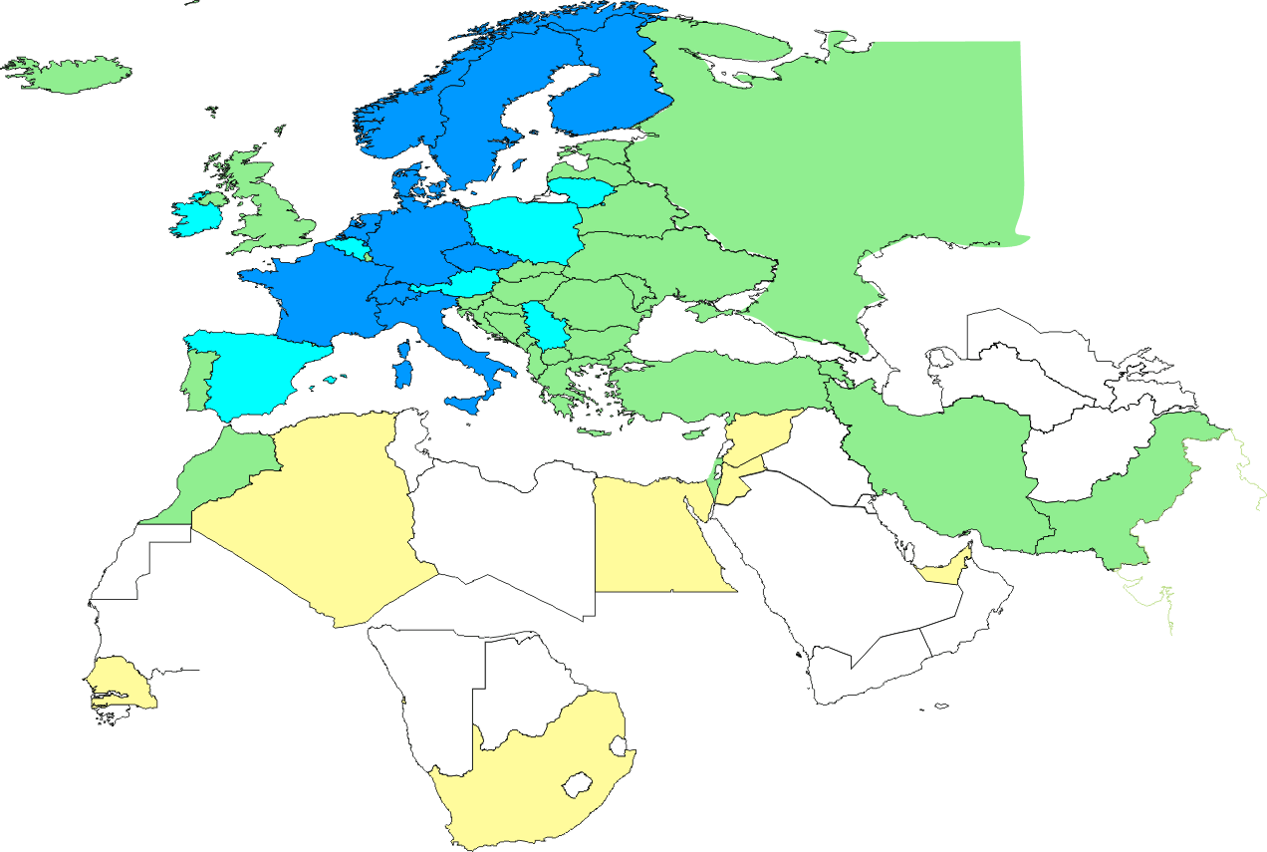
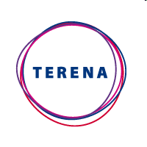


Federated Identity in Europe Today
Map colour coding
Green: classic accredited authority
Blue: classic + federated authority
Yellow: pending classic accreditation
Federated ‘translating’ authorities: integrity requirements propagate to all data sources
e.g. TERENA Certificate Service qualifying Federations IdPs meet all IGTF requirements
and TCS provides instant access to globally trusted identities
Also in Australia: ARCS SLCS, in USA: CILogon

Slide 18
Beyond identity
Many attributes come in to an authorization decision
  identity, community, group membership, roles, position, ...
  the ‘other attributes’ are important for contextual control
  and thus of importance beyond only resource providers
Operational requirements
translate easily to any kind of attribute source
Operational and assurance requirements
apply where assertions are bridged such as in the STS

Slide 19
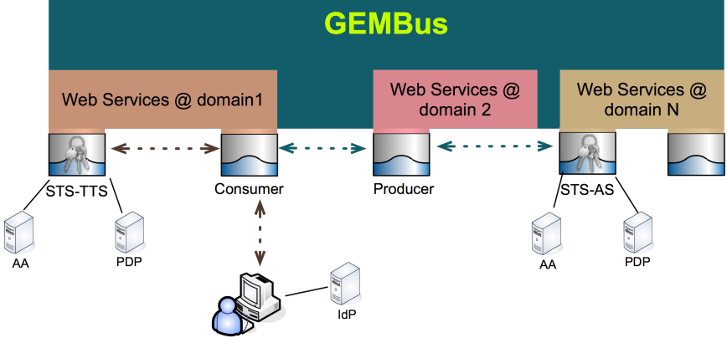

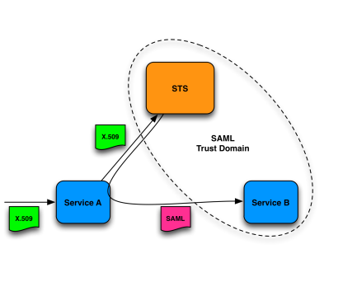
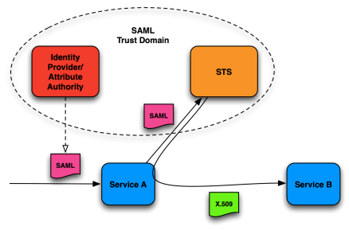
Carrying assertions across domains
Service access crosses technology and domain boundaries and may need translating in a Security Token Service (STS)
  trust relationship
  operational requirements
STS examples: GEMBus, EMI-STS, ...
Requirements on
assurance level
operational security
auditing, data protection
and transparency of process all remain
GEMBus image by Diego Lopez, RedIRIS and GEANT, 22nd EUGridPMA meeting
EMI STS image by Christoph Witzig, SWITCH and EMI, 22nd EUGridPMA meeting

Slide 20
Common Criteria and Diversity
Up till now ...
  providers of compute and storage services
  in e-Infra able to agree single ‘least common denominator’
  many content-only (web site) providers could live
  with lower assurance and asked no real LoA requirements
... but this may be changing
more diverse content and services being offered –
via many mechanisms, both web and non-web
  may need diversifying not only technology, but also LoA

Slide 21
So why IGTF?
Trust is technology independent
Agreeing on common minimum requirements on global scale
  facilitates interoperation across infrastructures
  significantly reduces potential for failures and obstacles for interop
Participative model, including major relying parties and
national representatives, ensures commensurate security level
  the single assurance level is convenient, but the world will likely diversify
  the IGTF assurance levels will follow and adapt as a result
  as well as expand to address changing technologies
Defining assurance requirements need strong involvement
by relying parties, resource providers and users

Slide 22
International Grid Trust Federation –
http://www.igtf.net/
EUGridPMA
European Policy Management Authority for grid authentication in e-Science –https://www.eugridpma.org/

