Slide 1
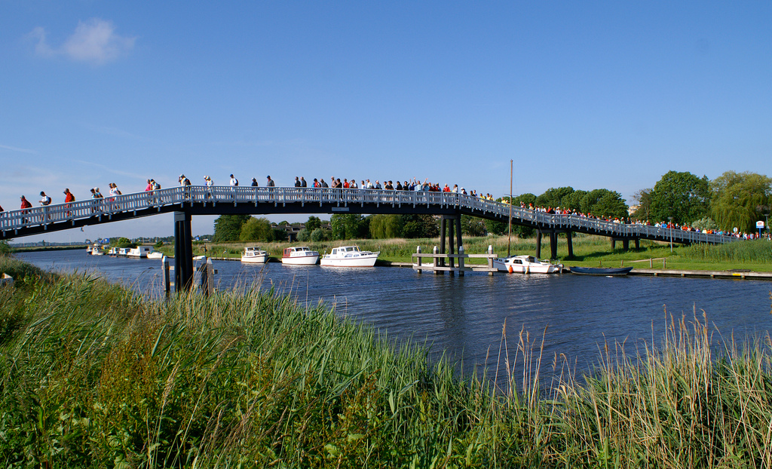
Bridging between infrastructures in the polder
Collaboration amongst e-Infrastructures at the
technical and policy level – a (biased) personal view
David Groep,
Nikhef and the Dutch National e-Infrastructure
TTC meeting 2015-11-23
except where otherwise noted on images
logos owned by respective trademark holders
and used as citations only
Foto: Reinier Sierag, CC-BY-NC, https://www.flickr.com/photos/sierag/4704274634

Slide 2
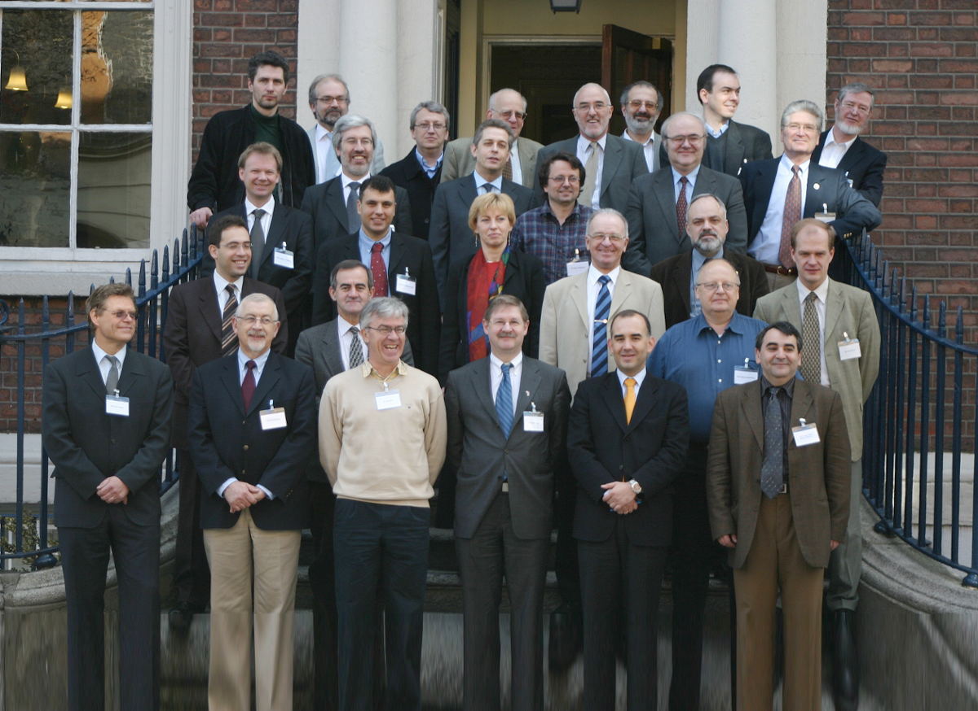
‘Operational aspects of service provisioning across e-Infrastructures’
The term e-Infrastructure is used to indicate
the integrated ICT-based Research Infrastructure in Europe.
Of course such an infrastructure builds on many ICT components that have been around for quite a while, such as networks, supercomputers and storage. There are many interdependencies between these components, so their future should be planned coherently. The e-Infrastructure viewpoint allows to join and fit all interrelated infrastructures together and start think of them as a system – and optimise not for each individual part, but for the whole.
e-Infrastructures Roadmap 2005
e-IRG inaugural meeting, Dublin 2004 – a wide range of policy makers from across many infrastructures

Slide 3
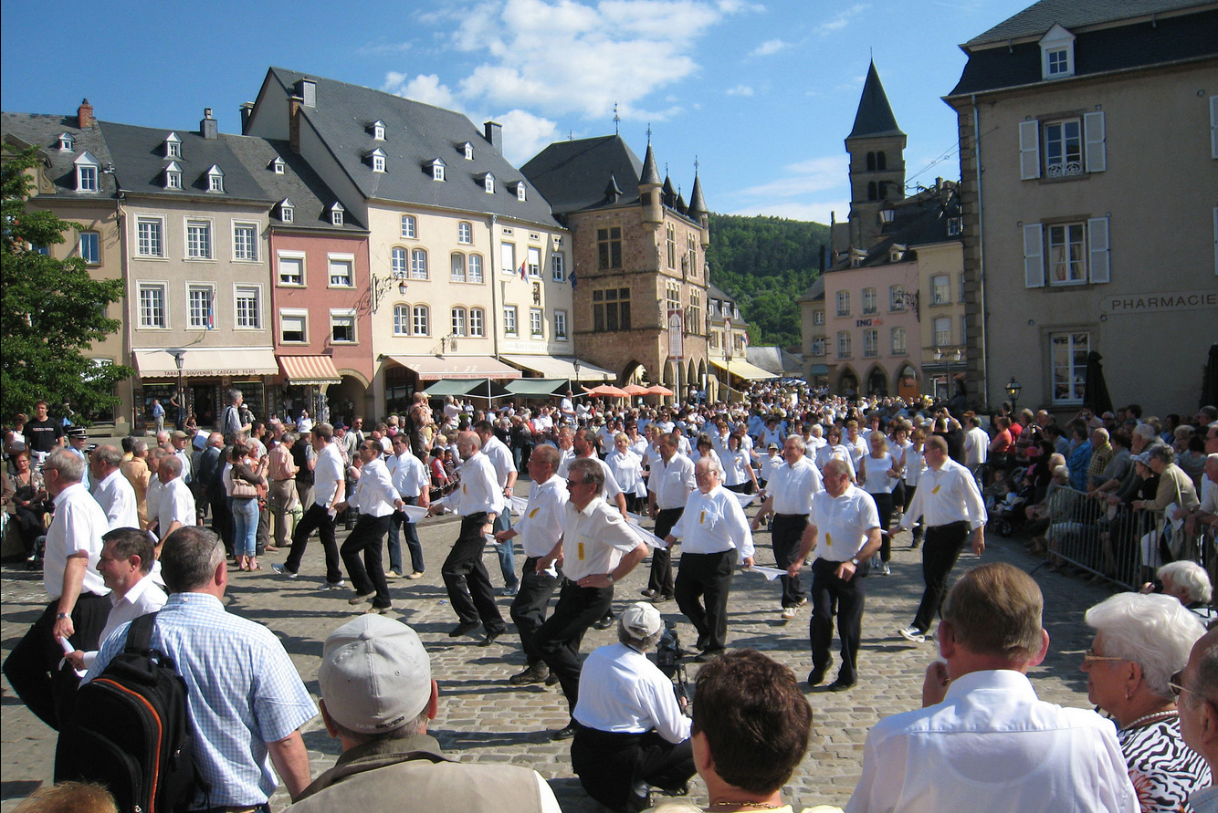




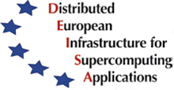

Cross-infrastructure services are not new
… even if success at times is incidental rather than by construction …
… it may be two steps forward, then one step back …
… since shortcuts are frequent as It Has To Work™ – right now …
interconnection of complex heterogeneous High Performance Computing systems in a cross-organizational and cross-domain manner.
‘designing middleware to support a particular kind of distributed application, known as a close-coupled application, and at assessing the middleware using industrial applications across the European GEANT network.’
Background picture: Willibrord’s processing, Echternach, LU
Photo: David Edgar, CC-BY-SA, from WikiMedia

Slide 4
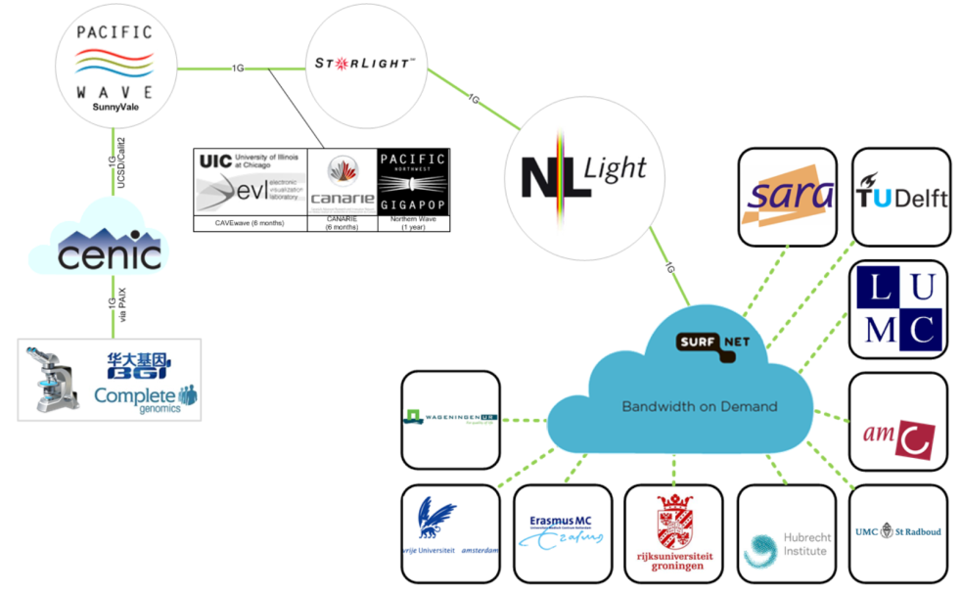
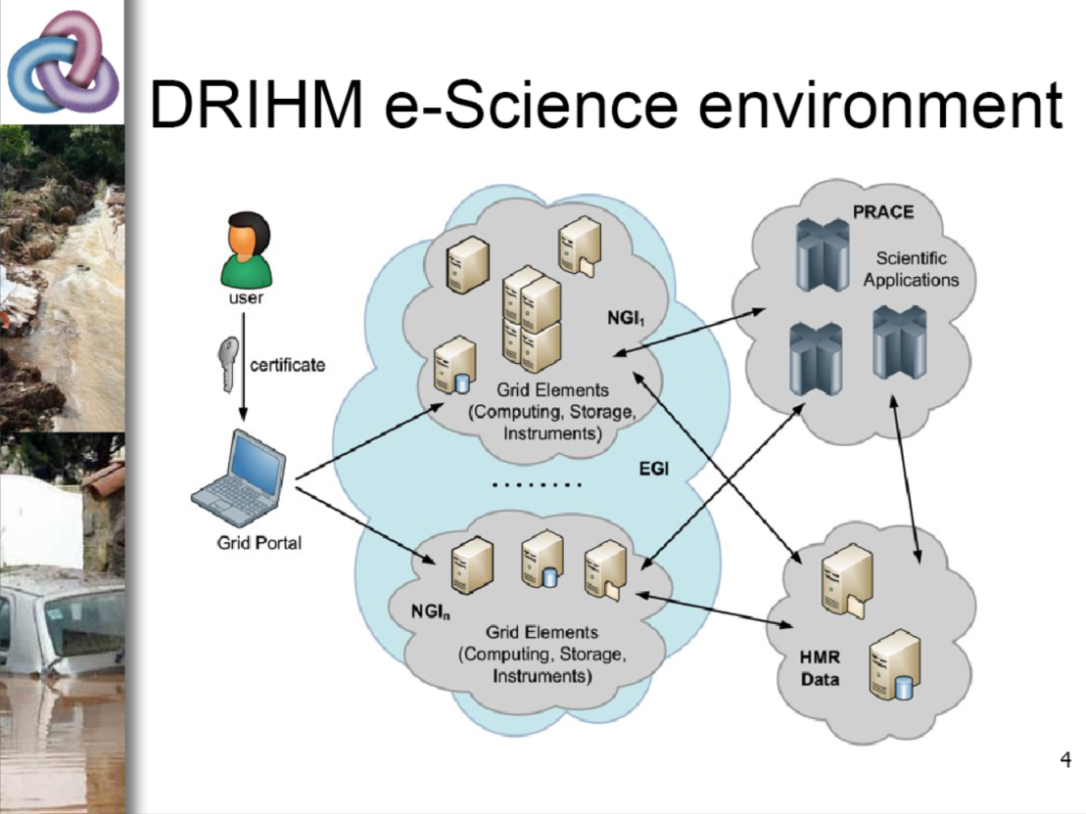
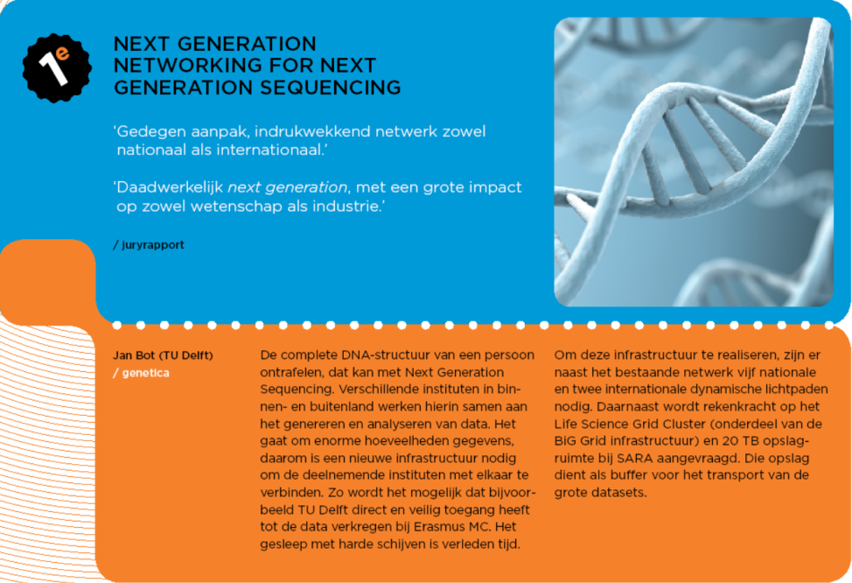
Shared applications
Slide: Nicole Gregoire, SURFnet for EYR3, CC-BY
T.K.Millard, Q.K.Harpham, HR Wallingford
at the GO-ESSP Abingdon meeting, Feb 2015
SURFnet, EYR3 flyer

Slide 5


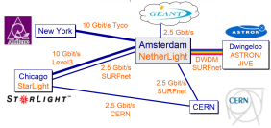





Common technology and direction?
Where needed & obvious, common solutions were applied
But specific use cases and models resulted in divergent interfaces and middlewares for (higher-level) services
Driven by the need to Make It Work Now
  the e-Infrastructures today are the result of an emergent system
  there was not the luxury to ‘play around’ for a decade
  operational production infrastructure for research (like LCG) needed

Slide 6
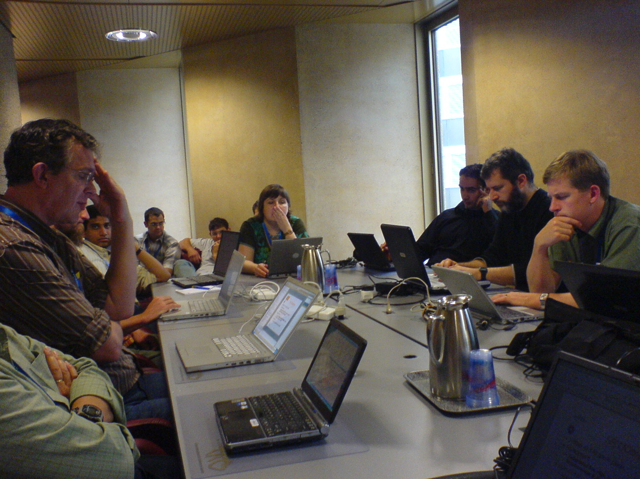
Shared users – shared concerns
Emerging user-fronting multi-domain infrastructures faced
similar issues in Authentication, Policy, and Authorization
Authentication and identification
Accounting and metering
Application and Granting
Middleware Protocols
Acceptable Use
Coordinated Resource Sharing
Authorization, access control, and provisioning
‘EUGridPMA’
‘UR-WG’
‘IPG’
‘JSPG’
‘OGF’
‘IGTF’
‘SCI’
‘e-IRG White Papers’

Slide 7
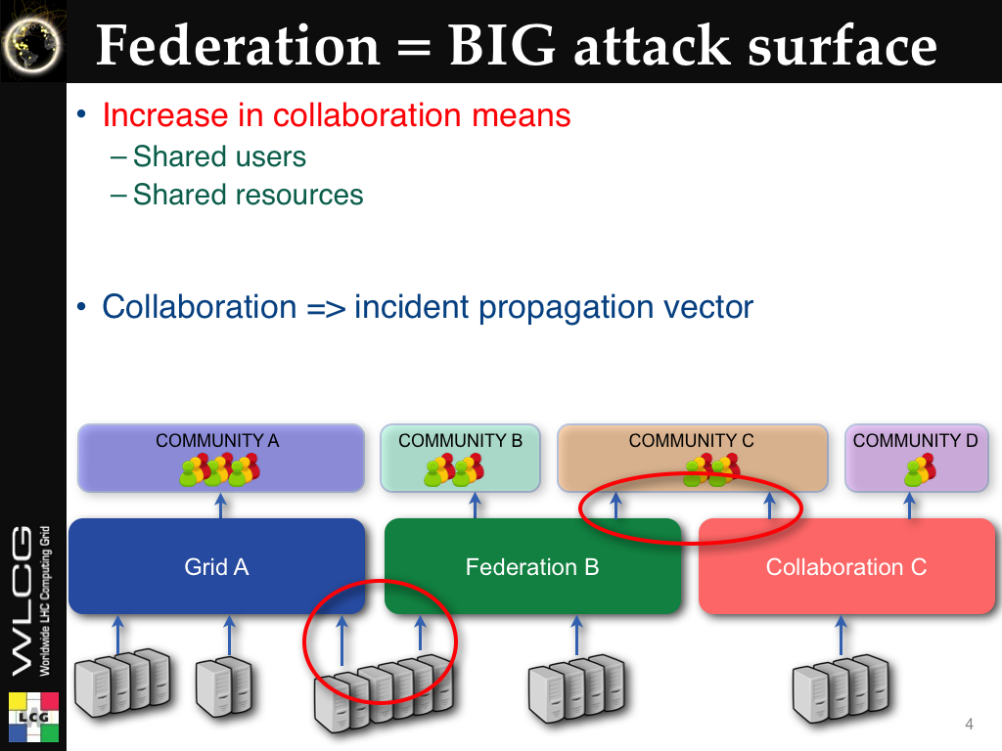
Shared users spurring practical, global, collaboration …
Slide: Romain Wartel, CERN – wLCG Security

Slide 8
Common authentication of users
… a ‘bottom-up’ approach may just work
* First meeting March 2003 at GGF 7 in Tokyo
* Will continue to meet at GGF conferences. Next meeting Seattle.
* Will work on forming the Grid Policy Management Authority:
GRID PMA.org
- Develop Minimum operational requirements - based on EDG work
- Develop a Grid Policy Management Authority Charter
* Representatives from Major Grid PMA
- European Data Grid and Cross Grid PMA
* 16 countries, 19 organizations
- NCSA Alliance
- Grid Canada
- DOEGrids PMA
- NASA Information Power Grid
- TERENA
- Asian Pacific PMA
* AIST, Japan
* SDSC, USA
* KISTI, Korea
* Bll, Singapore
* Kasetsart Univ., Thailand
* CAS, China
‘TeraGrid/XSEDE US HPC’
You know them ☺
Tokyo Accord, 2003, the inception of the IGTF

Slide 9
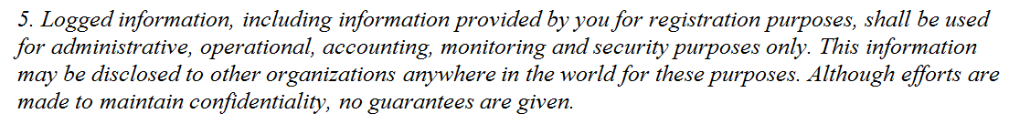
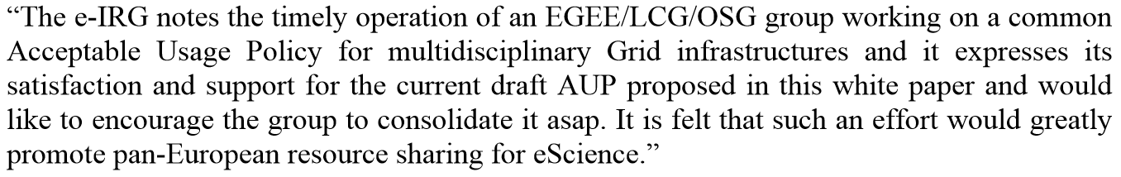

Common AUP to enable collaboration
E-Infrastructures, being ‘end-user facing’ and independent of ‘home’ administrative domains, need an AUP to inform and bind users – and to foster collaboration, all major international ‘e-’ and ‘cyber’ infrastructures agreed on a single common basis: the ‘Taipei Accord’ (2005)
EGI, wLCG, OSG, PRACE, XSEDE

Slide 10

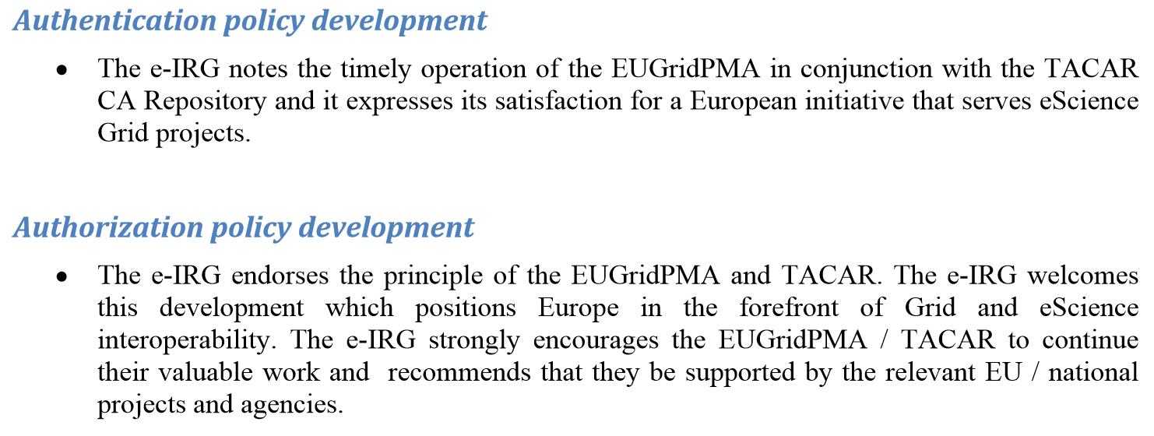



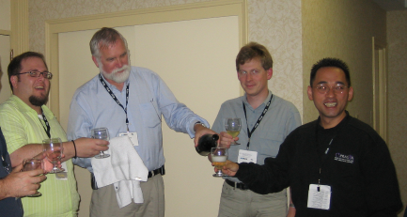


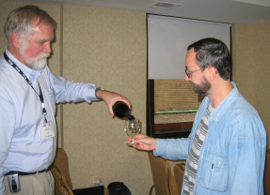




e-IRG White Paper created a fruitful collaboration
e-IRG white paper 2004 (IE)
Infrastructure ‘Relying Party’ members in 2005 and later

Slide 11


A mandate that has been there all along
[In the] Council of the European Union … a substantial majority of delegations supported the following Presidency conclusions: …
E.15. UNDERLINES that the present actions to support existing research infrastructures, integrating activities and trans-national access to facilities should be continued and reinforced …
Including e-Infrastructures, i.e. GEANT infrastructure projects for the interconnection of electronic research networks and GRID architecture empowered infrastructures.
2624th Council Meeting, 25-26 November 2004

Slide 12
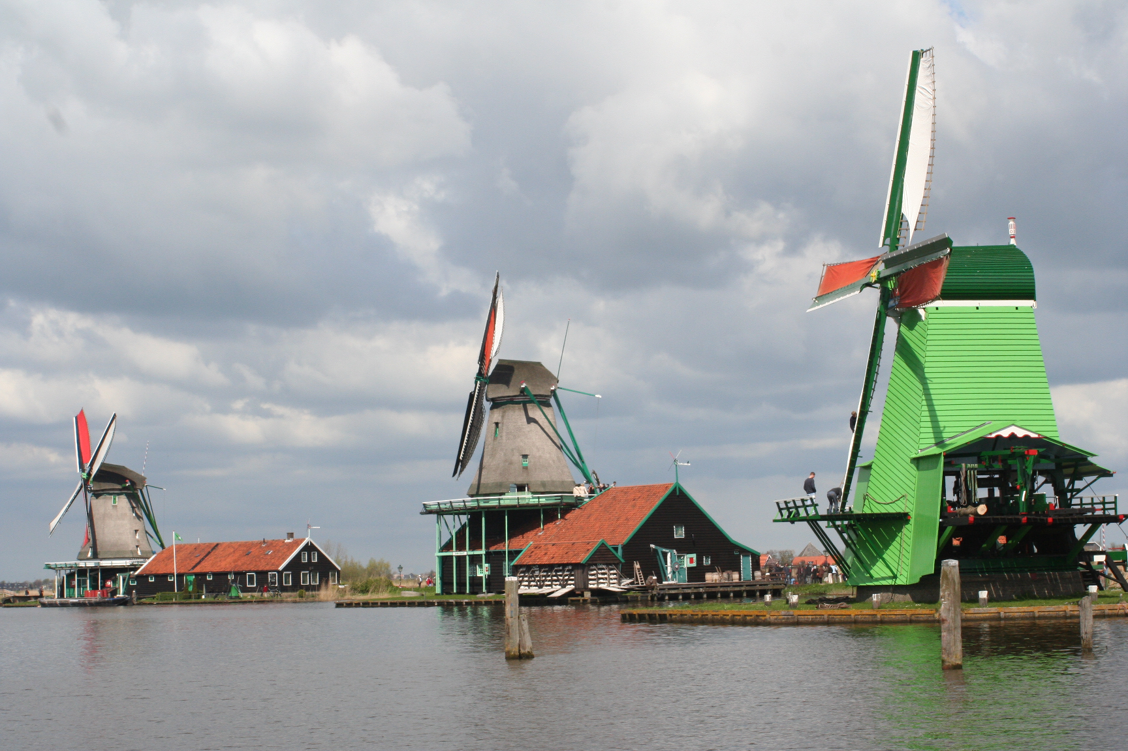
But working together takes time
– let’s look at the Dutch example
Photo: Teun Spaans – WikiMedia commons CC-BY-SA

Slide 13
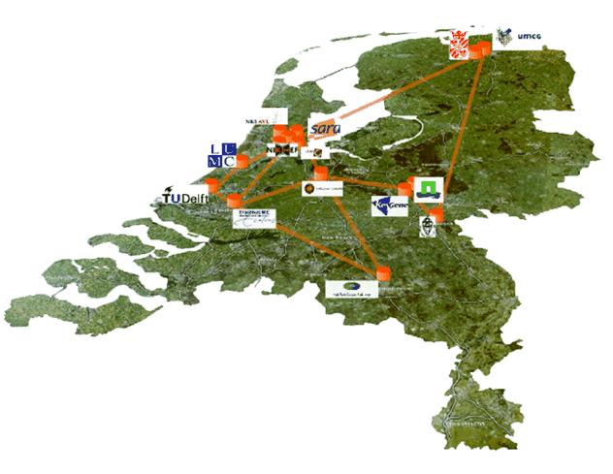



Dutch National e-Infrastructure today
operational partners
coordinated by

Slide 14
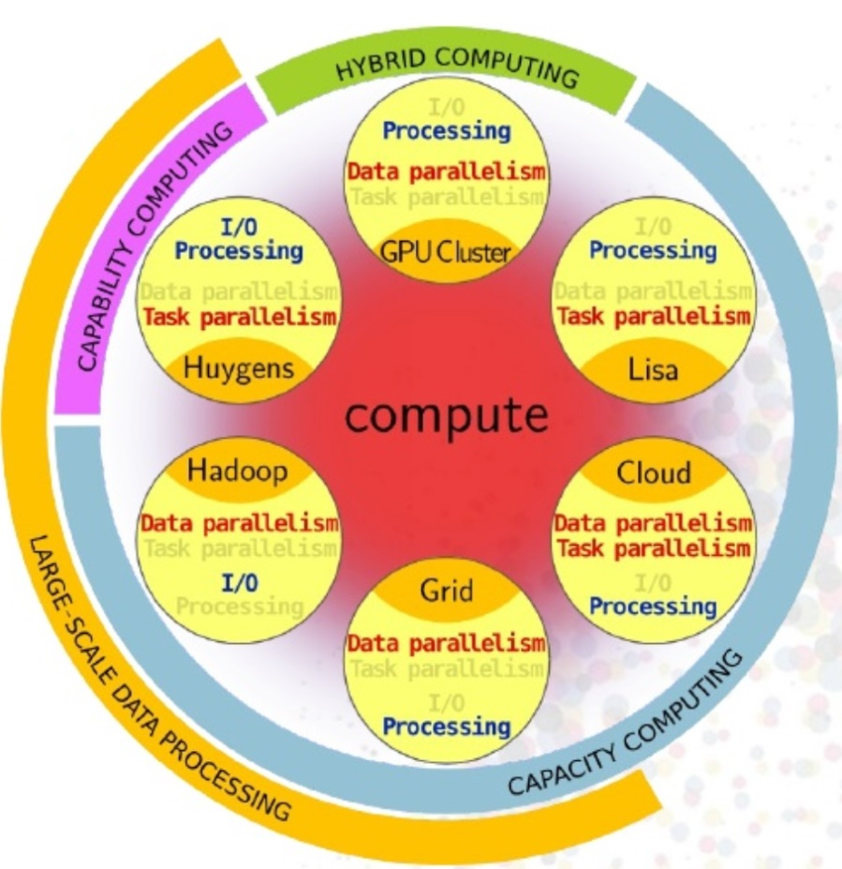
DNI data and compute services
Data Ingest Service
High-throughput
storage
Long-term archival
“Lisa” low-latency compute cluster
Carthesius T1 HPC
HTC IaaS data processing Cloud (several, est: 2016)
‘Grid’ data intensive processing platform
HPC Cloud (IaaS)
Hadoop
GPU
BeeHub
SURFdrive
Graphic: SURFsara, Evert Lammers

Slide 15








An Interesting Journey: 2000…2015…2018+
2000
2008
2013
2015

Slide 16





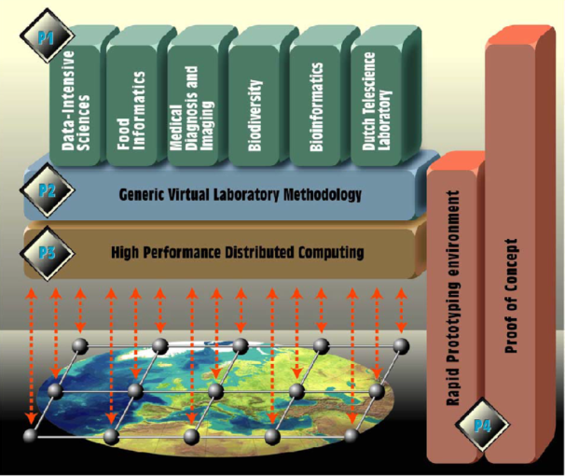
Convergence needs concrete use cases
Especially in the ’90s and early millenium SURFnet was a highly ‘researchy’ NREN supporting basic research through GigaPort – but engaged real end-users at the same time
Virtual Laboratory for e-Science: a joint experiment driven by users, but set up to establish a scalable, reliable infrastructure
food informatics, medical imaging, biodiversity,
bio-informatics, ‘tele-science’ lab, data-intensive science

Slide 17

Development of an Infrastructure
In the Netherlands, throughout VL-e, EU DataGrid NL, and NCF ‘NL-Grid’, although driven by (mainly) Nikhef and UvA use cases, the target was explicitly to build a generic infrastructure for research and innovation.
It yielded BiG Grid – the Dutch e-Science Grid – following a intense (but messy) episode, a foundational project driven by actual end-users but giving a prominent role to operational infrastructure partners (esp. SARA, but also RUG-CIT and at the Philips Research HTC)

Slide 18
BiG Grid – the Dutch e-Science Grid
~ 30M€ data and compute infrastructure ‘pathfinder’ investment project
“Best project I’ve ever been involved with” (and yielding ~ 1MEur/page)
Combining HTC/Grid, HPC co-funding, data services, and infra innovation (cloud)
Hardware (80%)
Application support (20%) with a focus on LS + humanities
Almost entirely application driven: Nikhef + NBIC + NCF (on behalf of the HPC users) but pushing for a service fostering a national e-Infrastructure
We had seen what happened elsewhere: if we want to keep getting funding for HEP and LS to come from generic sources, we have to present and run it as a generic service. For a single domain one will never get generic funding – so you need to diversify, and SARA was the obvious nucleus
with industrial R&D involvement for both applications and operations
But VL-e, GigaPort, and BiG Grid were all ‘impulse-financed’
– and not sustainable. A radically new approach was needed …

Slide 19
ICTRegie rapport
In 2008 we – application domain, infrastructure providers, networks – collectively convinced the government that “maintaining the recognized high level of scientific output in the Netherlands requires an excellent ICT infrastructure. Even more, the Netherlands has great opportunities in the field of the development of e-science. These opportunities are originating from directed investments in the network (SURFnet6/GigaPort), in extension and renewal of supercomputers (Huygens, Blue Gene), and in projects like LOFAR, VL-e and BIG Grid, next to NWO research programs like STARE, GLANCE and VIEW.”
Everyone collaborated because the push was to move from project to sustainable funding – a luring perspective!

Slide 20

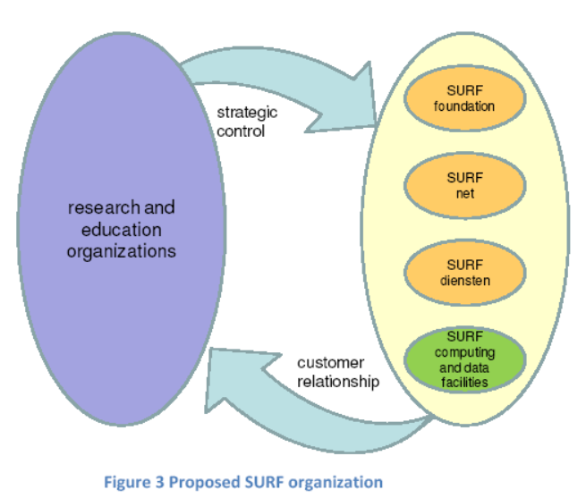
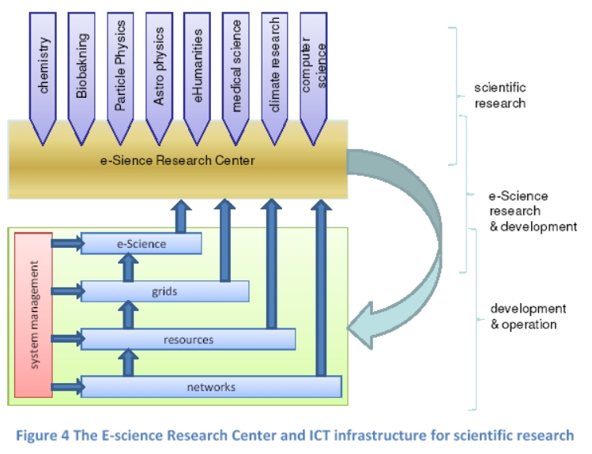
You then get some …
‘users don’t care who provides the service, as long as they get all of it in one spot, without hassle’
science domain input through both SURF
stakeholder engagement and via the NLeSC
after the dust has settled, which takes >1-2 years

Slide 21
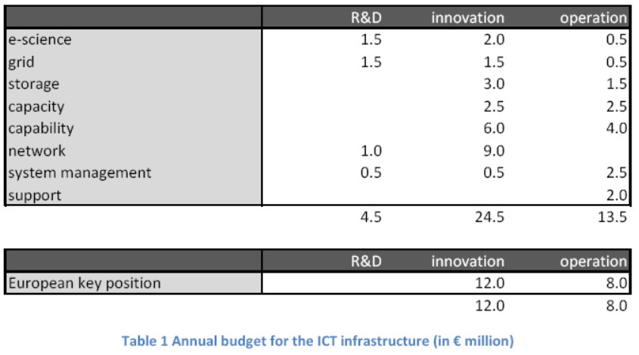
… but not all
First of all, you get less money
  “SuperNode” (PRACE-T0)
  ambition had to be abandoned
  Not all the money was forthcoming as intended, so we got
  both sustained funding as well as a sustained funding gap
Granting bodies (NWO)did not want to relinquish control over the (super)computing granting process which they traditionally controlled
  government followed their advice
  and that anomaly hunts us to this day …

Slide 22


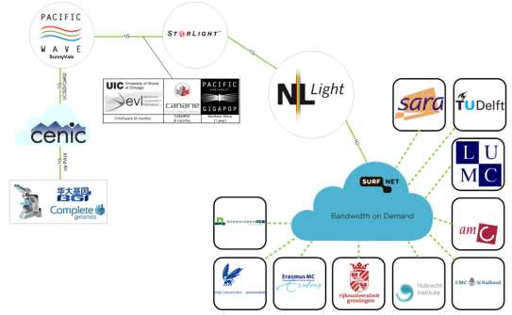

But once you think of it …
Hardware
Support people
Money
Jan Bot – ‘Next generation networking for next generation sequencing’
linking data sources at BGI through lightpaths and GLORIAD to a distributed grid of clusters at UMCs and with central HPC Cloud @SARA
Frank Seinstra – ‘Jungle Computing’
Dynamic allocation of HTC, HPC, and cloud resources connected by lightpaths

Slide 23
















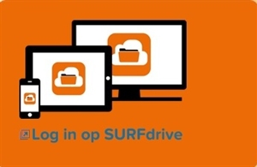
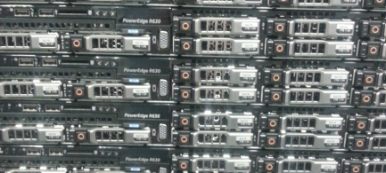
SURFdrive
DNI CCDP @ SURFsara

Slide 24
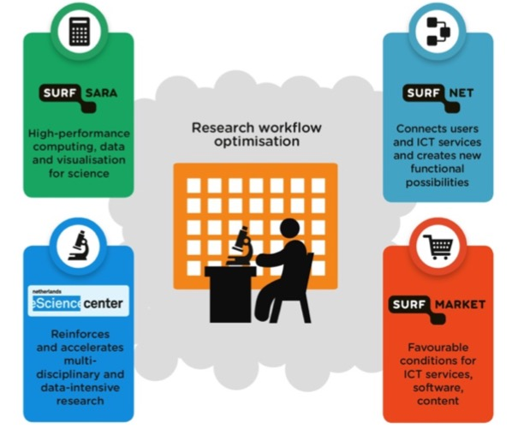
SURF
Compute
Super computer (Caratesius)
Beowulf cluster (LISA)
GRID (GINA + LSG)
HPC Cloud
HADOOP
Network
Routed
Lightpaths (MSPs)
Wireless
Storage
Archive
Grid (disk + tape)
OwnCloud
NoSQL / ElasticSearch
SURFsara: NGI + super computing center
SURFnet: NREN
SURFmarket: collaborative buying
NLeSC: Netherlands eScience Center
SURF is (as of 2015) a cooperative. Universities,
University Medical Centers and research institutes
are members.
Courtesy of Jan Bot, SURFsara

Slide 25
Research Data Life Cycle & SURF Portfolio
Creating
data
Enter a new
Cycle, develop a workplan and apply ICT solutions
Lichtpaths, Netherlight
Bandwidth on Demand
Data Ingest Service
Storage (raw data)
Reusing
data
Processing
data
supporting the
research data
life cycle
SURFmarket licences/brokering
Authentication
Authorization
collaboration tools
(e.g. FileSender)
Cluster, Supercomputing
GRID Cloud computing
HADOOP
Giving access to data
Analyzing
data
NLeScience center
integration support
Trusted Digital Repository
B2SAFE/B2SHARE (EUDAT),
Persistent Identifier services
Archiving @ Research data NL
Visualisation services,
Remote clusters & GPUs
Collaboratorium, Support
Preserving
data
Courtesy of Jan Bot, SURFsara
Notes:
[Optional slide] This looks pretty much like you’re need solutions for every step in this (modified) life cycle.
Analyzing and interpreting data

Slide 26


























Research Services & Support Context
Researchers ask
Where to get facilities?
Where do I find expertise, training and support?
What regulation do I need to comply with?
“Generic”
Providers/Support
“LS&H”
Support Providers
Support/Guidelines/
Good practices/
Networking
Funding bodies
Regulations Collaborations
Int. Research e-Infra
Commercial
providers
NL Research e-Infra
Commercial
providers
-NL
Instit. Research e-Infra
* Project based services
Courtesy of Jan Bot, SURFsara

Slide 27
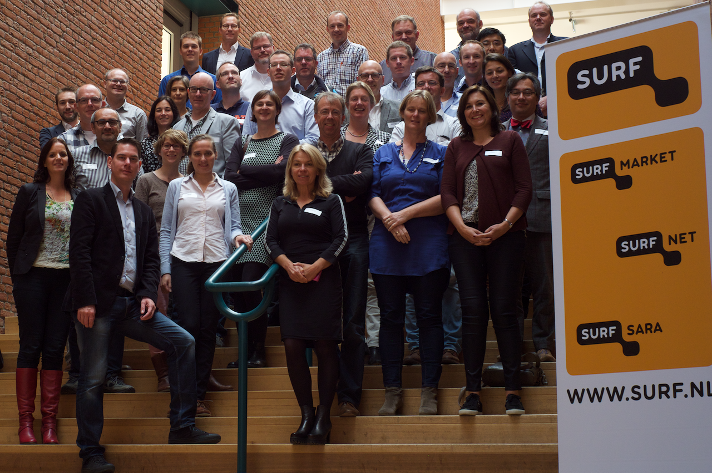

Slide 28
Support4research (S4R)
A four year program across all SURF subsidiaries to address the aforementioned challenges
  2015 - 2018
  Work on visibility of SURF
  Enhance knowledge exchange
Started from another outreach activity: the Enlighten Your Research competition (Dutch, Global)
  Combined support across all SURF subsidiaries highly appreciated by users
Leverage the strengths of the individual subsidiaries
  SURFnet (NREN): links with ICT directors at research institutes
  SURFsara (NGI): links with researchers & research support
  SURFmarket: knowledge of market services
  NLeSC: software development & research involvement
Courtesy of Jan Bot, SURFsara

Slide 29
Goals Support4Research (S4R)
Gather e-infrastructure requirements form research institutes
Facilitate interaction, discussions, pilots
Increase knowledge (at the institutes) on compute, data and network services
Integrated catalog for SURF and partner institutes
Strengthen bonds between research supporters
Community building & knowledge exchange
Improved support flow between SURF subsidiaries and institutes
Increase knowledge about e-infrastructures
Knowledge exchange, seminars → Involve local information managers
SURF and the Dutch research institutes are taking a ‘local first’ approach
Scale to national facilities when local e-infra is not sufficient or when explicitly requested
Scale to European infrastructure when necessary or in context of European projects: great for cross border collaborations, Innovation & technology provider, Knowledge exchange partner, Part of the service portfolio of SURF
Courtesy of Jan Bot, SURFsara

Slide 30
Access for Research programme
Remember that granting body for some infrastructures remained with NWO?
Problems in applying for resources
Network resources
via home institute to SURFnet
Archive and OwnCloud via home institute to SURFsara or SURFnet, respectively (but it’s a joint service!)
HTC Grid, HPC Cloud, Hadoop, visualisation, Data Ingest, LSGrid, HTStorage via researcher self-service form to National e-Infra via SURFsara
NRC “Lisa” beowulf compute and HPC “Carthesius” via NWO heavy-weight review process (and an incomprehensible form)
Takes between 2 weeks and 6+ months
Problems in reporting
Institute-granted resources are typically co-funded by the home organisation and the researcher need not report anything
National e-Infra (SURFsara) self-request resources request a yearly short PR report, but not much more
“Lisa” and “Carthesius” need a formal yearly report-out
Each filed to respective granting body

Slide 31
Improvements and issues identified for NL
Access is centered around the offerings, not the requested use cases
No obvious relation between capacity request and financing or cost – apart from those for HPC and “Lisa”
  makes for difficult capacity planning and funding thereof
  does not match regular science funding for other investments
Increase engagement of research groups in the access and granting process
  explicitly keeping the link between individual researchers and the experts in the national e-Infrastructure
Balance between rapid-reaction granting and efficient capacity planning is obvious, but both need to be there
Offering, access method, ownership, and development of the infrastructure are not yet well coordinated
Home organsiation IT “Support for Research” groups does not know the national capabilities and thus cannot effective collaborate or refer

Slide 32
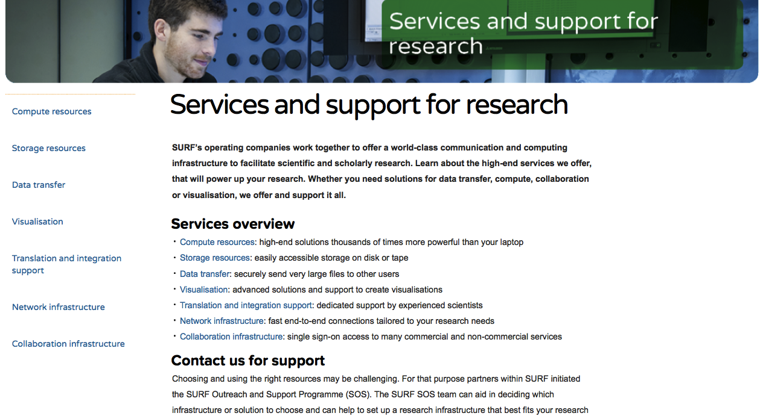

Visit: surf.nl/support4research
Courtesy of Jan Bot, SURFsara

Slide 33
Commitment, or co-funding?
‘We want to share your resources’
need a sustainable model to funding shared infrastructure
Dutch strategy is likely to be mixed
as long as the individual end-user will not get the bill
we never turn scientists into customers – or they’ll go shopping (wasting time & resources)
Depends on community and size
for individuals and small groups: central (small) funds
for very large communities, expect some contribution to the shared infra
but flexible: co-investment, bearing of operational cost – what is best depends on the community, and both work! (for Nikhef: LHCRoadmap)
All models exist, even within NL, and systems should allow all models to contribute in their own way to … but don’t turn communities into customers,
they’re collaborators

Slide 34
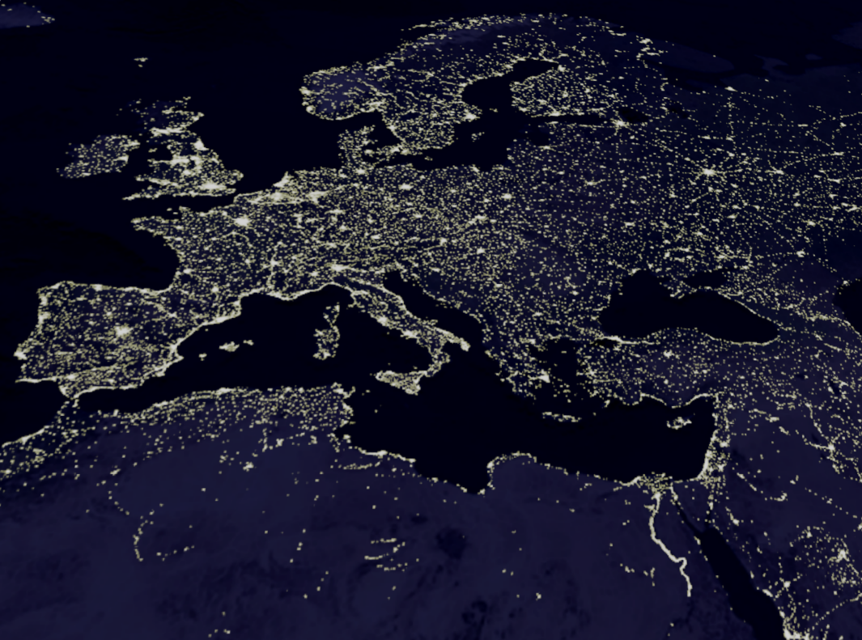
Meanwhile in Europe …
Foto: NASA

Slide 35
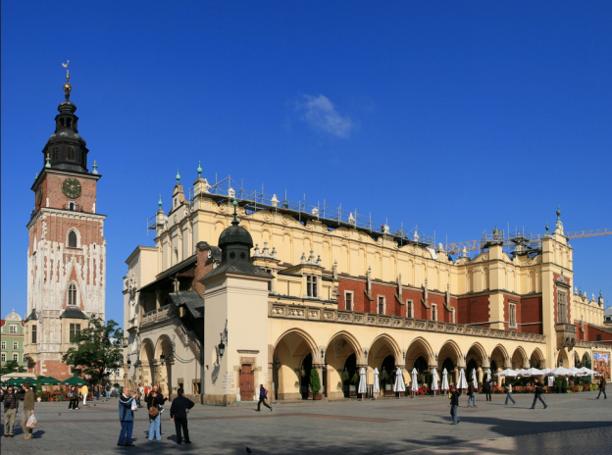

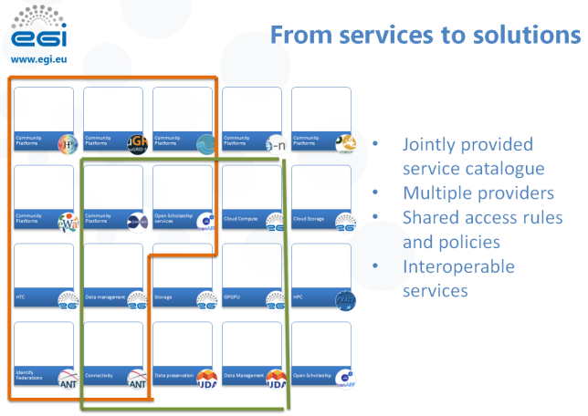



Convergence and divergence …
…

Slide 36
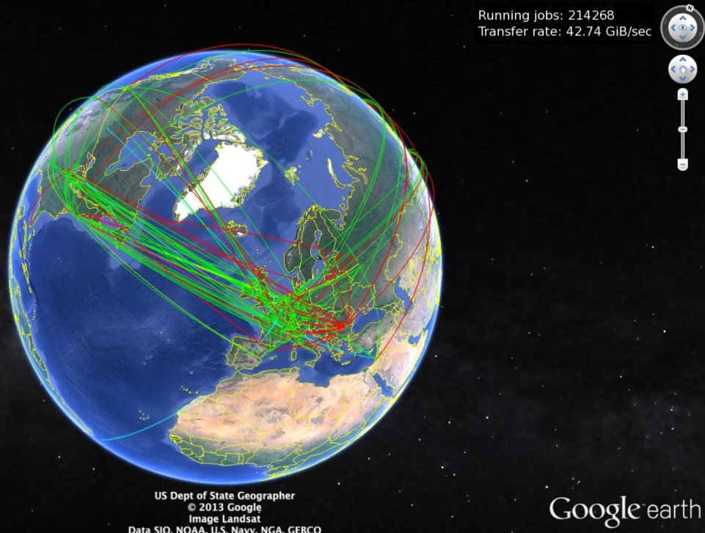
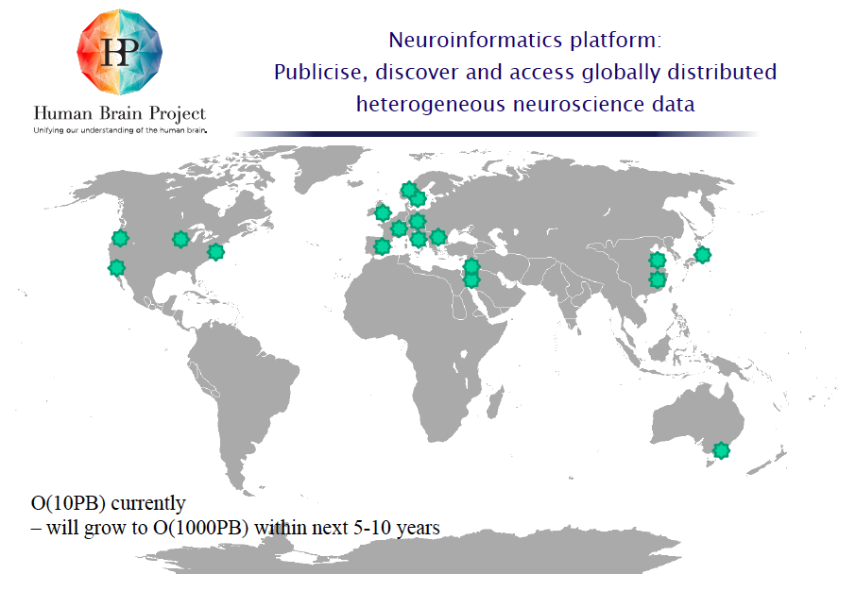

Application driven infrastructure
Research is truly global
S. Hill, HBP SP5
6th RDA Plenary
… and opportunistic
Larger communities
can go ‘shopping’ for the best service,
can pick the easiest place to ‘it done’
– like AAs & PII at CERN, since it’s an extra-territorial treaty org ☺
just set up their own if that’s expedient

Slide 37
Collaboration vs. branding
Continuing tension between collaboration (which in Dutch actually carries the meaning of ‘working with the enemy’) and giving a
‘corporate marketing’ face to a (national) e-Infrastructure
  BiG Grid built on the idea that the best marketing is marketing that others do
  on your behalf – so promote (research) communities to say how great you are,
  don’t do it yourself
  It was a hardware investment proposal, but only 8 out of the 40 pages, 20%,
  actually talked about hardware or investment money, rest was about research domains
  we on purpose relinquished the brand later – to promote SURF as a sustained entity
User communities must feel ‘in control’ to support you in your quest for sustainability
  that’s more than just an advisory group – it’s a steering group
  don‘t build for them, but also don’t let them build: target ‘joint ventures’
  some uneasy tension will typically remain

Slide 38
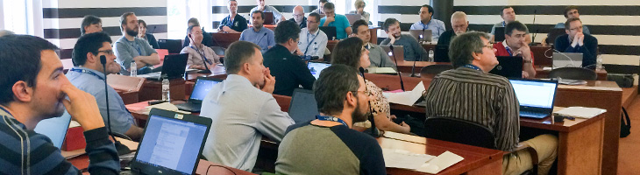
Bottom-up continues to work
We did and still do EUGridPMA, IGTF, TACAR, SCI, SirTFi
Multi-year run-up to AARC is a demonstration of success
WISE shows we can still pull that off – without fighting over funding first …
So maybe “Joint EYR Global” should not be too hard …
and might even be a nice use case to push an integrated AAI!
Image credits: Alessandra Scicchitano, GEANT

Slide 39
Collaboration need not wait for funding!
At times, working on a joint challenge most important part:
collaboration need vision more than money!
Remaining ‘outward facing’ is important
  A focus on changes within the org does not help – sorry!
  SURF disengaged for ~2 years during the merger, and that ‘did not help’ in creating a national e-Infra collaborative spirit
  Merging cultural differences is detrimental, since the most rigidly organised part tends to win early on (because it’s more pushy)
  But it later then becomes clear that the most outward facing org offers better prospects for sustainability since it makes external folk (its users) promote it on its behalf:
  “having someone else tout your excellence is far better than doing than banging yourself on the chest”

Slide 40
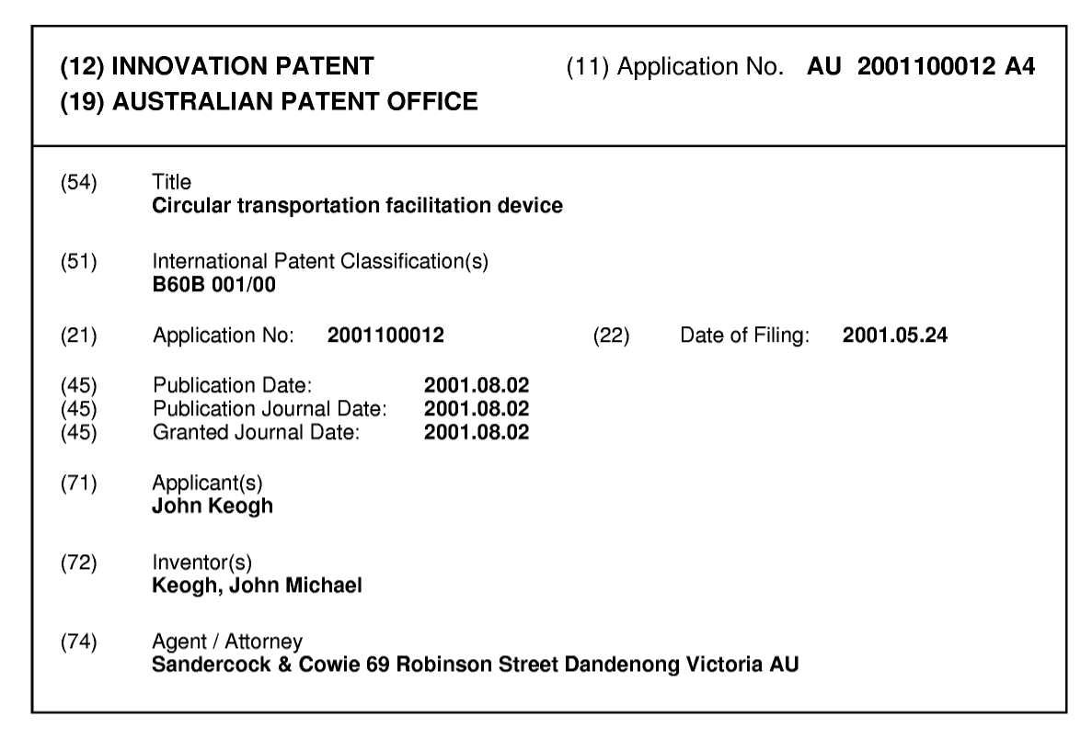
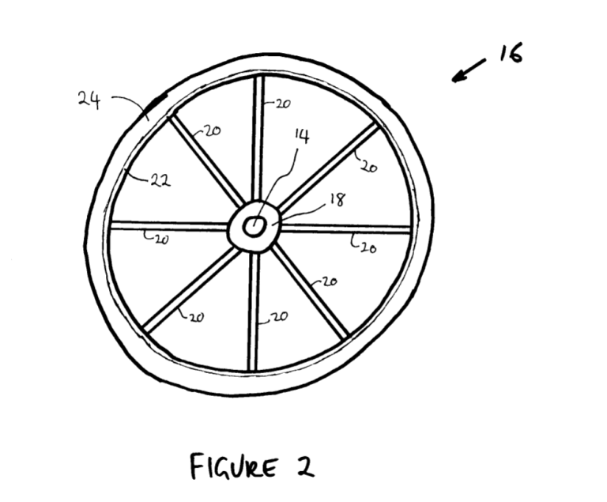
Re-inventing the wheel …
http://pericles.ipaustralia.gov.au/ols/auspat/applicationDetails.do?applicationNo=2001100012
http://pericles.ipaustralia.gov.au/ols/auspat/pdfSource.do?fileQuery=%AC%C0%B5%CE%CD%91%B8%C3%BBz%BA%BD%C0%B9%C2%B5%C1%B9%91%95%A9%86%84%84%85%85%84%84%84%85%86%95%88%86%84%84%86%84%8C%84%8C%82%C4%B8%BAz%BE%C9%C1%C4%B9%B8%91%B8%C3%BB

Slide 41
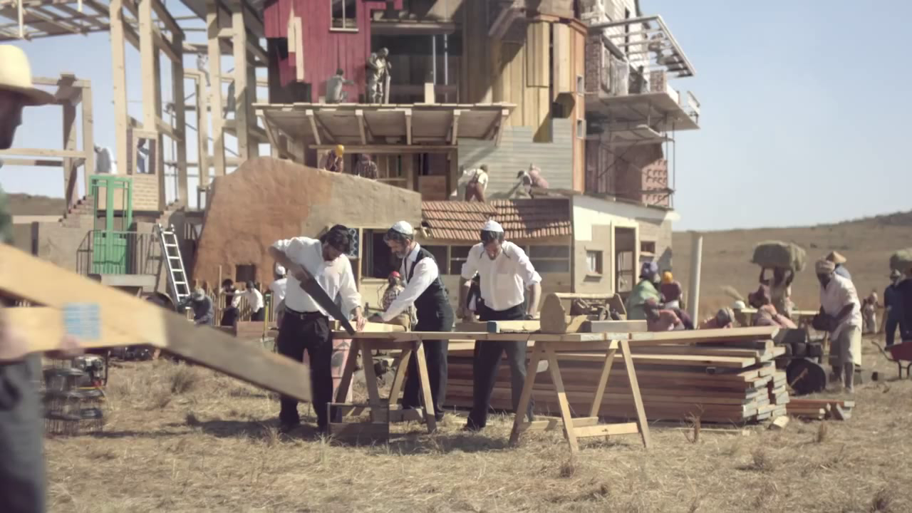
Jointness may appear shaky at times – but just continue to build!
https://www.youtube.com/watch?v=LVJOedTBogU
www.hornbach.de http://www.globalflagproject.com/de

Slide 42
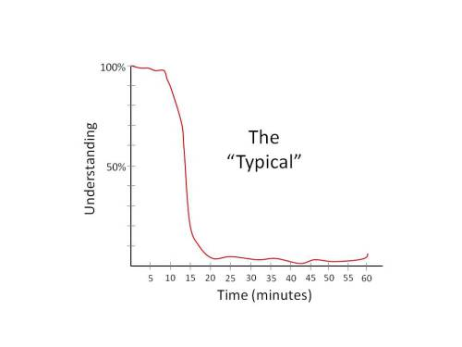
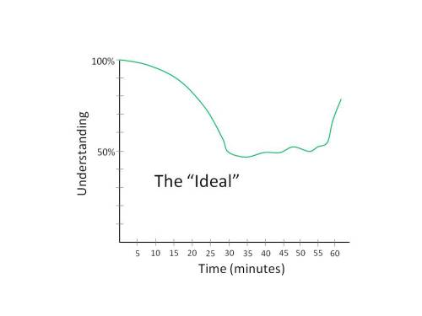
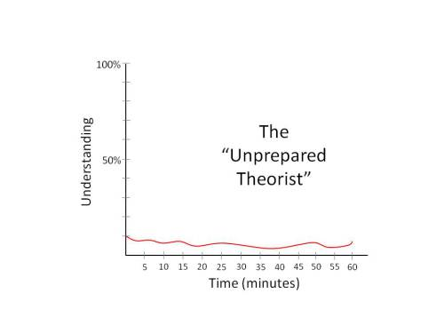
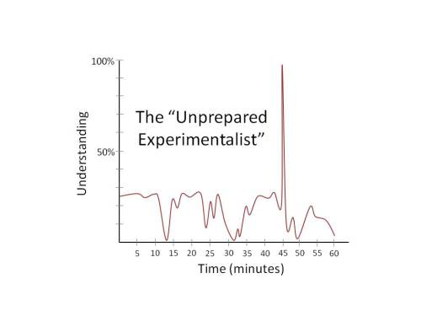
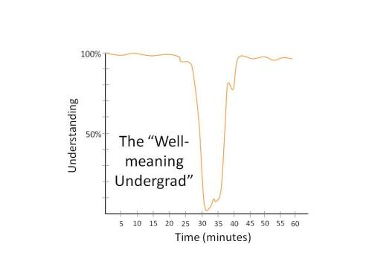
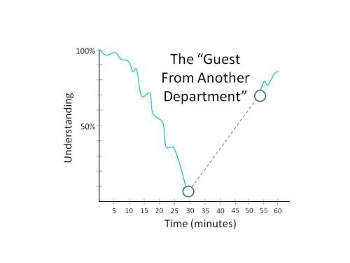
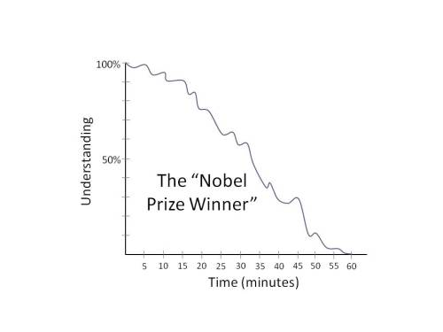
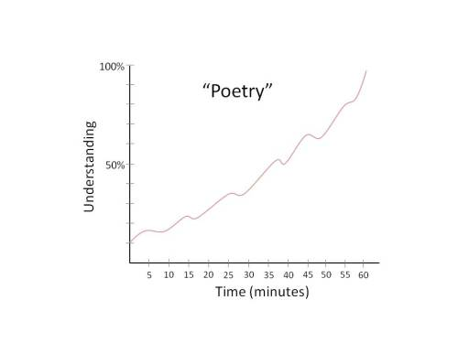
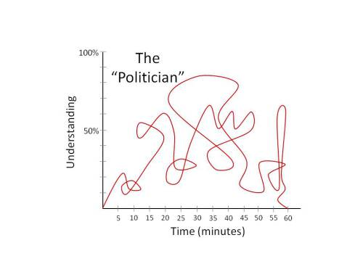
Thanks for sitting through all this!
http://manyworldstheory.com/2013/10/03/the-9-kinds-of-physics-seminar/

