Slide 1
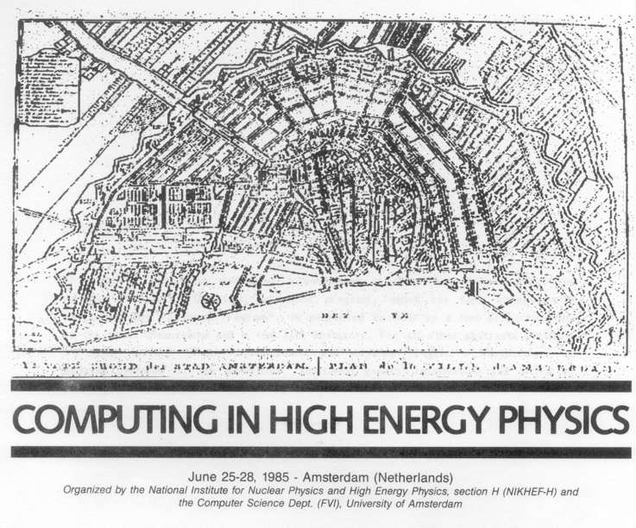
The 20th CHEP Conference
Amsterdam 2013
Amsterdam 1985
organized by
in collaboration with partners

Slide 2
Things have changed since 1985 …
… have completely gone away …
  “Portability Aspects of MODULA-2”
  “Using the 3081/E as a VAX Emulator”
  “A LAN with Real-Time Facilities
  based on OSI Standards”
… or have just changed a lot …
  “Satellite Communication”
  “LAN with an Experiment Command Interpreter and 2.5 MBaud Interfaces”
http://www.chep2013.org/1985

Slide 3
… but not all that much!
Multi-processor, multi-core & ‘GPU’
  “Loosely and Tightly Coupled Parallel Processors for High Energy Physics”
  “Parallelism in Scientific Engineering Computation”
  “Use of SIMD—SPMD Machines
  for Simulation in Particle Physics”
  Panel discussion:
  “Vector and Parallel Processing in HEP”
http://www.chep2013.org/1985

Slide 4
Large data volumes and transfers
  “Data Storage - Where Do We Store Terabytes Of Data?”
  “GIFT: An HEP Project For File Transfer”
Resource sharing
  ““Y”: a Distributed Resource Sharing System in Nuclear Research Environment”
http://www.chep2013.org/1985

Slide 5
A meta-summary
Data Acquisition, Trigger and Controls
Event Processing, Simulation and Analysis
Distributed Processing and Data Handling
Data Stores and Storage Systems
Software Engineering
Facilities, Infrastructures, Collaboration
Parallelism & Multi-Core
Data Preservation
Thanks to all speakers – you’ll see mostly their slides!
with some blue-ish text which is typically mine …

Slide 6
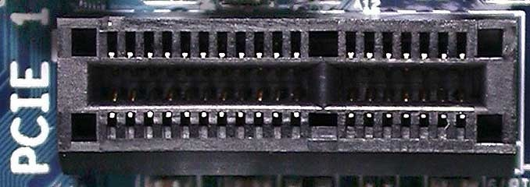
DAQ, Trigger and controls
Images from Wikimedia commons: Arnold Reinhold

Slide 7
“Trend to use more and more COTS equipment and all-software based solutions continues”
“DAQ systems outside HEP have been growing a lot: challenges comparable,
similar ideas & synergy coming on”

Slide 8
General purpose DAQ tools
First to appear in production for ‘lower volume’ experiments, but expanding to much more. E.g. for artDAQ:
  DarkSide-50 at LNGS: 10 Mbyte event, ~ 80 Hz
  LBNE (neutrino exp) FNAL -> Sanford: 4 GByte/s
Happily borrowing good re-usable components from elsewhere
  Run controls from IceCube
  Configuration management from NOvA
Just the reco-algorithms are experiment-specific

Slide 9
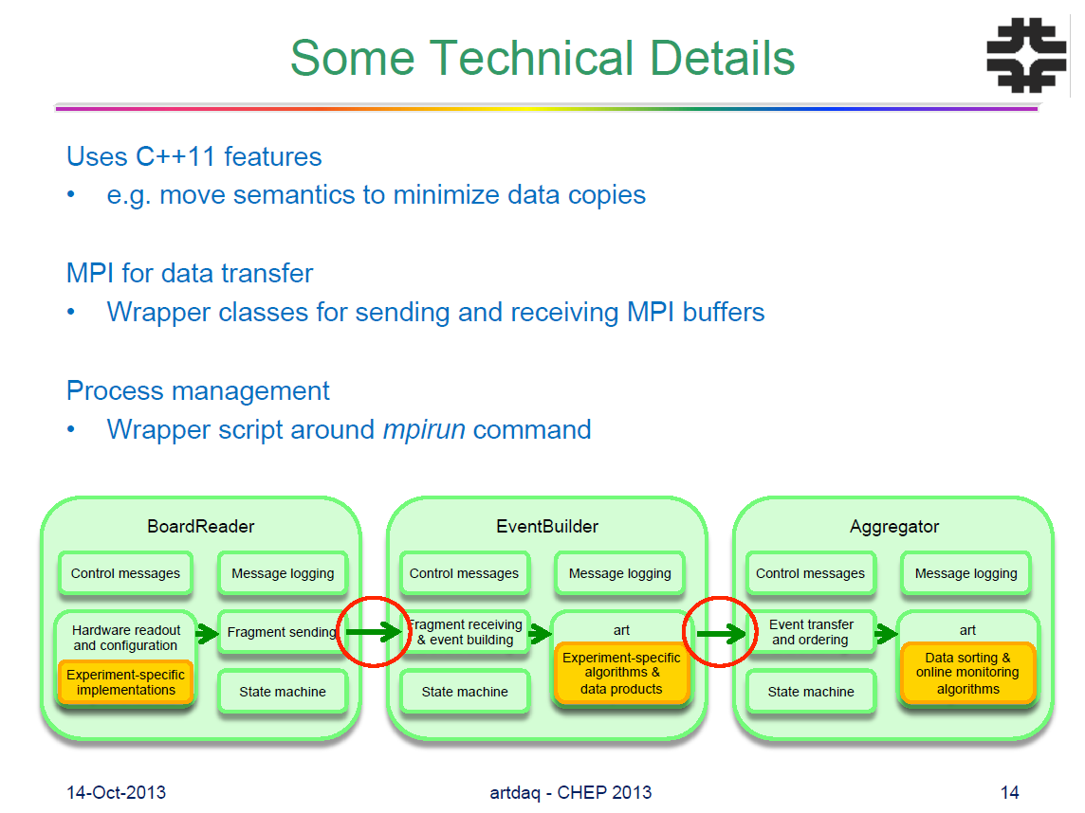
#466: Jim Kowalkowski et al. The artdaq Data Acquisition Software Toolkit

Slide 10
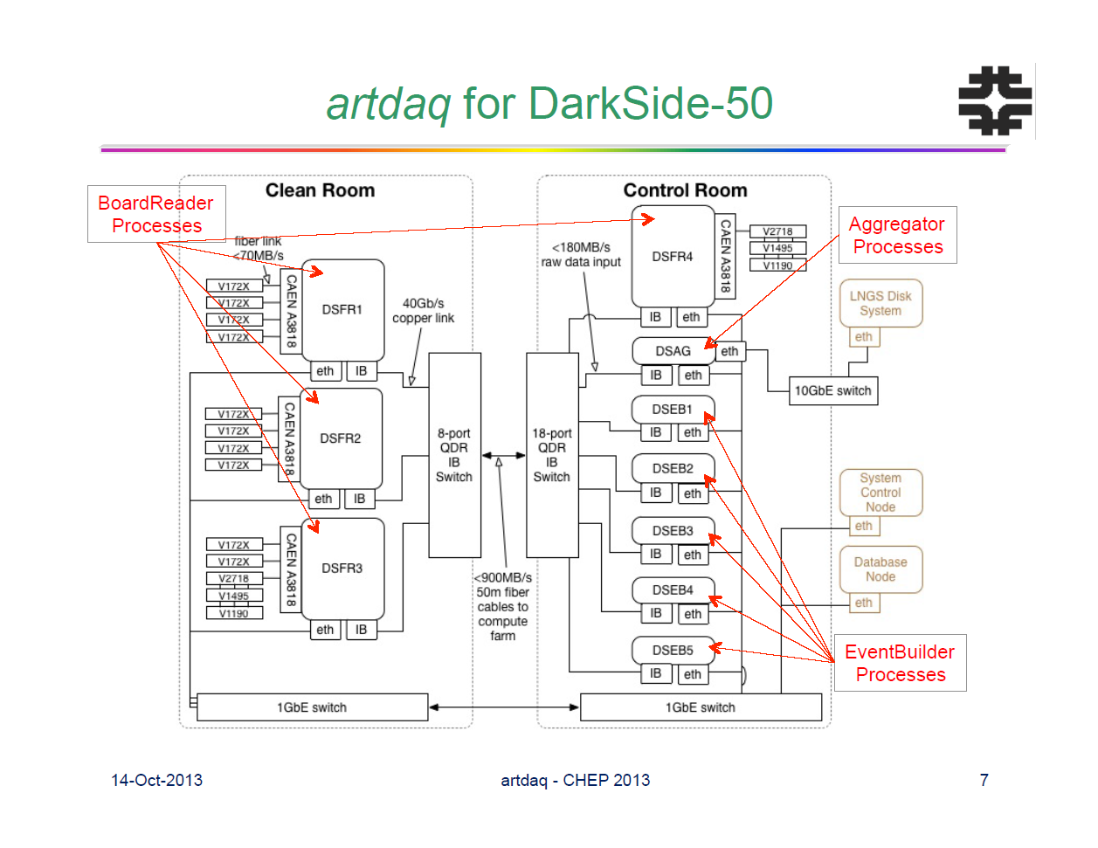
Re-use of commodity networking and hardware
Infiniband (40Gbps) and Ethernet (now: 10Gbps)
#466: Jim Kowalkowski et al. The artdaq Data Acquisition Software Toolkit
Notes:
Fully commoditized networks first appear in the new expeirments, like DarkSide-50 at LNGS. Also new architectures like ARM are studied

Slide 11
Evolution of host network cards
PCIe Gen4
expected
PCIe Gen3
available
EDR (100 Gb/s) HCA
expected
100 GbE NIC
expected
Chelsio T5 (40 GbE
and Intel 40 GbE
expected
Mellanox FDR
Mellanox 40 GbE NIC
Graphic by Niko Neufeld (CERN) at Joint DAQ@LHC workshop, March 2013,
https://indico.cern.ch/event/217480/session/1/contribution/40

Slide 12
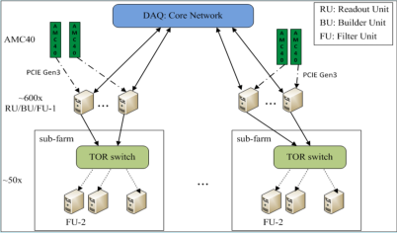
Commodity components everywhere
Example: LHCb
Emergence of ‘low-cost’ 32 Tbps DAQ
  Infiniband (40, 100Gbps) and Ethernet
  FPGA receiver cards in standard server PCs
  PCIe Gen3 fast (and simple!) enough for that
Utilize the (expensive) network full-duplex & leverage available CPUs in read-out systems also for building & filtering
Network speeds ~ 100Gbps in 2016?
Needed since in 2018+ both Alice & LHCb want to go triggerless!
Example: Alice, LHCb

Slide 13
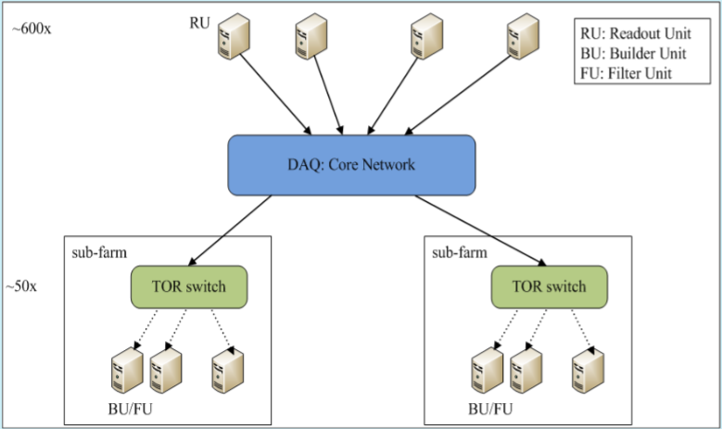
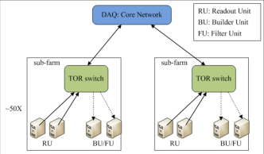


Trigger-less DAQ in 2018+ for LHCb?
Σdata rate to the farm is ~38.4 Tb/s
Simple solutions become very expensive!
Dual-NIC (IB+10GbE) multi-purpose nodes
Redistribute data full-duplex across
expensive DAQ Core Network
Cheap ToR switches to 2nd level filter
‘AMC40’ is a read-out board
with PCIe Gen3 i/f
#54: G. Liu, N. Neufeld DAQ Architecture for the LHCb Upgrade

Slide 14
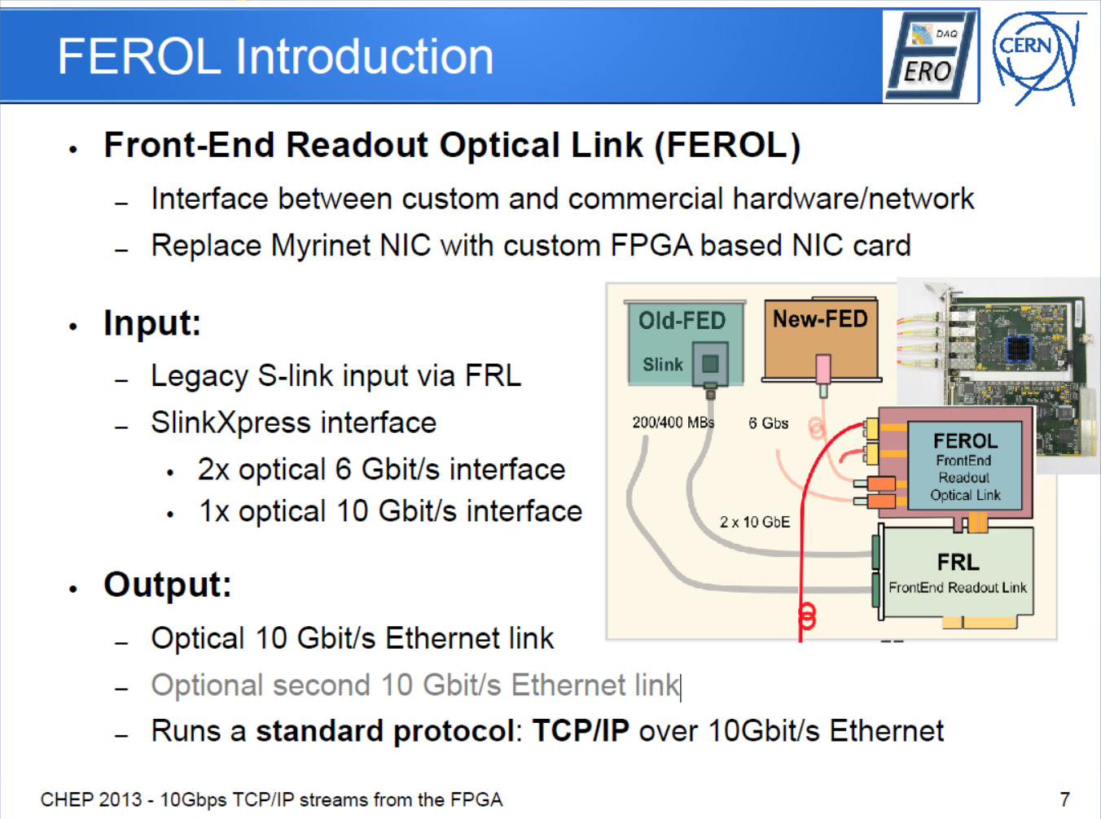
Commodetisation of FPGAs
#87: Petr Zejdl 10Gbps TCP/IP streams from the FPGA for High Energy Physics

Slide 15
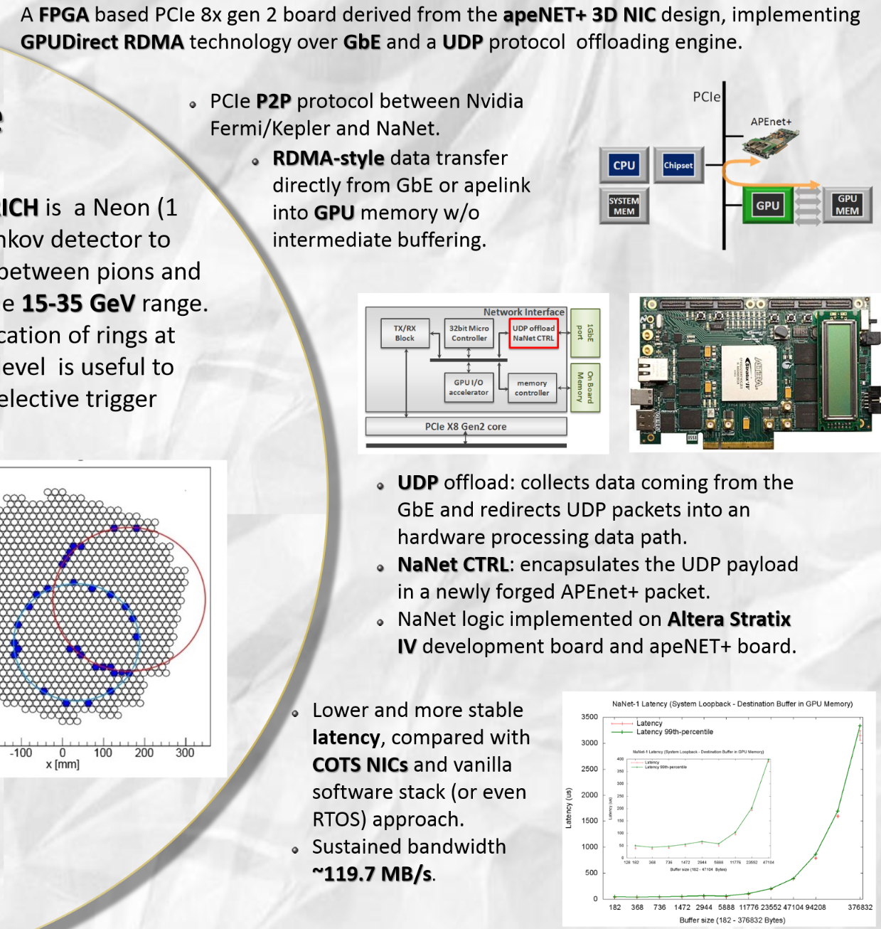
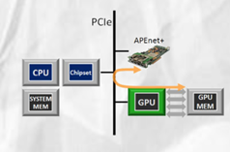
And the introduction of GPGPUs
NaNet
FPGA working together
with (Nvidia) GPU
in real-time over
PCI2 Gen2 x8 bus
field-tested in NA62
for real-time trigger
See also #297 H. Valerie
GPU Enhancement of the
High Level Trigger to extend the
Physics Reach at the LHC
#48: Roberto Ammendola GPU for Real Time processing in HEP trigger systems

Slide 16
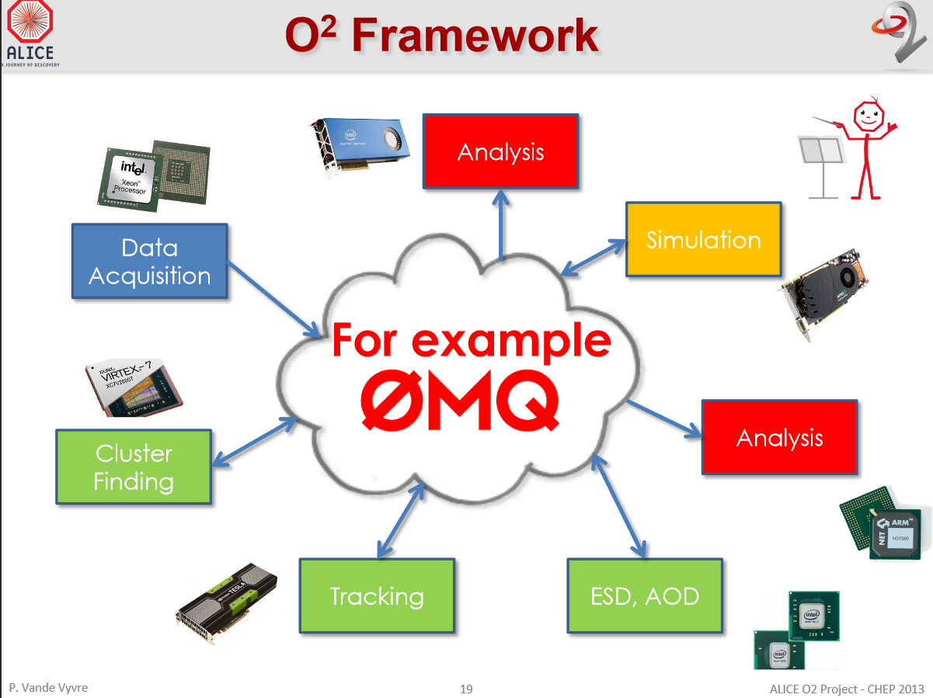
On-line moving off-line - or vice-versa?
Alice in 2018? A single framework
for DAQ, HLT and Off-line processing
#389: Pierre Vande Vrye O2 a novel combined online and offline computing system for ALICE after 2018

Slide 17
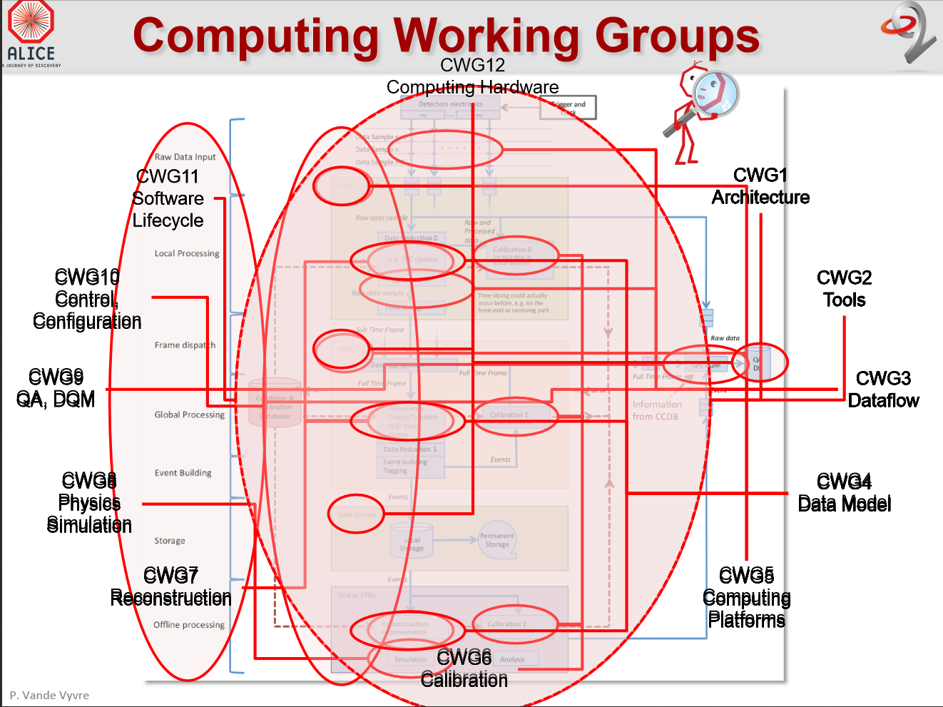
#389: Pierre Vande Vrye O2 a novel combined online and offline computing system for ALICE after 2018

Slide 18
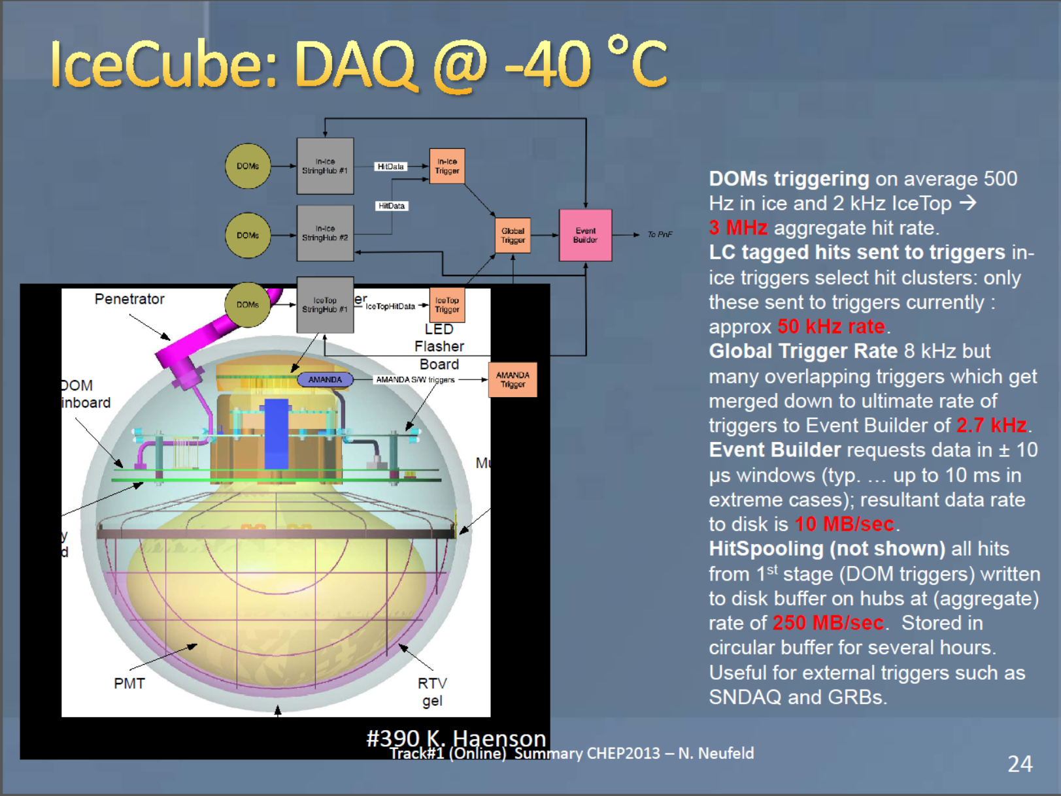

Slide 19
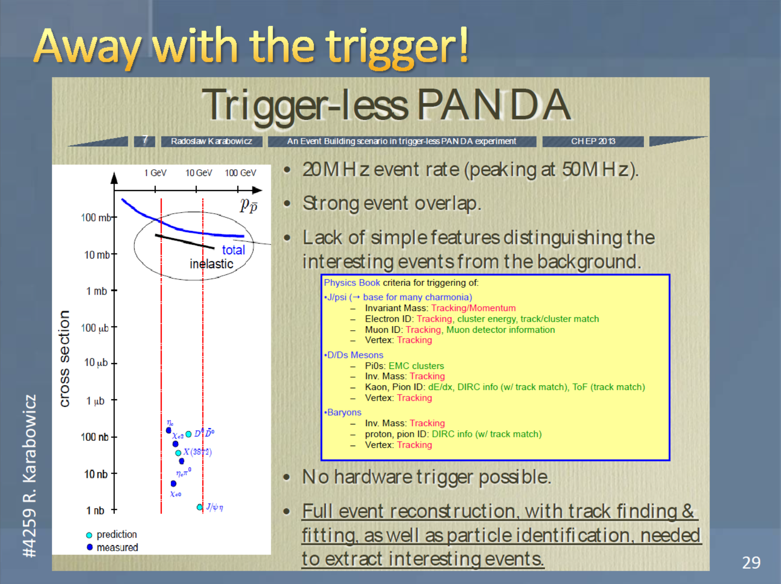

Slide 20
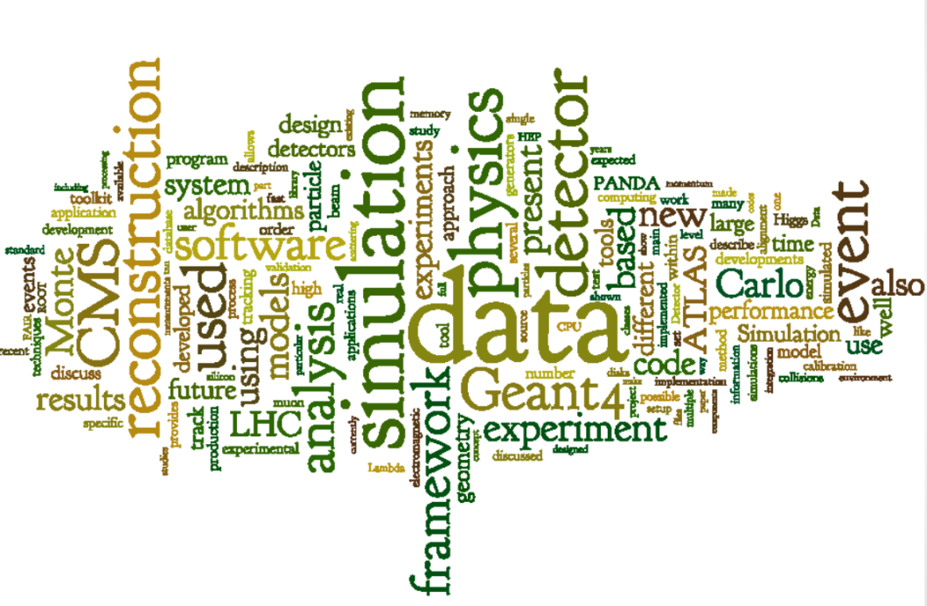
Simulation & Event processing
Geant 4+
Concurrent event processing
Russian Roulette, MC and pre-mixing of min-bias hits
Word Cloud from Rolf Seuster, Florian Uhlig, Lorenzo Moneta, Pete Elmer: Track 2 summary talk

Slide 21
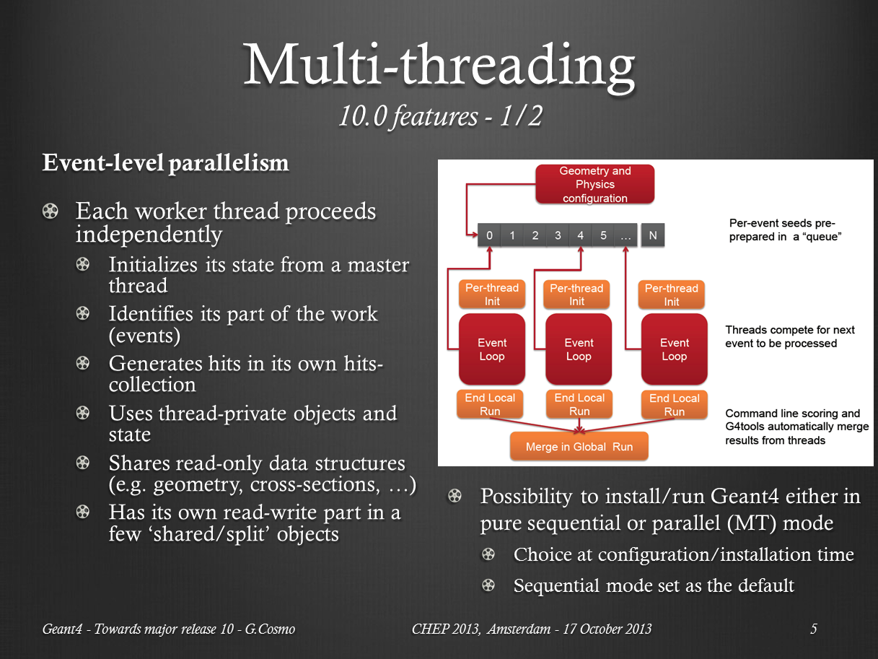
Geant4 10+ exploiting multi-threading
#177 Gabriele Cosmo: Geant4 - Towards major release 10

Slide 22
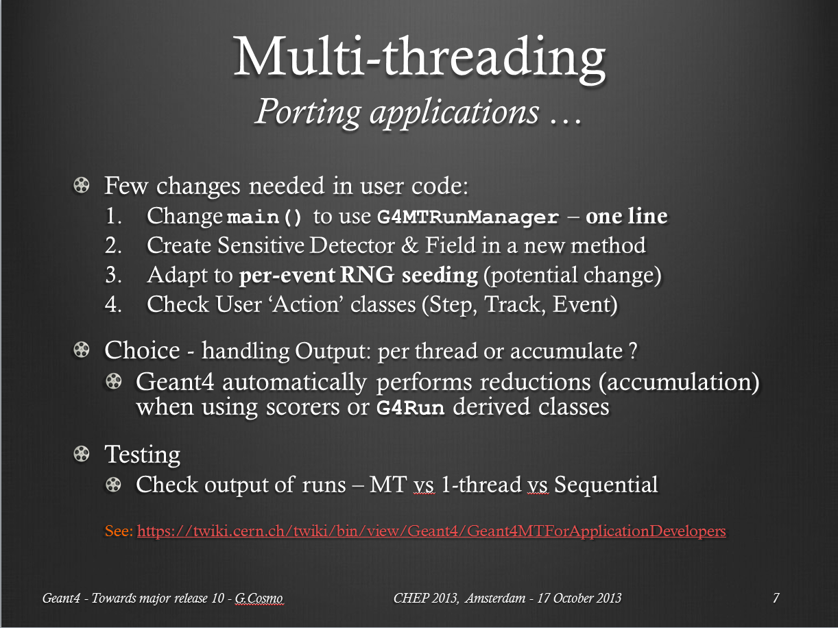
Geant4 10+ exploiting multi-threading
#177 Gabriele Cosmo: Geant4 - Towards major release 10

Slide 23
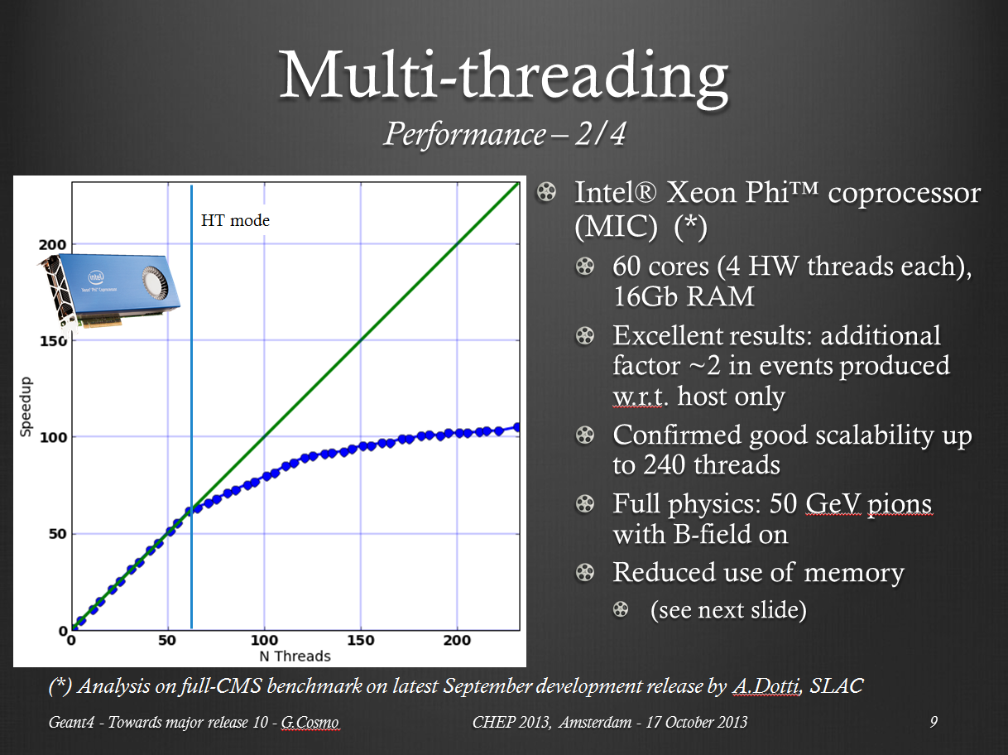
Spending time parallelizing pays off!
#177 Gabriele Cosmo: Geant4 - Towards major release 10

Slide 24
Event processing concurrency
2012 prediction: declare complete success
2013 reality: many different approaches
CMS: multiple events in parallel
Gaudi: multiple algorithms in parallel
FairRoot: multi-process with IPC
using Intel Threaded Building Blocks (TBB) &c

Slide 25
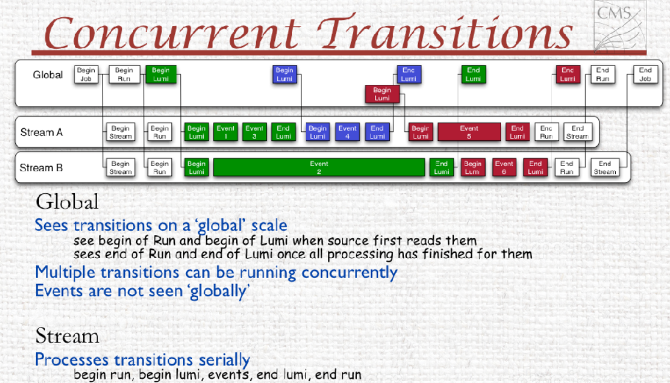
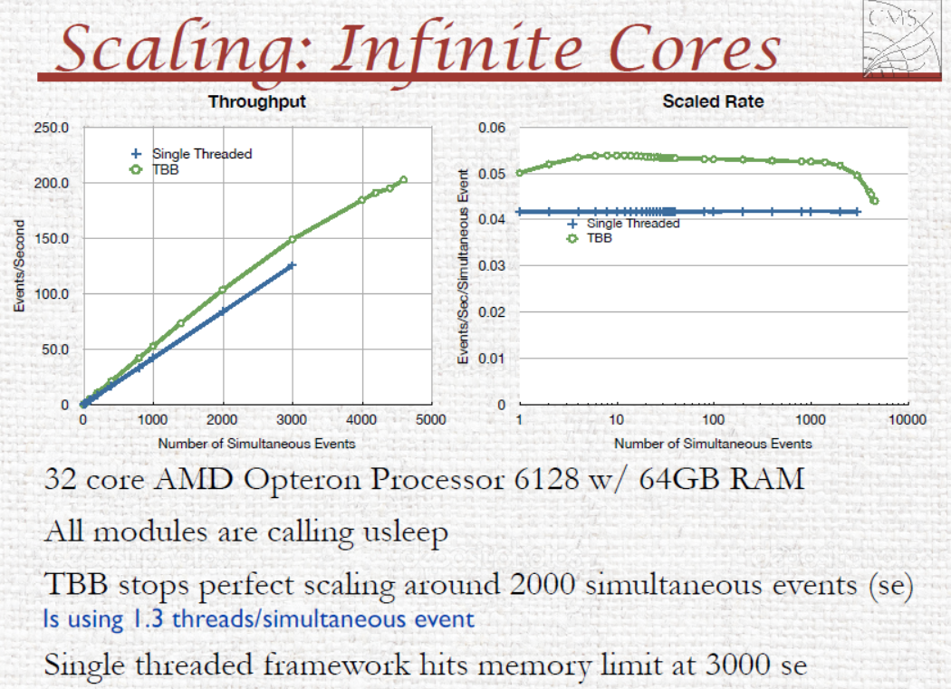
#158 Liz Sexton-Kennedy:Stitched Together: Transitioning CMS to a Hierarchical Threaded Framework

Slide 26
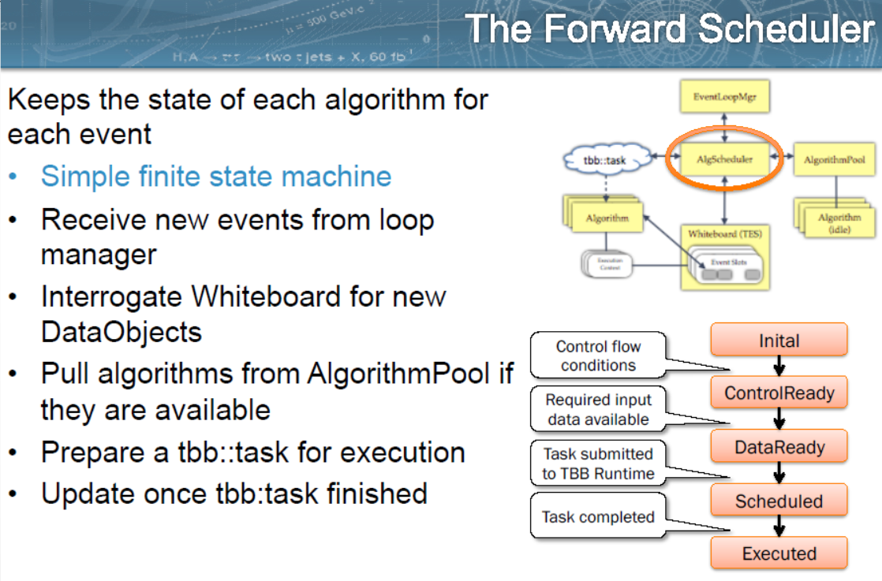
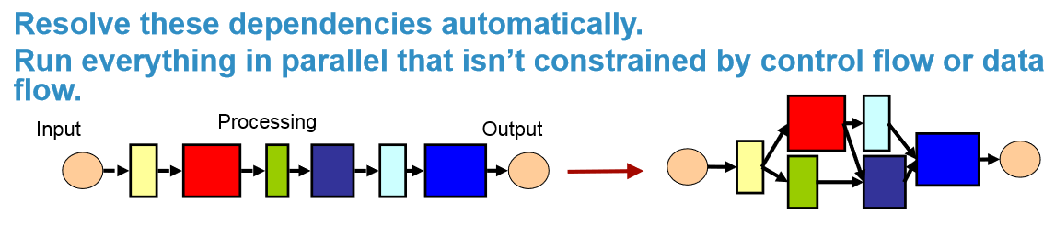
Gaudi: added task-level concurrency
#203 Benedikt Hegner:Introducing Concurrency in the Gaudi Data Processing Framework

Slide 27
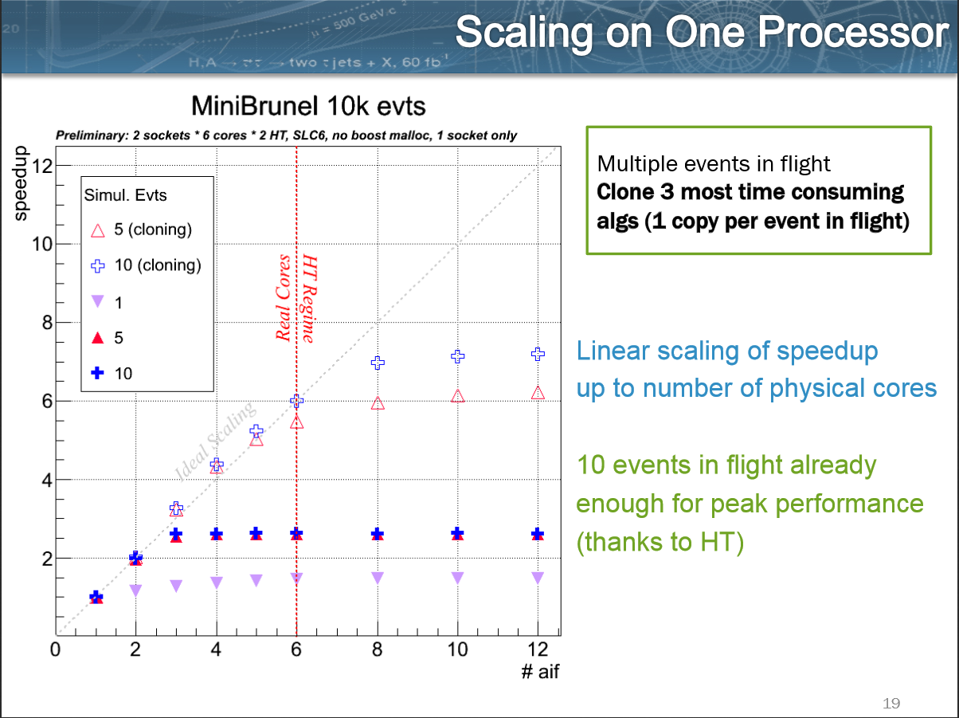
#203 Benedikt Hegner:Introducing Concurrency in the Gaudi Data Processing Framework

Slide 28
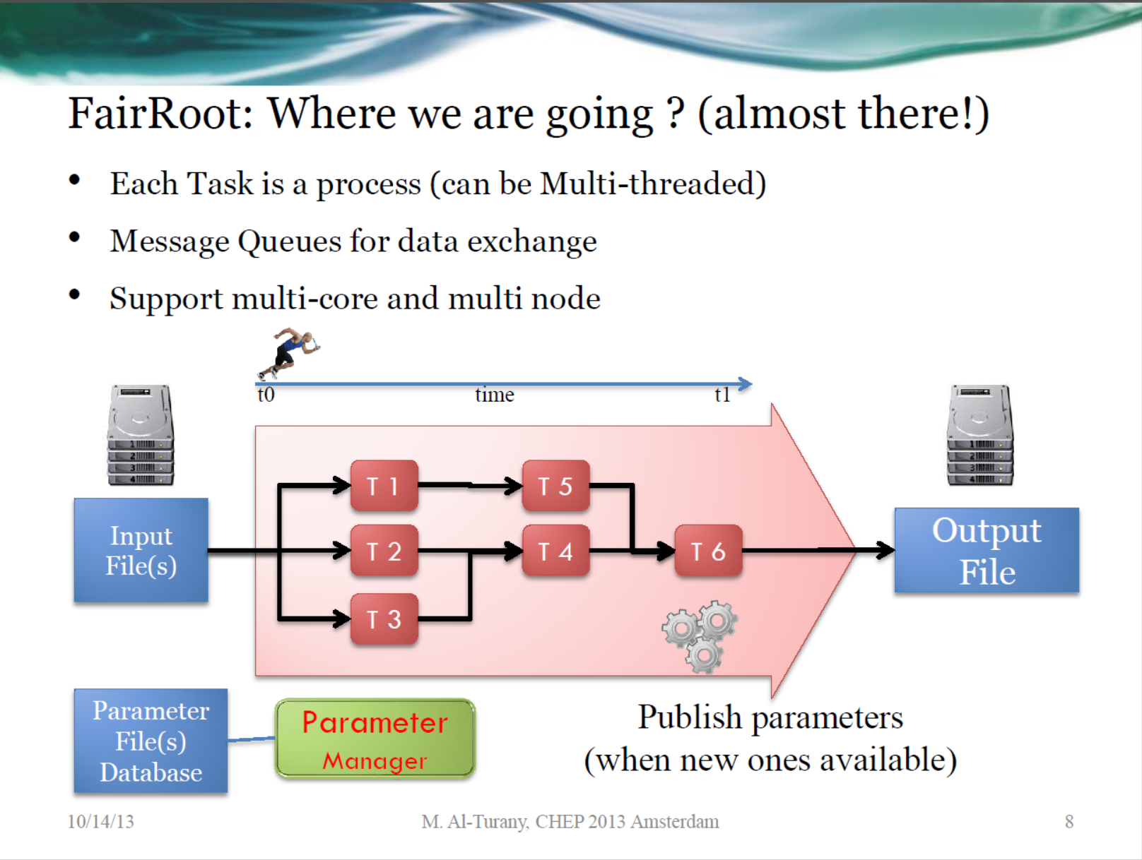
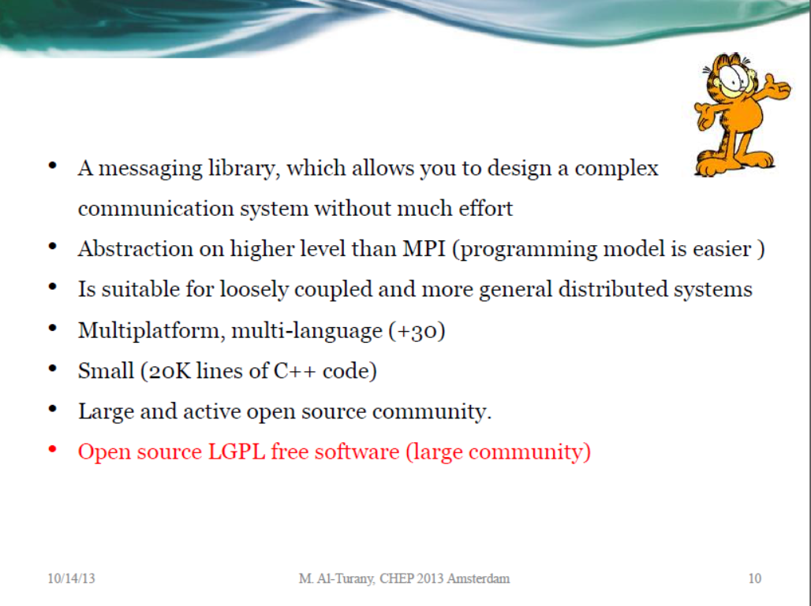
Or a multi-process approach with IPC
#408 Mohammed Al-Turany Extending the FairRoot framework to allow […] free streaming data

Slide 29
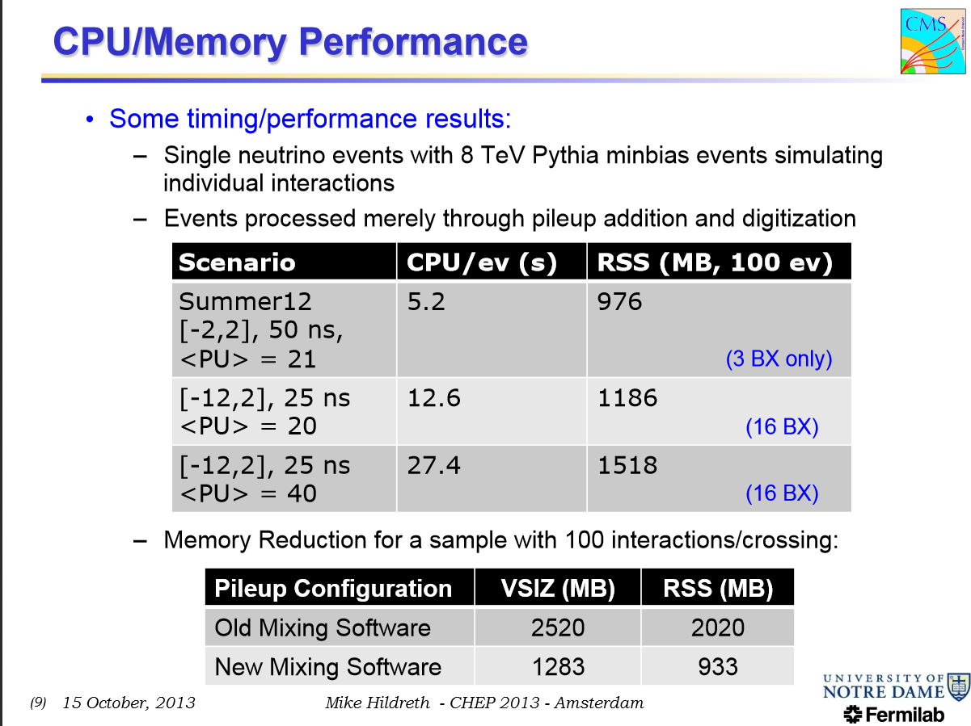
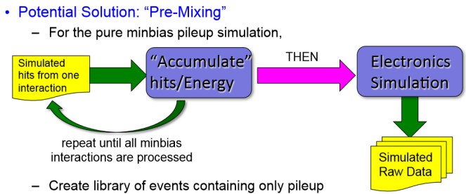
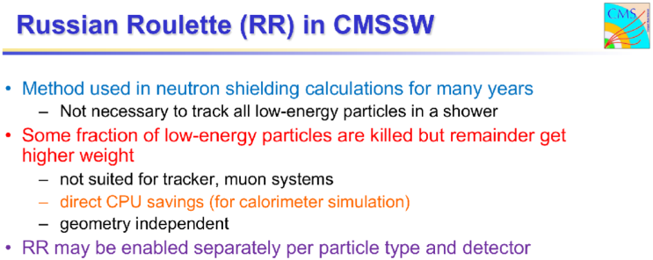
MC pile-up disaster
Premixing
Russian Roulette
#161 Mike Hildreth: Strategies for Modeling Extreme Luminosities in the CMS Simulation

Slide 30
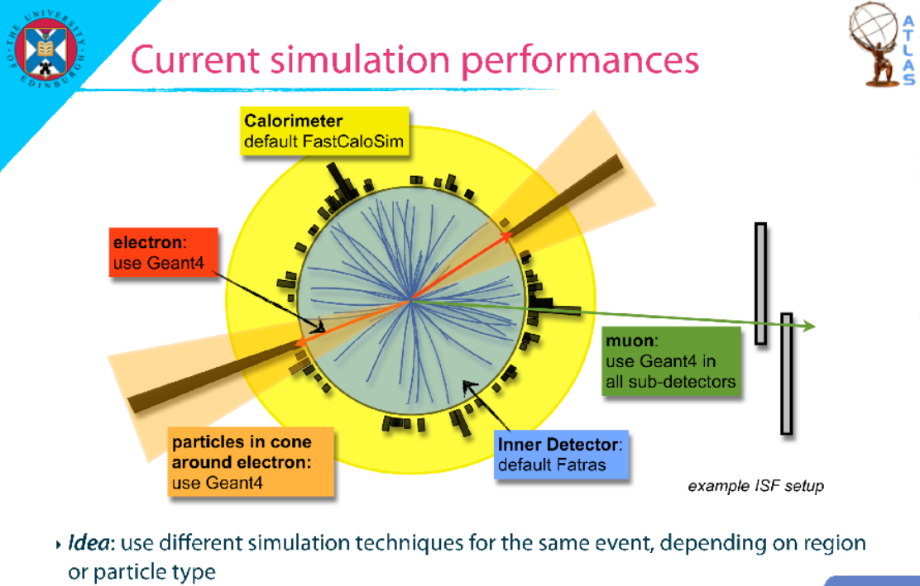
Atlas: MC mode selection per region
#291 Chiara Debenedetti: Fast Atlas MC Production

Slide 31
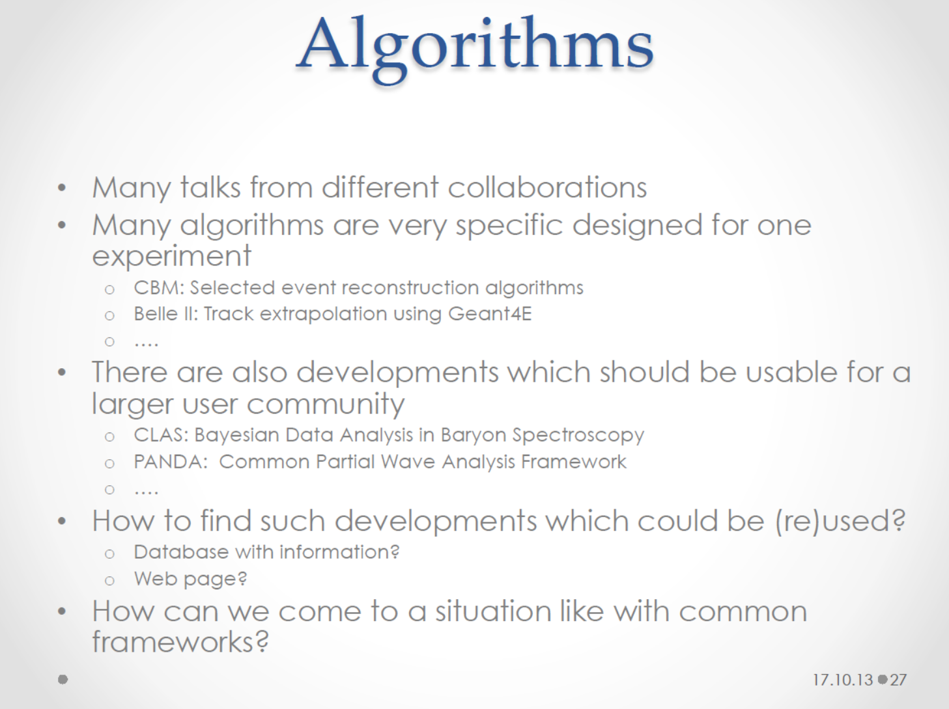
For dealing with MC pile up and ‘pre-mixing’ of minbias MC, see hidden slides
Rolf Seuster, Florian Uhlig, Lorenzo Moneta, Pete Elmer: Track 2 summary talk

Slide 32
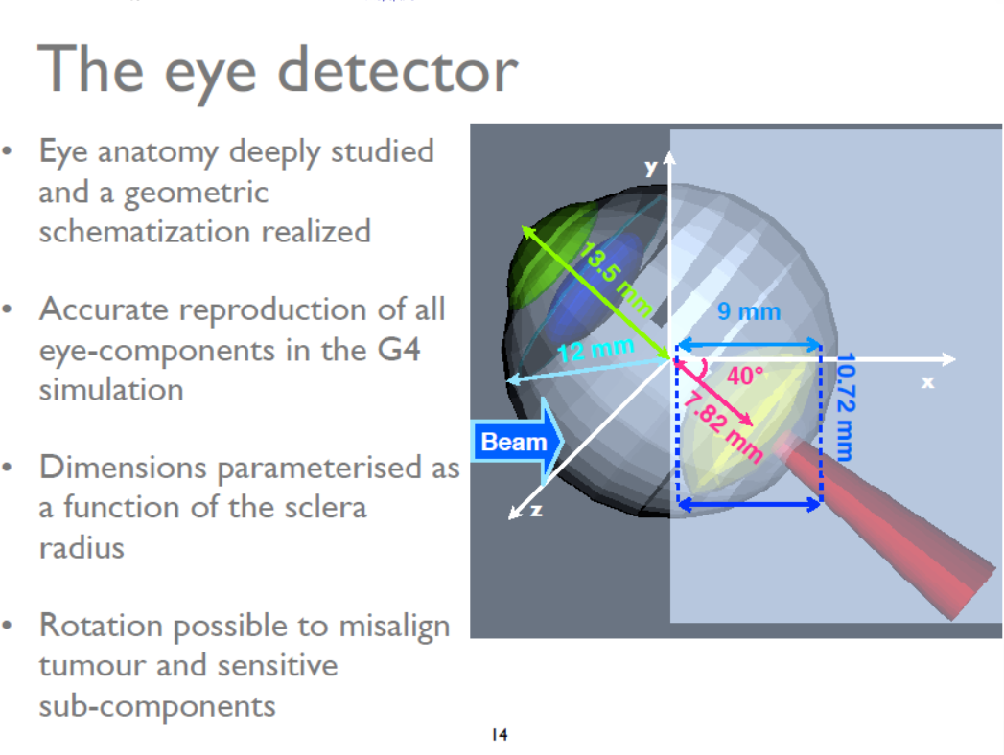
Simulation and MC outside HENP
#166 Adele Rimoldi: Geant4 studies of the CNAO facility system for hadron therapy treatment …

Slide 33
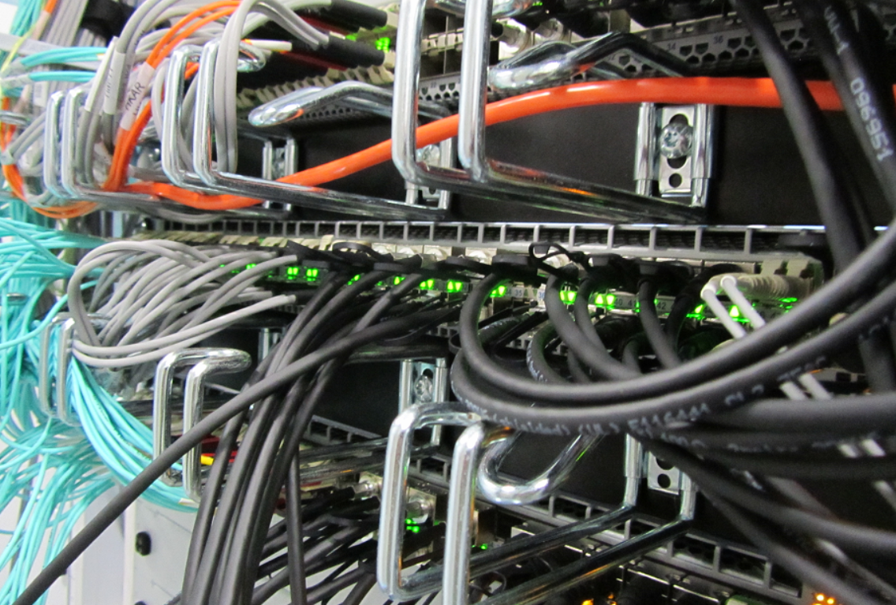
Distributed Processing and Data Handling
Infrastructure, sites, and virtualisation
Experiment data models, data handling, and computing models
Data driven analysis

Slide 34
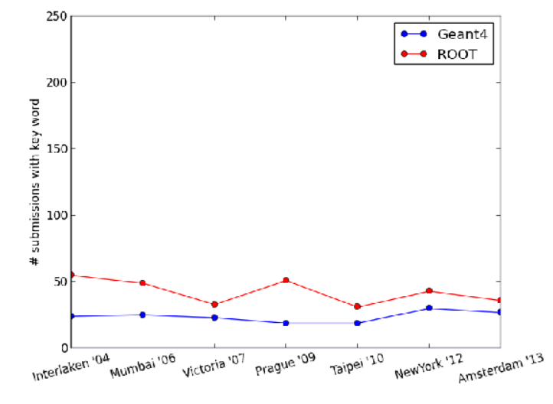
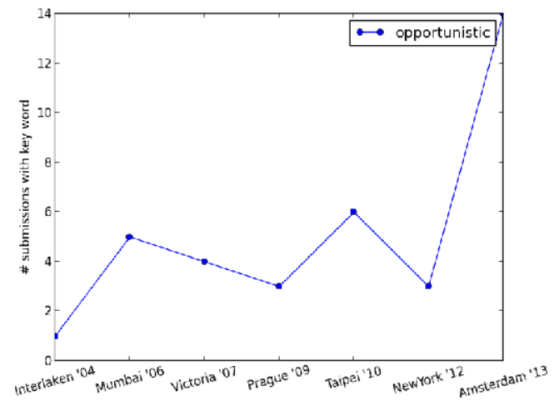
Emergence of opportunistic computing
Steady rise of virtualisation
IaaS resources used via
same overlay mechanisms
used in grids
Number of abstract with
given keyword vs. time
Stefan Roiser, Davide Salomoni: Track 3A summary talk

Slide 35
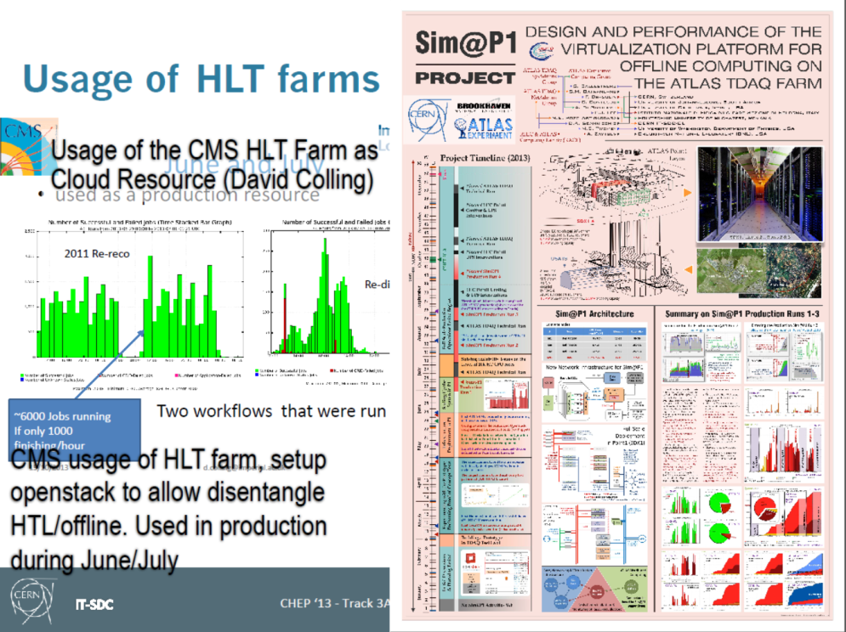
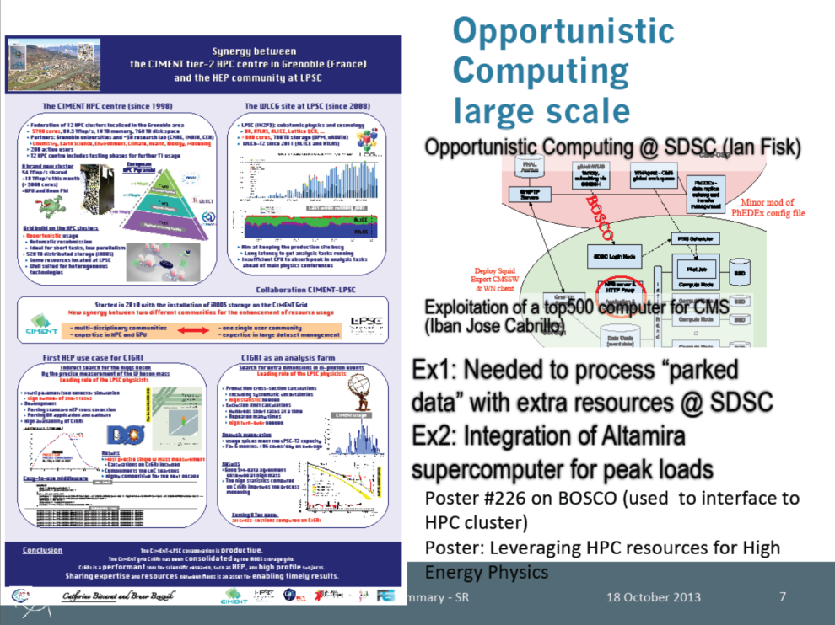
More ‘chaotic’ data organisation
Left-over CPU resources used from HPC centres, desktop grids, HLT farms, …
Data pre-placement is gone
  At least for the ‘small’ data sets of today
Stefan Roiser, Davide Salomoni: Track 3A summary talk

Slide 36
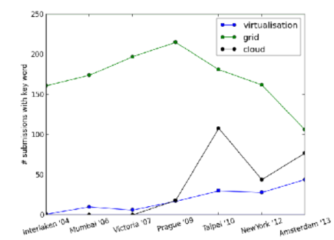
Virtualisation and VMs
Steady rise of (now-mature) virtualisation
‘cloud’ is a hype word for almost anything
IaaS resources effectively used via the same overlay mechanisms used in grids
‘opportunistic use’ again …

Slide 37
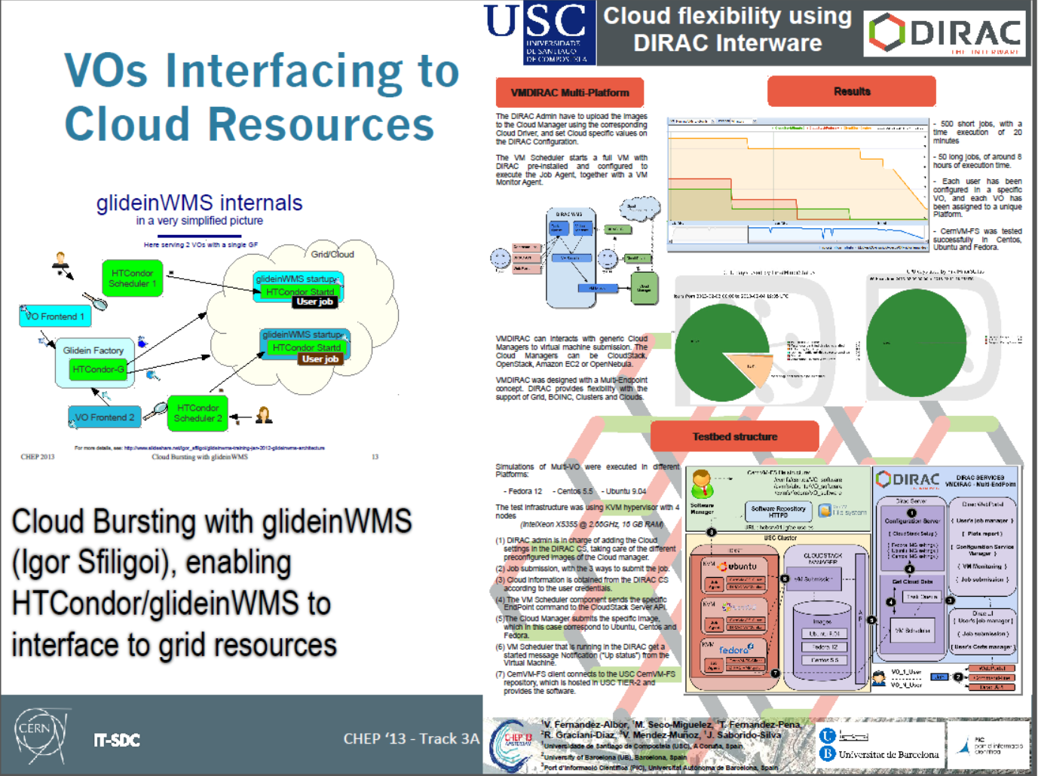
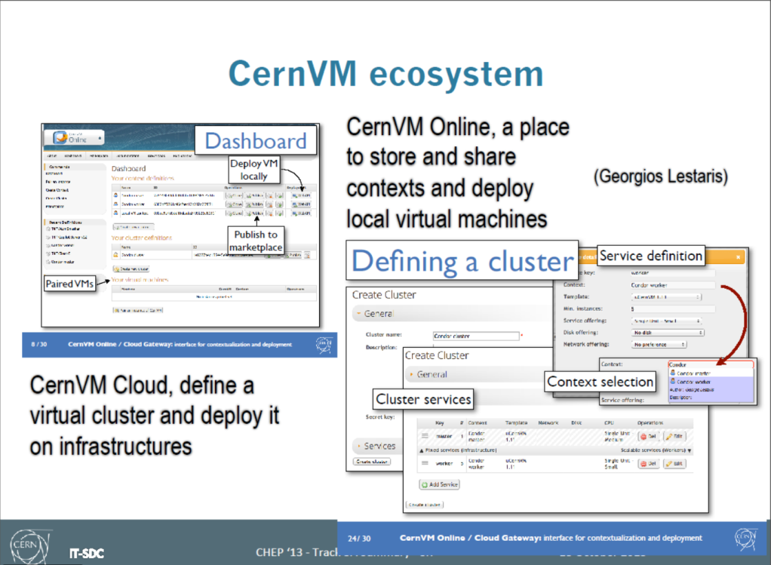
Extensive use of HTCondor and ‘elastiq’
Works great on exclusive clusters, and
on clusters that have ‘average’ occupancy
CVMFS
originally intended for VM deployments…
uCernVM gets also OS from CVMFS
Stefan Roiser, Davide Salomoni:
Track 3A summary talk

Slide 38

CVMFS
originally intended for VM deployments…
uCernVM gets also OS from CVMFS
Stefan Roiser, Davide Salomoni:
Track 3A summary talk

Slide 39
Adapting Experiment Frameworks
DIRAC emerges as multi-user framework
  CLIC/ILC, BelleII, BESIII, …
  Actively integrate non-HEP use cases
Atlas & CMS compute
  Workload management stays separate
  But job management maybe merged in PanDA
  data model: file-level granularity (Atlas Ruccio)
  Leverage new services like FTS2 and GFAL2
But: outside the ‘LHC bubble’
iRODS and databases are the popular choice
and SAM still lives!

Slide 40
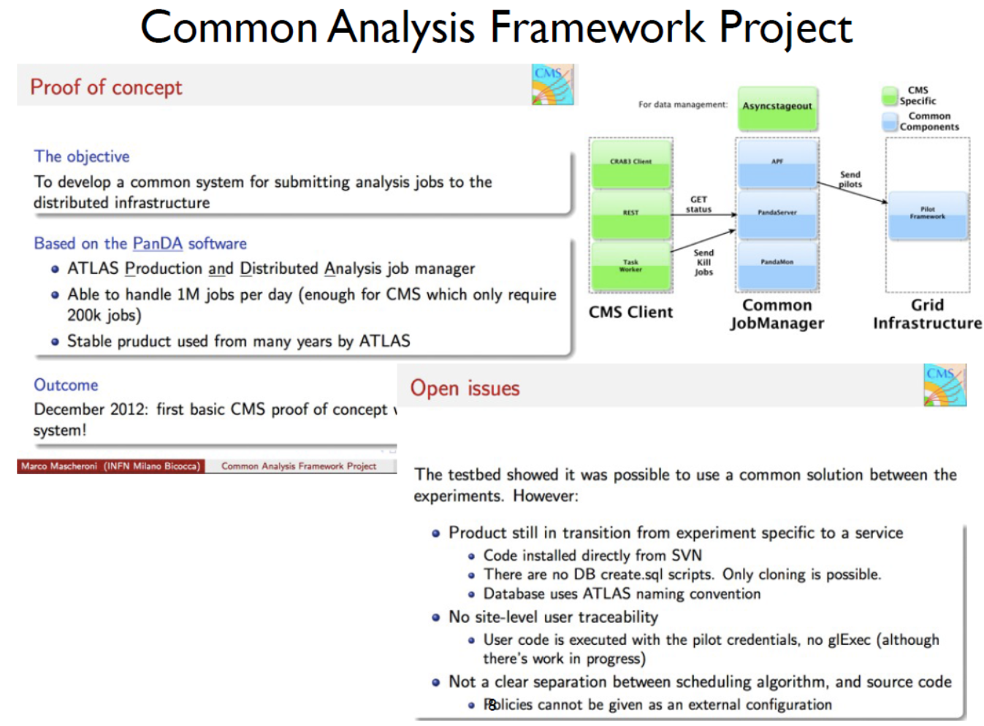
Nurcan Ozturk:
Track 3B summary talk

Slide 41
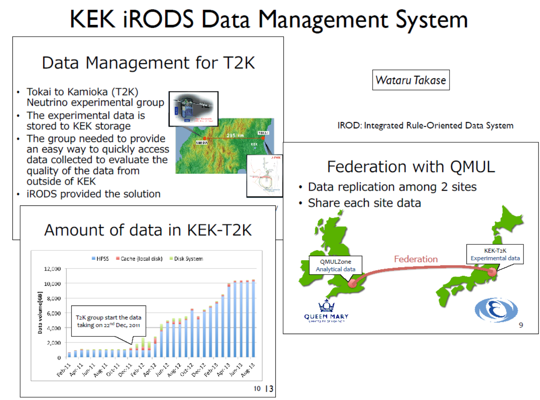
Also multi-PByte iRODS systems
10.5TByte
iRODS also typical general-purpose
solution for groups in OSG
Nurcan Ozturk:
Track 3B summary talk

Slide 42
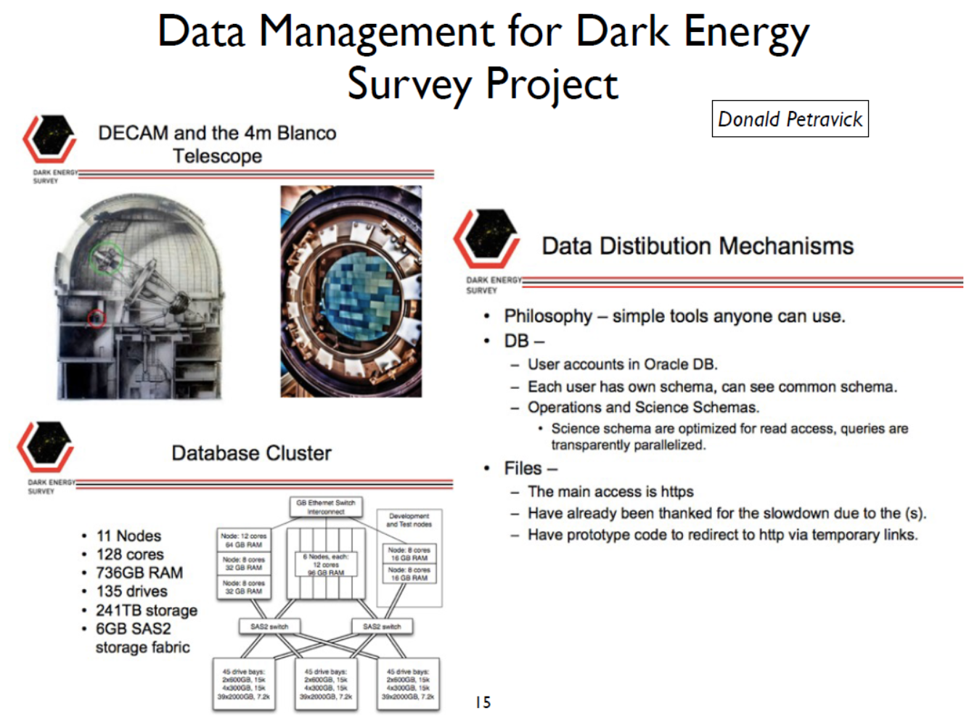
Nurcan Ozturk:
Track 3B summary talk

Slide 43
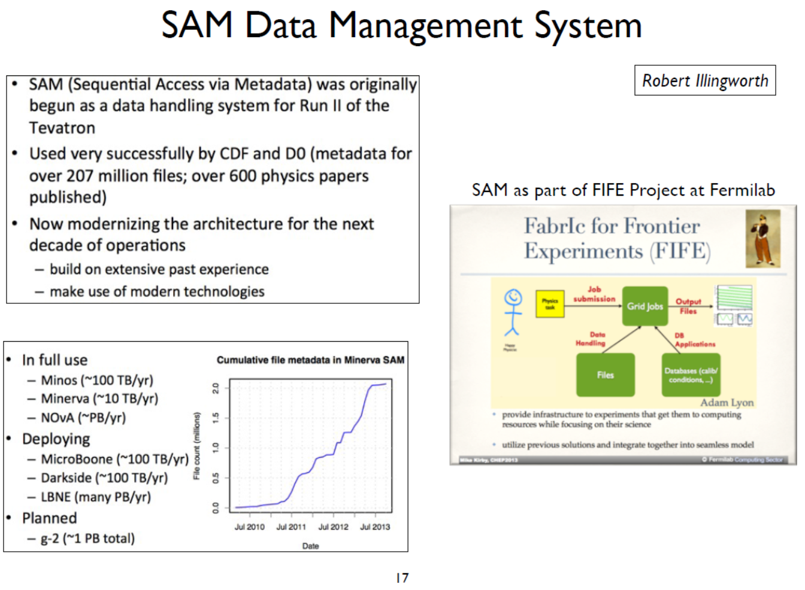
Nurcan Ozturk:
Track 3B summary talk

Slide 44
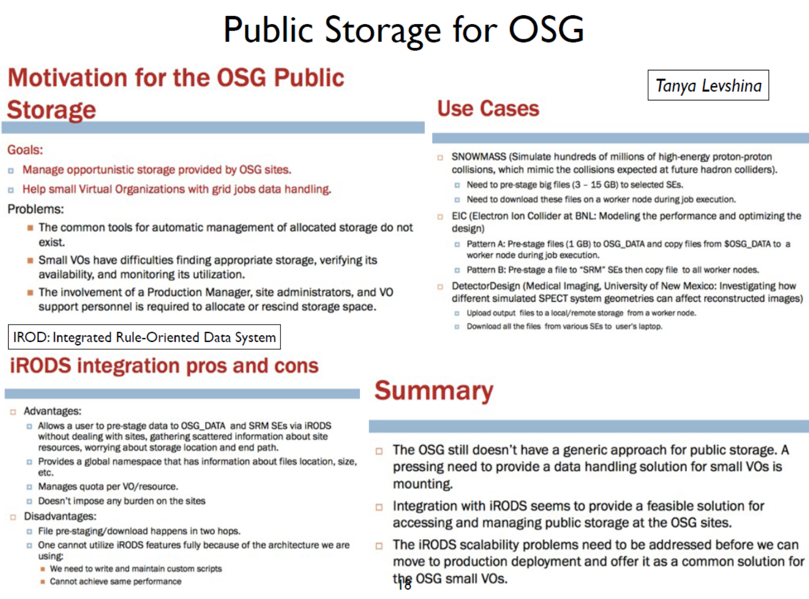
Nurcan Ozturk:
Track 3B summary talk

Slide 45
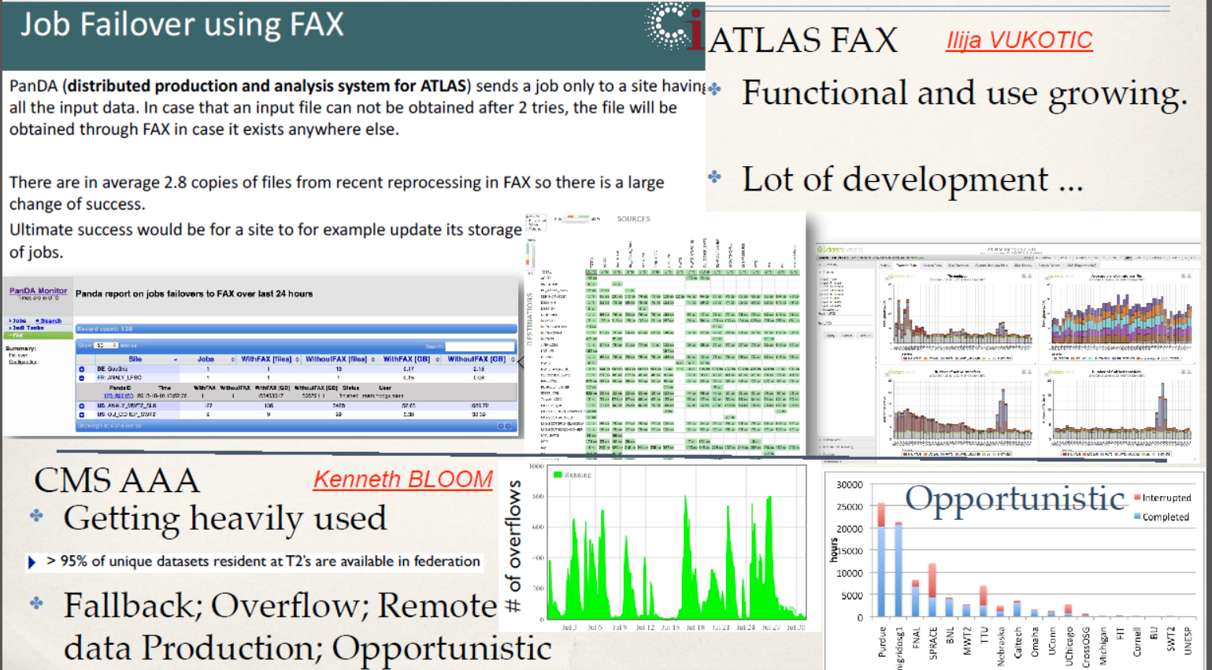
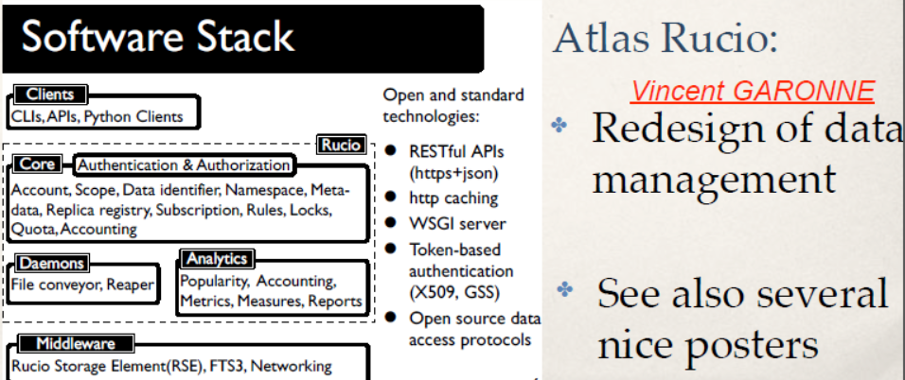
‘ATLAS&CMS’ data management evolution
‘Data Federation’
Basically ‘locate and get my file’ resolvers using HEP protocols like xrootd
and linited http use (see the storage track for industry-standard solutions)

Slide 46
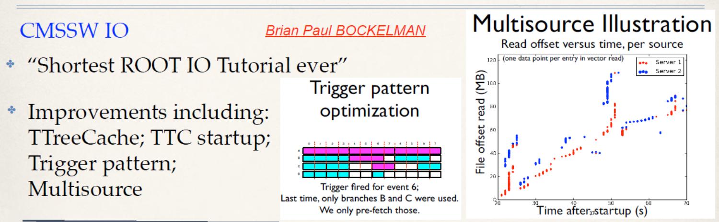
And outside the box …
Long-latency (remote) file access can be efficient!
  You need to tune RootIO to make it work well
  Parallel transfers (multi-source) also helps
  Read how to do it right in Brian’s talk!
#160 Brian Bockelman: Optimizing High-Latency I/O in CMSSW

Slide 47
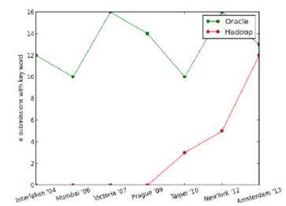
Data access patterns
Map-reduce (‘hadoop’) distributed data
  Brings compute jobs to
  prelocated data on cluster
  Distribute (multiple copies of) data across nodes
Merger of Hadoop (Java) and C++ code
  Demonstrated for Root with no changes to Root (but many to Hadoop …)
‘NoSQL’ databases
  On the rise, but need to pick use carefully!
  Useful in niches (e.g. monitoring-data collections)
  Not better ‘over-all’ than conventional DBMS…

Slide 48
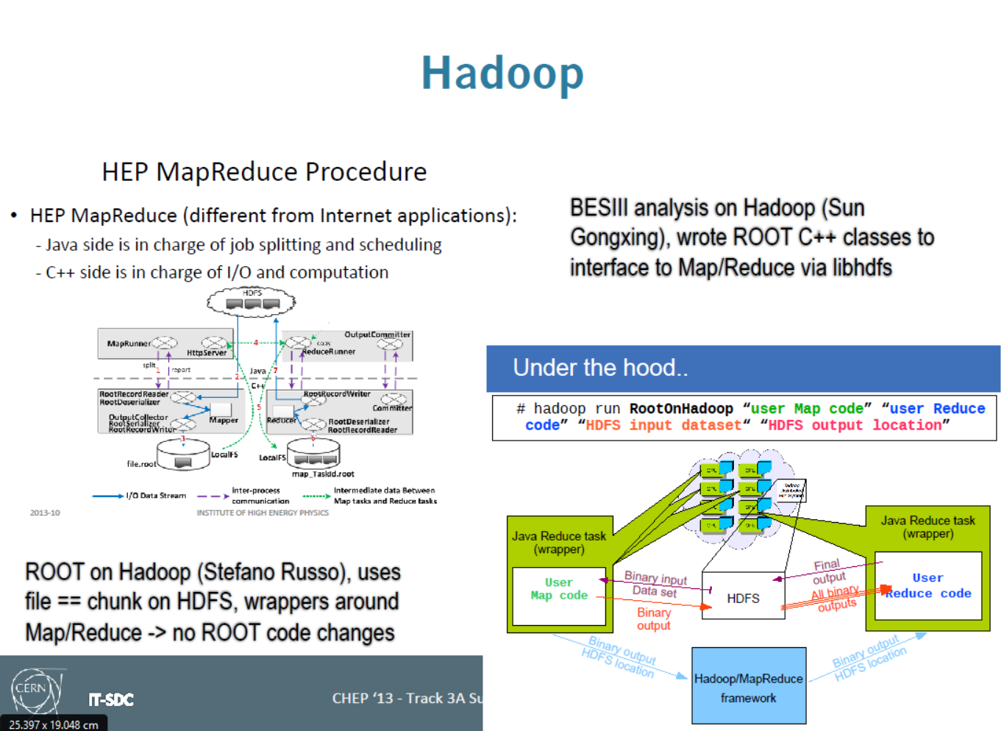
Stefan Roiser, Davide Salomoni:
Track 3A summary talk

Slide 49
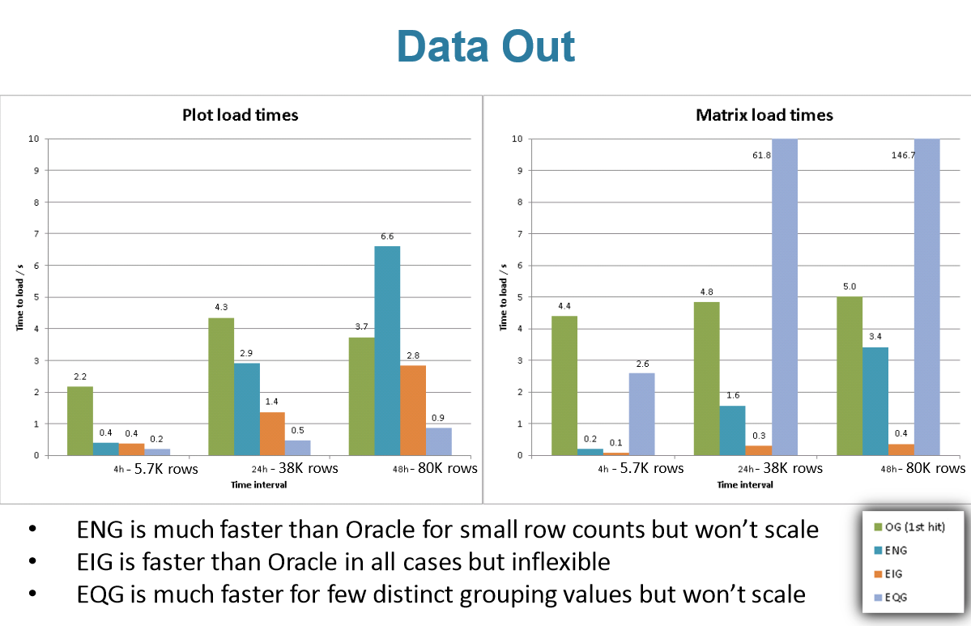
‘NoSQL’
OG: Oracle Grouping,
ENG: ElasticSearch NoGrouping,
EIG: ~IndexGrouping;
EQG: ~QueryGrouping
#106 E. Karavakis: Processing of the WLCG monitoring data using NoSQL

Slide 50

And away from Root
#225 Johannes Ebke: The Drillbit column store

Slide 51
Computing model evolution
All LHC expts revised the computing model
  Atlas mimicking the CMS analysis trains
  CMS takes an ‘interesting’ approach to multicore – essentially building single-node-multi-core miniclusters for their own
  LHCb to leverage new DIRAC features, and gets rid of first-pass reco in 2015!
More generic & pre-existing tools used
  Mainly by non-LHC experiments
Beyond HEP: data-driven analysis for SKA+

Slide 52

Nurcan Ozturk:
Track 3B summary talk

Slide 53

Nurcan Ozturk:
Track 3B summary talk

Slide 54


Outside HEP: fully data-driven analysis
Inherent data lineage and provenance
Edwin Valentijn - Probing Big Data for Answers using Data about Data – Wednesday plenary

Slide 55

Edwin Valentijn - Probing Big Data for Answers using Data about Data – Wednesday plenary

Slide 56


Data in optical astronomy
Few Pbyte/year
LOFAR: 5PByte/year
SKA: >EByte/yr
Edwin Valentijn - Probing Big Data for Answers using Data about Data – Wednesday plenary

Slide 57



Applicable to many domains
Edwin Valentijn - Probing Big Data for Answers using Data about Data – Wednesday plenary

Slide 58

Data stores, data bases and storage systems
Storage large and small
File systems forever
The cheapest storage front-end
Photo: Ian S http://www.flickr.com/photos/ian-s/2785762687/ CC-BY-NC-ND

Slide 59

Storage evolution: 2 extremes
#68 Dan van der Ster: Building an organic block storage service at CERN with Ceph
Local Note:
SURFsara and SURFnet soon to
announce eduBox here based on ownCloud!
CephFS NOT ready
for prime time yet
Wahid Bhimji: Track 4 summary talk (and upstream contributors)

Slide 60


File system woes
Wahid Bhimji: Track 4 summary talk (and upstream contributors)

Slide 61



Distributed file and object stores do work – and NFSv4.1 may help as FS
#376 Paul Millar: dCache: Big Data storage for HEP communities and beyond

Slide 62


Storing LHC data on EOS or CASTOR
For LHC Run2 several scenarios open:
DAQ to CASTOR, then copy to EOS
DAQ to both EOS and CASTOR
DAQ to EOS, use CASTOR as dark storage
Note HEP-specific protocols continue concurrent with
industry standadization and new products like pNFS
Tape is not dead: still fastest per-device throughput (240MB/s) and cheap
#83 Xavier Espinal: Disk storage at CERN: handling LHC data and beyond

Slide 63

Storage clouds – multiple back-ends
#376 Paul Millar: dCache: Big Data storage for HEP communities and beyond

Slide 64
Who knows of SRM?
Management of storage systems
  Find out which protocols are supported
  Quota and reservations
  Third-party copies
CDMI ‘cloud storage’ ISO standard support most of this – and we’ll see a migration to that one … at least via dCache
  Adds metadata management
  Object-stores (no more meaningless filenames)
  Notifications

Slide 65





Cheap meta-data management for DPM (and a scaling test …)
#146 Matin Hellmich: DPM - efficient storage in diverse environments

Slide 66

Disk and storage will fail
#83 Xavier Espinal: Disk storage at CERN: handling LHC data and beyond

Slide 67

Infrastructure and networks
Virtualization
Software Defined Networking
Integrating CPU, memory, and communications
Seating at the Universidad Nacional de La Plata, Facultad de Informática

Slide 68
Virtualization and ‘clouds’
On-demand deployment of resources using virtualisation clearly the way to go
  Still hear the ‘cloud’ buzz word, but what we see is ‘agile infrastructure’
  CERN pushing ahead due to dual-site setup
  lots of talks related to Wigner commissioning

Slide 69





CERN Cloud production service Grizzly
#17 Ramon Llamas:Testing as a Service with HammerCloud
#217 Belmiro Moreira: Production Large Scale Cloud Infrastructure Experiences at CERN

Slide 70


OpenStack
Rich community-contributed ecosystem
Many new components, most actively developed OSS stack
The only ‘cloudy’ thing in the architecture are the users ☺

Slide 71


Problems shift, but do not go away …
Adding virtualisation gives you more potential failure points to monitor …
And new services even more …
So just use Hadoop and ElasticSearch just to mine the monitoring data!
#206 Pedro Andrade: Agile Infrastructure Monitoring

Slide 72





From monitoring to testing
HammerCloud as a multi-purpose tool
Moved to Grizzly OpenStack cloud
#17 Ramon Llamas:Testing as a Service with HammerCloud

Slide 73


Commercial clouds: they work fine … (but: at a cost)
#84 Ramon Llamas:Helix Nebula and CERN: A Symbiotic Approach to Exploiting Commercial Clouds

Slide 74

Own data centre still very cost-effective – factor 3 compared to Amazon
You pay for the Amazon profit
and for the low occupancy (‘elasticity’)
#14 Tony Wong: Operating dedicated data centers - Is it cost-effective?

Slide 75

The network is not ‘just there’
multi-protocol world – at every level
Especially the core is a complex distributed multi-domain issue
Did you know that ~20% of the total infrastructure cost is network-related?
Did you know that we (at Nikhef NDPF alone) have 240 Gbps between CPU and disk?
Inder Monga – Software Defined Networking – Thursday plenary

Slide 76
And that network use exploded?
Inder Monga – Software Defined Networking – Thursday plenary

Slide 77

Inder Monga – Software Defined Networking – Thursday plenary

Slide 78


Inder Monga – Software Defined Networking – Thursday plenary

Slide 79

Inder Monga – Software Defined Networking – Thursday plenary

Slide 80


CERN internet peers
#30 David Rueda: Network architecture and IPv6 deployment at CERN

Slide 81

Non-blocking 1Tbps
#30 David Rueda: Network architecture and IPv6 deployment at CERN

Slide 82

100Gbps is coming fast – literally ☺
4Mbyte is a small file
#26 Gabriele Garzoglio: Big Data over a 100G Network at Fermilab

Slide 83

Xrootd cannot keep up and needs 4GByte+ files and >8 parallel clients
100Gbps is coming fast – literally ☺
#26 Gabriele Garzoglio: Big Data over a 100G Network at Fermilab

Slide 84

And 400GbE is also here already
Harvey Newman – Advanced Networks for the LHC Era – Thursday plenary

Slide 85

Inder Monga – Software Defined Networking – Thursday plenary

Slide 86


Who is there?
The “v4” internet is exhausted – really!
#360 David Kelsey:WLCG and IPv6 - the HEPiX IPv6 working group

Slide 87


IPv6 is there (and also here ;-)
#360 David Kelsey:WLCG and IPv6 - the HEPiX IPv6 working group

Slide 88




http://hepix-ipv6.web.cern.ch/wlcg-applications

Slide 89




… and human networking
Allows users to use CPU, disk and networks worldwide – without having to register at each site!
-- anyone remember the painful days @FNAL and all those forms?
#336 David Kelsey:WLCG Security: A Trust Framework for Security Collaboration among Infrastructures

Slide 90
Collaborative Tools

Slide 91



Planned, no date …

Slide 92


Slide 93

Parallelism
Multi-core and Vectorisation
Thermal death (beyond classic x86 cores)
Vectorization: how we learn anew what we though we lost
The OO curse, or the ‘how-to-waste-CPU-cycles’ how-to guide
C++11: a language to make concurrency understandable
Prepare for the future!
Image: die of the Intel XEON 5680 CPU

Slide 94
New architectures
Beyond x86: ARM, Nvidea
Vectorization (GPU)
Concurrency (Xeon Phi, multi-core)
and associated tools
C++ 11
Intel TBBs, ArrowStreet, …
But tools are no reason to stop thinking: the compiler cannot fix inefficient data structures

Slide 95

Lulled to sleep?
2004: Jayhawk cancelled by Intel
2005: end of Dennard scaling
Figure source: <http://www.gotw.ca/publications/concurrency-ddj.htm>,
data from Intel, public sources and Wikipedia, and Kunle Olukotun (Stanford University)

Slide 96


Why? Power!
#303 Peter Elmer: Explorations of the viability of ARM and Intel Xeon Phi for Physics Processing

Slide 97

#303 Peter Elmer: Explorations of the viability of ARM and Intel Xeon Phi for Physics Processing

Slide 98


516000 events/kWh
156000 events/kWh
#303 Peter Elmer: Explorations of the viability of ARM and Intel Xeon Phi for Physics Processing
Notes:
Power-only: on a Rpi 2.15Mevt/Euro; on L5520: 650kevt/Euro (

Slide 99


Solveig Albrand, Summary talk for track 5
with slide by Niko Neufeld

Slide 100



Jim Kowalkowski – Data Processing in the wake of massive multicore and GPU – Tuesday plenary

Slide 101

Solveig Albrand, Summary talk for track 5

Slide 102

Solveig Albrand, Summary talk for track 5

Slide 103


Vectorization – making your code fast today and tomorrow
Axel Naumann: C++ Evolves! – Monday plenary

Slide 104


Slide 105

Axel Naumann: C++ Evolves! – Monday plenary

Slide 106

‘if results are very sensitive to double precision (and surely if you see the difference between AMD and Intel CPUs!), you likely need to revise your implementation!’

Slide 107



Adding vectorization to your code
Axel Naumann: C++ Evolves! – Monday plenary

Slide 108


From the past - ignored for a long time
Writing of pipelineable and vectorisable code used to be part of a
standard physics bachelor curriculum! But it dropped out and efficiency suffered …
Sverre Jarp, How good is the match between LHC software and current/future processors? , CHEP2007
https://indico.cern.ch/event/3580/contribution/490

Slide 109

How to waste your CPU? We did it!
Unpredictable conditional jumps inside tight loops are Evil™
Memory layout:
Axel Naumann: C++ Evolves! – Monday plenary

Slide 110

Using ‘new’ to instantiate each XYZ causes this mess!
Axel Naumann: C++ Evolves! – Monday plenary

Slide 111

Quite a long way away …
22 cm

Slide 112

Slightly better …
Axel Naumann: C++ Evolves! – Monday plenary

Slide 113



Good!
Axel Naumann: C++ Evolves! – Monday plenary

Slide 114


Slide 115


C++11 compilers can generate good code (given the right constructions)
… just like what you would have done anyway (don’t you?)
But: compilers cannot fix inefficient memory layout!
So no arithmetic on vectors of objects please, but on objects with vectors in them!
And dont ‘new’ stuff inside a loop … heap scatter is Bad™

Slide 116


C++11++ – a feature-filled road ahead
Lessons from C++11
• don’t funnel everything into next standard
• be careful about intrusive changes
• Faster, smaller updates planned: ’14, ’17
‘In principle semi-democratic: all countries have one vote. But technical
discussions + “straw polls” involve everyone’
Axel Naumann: C++ Evolves! – Monday plenary

Slide 117


Garbage collection in C++11 in case you cant’ remember where you left your data …
Axel Naumann: C++ Evolves! – Monday plenary

Slide 118


Performance and optimizable code
Simplified code
Axel Naumann: C++ Evolves! – Monday plenary

Slide 119

Axel Naumann: C++ Evolves! – Monday plenary

Slide 120

Good and Bad
The good
The BAD!
Good and bad are my own qualifitions (DG)

Slide 121

Where do you find good examples?
Axel Naumann: C++ Evolves! – Monday plenary

Slide 122

Now that we have the tools and languages
How can we use this in frameworks?

Slide 123
CPU information changes rapidly
Haswell servers (E5v3) readily available
Good projections exist for Broadwell (‘small’ step) and Skylake (new microarch.)
which are newer than CHEP2013 data
Common mantra: you need concurrency (thread or data) to profit!
  Be friendly for SIMD vectorization
  Expect much more cores, some of which may be ‘lighter’ than others (2016+)

Slide 124

CPU architectures: exploit SIMD!
#397 Pawel SZOSTEK, Sverre Jarp:Beyond core count: a look at new mainstream computing platforms for HEP workloads

Slide 125

Jim Kowalkowski – Data Processing in the wake of massive multicore and GPU – Tuesday plenary

Slide 126

Not too far away ;-)
Jim Kowalkowski – Data Processing in the wake of massive multicore and GPU – Tuesday plenary

Slide 127

What if you can really do it anew?
Pick existing components
  Borrow a lot from non-physics concurreny frameworks
  Messaging (RabbitMQ, ZeroMQ, ActiveMQ) from the OSS world
  Root rulez!
On-line (DAQ, filtering)
and offline development
the same: continuous
sampling of data
Stefano Spataro Computing for future experiments – Tuesday Plenary

Slide 128


Stefano Spataro Computing for future experiments – Tuesday Plenary

Slide 129

Stefano Spataro Computing for future experiments – Tuesday Plenary

Slide 130

Jim Kowalkowski – Data Processing in the wake of massive multicore and GPU – Tuesday plenary

Slide 131

Jim Kowalkowski – Data Processing in the wake of massive multicore and GPU – Tuesday plenary

Slide 132

Software engineering

Slide 133


Treat your code as a scientific product!
FYI: The ‘curiously recurring template pattern’ (CRTP) is a C++ idiom in which a class X derives from a class template
instantiation using X itself as template argument
#493 Robert Lupton (Princeton, LSST):Writing Stellar Software – Monday Plenary
#242 Mario Lassnig: The ATLAS Data Management Software Engineering Process

Slide 134


Some Key Lessons
#493 Robert Lupton (Princeton, LSST):Writing Stellar Software – Monday Plenary

Slide 135


Documentation?
No documentation talks this CHEP!
#493 Robert Lupton (Princeton, LSST):Writing Stellar Software – Monday Plenary

Slide 136

Data Preservation
Where will your data be 30 years from now?

Slide 137

Pirjo-Leena Forsström – Data Archiving and Data Stewardship – Wednesday plenary

Slide 138


Pirjo-Leena Forsström – Data Archiving and Data Stewardship – Wednesday plenary

Slide 139

Pirjo-Leena Forsström – Data Archiving and Data Stewardship – Wednesday plenary

Slide 140

Pirjo-Leena Forsström – Data Archiving and Data Stewardship – Wednesday plenary

Slide 141

DPHEP
#323 Jamie Shiers: DPHEP: From Study Group to Collaboration

Slide 142

DHPHEP
#323 Jamie Shiers: DPHEP: From Study Group to Collaboration

Slide 143

DPHEP time line
So we continue to loose data till ≥ 2018?

Slide 144
So what about your data?
Keeping the bits is ‘easy’
  But deciding which bits to keep is something you should do, since only managed bits will stay!
  I still have 50+ Exabyte 8mm tapes (and a tape drive on my shelf!), but realistically will never read them back … but the physics ntuples and PAW macro are on disk … although my logbook is not
But what about
  Meta-data: what do the bits mean
  Processes: how convert bits to physics
  … when you are long since gone?
Do others understand your logbook??

Slide 145

Some final words

Slide 146
A Committed Community
1985 participants in 2013
Richard Mount
Harvey Newman
Fons Rademakers
http://www.chep2013.org/1985

Slide 147
Thanks!
To all track conveners for their summaries
Niko Neufeld, Tassos Belias, Andrew Norman, Vivian O'Dell,
Rolf Seuster, Florian Uhlig, Lorenzo Moneta, Pete Elmer,
Nurcan Ozturk, Stefan Roiser, Robert Illingworth,
Davide Salomoni, Jeff Templon, David Lange, Wahid Bhimji,
Dario Barberis, Patrick Fuhrmann, Igor Mandrichenko,
Mark van de Sanden, Solveig Albrand, Francesco Giacomini,
Liz Sexton, Benedikt Hegner, Simon Patton, Jim Kowalkowski, Maria Girone, Ian Collier, Burt Holzman, Brian Bockelman, Alessandro de Salvo, Helge Meinhard, Ray Pasetes,
Steven Goldfarb
The plenary speakers
And all participants for the talks and posters!

Slide 148
More?
http://chep2013.org/indico
http://chep2013.org/boa
http://chep2013.org/contrib/<n>
Soon:
http://chep2013.org/journal

Slide 149







Amsterdam 1985
CHEP2015
April 13 – 17 2015
UTokyo and KEK, with
RIKEN, OIST, and UOsaka
Amsterdam 2013
Okinawa 2015!

Slide 150









http://manyworldstheory.com/2013/10/03/the-9-kinds-of-physics-seminar/
From the plenaray talk of Stefano Spataro on Computing for future experiments

