Slide 1


Building Trust and Security with AARC, IGTF, EOSC, & WISE
David Groep
davidg@nikhef.nl
Enabling Communities through Trust, Identity, and Security in the Open Science era
part of the work programme of SURF -
the Dutch National e-Infrastructure,
GEANT 4-3 EnCo, EGI-ACE, and EOSC-Future
the work has received co-funding from the Horizon 2020 programme of the European Union
co-supported by Nikhef and the Dutch
National e-Infrastructure coordinated by SURF

Slide 2



Meanwhile in the EUGridPMA+ …
EUGridPMA constituency and profile developments
European Open Science Cloud – Security Baseline
Attribute Authority Operations guideline
Simple highly-available services with anycast – and a stateful service
Readiness and communications – the ‘SCCC-JWG’ and the IGTF RAT CC

Slide 3
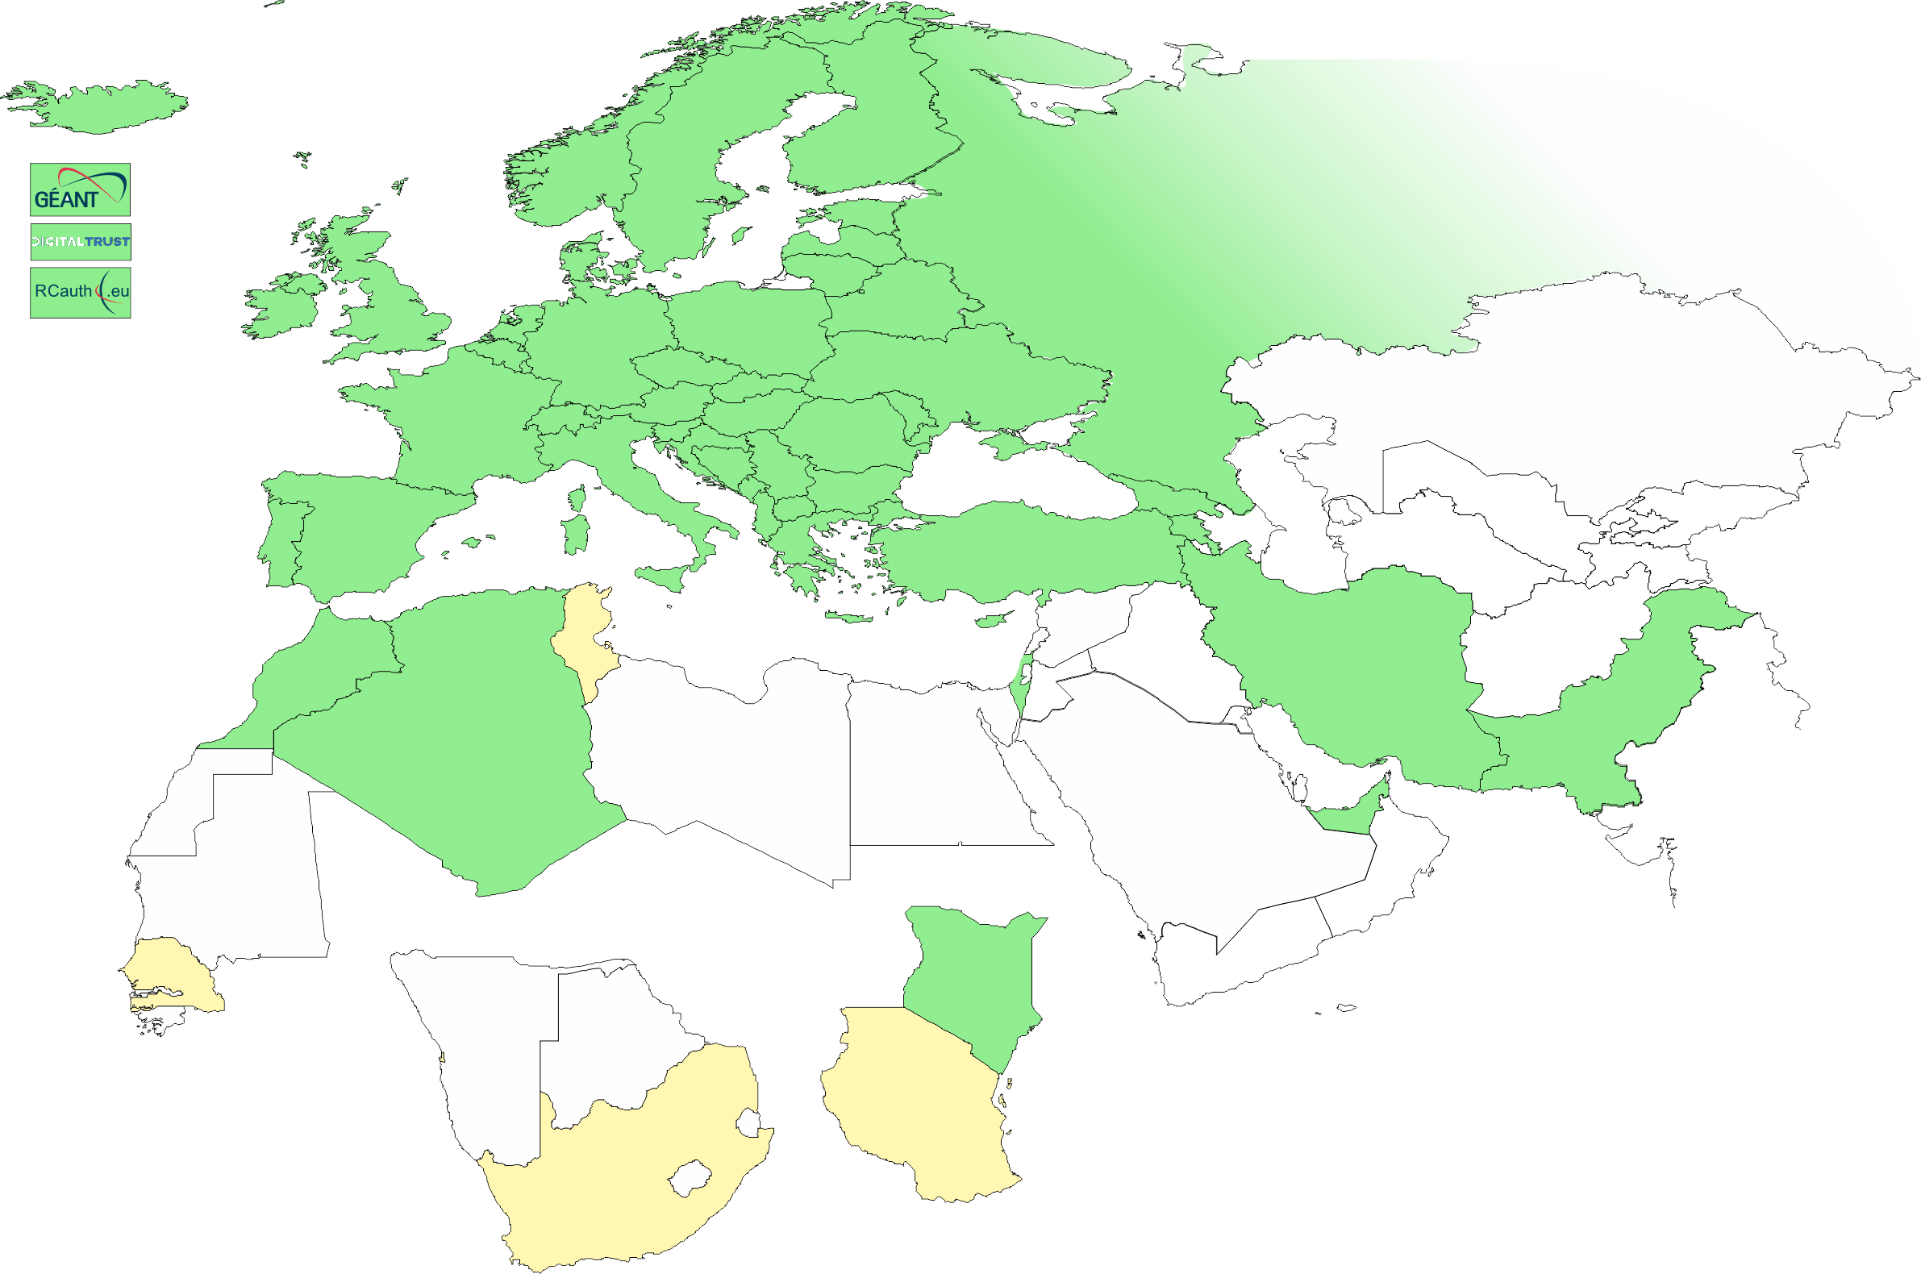
IGTF EMEA area membership evolution
Europe⁺: GEANT TCS, and CZ, DE, DK(+FI+IS+NO+SE), FR, GR, HR, HU, NL, PL, PT, RO, SI, SK; AM, GE, MD, ME, MK, RS, RU, TR, UA, UK
Middle East: AE, IR, PK
Africa: DZ, KE, MA
CERN, RCauth.eu,
DigitalTrust (AE)
Emphasis on collaboration
across the whole T&I space

Slide 4
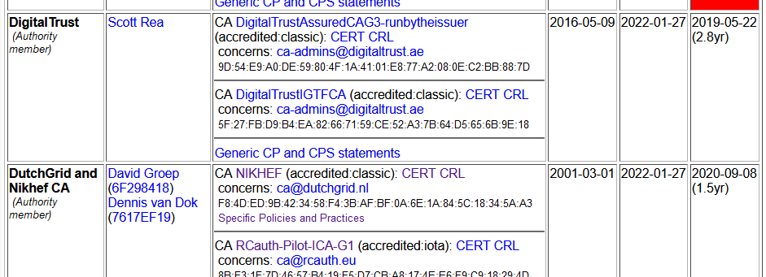
Membership and other changes
Identity providers: both reduction and growth
  some migration to GEANT TCS is still ongoing
  https://wiki.geant.org/display/TCSNT/TCS+Participants+Sectigo
  BCDR
Self-audit review
  Cosmin Nistor as review coordinator
  Self-audits are slacking a bit – fewer CAs …
Next meeting in Garching, DE, May 23-25!

Slide 5
WLCG and server credentials study WG
Increased use of automatic public cloud deployment (and at times lack of documentation) highlight the fact that in ‘conventional’ grid middleware server-trust and client-trust cannot be distinguished
Similarly, while combined-assurance (DOGWOOD) is available for client-auth, there is no equivalent for server trust
Although issues will change on introduction of ‘token-based’ access (which does distinguish client & channel trust), of limited help now
WLCG, with participants from the IGTF, set up a WG to study the issues
https://docs.google.com/document/d/1Sl0C_q-lGMCifChmFArHjsGzdnd-RM7O7jbpsGa8XRw

Slide 6
A Security Baseline for diverse infrastructures and the EOSC
European Open Science Cloud
EOSC Security Baseline
Evolving the Policy Development Kit in WISE SCI

Slide 7

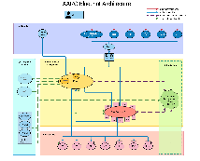


European Open Science Cloud - Interconnecting communities
https://aarc-community.org/about/aegis/

Slide 8
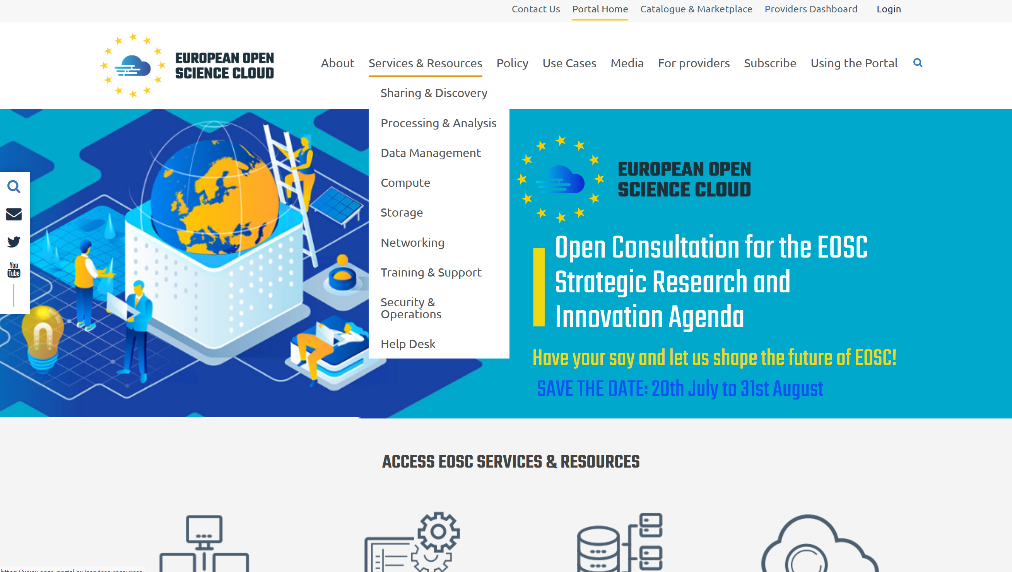
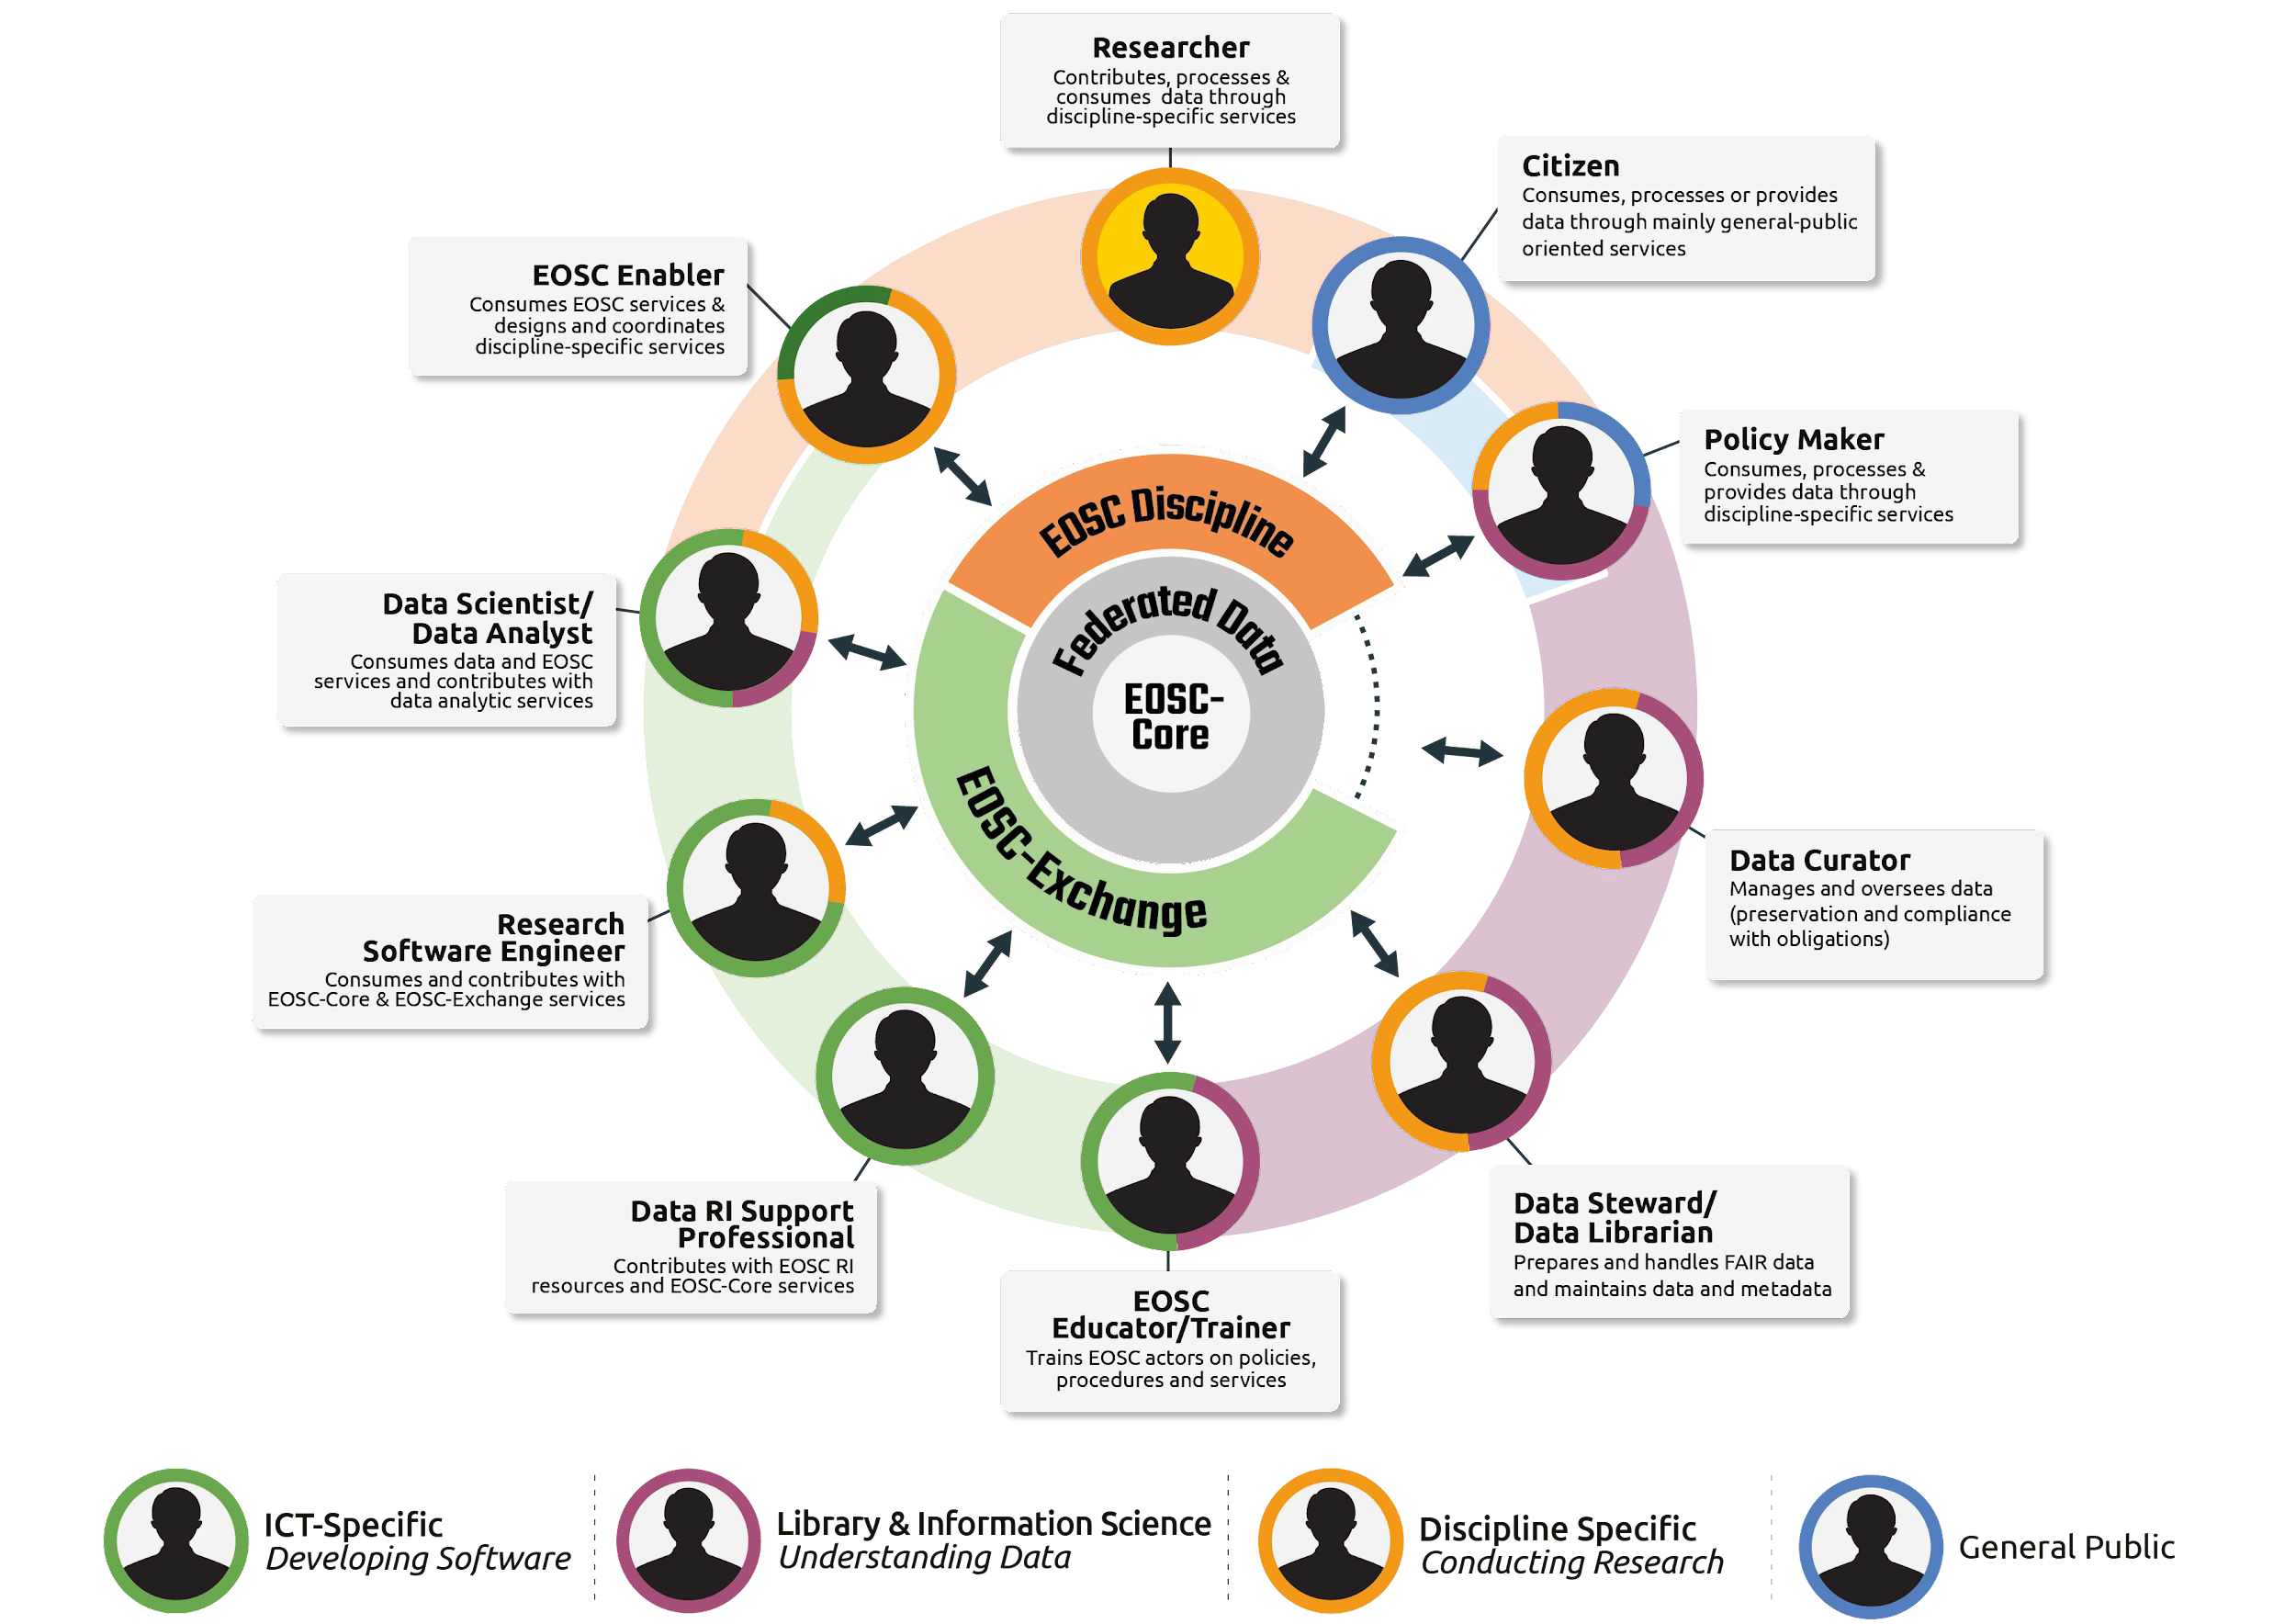
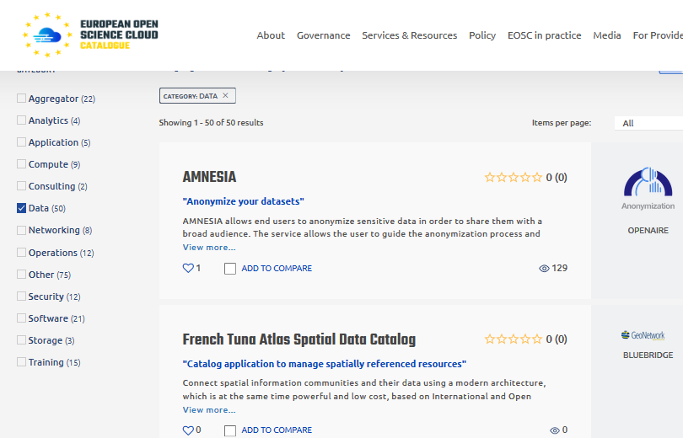
An ecosystem more than just the infrastructure
circle diagram: from Ignacio Blanquer’s ISGC 2022 keynote
Digital Skills for FAIR and open science doi.org/10.2777/59065
EOSC Portal (https://www.eosc-portal.eu/) – as built by EOSChub

Slide 9
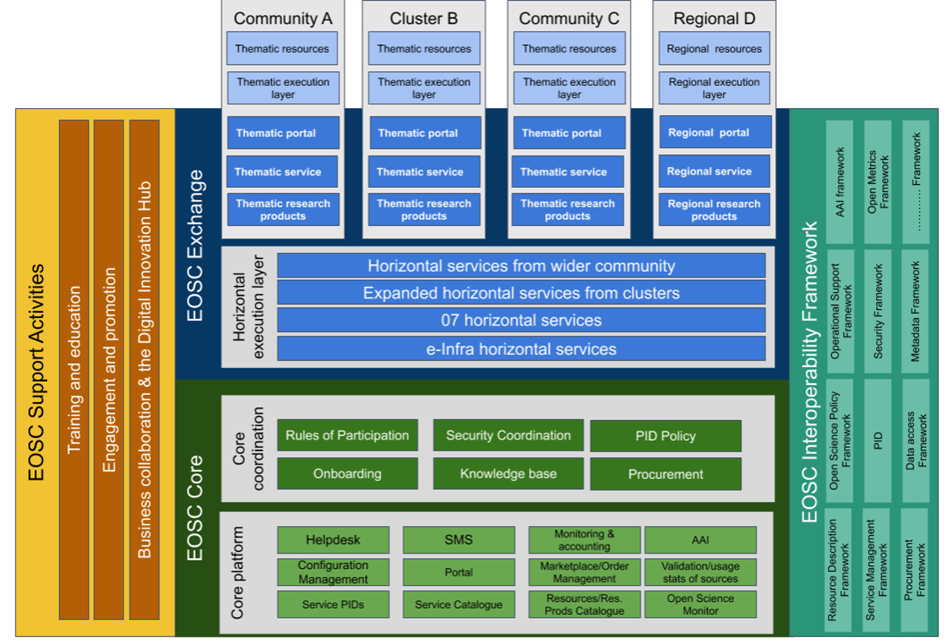

The EOSC ecosystem – core and an ‘exchange’

Slide 10
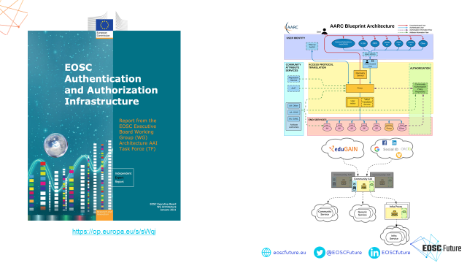
EOSC Authentication and Authorization Infrastructure
slide: Christos Kanellopoulos, GEANT, for EOSC Future WP7.3

Slide 11

A challenging security landscape
Entities of all kinds – diversity in the EOSC range
from data sets to storage to computing to publications & digital objects
An open ecosystem – rules of participation will favour low barrier to
entry regarding operational maturity, service management quality, &c
A diverse ecosystem – providers will come from e-Infrastructures,
from member states, from research infrastructures, and private sector
An interdependent ecosystem – aiming for composability
and collective service design through an open, core AAI federation

Slide 12
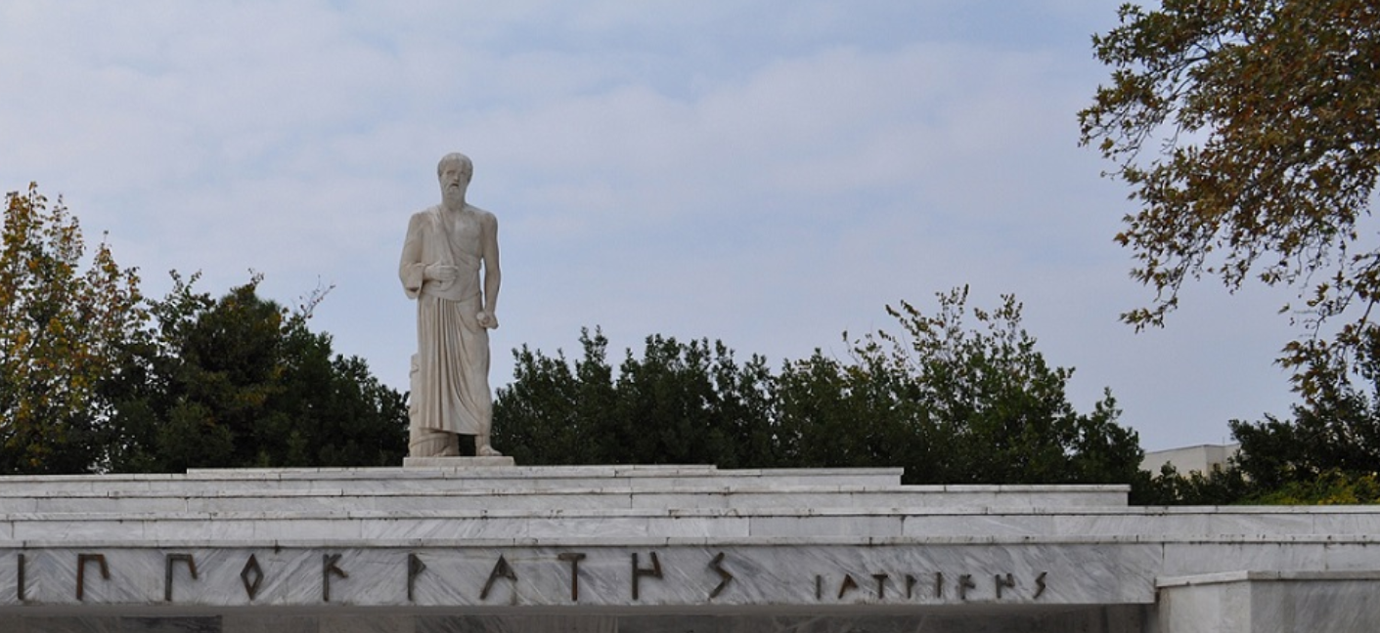
Back to Basics: the few tenets for the ecosystem security
A service provider should
do no harm to interests & assets of users
not expose other service providers
in the EOSC ecosystem to enlarged risk
as a result of their participation in EOSC
be transparent about its infosec maturity and risk to its customers and suppliers
From promoting and monitoring capabilities
to managing core risk
this will mean some minimum requirements in the Rules of Participation
Photo Hippokrates tomb: Melania Stubos, CC-BY-SA-3.0
http://himetop.wikidot.com/hippocrates-funeral-monument

Slide 13
Making the EOSC a trusted place
Risk-centric self-assessment framework
Baselining security policies & common assurance
An incident coordination hub and a trust posture
Actionable operational response to incidents
AARC, REFEDS, IGTF, PDK & practical implementation measures
EOSC core expertise to support resolution of cross-provider issues
spanning providers and core, based on experience & exercises
based on federated InfoSec guidance including WISE SCI
Fostering trust through a known skills programme
so that your peers may have confidence in service provider abilities
WISE SCI: wise-community.org/sci
AARC&c: aarc-community.org, refeds.org, igtf.net
PDK: aarc-community.org/policies/policy-development-kit

Slide 14
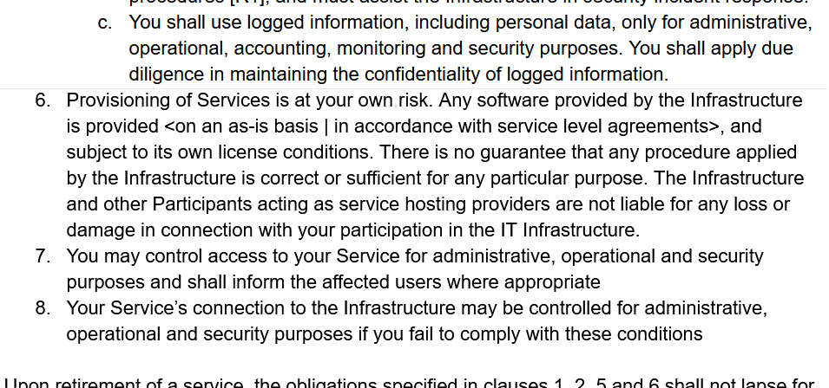
From an infrastructure to an ecosystem view
Original AARC PDK version of “Service Operations” was rather prescriptive
includes ‘service-internal’
operations and software
embedded in the PDK
document suite:
does not work well as
a ‘stand-alone’ document
has built-in assumption of
coherent and coordinated
single infrastructure

Slide 15
Evolving to the EOSC Security Baseline
In the EOSC ecosystem, more of the original assumptions no longer hold
services provided are less coherent, and much more autonomous then every before
need to accommodate providers with varying maturity levels - and different intentions!

Slide 16
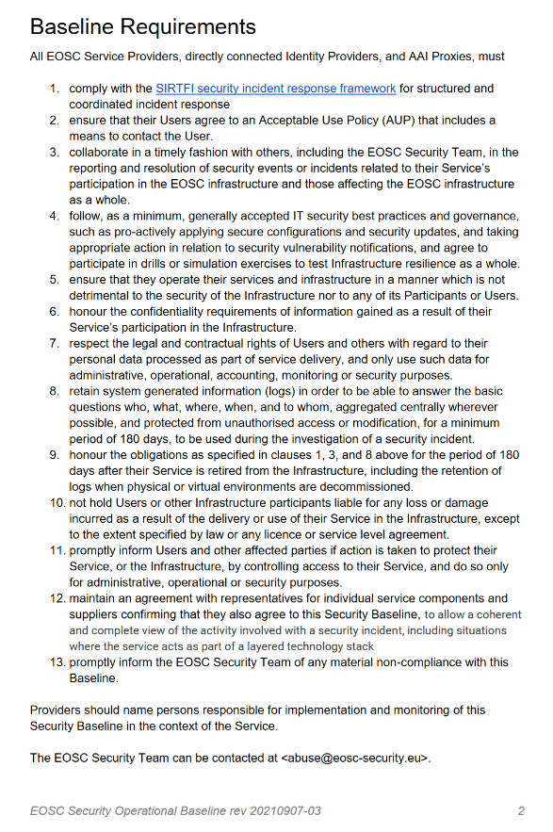
Baseline Process
Co-development of EOSC Future & AARC Policy Community
version based on UK-IRIS evolution of the AARC PDK
specifically geared towards the looser EOSC ecosystem
mindful of urgent need for collective coherent response
AARC Policy team consultation -> AEGIS -> EOSC
13 itemised points - https://edu.nl/avfv4
complemented by an ‘FAQ’ with guidance and refs
(no new standards, there is enough good stuff out there)
leverages Sirtfi framework
connects to the Core Security Team

Slide 17
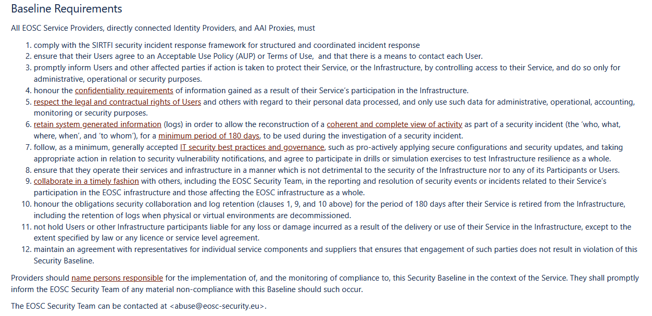
https://wiki.eoscfuture.eu/display/EOSCSMS/EOSC+Security+Operational+Baseline

Slide 18
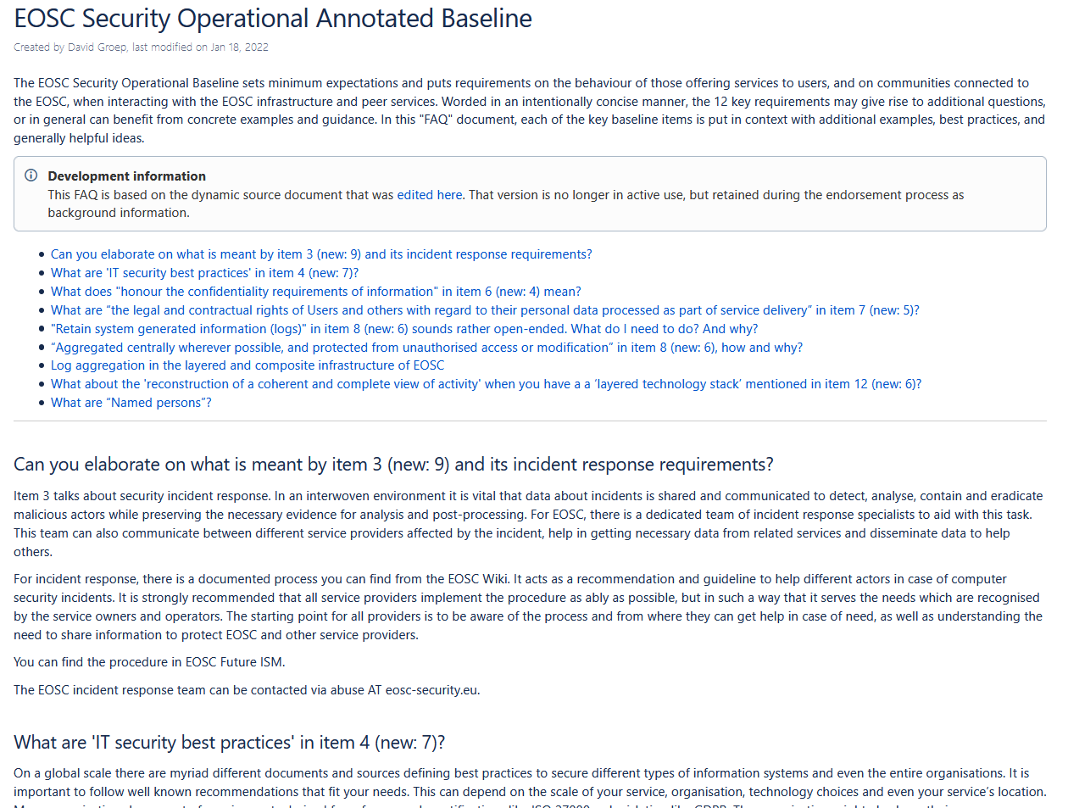
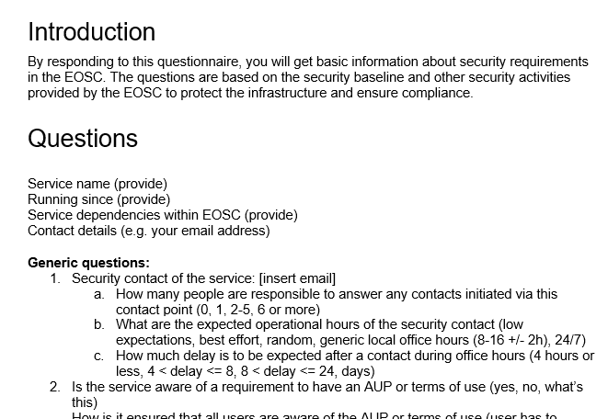
But an FAQ is almost mandatory
and a way to both get the required information out of providers, gauge maturity, and raise awareness …

Slide 19

Inspirational also for evolving the policy development kit
Join the
WISE SCI periodic meetings on Mondays (biweekly)

Slide 20

Attribute Authority operational security
AARC-G071
IGTF AAOPS (https://www.eugridpma.org/guidelines/aaops/)

Slide 21
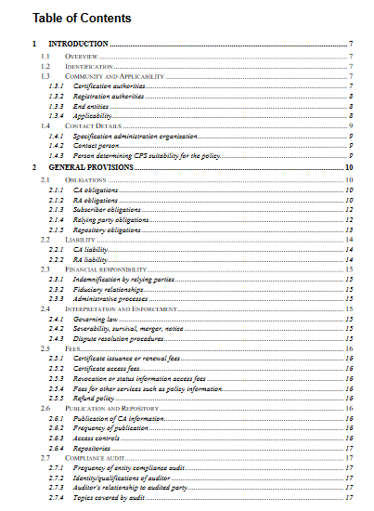
Taking proper care of trust sources
The AAI relies also on other attribute sources, and on the hubs & AARC Proxies
only generic guidance
proxies fully hide ID source
Protections for (IGTF) identity providers are known and documented
RFC3647
IGTF Guidelines
Technical profiles

Slide 22
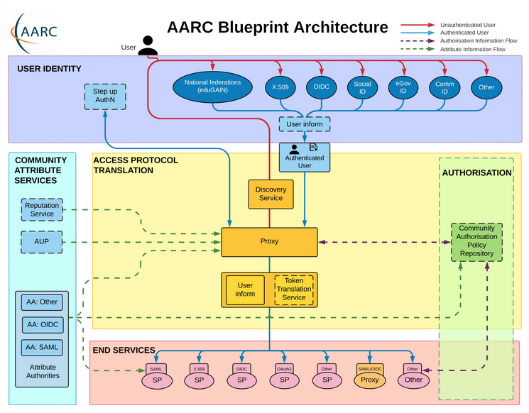
Operational guideline landscape for - proxy or source - AAI components
Authentication/identity sources
Sirtfi
(eduGAIN) baselining, RAF
IGTF AP Profiles
NIST SP800-63
eduGAIN sec. team workflow
RFC6238/4226
FIPS140
NISTSP800-53
Ephemeral credentials
trusted credential stores
protection at rest
Service provider operations
ISO27k
Sirtfi
Infrastructure response plans

Slide 23
Operational security focus in the BPA: beyond just the IdPs
Community membership management directories and attribute authorities
integrity of membership
identification, naming and traceability
site and service security
protection on the network
assertion integrity
Community membership management directories and attribute authorities
integrity of membership
identification, naming and traceability
site and service security
protection on the network
assertion integrity
Guidelines for Secure Operation of Attribute Authorities and other issuers of access-granting statements
(AARC-I048, in collaboration with IGTF AAOPS)

Slide 24
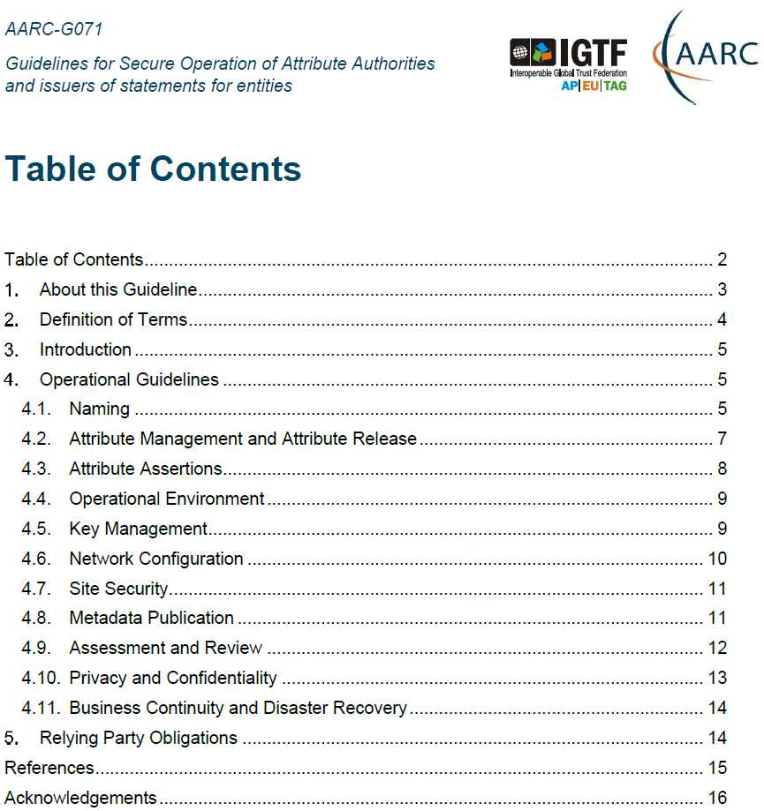
AARC-G071: keeping users & communities protected, moving across models
Structured around concept of “AA Operators”,
operating “Attribute Authorities”
(technological entities or proxies),
on behalf of, one or more, Communities, that are
trusted by Relying Parties
formerly AARC-G048bis
https://www.igtf.net/guidelines/aaops/
https://aarc-community.org/guidelines/aarc-g071/
Notes:
And dwells also on naming since that is the unique hook for the service providers to actually track back persistently to the proper community as well as operator …

Slide 25
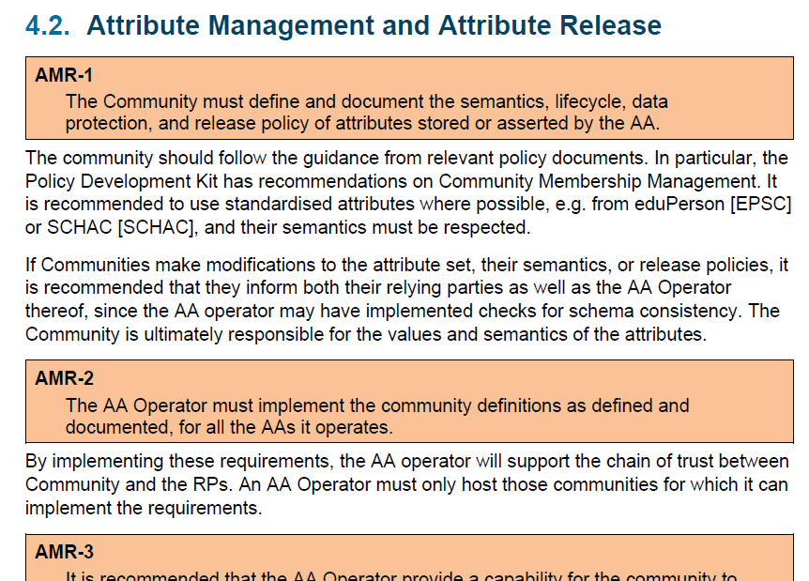
Deployment guidance included …

Slide 26
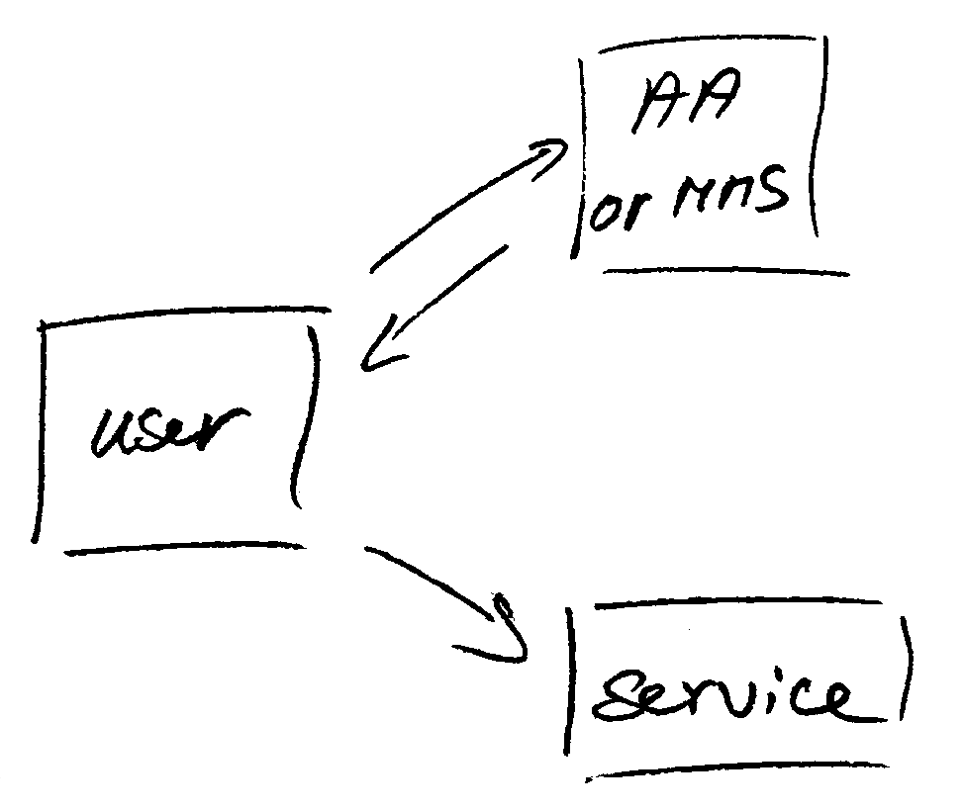
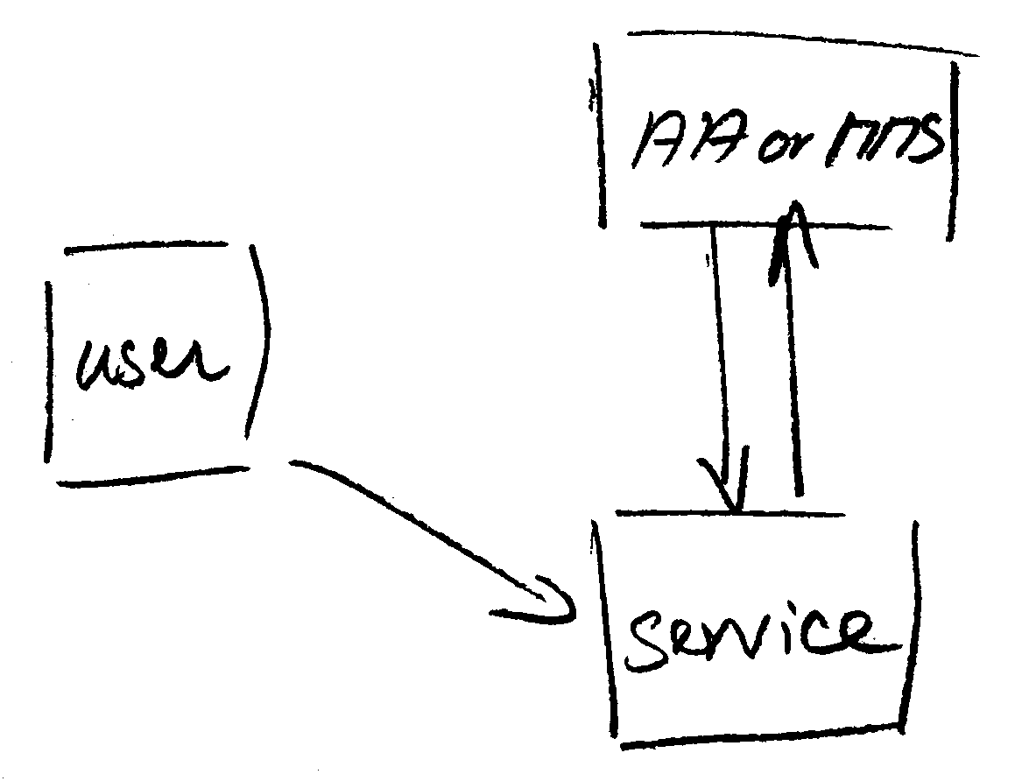
Protecting the community membership data and its proxy
Intentionally targeted broader than just the push model, since operational security spans
data centres and infrastructures using other forms of AA membership management
(SAML, OIDC, LDAP, …)
push model – the common BPA method
(e.g. SAML AttributeStatement, VOMS AC)
pull model – common when using directories
(e.g. LDAP in PRACE, userinfo endpoint in OIDC)
push and pull model diagrams as per RFC2904 – the 3rd (agent) model is uncommon in research/collaboration scenarios except for provisioning

Slide 27
When the AA is in a managed environment …
Many of the recommendations are already implemented ‘implicitly’
because common software implements it: e.g. signing SAML assertions and JWTs
because a good data centre already has network monitoring and central logging in place
because you signed up to Sirtfi (didn’t you?) – so you collaborate in incident response
because you have trained IT operations personnel looking after the service
And some are intuitive best practice
like assigning a unique and lasting name to a group
because implemented controls ought to be those that have been documented
Some items contain reminders about appropriate values and recommendations
that are good practice - based on the relevant standards involved

Slide 28
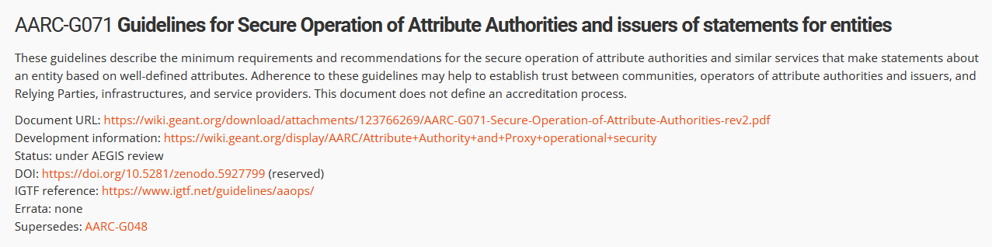
Implementation of the AA Operations (“AAI proxy”) Security guidelines
Major RPs and Infrastructures reviewed it based on current use cases and models
Guideline aimed at both Infrastructure and Community use cases
Useful input to e.g. ‘EOSC’ connected proxies as a good practice guideline
Assessment or review process is separate – could be IGTF or an RP consortium,
but does state what needs to be logged and saved to do a (self) assessment
https://aarc-community.org/guidelines/aarc-g071/

Slide 29
RCauth.eu – resilience and HA
multi-domain anycast

Slide 30
RCauth.eu – a ubiquitous federated IOTA
RCauth is an IGTF accredited IOTA (DOGWOOD class) CA
  Online credential conversion
  Connected to eduGAIN (R&S+Sirtfi) plus direct,
  e.g. EGI Check-in and eduTEAMS
Inspired by and leveraging the delegation service from CILogon
EOSC Hub and EOSC Future implementing a
High Availability setup across 3 sites

Slide 31
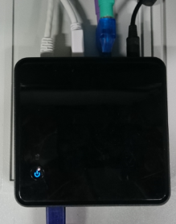




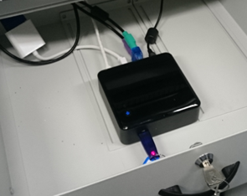






Long ago, in a drawer far, far away …
R&S
delegation
filtering
WAYF
server
31

Slide 32
Distributed RCauth
HA proxy
DS
DB
VPN
client
VPN server
STFC
GRNET
Nikhef
HA proxy
DS
DB
VPN client
VPN server
HA proxy
DS
DB
VPN client
VPN server
selected imagery: Mischa Sallé, Jens Jensen, Nicolas Liampotis

Slide 33
A transparent multi-site setup?
HA proxy
HA proxy
Need a way to send users to “closest” working service
Each HA proxy forward mainly to its own DS
If a HA loses its backend DS, it can still route to the other DSes
HA proxy
selected imagery: Mischa Sallé, Jens Jensen, Nicolas Liampotis

Slide 34
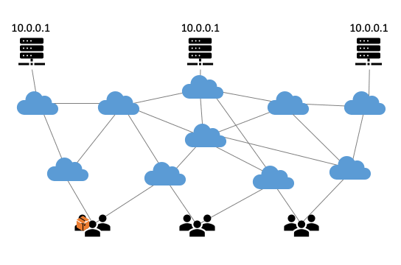
Use proven technology: ip anycast
So we used
3 (now: 2) sites
one VM at each site
exposing 145.116.216.1
smallest v4 subnet (/24)
bird + a service probe
each site’s own ASN
some IRR DB editing
v6 is similar, with a /48
and some monitoring
routing image: SIDNlabs - https://www.sidnlabs.nl/en/news-and-blogs/the-bgp-tuner-intuitive-management-applied-to-dns-anycast-infrastructure

Slide 35
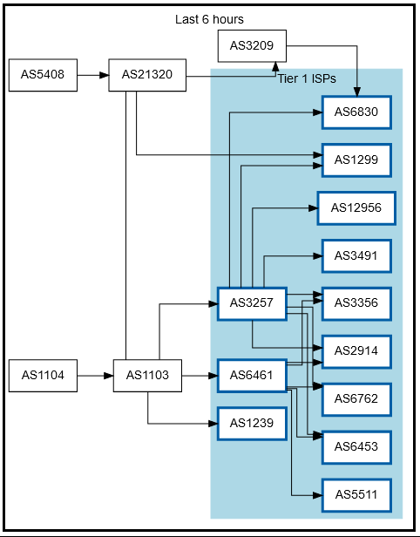
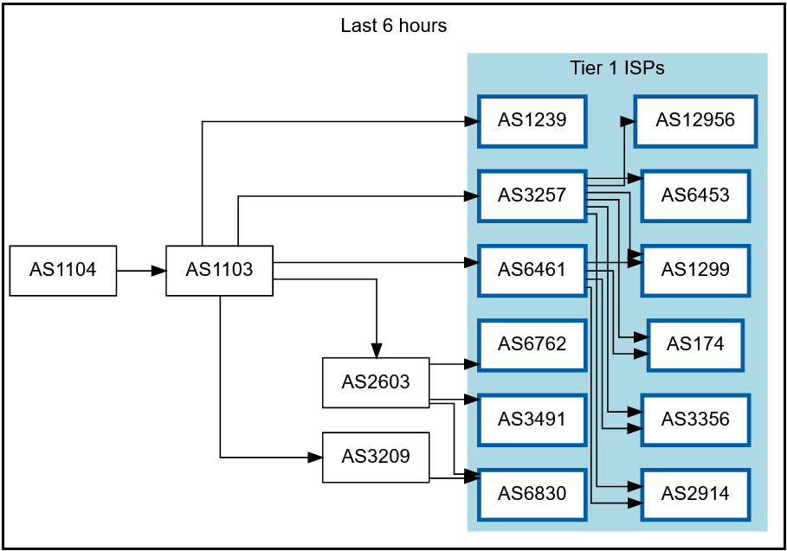
Getting 145.116.216.0/24 out there
route maps: bgp.tools for 145.116.216.0/24 – IPv6 would be similar

Slide 36
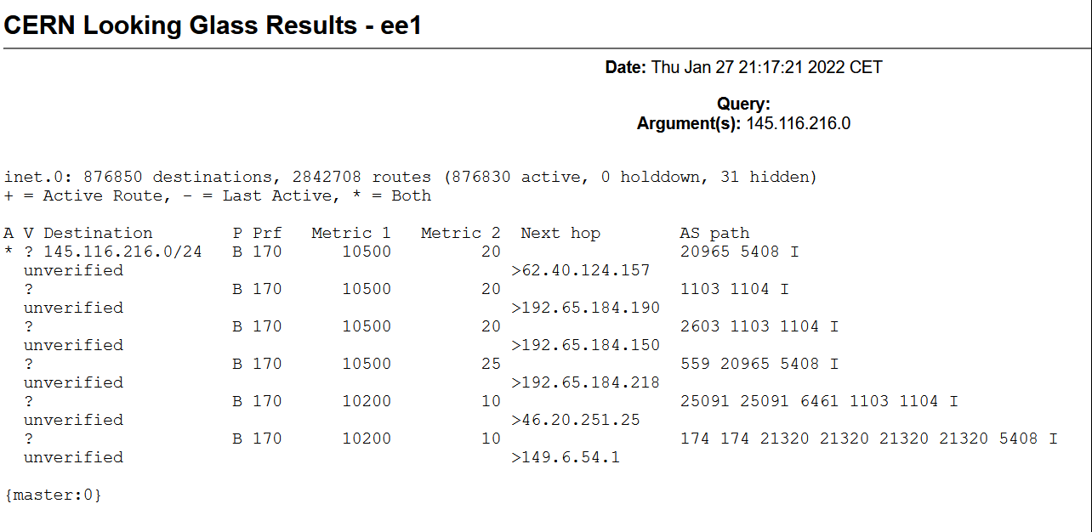
Same IP address, two AS paths ☺

Slide 37
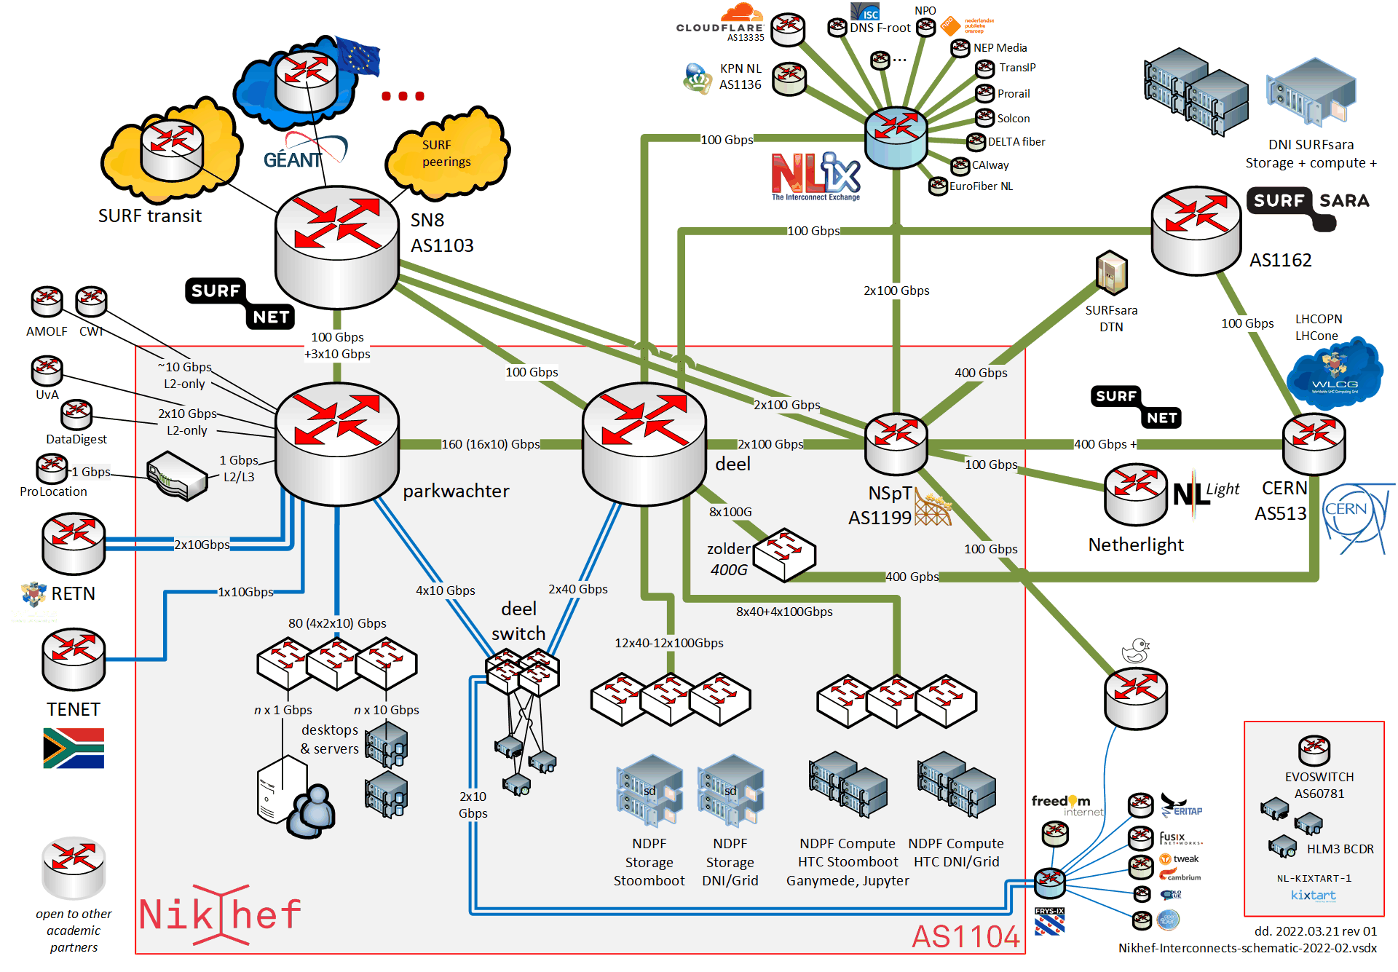
Will take any shortest route in the default-free zone
[root@kwark ~]# traceroute -IA 145.116.216.1
traceroute to 145.116.216.1 (145.116.216.1), 30 hops max, 60 byte packets
1 cmbr.connected.by.freedominter.net (185.93.175.234) [AS206238]
2 connected.by.freedom.nl (185.93.175.240) [AS206238]
3 et-0-0-0-1002.core1.fi001.nl.freedomnet.nl (185.93.175.208) [AS206238]
4 as1104.frys-ix.net (185.1.203.66) [*]
5 parkwachter.nikhef.nl (192.16.186.141) [AS1104]
6 gw-anyc-01.rcauth.eu (145.116.216.1) [AS786/AS5408/AS1104]
rcauth.eu HA proxy
Network graphic: https://www.nikhef.nl/pdp/doc/facility

Slide 38
Prerequisites are relatively simple
an IPv4 /24 netblock (and, or) an IPv6 /48
your own, or a friendly AS
a set of IRR route objects, and either none, or a correct RPKI VRP
(easily done in your local RIR registry: APNIC, RIPE, ARIN, AfriNIC, LACNIC)
bird, or quagga, with a monitoring plugin (to flap the route in case of downtime)
But you don’t per-se need:
a unique AS just for this anycast activity (it works equally well without it)
a balanced AS path length (unless you want load balancing as well as redundancy)
your own AS (if you have a friendly AS willing to re-announce your specific route)

Slide 39
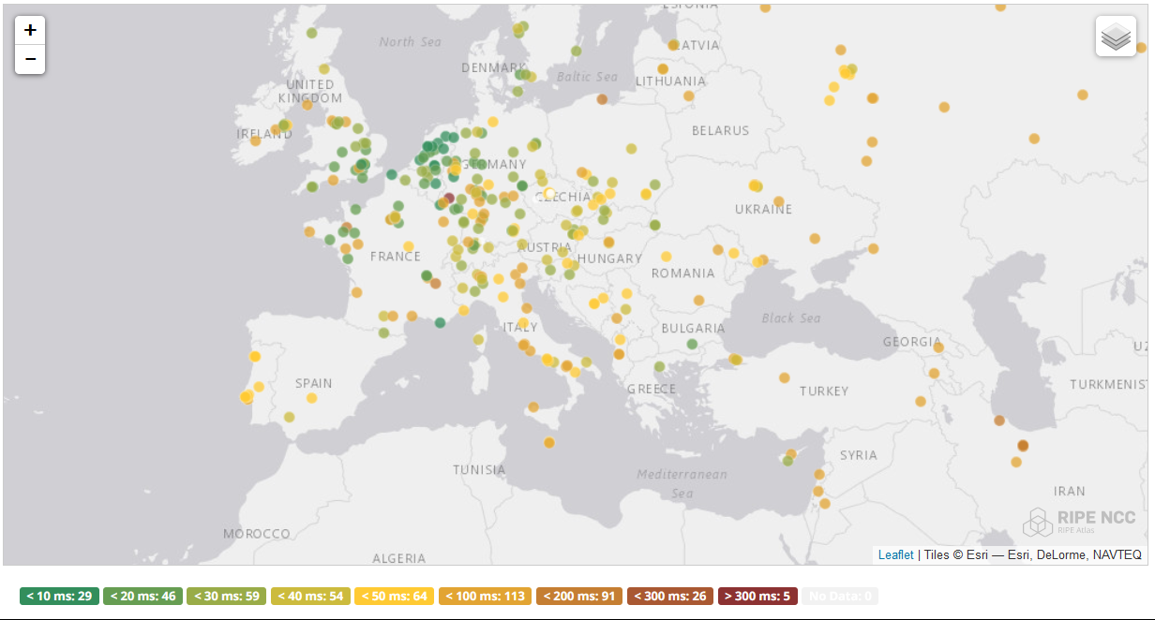
And you get reasonable load balancing
map: RIPE NCC RIPE Atlas- 500 probes, zoomed in on Europe

Slide 40
Other HA options
Local HA with an HA proxy and pacemaker/CRM failover works on the local network – and can be meshed with two signing systems
this is the local Nikhef RCauth instance setup
DNS-based fast-failover – the method used for InAcademia
automatic updating of DNS a distributed set of servers, auto-updating each other
But does require that the DNS domain level operator remains available, since you need *very* short TTLs (and of course your ccTLD/gTLD as well)
Add a dedicated HA link for the back-end databases
e.g. multiple redundant circuits over an MPLS cloud

Slide 41
And finally … What about
An IGTF RAT CC again?
From IGTF RAT CC to ‘Security Communications Challenge Coordination’ - SCCC

Slide 42
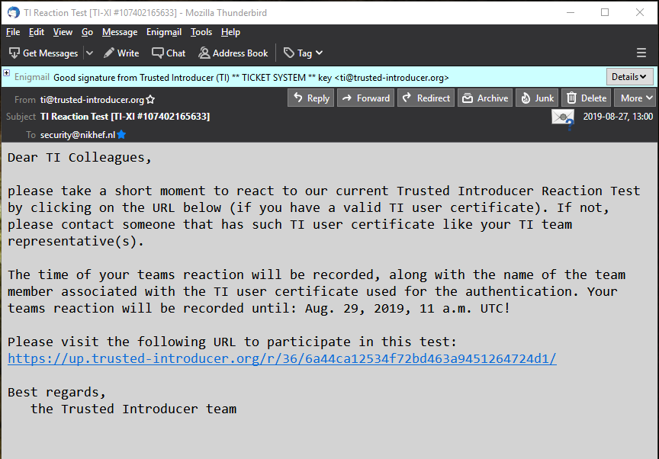
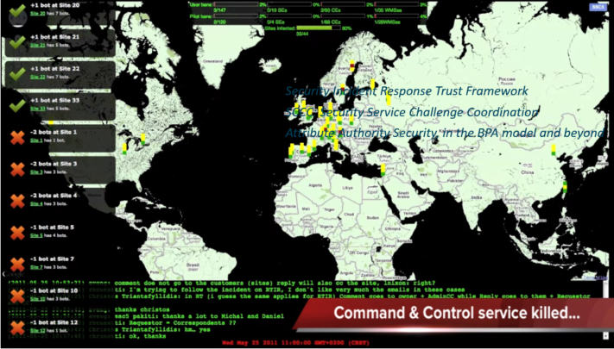
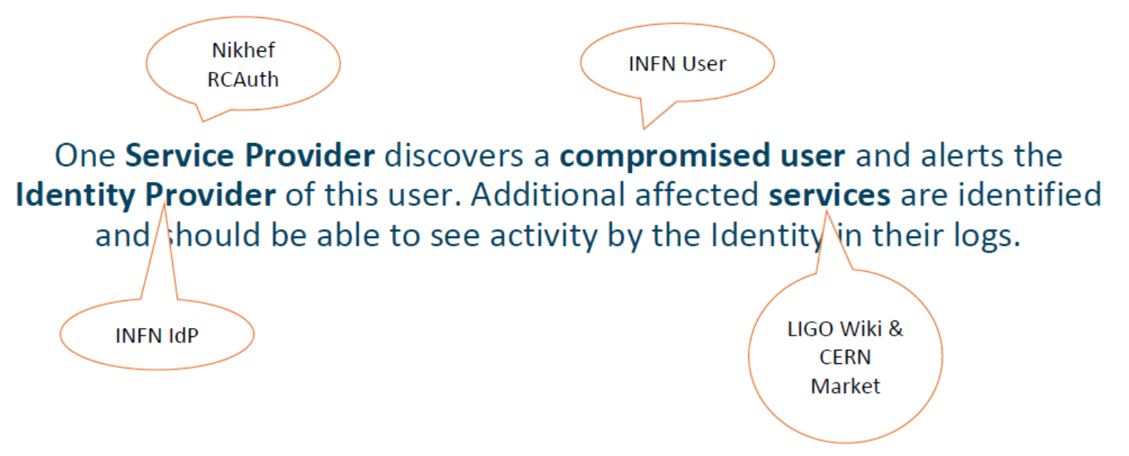


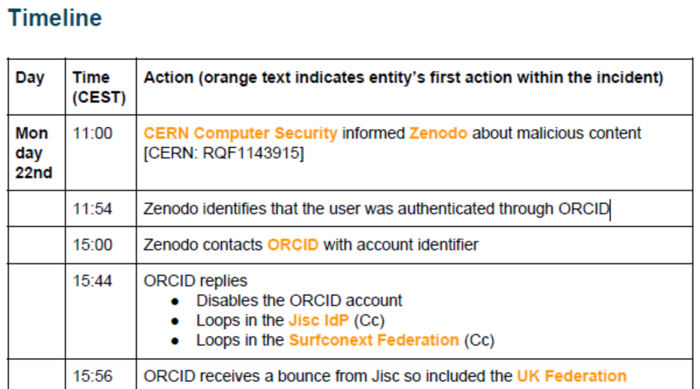



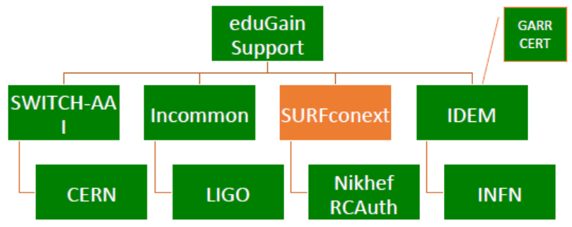
Communications Challenges – who picks up the call?

Slide 43




Challenge elements – what is valued or expected might differ …
A single test and challenge can answer one or more of these questions
ability to
take action
confidentiality
timeliness
investigative capability
when data available: infrastructure can set its own level of expectancy and gives deep trust
assessment supported with community controls (suspension) gives a baseline compliance
Communications challenges build ‘confidence’ and trust – an important social aspect!
different tests bring complementary results: responsiveness vs. ability act , or do forensics
unless you run the test yourself, you may not be growing more trust in the entities tested
for a ‘warm and fuzzy feeling of trust’, share results: but this is sociologically still challenging …

Slide 44
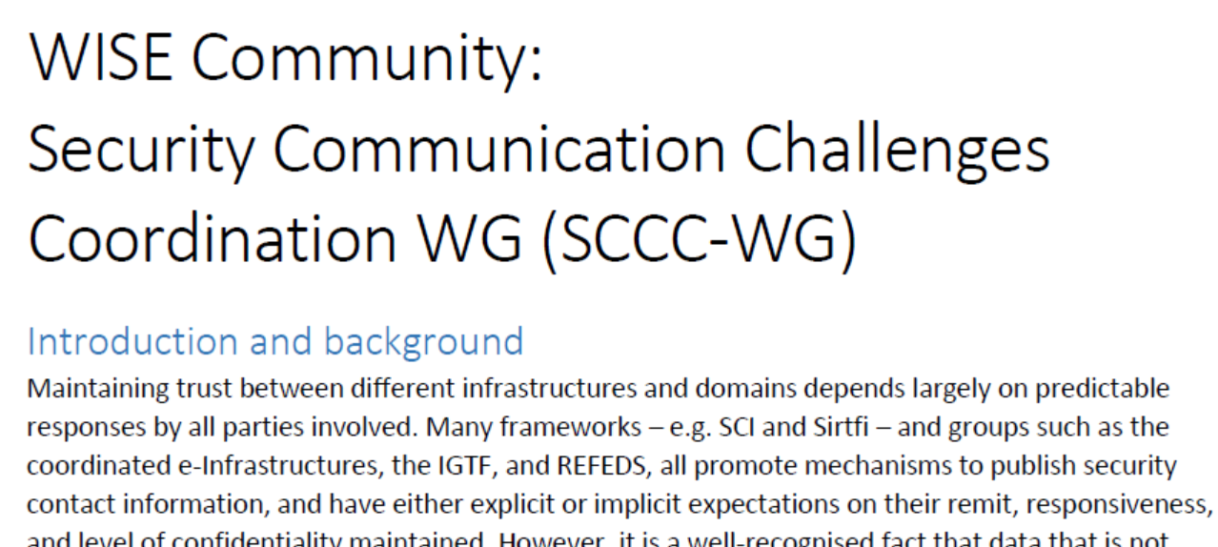
Continued engagement and coordination: WISE SCCC JOINT WG
WISE
SIG-ISM
REFEDS
IGTF
https://wiki.geant.org/display/WISE/SCCC-JWG

Slide 45
Subsidiary aim: make security contacts less ‘scary’
The most basic response is to (sorry!) click on a harmless link: making it a challenge to respond ‘as fast as possible’ – a bit like a competition
Ask also a very simple ‘question’ to raise awareness,
‘for security contacts, do you want to be (proactively) informed if we have
security information relevant to your organisation?’
esp. if the contact is the technical rep, i.e. there is no Sirtfi contact
‘you got this message because there is no designated security contact for your organisation. Would you want to receive security information, or who (if not you)
should be your security contact?
Are you aware of Sirtfi?’
And we can add some ads for Sirtfi, although having any kind of contact is better than none …

Slide 46
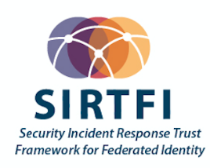
Would you like to be contacted?
Do you have a security contact listed for your organisation?
Is your CERT contact public?
Do you run (or control) an IdP, and do you support Sirtfi?
What kind of communications would you like to receive there?
  information about incidents in connected services,
  where your users are actively involved?
  information about incidents that are currently affecting institutions like yours
  and are spreading and attacking you soon?
  information that people with an email address from your domain
  are using non-federated services?
  communications challenges, to see whether you’re awake?
  surveys and questionnaires? ☺

Slide 47
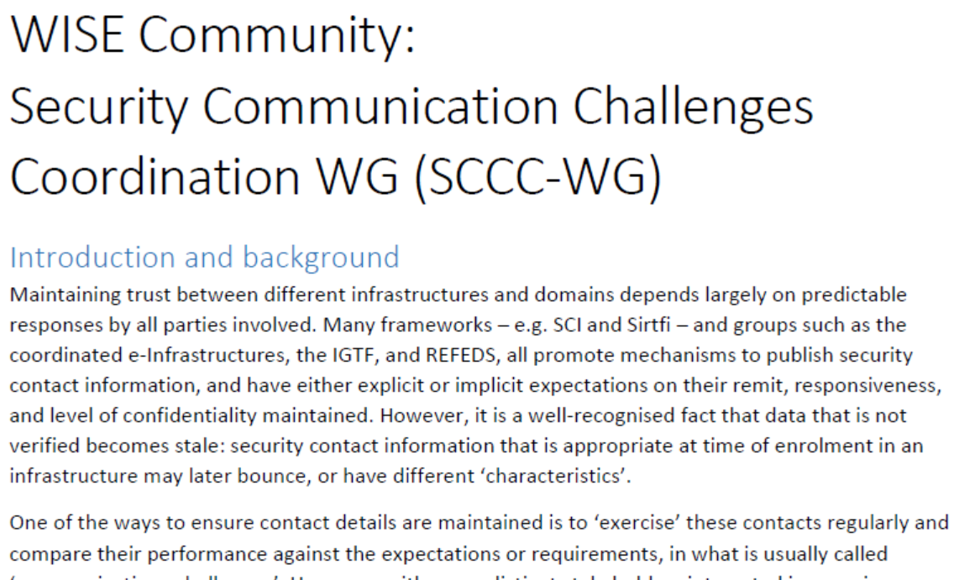
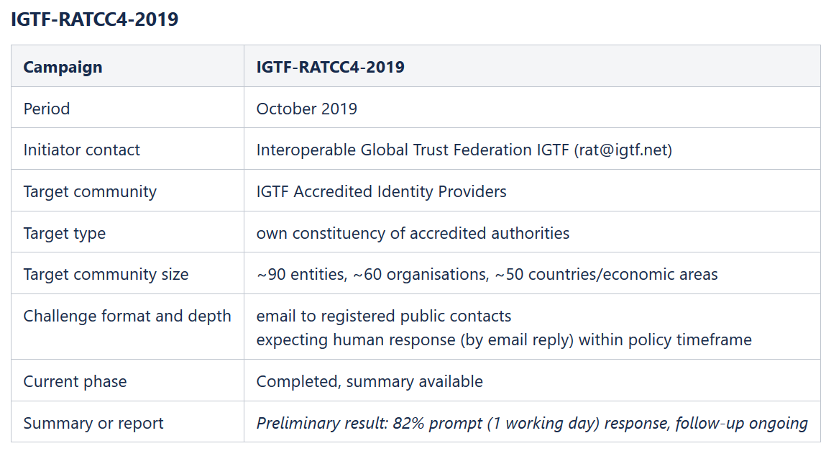
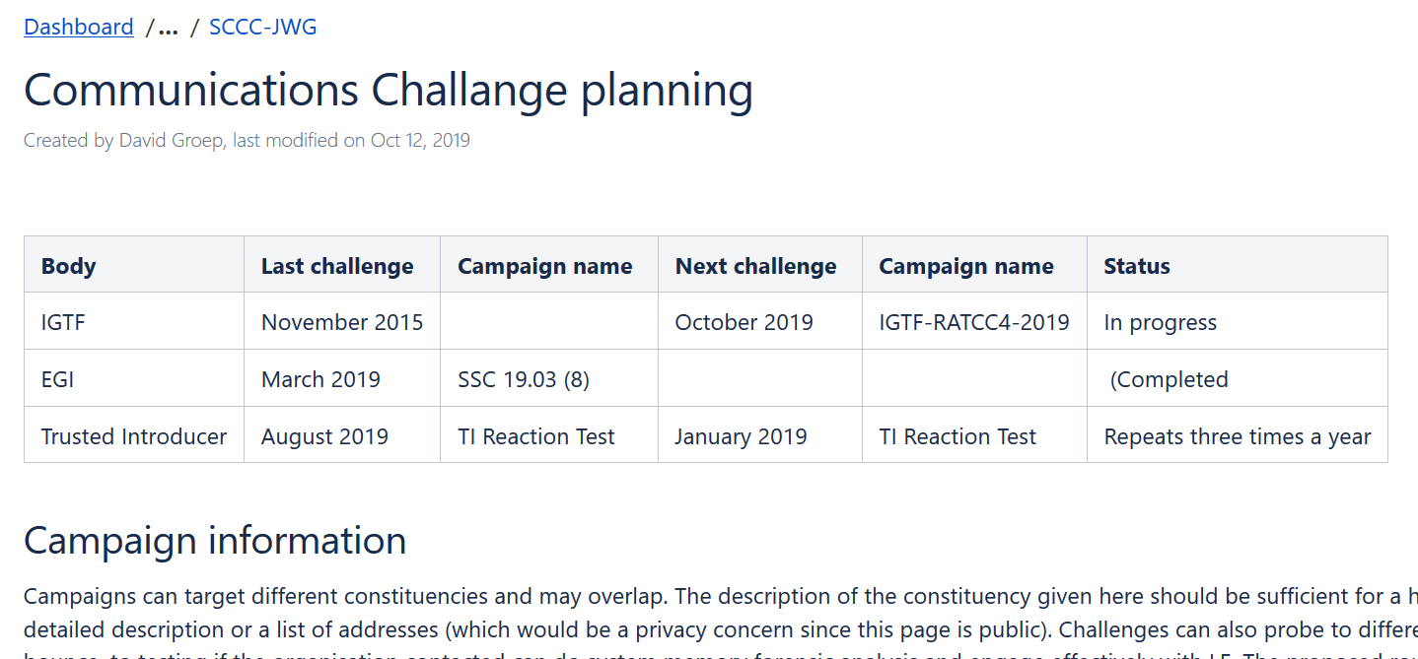
WISE SCCC-WG – participate!
WISE, SIGISM, REFEDS, TI joint working group
see wise-community.org wiki and join!
https://wiki.geant.org/display/WISE/SCCC-JWG
co-chairs: Hannah Short (CERN) and David Groep (Nikhef)

Slide 48
Building a global trust fabric
Questions?

Slide 49
this work is co-supported by the Trust and Identity workpackage of the GEANT4 project - phase 3
davidg@nikhef.nl
with material also from Christos Kanellopoulos, Hannah Short, Pinja Koskinen, Maarten Kremers, David Crooks,
Dave Kelsey, Nicolas Liampotis, Mischa Sallé, Jens Jensen, and others

