Slide 1
Towards a baseline Acceptable Use Policy
Authentication and Authorisation for Research and Collaboration
ACAMP input
TechEX18, Orlando, FL, USA
2018-10-18

Slide 2
How to prevent users from facing multiple AUPs?
No desire to accept a different AUP
for each and every service
In the simple-proxy model, the proxy can conceivable present a ‘common’ AUP
– provided that all back-end SPs agree
to a common baseline
To make it work for all back-services and
e-infrastructures, the basic AUP commandments
should be exactly the same for everyone

Slide 3

Difference to commonality in the Baseline AUP – sign once, use everywhere
Image: Mozes en de tafelen der Wet, Rembrandt van Rijn, 1659

Slide 4
Scaling Acceptable Use Policy and data release
impractical to present user ‘click-through’ screens on each individual service
Community conditions
Community specific terms & conditions
Community specific terms & conditions
RI Cluster-specific terms & conditions
Common baseline AUP
for e-Infrastructures and Research Communities
(current draft Baseline AUP –
leveraging comparison study and joint e-Infrastructure work)
Look ahead to an ACAMP
session on a global baseline AUP
https://wiki.geant.org/x/P4bWBQ

Slide 5
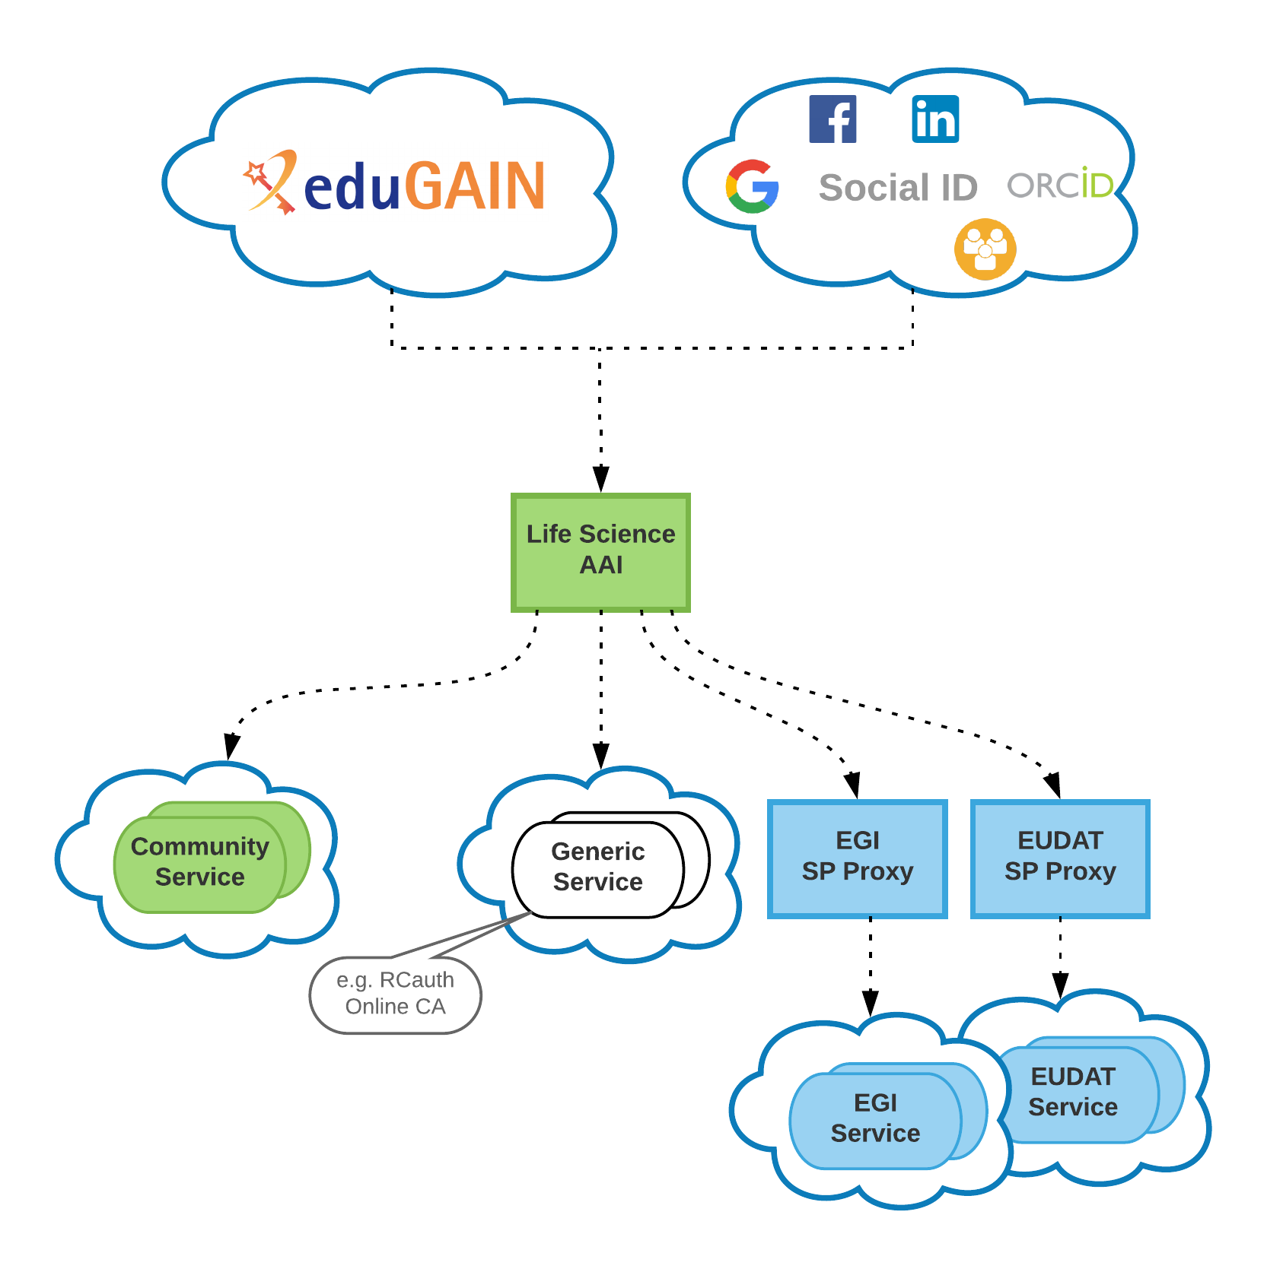
What about ‘generic enrolment’ AAIs
In a composite (‘multi-BPA’) proxy model, that point
would naturally shift to the Community AAI logical entrypoint
The community known the connected services and
proxies, and can present the union of augmented terms
alongside the baseline AUP (and the set of Privacy
Notices as well)
BUT:
if users first enroll in the AAI hub, and only then select
their community, the community is not yet known
and the generic enrolment service is encountered first
what should that entry-point present?
Can is use the baseline as such? What about ‘connected services’?

Slide 6
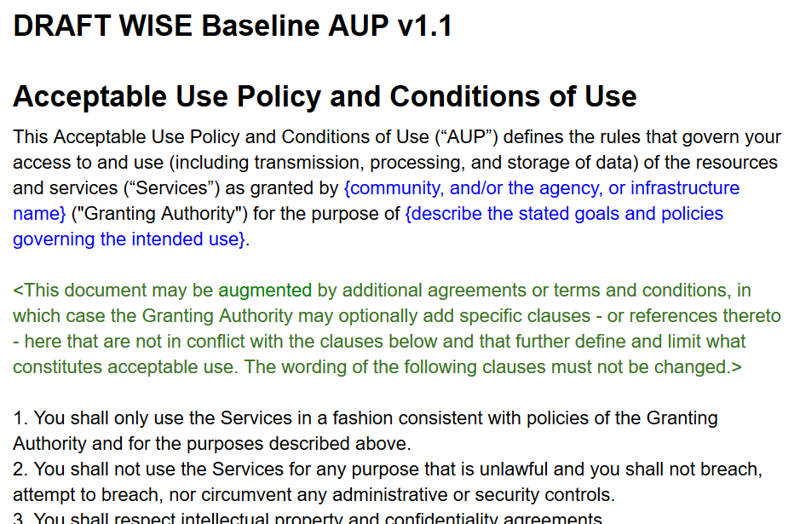
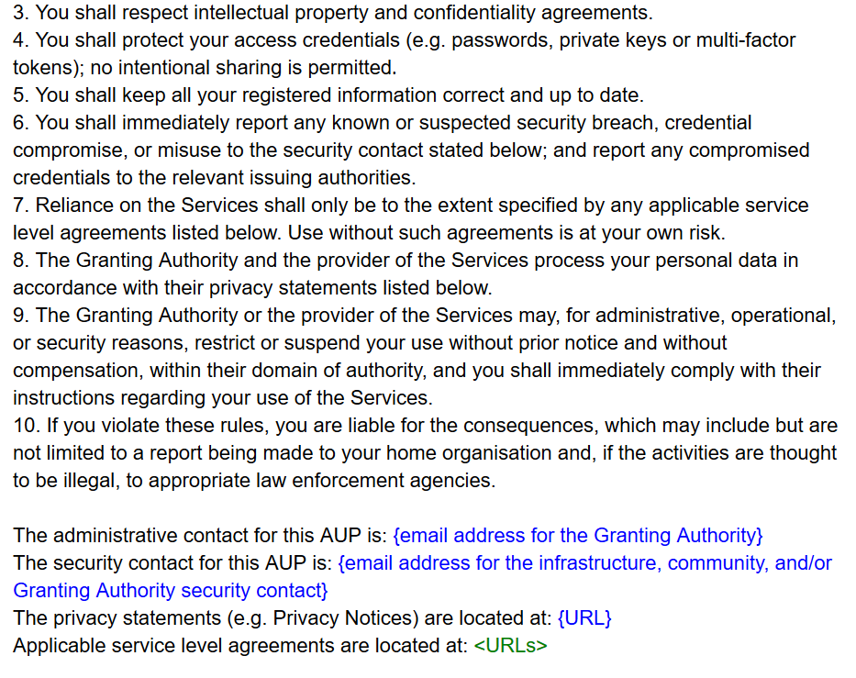
The Baseline AUP
https://goo.gl/JnUURY

Slide 7
The most controversial word
Give us an alternative for ‘Granting Authority’
to stand for
community, and/or the agency, or infrastructure name

Slide 8
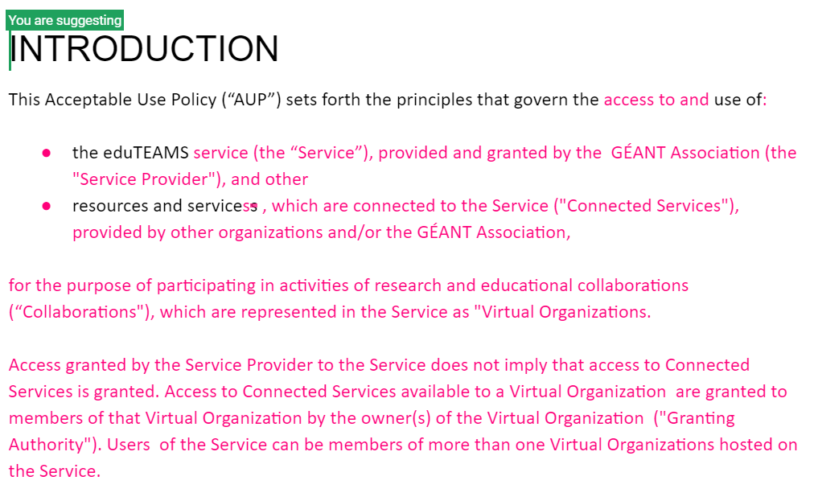
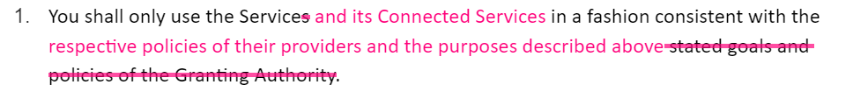
Christos’ eduTEAMS idea – present AUP for eduTEAMS and hang everything off that org

Slide 9
Or maybe …
Make the purpose clause
'for the purpose of participating in activities of research and educational collaborations (“Collaborations"), which are represented in the Service as "Virtual Organizations"‘
and the ‘green paragraph’ in the baseline AUP) to capture the concept of connected services:
“The eduTEAMS Service may be used to facilitate access to Connected Services provided by other organizations and/or the GÉANT Association. Access granted by the Service Provider to the eduTEAMS Service does not imply that access to Connected Services is granted. Access to Connected Services available to a Virtual Organization are granted to members of that Virtual Organization by the owner(s) of the Virtual Organization ("Granting Authority"). Users of the Service can be members of more than one Virtual Organizations hosted on the Service.
The Baseline clauses of this AUP apply equally to both the eduTEAMS service as well as to all Connected Services, as augmented by any specific terms to which adherence will be required during enrolment in any Virtual Organisation.“
and leave the AUP terms entirely unchanged

Slide 10
And now what ...
How can we make it easy for the user, and
give enough confidence to the services that they don’t feel the need
to show their own AUP and ‘T&C’
unless they are truly unique
Can we case the ‘generic enrolment’ case in that common Baseline AUP format?

Slide 11
davidg@Nikhef.nl

