Slide 1
Towards hamonized policies and best practices
The Story So Far …
David Groep
NA3 Coordinator
Dutch National Institute for sub-atomic Physics Nikhef
AARC2 AHM2 Amsterdam meeting
November 2017

Slide 2
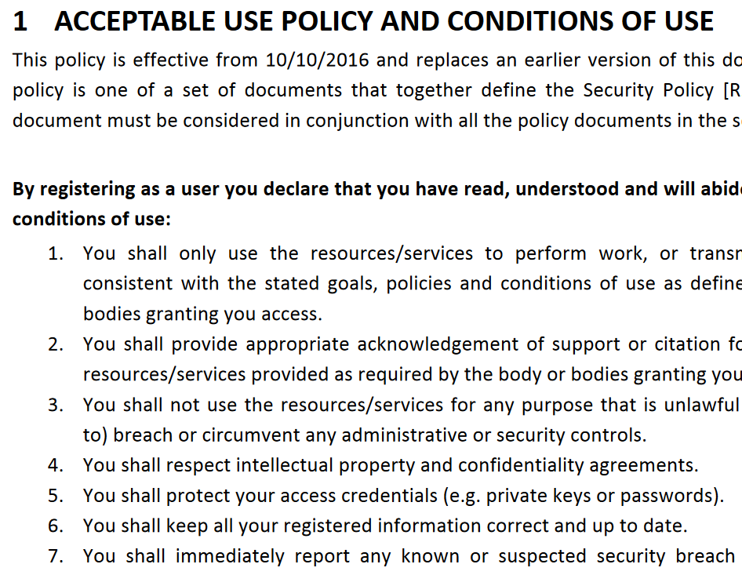
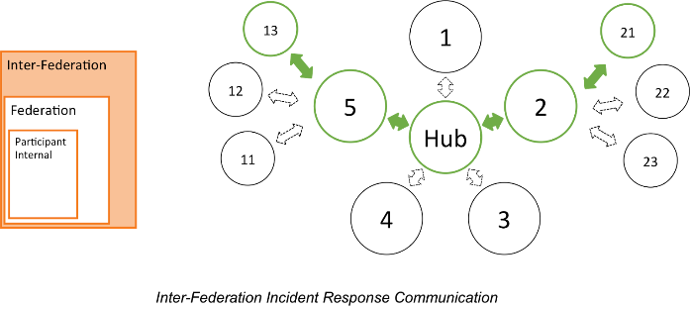
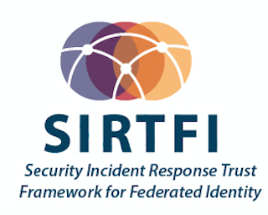


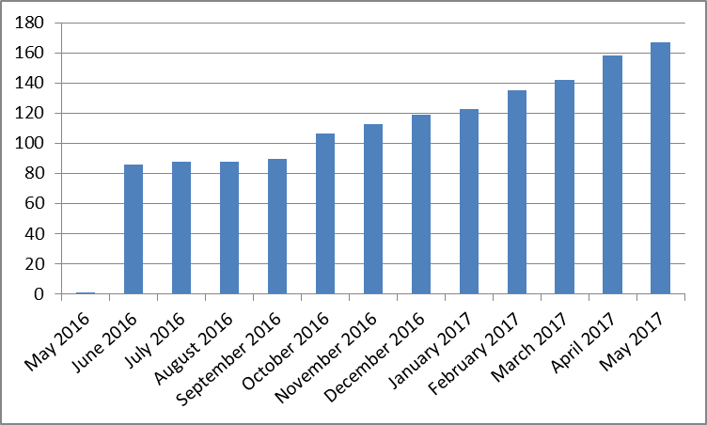
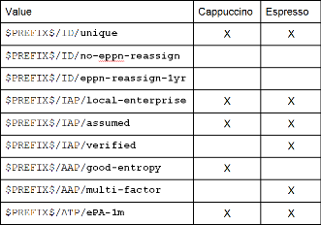
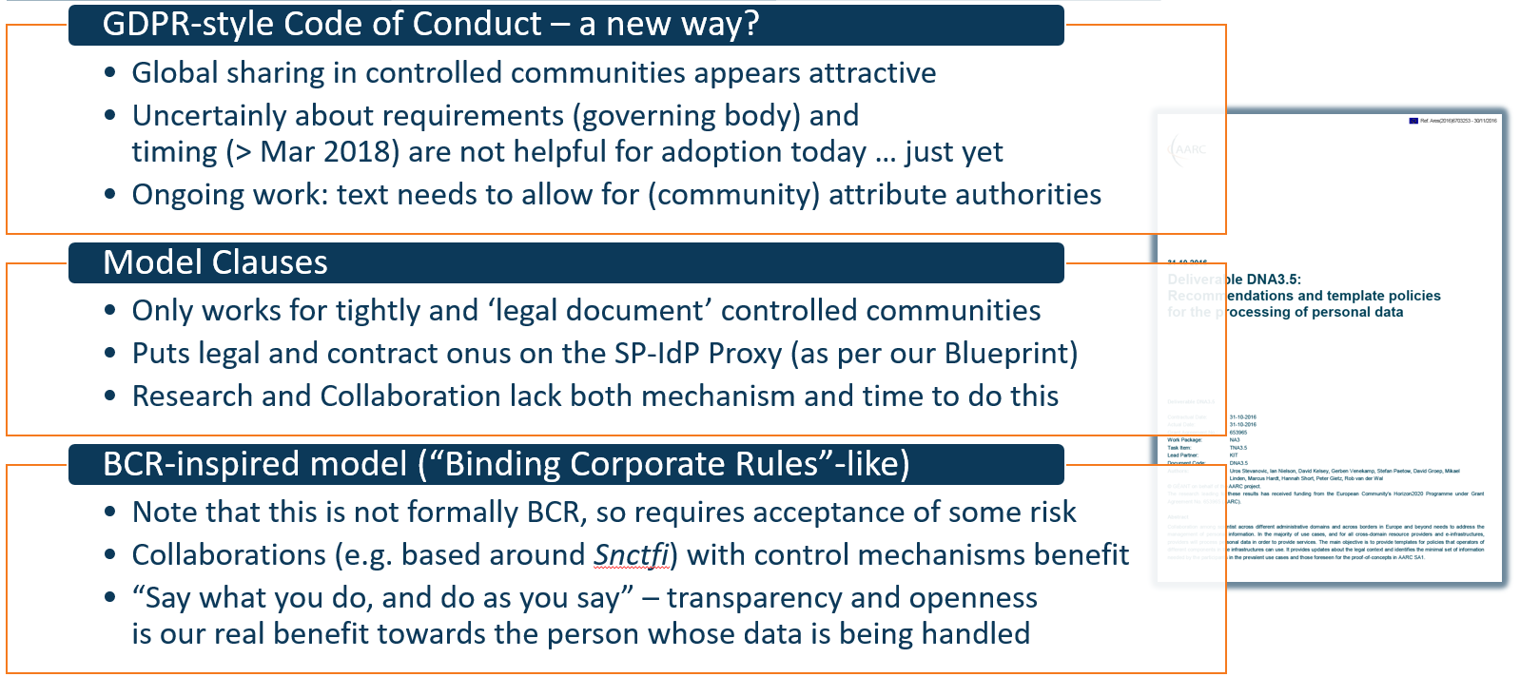
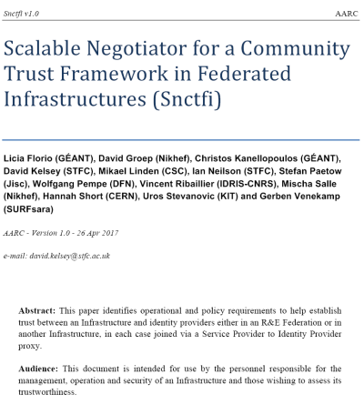
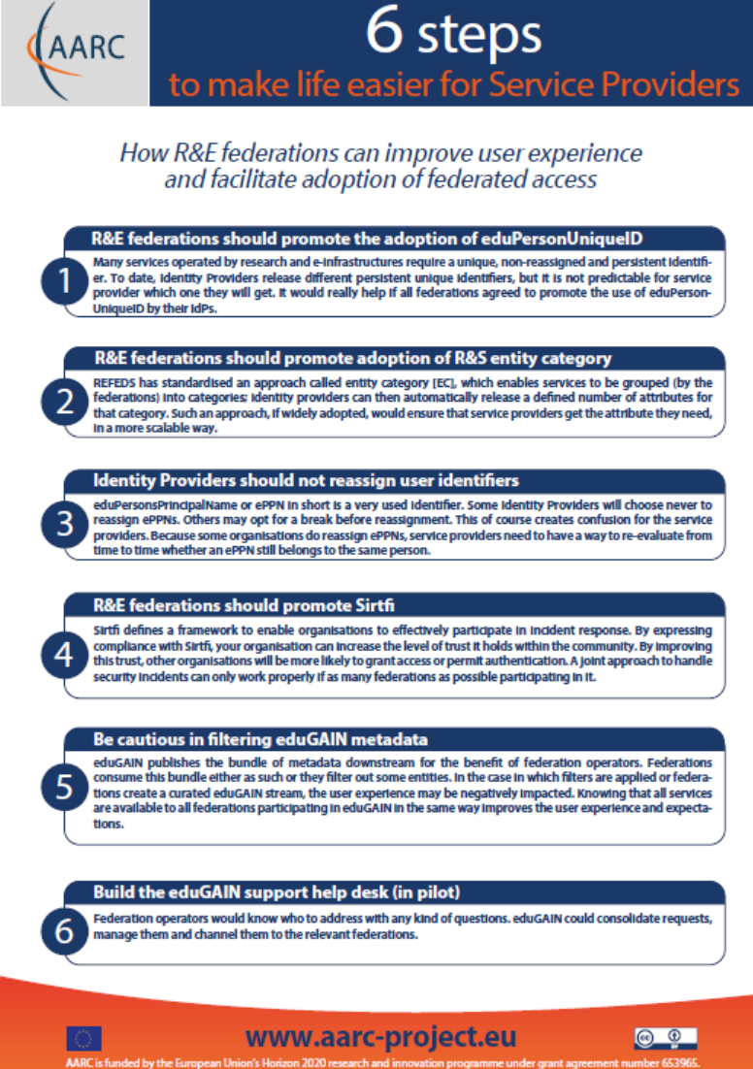


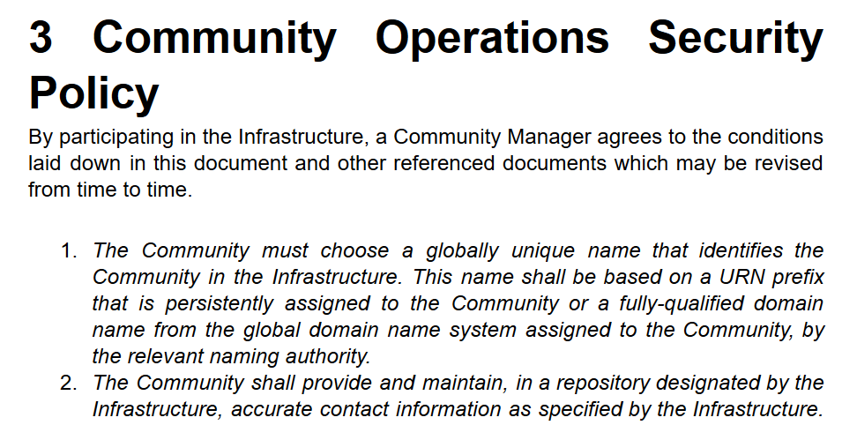
A tour of the policy space in AARC2
supporting the
Researchers & Community
‘low-risk’ use cases
few unalienable expectations by research and collaborative services
generic
e-Infrastructure services
access to common compute and data services that do not hold sensitive personal data
protection of sensitive
resources
access to data of real people, where positive ID of researchers and 2-factor authentication is needed
Operational Security
Baseline Assurance
known individual
Persistent identifiers
Documented vetting
Password authenticator
Fresh status attribute
Self-assessment
Slice includes:
assumed ID vetting
‘Kantara LoA2’, ‘eIDAS low’, or ‘IGTF BIRCH’
Good entropy passwords
Affiliation freshness
better than 1 month
Slice includes:
Verified ID vetting
‘eIDAS substantial’, ‘Kantara LoA3’
Multi-factor authenticator
bulk
model
167 entities
Engagement and Harmonisation
supporting policies
for Infrastructures
2

Slide 3
Operational Security – we’re all in it together!
In the past 2 years, we managed to address
security coordination for the federations, IdPs,
and the e-Infrastructure collective services …
… but everyone needs to be involved, globally!
✓
User Attribute Service operations security
Integrity and trust for the SP-IdP-Proxies
Link security hubs (eduGAIN Support Desk,
eInfra CSIRTs) to community capabilities
✓
Promote trust groups and their expansion
to effectively cover the eduGAIN network
Define reference templates on how
incident notifications should be conveyed
Encourage endorsement by
global standards bodies and communities
✓

Slide 4
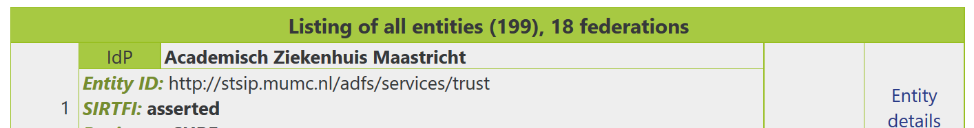
Sirtfi – its working, but the need for propaganda remains!
Relevant qualities to Infrastructures:
293 IdPs support R&S
188 IdPs from 18 feds support Sirtfi
only 63 IdPs (from 17 feds) support both …
Compare with SP adoption of
DPCoCo: 129 from 16 feds
R&S service: 75 from 11 feds
… both DPCoCo and R&S SPs: 75 from 11 feds
Sirtfi SPs: 13 from 8 feds
All entities | 4327
IdPs | 2570
SPs | 1763
Are our researchers only in the overlap of both?
Can we do better with a dedicated registry?
data: technical.edugain.org

Slide 5
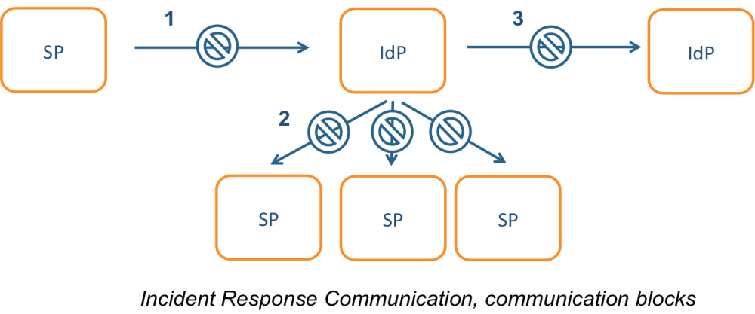

Incident response process evolution in federations – beyond this first step
Solution
Stronger role for federation operators, as
they are known to both SPs and IdPs
Add hub capability centrally (@ eduGAIN)
Challenges
IdP appears outside the service’
security mandate
Lack of contact, or lack of trust
in IdP which is an unknown party
IdP fails to inform other affected
SPs, for fear of leaking data or reputation
No established channels of communication

Slide 6
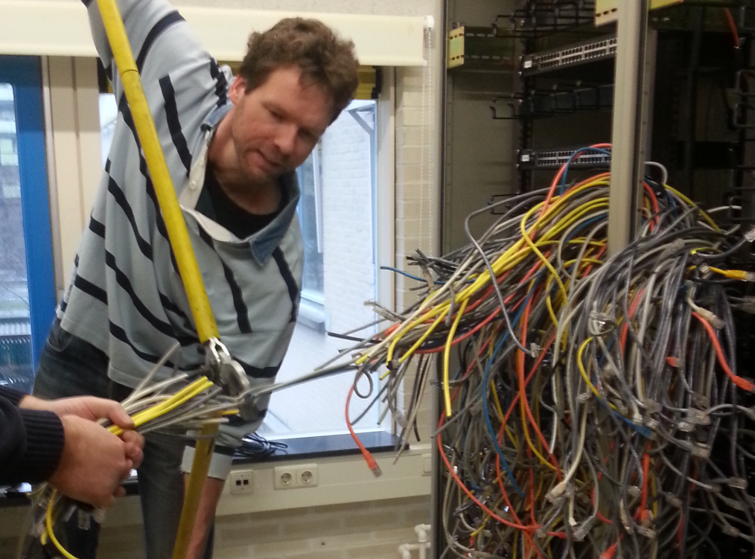
Helping out the providers – with service-centric harmonisation
˃
Traceability and accounting policy framework
Compare models for comparing and considering equivalency of policies
for traceability, accounting aggregation, and registration records retention in interfederation
˃
Explore the GDPR (2018) options for sharing of data on, and for, infrastructure usage
Infrastructures need to share data, globally, but a scalable model will be community dependent
˃
Recommendations for Blueprint Architecture Elements with Snctfi
Create the reference templates for SP-IdP-proxies, gateways, targeted credential repositories, &c

Slide 7
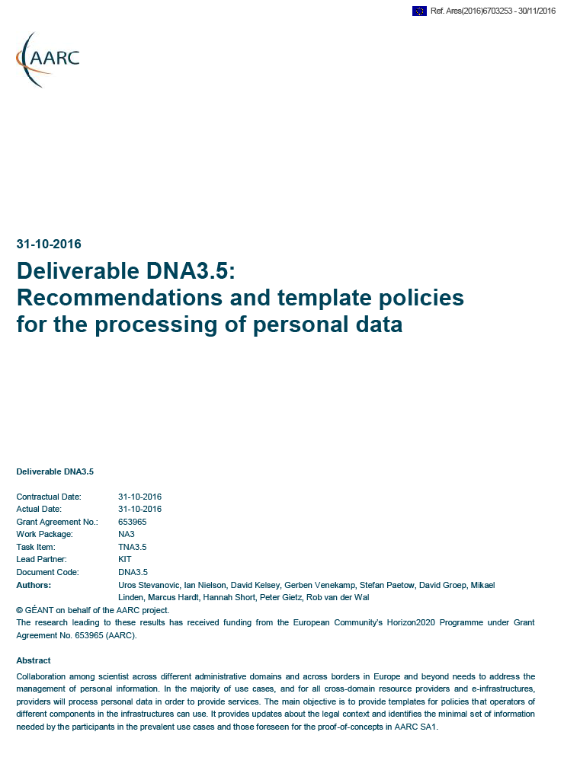
Three community models – three Recommendations?
GDPR-style Code of Conduct – a new way from May 2018
Model Clauses
BCR-inspired model (“Binding Corporate Rules”-like)
Global sharing in controlled communities appears attractive
Only works for tightly and ‘legal document’ controlled communities
Note that this is not formally BCR, so requires acceptance of some risk
Uncertainly about requirements (governing body) and
timing (> Mar 2018) are not helpful for adoption today … just yet
Ongoing work: text needs to allow for (community) attribute authorities
Puts legal and contract onus on the SP-IdP Proxy (as per our Blueprint)
Research and Collaboration lack both mechanism and time to do this
Collaborations (e.g. based around Snctfi) with control mechanisms benefit
“Say what you do, and do as you say” – transparency and openness
is our real benefit towards the person whose data is being handled

Slide 8

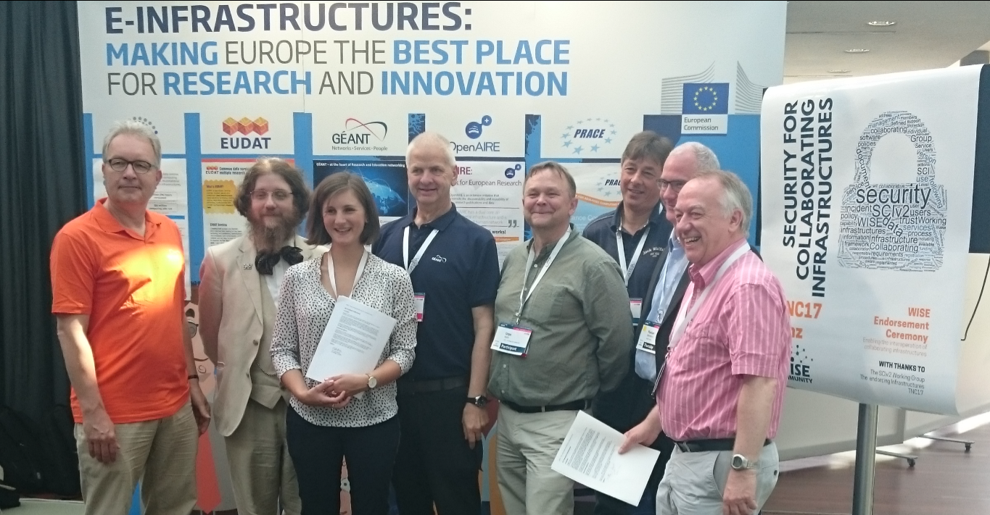
Snctfi: aiding Infrastructures achieve policy coherency
✓
allow SPIdP Proxies to assert ‘qualities’, categories, based on assessable trust
✓
Develop recommendations for an Infrastructure’s coherent policy set
Snctfi
Scalable Negotiator for a Community Trust Framework in Federated Infrastructures
Derived from SCI, the framework on
Security for Collaboration among Infrastructures
Complements Sirtfi with requirements on internal consistent policy sets for Infrastructures
Aids Infrastructures to assert existing categories to
IdPs: REFEDS R&S, Sirtfi, DPCoCo, …
See FIM4R presentation by David Kelsey!
Graphics inset: Ann Harding and Lukas Hammerle, GEANT and SWITCH

Slide 9
Snctfi infrastructure requirements, a summary
Operational Security
User Responsibilities
Protection and Processing of Personal Data
State common security requirements: AAI, security, incident and vulnerability handling
Awareness: users and communities need to know there are policies
Have a data protection policy that binds the infrastructure together, e.g. AARCs recommendations or DP CoCo
Ensure constituents comply: through MoUs, SLA, OLA, policies, or even contracts, &c
Have an AUP covering the usual
Community registration and membership should be managed
Have a way of identifying both individuals and communities
Define the common aims and purposes (that really helps for data protection …)
Make sure every ‘back-end’ provider has a visible and accessible Privacy Policy
https://igtf.net/snctfi

Slide 10
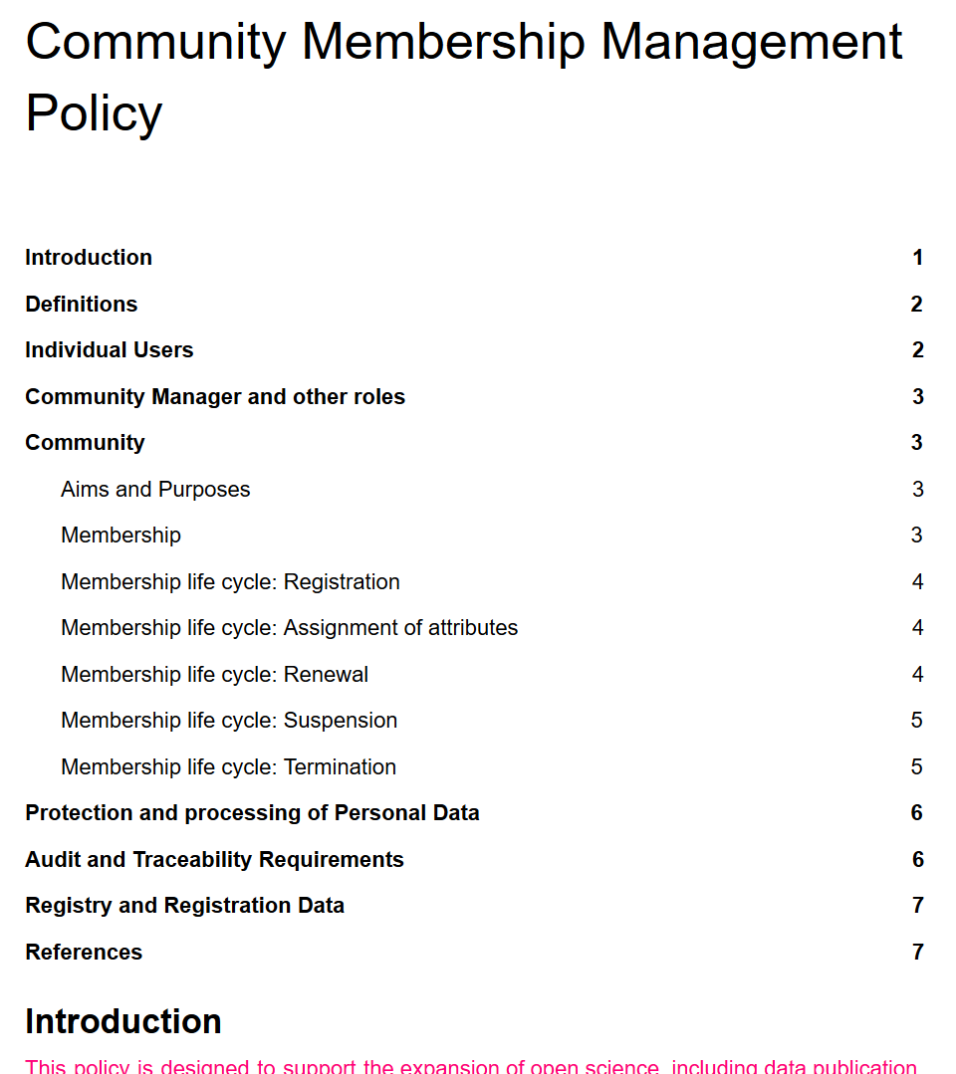
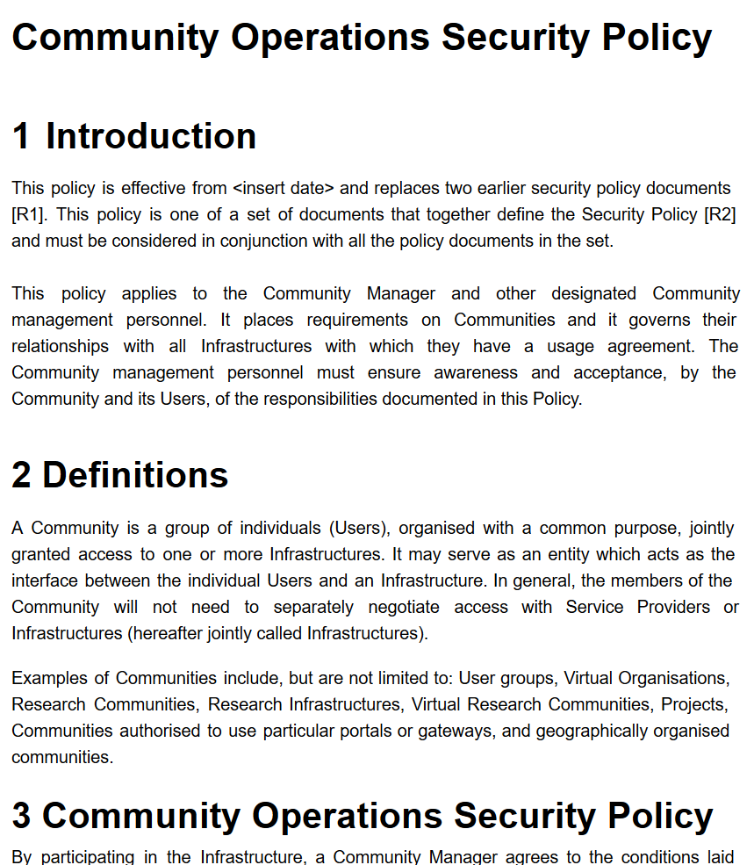
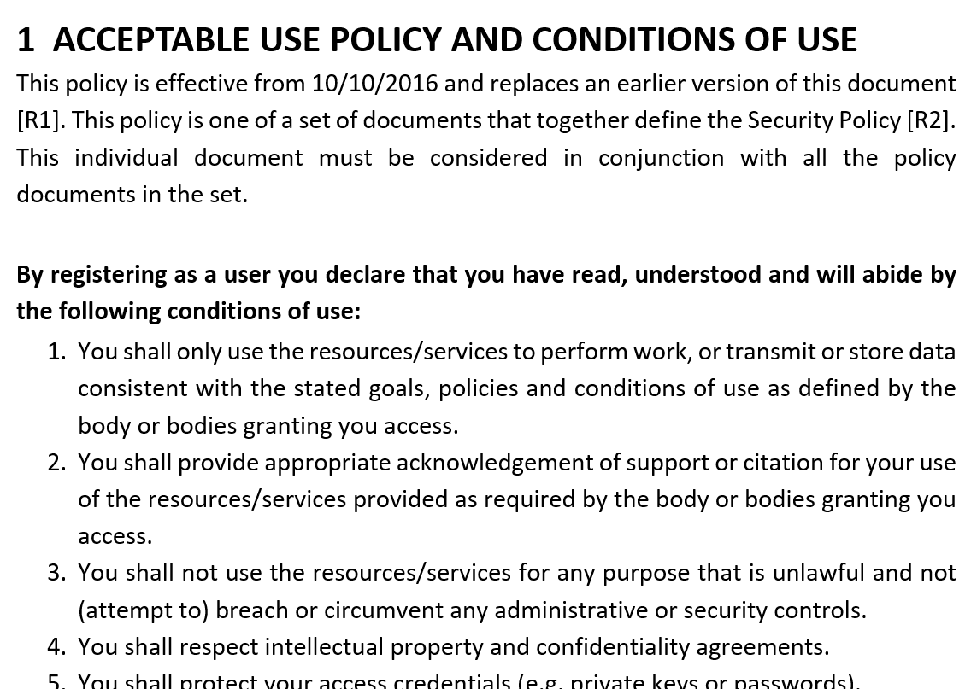
Evolving the Policy Development Kit for communities around Snctfi
…
https://wiki.geant.org/display/AARC/Policy+Engagement+and+Coordination

Slide 11

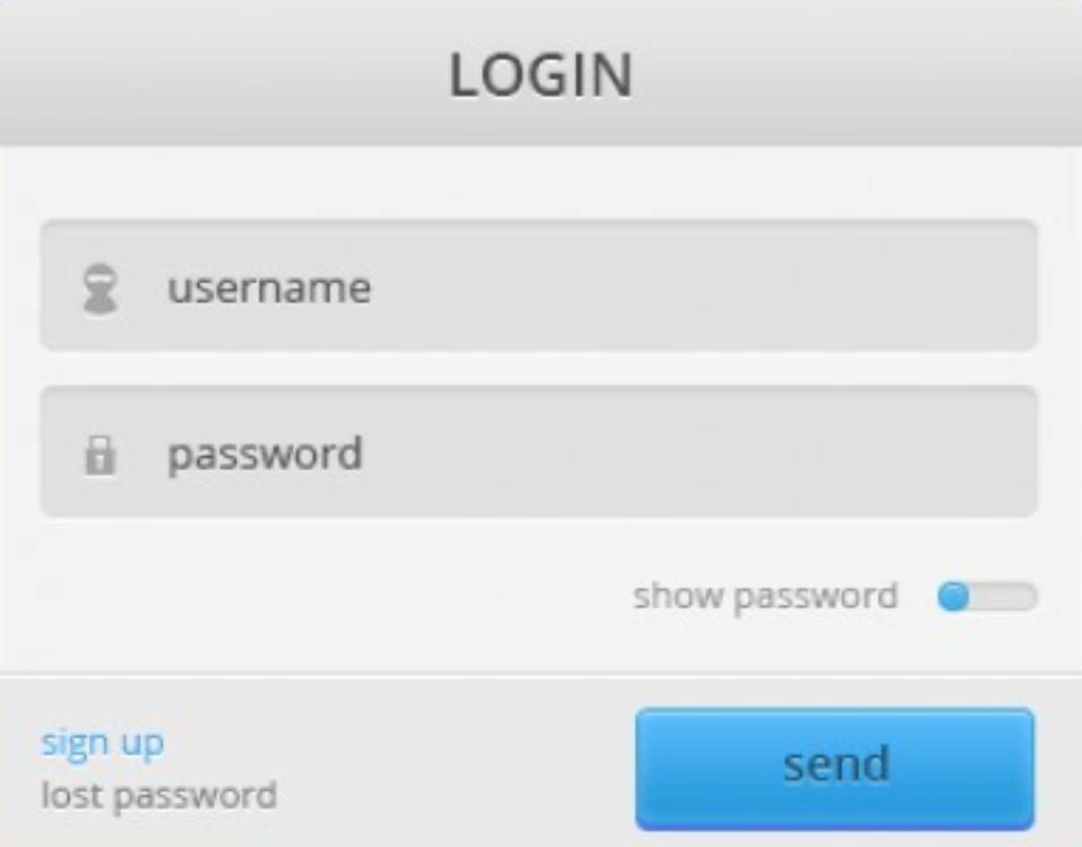

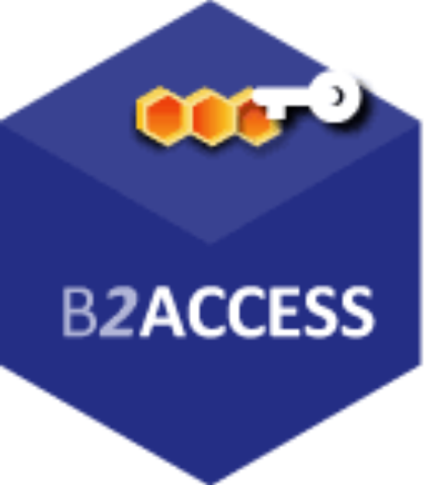





Everything meshed together … look for your favourite loop …
…
…
&
and many more hubs and bridges, apologies if your logo is not here …

Slide 12
Ease the flow across infrastructures – targeting users & communities!
˃
Identify and support commonality between acceptable use policies (AUPs)
So that a user that signed one of them need not be bothered again – and still move across silos
Remember the Taipei Accord: WLCG, EGI, PRACE, OSG, XSEDE share an understanding
and accept each other’s AUP as sufficient
˃
Enhance the Authentication Assurance Profiles
Get the new Profiles accepted and deployed for all target groups
Authenticating for access to biomedical and human-related data
Implementing verified identity vetting in the GDPR era
Making the baseline a real baseline, and Cappuccino a common occurrence
˃
Define a model for community attribute management and provisioning
Reference practices for communities setting up their membership and attribute services
So that the community is always in control, and the services can rely on that

Slide 13


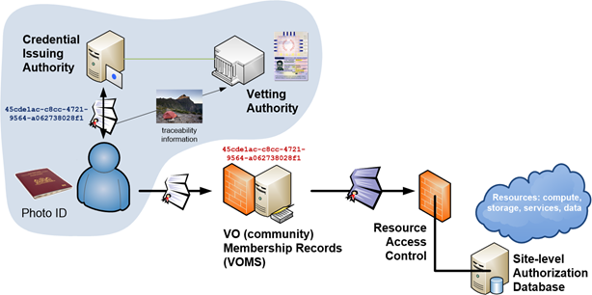
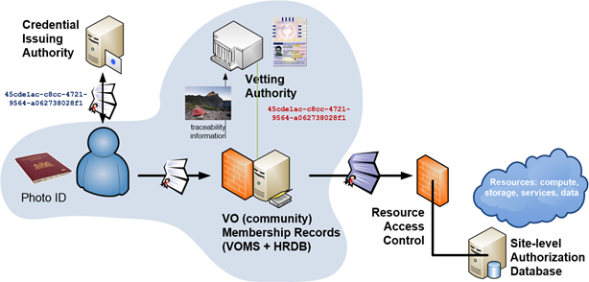
Using Assurance in practice: mixing your favourite coffee
Identifiers ID proofing Authentication Attributes
ID is unique, personal and traceable
Good enough for institution’s local systems
Good entropy passwords
Accurate and fresh affiliation information
ePPN is unique, personal and traceable
Assumed
(e.g. postal credential delivery)
Multi-factor authentication
Verified
(e.g. F2F)
Assurance can come from a single source …
… or be a combined/collabative assurance
by identifier source and vetting attributes

Slide 14
We will need your input today!
Operational Security and Incident Response
Evolve beyond Sirtfi: towards automated sharing and response
resolution through trust : grouping of trust models, with and through the Infrasturtcures
Cross-domain trust groups spanning Infrastructures & eduGAIN Support Desk to aid resolution
Service-centric policies
Adoption of Snctfi, harmonizing policies in composite and multi-role (‘stacked’) infrastructures
GDPR and TF-DPR impact on accounting, and accounting in complex communities (access control to accounting data)
e-Researcher-Centric Policies
Beyond Espresso: review complex Assurance Profile cases – in light of the GDPR and beyond
Align practices for (self-hosted and managed) communities, baseline AUP
Align attribute management practices & provenance for self-hosting and managed communities
Policy Development Engagement and Coordination
Guidance for communities: policy development and engagement ‘kit’ – via existing WISE, IGTF, & FIM4R
SCIv3: aligning Snctfi, Sirtfi, and Recommendations

Slide 15
Policy Working Session this afternoon
Sirtfi training, FAQ, and a registry
Smoothing incident information exchange through technology
Accounting data sharing within complex communities
GDPR … and keeping users informed
Policy alignment and the AUP development process
Assurance needs and validation
Policy development kit needs and engagement process
Assurance alignment – linking the JRA1 and NA3 work on assurance
20 min Hannah
20 min Uros
30 min DaveK
Later this week

Slide 16
davidg@nikhef.nl

