Slide 1
Supporting communities with harmonized policy
as well as best practices, templates, and guidelines
David Groep
NA3 Coordinator
Dutch National Institute for Subatomic Physics Nikhef
I2GS Federated ID Topics
May 2018

Slide 2
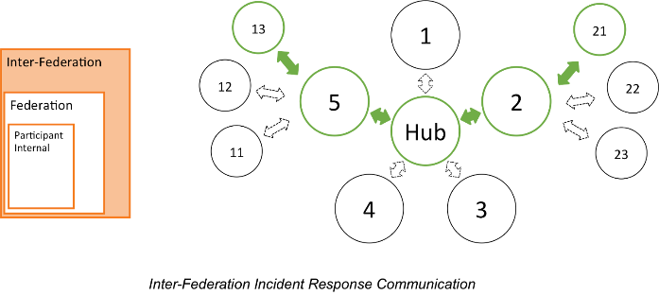
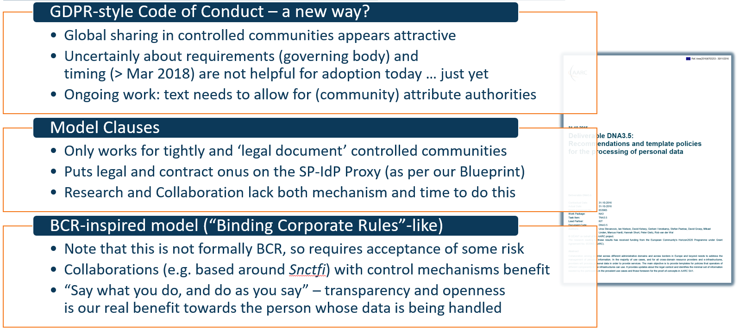
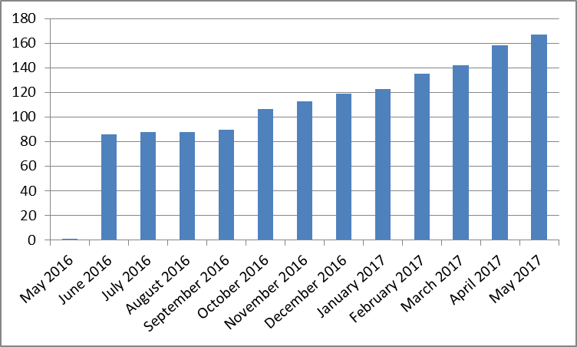
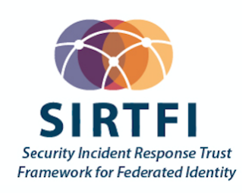
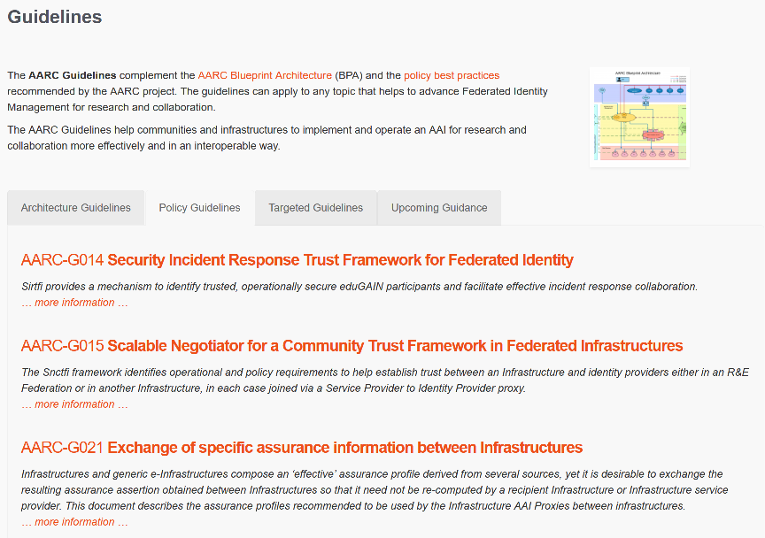

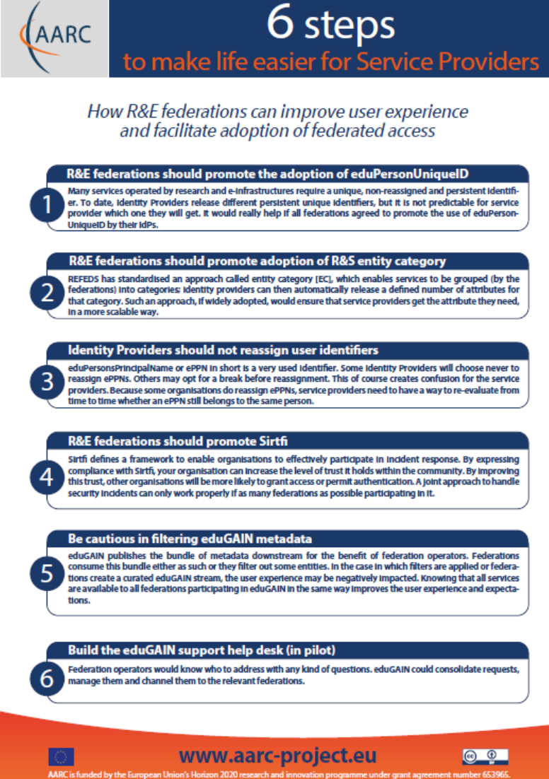
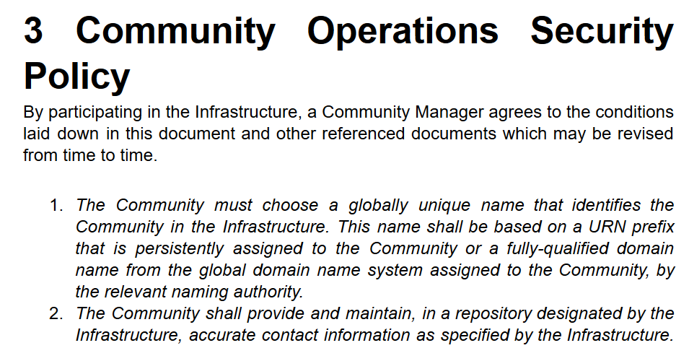
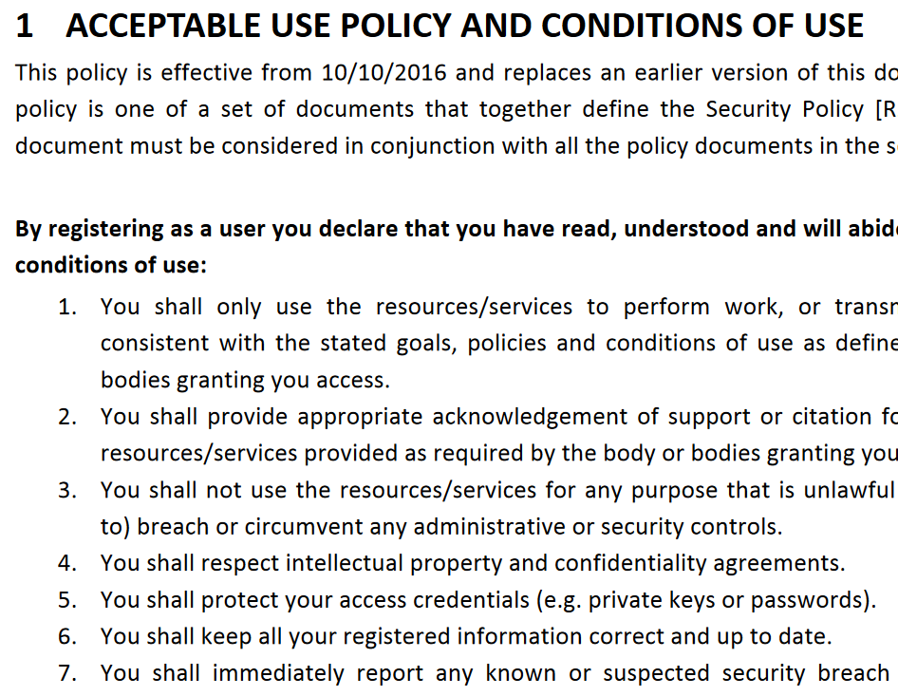
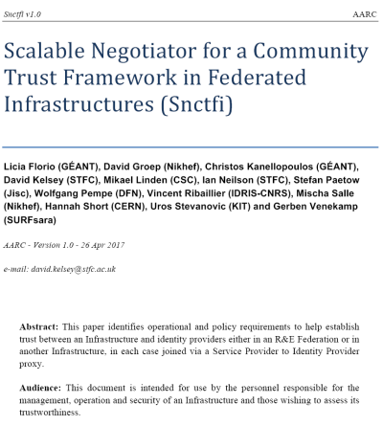



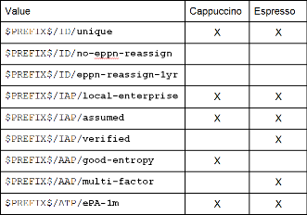
Policies and practices to support FIM for Research & Collaboration
Operational Security
for FIM Communities
167 entities
supporting policies
for Infrastructures
bulk
model
guidance for
Researchers & Community
‘low-risk’ use cases
few unalienable expectations by research and collaborative services
generic
e-Infrastructure services
access to common compute and data services that do not hold sensitive personal data
protection of sensitive
resources
access to data of real people, where positive ID of researchers and 2-factor authentication is needed
Engagement and Harmonisation
Baseline Assurance
known individual
Persistent identifiers
Documented vetting
Password authenticator
Fresh status attribute
Self-assessment
Slice includes:
assumed ID vetting
‘Kantara LoA2’, ‘eIDAS low’, or ‘IGTF BIRCH’
Good entropy passwords
Affiliation freshness
better than 1 month
Slice includes:
Verified ID vetting
‘eIDAS substantial’, ‘Kantara LoA3’
Multi-factor authenticator
2

Slide 3


A Security Incident Response Trust Framework – Sirtfi summary
Operational Security
Incident Response
Traceability
Require that a security incident response capability exists with sufficient authority
to mitigate, contain the spread of, and remediate the effects of an incident.
Assure confidentiality of information exchanged
Identify trusted contacts
Guarantee a response during collaboration
Participant Responsibilities
Improve the usefulness of logs
Ensure logs are kept in accordance with policy
Confirm that end users are aware of an appropriate AUP
see http://refeds.org/sirtfi

Slide 4
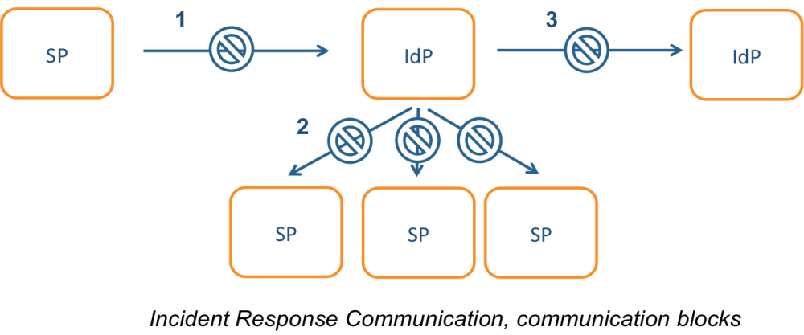

Incident response process evolution in federations – beyond this first step
Solution
More communications challenges
Instantly available tooling and defined
role for all parties. And: pick a coordinator
Challenges
IdP appears outside the service’
security mandate
Lack of contact, or lack of trust
in IdP which is an unknown party
IdP fails to inform other affected
SPs, fear of leaking data, of
reputation, or just lack of interest
No established channels of communication, esp. not to federations themselves!

Slide 5
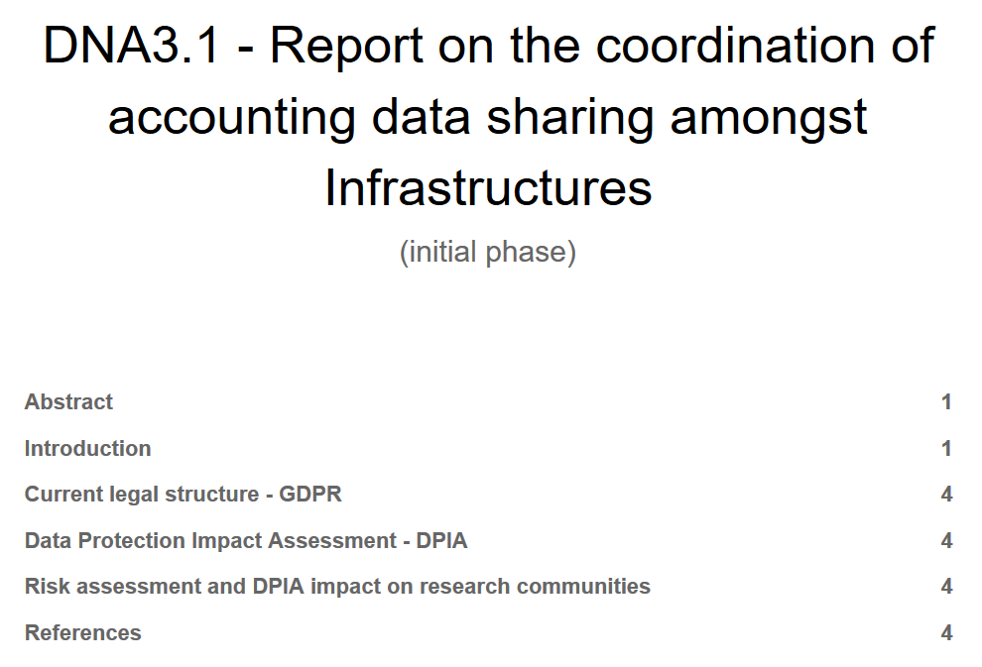
Guidance for research and generic Infrastructures
Impact of GDPR and risk assessment guidance
Protection of aggregations of accounting
data by (user) communities
Develop traceability and accounting
data-collection policy framework based on SCI
  e.g. why SCI & peer review may more appropriate
  than trying 27k and audits for Infrastructures?
  construct (‘service’ part of) a
  Policy Development Kit for Infrastructures
Do I Need A DPIA Risk Assessment
a guide for communities

Slide 6
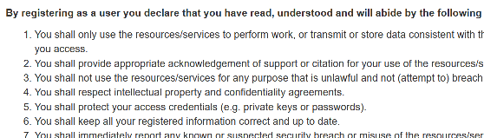
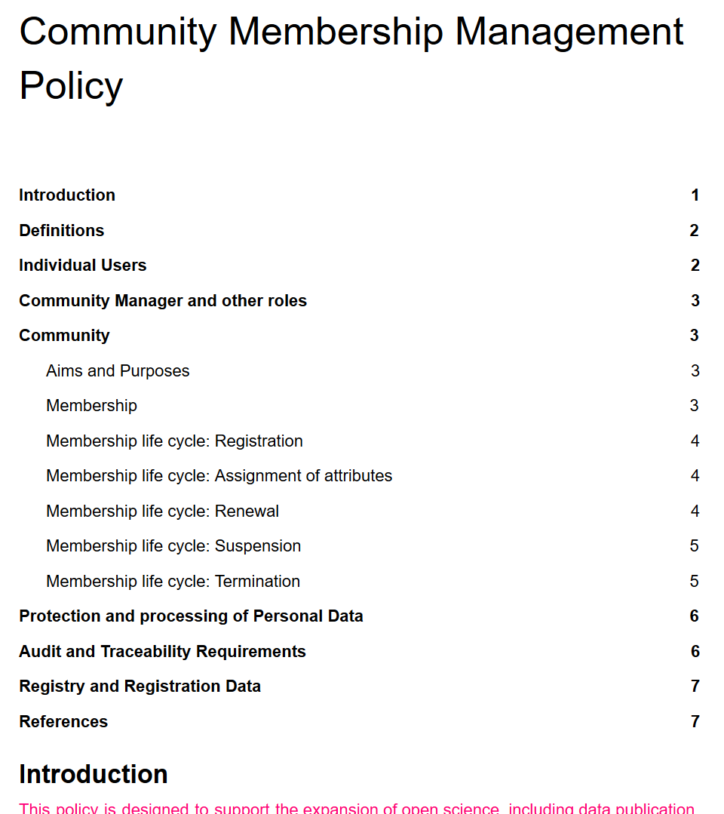
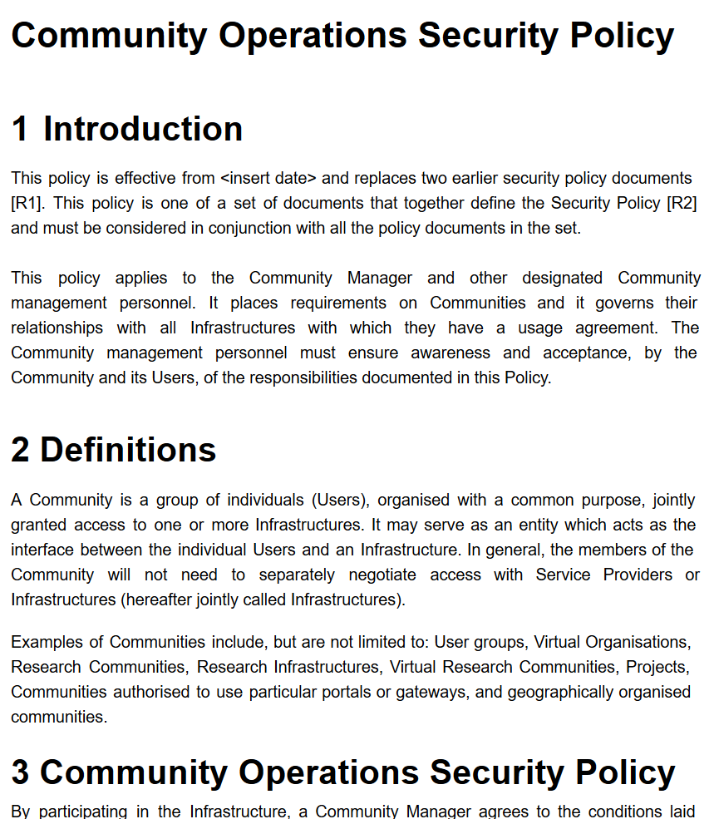
Guidance for research communities in the Infrastructure ecosystem
commonality between acceptable use policies using a layered approach
through assurance profiles
REFEDS RAF, but also cross Infrastructure:
Cappuccino, Espresso
BIRCH and DOGWOOD
Assam (social-ID authenticator assurance)
support community management, also to
ease use of the generic e-Infrastructures
can you support trustworthy community
operations? How should a community
collaborate in the Infra ecosystem, now
that we have very ‘powerful’ communities?

Slide 7
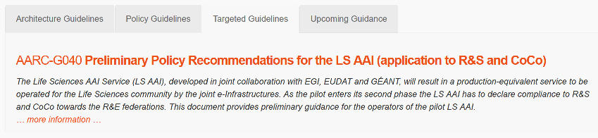
Policy guidance: generic and community-targeted

Slide 8

Engagement and coordination with the global community
Co-develop
/Guidelines
Through
WISE, SCI
REFEDS
IGTF
Or drive requirements in
FIM4R
In your Community, use
Unique non-reassigned identifiers
Snctfi policy structures
‘Community First’ Attributes
backed with Self-assessment
and peer review methods
Snctfi
Scalable Negotiator for a Community Trust
Framework in Federated Infrastructures
Derived from SCI, the framework on Security for Collaboration in Infrastructures
Basis for policy development kit – identify gaps in policy suite and leverage AARC templates
https://igtf.net/snctfi

Slide 9
davidg@nikhef.nl

