Slide 1
WP3: Policy and Best Practice Harmonisation
David Groep
AARC2 2018 AL/TL meeting
12-13 September, 2018
Amsterdam
0.4

Slide 2
Policy and best practice activity high-level objectives from our DoW
✓
“Minimise the number of divergent AAI policies and
empower identity providers, service providers and research communities
to identify interoperable policies”
✓
Define a reference framework to enable different parties to compare policies and assess policy compatibility
✓
Create (baseline) policy requirements,
driven by the explicit needs of the research communities
✓
Identify all necessary policy elements and
develop guidelines and assessment models to support communities
in establishing, adopting, or evolving their own policies

Slide 3
Results in our first 12 months
Formal stuff DNA3.1 – Report on the coordination of accounting data sharing amongst Infrastructures (initial phase) MNA3.3 Define and test a model for organisations to share account compromise information MNA3.5 Inventory of high-assurance identity requirements from the AARC2 use cases
With many other documents and results … eduGAIN and Sirtfi communications challenge, community guidance on using Codes of Conduct in the Blueprint Proxies, REFEDS Assurance Pilot, X-infrastructure assurance expression, social-ID assurance guide, Community (security) policies in the Policy Development Kit, FIM4R community engagement, …

Slide 4
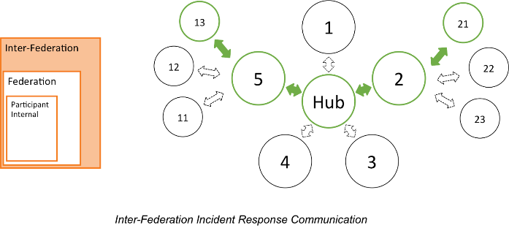

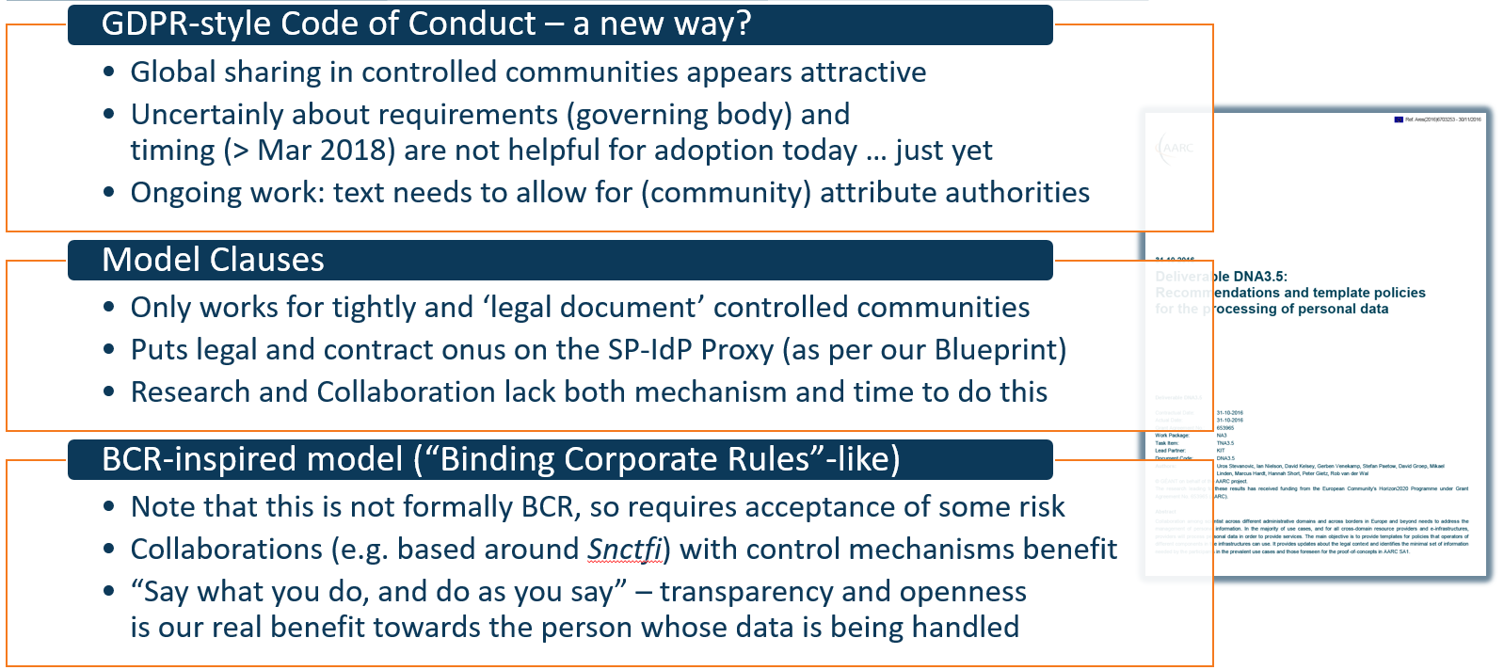

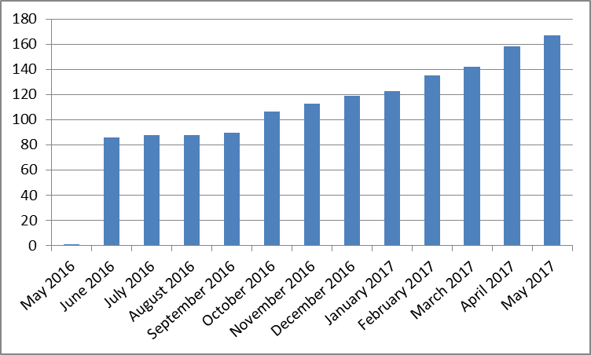
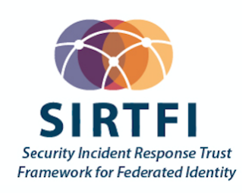
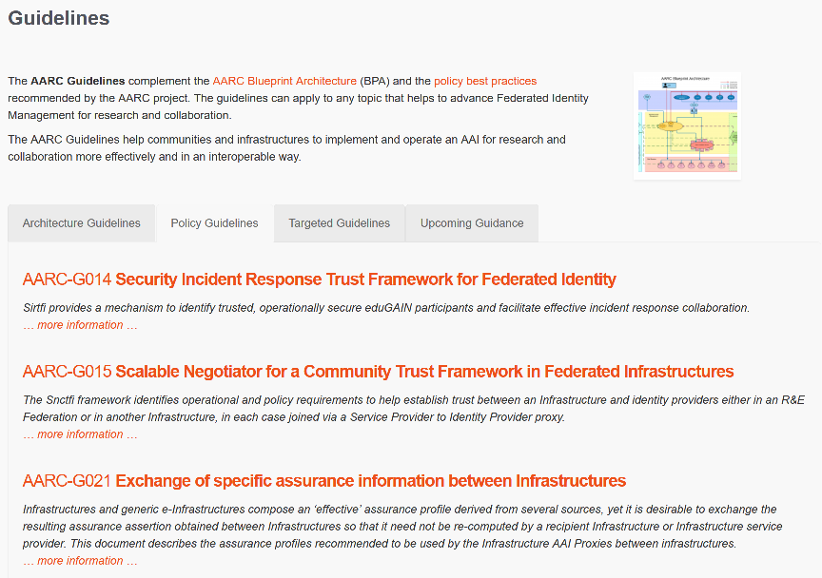

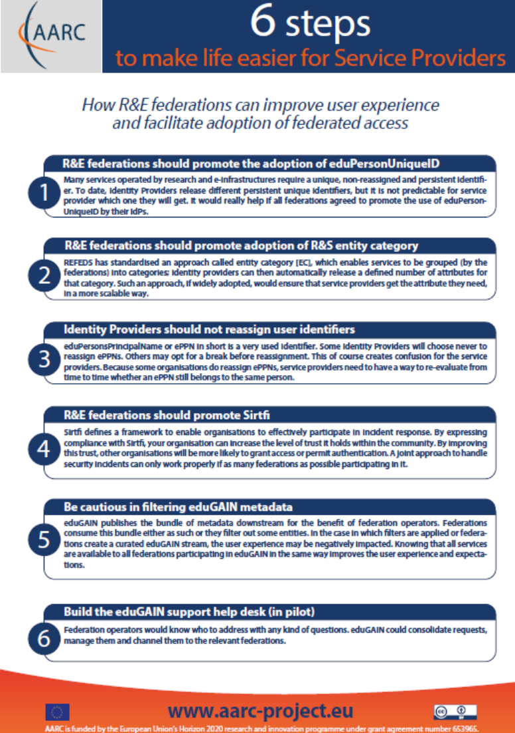
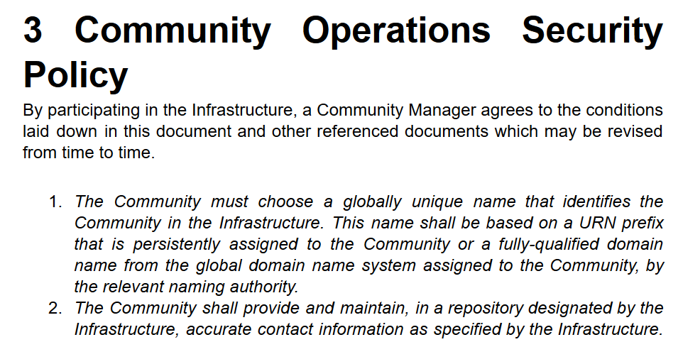
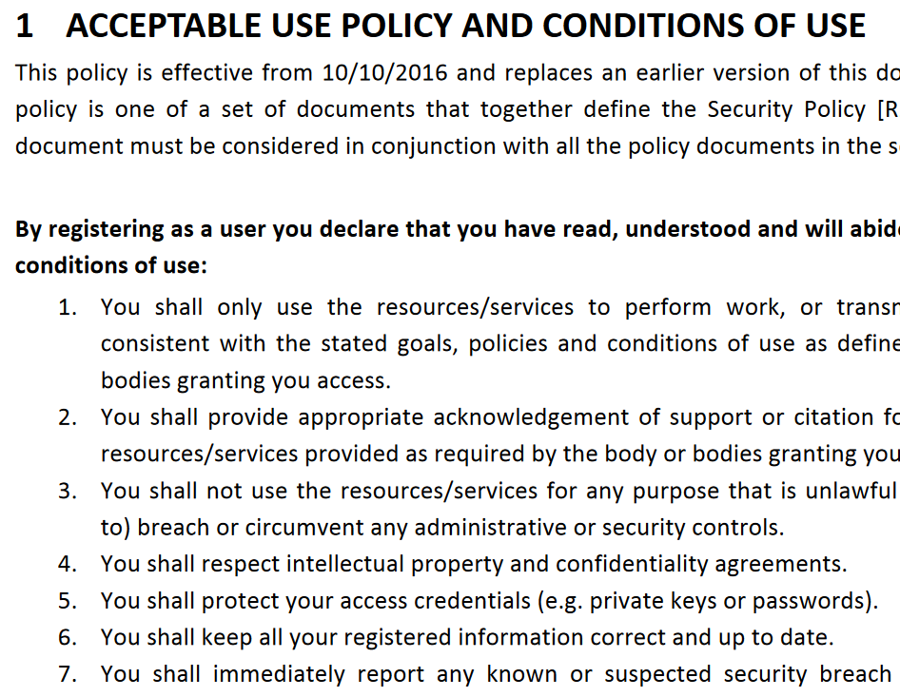


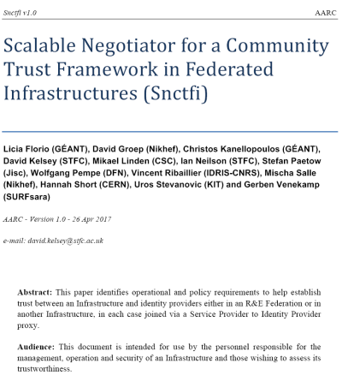



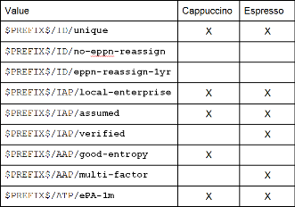
A tour of the policy space in AARC2
T1 Operational Security
for FIM Communities
167 entities
T2 supporting policies
for Infrastructures
bulk
model
T3 support for
Researchers & Community
‘low-risk’ use cases
few unalienable expectations by research and collaborative services
generic
e-Infrastructure services
access to common compute and data services that do not hold sensitive personal data
protection of sensitive
resources
access to data of real people, where positive ID of researchers and 2-factor authentication is needed
T4 Engagement and Coordination
Baseline Assurance
known individual
Persistent identifiers
Documented vetting
Password authenticator
Fresh status attribute
Self-assessment
Slice includes:
assumed ID vetting
‘Kantara LoA2’, ‘eIDAS low’, or ‘IGTF BIRCH’
Good entropy passwords
Affiliation freshness
better than 1 month
Slice includes:
Verified ID vetting
‘eIDAS substantial’, ‘Kantara LoA3’
Multi-factor authenticator
4

Slide 5
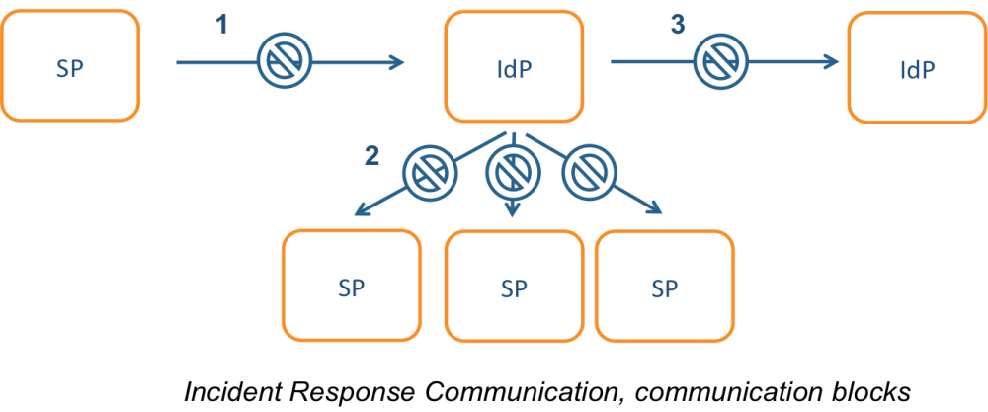

Incident response process evolution in federations –Sirtfi
AARC-1 Refresher
Challenges
IdP appears outside
the service’s security mandate
Lack of contact or lack of trust in the IdP
which to the SP is an unknown party
IdP fails to inform other affected SPs, for
fear of leaking data, of reputation,
or just lack of interest and knowledge
No established channels of communication, esp. not to federations themselves!

Slide 6
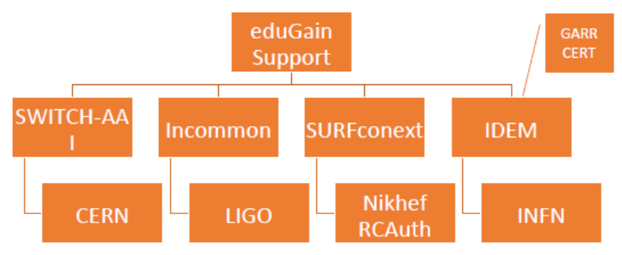
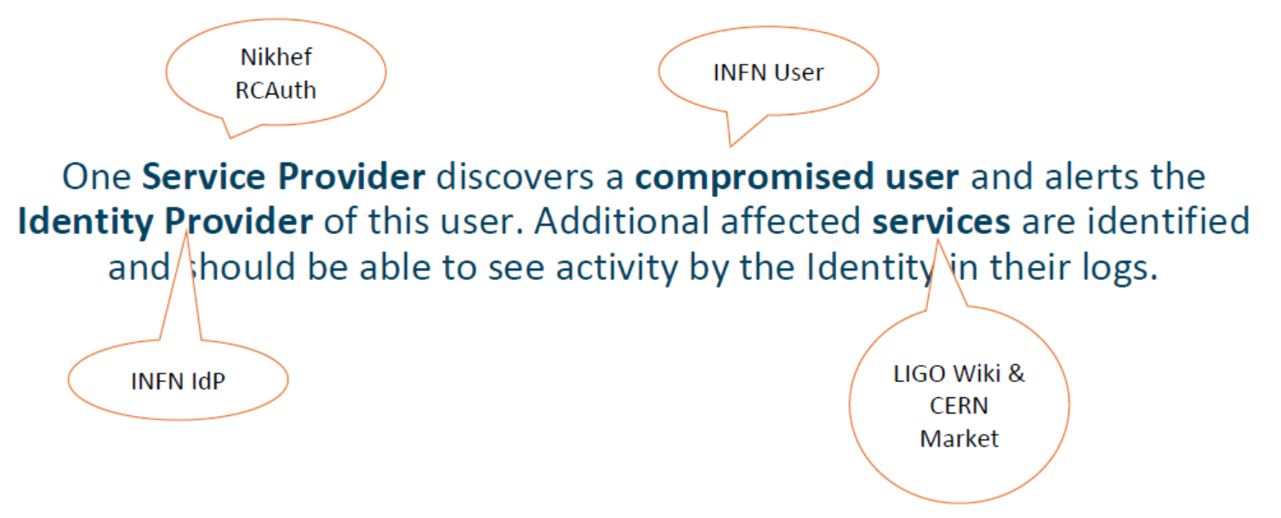


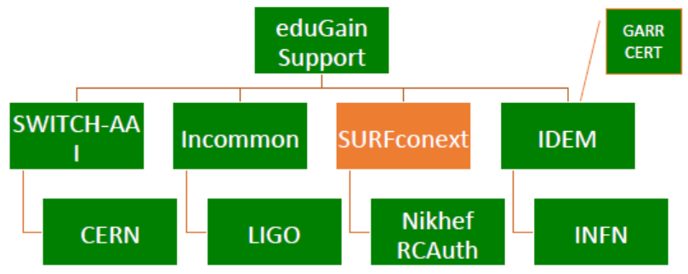



Test model for incident response (MNA3.3)
Defines the model actors
include eduGAIN Support Desk
(as per AARC-1 model)
Exercise the model attack scenario!
parties involved in response challenge
Report-out see https://wiki.geant.org/display/AARC/Incident+Response+Test+Model+for+Organizations

Slide 7
Main achievements in Operational Security
Sirtfi training and guidance | ➔ | Increased availability of security contact information in eduGAIN globally (167 → 325)
Incident response model test | ➔ | Responsiveness during actual FIM incidents
 | ➔ | WISE group (developing) on coordinating security communications challenges
 | ➔ | Demonstrated need for federation-level engagement beyond just IdPs and home orgs with an eduGAIN Support Security Team
PY2 | Attribute authority operations practice also for Infra proxies
 | Trust groups and the exchange of (account) compromise information

Slide 8
GDPR for Infrastructure AAI – both FUD and legitimate concerns
Large discrepancy between practice, perception, and actual risk:
communities don’t see (or forget) need to protect infrastructure AAI (accounting) data
– and don’t even consider our AARC-1 guidance ☹
others misunderstand the issue, over-state the risks, and fall victim to FUD law firms
instead of just reading Andrew Cormack’s blogs
even ‘simplified’ documents - like the GEANT Data Protection Code of Conduct – considered too complex to be understood and implemented well
DNA3.1 “assess privacy regulations on [accounting] data needed by service operators
AARC-G042 and e/r-infrastructures to ensure smooth and secure service operations”
specifically purposed to answer the basic questions:
how much impact does FIM have on your research infrastructure and accounting data?
what guidance is there already from member state regulators to help you determine risk?

Slide 9


A solution for our research communities?
UCE message sent on May 17th to Ian Neilson, and millions more …

Slide 10
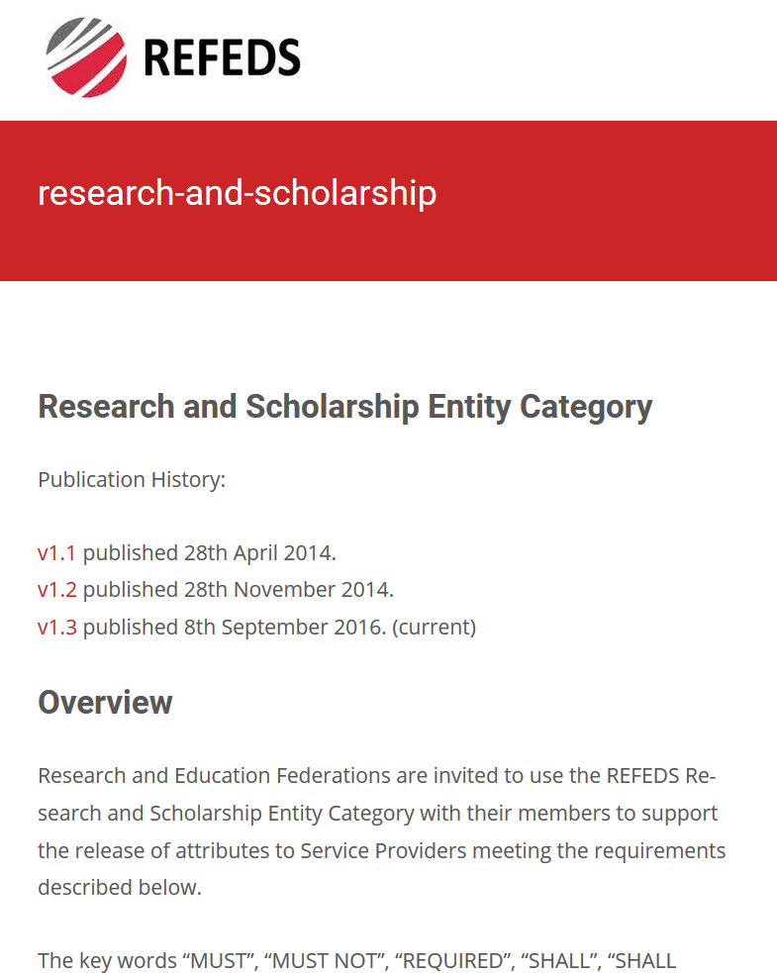
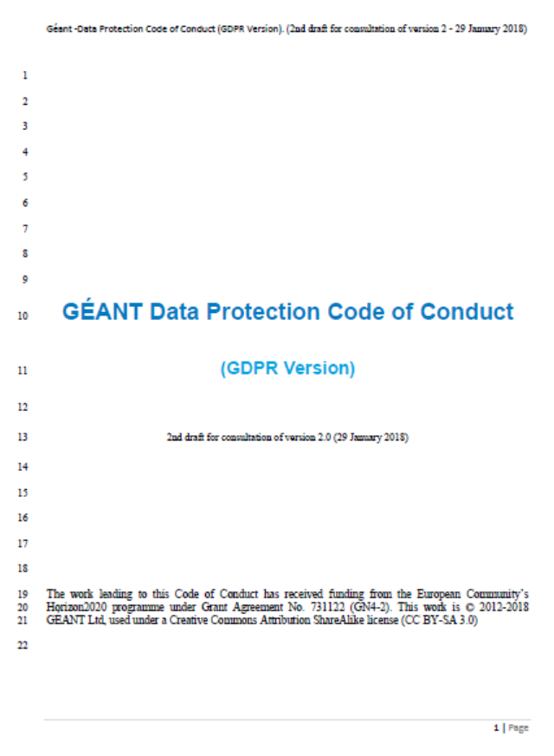
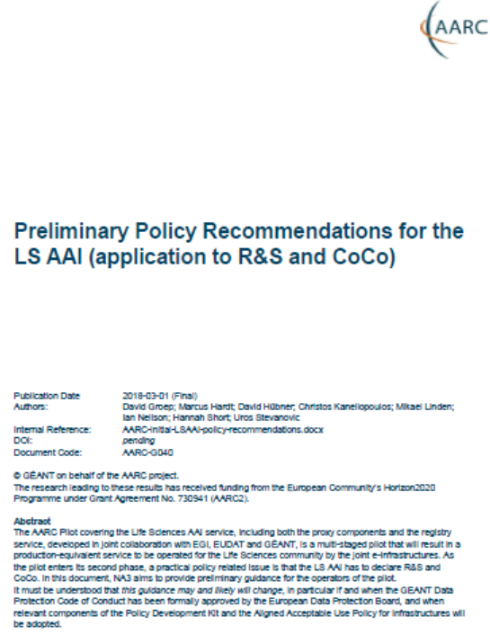
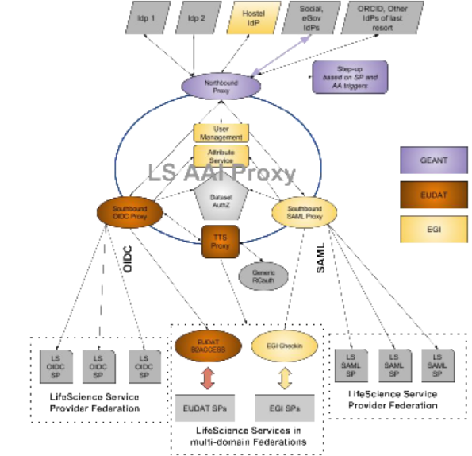
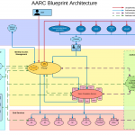
Implementing Snctfi: interpreting generic policies for BPA Proxy use cases
https://aarc-project.eu/guidelines/aarc-g040
REFEDS R&S: allow attribute flow from the IdPs, express intent and scope
GEANT DPCoCo & GDPR - ‘I’ll be good with personal data’
Casting policies into implementation and processes is a ‘bridging process’, requiring policy and architecture expertise and knowledge of the community use case
– i.e. the ingredients that make AARC!
LSAAI Infrastructures:
which components
will do what?
AARC-G040
AARC BPA: this is how information flows

Slide 11
Accounting and infrastructure-use data protection: a bit of clarification …
Work on accounting foresaw new communities joining AARC2
processing more sensitive (and: more competitive) work flows,
creating need for sub-structure and protection of accounting data within the community itself
Phased approach
Community Team A
1.
Support communities to deal with general data protection
issues
Impact of GDPR for communities
2.
Issue guidance on generic issues, such as assessing impact of infrastructure use
PY2
Depending on stage of community development, may continue emphasis on targeted guidance
Community Team C
RI Allocation Governance Domain

Slide 12
Main achievements in Service-Centric Policy
Guidelines model for policy and architecture | ➔ | Clear adoption process for ‘consumers’ of AARC results, including targeted advice
Community Specific Guideline: LSAAI proxy operations (for R&S + DPCoCo) | ➔ | Support the move of LSAAI to full production
Guideline: Data Protection Impact Assessment | ➔ | Reduced complexity for communities and infrastructures handing (accounting) data
PY2 | traceability and accounting data-collection policy framework based on SCI, providing a self-assessment methodology and comparison matrix for infrastructure services
 | Evolution of data protection guidance for services – driven by the community needs

Slide 13
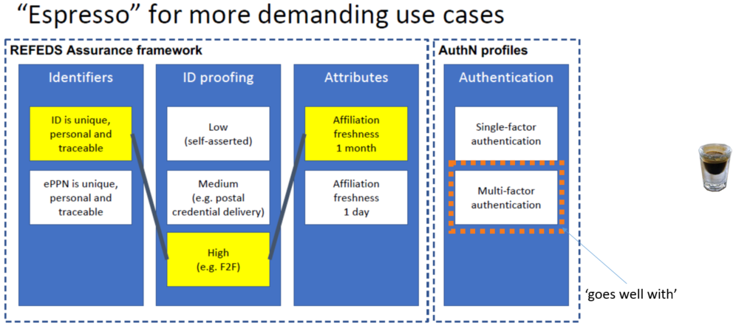
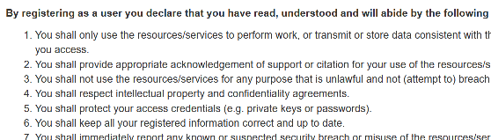
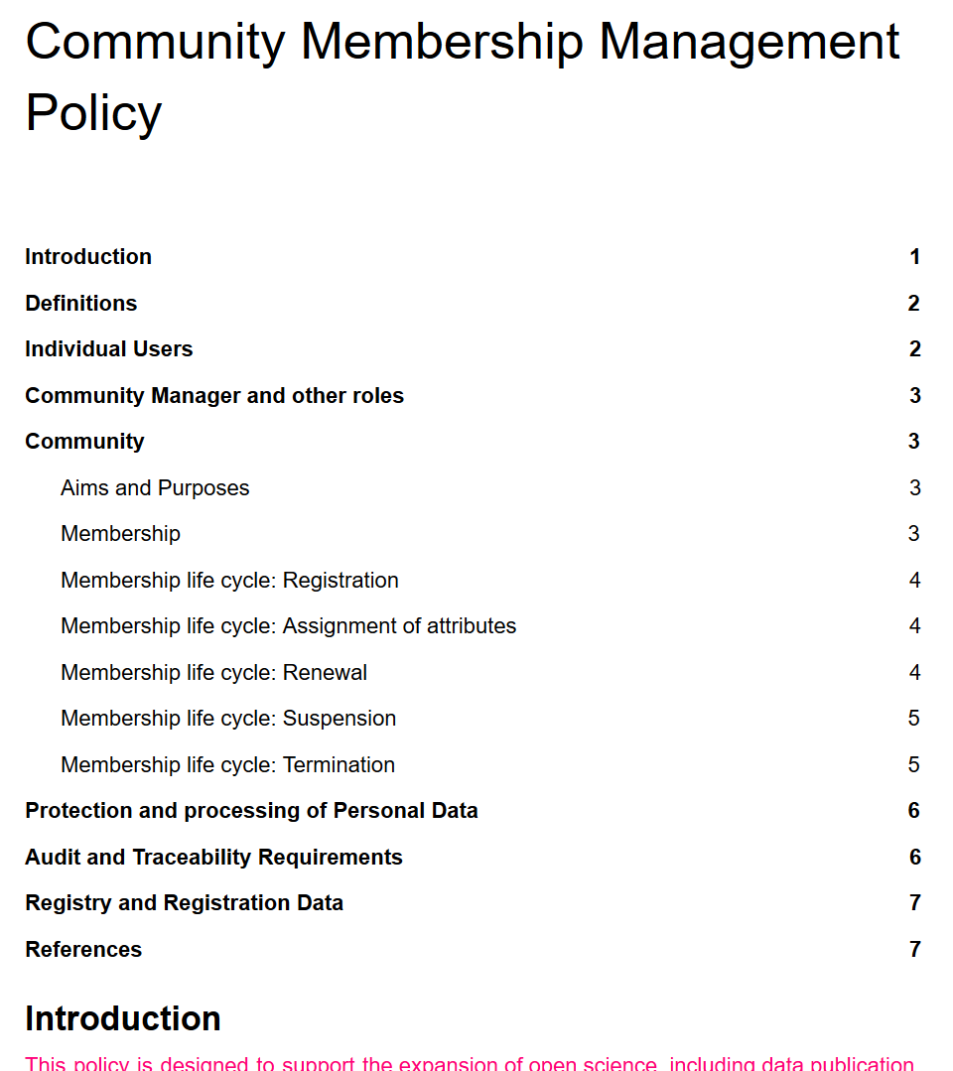
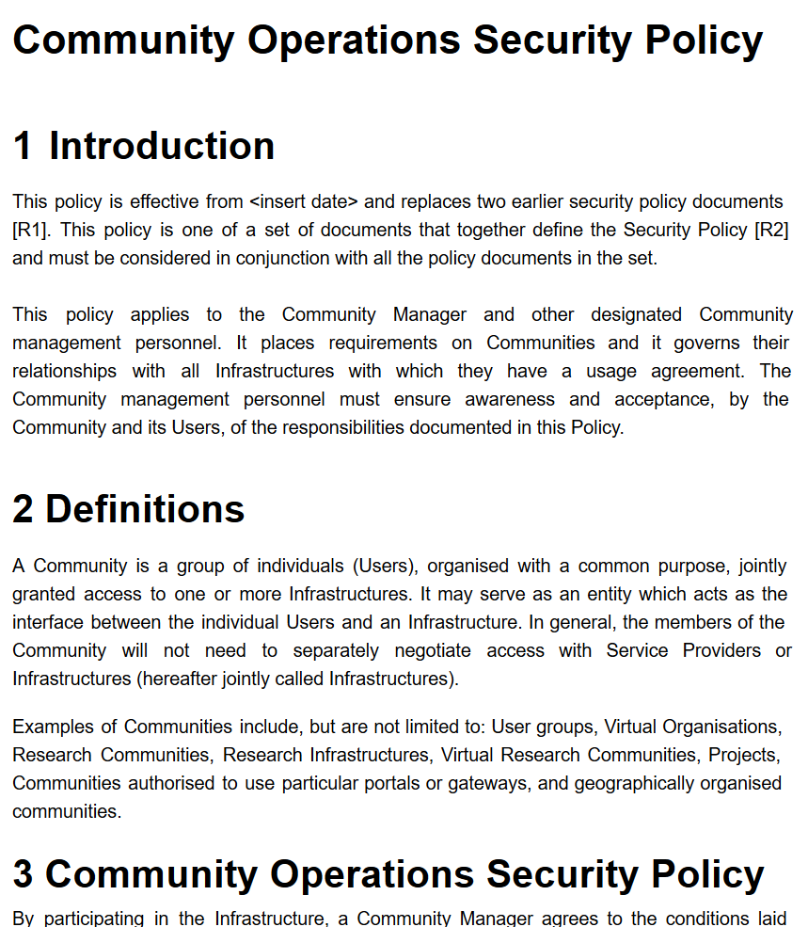
Guidance for research communities in the Infrastructure ecosystem
from REFEDS Assurance Framework: Cappuccino, Espresso
from IGTF Assurance Profiles: BIRCH, DOGWOOD
from the AARC JRA1 use case analysis: Assam – derived from a user-held social identity
Authentication Assurance
using both REFEDS RAF components
as well as cross Infrastructure profiles
considering social-ID authenticator assurance,
complementing account linking in BPA in G041
alignment with REFEDS SFA/MFA now needs update of AARC-G021
Exploit commonality between acceptable use
policies to ease cross-infrastructure resource use
Support community management using Snctfi
easing use of the generic e-Infrastructures
can you show community operations – sufficient to
act as a one-stop registration for every Infrastructure?

Slide 14
Implementing Snctfi: Community Membership Management and Security
Relevant to communities and
e-Infrastructures both
what are the requisite policy elements and processes you need to define to manage a structured community?
which of these are required to access general-purpose e-Infrastructures?
which roles and responsibilities lie with the community ‘management’ to that the BPA proxy model will scale out?
joint work with EGI-ENGAGE
and EOSC-Hub projects and
the EGI, PRACE, HBP, EUDAT
communities
ENGAGE

Slide 15
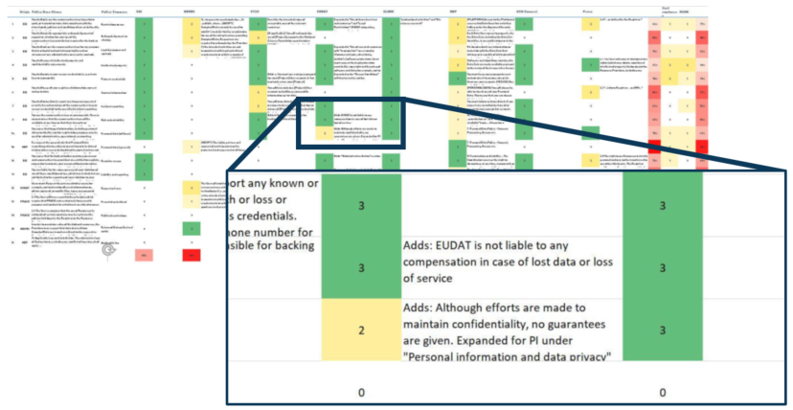
Scaling Acceptable Use Policy and data release
Community conditions
Community specific terms & conditions
Community specific terms & conditions
RI Cluster-specific terms & conditions
Common baseline AUP
for e-Infrastructures and Research Communities
(current draft: JSPG Evolved AUP –
leveraging comparison study and joint e-Infrastructure work)
Also picked up by others,
e.g. FH VORARLBERG
https://wiki.geant.org/x/P4bWBQ

Slide 16
Main achievements in e-Researcher-centric Policy
Assurance Framework alignment | ➔ | REFEDS RAF Pilot with production entities
 | ➔ | Profile-driven interop between Infrastructures achieved (AARC-G020)
Guideline: exchange of assurance information | ➔ | Workflows can cross multiple infrastructures
Guideline: social media assurance components | ➔ | Enable collaborative assurance with the community (and guide BPA implementers)
Acceptable Use policy scaling model and baseline | ➔ | Alignment model recognized by LSAAI and major e-Infrastructures
PY2 | Baseline AUP with major Infrastructures (EGI, EUDAT, PRACE, XSEDE) and communities
 | Deployment of assurance guideline and move to high-assurance use cases

Slide 17
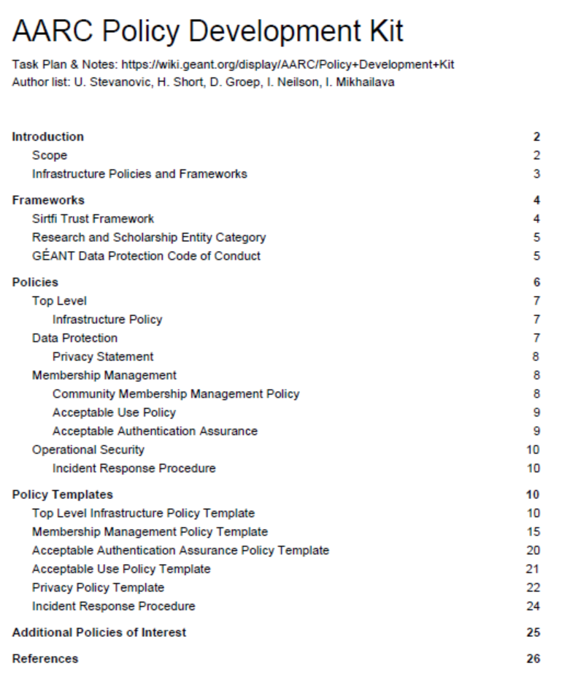
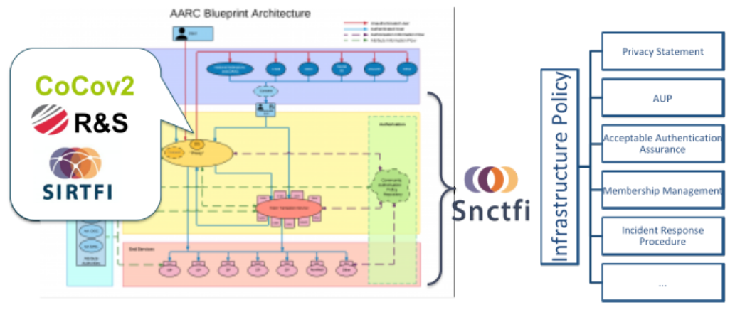
Policy Development Engagement and the ‘Kit’
Bring together a consistent suite of policies & guidance
based on e-Infrastructure best practices
from advanced operational infrastructures today

Slide 18
Main achievements in Policy Coordination and Engagement
Coordination through IGTF, WISE, REFEDS | ➔ | Involvement with AARC across the globe, including XSEDE, OSG, HPCI, and EU Infra’s (EGI, EUDAT, GEANT, PRACE)
Policy Development Kit | ➔ | Ease implementation of gapless policy set for new communities based on Snctfi
FIM4R reinvigoration process | ➔ | FIM4R 2018 paper gives recommendations for Infrastructures, federations operators, and funding agencies
Harmonisation | ➔ | More joint AAI offerings and increased use of the ‘shared service model’
PY2 | Evolve Policy Development Kit with a community risk assessment method to guide adoption of appropriate policy
 | Support communities and use cases in policy interpretation through Guidelines

Slide 19

Engagement and coordination with the global community
Scalable Negotiator for a Community Trust Framework
in Federated Infrastructures
Co-develop
/Guidelines
Globally through
WISE, SCI
REFEDS
IGTF
joint policy groups
(with EGI, EOSC, WLCG)
Implement
Adopt guidelines
Build on collective work with EGI, EOSC-Hub, GEANT, and REFEDS
Consult with AARC team
for targeted guidelines
Basis for policy development kit – identify gaps in policy suite, coordinate
best practice between peer Infrastructures, and leverage AARC templates

Slide 20

Challenges
Policy is – still – usually last on the community’s priority list, yet
we need community involvement to develop appropriate policy
provide targeted or bespoke guidance first, and
abstract from it later when possible
though when a policy need arises,
the community wants applicable policy and processes instantly!
Same small group of experts gets to develop most if not all of the policies – general lack of distributed skilled expertise
through e-Infrastructures (alongside AARC2 pilots) and communities aim to identify the people that have policy interest and expertise

Slide 21
The ‘formal’ stuff that is coming up
MS17/MNA3.4a in M13
Identify community accepted frameworks to present to the competence centre: draft PDK
MS18/MNA3.4b in M22
Identify community accepted frameworks to present to the competence centre: evolved PDK
MS20/MNA3.7 in M16
Initial Data protection impact assessment on blueprint architecture
DNA3.2 in M22
Report on Security Incident Response and Cybersecurity in Federated Authentication Scenarios
DNA3.3 in M23
Accounting and Traceability in Multi-Domain Service Provider Environments
DNA3.4 in M24
Recommendations for e-Researcher-Centric Policies and Assurance
and (including) the document the reviewers requested on assurance framework comparison

Slide 22
Things to do in AARC when you’re still alive by now …
OpSec | Attribute authority operations practice also for Infra proxies (DNA3.2)
 | Trust groups and the exchange of (account) compromise information: Sirtfi+ (DNA3.2)
Infra- centric | traceability and accounting data-collection policy framework based on SCI, providing a self-assessment methodology and comparison matrix for infrastructure services (NA3.3)
 | Evolution of data protection guidance for services – driven by the community needs
Researcher-centric | Baseline AUP with major Infrastructures (EGI, EUDAT, PRACE, XSEDE) and communities
 | Deployment of assurance guideline and move to high-assurance use cases “DNA3.4”
Engagement | Evolve Policy Development Kit with a community risk assessment method to guide adoption of appropriate policy (MS17/18)
 | Support communities and use cases in policy interpretation through Guidelines

Slide 23
davidg@nikhef.nl

