Slide 1
You ain’t seen nothing yet in
Policy and Best Practice Harmonisation
where we are and where we go …
David Groep for the entire AARC Policy Team
AARC2 AHM4 meeting
19 November 2018
Milano, IT

Slide 2
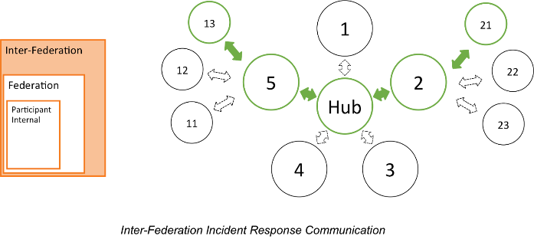

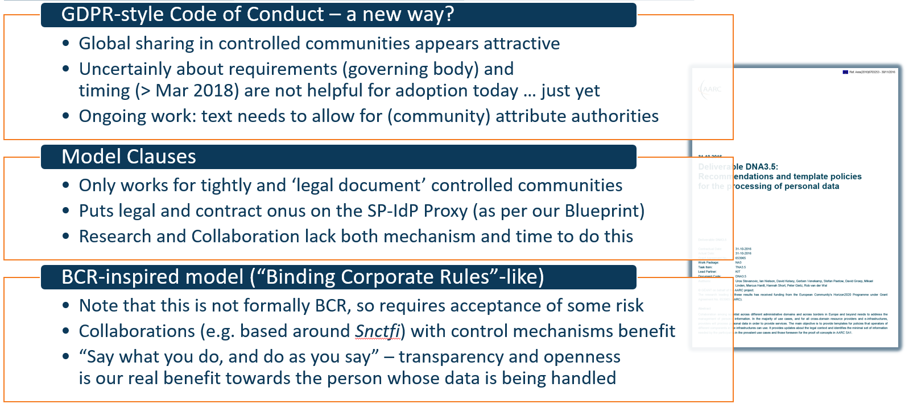

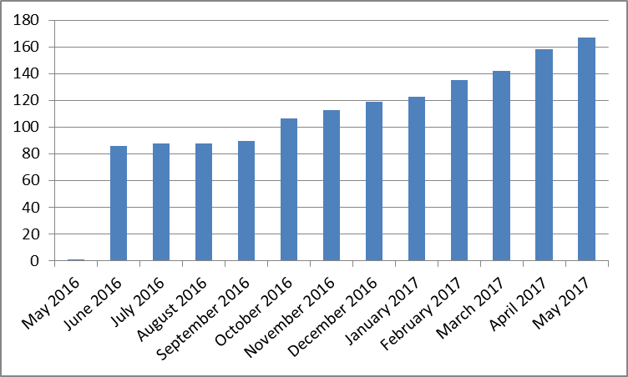
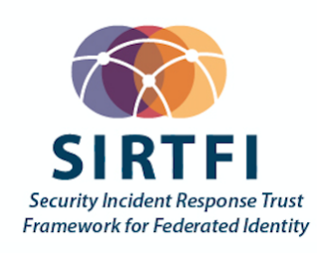
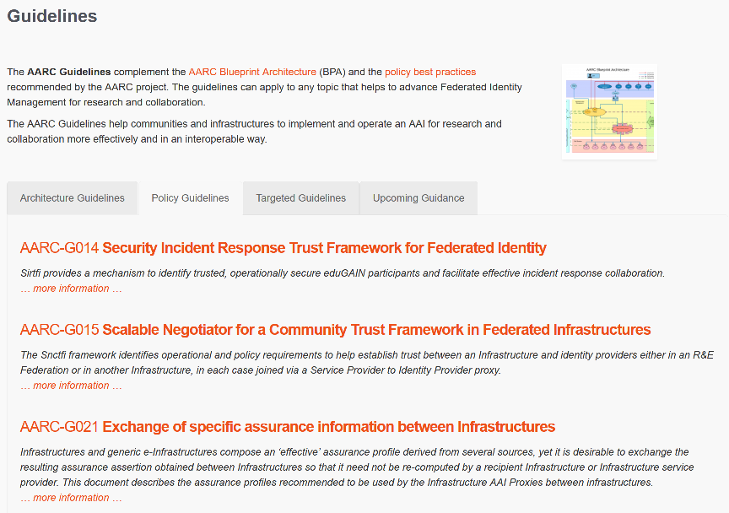

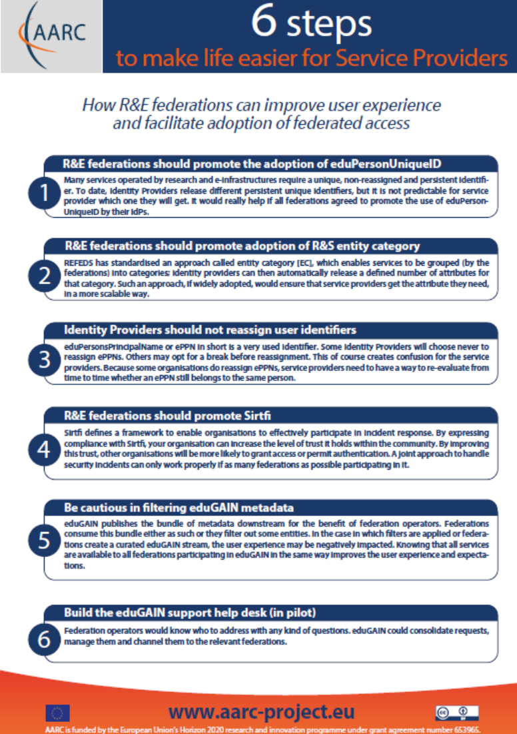
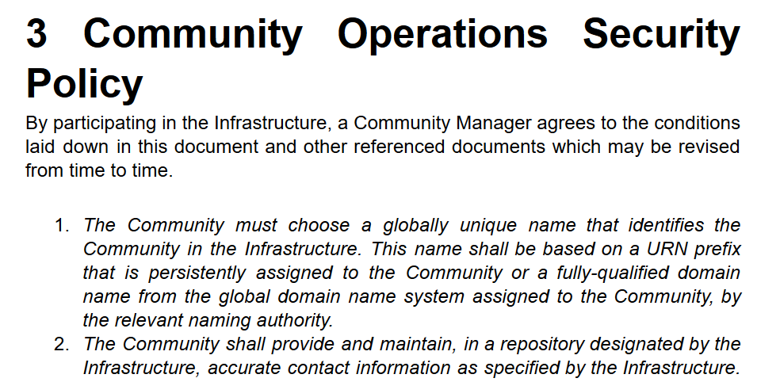
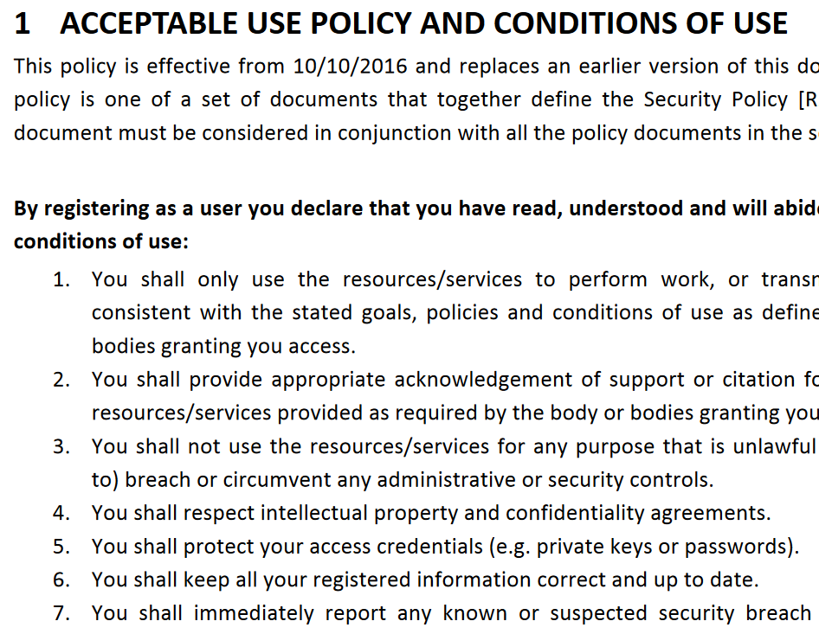


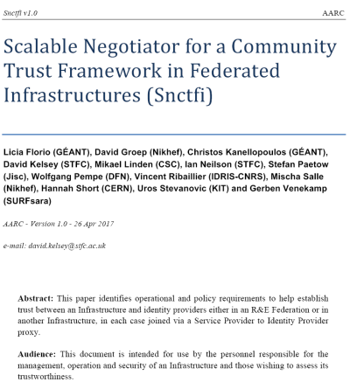



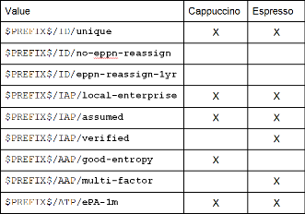
How can policy help you ease collaboration? A holistic view
Operational Security
for FIM Communities
167 entities
supporting policies
for Infrastructures
bulk
model
support for
Researchers & Community
‘low-risk’ use cases
few unalienable expectations by research and collaborative services
generic
e-Infrastructure services
access to common compute and data services that do not hold sensitive personal data
protection of sensitive
resources
access to data of real people, where positive ID of researchers and 2-factor authentication is needed
engagement and coordination
Baseline Assurance
known individual
Persistent identifiers
Documented vetting
Password authenticator
Fresh status attribute
Self-assessment
Slice includes:
assumed ID vetting
‘Kantara LoA2’, ‘eIDAS low’, or ‘IGTF BIRCH’
Good entropy passwords
Affiliation freshness
better than 1 month
Slice includes:
Verified ID vetting
‘eIDAS substantial’, ‘Kantara LoA3’
Multi-factor authenticator
2

Slide 3
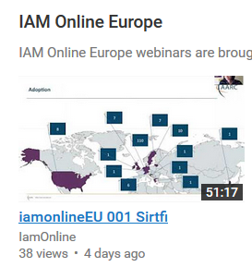
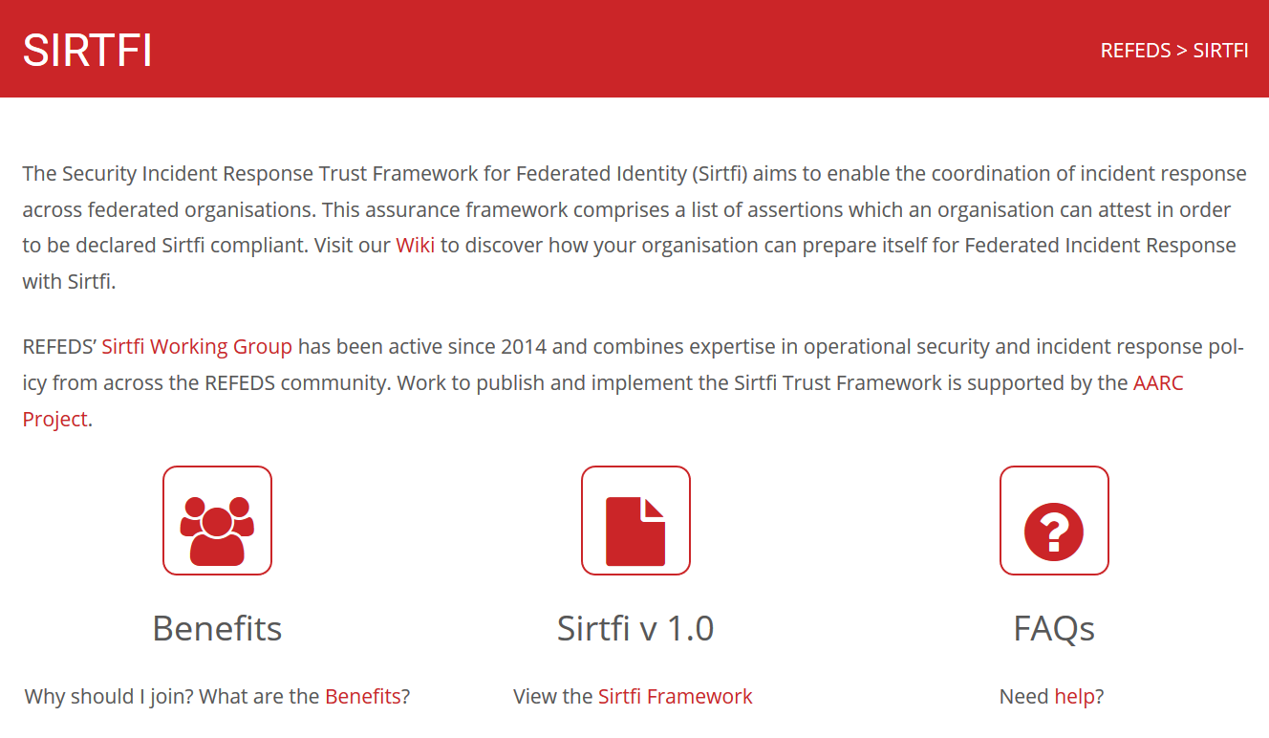
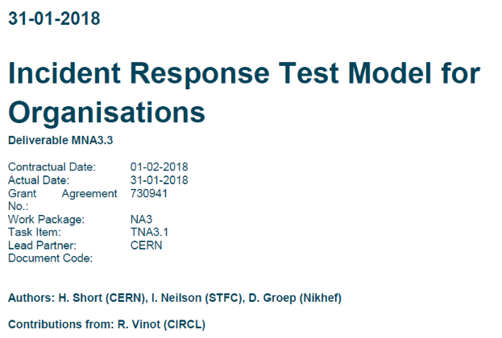
Sirtfi – presentation, training, adoption in AARC2
https://refeds.org/SIRTFI
Promotional activities successful
REFEDS, Internet2 TechX, ISGC Taipei, TNC,
TF-CSIRT, FIM4R, Kantara webinars, …
Now 427 entities (but inly in 25 federations)
Ready to move to the next phase:
‘I Need Sirtfi
Right Now™’
Services increasingly demand and use Sirtfi
CERN & LCG, CILogon (US),
RCauth.eu, IGTF-to-eduGAIN bridge
and
Sirtfi is included verbatim in the (GN4)
DPCoCo version 2 to be submitted to EDPB
statistics: technical.edugain.org, visited 2018-10-16

Slide 4
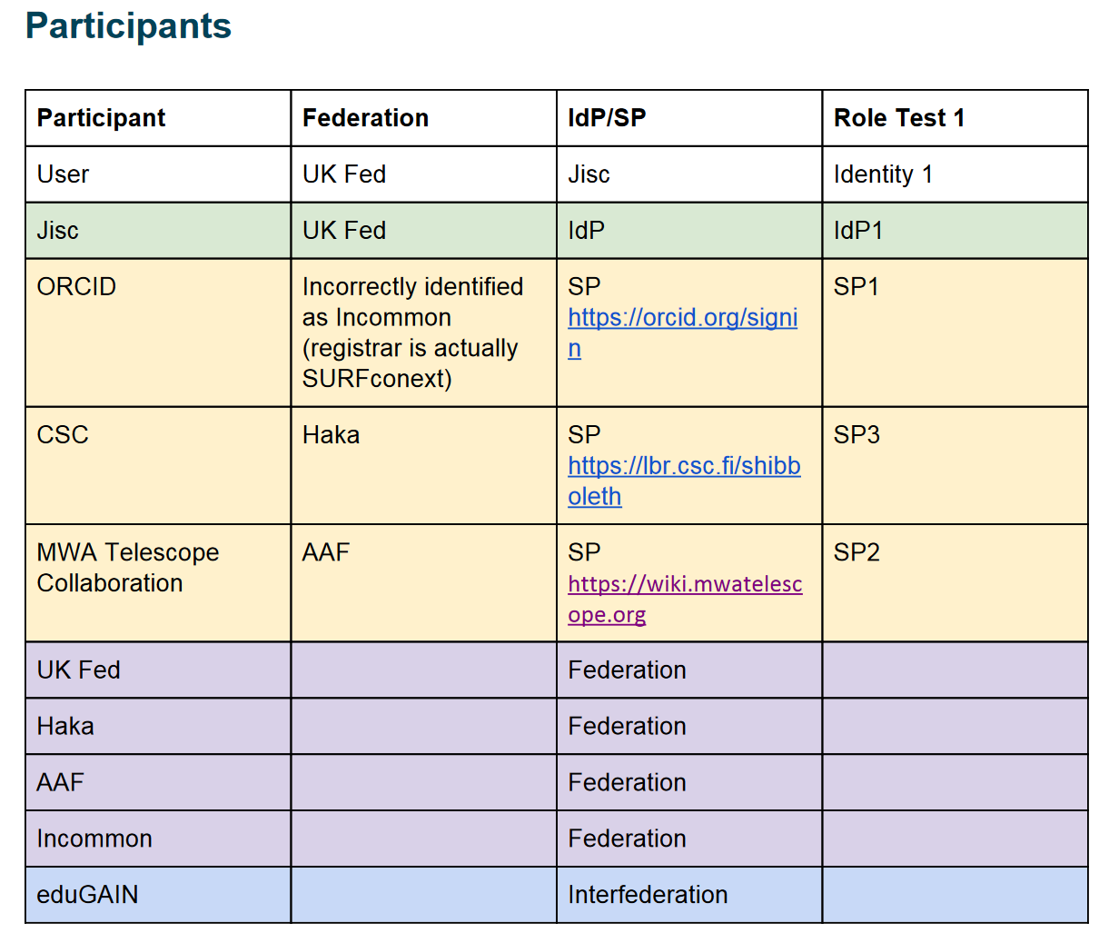
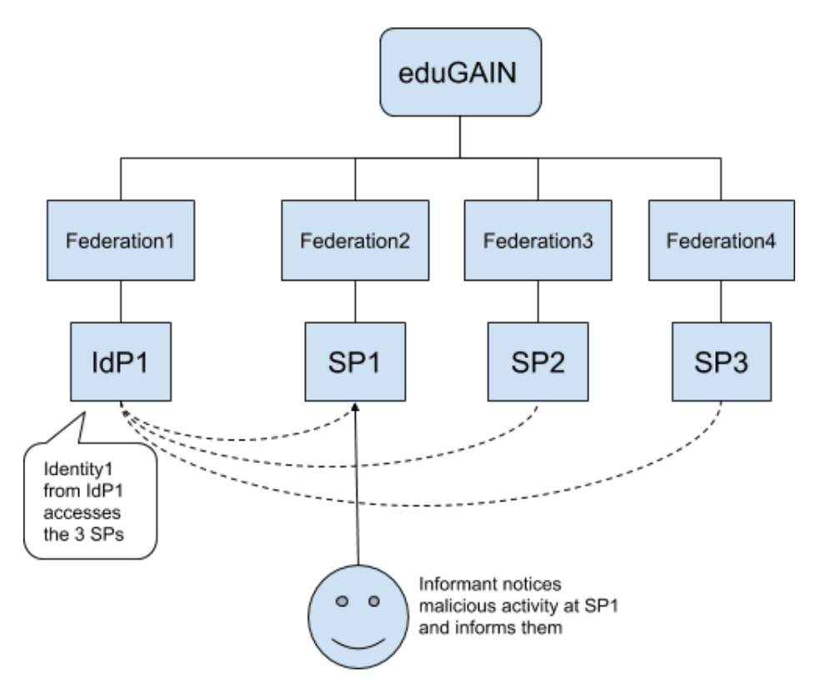
Test model for incident response – a continuing process …
2nd Sirtfi Communications Challenge
include eduGAIN Support Desk
Exercise the model attack scenario … ☺
parties involved in response challenge
See https://aarc-project.eu/wp-content/uploads/2018/11/Incident-Response-Test-Model-for-Organisations-Simulation-2.pdf

Slide 5

Incident response process evolution in federations – beyond basic Sirtfi
Continuing Challenges
IdP fails to inform other affected SPs, for
fear of leaking data, of reputation,
or just lack of interest and knowledge
No established channels of communication, esp. not to federations or eduGAIN
Can we evolve operational security in our federated academic environment?
Expand Sirtfi in places where there is no federation support (Sirtfi+ Registry)
And extend the concept of trust groups and facilitate exchanging incident information?

Slide 6





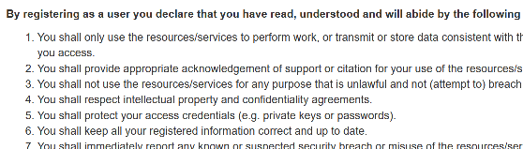
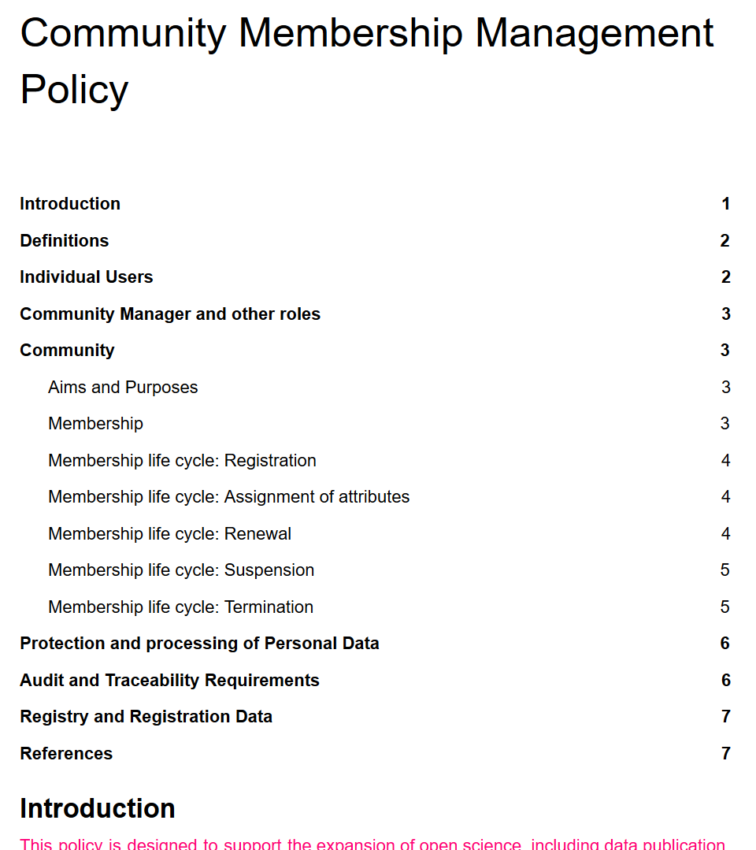
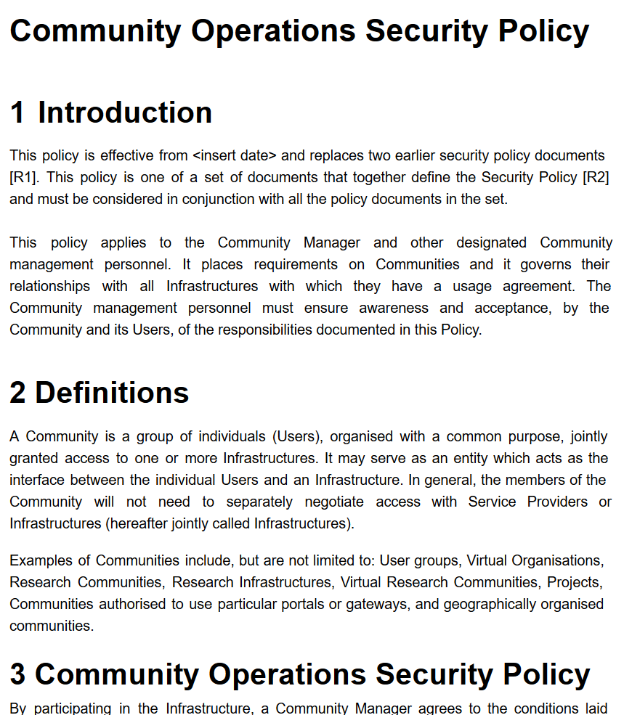
Guidance for research AAIs in the Infrastructure ecosystem
Authentication Assurance – a truly joint exercise
using both REFEDS RAF components as well as cross Infrastructure profiles
considering social-ID authenticator assurance, complementing account linking in BPA
Protecting personal data from infrastructure use
Exploit commonality between acceptable use
policies to ease cross-infrastructure resource use
Support community management and a policy suite
using Snctfi to ease use of generic e-Infrastructures
and interoperability
with the Policy Development Kit and SCI assessment

Slide 7
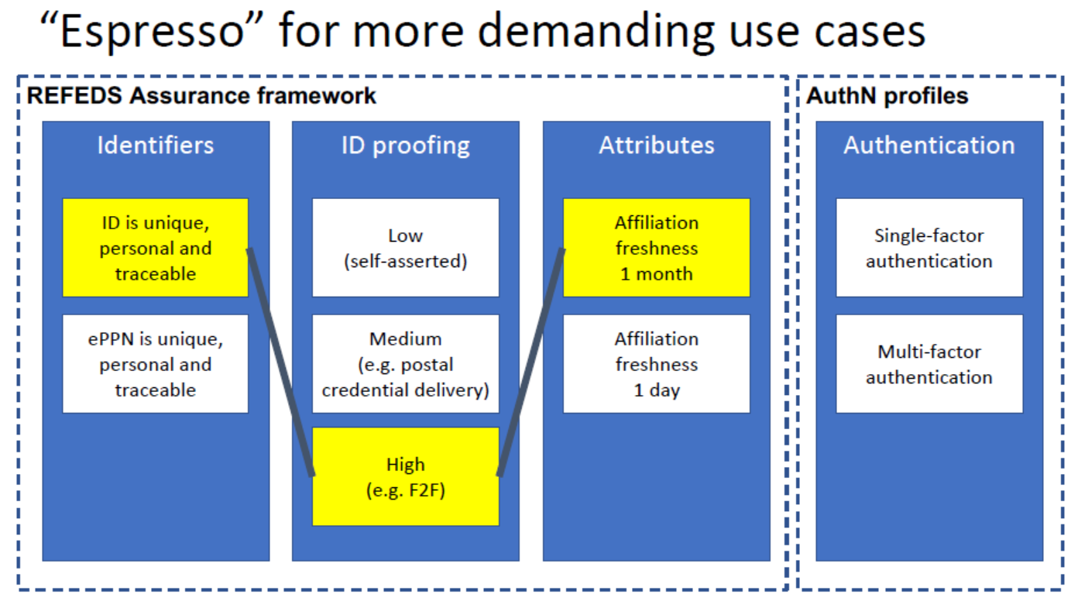

Example: “Espresso” profile for demanding use cases
‘goes well with’
REFEDS RAF, SFA, and MFA now endorsed – supplementary inter-infrastructure profiles in G021 and G041

Slide 8
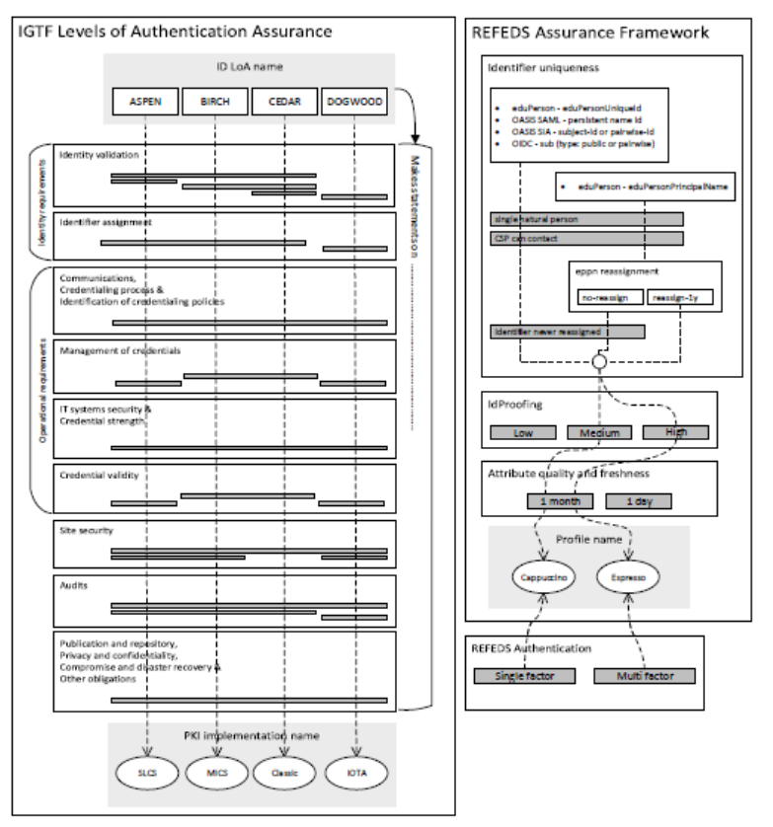
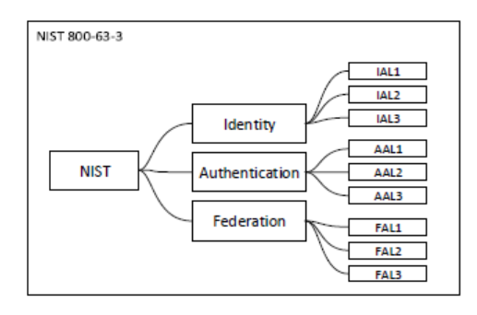

Many assurance frameworks – how do they compare?
Ian Neilson’s Assurance Comparison Concept Leaflet

Slide 9
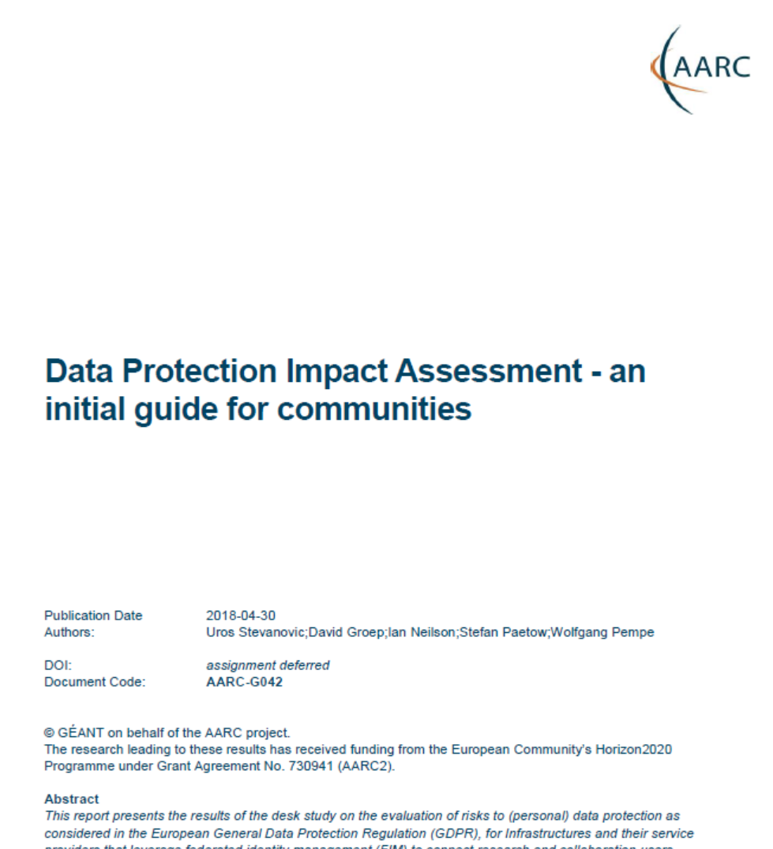
Protection of Personal Data and PII for Infrastructure AAIs
– there is both FUD but also legitimate concerns
Large discrepancy between practice, perception, and actual risk:
communities themselves don’t see need to protect infrastructure AAI (accounting) data
– and don’t even consider existing AARC guidance ☹
misunderstanding issue, over-stating risk, falling victim to FUD law firms
even ‘simplified’ documents - like the GEANT Data Protection
Code of Conduct – considered too complex to be understood
help determine risk and impact of FIM on research infrastructure
https://aarc-project.eu/guidelines/aarc-g042/

Slide 10

Difference to commonality in the Baseline AUP – sign once, use everywhere
Image: Mozes en de tafelen der Wet, Rembrandt van Rijn, 1659

Slide 11
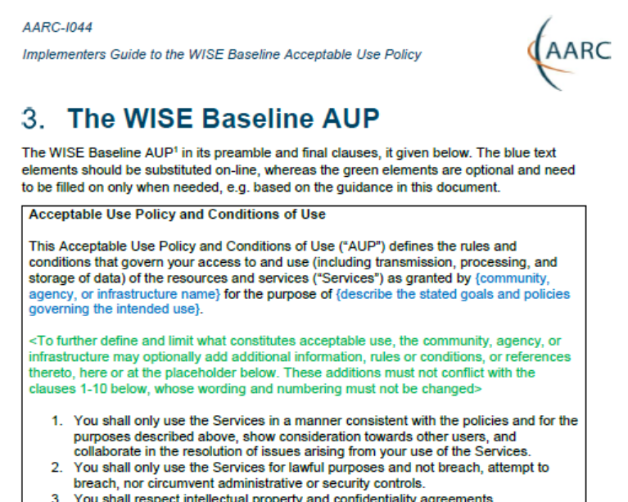
Scaling Acceptable Use Policy and data release
impractical to present user ‘click-through’ screens on each individual service
Community conditions
Community specific terms & conditions
Community specific terms & conditions
RI Cluster-specific terms & conditions
Common baseline AUP
for e-Infrastructures and Research Communities
(current draft Baseline AUP –
leveraging comparison study and joint e-Infrastructure work)
AARC-I044 Implementers Guide
https://aarc-project.eu/guidelines/aarc-i044/

Slide 12
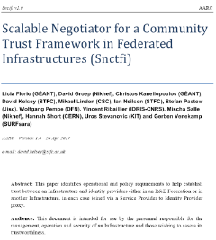
Beyond just identity providers, services, and Federations: AA security
BPA Proxy and connected sources of trusted attributes critical to infrastructure security
Help AA operators with operational security
requisite processes and traceability support
secure operation and deployment
protected transport
for different attribute distribution models
Snctfi
Scalable Negotiator for a Community Trust Framework in Federated Infrastructures
igtf.net/snctfi
Derived from SCI, the framework on Security for Collaboration in Infrastructures
WISE Information Security for E-infrastructures got global endorsement SCI in June 2017

Slide 13
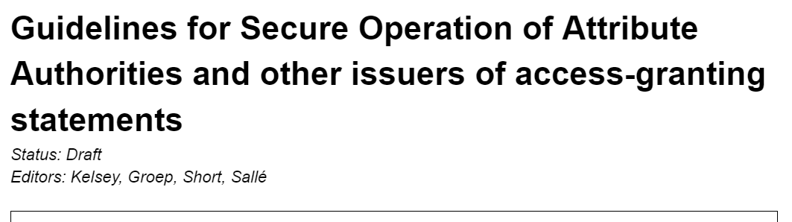
Implementing Snctfi:
Community Management and Security, AA Operations Security, …
Relevant to communities and
e-Infrastructures both
what are the requisite policy elements and processes you need to define to manage a structured community?
which of these are required to access general-purpose e-Infrastructures?
which roles and responsibilities lie with the community ‘management’ to that the BPA proxy model will scale out?
joint work with EGI-ENGAGE
and EOSC-Hub projects and
the EGI, PRACE, HBP, EUDAT
communities
ENGAGE

Slide 14
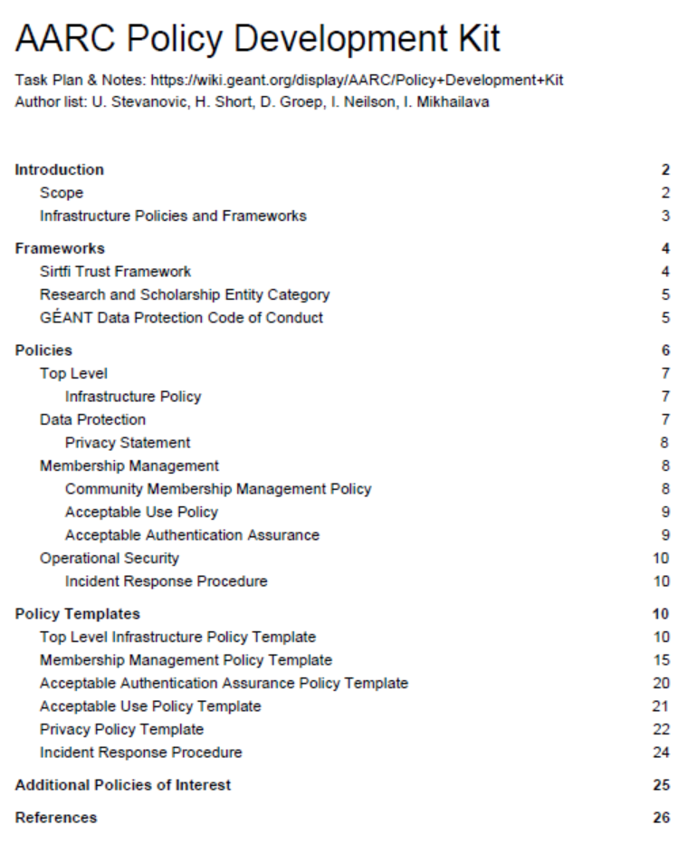
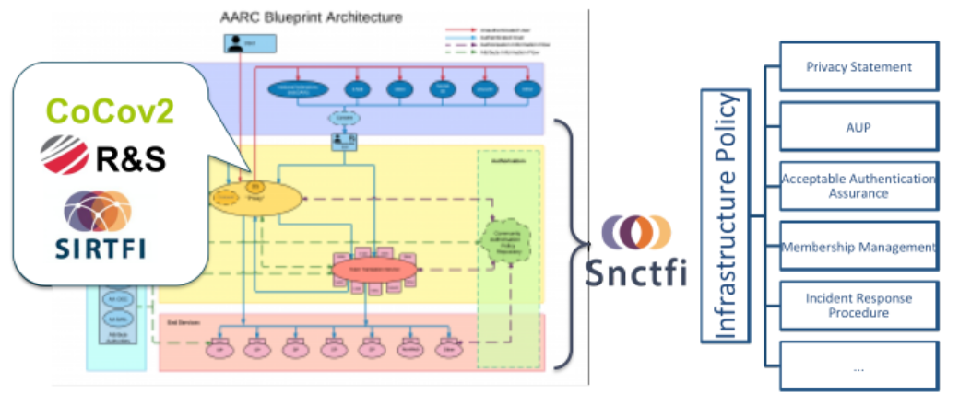
Policy Development Engagement and the ‘Kit’
Bring together a consistent suite of policies & guidance
based on e-Infrastructure best practices
from advanced operational infrastructures today
https://wiki.geant.org/display/AARC/Policy+Development+Kit

Slide 15
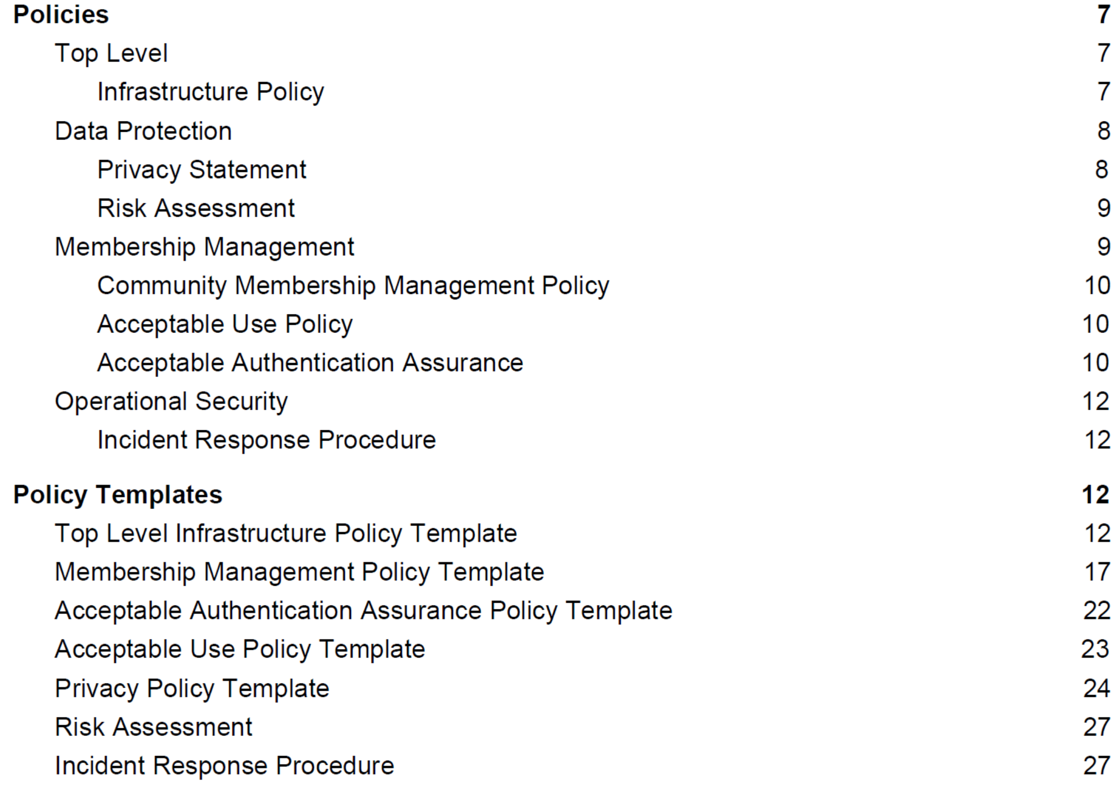
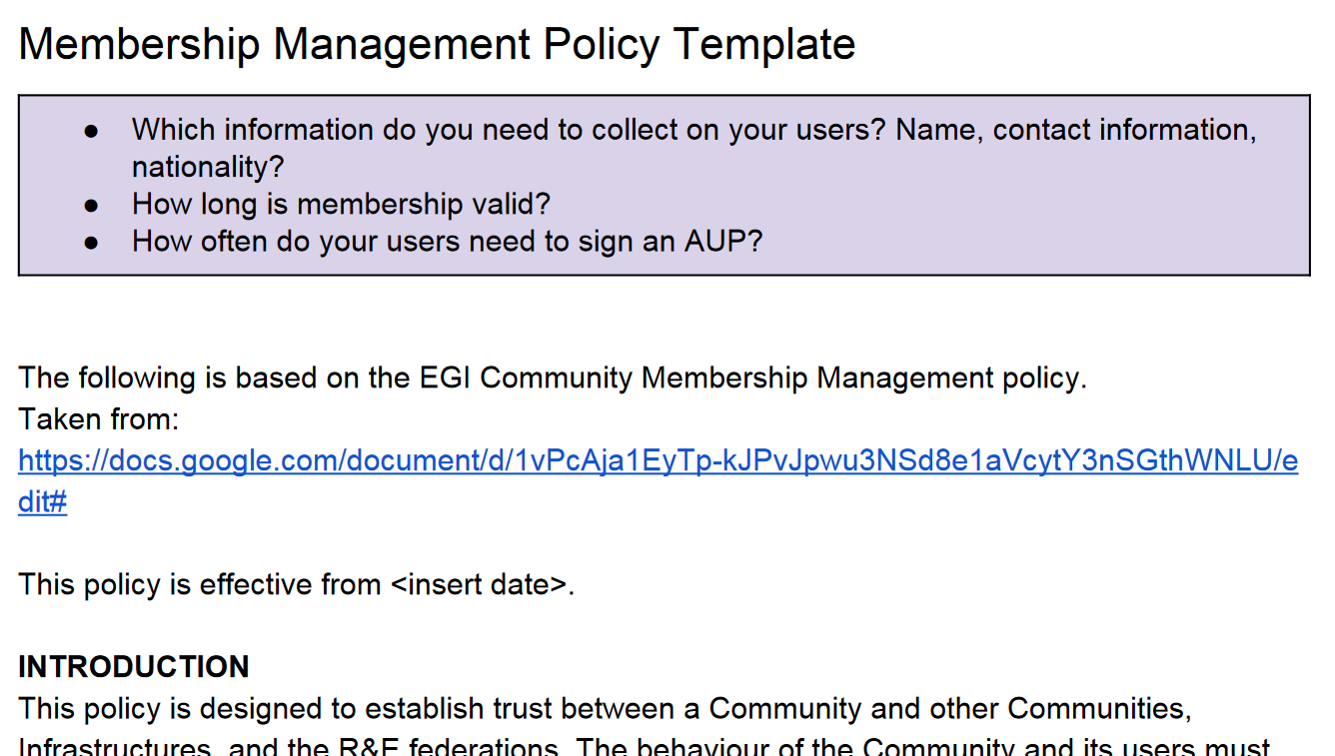
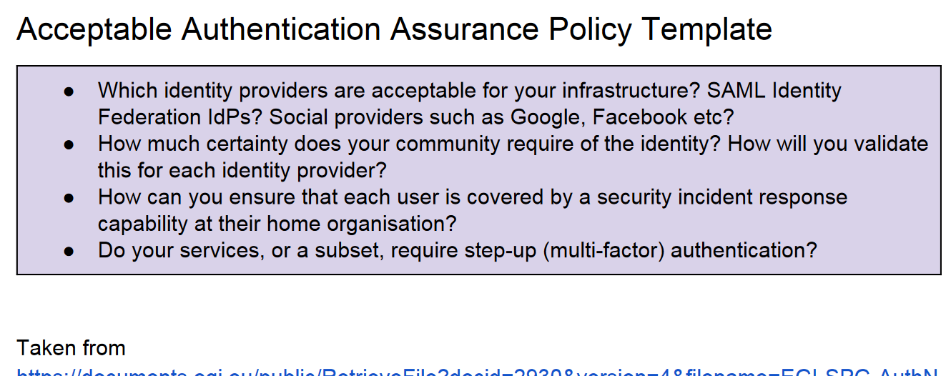
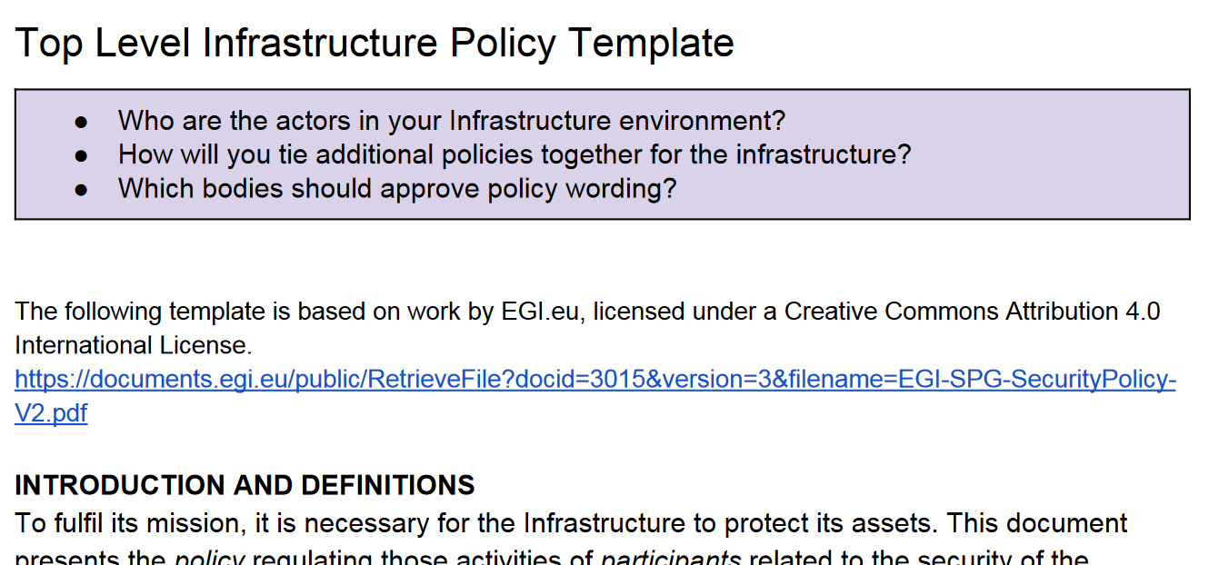
Helping you towards SCI and Snctfi: templates in the PD Kit

Slide 16
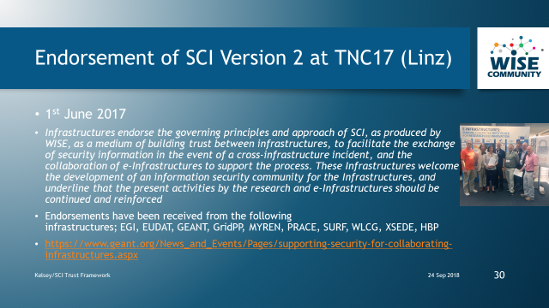
The SCI Trust Framework – globally comparable structure in Security Policy
see the SCI Webinar by David Kelsey on Sept 24th!
https://www.youtube.com/watch?v=vZvfRvMQfFg

Slide 17
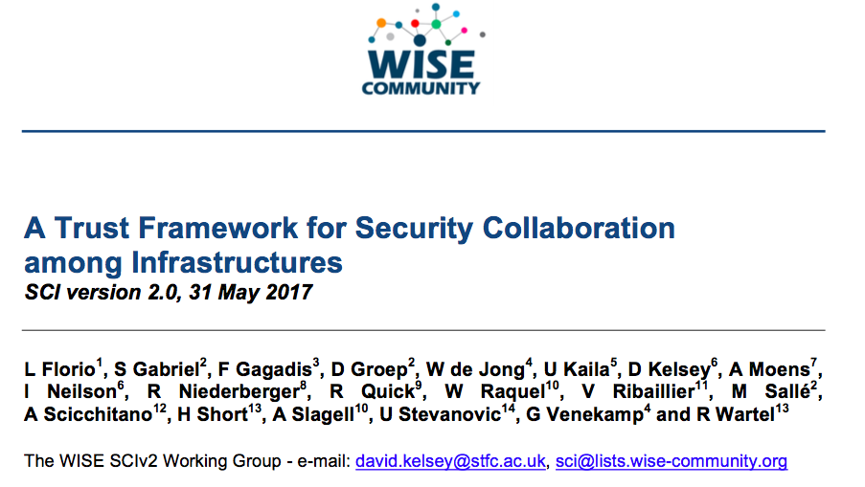
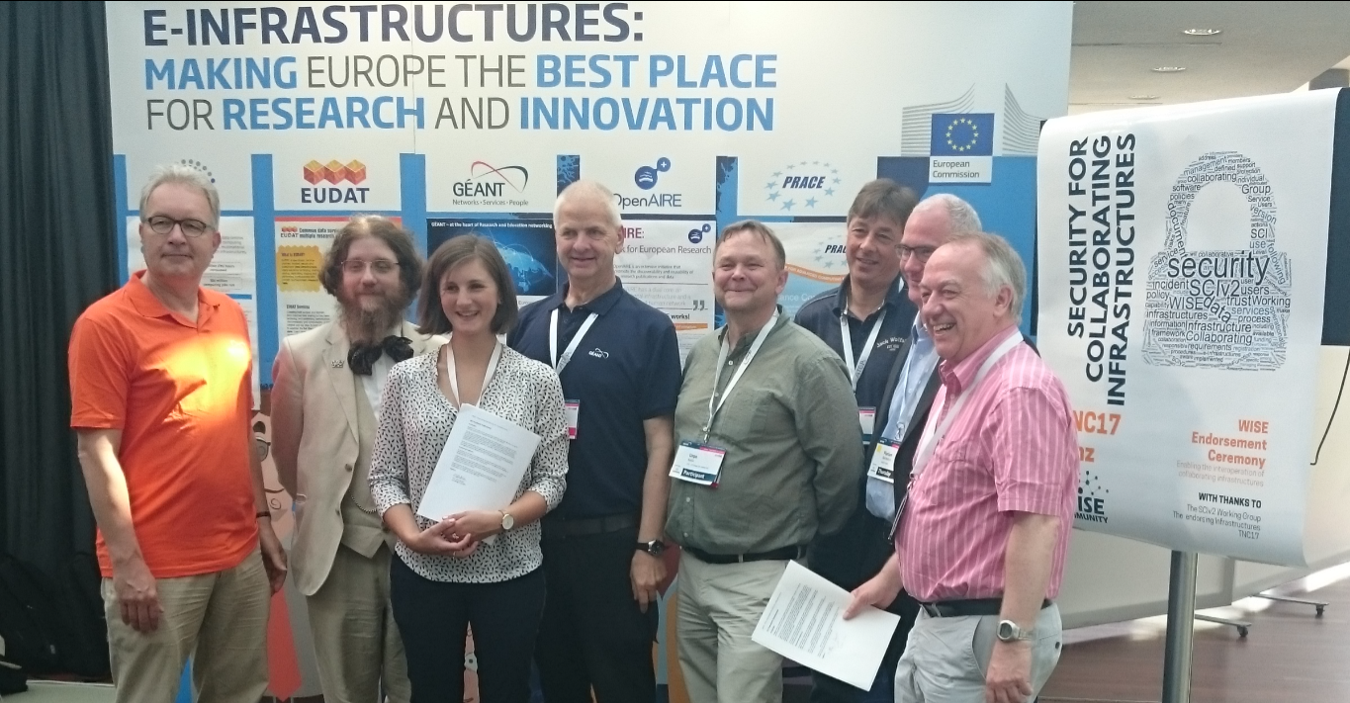

SCIv2 – beyond its endorsement to self-assessment and review
example, not an infrastructure
AARC may help by supporting evolving the
peer review self-assessment model for SCI
and how that compares to e.g. ISO-based audits
http://wise-community.org/sci

Slide 18
Things to do in AARC’s last 6 mo and beyond when you’re still alive by now …
OpSec | Attribute authority operations practice … also for Infra proxies
 | Trust groups and the exchange of (account) compromise information: beyond Sirtfi
Infra- centric | traceability and accounting data-collection policy framework based on SCI, providing a self-assessment methodology and comparison matrix for infrastructure services
 | Evolution of data protection guidance for services
Researcher-centric | Baseline AUP with major Infrastructures (EGI, EUDAT, PRACE, XSEDE) and communities
 | Deployment of assurance guidelines and assess high-assurance use cases (BBMRI)
Engagement | Evolve Policy Development Kit and a simpler top-level security policy with a community ‘assessment method’ or ‘guide’ to the adoption of appropriate policy
 | Support communities and use cases in policy interpretation through Guidelines

Slide 19
Thanks to the AARC2 policy collaborators: David Kelsey, Hannah Short, Ian Neilson, Uros Stevanovic, Mikael Linden, Ralph Niederberger, Petr Holub, Wolfgang Pempe, Stefan Paetow, and many contributions from across the AARC project, REFEDS, IGTF, and WISE!
Selected policy work performed in collaboration with the EOSC-HUB WP4.4 ISM activity
davidg@nikhef.nl

