Slide 1
and all that I can see is just another … AARC TREE!
a preliminary insight in potential developments in the AARC Community
David Groep
AARC Policy Area Coordinator
Nikhef Physics Data Processing programme and UM Dept. Advanced Computing Sciences
EUGridPMA+ meeting
May 2023

Slide 2
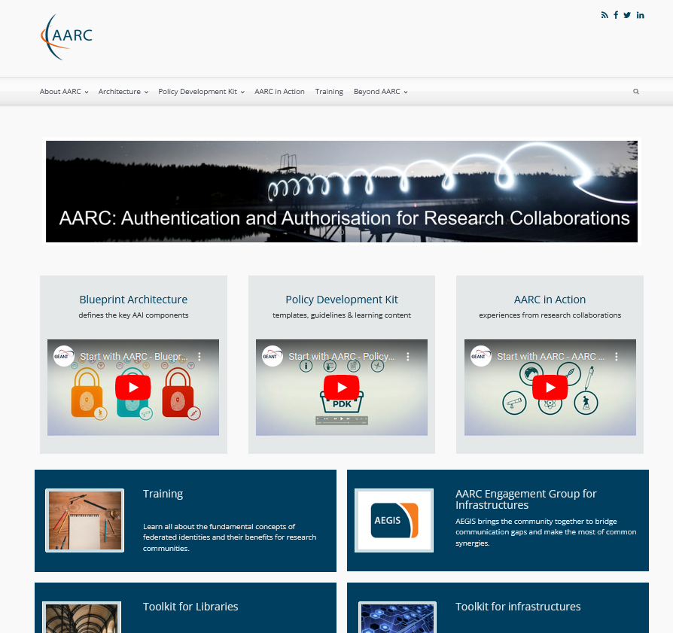
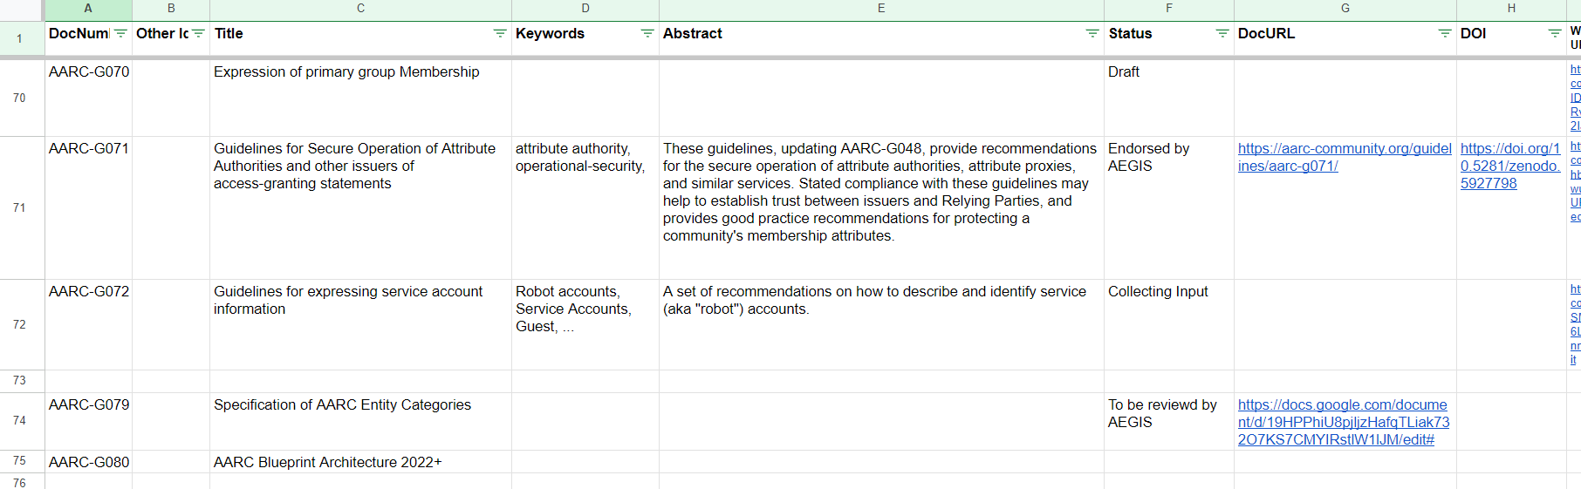
AARC Community
Work on structuring AAI is far from over – the AARC community & ‘AEGIS’ provide a persistent framework
new architecture guidelines: primary group membership, service account information, entity categories, composite BPA models
policy development: AAOPS, trust federation
‘across proxies’ (SNCTFI), assurance information from eIDAS, mid-sized community PDK
Today supported by a range of
(inter)national infrastructures and
projects (like ‘EnCo’ and ‘EOSC’)

Slide 3
We have the BPA, but can we do better, or more?
increase effectiveness of the AARC Blueprint Architecture (BPA) and
the policy development kit, reaching more research infrastructures?
leverage AARC’s structuring effect to ease interoperation across thematic areas?
demonstrate better the impact of the BPA in new communities (within and outside of EOSC)?

Slide 4
A proven methodology
Provide guidance based on a broad and open community process: FIM4R, EOSC, AEGIS, WISE, REFEDS, IGTF, AppInt, …
Experts gather in open, dedicated teams
Iterative stakeholder engagement
practical validation in use cases of
the research and e-infras, e.g. through AEGIS

Slide 5
Who should sit under the AARC TREE …
Research Infrastructures and e-Infrastructures, both national and international facilities
providers of resources and services for research communities, ERICs, ESFRIs, and other (data) sources
Research Communities
scientific communities, collaborations and individual researchers, (so including our mid-sized groups)
EU and global initiatives
International Data Spaces Association (IDSA), GAIA-X, EU eID wallets, FIM for Research (FIM4R), &c
Service and resource providers:
AAI and other providers interested in offering their services and resources to researchers
EOSC Ecosystem
EOSC related initiatives like EOSC Association Task Forces and other EOSC projects

Slide 6
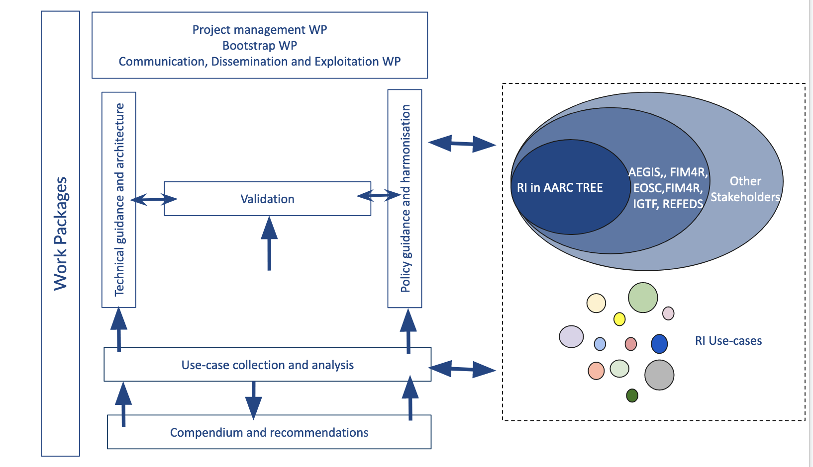
Growing an AARC TREE

Slide 7
AARC Policy Development
Research-infrastructure alignment and policy harmonisation
Operational Trust for Community and Infrastructure BPA Proxies
Snctfi - increasing acceptance of research infrastructure proxies with R&E identity providers and sources of authentication
Review infrastructure models for coordinated AUP, T&C, and privacy notices, improving cross-infrastructure user experience
User-centric trust alignment and policy harmonisation
Lightweight community management policy template
Guideline on cross-sectoral trust in novel federated access models
Assurance in research services through (eIDAS) public identity assertion
FIM4R policy workshop series on validation of the restructured policy framework (together with the new ‘BPA’)

Slide 8
davidg@nikhef.nl
Information in this document is preliminary and should not be construed as an endorsement of any particular organisation or plan. All information subject to change without notice. Information presented here MUST NOT be quoted out of context

