Slide 1
The RCauth.eu CILogin-like TTS Pilot in EGI
Deployment and Sustainability Models
for the AARC CILogon-like TTS Pilot
David Groep
AARC NA3 policy and best practice coordinator
Nikhef PDP group
EGI ENGAGE Conference
May 2017

Slide 2
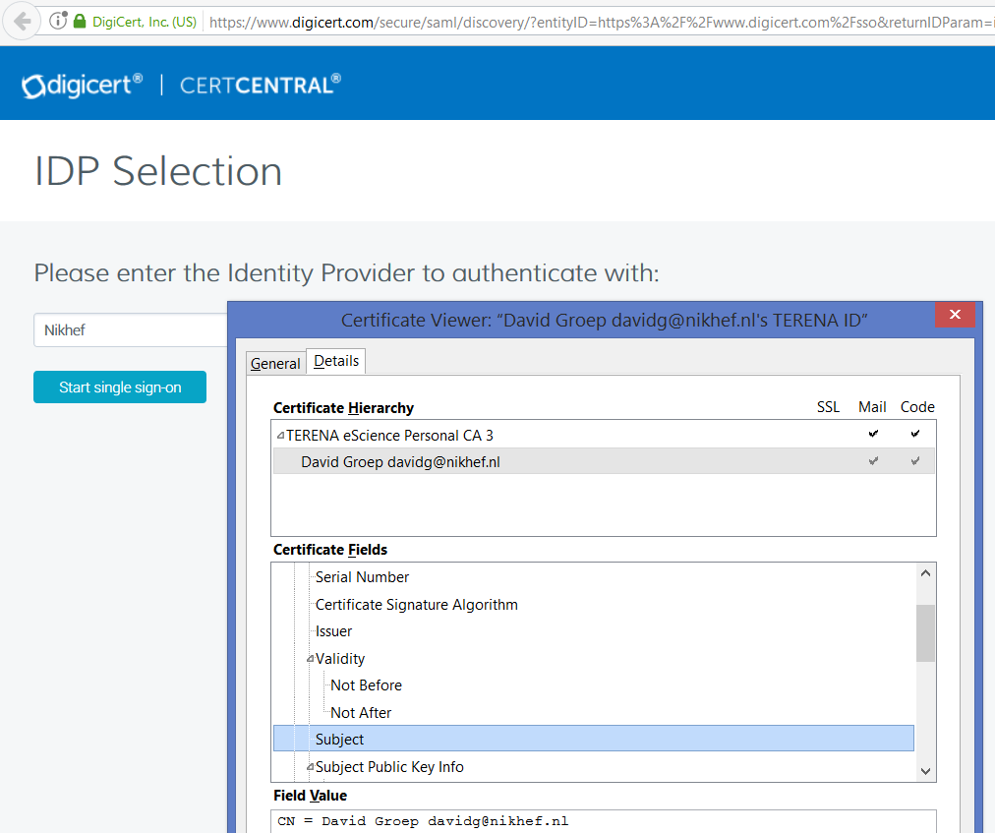
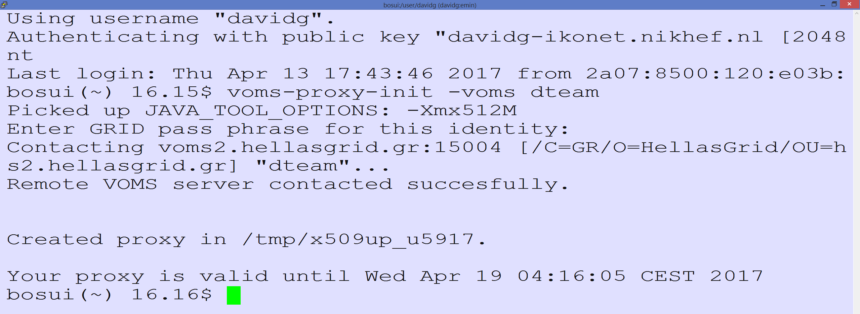
Seamless (eduGAIN) Access to (non-Web) Resources using PKIX?
Traditional workflow – using a client-held credential
Works great provided the user understand the technology – and we may have found all users that know how to manage ☹

Slide 3
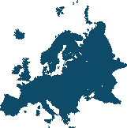


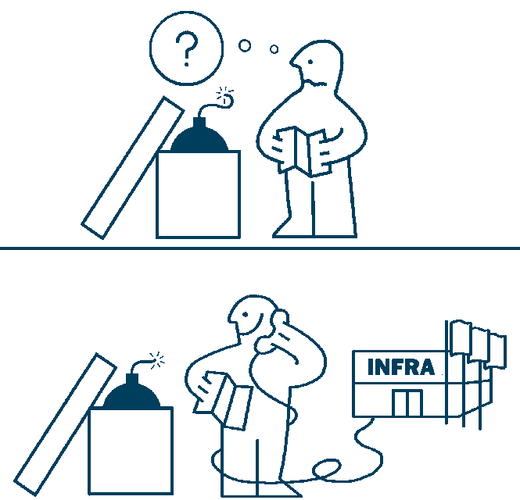
Aim: seamless access to existing services with eduGAIN for all
Pan-European Access
not country-opt-in based
standards-based assurance
No Changes to the Model
for infrastructures and
their service providers
1
:
1
Dispersed User Base
critical mass is beyond
any single institution
$ exec
$oidc->
authenticate()
echo "Hola
$name"
Brokered access and VOMS
with delegation, brokering,
and optional cli access
Concentrate Sensitive Components
no long-term token needs in the VO portal
credential management by the Infrastructures
Minimal Coding
for the VO portals

Slide 4
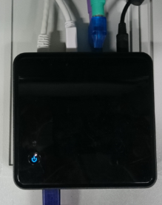

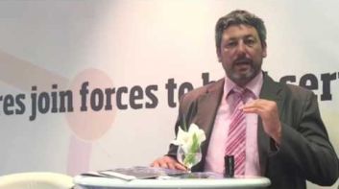










CILogon-like TTS Pilot, the User’s work flow
user login flow: VO portal → Community Infrastructure → RCauth service → federated AAI
credential flow: authentication, SAML federation, Policy Filter, OpenID Connect, PKIX+OIDC, (VOMS), proxy-on-portal
R&S
science gateways
delegation
AARC Master Portal or
Infrastructure Solution
filtering
WAYF
server

Slide 5

DIY DEMO
https://rcdemo.nikhef.nl/
once your home institution meets baseline criteria (R&S + Sirtfi) …
you can do most things except VOMSified access to the Prometheus dCache pool
that last elements needs your credential to be added to the permitted list

Slide 6
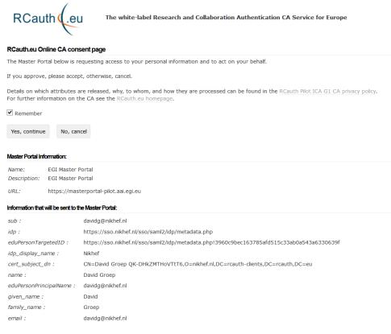
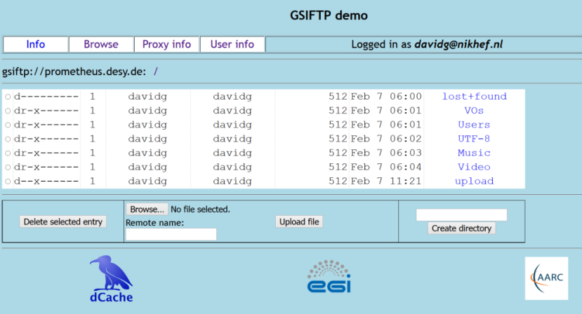
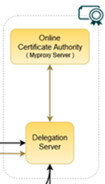


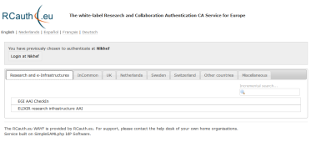

Flow for RCauth-like scenarios
Community Science Portal
Accredited
PKIX Authority
Infrastructure Master
Portal Credential Store
REFEDS R&S
Sirtfi Trust
User Home Org
or Infrastructure IdP
Policy Filtering WAYF / eduGAIN
Built on CILogon and MyProxy
www.cilogon.org
6
see also https://rcdemo.nikhef.nl/
Notes:
VO portal can be anything even a simple shell
Certs stored only for 11 days
Master portal can add attributes via VOMS (or others in the future)

Slide 7
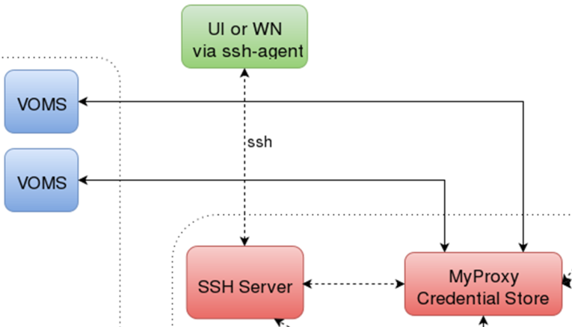
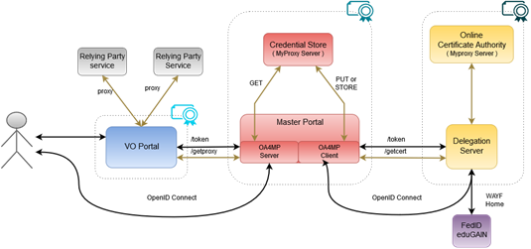
CILogon-like TTS Pilot - distributable elements

Slide 8
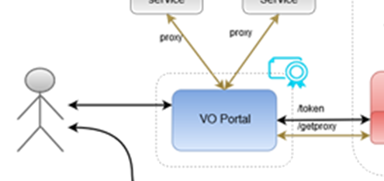
Blue: VO services and resources
Are around today, either self-managed or hosted, in most communities
Science gateways, portals, e.g. HADDOCK, Galaxy, LifeRay (generic), WebFTS, …
Omnipresent (and has unfortunately proven to be an easily compromised target)
Will have to get credentials from the MPs, but should be able to
do so only for authenticated users
Downtime will impact its’ own users, but there will be
many of these (same service by different sites?)
Considerations:
Operated as today by the communities
Bound slightly stronger to the community via the Master Portal
$oidc->
authenticate()
echo "Hola
$name"

Slide 9
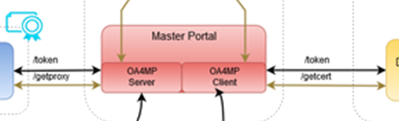
Red: the Master Portal (MP) and Credential Repository
Needs to be a trusted element (to permit credential storage by the TTS)
Requires some operational and security expertise (managed data centre, locked racks, access controls, ability to designate infrastructure for security operations, trained staff)
Connects to (many) workflow-specific VO portals
Connects to a single Delegation Service/TTS – and can give IdP hints
Downtime of an MP disables resource access for connected VO portals
Considerations:
One per Research or e-Infrastructure
Should be highly available (database sync)
Infrastructures can also build their own (e.g. in WaTTS, Unity, …)

Slide 10
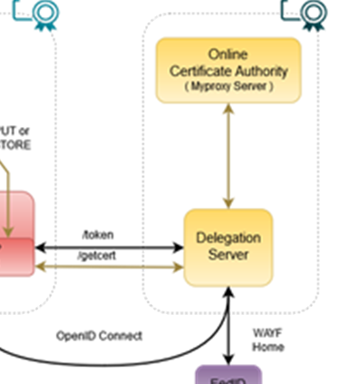
Yellow: the Token Translator/OA4MP/CA service
Needs security and policy expertise – and ability to maintain accreditation
Needs operational and technical capabilities: hardware security modules,
managed data centres, off-line and on-line secure areas
Connects to a few Master Portals (MPs) based on explicit agreements
to take care of user credential protection and compliance
Connects (many, we hope scalably) federations, IdPs and (few) SP-IdP-Proxies
May have to present a WAYF, if the VO portal does not pass IdP entityID
Bridges many technologies: SAML – PKIX – OIDC
Considerations:
Trust and compliance, with IGTF accreditation
Single logical instance, with HA built in for production
Managed by a consortium: in Europe agreed by at least EGI, EUDAT, GÉANT, ELIXIR, and SURF
1
1
:

Slide 11
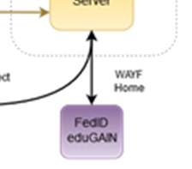
Purple: connected federations and IdPs (proxies)
In the generic case (conventionsl R&E federations) only limited control possible
Infrastructure-managed IdPs will provide more specific capabilities, e.g., uniqueness
Connects to many services, of which the RCauth.eu service is just one
Build on common technology - thus keep SAML federations, and no OIDC here yet
policy compliance using shared concepts: REFEDS R&S, Sirtfi
Negotiate only when needed (but it must serve all users to prevent fragmentation)
Cope with heterogeneity (i.e.: use a ‘filtering WAYF/entity filter proxy’)
Considerations:
eduGAIN registration, Sirtfi adoption, REFEDS R&S, filtering capability
Needs a friendly registrar, but is otherwise ‘just another SP’

Slide 12

AARC’s CILogon-for-Europe: ‘of the Pilot, the Blueprint, and the Policy’
Blueprint Architecture
Scalable policy models
Demonstrates the use of credential translation to connect infrastructures
Sustainable business design
Use of ECs in IdP-SP-proxy to bridge policy domains
Global Collaboration
Sustainability model study
to enable EGI, ELIXIR, etc, to decide business model
Joint work+coordination
with CTSC and CILogon
Operational guarantee for RCauth.eu
by Dutch National e-Infrastructure (SURF) at Nikhef as long as needed
What Makes the
CILogon - for - Europe an Integrated Pilot?
Accredited Trust
Accreditation to the IGTF pilots sufficiency of Sirtfi and R&S entity categories
Coordinated Security Response
Community-standard Assurance
Reference implementation of traceable non-reassigned identifiers using R&S + Sirtfi
Deployed in production
Implements the Baseline;
Introduces collaborative assurance basis for federated identity in EIs
Enabled the SA1 Pilot to demonstrate with ELIXIR, EGI, and SURF Project MinE

Slide 13
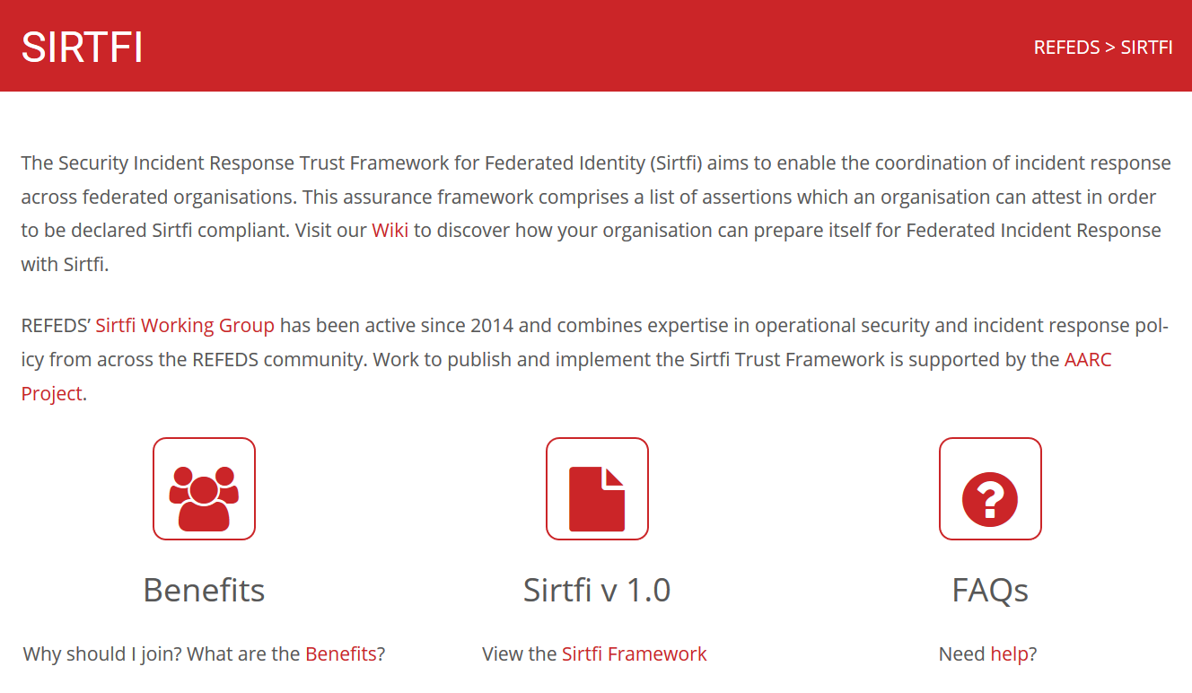
Sirtfi and R&S – policy needs for trust in identity providers and federations
REFEDS and federation focused FAQ
Definition of the global Security Contact
meta-data profile for use in eduGAIN
Namespace for Sirtfi Assurance at IANA
Used in cyber ops roleplay exercises
Promoted at I2TechX,
FIM4R, Kantara, and TF-CSIRT
Ingredient to the ‘CILogon pilot’
combination of
REFEDS “Research and Scholarship”
and
Sirfti v1.0
meets assurance requirements for RIs and EIs according to the IGTF “assured identifier trust”
https://refeds.org/SIRTFI
✓
Apr 17th 160 eduGAIN entities
that support Sirtfi

Slide 14
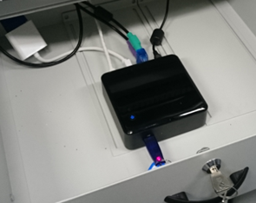
Where are we now?
Several master portal instances deployed for EGI and ELIXIR (all managed by Nikhef for now)
A ‘production demonstrator’ instance of the TTS set up in conceptually the ‘right way’:
  Dedicated secure environment, FIPS 140 level 3 approved HSM, anchored in a stable way
  Policy and practices accredited under ‘unique-identifier’ profile at the IGTF
  –good enough for some infrastuctures, and within EGI in combination with vetted & managed communities
  Scalable negotiation model based on Sirtfi and REFEDS R&S section 6
  Model requirements on attached MPs defined (for key protection)
  Trust anchors in production (RCauth.eu is part of the ‘EGI-CAM’ package)
But it’s a production demonstrator, not production,
without an SLA, and with limited capacity
… and it’s a bit a ‘Heath Robinson’ service, using
mostly pre-available hardware

Slide 15







Potential RCauth.eu management model
shared governance through a
Policy Management Authority
non-discriminatory policy and practices
joint PMA authoritative
for policy and operations
Stakeholders
EGI, EUDAT, SURF,
GÉANT, ELIXIR, …
in-kind or explicit contributions
of services, kit, and operators
trust by any and all
global relying parties
Infrastructure-specific Master Portals
and Credential Repository
user contact service by
specific stakeholder

Slide 16
Costing the services
Highly depends!
What is ‘the service’? Delegation Service & WAYF? Master Portals?
Can be anywhere between a few kEur to well over 100+kEur cost per year …
The EOSC Hub Consortium picked a middle ground, proposing to contribute effort and some hardware resources to the joint pan-European pool, and help steer the development
Recuperation model appears to converge
Master Portals (Credential Management) on a per-Infrastructure basis, from own funding
Delegation Service/RCauth.eu: free at point of use
Funded via in-kind contributions by the major e-Infrastructures
Distributed H/A setup, leveraging existing capabilities and some additional person effort

Slide 17
References
https://wiki.geant.org/display/AARC/Models+for+the+CILogon-like+TTS+Pilot
https://www.rcauth.eu/
https://rcdemo.nikhef.nl/

Slide 18
davidg@nikhef.nl

