Slide 1
Policy and Best Practice Harmonisation (‘NA3’)
from the present to the future
David Groep
NA3 activity coordinator
Nikhef
AARC2 Kick-Off meeting
6 – 8 June, 2017
Bad Herrenalb, Baden Württemberg, DE

Slide 2
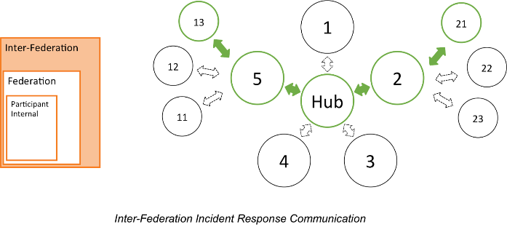
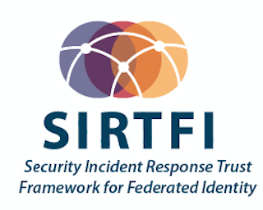
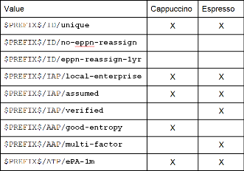
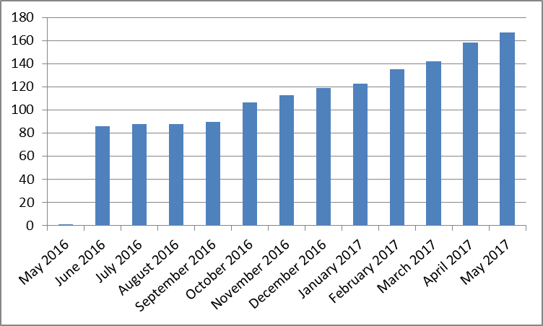



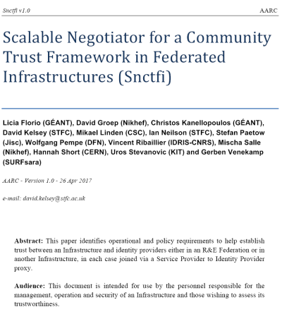
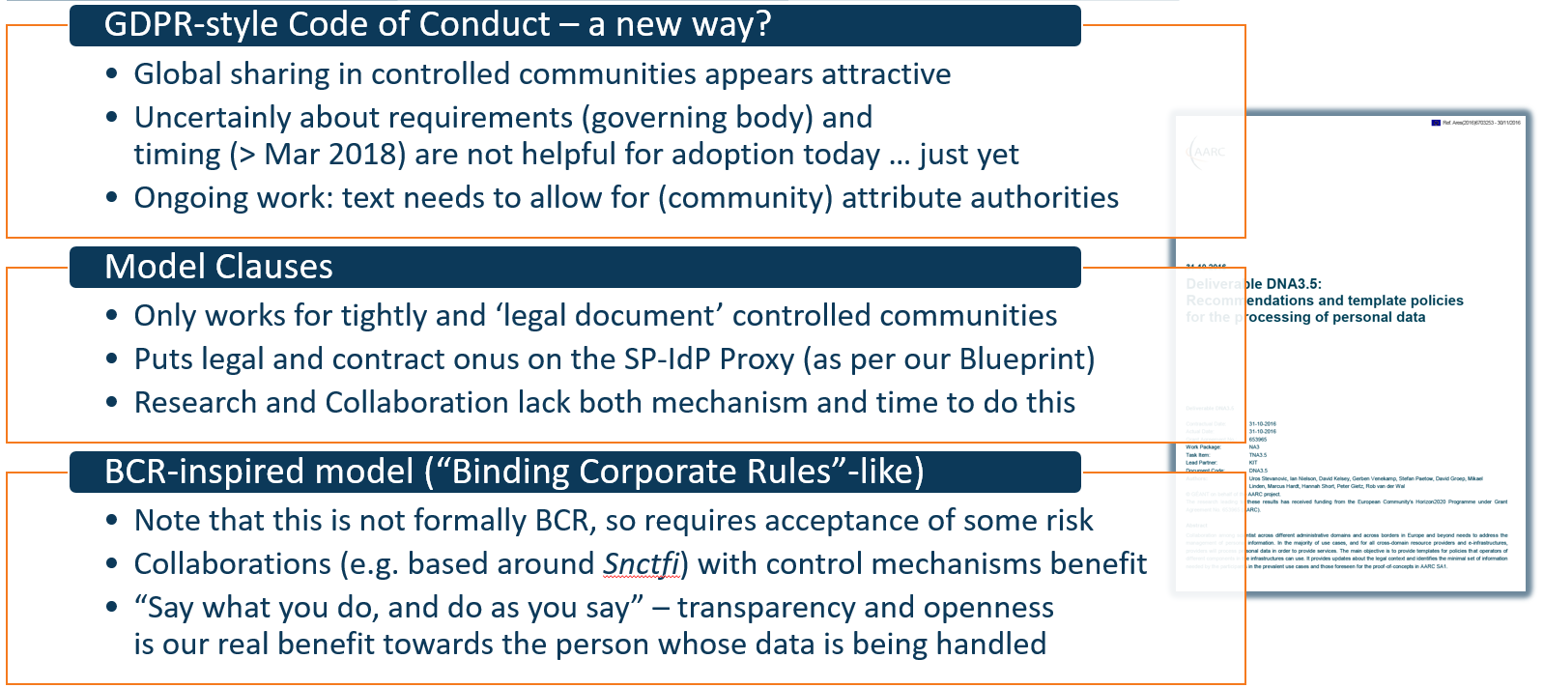
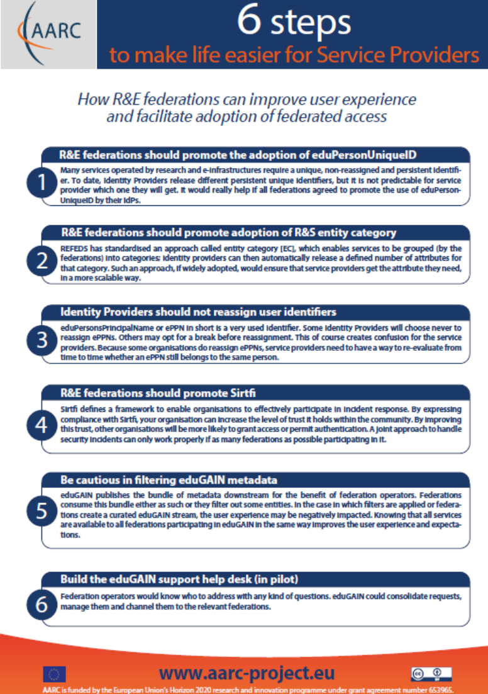






From ‘the past’ …
Assurance
protection of sensitive
resources
access to data of real people, where positive ID of researchers and 2-factor authentication is needed
Operational Security
‘low-risk’ use cases
few unalienable expectations by research and collaborative services
generic
e-Infrastructure services
access to common compute and data services that do not hold sensitive personal data
bulk
model
167 entities
Baseline Assurance
known individual
Persistent identifiers
Documented vetting
Password authenticator
Fresh status attribute
Self-assessment
Slice includes:
assumed ID vetting
‘Kantara LoA2’, ‘eIDAS low’, or ‘IGTF BIRCH’
Good entropy passwords
Affiliation freshness
better than 1 month
Slice includes:
Verified ID vetting
‘eIDAS substantial’, ‘Kantara LoA3’
Multi-factor authenticator
Sustainable Recommendations
Scalable Trust
Global sharing of
user accounting data
shared governance through a
Policy Management Authority
non-discriminatory policy and practices
joint PMA authoritative
for policy and operations
Stakeholders
EGI, EUDAT, SURF,
GÉANT, ELIXIR, …
in-kind or explicit contributions
of services, kit, and operators
trust by any and all
global relying parties
Infrastructure-specific Master Portals
and Credential Repository
user contact service by
specific stakeholder

Slide 3
Yet what did we do it for?
✓
Provide an assurance framework meeting to make federated identities more valuable for research and e-Infrastructures yet is feasible to implement by most home IdPs
✓
Expose existing security capabilities in federated organisations, and organise the flow of information through Sirtfi contact details and a tiered coordination function
✓
Recommendations for federations to make life easier for collaboration, and
better models for sustainability for ‘guest’ identities and services in infrastructures
✓
Make it easier for communities to use federation by organizing in groups, and
support the SP-IdP Proxies build a consistent view of their services with the Snctfi scheme
✓
Propose practical models to allow infrastructures to exchange per-user accounting data, globally and across organisations that limits compliance risks for personal data protection

Slide 4

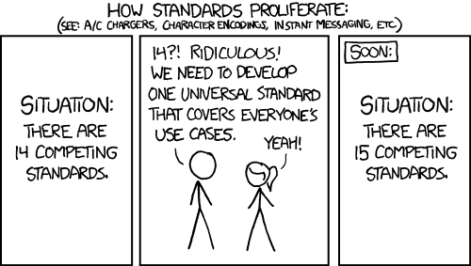

Mechanisms for ensuring policies & practices serve the community
✓
Use pre-existing groups and communities to develop policies and harmonise practices
and thus avoid AARC becoming yet another island
https://xkcd.com/927/

Slide 5
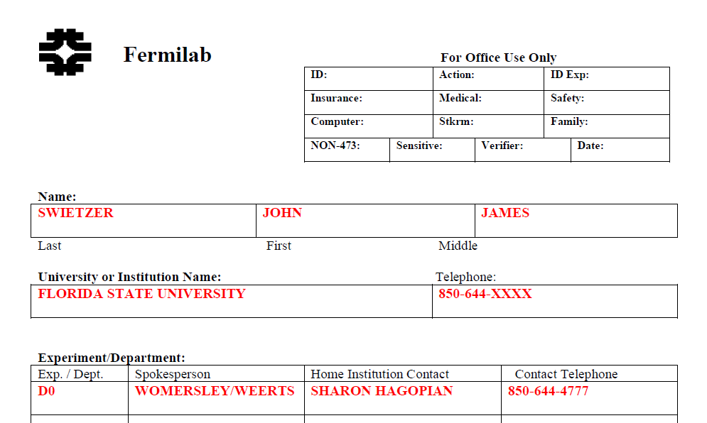
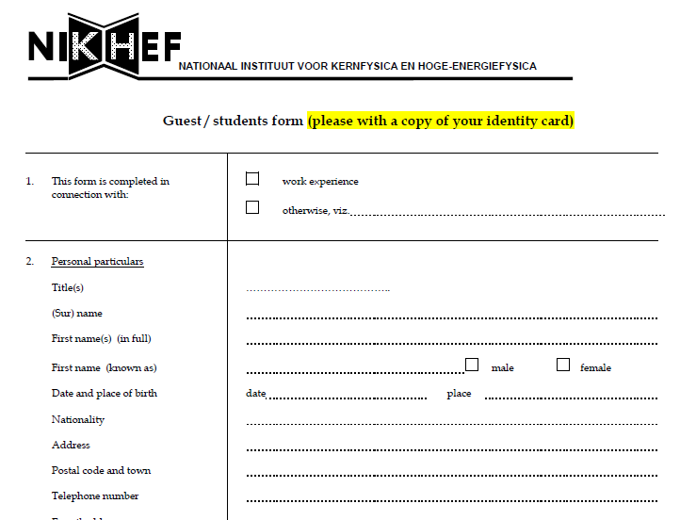
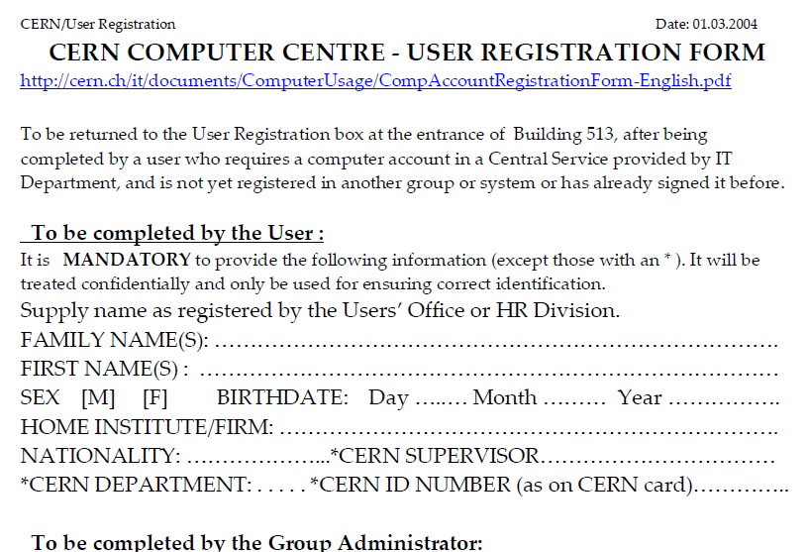
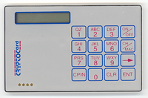
Policy and Best Practices Harmonisation
Development of best practices for Assurance Profiles

Slide 6
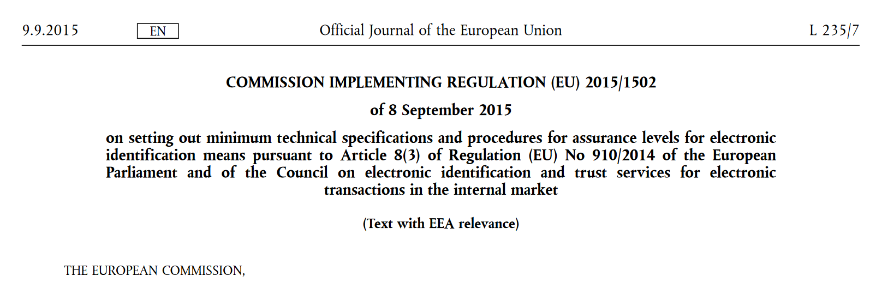
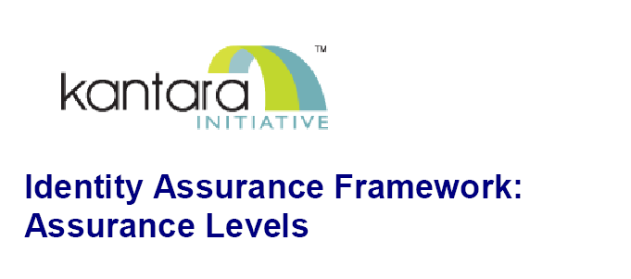
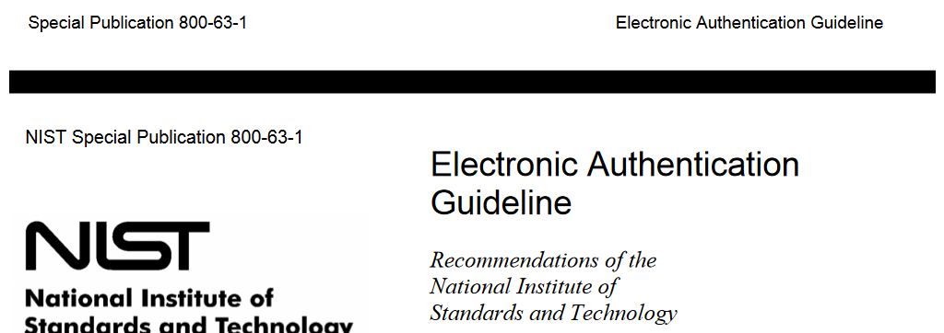
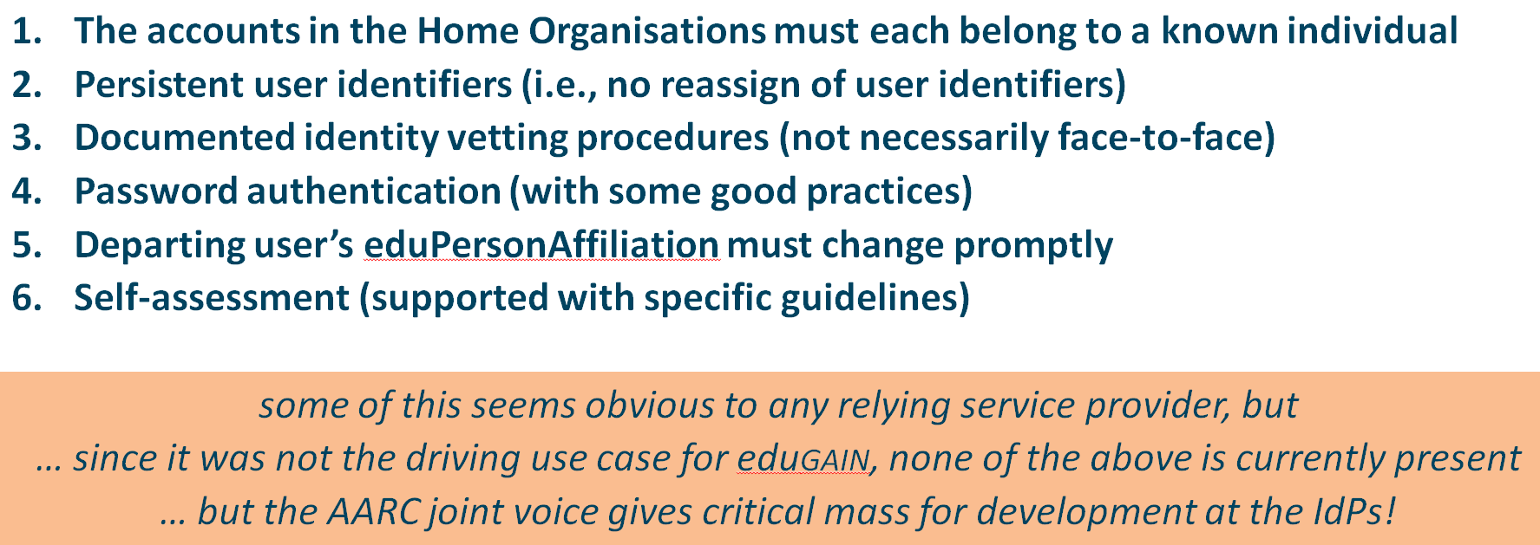
Assurance Profiles and ‘differentiated’ levels of assurance
Many layered models (3-4 layers)
but: specific levels don’t match needs
of Research- and e-Infrastructures:
Specific combination
‘authenticator’ and ‘vetting’ assurance
doesn’t match research risk profiles
Disregards existing trust model
between federated R&E organisations
Cannot accommodate
distributed responsibilities
As a result, in R&E there was
in practice hardly any documented
and agreed assurance level
Last year:
baseline assurance for research use cases

Slide 7



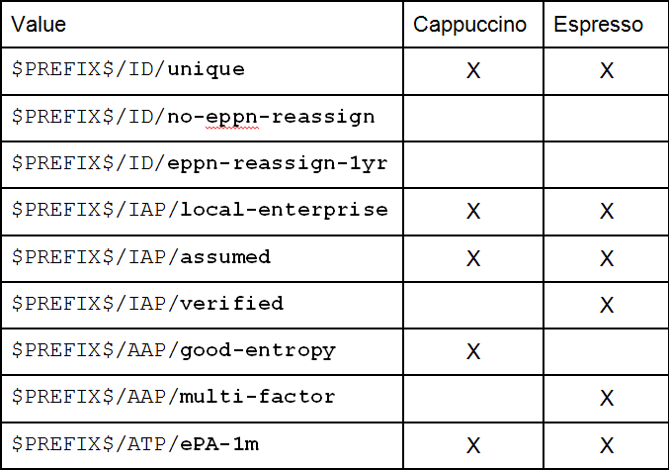
Differentiated assurance from an Infrastructure viewpoint
‘low-risk’ use cases
few unalienable expectations by research and collaborative services
generic
e-Infrastructure services
access to common compute and data services that do not hold sensitive personal data
protection of sensitive
resources
access to data of real people, where positive ID of researchers and 2-factor authentication is needed
Baseline Assurance
known individual
persistent identifiers
documented vetting
password authenticator
fresh status attribute
self-assessment
Slice includes:
assumed ID vetting
‘Kantara LoA2’, ‘eIDAS low’, or ‘IGTF BIRCH’
good entropy passwords
affiliation freshness
better than 1 month
Slice includes:
verified ID vetting
‘eIDAS substantial’, ‘Kantara LoA3’
multi-factor authenticator
Mikael Linden’s work with the REFEDS Assurance WG, see also
https://refeds.org/meetings/35th-meeting-may-2017

Slide 8



REFEDS Assurance
Framework
REFEDS meeting 29 May 2017 Mikael Linden, REFEDS assurance wg chair
mikael.linden@csc.fi

Slide 9


REFEDS assurance working group
In 6/2016 REFEDS established the Assurance working group
  Open to anyone to participate
  Take AARC recommendation as input and extend it to a specification
  International – participants from Europe&US
  Cross-community – participants from federations & research communities
REFEDS Assurance Framework 1.0 draft
https://wiki.refeds.org/x/JwBYAQ
Exposed to a public consultation until 9th June 2017

Slide 10
REFEDS assurance fw: four dimensions of LoA
Identifiers ID proofing Authentication Attributes
ID is unique, personal and traceable
Good enough for institution’s local systems
Accurate and fresh affiliation information
Good entropy passwords
ePPN is unique, personal and traceable
Assumed
(e.g. postal credential delivery)
Multi-factor authentication
Verified
(e.g. F2F)

Slide 11
”Cappuccino” profile for low risk use cases
Identifiers ID proofing Authentication Attributes
ID is unique, personal and traceable
Good enough for institution’s local systems
Accurate and fresh affiliation information
Good entropy passwords
ePPN is unique, personal and traceable
Assumed
(e.g. postal credential delivery)
Multi-factor authentication
Verified
(e.g. F2F)

Slide 12
”Espresso” profile for demanding use cases
Identifiers ID proofing Authentication Attributes
ID is unique, personal and traceable
Good enough for institution’s local systems
Accurate and fresh affiliation information
Good entropy passwords
ePPN is unique, personal and traceable
Assumed
(e.g. postal credential delivery)
Multi-factor authentication
Verified
(e.g. F2F)

Slide 13
Representing the assurance profile on SAML 2.0
Value | eduPersonAssur ance | Authentication ContextClassR ef | Metadata entity attribute
$PREFIX$ |  |  | X
$PREFIX$/ID/unique | X
$PREFIX$/ID/no-eppn-reassign | X
$PREFIX$/ID/eppn-reassign-1y | X
$PREFIX$/IAP/local-enterprise | X
$PREFIX$/IAP/assumed | X
$PREFIX$/IAP/verified | X
$PREFIX$/AAP/good-entropy |  | X
https://refeds.org/profile/mfa |  | X
$PREFIX$/ATP/ePA-1m | X
$PREFIX$/profile/cappuccino | X |  | X
$PREFIX$/profile/espresso | X |  | X
6

Slide 14
Public consultation
REFEDS Assurance Framework 1.0 draft
https://wiki.refeds.org/x/JwBYAQ
Exposed to a public consultation until 9th June 2017
For more information
See the REFEDS assurance framework infoshare 24 May: goo.gl/HFNyXd

Slide 15
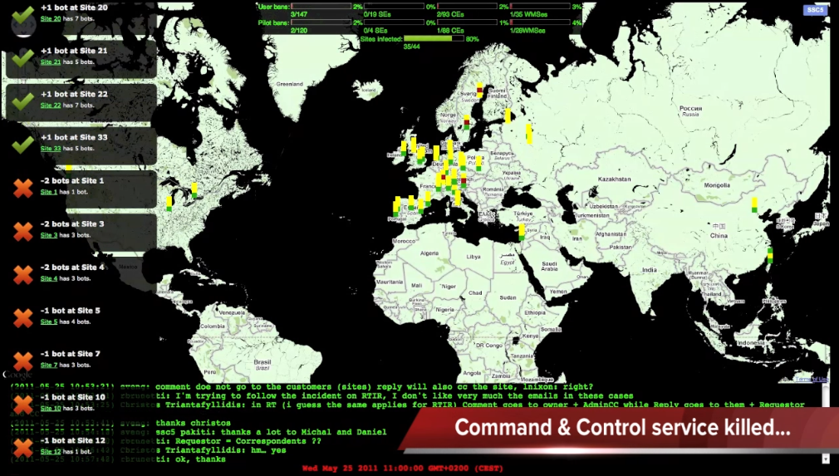
Policy and Best Practices Harmonisation
Security Incident Response

Slide 16
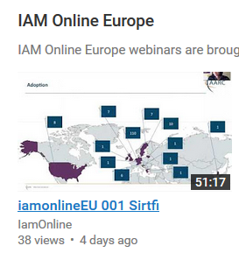
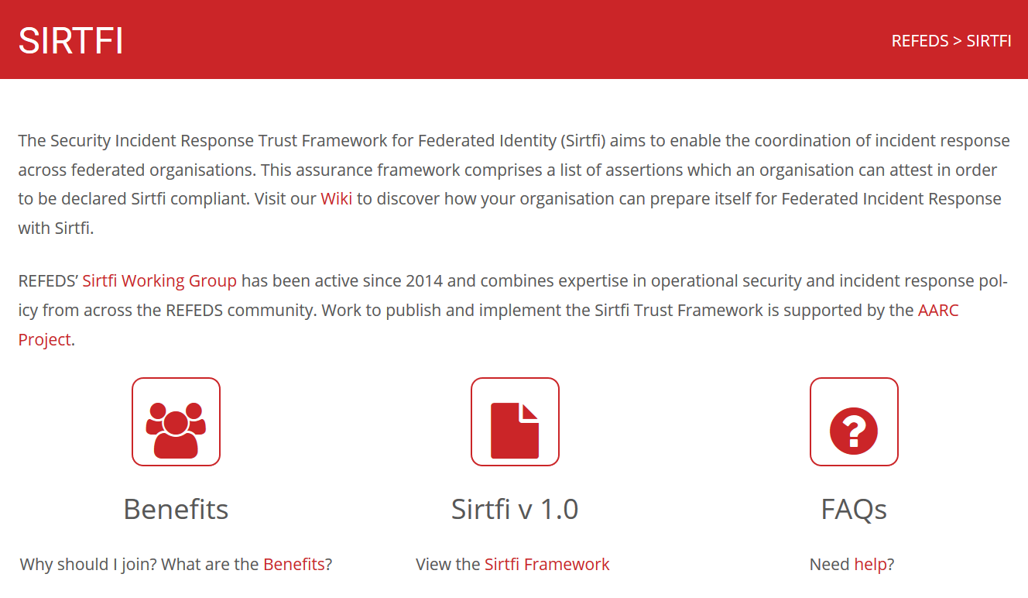
Sirtfi - supporting our federated respons to security incidents
https://refeds.org/SIRTFI
Security Incident Response Trust Framework for Federated Identity
You cannot have missed it …
… even used in CyberOps role play exercises
167 entities
bulk
model
Adds security contact meta-data in eduGAIN
namespace for Sirtfi Assurance at IANA
with R&S specification:
meets baseline assurance requirements
and IGTF “assured identifier trust”

Slide 17
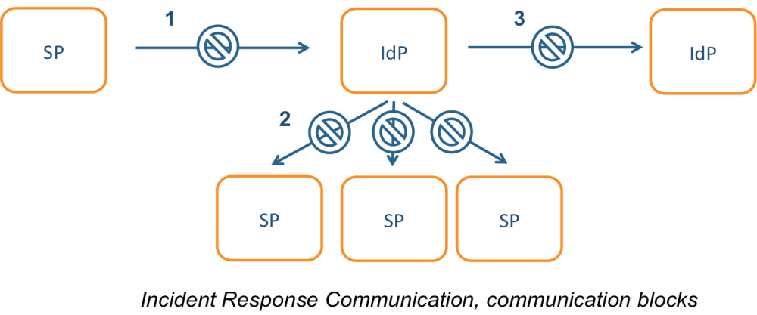

Incident response process evolution in federations
Solution
Stronger role for federation operators, as
they are known to both SPs and IdPs
Add hub capability centrally (@ eduGAIN)
Challenges
IdP appears outside the service’
security mandate
Lack of contact, or lack of trust
in IdP which is an unknown party
IdP fails to inform other affected
SPs, for fear of leaking data or reputation
No established channels of communication

Slide 18
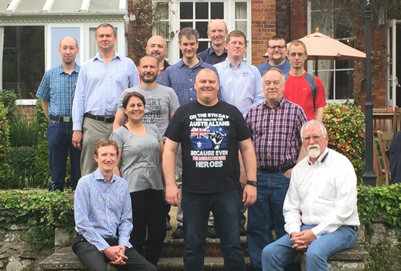
Policy and Best Practices Harmonisation
Development of scalable policy negotiation mechanisms

Slide 19
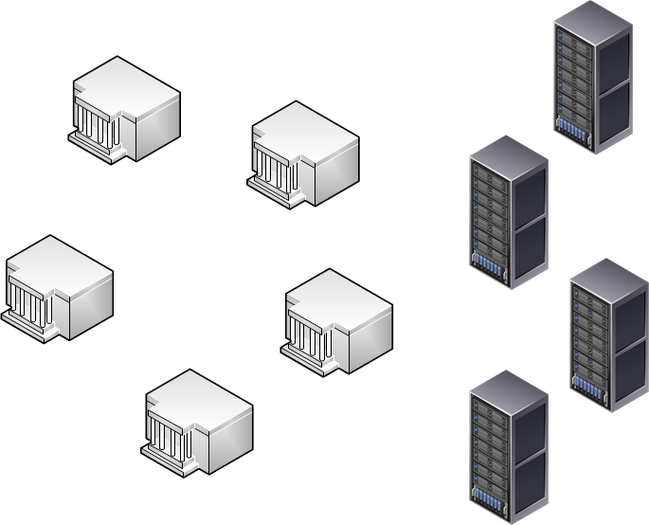
Getting agreements in a distributed world: scalable policy mechanisms
Group entities to ease agreements with federations
Collaborations by design have their services distributed
and
not that many collaborations are a legal entity
or are not ‘authoritative’ for constituent services
Aim: improve attribute release by IdPs & Federations
Entity Category mechanism: ‘R&S’, DP CoCo, Sirtfi, …
Define trust framework for Infrastructures – SPs-to-IdPs
Framework for Infrastructures to assess back-end SPs
Permit Gateway to assert entity categories with confidence
Readiness survey for services evaluated with HNSciCloud PCP
‘n x m’
IdP
Home
Institute
SP
Collaborative
Resource
or SIte
Develop policies models for SP-IdP Proxy – IdPs to SPs
Model for service providers that ‘hide’ complexity of all R&E
Through concrete (RCauth.eu) use case & with global review

Slide 20

Snctfi: aiding Infrastructures achieve policy coherency
✓
allow SPIdP Proxies to assert ‘qualities’, categories, based on assessable trust
✓
Develop recommendations for an Infrastructure’s coherent policy set
Snctfi
Scalable Negotiator for a Community Trust Framework in Federated Infrastructures
Derived from SCI, the framework on Security for Collaboration among Infrastructures
Complements Sirtfi with requirements on internal consistent policy sets for Infrastructures
Aids Infrastructures to assert existing categories to IdPs
REFEDS R&S, Sirtfi, DPCoCo, …
Graphics inset: Ann Harding and Lukas Hammerle, GEANT and SWITCH

Slide 21
Snctfi infrastructure requirements, a summary
Operational Security
User Responsibilities
Protection and Processing of Personal Data
State common security requirements: AAI, security, incident and vulnerability handling
Awareness: users and communities need to know there are policies
Have a data protection policy that binds the infrastructure together, e.g. AARCs recommendations or DP CoCo
Ensure constituents comply: through MoUs, SLA, OLA, policies, or even contracts, &c
Have an AUP covering the usual
Community registration and membership should be managed
Have a way of identifying both individuals and communities
Define the common aims and purposes (that really helps for data protection …)
Make sure every ‘back-end’ provider has a visible and accessible Privacy Policy

Slide 22
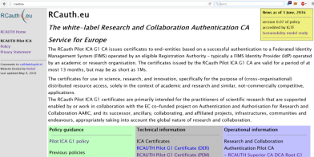
Model scalable policies for SP-IdP Proxies – the RCauth.eu example
How can a SP-IdP proxy leverage federation policies?
What are useful design criteria for a scalable service?
Focus on permitting individual access, engaging both federations and Infrastructures
Avoid an opt-in model, or a scheme where specific countries can opt-out or block access
Allow infrastructures explicitly to operate an IdP of last resort, and recognise its qualities
Meet your (target) infrastructure needs
For cross-infrastructure services, peer review and accreditation significantly helps adoption
Leverage entity categories and assurance profiles
Don’t ask IdPs to do something special just for your gateway
Be ready to deal with a complex, multi-national, and multi-federation reality
Incidental non-compliance needs to be mitigated in your service – use Sirtfi & eduGAIN support

Slide 23
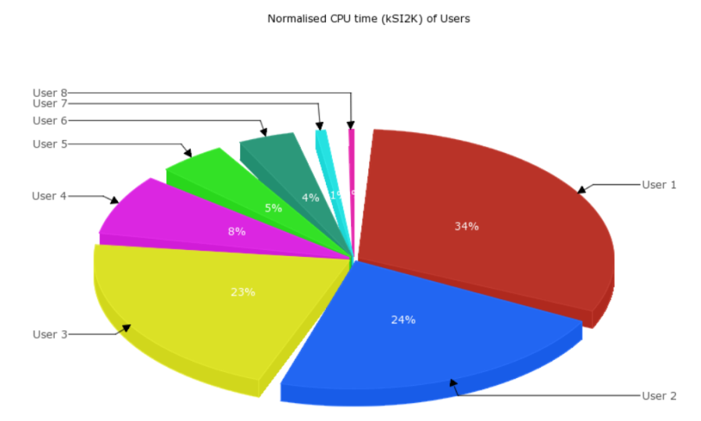
Policy and Best Practices Harmonisation
Accounting and the processing of data

Slide 24
Scope of the AARC Accounting and Processing of Data task
Protection of personal data in research data
User attribute release by federated organisations
Personal data processing in accounting & collaboration
patient records
survey data collation
big data analytics
research data combination
Research Infrastructures
Institutional
Ethical Committees
ESFRI Cluster Projects
institutional IdP attributes
GEANT DP CoCo*
minimal release in eduGAIN
REFEDS
Research & Scholarship
REFEDS, GEANT4
community management
Joint RIs, EIs and AARC work
collection of usage data
in RIs and e-Infrastructures
correlating resource usage
to people and groups
collate usage data across countries and continents
personal data used for incident response
AARC (1)’s work
* GEANT Data Protection Code of Conduct – see
http://geant3plus.archive.geant.net//uri/dataprotection-code-of-conduct/v1/Pages/default.aspx

Slide 25
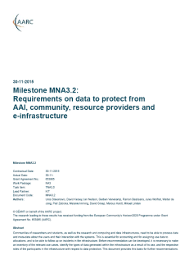
Identified needs and structure – identify need and the parties involved
Data collection necessary for ‘legitimate interests’ for Research and e-Infra
Justification of global resource use, with infrastructures collecting data collaboratively
Operational purposes: fault finding, researcher support, Incident response
Global view needed for accounting data
Policy coherency as enabler – model policies
Security Incident Response – data exchange
exchange of personal data is imperative – both for EIs and Research Collaboration funding
put in place policies on retention, permissible use, secure exchange, purpose limitation
add as permissible purpose, but leave its scope to Sirtfi and existing forums
‘binding’ - in the sense that a party can only remain in the club if it’s compliant
policy suite identified by Security for Collaborating Infrastructures (SCI) group
roles are defined to limit access to personally identifiable data

Slide 26
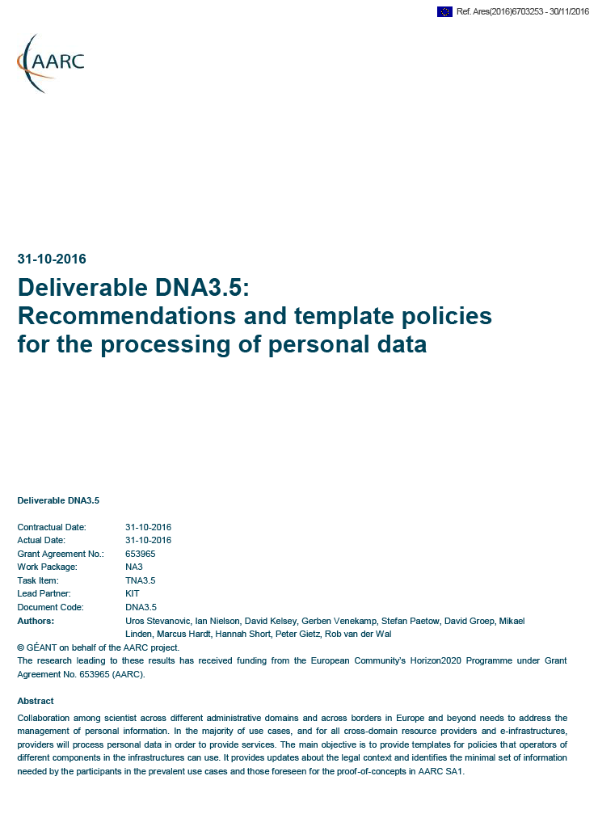
Three community models – three Recommendations?
GDPR-style Code of Conduct – a new way?
Model Clauses
BCR-inspired model (“Binding Corporate Rules”-like)
Global sharing in controlled communities appears attractive
Only works for tightly and ‘legal document’ controlled communities
Note that this is not formally BCR, so requires acceptance of some risk
Uncertainly about requirements (governing body) and
timing (> Mar 2018) are not helpful for adoption today … just yet
Ongoing work: text needs to allow for (community) attribute authorities
Puts legal and contract onus on the SP-IdP Proxy (as per our Blueprint)
Research and Collaboration lack both mechanism and time to do this
Collaborations (e.g. based around Snctfi) with control mechanisms benefit
“Say what you do, and do as you say” – transparency and openness
is our real benefit towards the person whose data is being handled

Slide 27
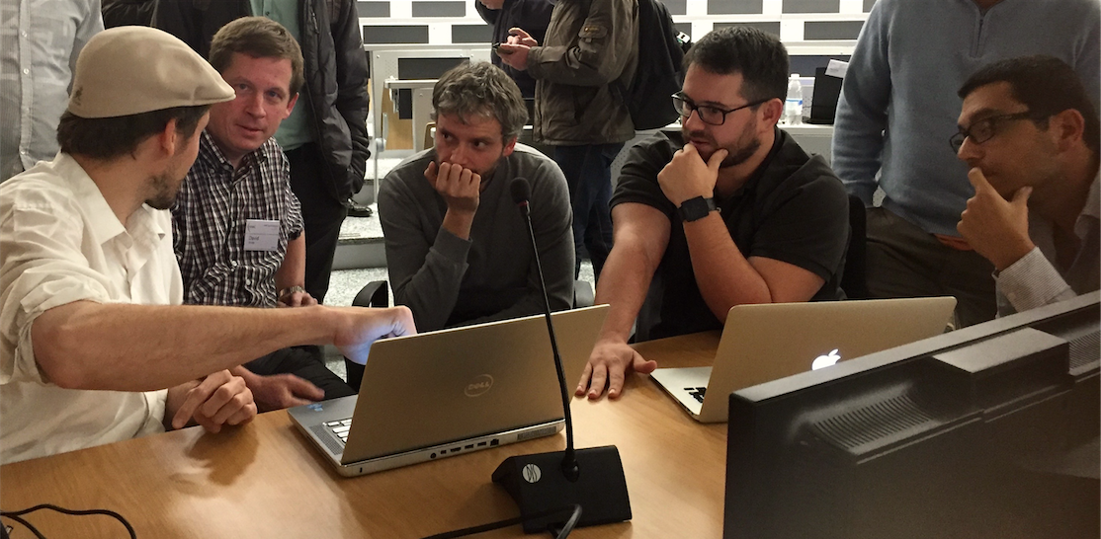
Policy and Best Practices Harmonisation
Recommendation for sustainable services and models

Slide 28
Recommendations for
Research and e-Infrastructures to Build Sustainable Services
‘Investigate terms of (AAI) usage for delivering services’
˃
Making services sustainable – beyond funding cycles and across domains
Guidelines, templates, and how to apply them to the AARC pilots
˃
Mitigating heterogeneity in Infrastructure and Federation policies and practices
Recommendations for future federation development in line with FIM4R
˃
Identity providers ‘of last resort’, by the Infrastructure or the community
Strategies and risks in staring a guest identity provider

Slide 29
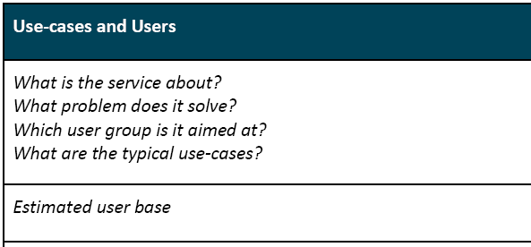
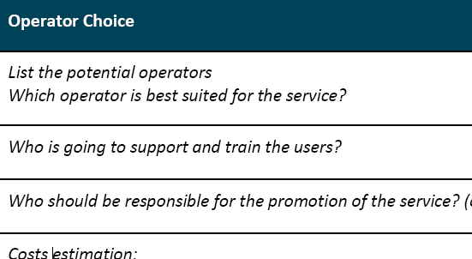
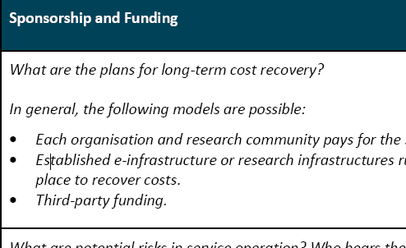
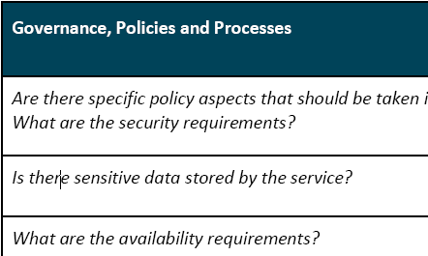
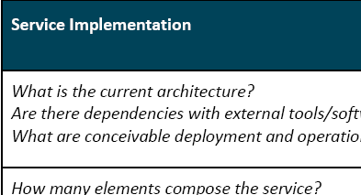
Promoting sustainability through recommended templates
Common analysis
Initial focus usually on ‘use cases’ and ‘service implementation’
this misses the long-term sustainability
Only few pilots have yet addressed full set
Template approach encourages focus ☺
AARC SA1 Pilots with a sustainability plan
RCauth.eu*
DARIAH Guest IdP
Social IDs to SAML
WaTTS

Slide 30
Collect Recommendations in one place – for Infrastructures & Federations
For Research and generic e-Infrastructures
Following the AARC BluePrint and the intent of the FIM4R group – make it easier for users
Support GEANT DP CoCo when possible + R&S – ease the liability on IdPs to give you data
Joint Sirtfi – and help the R&E security stance
Apply homogeneous policy mapping frameworks inside your Infrastructure: ‘Snctfi’!
For Federations, REFEDS, and eduGAIN
Support an omnidirectional, non-reassigned ID for users that is standard everywhere
Don’t filter authentication to only services you know about: allow meta-data to flow
Support attribute release through R&S, and collaborate in Sirtfi
Help eduGAIN operate a support desk to help international research and collaboration
Recommendations go to REFEDS, eduGAIN – and the Infrastructures through FIM4R & IGTF

Slide 31
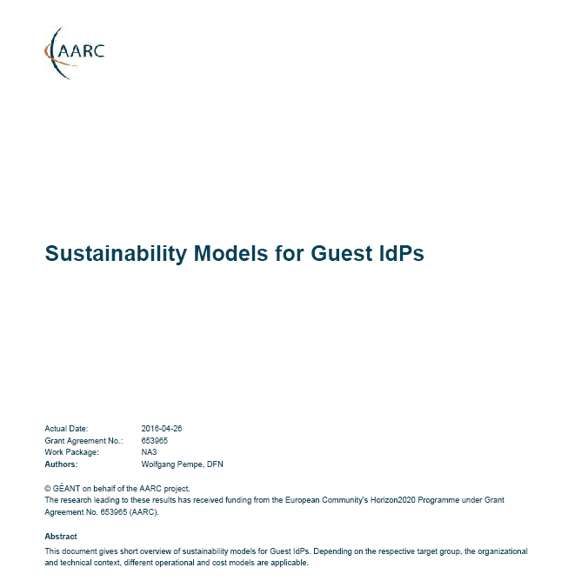
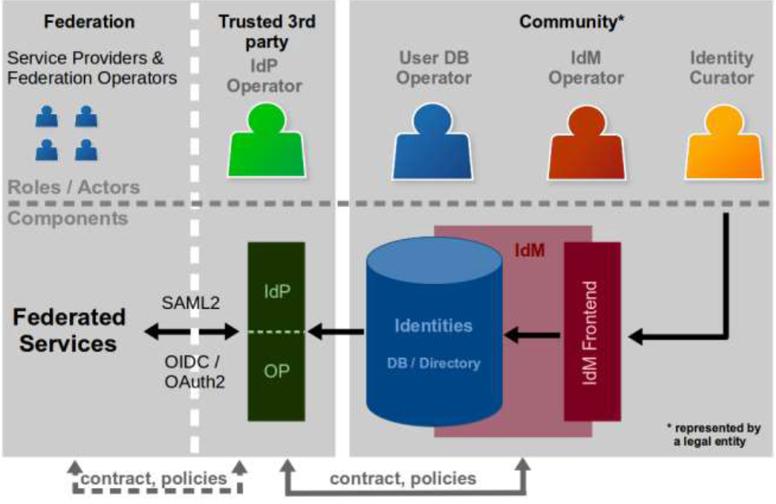
Models for ‘guest’ IdPs – serving users beyond academia
Guest IdPs are critical to almost all collaboration use cases
Collaboration does not end at the door of the university!
Model study: too often ‘guest’ IdPs have faded –
sustainable elements extracted:
Use established, long-lived, institutional partners
Ensure funding beyond projects
Framework needed for ‘non-trivial’ communities
As collaboration moves to meeting at least baseline assurance, cheap-and-cheerful guest IdPs will fail
https://wiki.geant.org/display/AARC/Sustainability+models+for+Guest+IdPs

Slide 32
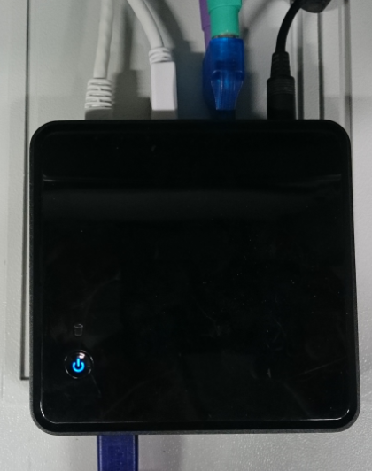
Policy and Best Practices Harmonisation
Pulling it all together

Slide 33
So where are we now?
Bridged need for specific guidance and actionable assurance with infrastructure-driven profiles
Developed via REFEDS to get global adoption and federation acceptance
Sirtfi approved and rapidly implemented: strong growth in eduGAIN with already 167 entities
Practical process for addressing global incidents, in close collaboration with eduGAIN Support
Concrete recommendations for Infrastructures and Federation to drive FIM4R and eduGAIN
Ensure the result will live: sustainability templates lead to successful long-lived services
Snctfi aids Infrastructures presenting coherent qualities towards federations with confidence
Accounting Data Protection recommendations help Infrastructures provide services jointly

Slide 34
We want AARC t[wo]o!
Moving on from here …

Slide 35
… yet there’s a lot to do still!
Operational Security and Incident Response
Security capabilities and response for community attribute authorities and services
Promote trust groups and reference templates and models to be used throughout eduGAIN
Service-centric policies
Harmonize traceability, accounting, and attribute policies in infrastructures based on SCI model
Explore GDPR and CoCo models for sharing necessary information, and meet policy needs for SP-IdP Proxies, repositories and translators
e-Researcher-Centric Policies
Aligning AUPs and assurance profiles to ease cross-infrastructure sharing beyond the silo
Align models for community attribute management & provisioning (e.g. ease risk assessment)
Policy Development Engagement and Coordination
Work with the communities to promote alignment across research and generic Infrastructures

Slide 36
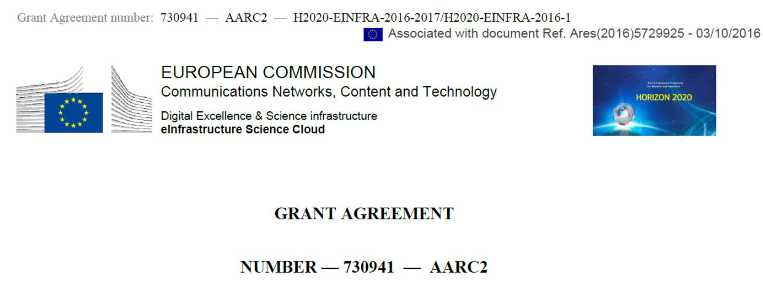
Our high-level (programme) objectives
Development of a pan-European identity federation, interoperable at global level
Leverage eduGAIN plus Infrastructures – using global mechanisms (WISE, IGTF, FIM4R, REFEDS)
Stimulate … to manage and share their resources
Ease movement of users and data across infrastructures
that’s why we want to align best practices across so many domains
Deliver an integrated identity management infrastructure
that responds to cybersecurity and community assurance requirements.
Getting the Assurance Profiles deployed, esp. the ones needed by new research use cases
Security incident response, through trust groups, WISE, and REFEDS
User-driven design and prototyping
Practices must apply beyond just the project, we need wide consultation

Slide 37
Operational Security – we’re all in it together!
In the past 2 years, we managed to address
security coordination for the federations, IdPs,
and the e-Infrastructure collective services …
… but everyone needs to be involved, globally!
✓
User Attribute Service operations security
Integrity and trust for the SP-IdP-Proxies
Link security hubs (eduGAIN Support Desk,
eInfra CSIRTs) to community capabilities
✓
Promote trust groups and their expansion
to effectively cover the eduGAIN network
Define reference templates on how
incident notifications should be conveyed
Encourage endorsement by
global standards bodies and communities
✓

Slide 38
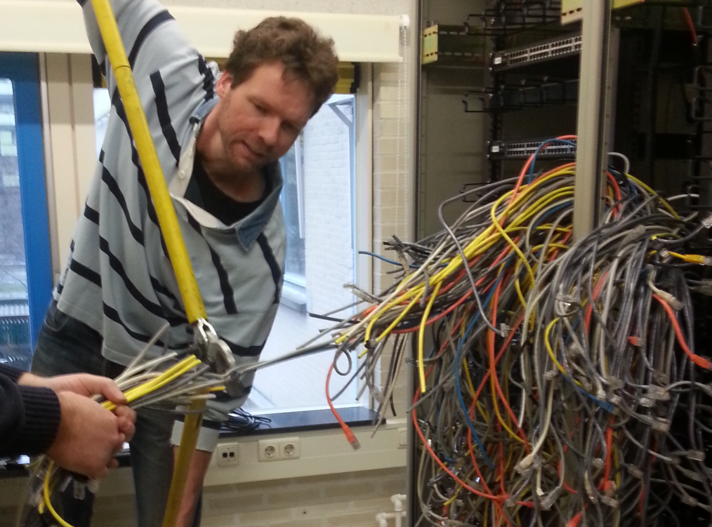
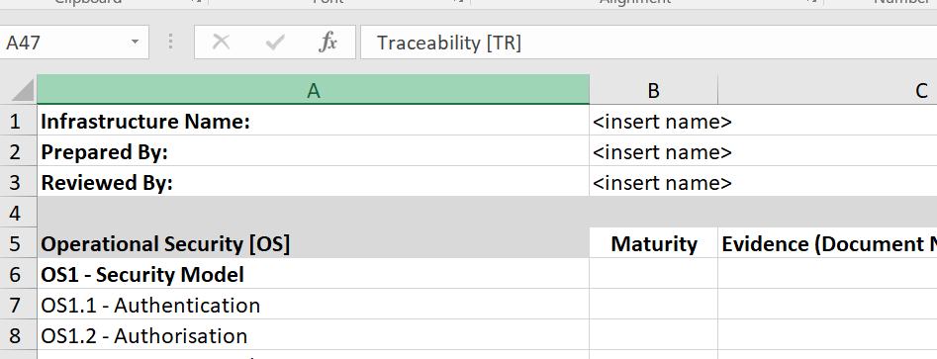
Helping out the providers – with service-centric harmonisation
˃
Traceability and accounting policy framework
Compare models for comparing and considering equivalency of policies
for traceability, accounting aggregation, and registration records retention in interfederation
˃
Explore the GDPR (2018) options for sharing of data on, and for, infrastructure usage
Infrastructures need to share data, globally, but a scalable model will be community dependent
˃
Recommendations for Blueprint Architecture Elements
Create the reference templates for SP-IdP-proxies, gateways, targeted credential repositories, &c

Slide 39
Ease the flow across infrastructures – targeting users & communities!
˃
Identify and support commonality between acceptable use policies (AUPs)
So that a user that signed one of them need not be bothered again – and still move across silos
Remember the Taipei Accord: WLCG, EGI, PRACE, OSG, XSEDE share an understanding
and accept each other’s AUP as sufficient
˃
Enhance the Authentication Assurance Profiles
Get the new Profiles accepted and deployed for all target groups
Authenticating for access to biomedical and human-related data
Implementing verified identity vetting in the GDPR era
Making the baseline a real baseline, and Cappuccino a common occurrence
˃
Define a model for community attribute management and provisioning
Reference practices for communities setting up their membership and attribute services
So that the community is always in control, and the services can rely on that

Slide 40
Engagement and global alignment
Develop
Adopt
Through
WISE and SCI
REFEDS
IGTF
(FIM4R)
… and all willing policy & CSIRT groups
In your Infrastructure, Federation, and FIM4R
Persistent, non-reassigned identifiers
Incident Response capabilities & Sirtfi NG
Snctfi
Trusted Credential Mngt & Attribute Authy Ops
Self-assessment and peer review methods
AARC ‘Competence Centre’
work with us by collaborating in these groups
AARC Engagement
help us progress by adopting results

Slide 41
Meanwhile, we do have to produce these reports as well
2 (phased) reports on service-centric practices
DNA3.1 - Report on the coordination of accounting data sharing amongst Infrastructures (initial phase) - (M12)
DNA3.3 –Accounting and Traceability in Multi-Domain Service Provider Environments (M23)
Security incident response
DNA3.2 – Report on Security Incident Response and Cybersecurity in Federated Authentication Scenarios (M22)
Assurance and researcher-centric policies
DNA3.4 – Recommendations for e-Researcher-Centric Policies and Assurance (M24)

Slide 42

Obligatory Lord Kitchener Poster
Substantial discussions on
wise@lists.wise-community.org
sciv2-wg@lists.wise-community.org
igtf-general@igtf.net
sirtfi@lists.refeds.org
assurance@lists.refeds.org
refeds@lists.refeds.org
federatedIdentity-members@cern.ch
fim4r-editors@cern.ch
Project deliverables welcome on
aarc-na3@geant.org

Slide 43
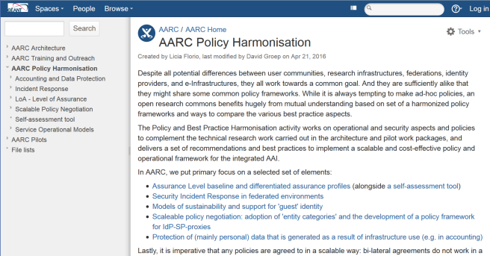
https://aarc-project.eu/workpackages/policy-harmonisation/
https://wiki.geant.org/display/AARC/AARC+Policy+Harmonisation
davidg@nikhef.nl

