Slide 1
Policy and Best Practices … the Story So Far
David Groep
P&BP activity lead
Nikhef, Amsterdam
AARC All Hands meeting Geneva
2016-11-29

Slide 2
Solving the Policy Puzzle
Pushing forward best practices and like policies across many participants
  “Levels of Assurance” – baseline and differentiated profiles, capabilities and grouping
  “Incident Response” – beyond Sirtfi: a common understanding on operational security
  “Sustainability, Guest IdPs, use models” – how can a service be offered in the long run?
  “Scalable policy negotiation” – helping SPs move beyond bilateral discussion
  “Protection of (accounting) data privacy” – necessary aggregation without breaking
  the law too much
Strategy
to support and extend established and emergent groups
leverage their support base - and ‘multiply’ the effect of policy work from AARC
IGTF
FIM4R
REFEDS
WISE
GN4
AARC
. . .
SIRTFI

Slide 3
Baseline Assurance Profile – a widely supported set of qualities
Minimum baseline is targeted to concrete use cases from currently running infrastructures
The accounts in the Home Organisations must each belong to a known individual
Persistent user identifiers (i.e., no reassign of user identifiers)
Documented identity vetting procedures (not necessarily face-to-face)
Password authentication (with some good practices)
Departing user’s eduPersonAffiliation must change promptly
Self-assessment (supported with specific guidelines)
some of this seems obvious to any relying service provider, but
… since it was not the driving use case for current (inter)fed it is not ‘implicit’,
and needs specific work on identifying authorities and eligible entities …

Slide 4
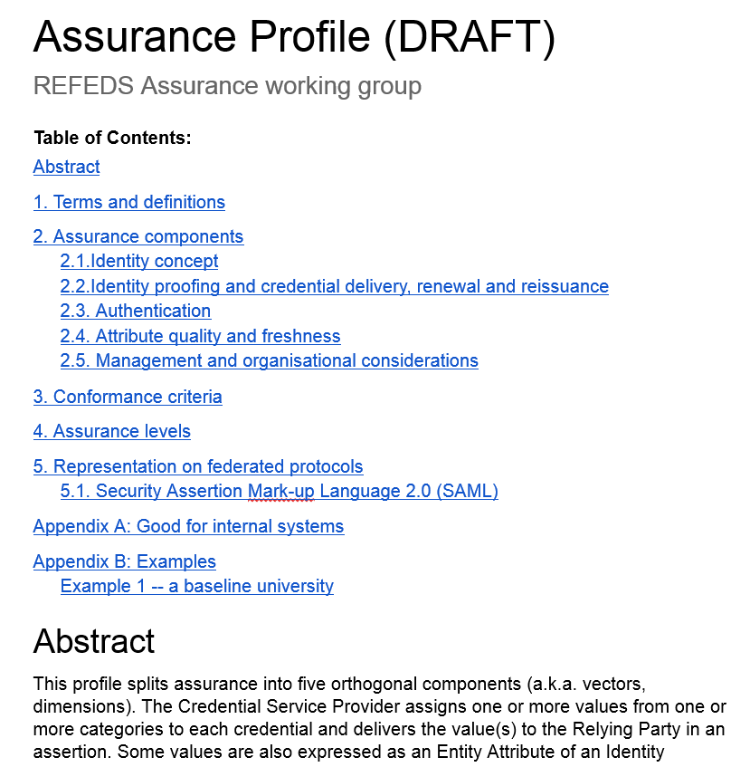
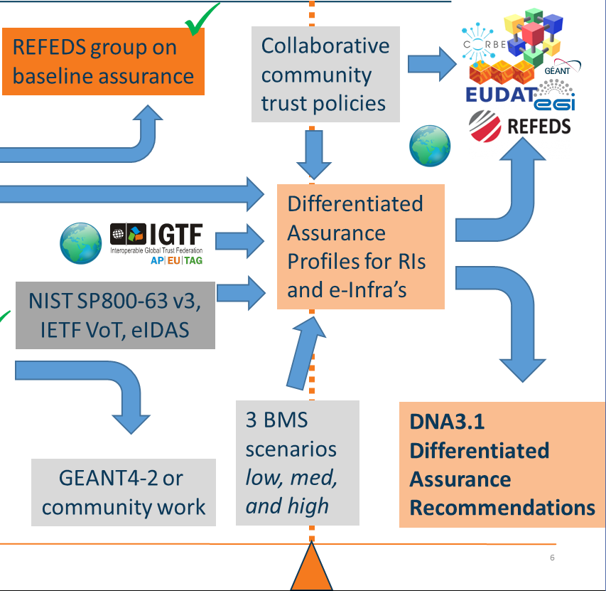
From Baseline to Differentiated Assurance
REFEDS WG (mainly for IdPs) based on capabilities (‘vectors’)
Grouping of capabilities with our SPs into profiles
Different profiles and
joint alignment of assurance
between e-Infras ongoing …
@REFEDS: Assurance Components consultation early 2017 – simple structure
https://docs.google.com/document/d/15v65wJvRwTSQKViep_gGuEvxLl3UJbaOX5o9eLtsyBI

Slide 5
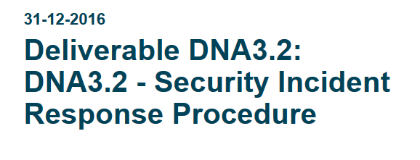
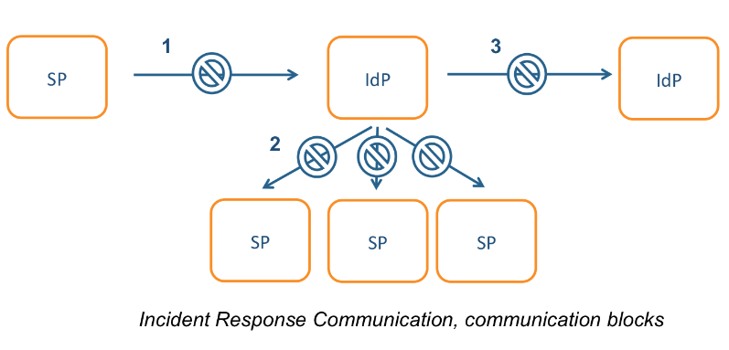
Security Operational Procedures
‘A Very Timely Activity’
Incident response capabilities at IdPs and SPs:
Sirtfi v1 brings these to light
Beyond v1: proper channels, expectations,
and the operational capability are still missing
Need to establish homogeneous
Incident Response Procedure – see the doc!
– with a need for a central operational capability …
Read (quickly …) and comment – this affects you all
Link is on the AARC Wiki under Policy Coordination -> Incident Response
https://docs.google.com/document/d/1I3IhatjdP5sa6Sfji8SIT6yXo4CI1tf2kNOaccD9QCU

Slide 6
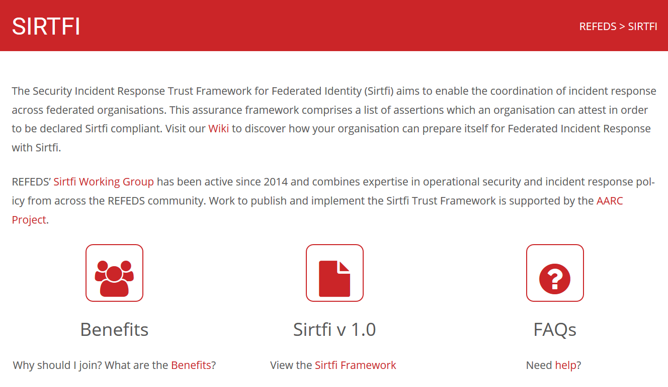
Sirtfi Training and Outreach
REFEDS and federation focused FAQ
Definition of the global Security Contact
meta-data profile for use in eduGAIN
Namespace for Sirtfi Assurance at IANA
Used in cyber ops roleplay exercises
Promoted at I2TechX,
FIM4R, Kantara, and TF-CSIRT
Ingredient to the ‘CILogon pilot’
combination of
REFEDS “Research and Scholarship”
and
Sirfti v1.0
meets assurance requirements for RIs and EIs according to the IGTF “assured identifier trust”
https://refeds.org/SIRTFI
✓
Nov 24th 114 IdPs ineduGAIN
that support Sirtfi
6

Slide 7
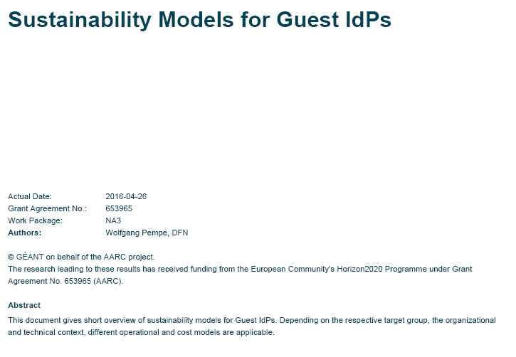
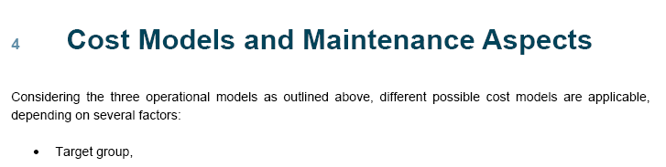


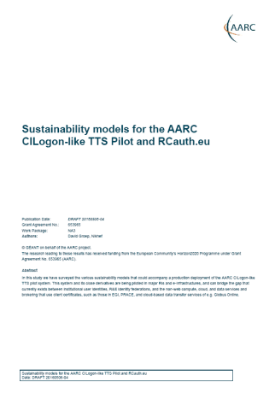
Operational models, federation and sustainability
Sustainability models for guest IdPs
Distribution of roles, costing model, maintenance, …
Operational mechanisms for federations and SPs and IdPs
Governance, gaps in policy space, service operations for
SPs, SP federations, … and Attribute Authorities (basis)
Across both ESFRIs and
global infrastructures
Sustainability for the AARC pilots and their adoption by research and
for collaborations
Joint effort needed on making the SA1 pilots outlive their demo phase
Case studies: collabra suite, CILogon/RCauth, … but we need this for all pilots
There will be a template coming that will guide you in building such a plan
Collabora Productivity
Dedicated 30’ slot tomorrow
On-premise or SaaS trusted collaboration
using LibreOffice Online and OwnCloud
with integration of eduGAIN IdPs
https://docs.google.com/document/d/15v65wJvRwTSQKViep_gGuEvxLl3UJbaOX5o9eLtsyBI

Slide 8
E.g.: Federation operations – alignment recommendations for use in Pilots
Combined desk study (based on automated meta-data) and interviews (DFN AAI, SURFconext)
Differences | care level offered to participants collective acceptance and provisioning of services
 | national funding model and adequacy, federation structure
Alignment | acceptance policy for service providers and IdPs – intent is all the same
 | charging models: IdP connected without additional cost, SPs are ‘free’
 | entity categories for grouping ‘alike’ services and IdPs is supported
Alignment | eduGAIN participation is still opt-in (needs convincing of each IdP)
The report will also try to address attribute authority models – as a basis for AARC2
https://wiki.geant.org/display/AARC/Federations+Current+Policies+and+Practices

Slide 9
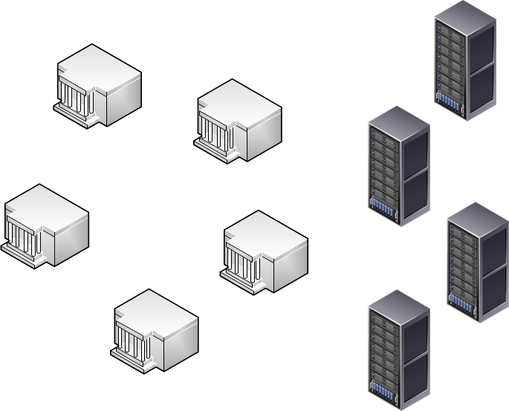
Full mesh policy negotiation does not scale – we cannot afford it!
Collaborations by design have their services distributed
and
not that many collaborations are a legal entity
or are not ‘authoritative’ for constituent services
‘n x m’
IdP
Home
Institute
IdPs and Home Institutes
do not have the effort to evaluate services
that only impact a couple of their people
are – in academia – in general very risk-averse
SP
Collaborative
Resource
or SIte
Group entities to easy negotiation process

Slide 10
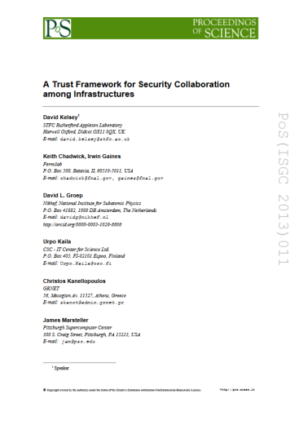

Developing scalable policy models in light of the Blueprint: Snctfi!
✓
allow proxy operators to assert ‘trust marks’ based on known SP properties
✓
Develop framework recommendations for RIs for coherent policy sets
evaluate with the SP-IdP-Proxies in pilots,
based on the Blueprint (DNA3.4)
Collaborate in WISE & FIM4R
to get global endorsement
Many SPs are alike
Policy frameworks for collective service providers Shared use of and collaboration on reputation services, together in FIM4R
Thursday morning
Snctfi breakout
Graphics inset: Ann Harding, SWITCH

Slide 11
Scope of the AARC Accounting and Processing of Data task
Protection of personal data in research data
User attribute release by federated organisations
Personal data processing in accounting & collaboration
patient records
survey data collation
big data analytics
research data combination
Research Infrastructures
Institutional
Ethical Committees
ESFRI Cluster Projects
institutional IdP attributes
GEANT DP CoCo*
minimal release in eduGAIN
REFEDS
Research & Scholarship
REFEDS, GEANT4
community management
Joint RIs, EIs and AARC work
collection of usage data
in RIs and e-Infrastructures
correlating resource usage
to people and groups
collate usage data across countries and continents
personal data used for incident response
AARC “TNA3.5” – this task
* GEANT Data Protection Code of Conduct – see
http://geant3plus.archive.geant.net//uri/dataprotection-code-of-conduct/v1/Pages/default.aspx

Slide 12
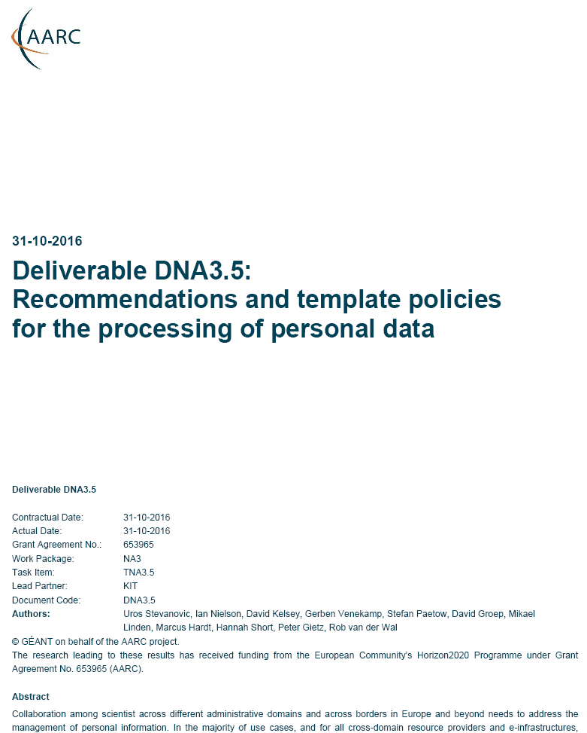
Data Protection Recommendation: the next step
How to work together without breaking too much the EU law?
Accounting data exchange is needed:
sustainable operating models, during incident response,
and for meeting funding rules
Yet the GDPR & current rules ‘not always helpful’ ☹
for attribute release CoCo helps, but this is a different use case
Novel use of existing policy frameworks
that already bind RIs and e-Infra together
Practical recommendations inspired by
the ‘Binding Corporate Rules’ (BCR) mechanism
Especially for collaborations that cannot rely on contracts
but are willing to balance risk vs actual need …
Now: how to we share our experience with new communities?

Slide 13

Inconsistency as our gravest risk? – towards AARC2
Reflected in updated AARC2 structure
Operational security capabilities and Incident response in federations – beyond Sirtfi v1
Service-centric policies: traceability & accounting, privacy, gateway operations & proxies
e-Researcher-centric policies: alignment of AUPs and templates,
authentication assurance, community attribute management models
and provisioning
Policy Engagement and Coordination:
contributes to Community Engagement, provision of
policy expertise to the Competence Centre, promotion of
best practices globally (WISE, FIM4R, IGTF, REFEDS),
easing end-to-end coordination across the chain

Slide 14
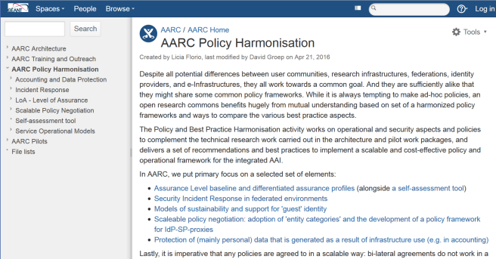
Thanks to all P&BP collaborators
from CSC, CERN, DAASI, RAL/STFC,
KIT, GRNET, DFN, SURFsara, LIBER,
and the community at large!
davidg@nikhef.nl

