Slide 1
Beyond the finish onwards to the policy horizon
Consolidating policy and best practice activities from NA3
David Groep
NA3 coordinatior
Nikhef
AARC2AHM5 meeting Abingdon
March 2019

Slide 2
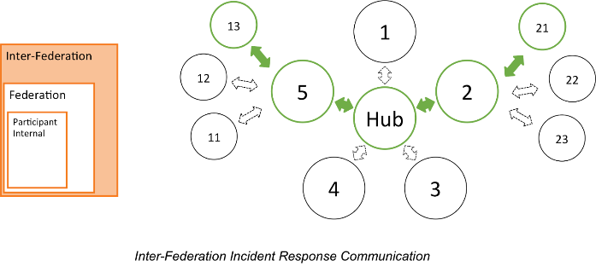

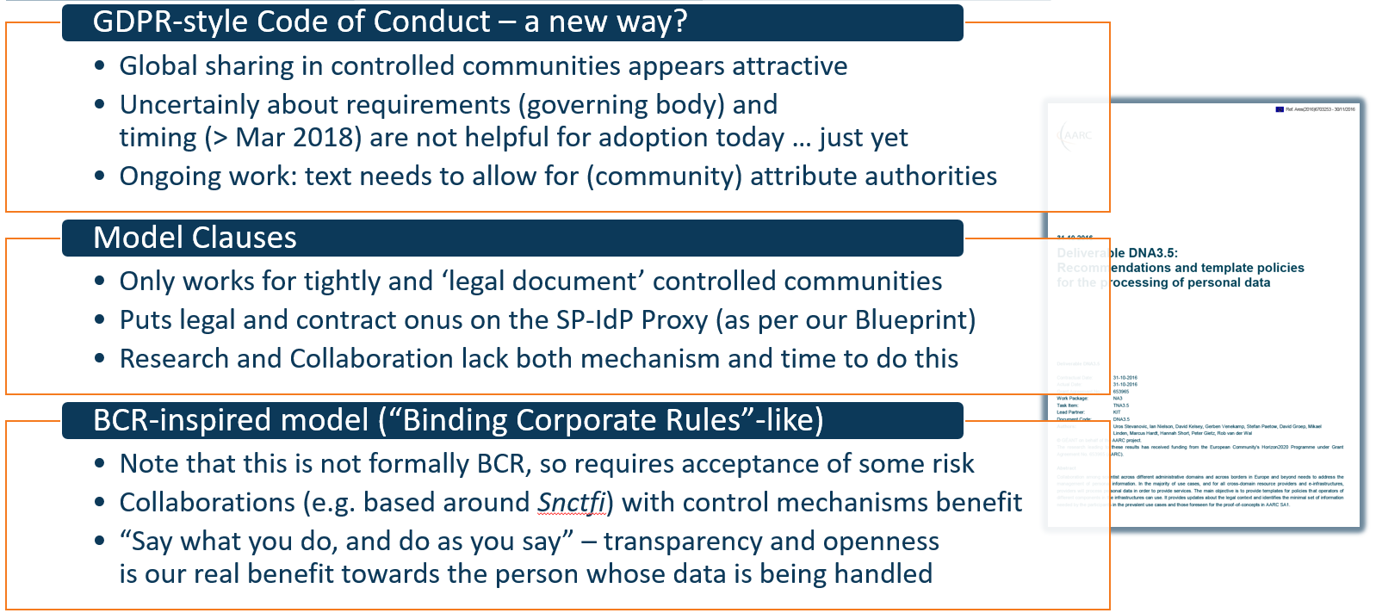

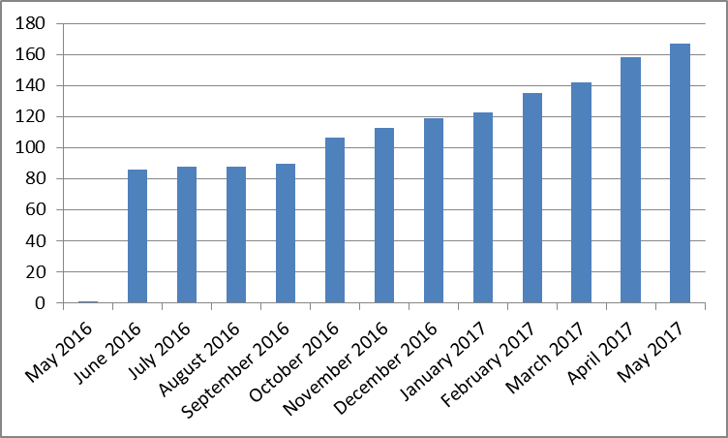

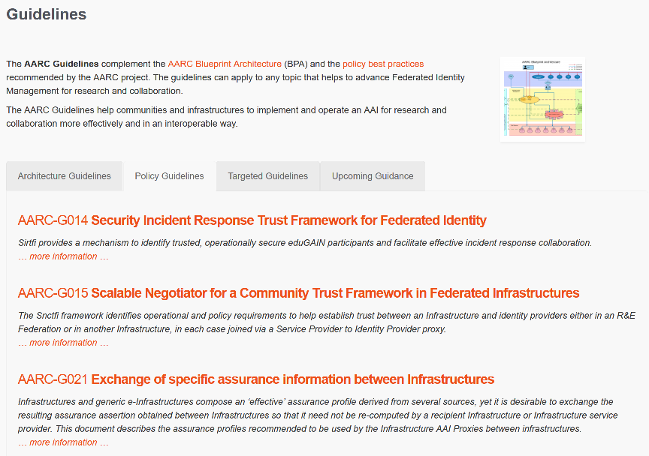

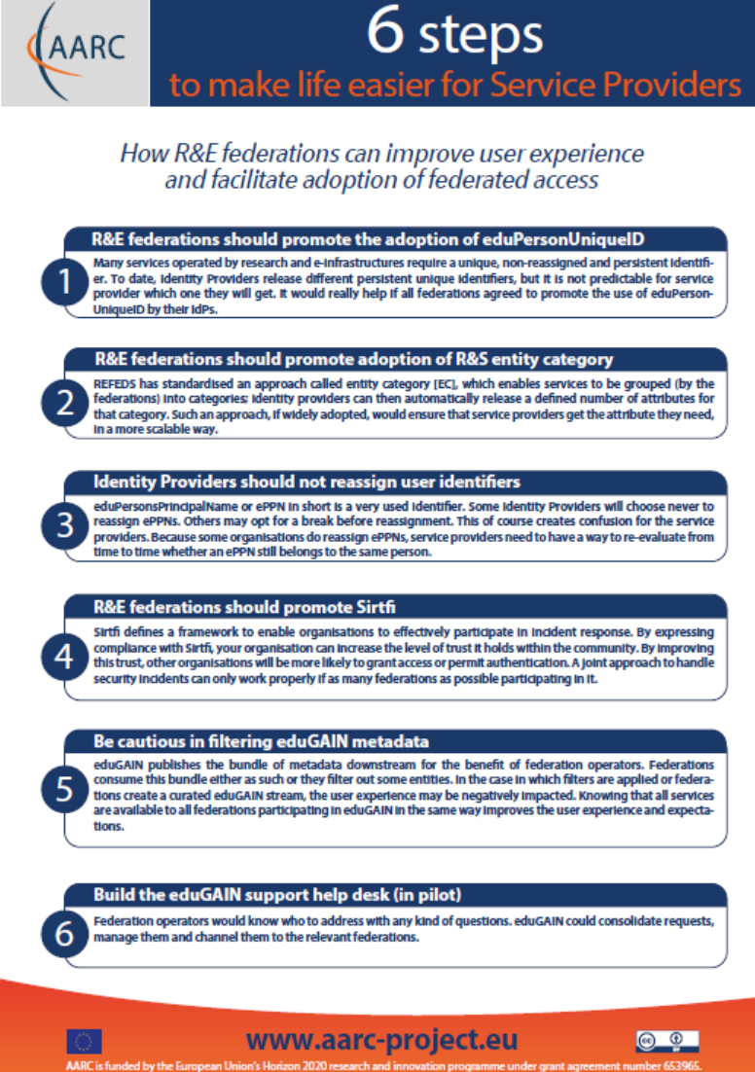
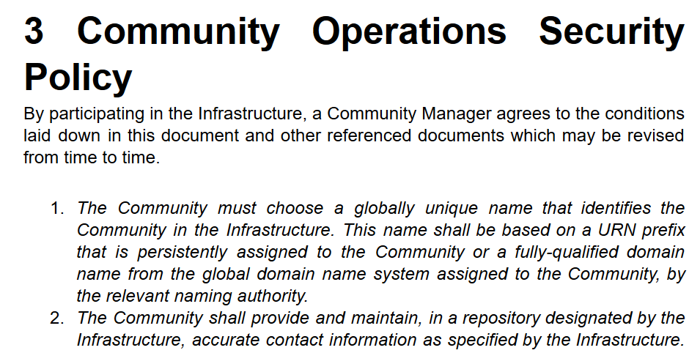
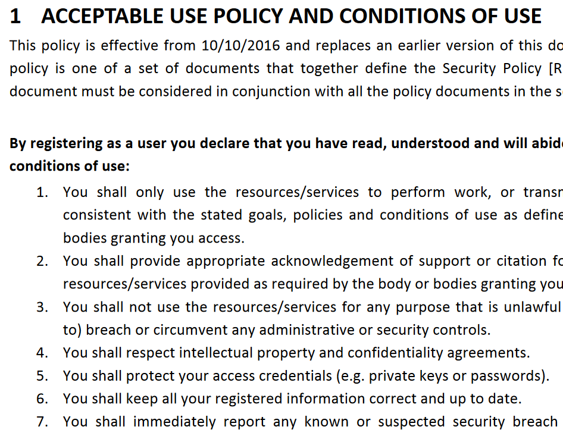


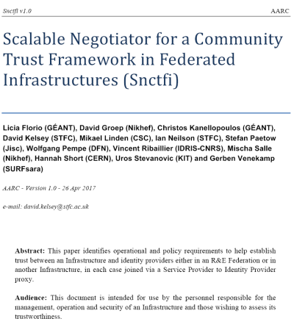



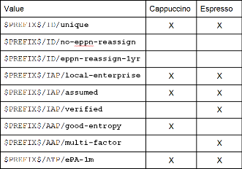
How can policy help you ease collaboration?
Operational Security
for FIM Communities
167 entities
supporting policies
for Infrastructures
bulk
model
support for
Researchers & Community
‘low-risk’ use cases
few unalienable expectations by research and collaborative services
generic
e-Infrastructure services
access to common compute and data services that do not hold sensitive personal data
protection of sensitive
resources
access to data of real people, where positive ID of researchers and 2-factor authentication is needed
engagement and coordination
Baseline Assurance
known individual
Persistent identifiers
Documented vetting
Password authenticator
Fresh status attribute
Self-assessment
Slice includes:
assumed ID vetting
‘Kantara LoA2’, ‘eIDAS low’, or ‘IGTF BIRCH’
Good entropy passwords
Affiliation freshness
better than 1 month
Slice includes:
Verified ID vetting
‘eIDAS substantial’, ‘Kantara LoA3’
Multi-factor authenticator
2

Slide 3
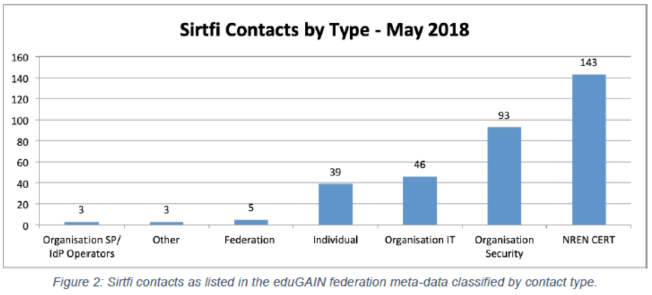
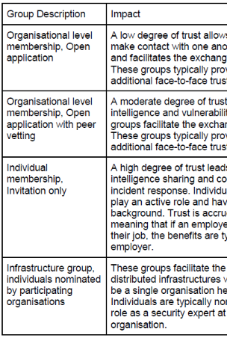
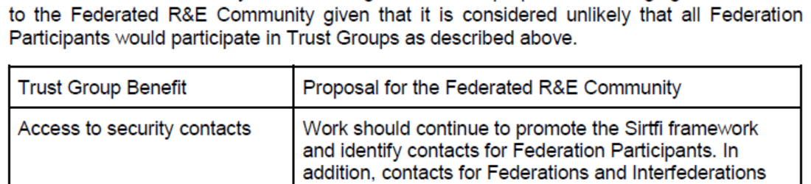
Responding to incidents – sharing relevant information
Sirtfi take-up at proper organizational level
Beyond basic Sirtfi
federation-level engagement in process
Sirtfi+ registry broadens global base
engagement in trust groups valuable
for federated collective response
from DNA3.2 Report on Security Incident Response and Cybersecurity in Federated Authentication Scenarios

Slide 4
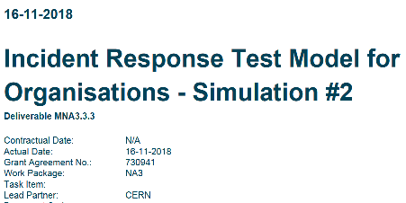
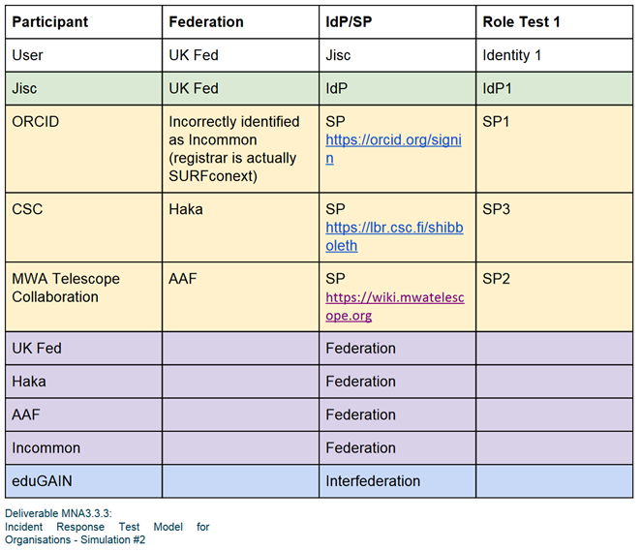
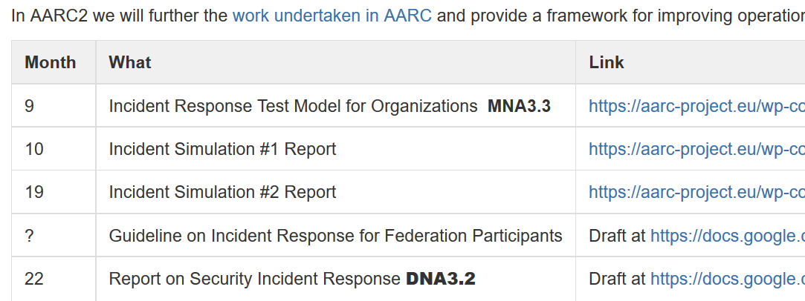

… the rest we test …
‘AARC-G051’, maybe ?
https://wiki.geant.org/display/AARC/AARC2+NA3+Task+1+-++Overview

Slide 5

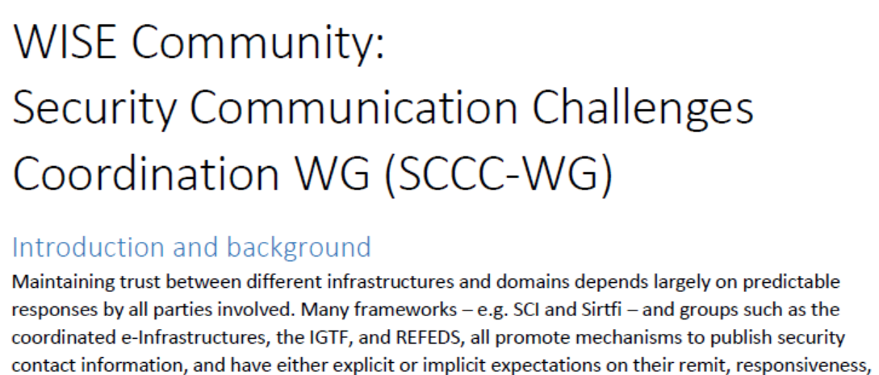
WISE SCCC WG
https://wise-community.org/events/
https://eventr.geant.org/events/3044

Slide 6
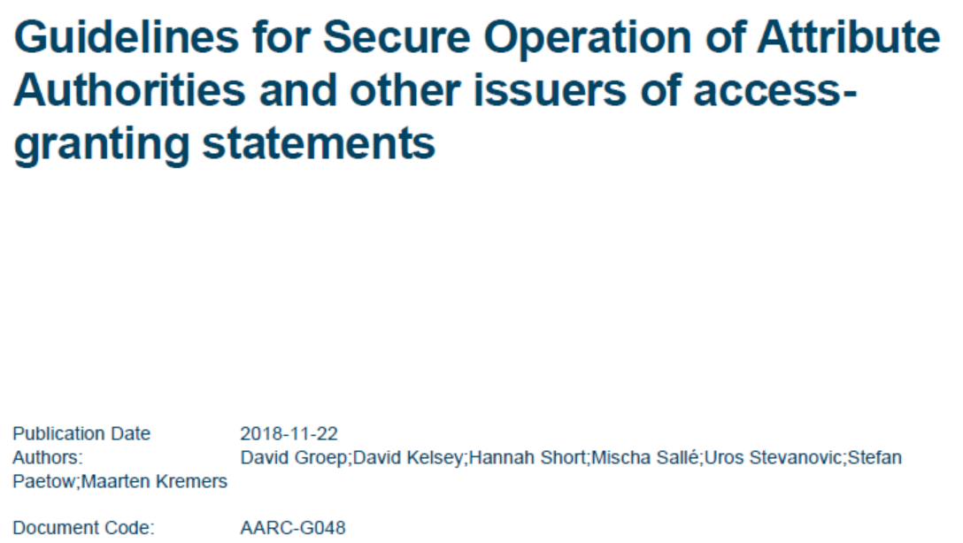
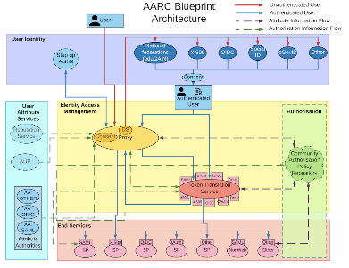
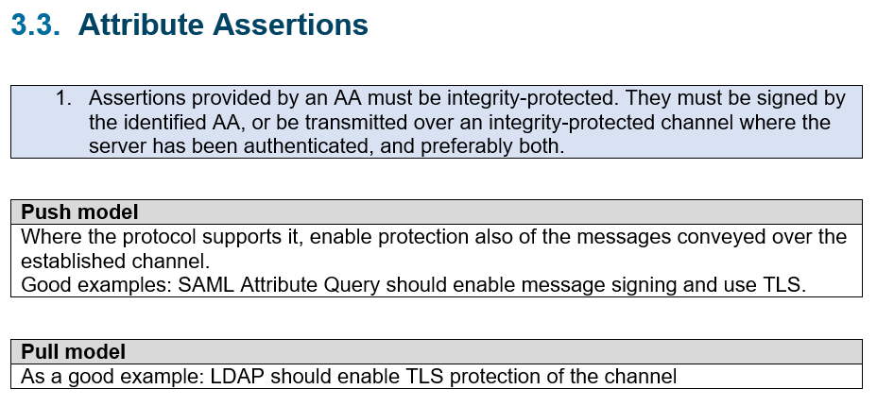
Attribute Authority Operations and ‘MMS assessment’
3. Operational Guidelines
3.1. Naming
3.2. Attribute Management and Attribute Release
3.3. Attribute Assertions
3.4. Operational requirements
3.4.1. Key Management
3.4.2. Network Configuration
3.5. Site Security
3.6. Metadata publication
3.7. Assessments and auditability
3.8. Privacy and confidentiality
3.9. Compromise and
disaster recovery
4. Relying Party obligations
`
https://aarc-project.eu/guidelines/aarc-g048/
https://www.eugridpma.org/guidelines/aaops/

Slide 7
Traceability in Multi-Domain Service Provider Environments (“D3.2”)
All what we have, and what we ‘lump in’ here (since it has nowhere else to go)
SCI v2 and the assessment methodology
Managing the proxy: data minimization, why the proxy can release attributes and still be data-minimalistic (“Interest of users to reduce the release of personal, as well as the potential risks for the users info vs. the need of resources to have proper accounting and security”)
Policy Development Kit – how to help infrastructures meet their requirements on traceability and much more
should G021 (“exchange of assurance information between infrastructures”) go here as well?

Slide 8
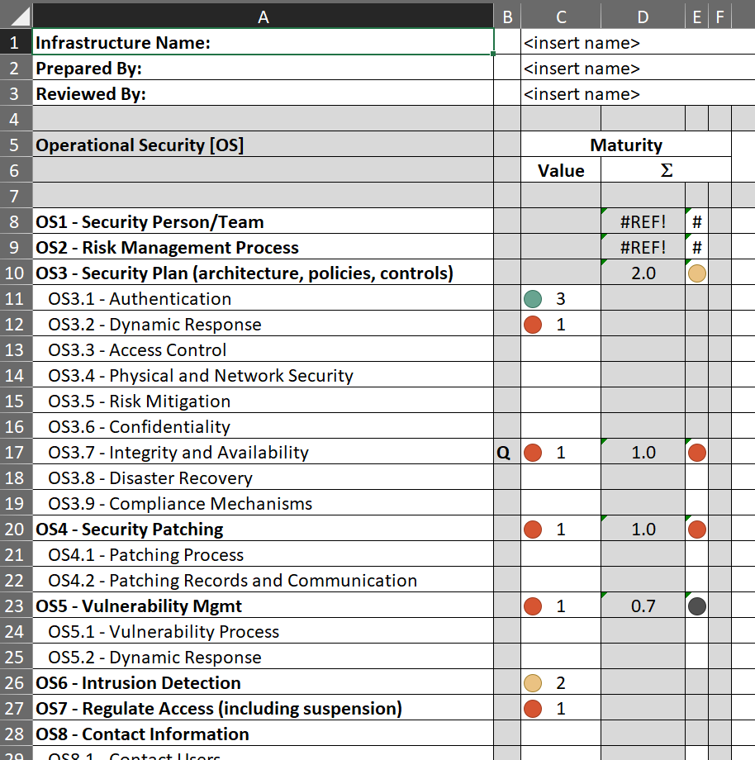
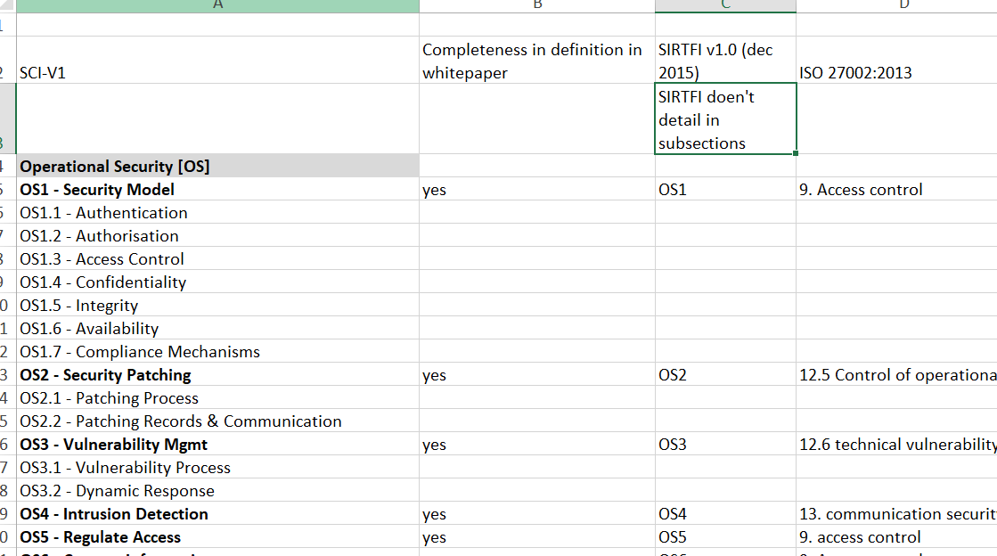
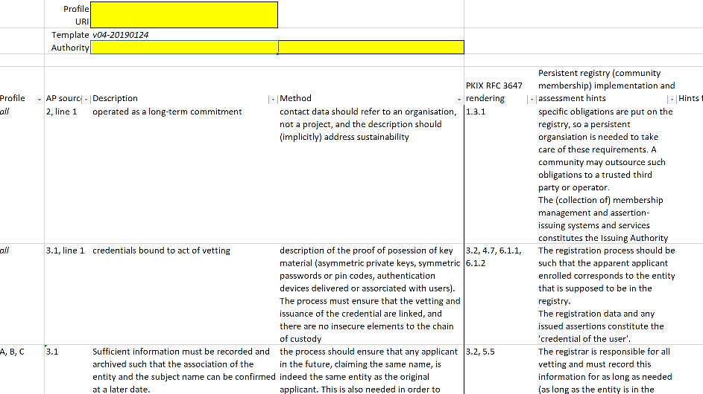
Service policies: helping peer-reviewed self-assessment in SCI and more
SCI assessment framework is there
mapping to ISO 27k is quite rough, though …
https://wiki.geant.org/display/WISE/SCIV2-WG+documents
http://wise-community.org/sci/
https://wiki.eugridpma.org/Main/AssuranceAssessment

Slide 9
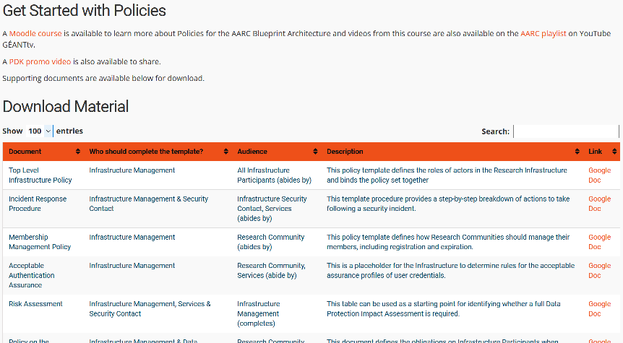
Policy Development Kit
introduction video – training – 9 reference templates – continuous improvement
https://aarc-project.eu/policies/policy-development-kit/

Slide 10
Supporting e-Researchers and communities (“D3.4”)
All what we have, and what we ‘lump in’ here (since it has nowhere else to go)
Assurance
Acceptable use policy and guidance
FIM4R

Slide 11
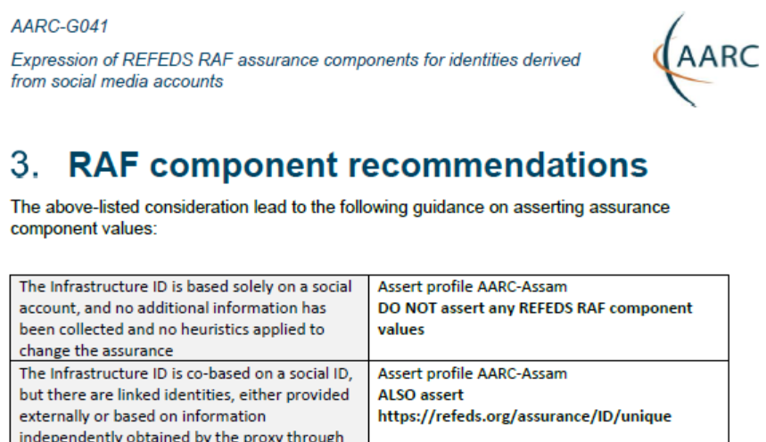
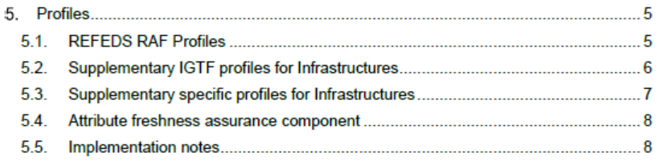
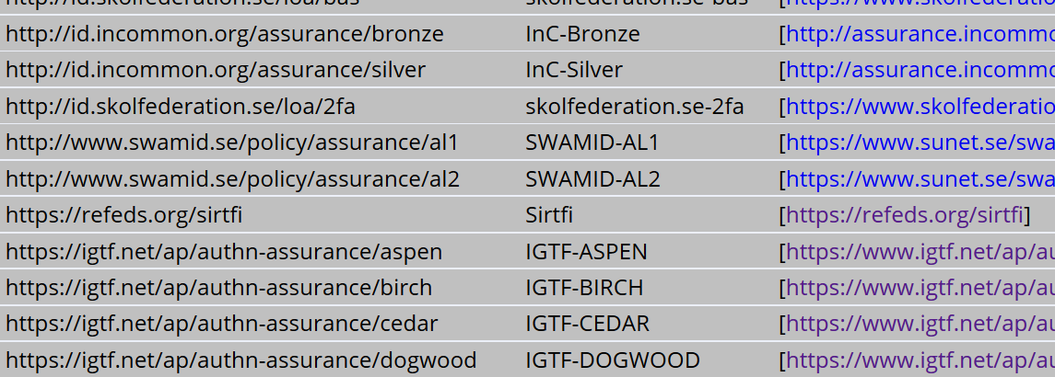
Assurance – standard profiles and ‘untangling spaghetti’
REFEDS RAF profiles (feasible assurance from all over R&E federations – as far as we can!)
inter-infrastructure profiles and relying-party oriented profiles (IGTF BIRCH, DOGWOOD)
how to express social media assurance, for citizen science and in support of account linking
or put AARC-G021 here?
https://www.iana.org/assignments/loa-profiles/

Slide 12

Untangling Assurance Spaghetti:
Comparison Guide to Identity Assurance Mappings for Infrastructures
https://aarc-project.eu/guidelines/aarc-i050/

Slide 13
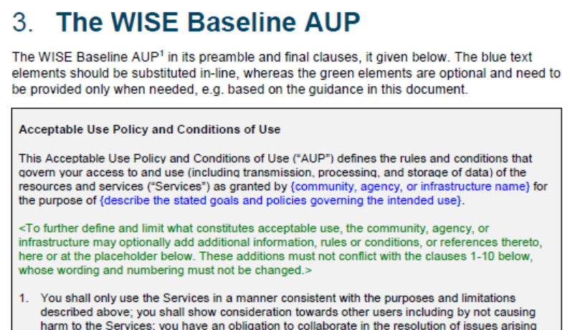
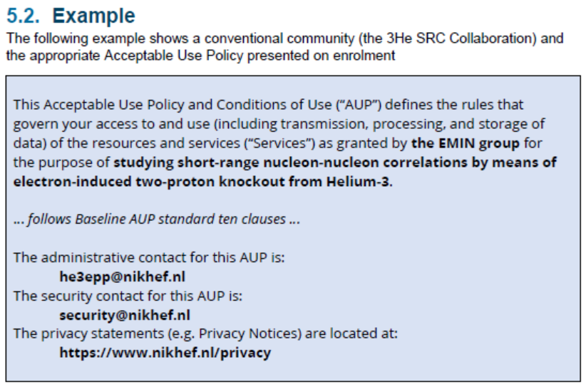
WISE Baseline AUP – and how to apply it for your Infrastructure
AARC-I044
Includes the final WISE Baseline AUP text
for both ‘community-first’ and ‘user-first’
MMS services (attribute authorities)
examples make it concrete
Quick take-up by e-Infras
(both global and national)

Slide 14
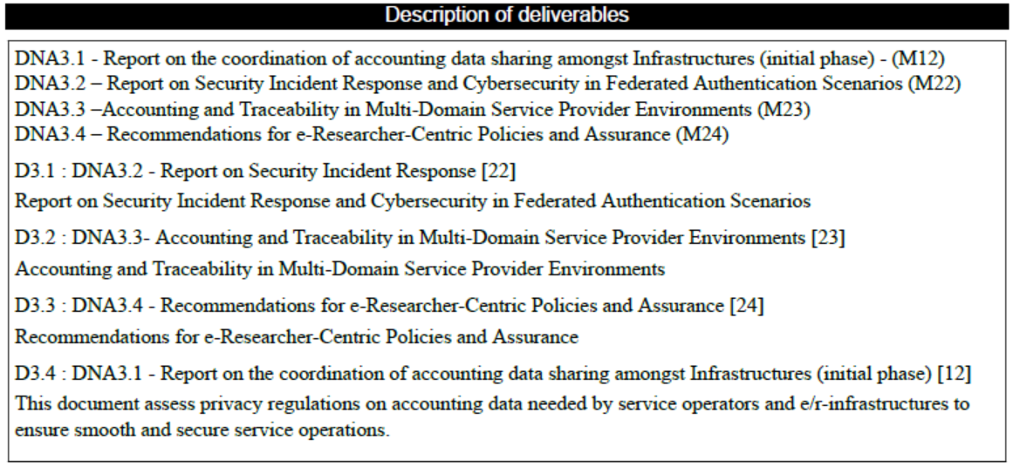
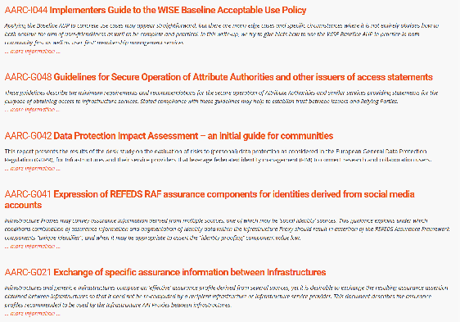
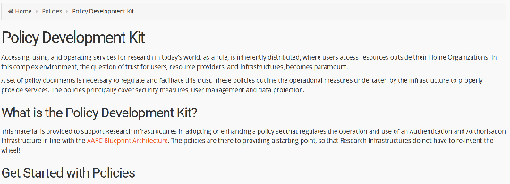
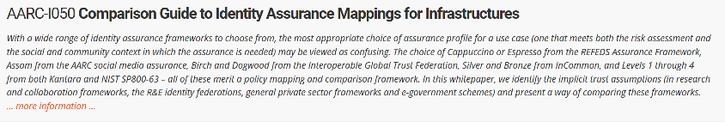
Our collective wisdom from AARC2
plus all our AARC1 wisdom!
and the AARC-G051 incident response process draft?

Slide 15
Since Milano – our final 6 months
OpSec | Attribute authority operations practice … also for Infra proxies
 | Trust groups and the exchange of (account) compromise information: beyond Sirtfi
✓
✓
Infra- centric | traceability and accounting data-collection policy framework based on SCI, providing a self-assessment methodology and comparison matrix for infrastructure services
 | information obtained from the proxy good enough for data protection, security, &c
✓
✓
Researcher-centric | Baseline AUP with major Infrastructures (EGI, EUDAT, PRACE, XSEDE) and communities
 | Deployment of assurance guidelines and assess high-assurance use cases (BBMRI)
✓
✓
Engagement | Evolve Policy Development Kit and a simpler top-level security policy with a community ‘assessment method’ or ‘guide’ to the adoption of appropriate policy
 | Support communities and use cases in policy interpretation through Guidelines
✓
✓

Slide 16
Some loose ends
For the “service-centric” work a final touch is needed on how to apply the frameworks
and help interoperability
Assessment methodology for SCI – and how is peer-reviewed self-assessment better then pushing everyone through ISO27k
How to apply data minimization in attribute release from the membership services
For Assurance
Do our high-assurance in REFEDS (“Espresso”) actually meet the target community need?
Do we need to update G021 (“Exchange of specific assurance information between Infrastructures”), which is also on Zenodo, before we close?
Incident Response: we should publish draft response procedure before the end (as ‘G051’)?

Slide 17
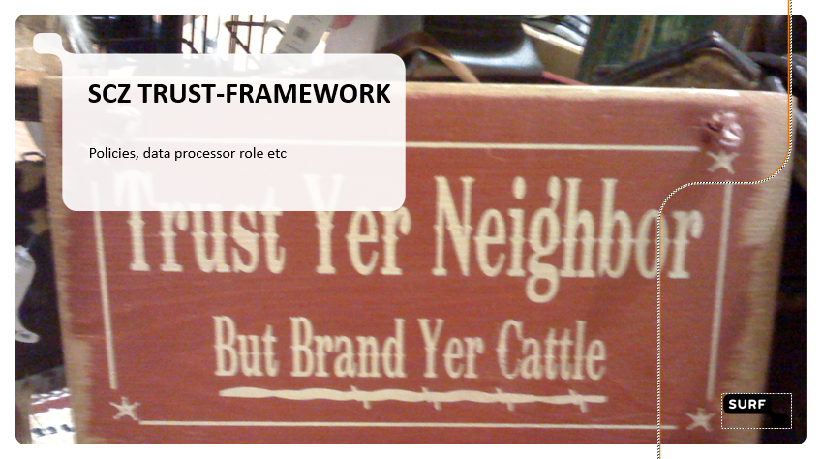
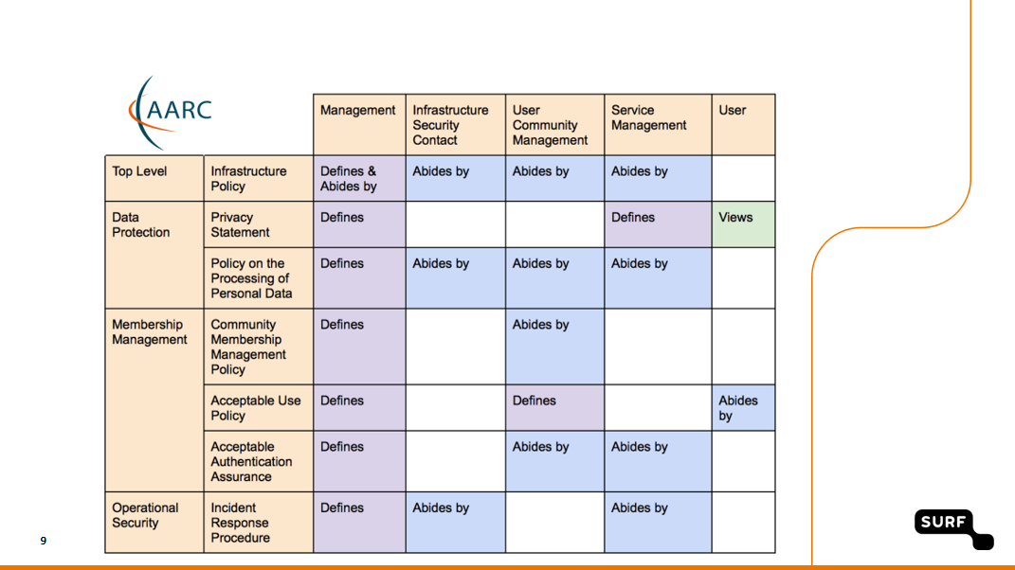
Adoption – how to promote that for ourselves and the review?
And much more (do we want a list?):
PDK adoption: by HDF, WLCG
MMS services adopting AUP
LSAAI R&S+DPCoCo
EOSC-HUB and WLCG
policy framework revision
AUP by many (even by a FH)
FIM4R impact
…
Policy Development Kit showing up without me prompting
in a Dutch collaborative science presentation …

Slide 18
Beyond AARC – how can the good work continue and thrive?
EOSC-HUB: mainly WP4.4 “ISM”, WP5.1 “AAI”, and WP13 “Virtual Access” for RCauth
GN4-3: T5.1.4 – eduGAIN security operations and readiness
GN4-3: T5.4 – enabling communities
Without specific funding but endorsed by funded infrastructures & projects:
IGTF
Collaboration Agreement GN4-* and EOSC-HUB
WISE
AEGIS
REFEDS
FIM4R
Complementary sources: national e-Infrastructures, domain funding, ESFRIs and EOSC projects

Slide 19
Finding a home – some proposals
Sirtfi
already in a REFEDS WG (Sirtfi+)
‘response model’ to the extent it involves federations can go here as well
actual incident response plus readiness challenges on federated ID side go with
new eduGAIN security capability
Communications challenges for security that involve also the Infrastructures
WISE, specifically the new SCCC WG
needs some love and care from all Infrastructures
Infrastructure-specific challenges remain infrastructure, but coordinated through SCCC
like the IGTF RAT CC

Slide 20
Finding a home – some proposals
SCI Assessment
WISE SCI WG, with assessment in the IGTF
support through EOSC-HUB WP4.4 and GN4-3T5.4
but obviously also from PRACE, XSEDE, GridPP, SURF, &c
Assurance Profiles – from federations to Infrastructures, and between R/E infrastructures
the ‘feasible’ assurance and alignment with IdPs and federations belongs in REFEDS RAF
assurance requirements of, and exchange of assurance between, infrastructures: in IGTF
AUP and Terms of Use
the home is WISE SCI, but it needs care and nourishment from EOSCHUB and GN4-3
extends beyond just WP4.4/T5.4 and involves e.g. also eduTEAMS, CheckIn, B2ACCESS

Slide 21
Finding a home – some proposals
Data Protection and GDPR – service centric policy support
we should lean heavily on AndrewC and the TF-DPR, but more is needed
risk-assessment methodology for infrastructures and communities
consultancy role for new communities to enable use of the infrastructures -> mailing list?
joint GN4-3 + EOSC-HUB + WLCG effort, homed (for lack of anything else) in AEGIS?
Tuning the policy development kit
the WISE SCI WG can coordinate, but the effort should come from somewhere
again GN4-3 + EOSC-HUB (EGI, EUDAT) seem the natural choice, with input from PRACE
other sources have been very successful as well: HDF, GridPP, SURF
For the rest and new things needed, leverage GN-EOSCH collaboration agreement & AEGIS?
one-on-one consulting with communities highly appreciated also beyond AEGIS,
but must be and be seen as neutral (maybe a FIM4R or WISE WG? or RDA?)

Slide 22
From now on …
Coherency of vision and an umbrella for Collaborative policy work will be more challenging
Exploit personal overlap in the various groups (and cross-membership of lists)
Provide a forum for cross-fertilization through continued joint workshops

Slide 23
davidg@nikhef.nl

