Slide 1
Beyond the AARC horizon
Consolidating policy and best practice activitiesfrom NA3
David Groep
NA3 coordinatior
Nikhef
EUGridPMA54 and AARC NA3 meeting Geneva
January 2019

Slide 2
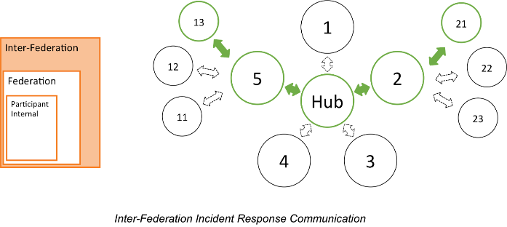
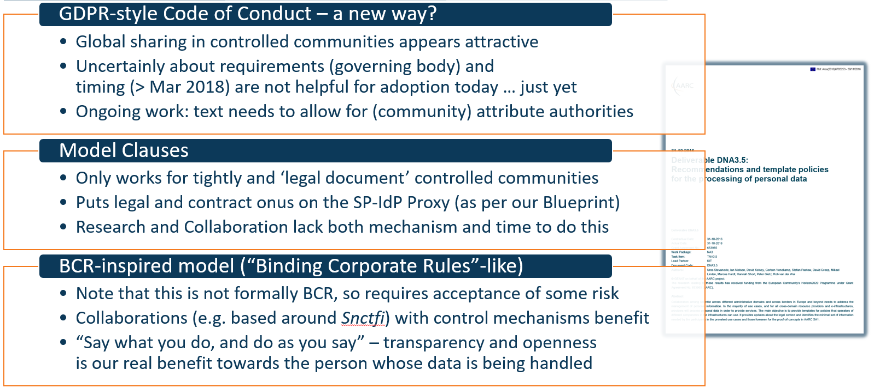
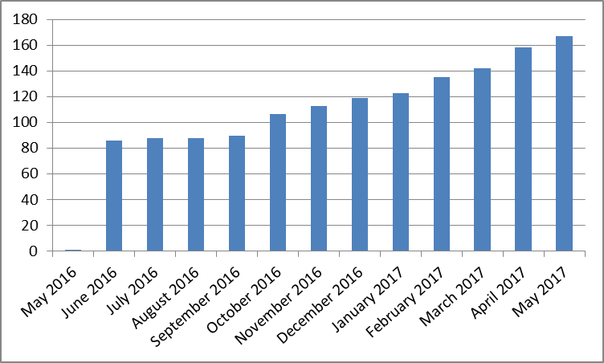
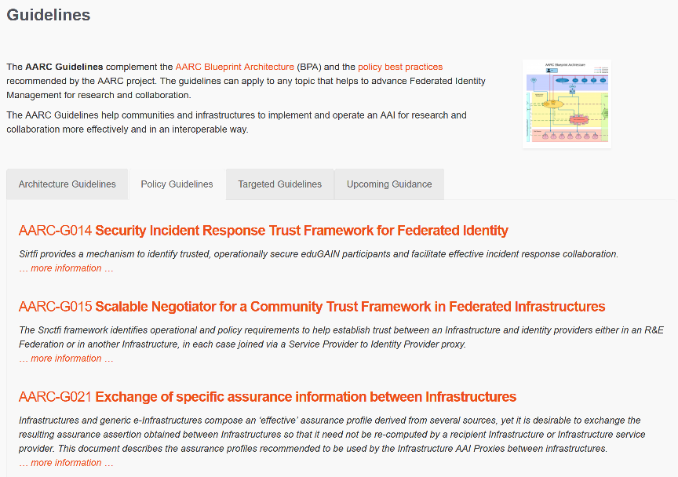
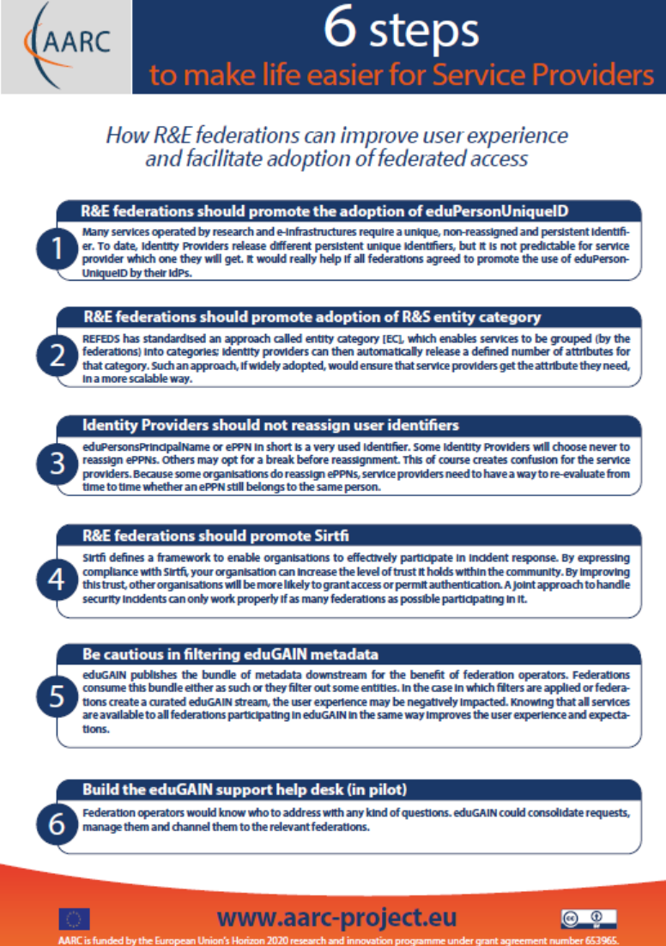
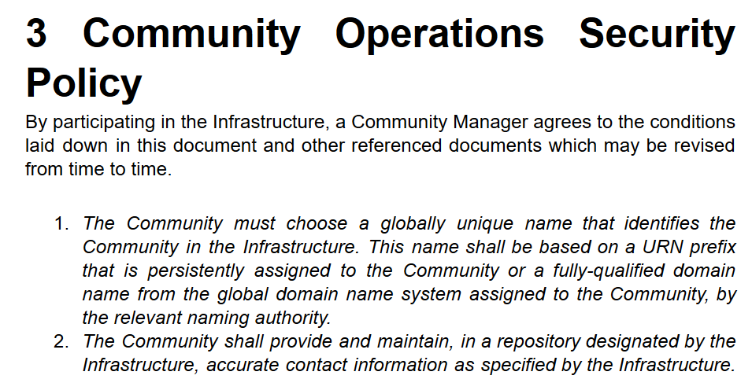
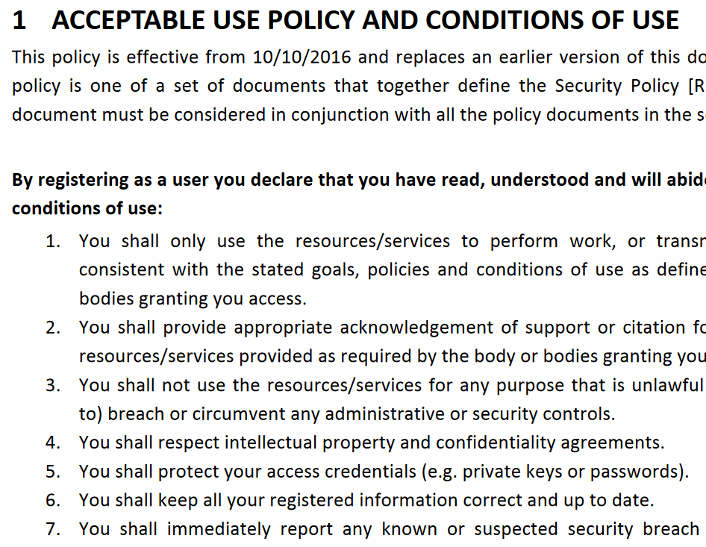
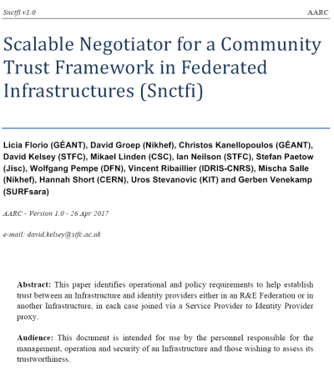
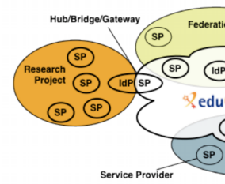
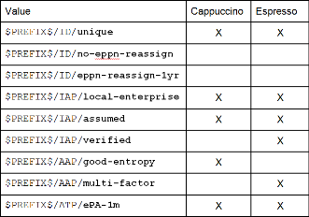
How can policy help you ease collaboration? A holistic view
Operational Security
for FIM Communities
167 entities
supporting policies for Infrastructures
bulk model
support for Researchers & Community
‘low-risk’ use cases
few unalienable expectations by research and collaborative services
generic e-Infrastructure services
access to common compute and data services that do not hold sensitive personal data
protection of sensitive resources
access to data of real people, where positive ID of researchers and 2-factor authentication is needed
engagement and coordination
Baseline Assurance
known individual
Persistent identifiers
Documented vetting
Password authenticator
Fresh status attribute
Self-assessment
Slice includes:
assumed ID vetting ‘Kantara LoA2’, ‘eIDAS low’, or ‘IGTF BIRCH’
Good entropy passwords
Affiliation freshness better than 1 month
Slice includes:
Verified ID vetting ‘eIDAS substantial’, ‘Kantara LoA3’
Multi-factor authenticator
2

Slide 3
Things to do in AARC’s last 6 mo and beyond when you’re still alive by now …
OpSec | Attribute authority operations practice … also for Infra proxies
 | Trust groups and the exchange of (account) compromise information: beyond Sirtfi
Infra- centric | traceability and accounting data-collection policy framework based on SCI, providing a self-assessment methodology and comparison matrix for infrastructure services
 | Evolution of data protection guidance for services
Researcher-centric | Baseline AUP with major Infrastructures (EGI, EUDAT, PRACE, XSEDE) and communities
 | Deployment of assurance guidelines and assess high-assurance use cases (BBMRI)
Engagement | Evolve Policy Development Kit and a simpler top-level security policy with a community ‘assessment method’ or ‘guide’ to the adoption of appropriate policy
 | Support communities and use cases in policy interpretation through Guidelines

Slide 4
Beyond AARC – how can the good work continue and thrive?
EOSC-HUB: mainly WP4.4 “ISM”, WP5.1 “AAI”, and WP13 “Virtual Access” for RCauth
GN4-3: T5.1.4 – eduGAIN security operations and readiness
GN4-3: T5.4 – enabling communities
Without specific funding but endorsed by funded infrastructures & projects:
IGTF
Collaboration Agreement GN4-* and EOSC-HUB
WISE
AEGIS
REFEDS
Complementary sources: national e-Infrastructures, domain funding, ESFRIs and EOSC projects

Slide 5
Finding a home – some proposals
Sirtfi
already in a REFEDS WG (Sirtfi+)
‘response model’ to the extent it involves federations can go here as well
actual incident response plus readiness challenges on federated ID side go with new eduGAIN security capability
Communications challenges for security that involve also the Infrastructures
WISE, specifically the new SCCC WG
needs some love and care from all Infrastructures
Infrastructure-specific challenges remain infrastructure, but coordinated through SCCC
like the IGTF RAT CC

Slide 6
Finding a home – some proposals
SCI Assessment
WISE SCI WG
support through EOSC-HUB WP4.4 and GN4-3T5.4
but obviously also from PRACE, XSEDE, GridPP, SURF, &c
Assurance Profiles – from federations to Infrastructures, and between R/E infrastructures
the ‘feasible’ assurance and alignment with IdPs and federations belongs in REFEDS RAF
assurance requirements of, and exchange of assurance between, infrastructures: in IGTF
AUP and Terms of Use
the home is WISE SCI, but it needs care and nourishment from EOSCHUB and GN4-3
extends beyond just T5.4 and involves e.g. also eduTEAMS, CheckIn, B2ACCESS

Slide 7
Finding a home – some proposals
Data Protection and GDPR – service centric policy support
we should lean heavily on AndrewC and the TF-DPR, but more is needed
risk-assessment methodology for infrastructures and communities
consultancy role for new communities to enable use of the infrastructures
joint GN4-3 + EOSC-HUB + WLCG effort, homed (for lack of anything else) in AEGIS?
Risk Assessment and tuning the policy development kit
the WISE RAW WG can coordinate, but the effort should come from somethere
again GN4-3 + EOSC-HUB (EGI, EUDAT) seem the natural choice, with input from PRACE
other sources have been very successful as well: HDF, GridPP
For the rest and new things needed, leverage GN-EOSCH collaboration agreement & AEGIS?

Slide 8
What AARC policy work have we forgotton?
Which additional activities could help enable communities?

Slide 9
davidg@nikhef.nl

