Slide 1
AARC Athens AHM meeting – NA3 session
David Groep
5th AHM Athens meeting
20-22 March 2017
Athens

Slide 2
Agenda 15.15 – 16.45 (90’)
Introduction and outline of NA3 in AARC and AARC2 (15’)
Hauling in the final AARC1 results
DNA3.3: presentation of final document (15’)
DNA3.4: scalable policy presentation and feedback (input to M24 document) (15’)
The highlights of 24 months of AARC (30’)
What do you think should be highlighted as a success for NA3?
For NA3 people: which elements are you proud of having achieved?
For non NA3 people: which elements did you find most useful in the NA3 output?
Towards AARC2 (15’)
Structure and community engagement
what elements should be prioritized from May this year?

Slide 3
Solving the Policy Puzzle
Pushing forward best practices and like policies across many participants
“Levels of Assurance” – baseline and differentiated profiles, capabilities and grouping
“Incident Response” – beyond Sirtfi: a common understanding on operational security
“Sustainability, Guest IdPs, use models” – how can a service be offered in the long run?
“Scalable policy negotiation” – helping SPs move beyond bilateral discussion
“Protection of (accounting) data privacy” – necessary aggregation without breaking the law too much
Strategy
support and extend established and emergent groups (REFEDS, FIM4R, WISE, IGTF, …)
leverage their support base - and ‘multiply’ the effect of policy work from AARC
IGTF
FIM4R
REFEDS
WISE
GN4
AARC
. . .
SIRTFI

Slide 4
Differentiated Assurance Profile – the story so far
Specific definitive guidance to IdPs and federations
Logical grouping and profiles for the Infrastructures
Uniqueness at least ePUID or ePTID/NameID extra: ePPN non-reassigned or 1-year-hiatus
ID proofing: ‘local enterprise’, ‘assumed’ (Kantara LoA2, IGTF BIRCH, eIDAS low), or ‘verified (LoA3, eIDAS substantial)
Authenticator: follow REFEDS MFA ‘good-entropy’ or ‘multi-factor’
Freshness: ePA/ePSA reflect departure within 30 days
All: organisational-level authority, also used locally for ‘real work’, good security practices
… and simplicity for all
https://docs.google.com/document/d/1HHbXG48WippMEAVnPybZngEyTYI6I0Hh84Arr-l2MW8/pub

Slide 5
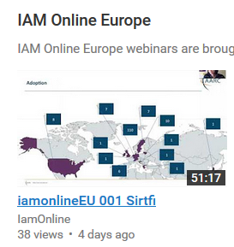
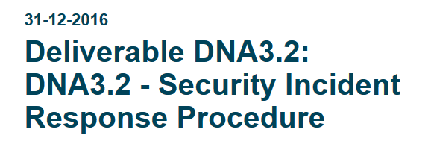
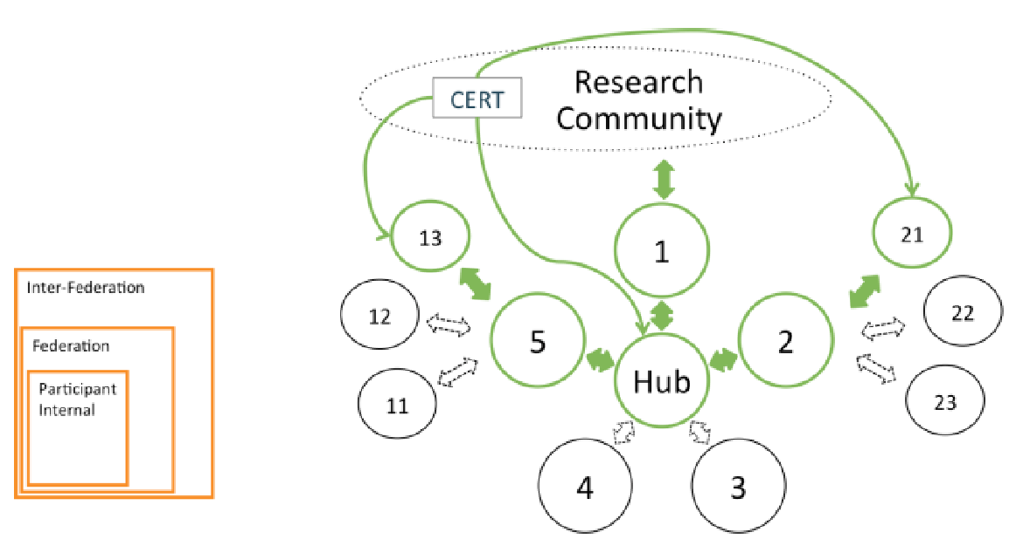
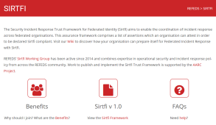
Security Operational Procedures
‘A Very Timely Activity’
Incident response capabilities at IdPs and SPs: Sirtfi v1 brings these to light
Beyond v1: establish proper channels, expectations, and the operational capability
Establish ‘homogeneous’ Incident Response Procedure
with central operational capability
and information sharing
✓
Mar 17th 137 IdPs (+23) that support Sirtfi
https://aarc-project.eu/wp-content/uploads/2017/02/DNA3.2-Security-Incident-Response-Procedure-v1.0.pdf

Slide 6
Recommendations for research and e-infrastructures to build sustainable services
Sustainability model template
With concrete examples from SA1 pilots
Recommendations to
Infrastructures to adopt standard practices
Federation ops to align approaches – keeping in mind the FIM4R requriements
We got ourselves +2 months (now just 1 week left …)
David Hübner and Peter Gietz will present it ☺

Slide 7
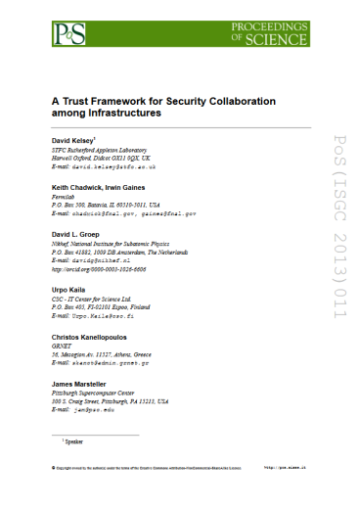
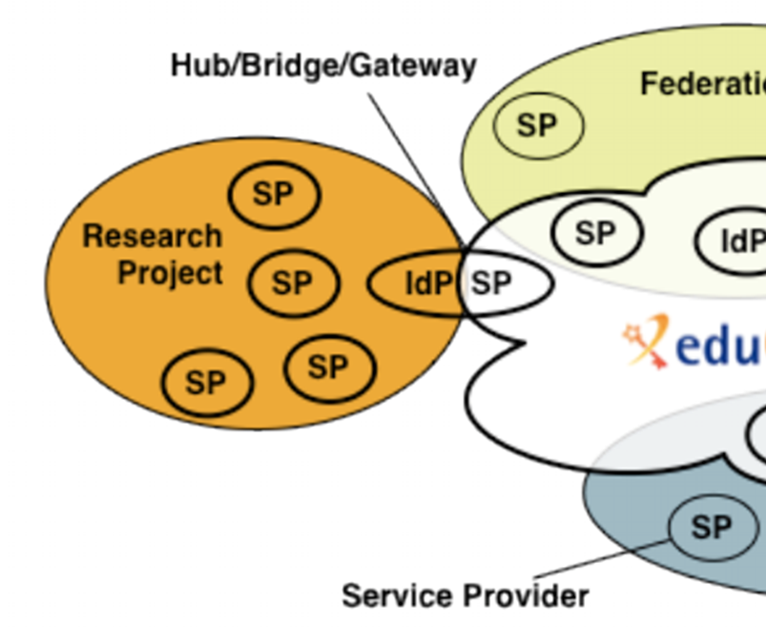
Developing scalable policy models in light of the Blueprint: Snctfi!
✓
allow proxy operators to assert ‘trust marks’ based on known SP properties
✓
Develop framework recommendations for RIs for coherent policy sets
evaluate with the SP-IdP-Proxies in pilots, based on the Blueprint (DNA3.4)
Many SPs are alike
Policy frameworks for collective service providers Shared use of and collaboration on reputation services, together in FIM4R
David Kelsey will talk about Snctfi and DNA3.4 shortly!
Graphics inset: Ann Harding, SWITCH

Slide 8
Accounting Data Protection
InfoShare on March 2nd
Guidance continues to evolve as the GDPR date comes closer
BCP-like (not BCP!) for communities that fit that model – ‘say what you do and do as you say’ – and keep the users always informed
New-style code of conduct can also address the similar set of challenges, but depends strongly on the new GDPR (it cannot take effect before March 2018), may require some new hoops (and maybe even a body to take on liability!)
and would benefit from minor tweaks to wording to explicitly put attribute authorities in scope

Slide 9
Work items with some dedicated time (once I stop talking …)
DNA3.3 Recommendations for research and e-infrastructures to build sustainable services now at M23
DNA3.4 & Snctfi Recommendations on the grouping of entities and their deployment mechanisms in scalable policy negotiation at M24

Slide 10
Review Highlights Survey
Survey https://goo.gl/5hYwP4
3 responses already beforehand
this is an interactive session, so you will have to contribute ☺
Contribute Live at https://goo.gl/32OFRP

Slide 11
Some early input for the review
Proud that we have generated discussion within a broad community of requirements for a interfederation incident response procedure. The AARC work can probably take some credit for inspiring the eduGAIN support platform. Proud of the work done trying to decrypt GDPR and make it understandable for our community, in the form of an adoptable policy. Proud of the efforts made to quantify LoA in line with existing research community practices. This way it should be useful straight out of the box.
Data protection primarily. Snctfi and LoA are also very useful to see how we should work together.
I really like Sirtfi for it's simplicity but still great usefulness. As a good second, I like the sustainability model for e.g. RCauth.eu, since sustainability is often missed in finite-time project-based development work, resulting in the loss of good products. The other work is very important too, but perhaps more difficult to show-case.
Contribute Live at https://goo.gl/32OFRP

Slide 12
Towards AARC2 …
Recommendations for the infrastructures
How to ensure that AARC results are deployed
what to push, highlight, or prioritize in AARC2 starting in May?

Slide 13
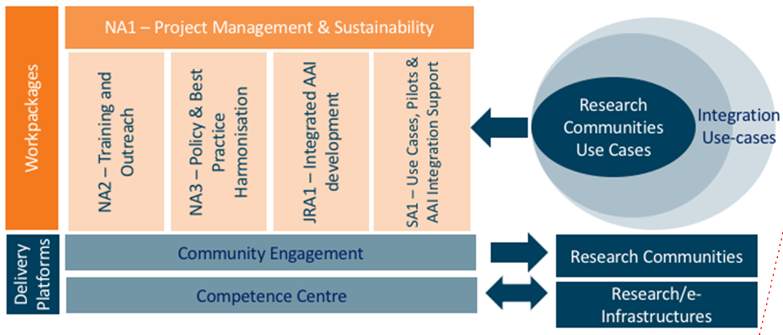
AARC2 Structure Refresher

Slide 14
AARC2 Methodology
objective 3 Deliver an integrated identity management infrastructure that responds to cybersecurity and community assurance requirements
Collaboration with Infrastructures
Training and outreach
Incident Response
Levels of Assurance (LoAs) – read Assurance Profiles
Deployment of results
International Liaisons (again, many on policy)
REFEDS
FIM4R (RDA)
IGTF
WISE

Slide 15
Policies in support of collaboration
Reflected in updated AARC2 structure
Operational security capabilities and Incident response in federations – beyond Sirtfi v1
Service-centric policies: traceability & accounting, privacy, gateway operations & proxies
e-Researcher-centric policies: alignment of AUPs and templates, authentication assurance, community attribute management models and provisioning
Policy Engagement and Coordination: contributes to Community Engagement, provision of policy expertise to the Competence Centre, promotion of best practices globally (WISE, FIM4R, IGTF, REFEDS), easing end-to-end coordination across the chain
Structuring the exchange of information amongst SP groups

Slide 16
In AARC, NA3 has fewer explicit partners – yet we need all of you!
In work programme only: BBMRI-ERIC (CSC), CERN, EMBL, FZJ (PRACE), KIT, Nikhef, RAL
Define a reference framework to enable different parties to compare policies and assess compatibility as needed. [SCI-V3, convergence of Snctfi & Sirtfi - RAL]
Create (baseline) policy requirements, driven by research to engage with a large number of compliant stakeholders without the need for mapping. […] Permits scalability in negotiating agreements [through] the Competence Centre. [‘researcher-centric’ policies, baseline AUP, Assurance Profile for BMS, frameworks for attribute management and provisioning - RAL]
Identify all necessary policy elements and develop guidelines and assessment models to support communities in establishing, adopting, or evolving their own policies – covered by the topic-based Tasks on operational security, service-centric policies, and community-centric policies. [ensemble of ‘service-centric’ policies, think Accounting, GDPR, Attribute authority mngt, evolution of Snctfi, IdP-SP-Proxies - KIT]
Operational Security and Incident Response [move beyond re-active communications - RAL]
We Need You – and the Competence Centre and Community Engagement!

Slide 17
After the last month of AARC …
Recommendations and policy templates & guidance
Which recommendations do we push most urgently?
To which infrastructures beyond the ‘usual’ ones (ELIXIR, EGI, EUDAT, EOSC-HUB, PRACE)?
How do we reach those in AARC2 not yet involved in AARC1?
The ‘90% we miss’ (from AARC2 and in FIM4R as well)
should we recommend policy alongside the federation training?
or get them ‘hooked’ first?
What are the most urgent items we should start working on in May?
Contribute Live at https://goo.gl/32OFRP

Slide 18
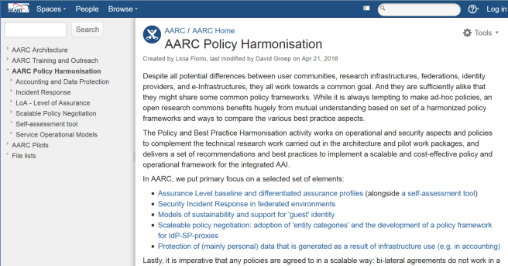
https://aarc-project.eu/workpackages/policy-harmonisation/
https://wiki.geant.org/display/AARC/AARC+Policy+Harmonisation
Thanks to all P&BP collaborators
from CSC, CERN, DAASI, RAL/STFC, KIT, GRNET, DFN, Renater, SURFsara, LIBER, and Nikhef,
and to Jim Basney of NCSA, CTSC and CILogon
davidg@nikhef.nl

