Slide 1

AARC multi-community BPA and assurance mapping
Harmonisation of policy, practice and architecture
David Groep
Policy and Best Practice Coordination
Nikhef
In collaboration with and
co-supported by EOSC-HUB
IGTF All Hands meeting Taipei
April 1, 2019
Supported by the Dutch National
e-Infrastructure coordinated by SURF

Slide 2















Welcome to the Research and e-Infrastructure Collaboration Landscape
Communities / e-infrastructures surveyed in AARC
Notes:
So we identified a large number of requirements and common challenges across (14) research communities and e-infrastructures. (based on FIM4R)
Balancing the interest of all the different communities
The input we needed to commence our pilots
Attribute aggregation: Most federated identity management systems are limited by users' ability to choose only one identity provider per service session. There should be a linking service that lets users securely link their various identity provider (IdP) accounts without having to authenticate separately to each IdP.
User friendliness: The tools that support the FIM framework should be simple and intuitive and integrate with the many other IT tools used in daily life. Multiple redirection problem, standardise (shib loging, institutional login).
Credential translation: Converting credentials to different formats enables interaction between services using different authentication technologies
Level of insurance: 1. level of assurance as to whether someone or something is who or what it claims to be in a digital environment. 2. The way you login. How safe is the digital way to login you are using (password? Crappy. Token? Super safe) 3. How much do I trust your infrastructure (your admin? Your network?)
Bridging communities. FIM is important and it’s becoming even more. Bridging between the various communities is a central issue with an efficient mapping of the respective attributes.
non-browser federated access. Non-browser based interfaces are essential to support machine-machine interactions in secured workflows.

Slide 3
The AARC Blueprint Architecture to bring everyone together
Defines a model and building blocks to address researcher needs
Cross-domain interoperation and services based on community and provider criteria expressed using common guidelines
Allows researchers to use ONE digital identity to access MANY services and resources available through eduGAIN
and in collaborative r/e-Infrastructures

Slide 4
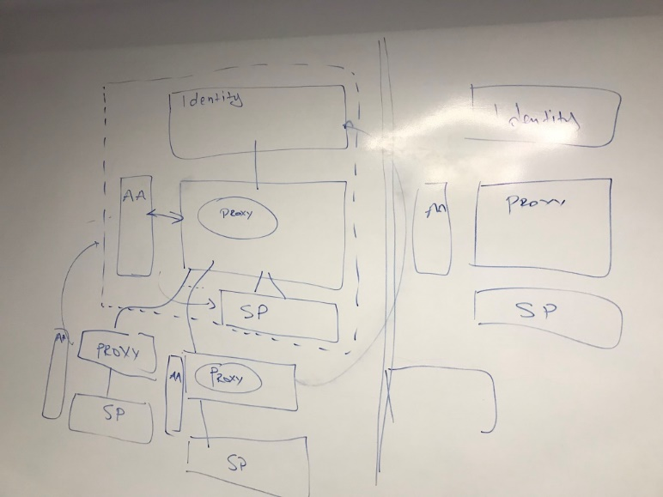
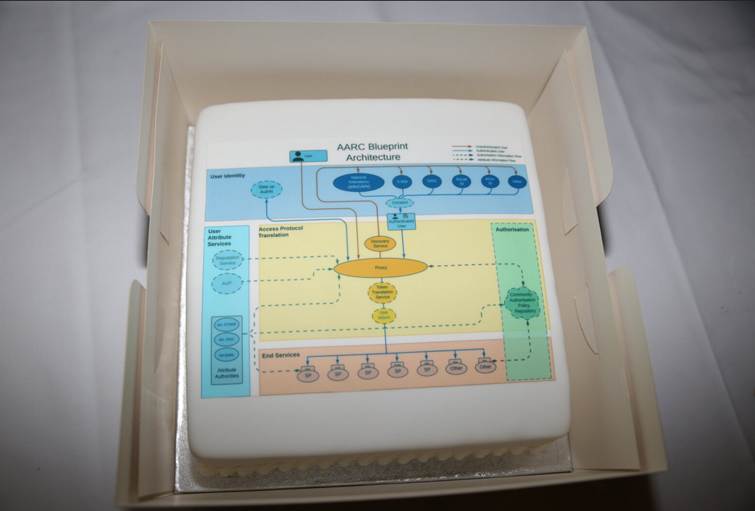
Blueprint for an AAI serving research and collaboration
The AARC Proxy Architecture model

Slide 5
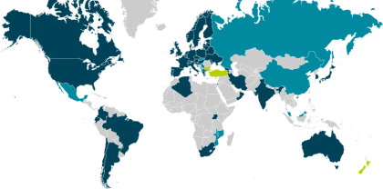
Identity providers – eduGAIN, social, eGov, …
  over 50 members & many different models
  architecture (hub-and-spoke vs mesh)
  baseline policies present or absent
  non-reassigned id and attributes:
  ‘by default’, optional, or sometimes discouraged(!)
  tagging of entities and IdPs (‘categories’):
  open, limited, or needs implementation repeatedly
  constituency: including or excluding e.g. private R&D
  paid option or part of nren base services package
  support available for organisational IdP software (e.g. ADFS)
  and then there is social ID for (citizen) science, eGov IDs &c
Federations in eduGAIN
Members | 49
Voting-only | 6
Candidates | 13
Entities in eduGAIN
All | 4538
IdPs | 2654
SPs | 1888
Standalone AAs | 5
data: technical.edugain.org as of 11 March 2018

Slide 6
Identified common challenges
Communities / e-infrastructures surveyed in AARC
Homeless
users
User
friendliness
PII Data Protection
Community
based AuthZ
SP
friendliness
Credential
translation
Bridging Communities
Engaging
SPs
Notes:
So we identified a large number of requirements and common challenges across (14) research communities and e-infrastructures. (based on FIM4R)
Balancing the interest of all the different communities
The input we needed to commence our pilots
Attribute aggregation: Most federated identity management systems are limited by users' ability to choose only one identity provider per service session. There should be a linking service that lets users securely link their various identity provider (IdP) accounts without having to authenticate separately to each IdP.
User friendliness: The tools that support the FIM framework should be simple and intuitive and integrate with the many other IT tools used in daily life. Multiple redirection problem, standardise (shib loging, institutional login).
Credential translation: Converting credentials to different formats enables interaction between services using different authentication technologies
Level of insurance: 1. level of assurance as to whether someone or something is who or what it claims to be in a digital environment. 2. The way you login. How safe is the digital way to login you are using (password? Crappy. Token? Super safe) 3. How much do I trust your infrastructure (your admin? Your network?)
Bridging communities. FIM is important and it’s becoming even more. Bridging between the various communities is a central issue with an efficient mapping of the respective attributes.
non-browser federated access. Non-browser based interfaces are essential to support machine-machine interactions in secured workflows.

Slide 7
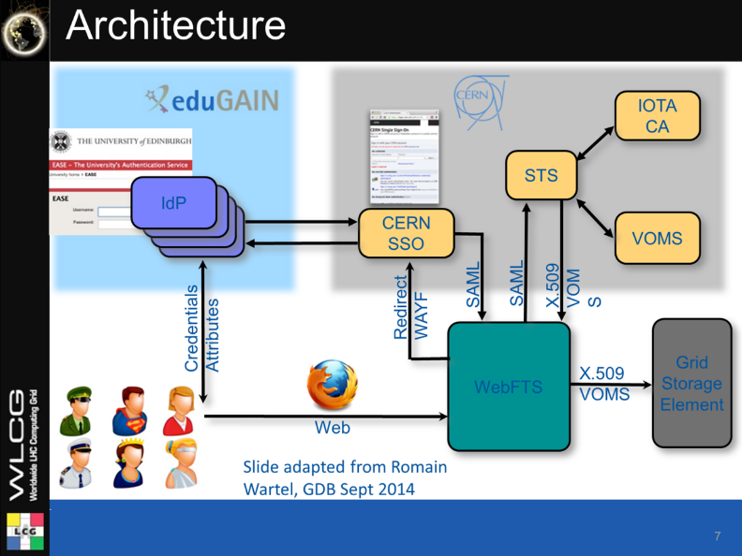
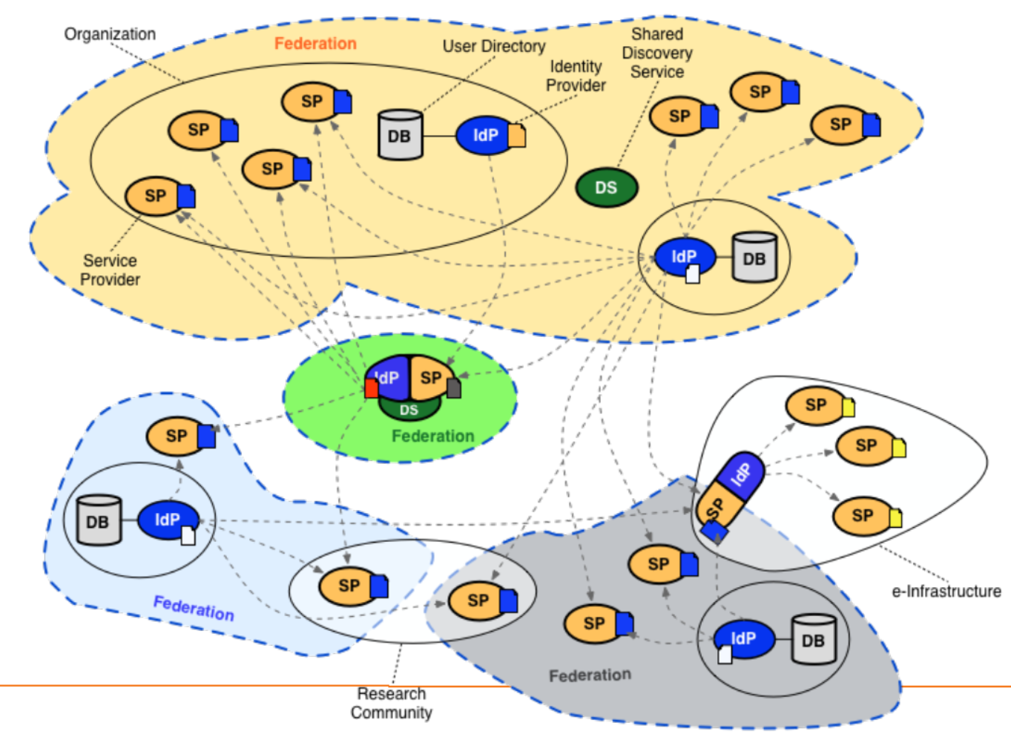
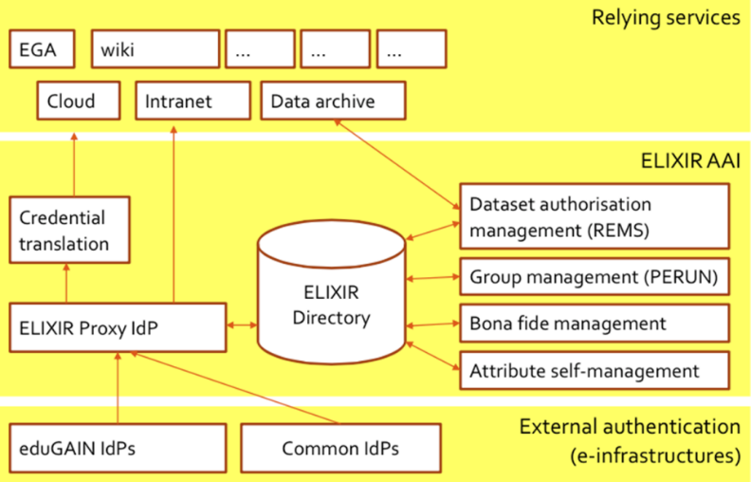
Whence we came – collaborative research AAIs predating AARC
WebFTS ‘FIM4R’ in wLCG
Romain Wartel
ELIXIR reference architecture
Mikael Linden et al.
communities had either invented
their own ‘proxy’ model to abstract complexity
or they were composed of many services
each of which had to manage federation complexity

Slide 8

AARC Blueprint Process
  Guidelines and supporting documents
  reference architecture
  conventions and community standards
  best policy practices
  implementation hints
  training for ‘FIM’ communities
https://aarc-project.eu/architecture/
https://aarc-project.eu/guidelines/

Slide 9
Harmonisation at the proxy – the technical bits user identity layer and attribute services
To harmonise incoming attributes, the proxy will need state
Long term state
assignment of infrastructure-specific unique identifier
current recommendation: eduPersonUniqueID or sub (type: public)
heuristics to determine ‘unexpected’ changes in source IdPs
even SAML NameID and eduPersonTargetedId may be suspect,
and ePPN is not guaranteed
(see Christos’ post on REFEDS list 2019-03-22 at 22:05)
account linking
Ephemeral state
SSO caching
optional step-up authentication done for this session
assurance profile based on linked authentications
https://aarc-project.eu/guidelines/#architecture

Slide 10
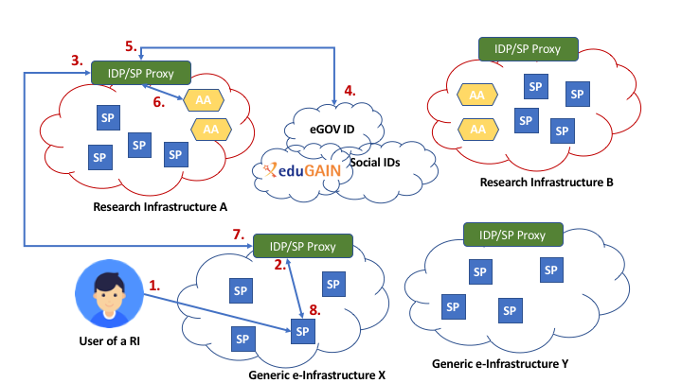
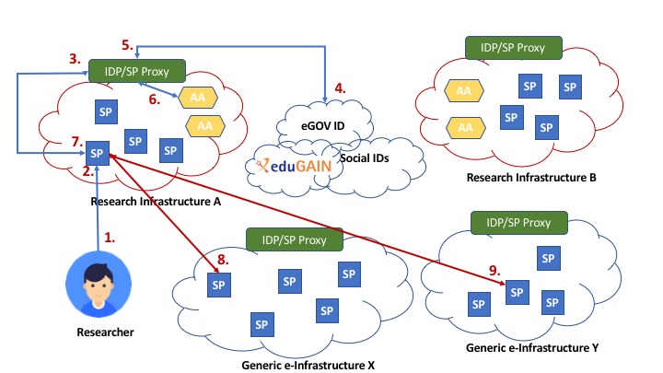
AARC2: Collect community feedback and requirements about cross-infrastructure interoperability
Use-Cases for Interoperable Cross-Infrastructure AAI
Analysis of research community specific use cases of
cross-infrastructure access to services/resources:
  Generic use cases
DARIAH
Life Science
EPOS
...

Slide 11
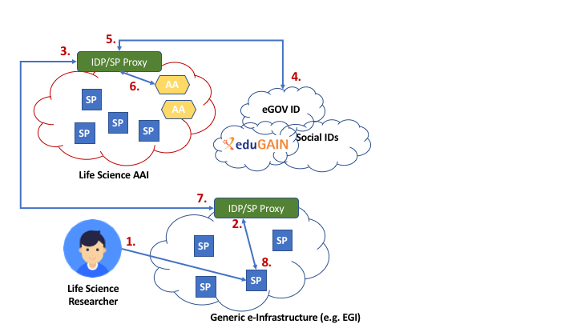
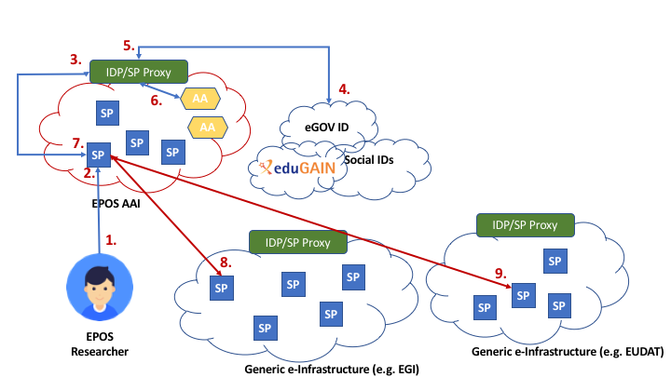
AARC2: Collect community feedback and requirements about cross-infrastructure interoperability
Use-Cases for Interoperable Cross-Infrastructure AAI
Generic Use Case 1 - Research Infrastructure users accessing e-Infrastructure services
Generic Use Case 2 - Research Infrastructure services accessing e- Infrastructure resources on behalf of the user

Slide 12
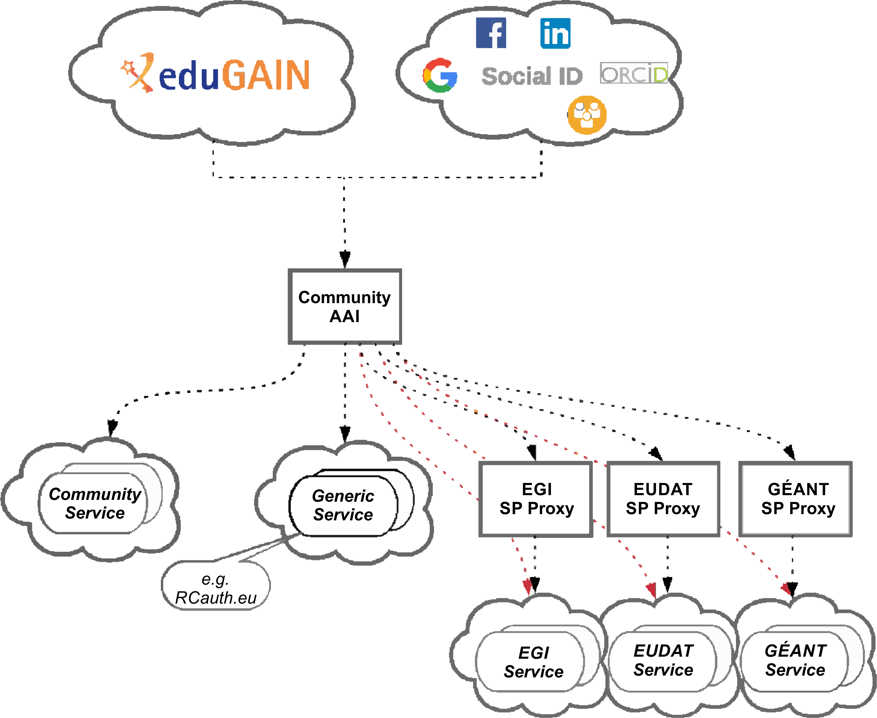
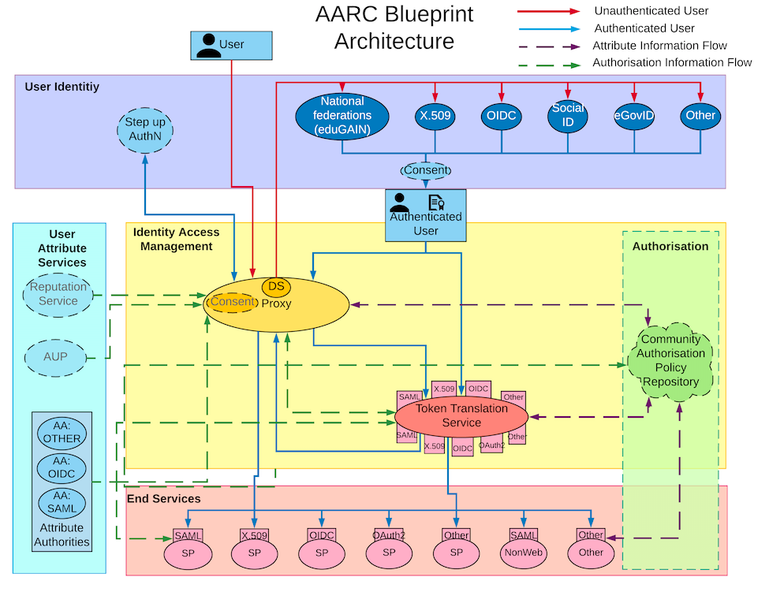
Evolving the AARC BPA to address multi-proxy scenarios
Mesh of services tends to group together in ‘conglomerates’: community-specific services, generic services offered to multiple communities, e-Infrastructures offering combined services

Slide 13
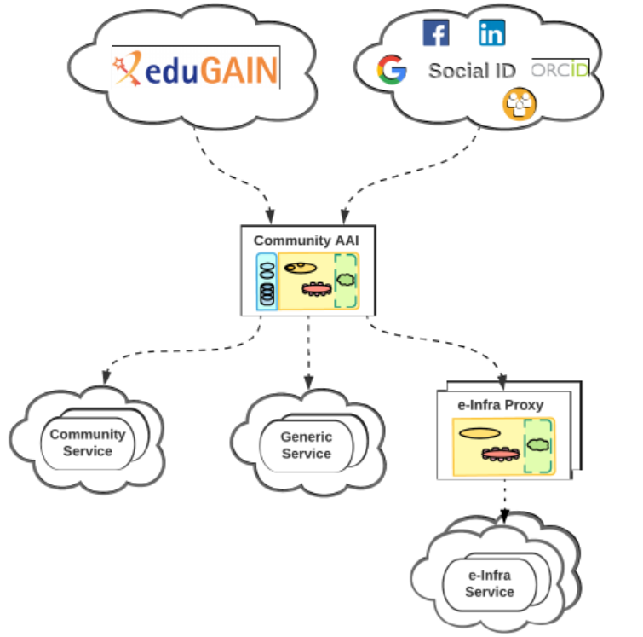
Community-First AAI approach
Community-first AARC BPA approach
Researchers sign in using their institutional (eduGAIN), social or community-managed IdP via their Research Community AAI
Community-specific services are connected to a single Community AAI
Generic services (e.g. RCauth.eu Online CA) can be connected to more than one Community AAI proxy
e-Infra services are connected to a single e-infra SP proxy service gateway,
e.g. B2ACCESS, Check-in, Identity Hub, etc

Slide 14
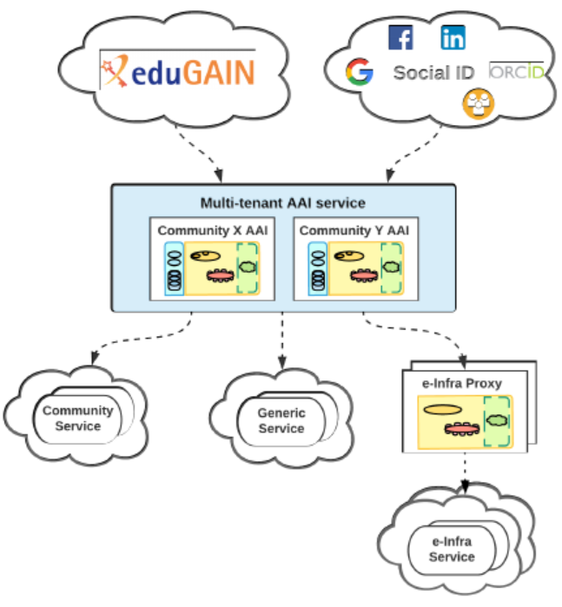
But architecture is not necessarily implementation: hosted AAIs!
Multiple offerings emerging (but the choice is non-trivial…)
Seen initially for LSAAI as single-tenant ‘hosted’
EOSC-hub e-Infra proxies: gain access to generic e-Infra services either dedicated or multi-tenant deployments of AAI services operated by EOSC-hub
Multi-tenant deployments:
aimed at medium-to-small research communities/groups or individual researchers.
community members, groups and authorisation attributes are still managed by community managers
Dedicated deployments:
allow customisation of user-facing interfaces: IdP discovery page, enrolment, group membership UI
customisation of AAI proxy behaviour(e.g. attribute aggregation rules, service entitlements)
possibility of bespoke AAI solutions, which might include individual Components from the GÉANT eduTEAMS, EGI Check-in, INDIGO IAM, EUDAT B2ACCESS, and PERUN (like in LSAAI)

Slide 15
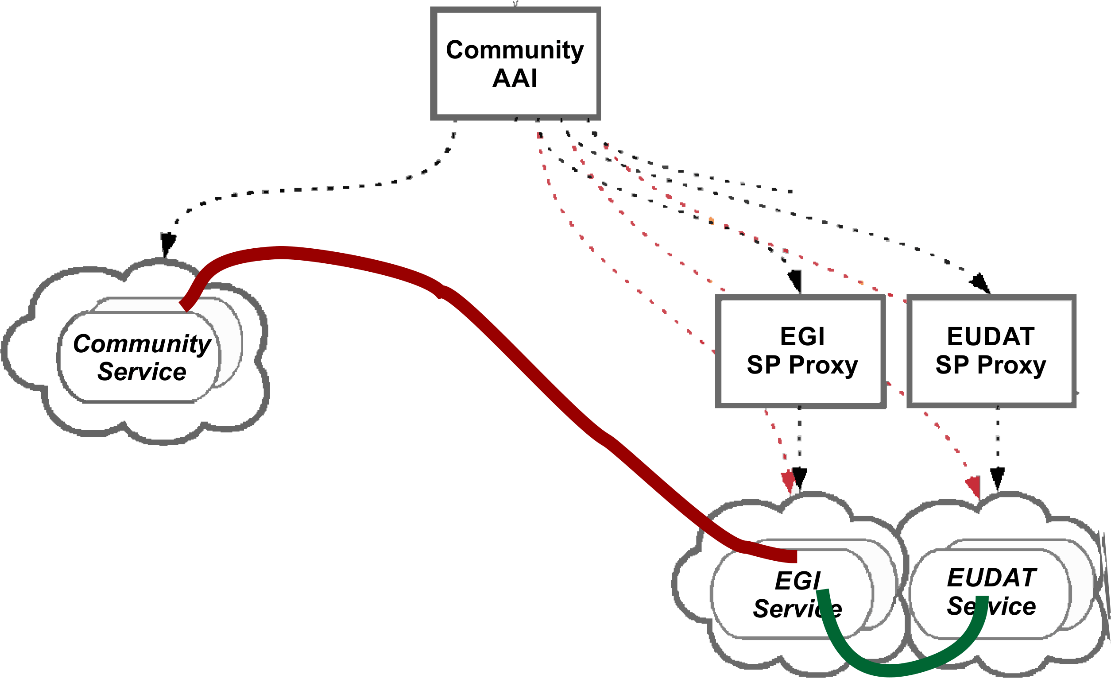
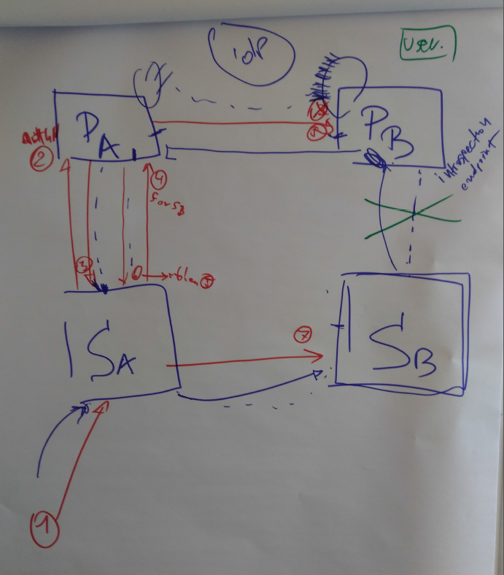
Multi-BPA in practice: the cross-infra OAuth2 delegation scenario example
‘How can Service Sb recognize and process an access token coming from a job at Sa in another infrastructure, without either Sa or Sb having to be modified, Sb being able to trust Pb, and access tokens being both scoped and encrypted to the proper protected resource Sb?
In the multi-BPA model, this can work using an (updated draft) OAuth Token Exchange flow that does exactly what you want
– if the process at Sa asks Pa to exchange its Sa token at Pb – which means Pb should trusts Pa, which it has to do anyway. And so Pb is fed a token it can verify at its own Pb infra proxy’

Slide 16
Proxies: more than technology

Slide 17


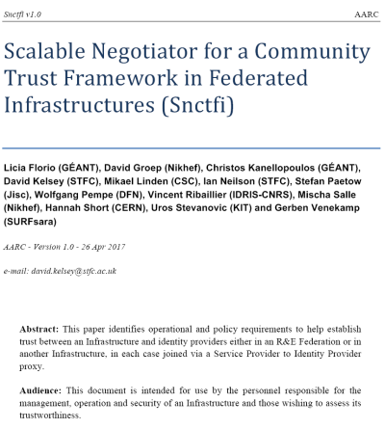
A policy framework for service providers groups and proxies in the BPA
Snctfi
Scalable Negotiator for a Community Trust Framework in Federated Infrastructures
Derived from SCI, the framework on Security for Collaboration in Infrastructures
WISE Information Security for E-infrastructures got global endorsement SCI in June 2017
graphic IdP-SP bridge: Lukas Hammerle and Ann Harding, SWITCH

Slide 18
Filling the framework: generic and community-targeted guidance
aarc-project.eu/guidelines
aarc-project.eu/policies/policy-development-kit/
Snctfi covers both
service-centric and some researcher-centric policies

Slide 19
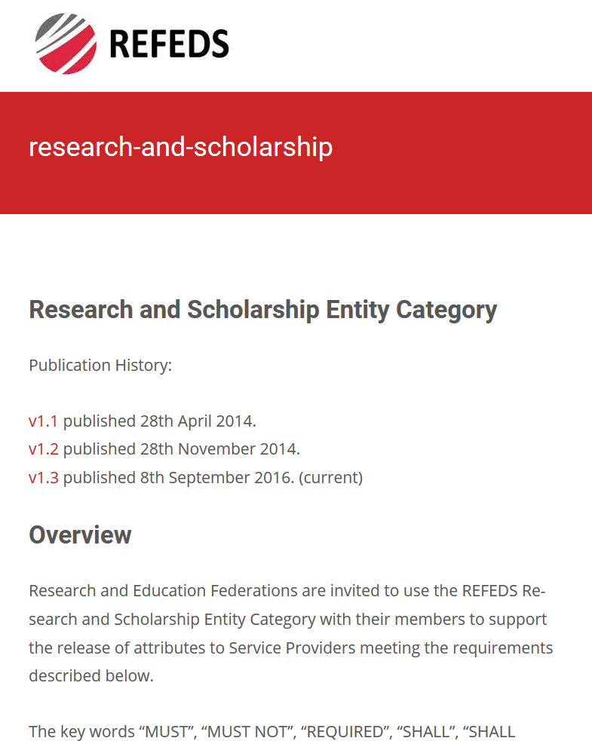
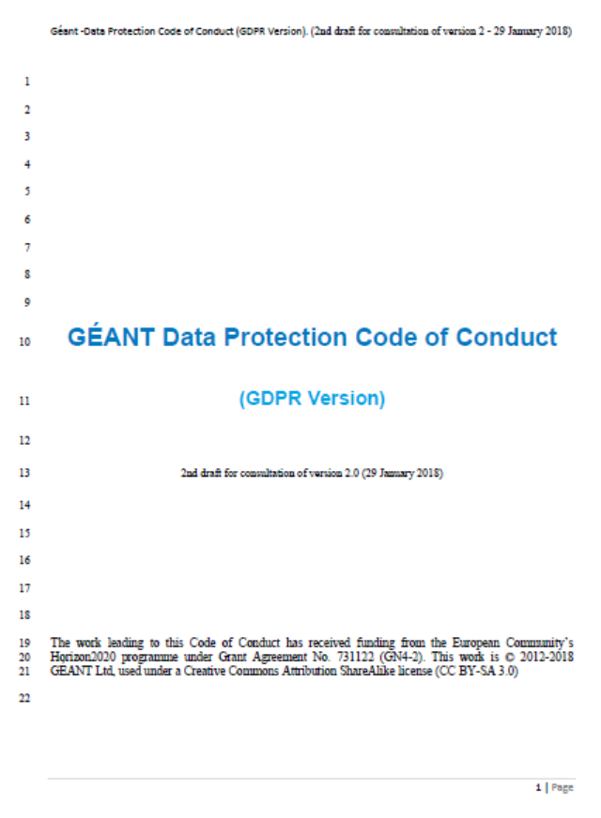
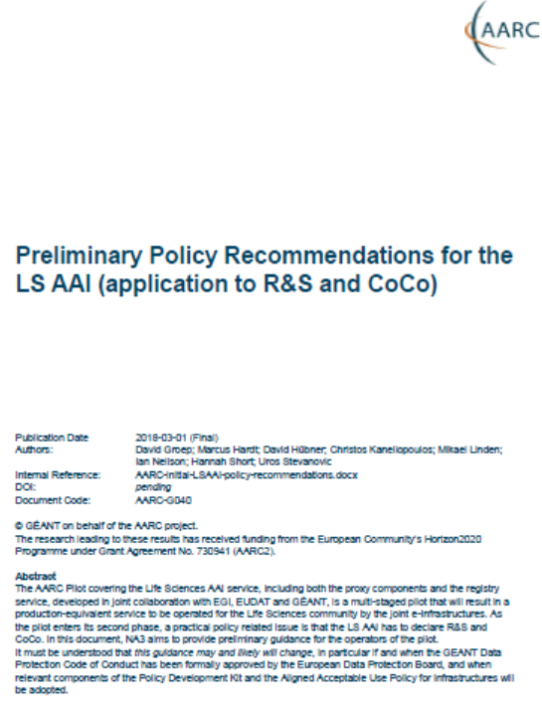
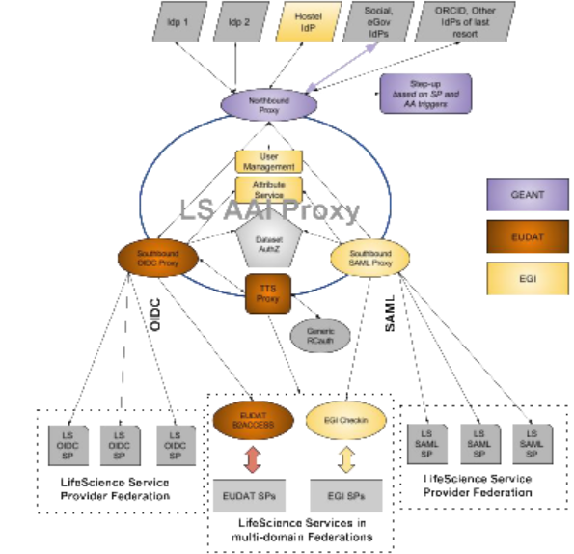
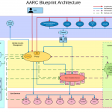
Implementing Snctfi: interpreting generic policies for BPA Proxy use cases
https://aarc-project.eu/guidelines/aarc-g040
REFEDS R&S: allow attribute flow from the IdPs, express intent and scope
GEANT DPCoCo & GDPR - ‘I’ll be good with personal data’
Casting policies into implementation and processes is a ‘bridging process’, requiring policy and architecture expertise and knowledge of the community use case
– i.e. the ingredients that make AARC!
LSAAI Infrastructures:
which components
will do what?
AARC-G040
AARC BPA: this is how information flows

Slide 20
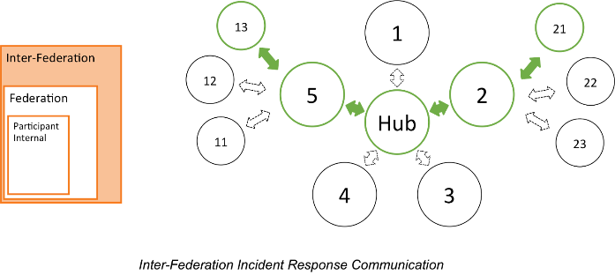

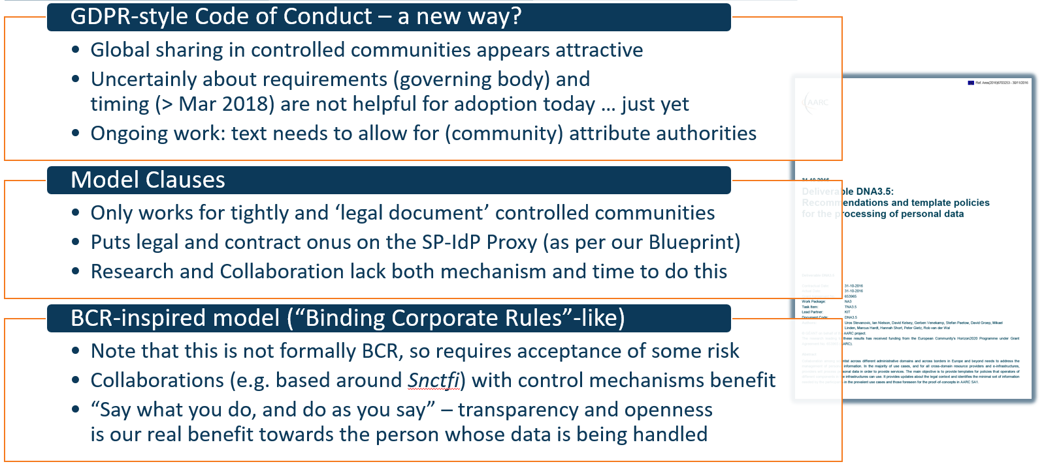

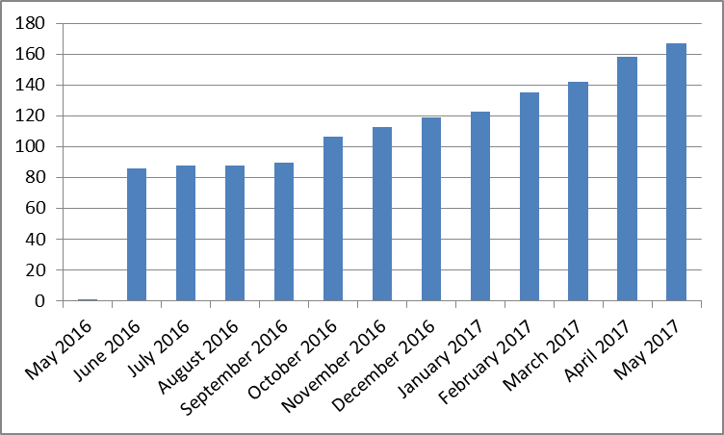
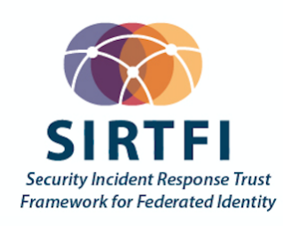
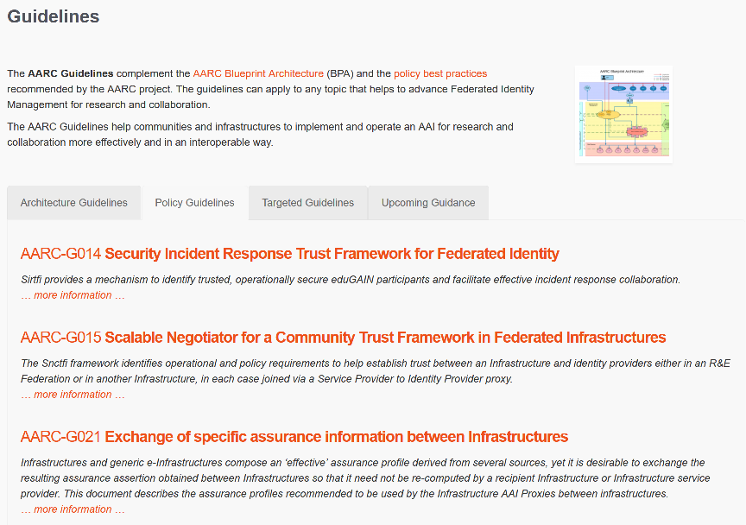
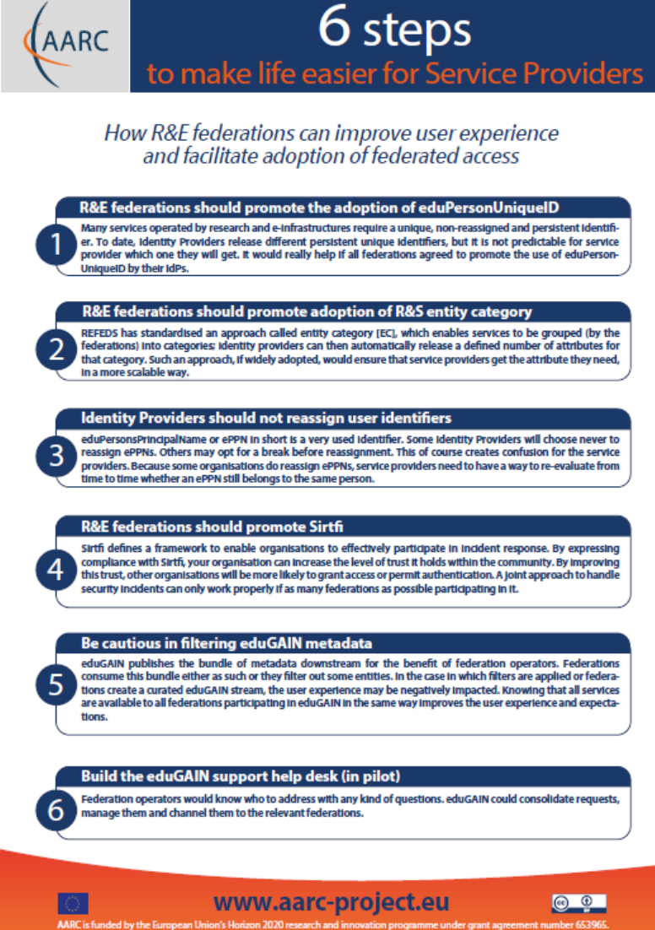
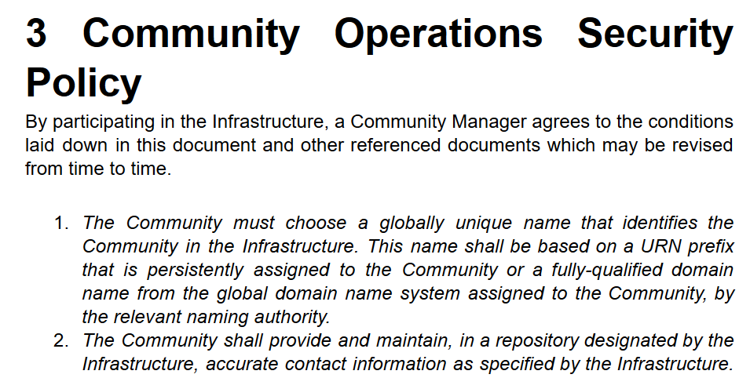
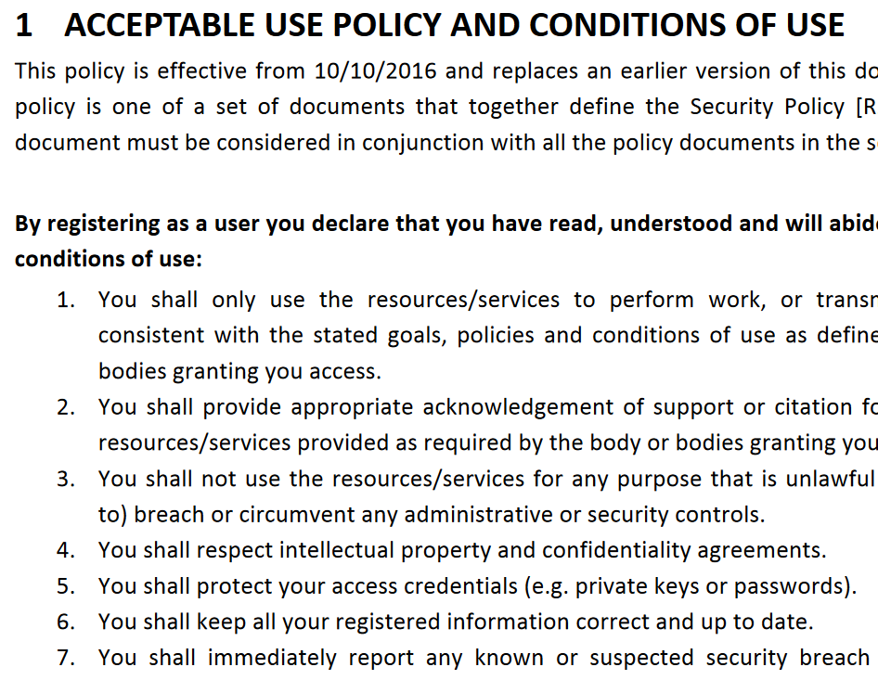





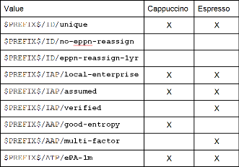
How can policy help you ease collaboration?
Operational Security
for FIM Communities
167 entities
supporting policies
for Infrastructures
bulk
model
support for
Researchers & Community
‘low-risk’ use cases
few unalienable expectations by research and collaborative services
generic
e-Infrastructure services
access to common compute and data services that do not hold sensitive personal data
protection of sensitive
resources
access to data of real people, where positive ID of researchers and 2-factor authentication is needed
engagement and coordination
Baseline Assurance
known individual
Persistent identifiers
Documented vetting
Password authenticator
Fresh status attribute
Self-assessment
Slice includes:
assumed ID vetting
‘Kantara LoA2’, ‘eIDAS low’, or ‘IGTF BIRCH’
Good entropy passwords
Affiliation freshness
better than 1 month
Slice includes:
Verified ID vetting
‘eIDAS substantial’, ‘Kantara LoA3’
Multi-factor authenticator
20

Slide 21
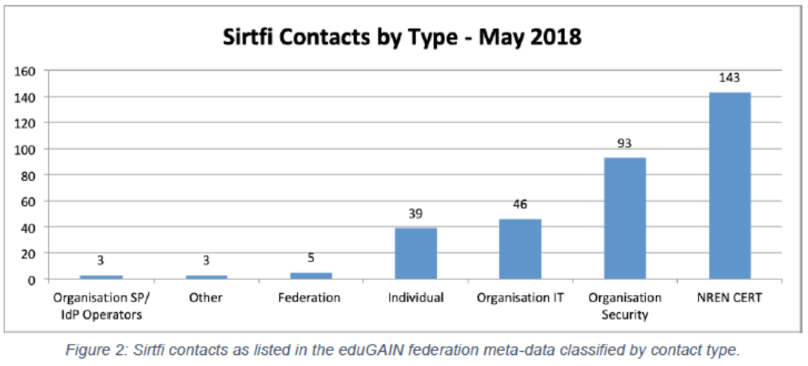
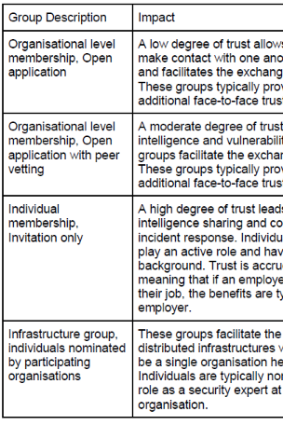
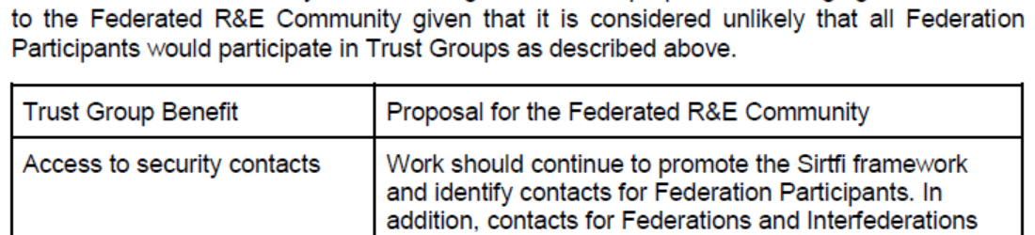
Responding to incidents – sharing relevant information
Sirtfi take-up at proper organizational level
Beyond basic Sirtfi
federation-level engagement in process
Sirtfi+ registry broadens global base
engagement in trust groups valuable
for federated collective response
from DNA3.2 Report on Security Incident Response and Cybersecurity in Federated Authentication Scenarios

Slide 22
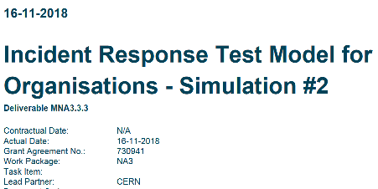
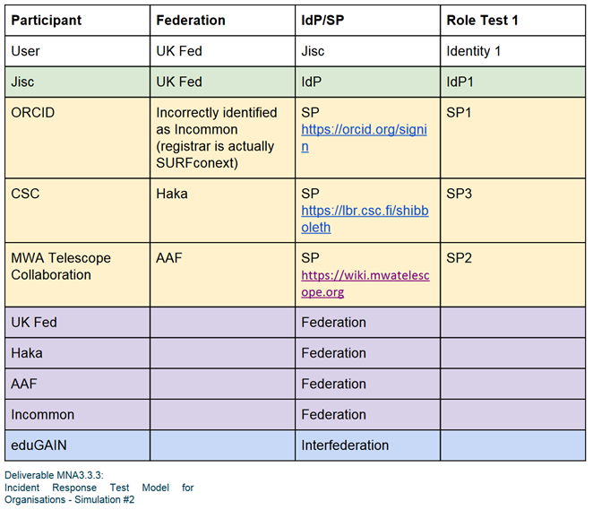
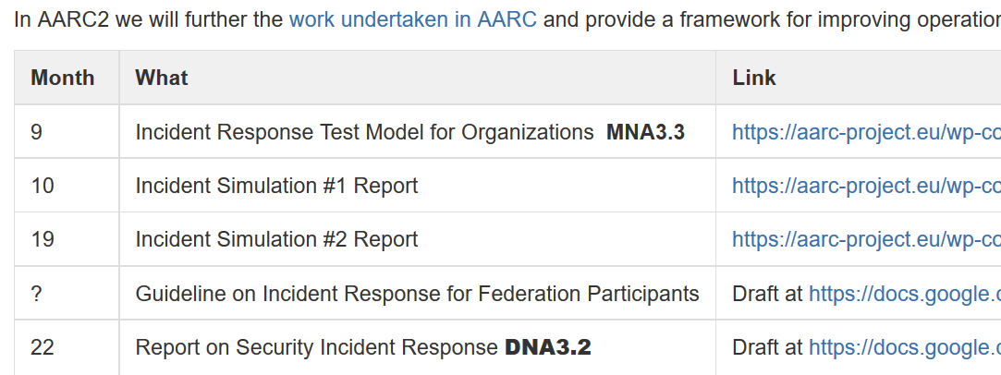
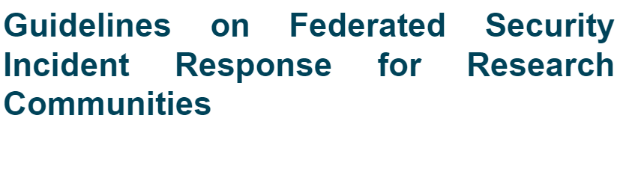
… the rest we test …
AARC-G051
https://wiki.geant.org/display/AARC/AARC2+NA3+Task+1+-++Overview
https://aarc-project.eu/guidelines/aarc-i051/

Slide 23
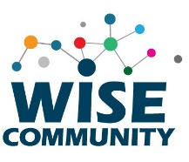
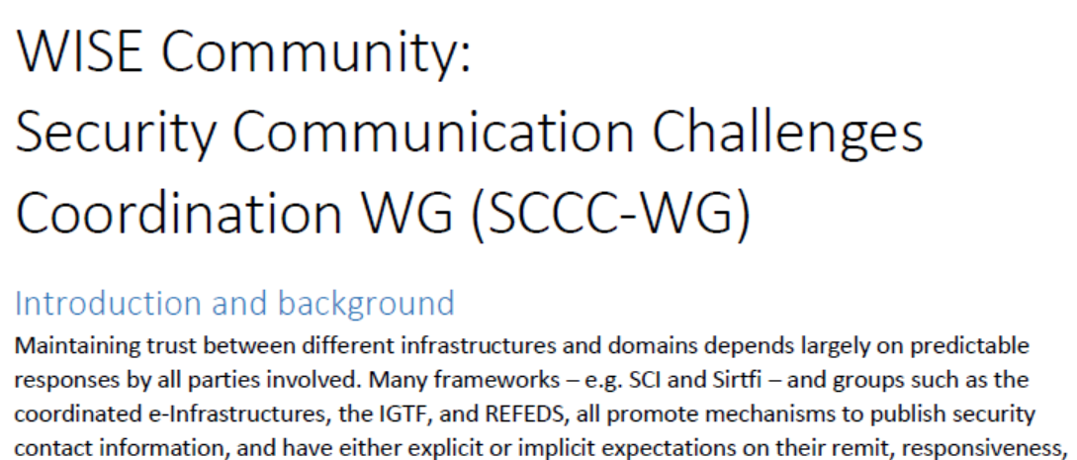
WISE SCCC WG
https://wise-community.org/events/
https://eventr.geant.org/events/3044

Slide 24
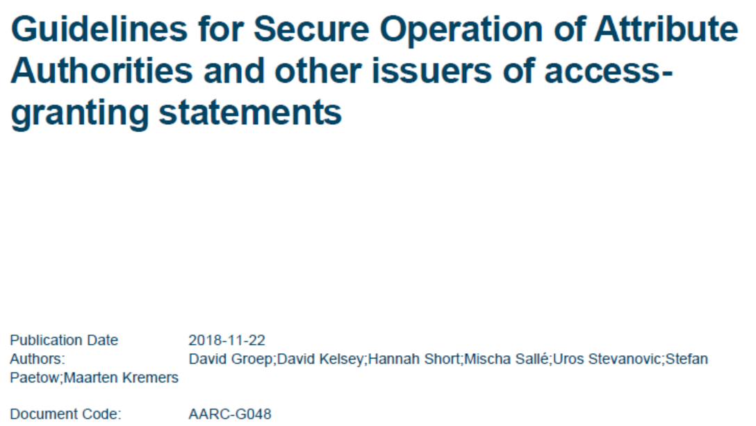
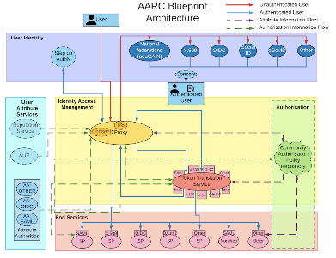
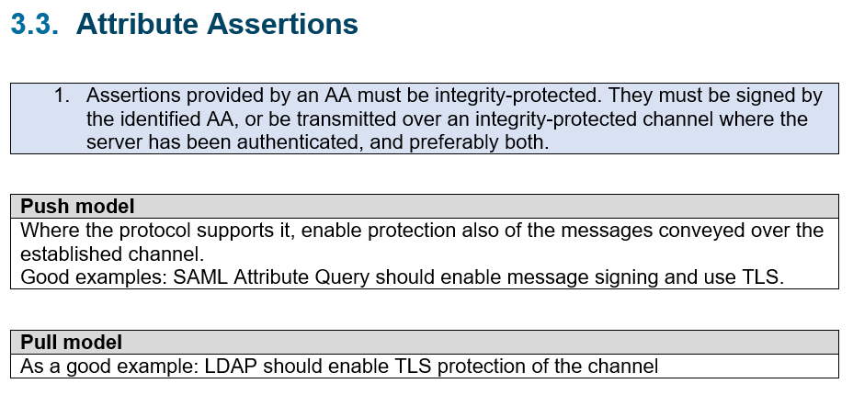
Attribute Authority Operations and ‘MMS assessment’
3. Operational Guidelines
3.1. Naming
3.2. Attribute Management and Attribute Release
3.3. Attribute Assertions
3.4. Operational requirements
3.4.1. Key Management
3.4.2. Network Configuration
3.5. Site Security
3.6. Metadata publication
3.7. Assessments and auditability
3.8. Privacy and confidentiality
3.9. Compromise and
disaster recovery
4. Relying Party obligations
`
https://aarc-project.eu/guidelines/aarc-g048/
https://www.eugridpma.org/guidelines/aaops/

Slide 25
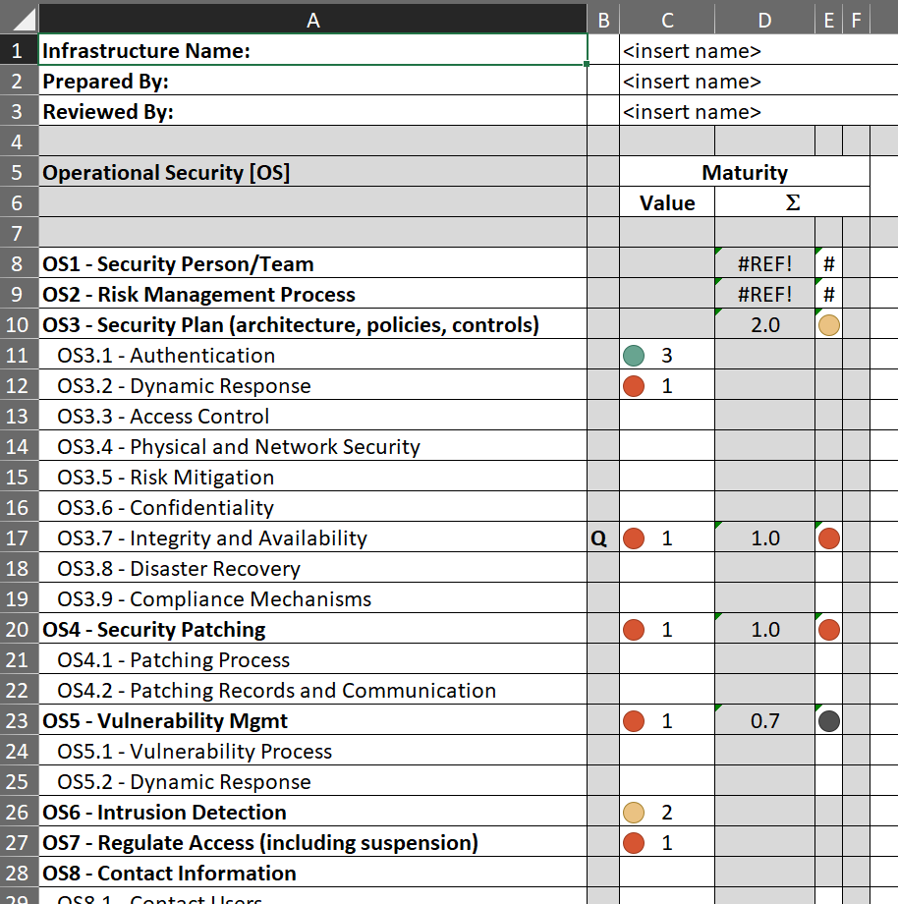
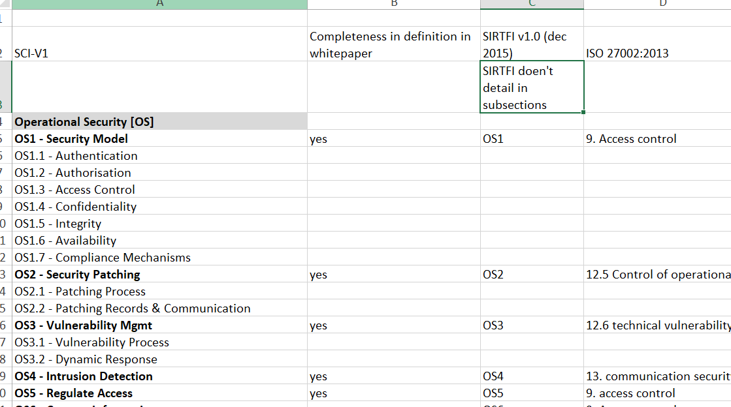
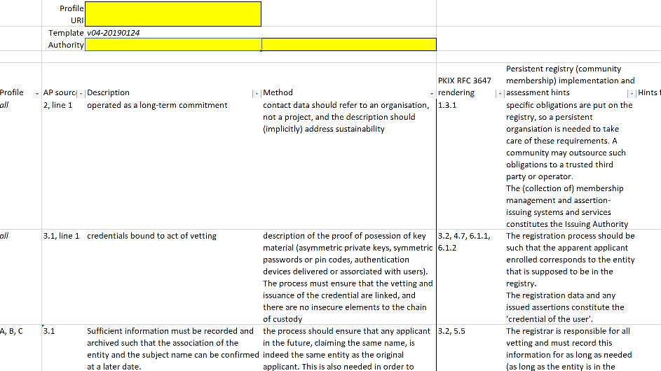
Service policies: helping peer-reviewed self-assessment in SCI and more
SCI assessment framework is there
mapping to ISO 27k is quite rough, though …
https://wiki.geant.org/display/WISE/SCIV2-WG+documents
http://wise-community.org/sci/
https://wiki.eugridpma.org/Main/AssuranceAssessment

Slide 26
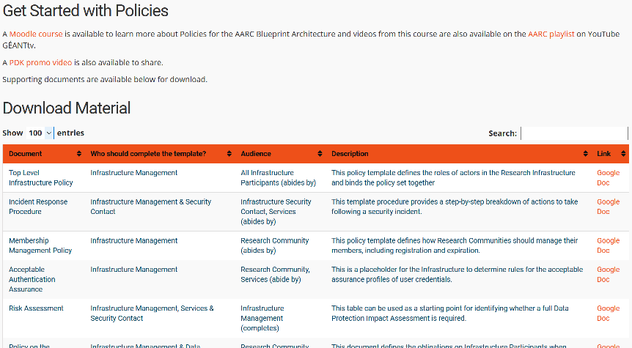
Policy Development Kit
introduction video – training – 9 reference templates – continuous improvement
https://aarc-project.eu/policies/policy-development-kit/

Slide 27
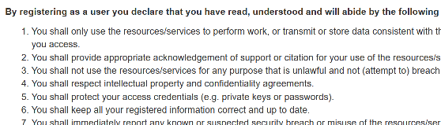
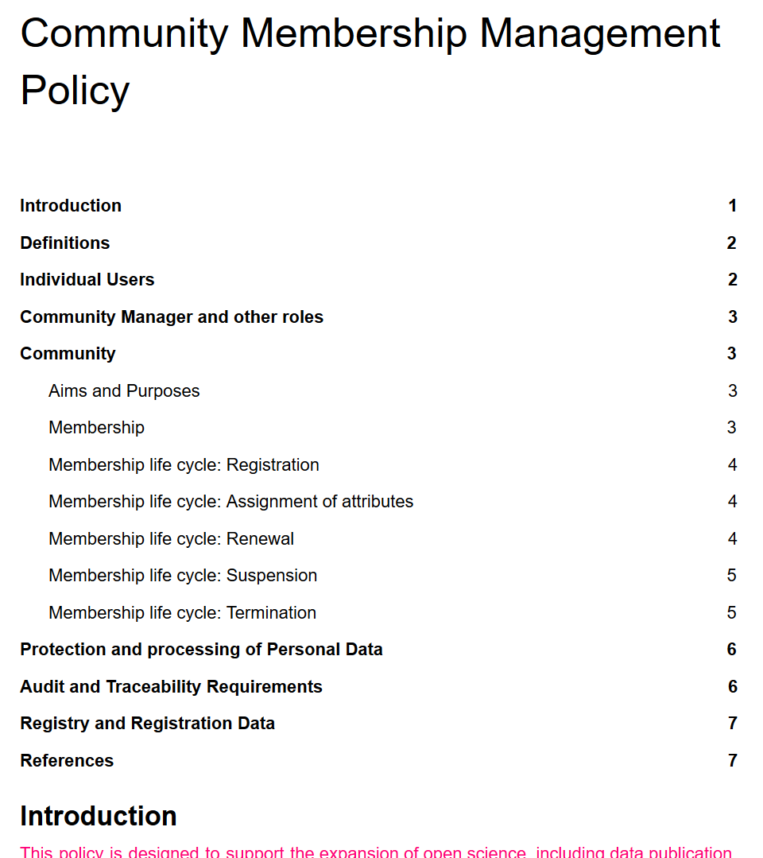
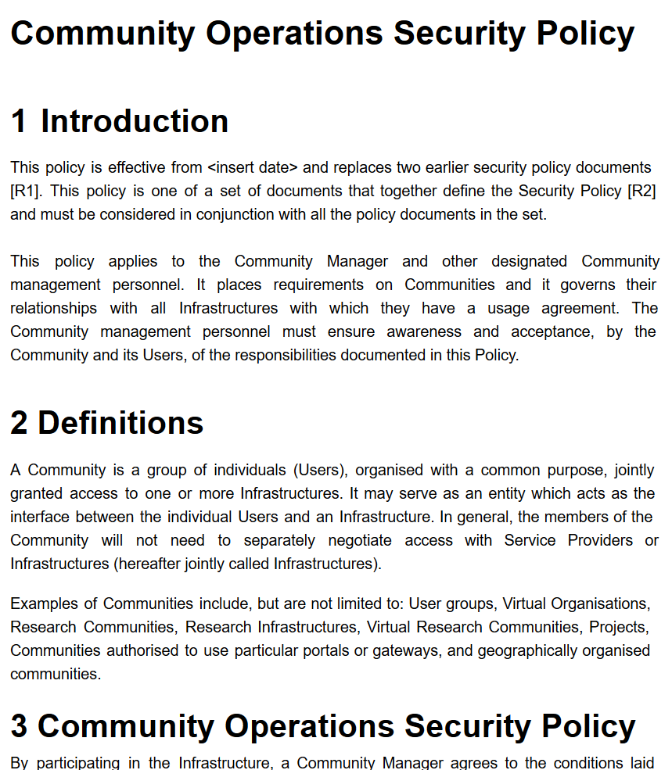
Guidance for research communities in the Infrastructure ecosystem
Authentication Assurance
using both REFEDS RAF components as well as cross Infrastructure profiles
considering social-ID authenticator assurance, complementing account linking in BPA
Exploit commonality between acceptable use
policies to ease cross-infrastructure resource use
Support community management using Snctfi
easing use of the generic e-Infrastructures
can you show community operations – sufficient to
act as a one-stop registration for every Infrastructure?

Slide 28


Differentiated Assurance Profile – in eduGAIN and REFEDS
Specific definitive guidance to IdPs and federations
Logical grouping and profiles for the Infrastructures
Uniqueness at least ePUID or ePTID/NameID
ID proofing: ‘low’ (good for local use), ‘medium’ (Kantara LoA2, IGTF BIRCH, eIDAS low), or ‘high’ (Kantara LoA3, eIDAS substantial)
Authenticator: devolved to REFEDS single and multi-factor authentication SFA and MFA
Freshness: better than 1 month
Any and all assurance profiles
organisational-level authority, also used locally for ‘real work’, good security practices
consolidation depends also on REFEDS SFA (which is not quite AARC…)
https://refeds.org/assurance

Slide 29


Example: “Espresso” profile for demanding use cases
‘goes well with’
alignment with REFEDS SFA/MFA WG is part of the work programme of AARC2

Slide 30







Using the REFEDS Assurance Framework in practice: the RAF Pilot ☺
Goal: gain practical experience with Assurance framework and REFEDS Single-factor authentication (SFA) profile, both on specification and in deploying existing SAML products
Today: both IdP software (now mostly Shibboleth) can express components and profiles, and use cases can leverage REFEDS assurance profiles (Cappuccino, Espresso) directly
https://wiki.refeds.org/display/GROUPS/Pilot+on+RAF+and+SFA
https://wiki.refeds.org/display/GROUPS/Pilot+resources

Slide 31


Re-usable Assurance between Infrastructures
BPA (community) proxy constructs identity based on multiple sources: home organisation, attributes, linked identities, authenticators
– and process these with (community-specific) heuristics
resulting assurance level may be different from one in home organization – and may depend on intelligence (components) that are
not ‘passable’ to the next (infrastructure) proxy
luckily: number of proxies in an exchange limited, and there’s explicit trust
AARC-G021
each BPA IdP-SP proxy should convey its ‘established assurance’
use a limited number of profiles targeted
at Infrastructure and Services risk levels (not in IdP capabilities)
re-use existing profiles as much as reasonable
AARC-G021: https://doi.org/10.5281/zenodo.1173558

Slide 32


Specific assurance information BETWEEN Infrastructures
from REFEDS Assurance Framework: Cappuccino, Espresso
from IGTF Assurance Profiles: BIRCH, DOGWOOD (https://iana.org/assignments/loa-profiles)
from the AARC JRA1 use case analysis: Assam – derived from a user-held social identity
social identity assurance level is ‘unique’
to the Infrastructure use case here, since
home IdPs in eduGAIN are not ‘social ID’
but proxies can use + augment social IDs
so out of REFEDS scope, but needed for AARC Infras
AARC-G041
https://aarc-project.eu/guidelines/aarc-g041/

Slide 33


High-assurance requirements
REFEDS RAF “Espesso” profile designed to support sensitive use cases
BBMRI definitely known to need it (and in DoW)
  biobanks by design contain sensitive data
  need for stringent access control,
  based around reviews and ethics commissions
  same researcher in different role
  may have different access rights even
NA3 survey for more use cases: adds ELIXIR
survey remains open for new cases –
community engagement around Policy Dev Kit
may identify more communities to consider risks
based on REFEDS RAF pilot and ‘Espresso’,
NA3 will do full (compliance) review with BBMRI
https://wiki.geant.org/x/woXABQ

Slide 34
Combining Assurance source - and policy in EOSC-hub
… just wait for Dave’s talk …

Slide 35



Assurance – standard profiles and ‘untangling spaghetti’
REFEDS RAF profiles (feasible assurance from all over R&E federations – as far as we can!)
inter-infrastructure profiles and relying-party oriented profiles (IGTF BIRCH, DOGWOOD)
how to express social media assurance, for citizen science and in support of account linking
https://www.iana.org/assignments/loa-profiles/

Slide 36




Interpreting the graphs
on context and missing ‘breadcrumbs’
components vs. profiles
implicit trust vs. completeness

Slide 37

Untangling Assurance Spaghetti:
Comparison Guide to Identity Assurance Mappings for Infrastructures
https://aarc-project.eu/guidelines/aarc-i050/

Slide 38

Divergence and convergence – the AUP Alignment Study
Image: Mozes en de tafelen der Wet, Rembrandt van Rijn, 1659

Slide 39
Scaling Acceptable Use Policy and data release
impractical to present user ‘click-through’ screens on each individual service
Community conditions
Community specific terms & conditions
Community specific terms & conditions
RI Cluster-specific terms & conditions
Common baseline AUP
for e-Infrastructures and Research Communities
(current draft: JSPG Evolved AUP –
leveraging comparison study and joint e-Infrastructure work)
Also picked up by others,
e.g. FH VORARLBERG
https://wiki.geant.org/x/P4bWBQ

Slide 40


WISE Baseline AUP – and how to apply it for your Infrastructure
AARC-I044
Includes the final WISE Baseline AUP text
for both ‘community-first’ and ‘user-first’
MMS services (attribute authorities)
examples make it concrete
Quick take-up by e-Infras
(both global and national)

Slide 41




Our collective wisdom from AARC2
plus all our AARC1 wisdom!
and the AARC-G051 incident response process

Slide 42
Life Beyond AARC

Slide 43
Beyond AARC – how can the good work continue and thrive?
EOSC-HUB: mainly WP4.4 “ISM”, WP5.1 “AAI”, and WP13 “Virtual Access” for RCauth
GN4-3: T5.1.4 – eduGAIN security operations and readiness
GN4-3: T5.4 – enabling communities
Without specific funding but endorsed by funded infrastructures & projects:
IGTF
Collaboration Agreement GN*-* and EOSC-HUB
WISE
AEGIS
REFEDS
FIM4R
Complementary sources: national e-Infrastructures, domain funding, ESFRIs and EOSC projects

Slide 44
Finding a home – some proposals
Sirtfi
already in a REFEDS WG (Sirtfi+)
‘response model’ to the extent it involves federations can go here as well
actual incident response plus readiness challenges on federated ID side go with
new eduGAIN security capability
Communications challenges for security that involve also the Infrastructures
WISE, specifically the new SCCC WG
needs some love and care from all Infrastructures
Infrastructure-specific challenges remain infrastructure, but coordinated through SCCC
like the IGTF RAT CC

Slide 45
Finding a home – some proposals
SCI Assessment
WISE SCI WG, with assessment in the IGTF
support through EOSC-HUB WP4.4 and GN4-3T5.4
but obviously also from PRACE, XSEDE, GridPP, SURF, &c
Assurance Profiles – from federations to Infrastructures, and between R/E infrastructures
the ‘feasible’ assurance and alignment with IdPs and federations belongs in REFEDS RAF
assurance requirements of, and exchange of assurance between, infrastructures: in IGTF
AUP and Terms of Use
the home is WISE SCI, but it needs care and nourishment from EOSCHUB and GN4-3
extends beyond just WP4.4/T5.4 and involves e.g. also eduTEAMS, CheckIn, B2ACCESS

Slide 46
Finding a home – some proposals
Data Protection and GDPR – service centric policy support
we should lean heavily on AndrewC and the TF-DPR, but more is needed
risk-assessment methodology for infrastructures and communities
consultancy role for new communities to enable use of the infrastructures -> mailing list?
joint GN4-3 + EOSC-HUB + WLCG effort, homed (for lack of anything else) in AEGIS?
Tuning the policy development kit
the WISE SCI WG can coordinate, but the effort should come from somewhere
again GN4-3 + EOSC-HUB (EGI, EUDAT) seem the natural choice, with input from PRACE
other sources have been very successful as well: HDF, GridPP, SURF
For the rest and new things needed, leverage GN-EOSCH collaboration agreement & AEGIS?
one-on-one consulting with communities highly appreciated also beyond AEGIS,
but must be and be seen as neutral (maybe a FIM4R or WISE WG? or RDA?)

Slide 47
From now on …
Coherency of vision and an umbrella for Collaborative policy work will be more challenging
Exploit personal overlap in the various groups (and cross-membership of lists)
Provide a forum for cross-fertilization through continued joint workshops

Slide 48
davidg@nikhef.nl

