Slide 1
Attribute Authority (and proxy) Operations
Completing the AARC G048bis process with ‘G071’
David Groep
AARC Community Policy WG
AEGIS February 2022 meeting
2022-02-14

Slide 2
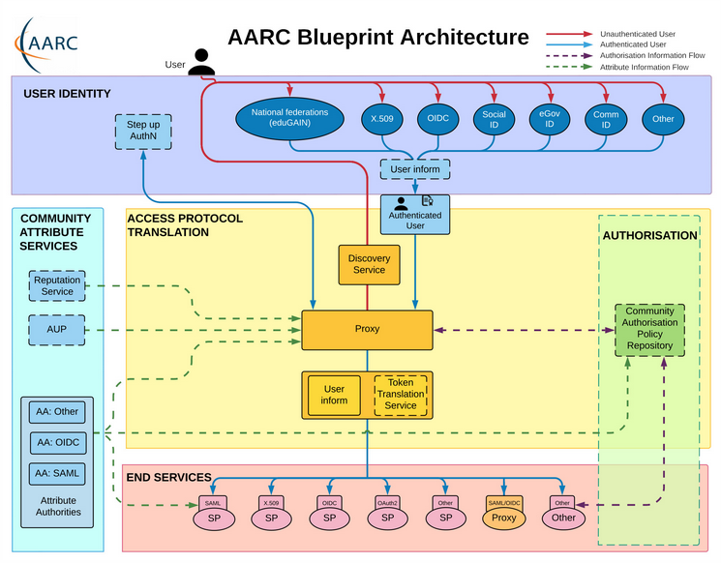
Operational guideline landscape for - proxy or source - AAI components
Authentication/identity sources
Sirtfi
(eduGAIN) baselining, RAF
IGTF AP Profiles
NIST SP800-63
eduGAIN sec. team workflow
RFC6238/4226 FIPS140
NISTSP800-53
Ephemeral credentials
trusted credential stores
protection at rest
Service provider operations
ISO27k
Sirtfi
Infrastructure response plans

Slide 3
Operational security focus in the BPA: beyond just the IdPs
Community membership management directories and attribute authorities
integrity of membership
identification, naming and traceability
site and service security
protection on the network
assertion integrity
Community membership management directories and attribute authorities
integrity of membership
identification, naming and traceability
site and service security
protection on the network
assertion integrity
Guidelines for Secure Operation of Attribute Authorities and other issuers of access-granting statements (AARC-I048, in collaboration with IGTF AAOPS)

Slide 4
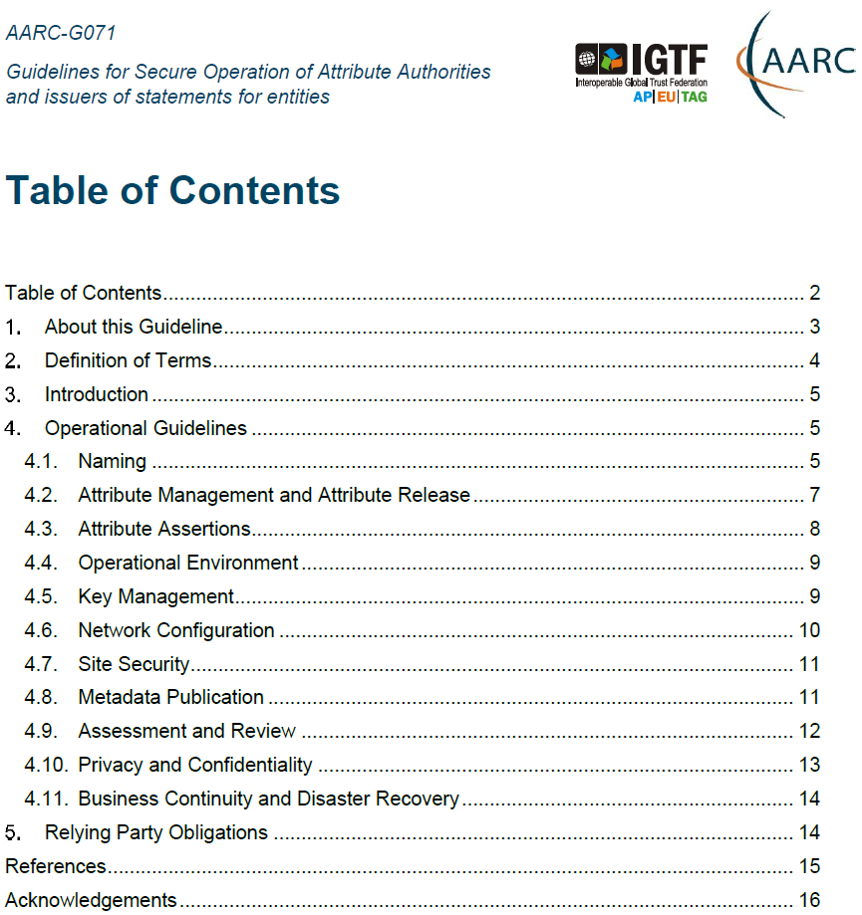
AARC-G071: keeping users & communities protected, moving across models
Structured around concept of “AA Operators”,
operating “Attribute Authorities”
(technological entities or proxies),
on behalf of, one or more, Communities, that are
trusted by Relying Parties
formerly AARC-G048bis
https://www.igtf.net/guidelines/aaops/
https://aarc-community.org/guidelines/aarc-g071/
Notes:
And dwells also on naming since that is the unique hook for the service providers to actually track back persistently to the proper community as well as operator …

Slide 5
Deployment guidance included …

Slide 6
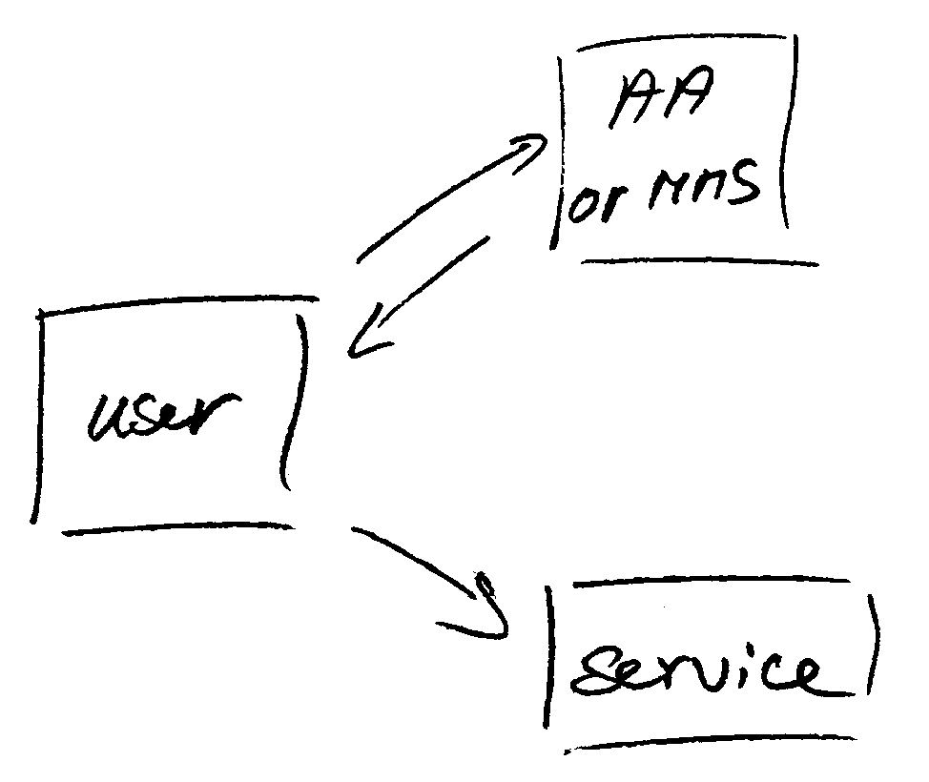
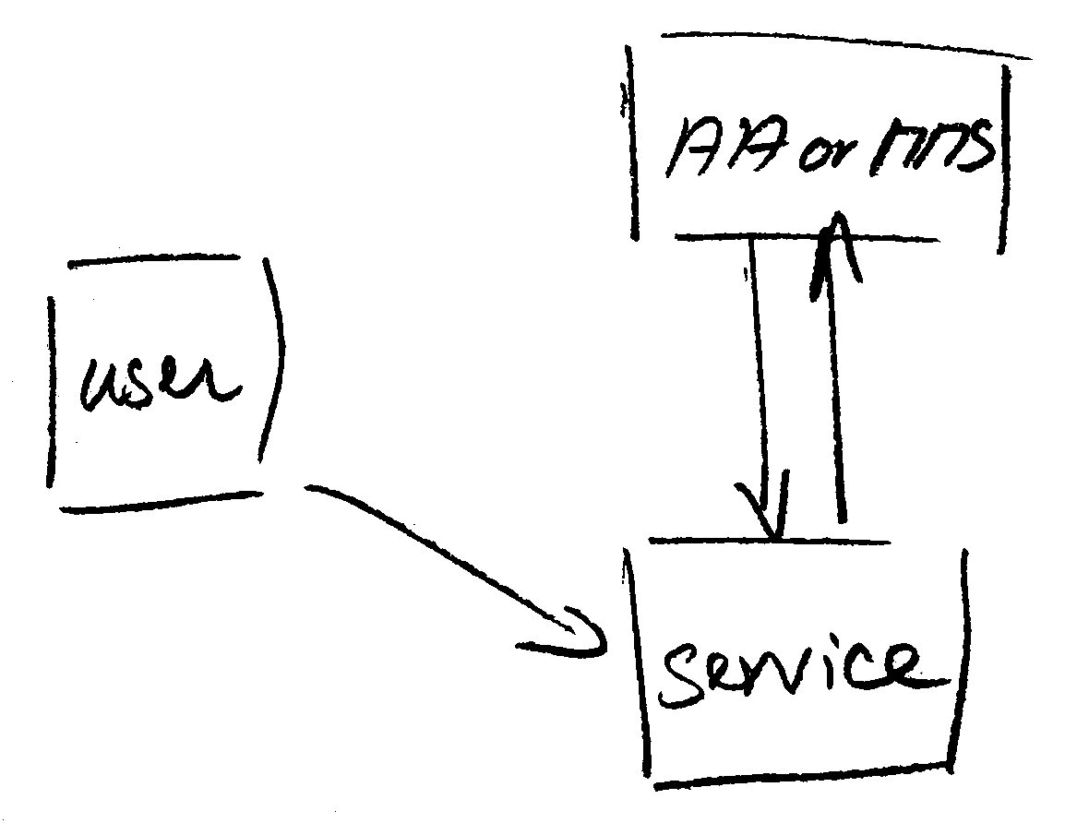
Protecting the community membership data and its proxy
Intentionally targeted broader than just the push model, since operational security spans data centres and infrastructures using other forms of AA membership management (SAML, OIDC, LDAP, …)
push model – the common BPA method (e.g. SAML AttributeStatement, VOMS AC)
pull model – common when using directories (e.g. LDAP in PRACE, userinfo endpoint in OIDC)
push and pull model diagrams as per RFC2904 – the 3rd (agent) model is uncommon in research/collaboration scenarios except for provisioning

Slide 7
When the AA is in a managed environment …
Many of the recommendations are already implemented ‘implicitly’
because common software implements it: e.g. signing SAML assertions and JWTs
because a good data centre already has network monitoring and central logging in place
because you signed up to Sirtfi (didn’t you?) – so you collaborate in incident response
because you have trained IT operations personnel looking after the service
And some are intuitive best practice
like assigning a unique and lasting name to a group
because implemented controls ought to be those that have been documented
Some items contain reminders about appropriate values and recommendations that are good practice - based on the relevant standards involved

Slide 8
Implementation of the AA Operations (“AAI proxy”) Security guidelines
AEGIS, major RPs, and Infrastructures reviewed it in light of their the current (up-to-date) use cases and models
Guideline aims at both Infrastructure and Community use cases, in any combination – independent of their business relationships
Useful input to the EOSC connected proxies as a good practice guideline
Does not address any assessment or review process, but does state what needs to be logged and saved to make (self) assessment, and incident response, possible
https://aarc-community.org/guidelines/aarc-g071/
it incorporated much of your input as well – thanks for that! Now is your 2nd chance …
https://wiki.geant.org/display/AARC/Attribute+Authority+and+Proxy+operational+security

Slide 9
davidg@nikhef.nl

