Slide 1
Attribute Authority Operations Revisited
A brief introduction to the AARC G048bis process
David Groep
AARC Community Policy WG
EUGridPMA 52 meeting
2021-06-08

Slide 2
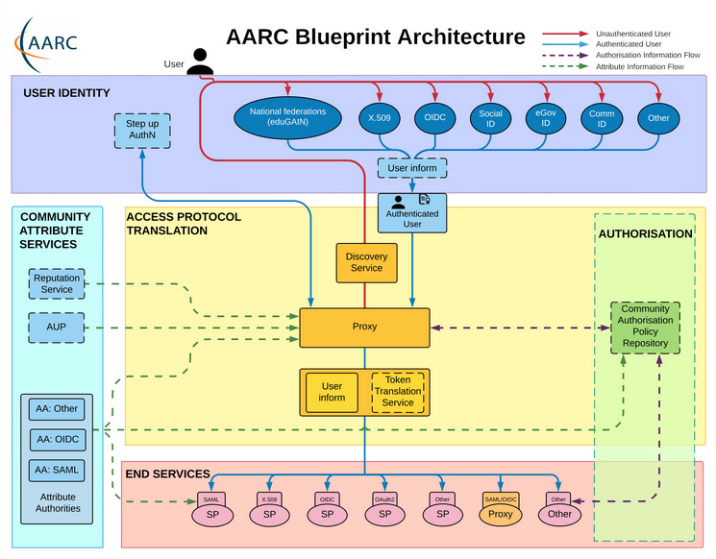
Operational guideline landscape for - proxy or source - AAI components
Authentication/identity sources
Sirtfi
(eduGAIN) baselining
IGTF AP Profiles
NIST SP800-63
eduGAIN sec. team workflow
MFA
RFC6238/4226
FIPS140
NISTSP800-53
Ephemeral credentials
trusted credential stores
protection at rest
Service provider operations
ISO27k
Sirtfi
Infrastructure response plans

Slide 3
Operational security focus in the BPA: beyond just the IdPs
Community membership management directories and attribute authorities
integrity of membership
identification, naming and traceability
site and service security
protection on the network
assertion integrity
Community membership management directories and attribute authorities
integrity of membership
identification, naming and traceability
site and service security
protection on the network
assertion integrity
Guidelines for Secure Operation of Attribute Authorities and other issuers of access-granting statements
(AARC-I048, in collaboration with IGTF AAOPS)

Slide 4
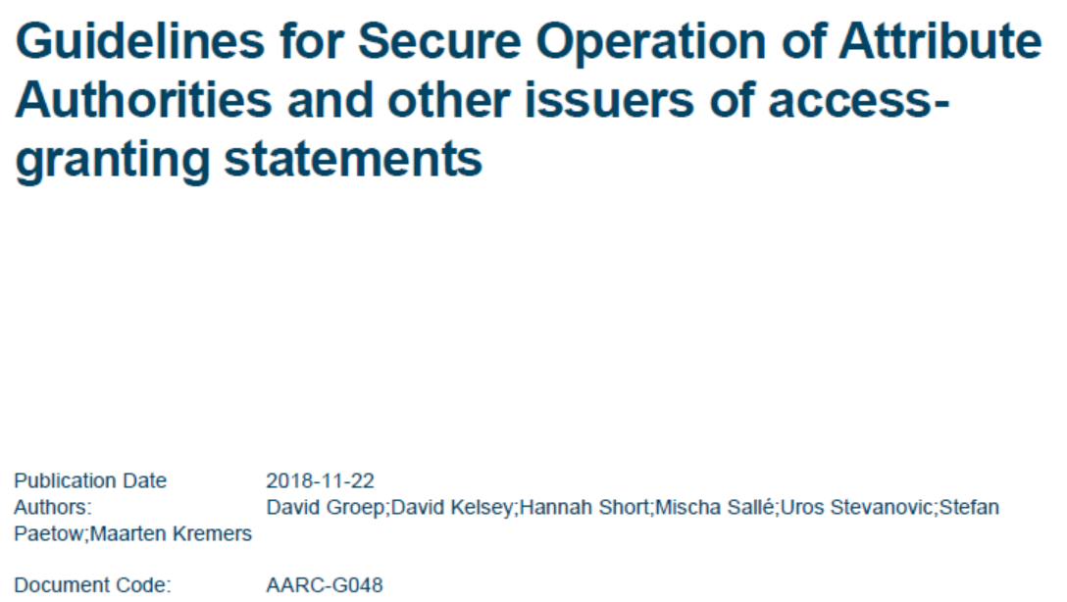
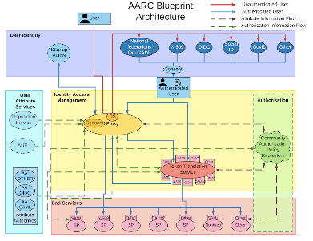
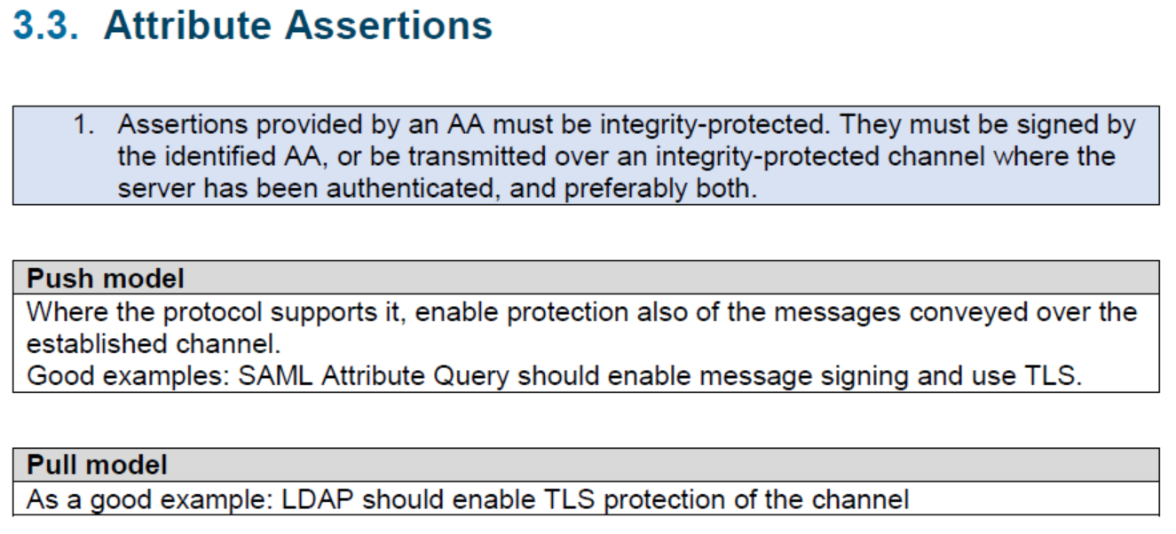
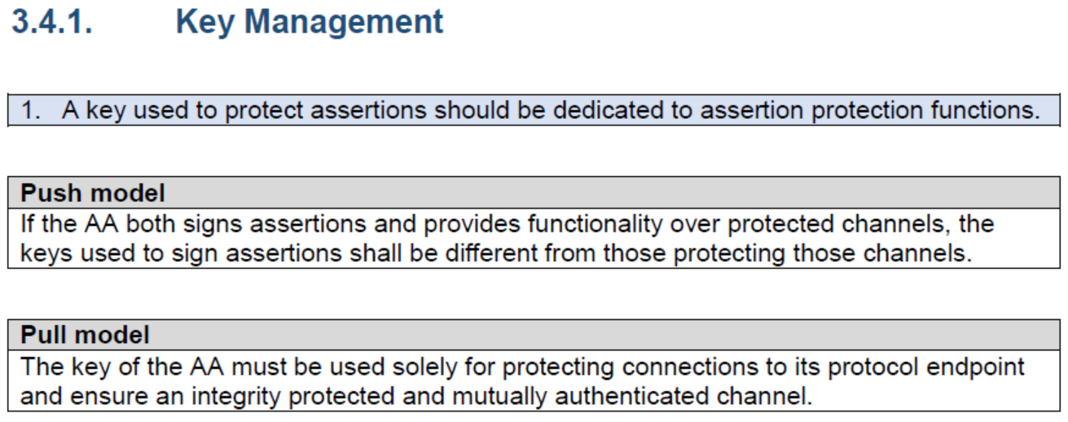
AARC-G048: keeping users & communities protected, moving across models
trusted delegation of response from communities to operators,
and from services to communities in recognizing their assertions
Structured around concept of “AA Operators”,
operating “Attribute Authorities” (technological entities),
on behalf of, one or more, Communities
`
https://www.igtf.net/guidelines/aaops/
https://aarc-community.org/guidelines/aarc-g048/
Notes:
And dwells also on naming since that is the unique hook for the service providers to actually track back persistently to the proper community as well as operator …

Slide 5
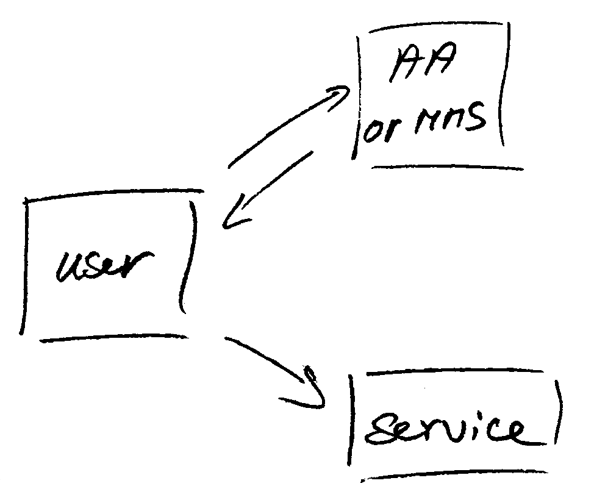
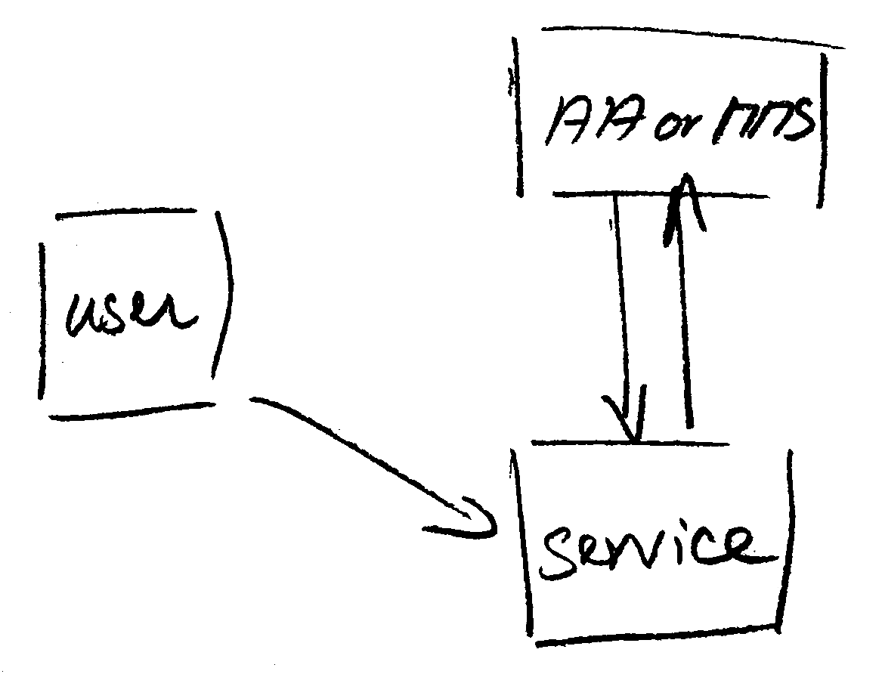
Protecting the community membership data and its proxy
Intentionally targeted broader than just BPA-style communities, since operational security spans data centres and infrastructures using other forms of AA membership management
push model – the common BPA method
(e.g. SAML AttributeStatement, VOMS AC)
pull model – common when using directories
(e.g. LDAP in PRACE, GUMS in OSG)
push and pull model diagrams as per RFC2904 – the 3rd (agent) model is uncommon in research/collaboration scenarios except for provisioning

Slide 6
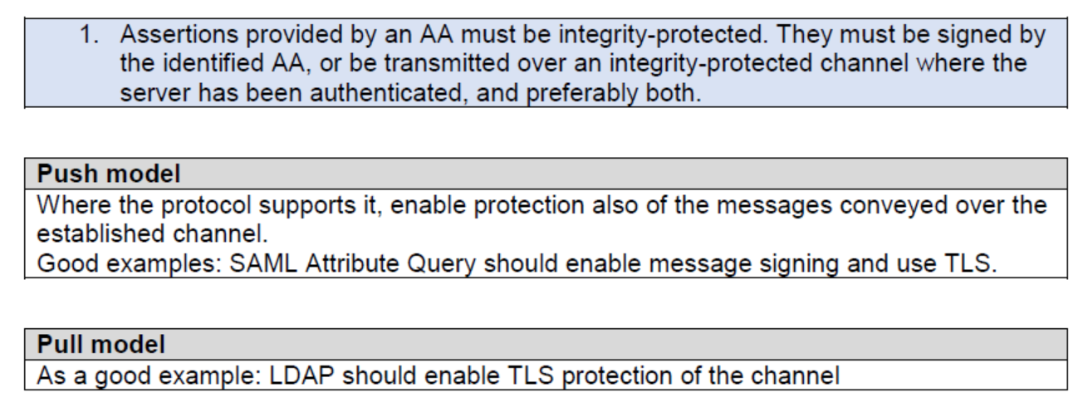
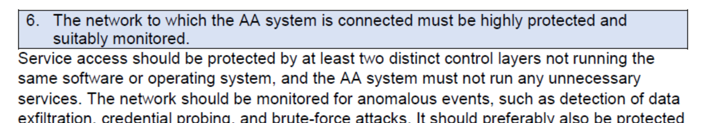
Deployment guidance included …

Slide 7
When the AA is in a managed environment …
Many of the recommendations are already implemented ‘implicitly’
because common software implements it: e.g. signing SAML assertions and JWTs
because a good data centre already has network monitoring and central logging in place
because you signed up to Sirtfi (didn’t you?) – so you collaborate in incident response
because you have trained IT operations personnel looking after the service
And some are intuitive best practice
like assigning a unique and lasting name to a group
because implemented controls follow ought to be those that have been documented
But some items contain specific values and recommendations that are good practice,
but where best practice varies among constituencies

Slide 8
Forward looking and specific requirements
Controls that are specific to AA operations and protect against current and future threats
minimum signing key length so that the community is not broken in the next few years (at least 112-bit symmetric, i.e. >=2048 bit RSA keys)
protect the key from data breaches, compromise, ransomware, and exfiltration by using HSM Hardware Security Modules or equivalent controls (and the HSMs you need are not that expensive, or you can even rent them in AWS…)
Or deal with commensurate incident response (you don’t want just a big red button):
re-issuance of attribute statement must be based on fresh data
release them only in accordance with the community’s policy and maximum life time
require appropriate client authentication before releasing attributes to prevent data breaches
for non-revocable tokens (like OAuth Access Tokens or PKIX 3820 proxies), limit life time <24hrs
(for OIDC, these are anyway typically 15 minutes)

Slide 9
G048 AA Ops guidelines and AA hosting
Guideline was written with both physical and virtual deployment in mind
“An AA may be run in a virtual environment that has security requirements the same or better than required for the AA, and for all services running in this environment, and it must not leave this security context. Any virtualization techniques employed (including the hosting environment) must not degrade the context as compared to any secured physical setup. Only AA Operator designated personnel should have control over the virtualisation and security context of the AA.”
if you can host it on-prem, the easiest solution is to host it on your security-service VM infrastructure (e.g. alongside your IdP, your AD, or your master LDAP servers) to limit guest compromise)
If you run it in a cloud provider, select a provider that offers proper security and network controls, implement account role separation, and deploy the offered protections. E.g. in AWS you have a lot of controls available to do so. But Azure &co have the same … and rent a netHSM

Slide 10
Implementation of AA Operations Security guidelines
via AEGIS, major RPs and Infrastructures reviewed it in light of their the current (up-to-date) use cases and models
review showed the doc has some ‘hidden legacy’
(too specific in some cases, but then vague for other scenarios)
some acronyms were taken for granted (RP, OP, &c)
wording unintentionally conveyed that ‘physical on-prem’ was required
guideline put emphasis on community autonomy (and responsibility) which some infrastructures may want to see as a ‘business relationship’ with their community
but then, what ‘community’ means in a context is easy to mix up, as seen in
the community membership management discussion in UK IRIS yesterday
https://wiki.geant.org/x/-YVgBw
https://docs.google.com/document/d/1-hbqSpQegm7UaC_wupFzFMm19Q024UPkG-8Jwokkmzc
https://wiki.geant.org/display/AARC/Attribute+Authority+and+Proxy+operational+security

Slide 11
Discussion items: auditability, integrity, logging, and incident response
Section 3.7, item 2, "The AA Operator must record and archive at lest the follow for all its hosted AAs . . . (b) all issued attribute assertion . . ."
GEANT (Christos): This implies that the AA operator will have to keep in its logs all the personal data of the user. It makes more sense to log information about the identification of the (e.g. community identifier) and assertions that can be used for authorization, but not information like name, email address etc of the user.
Section 3.6, item 6: "The AA Operator must accept being audited following reasonable requests from a Community it serves and from relying parties […]”
GEANT (Christos): This is something that is typically part of the contractual relationship between the AA operator and the community. Such a requirements has many assumption about the business relationships between the parties.

Slide 12
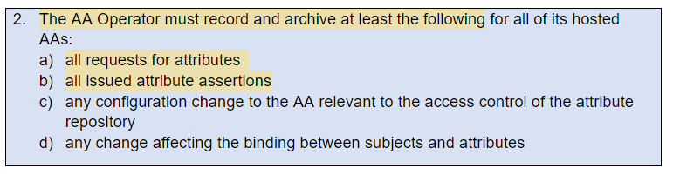
On auditablility and having the logs to ability to do incident response
Section 3.7, item 2, "The AA Operator must record and archive at lest the follow for all its hosted AAs . . . (b) all issued attribute assertion . . ."
GEANT: This implies that the AA operator will have to keep in its logs all the personal data of the user. It makes more sense to log information about the identification of the (e.g. community identifier) and assertions that can be used for authorization, but not information like name, email address etc of the user.
EUDAT: sees GDPR issues
XSEDE (JimB): Archiving the results of every LDAP query for 400 days seems excessive.
(and besides, there are more absolute numbers in the document)

Slide 13
Disaster recovery and response to compromise
Section 3.9 "The AA operator must have an adequate compromise and disaster recovery procedudre and must be willing to disclose this to the hosted Communities or to either an assessor or all related relying parties"
GEANT: This is something that is typically part of the contractual relationship between the AA operator and the community. Such a requirements has many assumption about the business relationships between the parties. [echoed by EUDAT]
But beware of writing this in such a way that compromise and recovery leaves the relying parties in the cold!
Importance of BC/DR and compromise handling is for RPs, who are typically left with absorbing all risk, cost, and liability, if not formally than at least in practice … !

Slide 14
Community relations – on resp. duties of customers and AAOPS providers
Section 3.3, item 5: "The AA Operator must only issue Attribute Assertions or release attributes to requesters in accordance with the Community policies."
GEANT (Christos): This implies that a certain type relation between the community and the AA operator, which is not always the same. In the eduTEAMS Shared Service, the policies are owned and managed by GEANT for example.
Section 3.6 “[publishing by AAOP] a web URL to a general information page about the community"
GEANT: Again, this implies that the relationship of the relying party is with the AA operator and not with the community. This is correct in some case, but incorrect in others
“not using project domain names unless due organizational care is taken“
XSEDE (JimB): Are we not allowed to use xsede.org names?

Slide 15
Section 3.2, item 3 "The AA Operator must collect and publish the community documents for the benefits of Relying parties"
GEANT (Christos): This recommendation assumes a certain model of operation where the Relying Parties have a relationship directly with the AA operator. This is not the case everywhere and actually in most of the cases that we know it is not like that.
EUDAT (Sander): I agree that there is not always a relationship between AA and RP.
Section 3.3, item 2: “This may mean that AAs require client authentication, in addition to the encryption of the messages and the communication channel”
EUDAT (Sander): IMHO client authentication should be recommended. This would enhance the data protection, too.

Slide 16
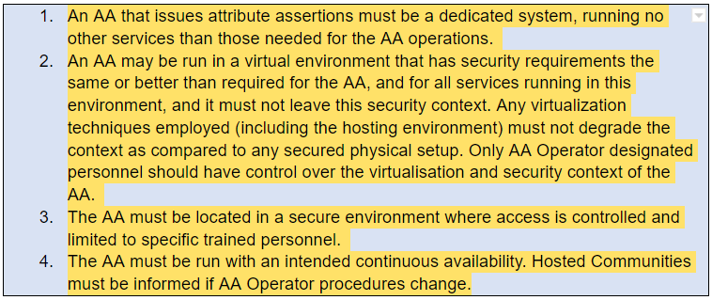
About protections and isolation
Section 3.4
GEANT: The document seems to suggest that running services on dedicated systems is better than running services on a virtualised system and furthermore, hat running service on your own data centre is more secure than using a public cloud. We believe this notion, might have been valid 5 years ago, but this does not reflect the current common practices. Furthermore, the statement "Only AA Operator designated personnel" seems to be in contradiction to running AA services on public clouds
EUDAT: This sounds like you need hardware for the AA. I do not agree with it. Of course they must secured, but not dedicated hardware. This statements should be a dedicated subsection, e.g. server requirements.

Slide 17
Enforcement by contract or by doing it: it is not clear enough in the doc
Section 3.5 "The AA Operator should document the physical site security controls and maintain them in a state consistent with the security requirements of the hosted Communities.”
GEANT: Again, to a reader it seems that the document implies that running AA service in your own physical location is better than running them on a public cloud. Of course there must be physical security control on the physical infrastructure, but the wording could be changed not to leave the read with the feeling that the rule it that they have to run their own infrastructure
Yet also, by EUDAT: Is documentation available for communities and RPs?
This security controls are important to diced to trust the AA operator.
"encouraged to consider using an HSM to store signing keys“
XSEDE (JimB): is this a requirement or recommendation? Unclear and often infeasible.

Slide 18
On explicit limits and specifications
Section 3.3, item 3:
"If an AA Operator issues Attribute Assertions containing a lifetime, this lifetime must be compliant with the Community policies, be no more than 24 hours, and the Attribute Assertion must not be valid beyond the validity period of the attributes it contains. The Community Management is responsible for the content of the Attribute Assertion, as issued, during its entire lifetime"
GEANT (Christos): The document tends to be pretty high level, but at some points it becomes very specific. Where the requirements for no more than 24 hours is coming from? This should be something that should following the requirements of the communities and the relying parties.
and EUDAT sees a potential conflict with community policies as well

Slide 19
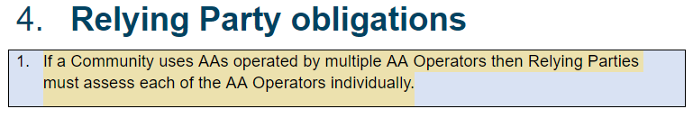
Unclarity in the text and use case description
EUDAT: IMHO communities must ensure in this case, that they do not release contradictory attributes, specially because the RP must fetch all AAs.
which indicates that the text is unclear. This was intended not model where they are augmenting, but as a multi-homes community with redundant AAs ☺

Slide 20
davidg@nikhef.nl

