Slide 1
Attribute Authority Operations
A fond of knowledge worth protecting
David Groep
AARC Community Policy WG
AEGIS meeting
2020-02-10

Slide 2
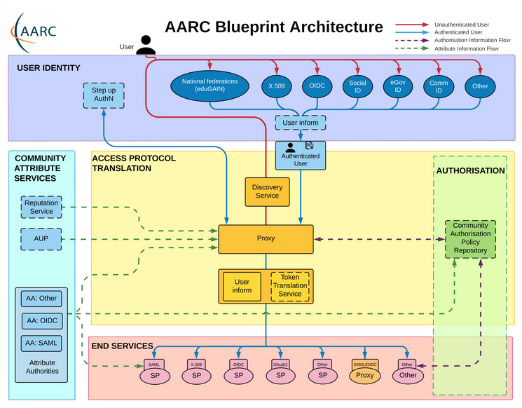
Operational guideline landscape for - proxy or source - AAI components
Authentication/identity sources
Sirtfi
(eduGAIN) baselining
IGTF AP Profiles
NIST SP800-63
eduGAIN sec. team workflow
MFA
RFC6238/4226
FIPS140
NISTSP800-53
Ephemeral credentials
trusted credential stores
protection at rest
Service provider operations
ISO27k
Sirtfi
Infrastructure response plans

Slide 3
Operational security focus in the BPA: beyond just the IdPs
Community membership management directories and attribute authorities
integrity of membership
identification, naming and traceability
site and service security
protection on the network
assertion integrity
Guidelines for Secure Operation of Attribute Authorities and other issuers of access-granting statements
(AARC-I048, in collaboration with IGTF AAOPS)

Slide 4
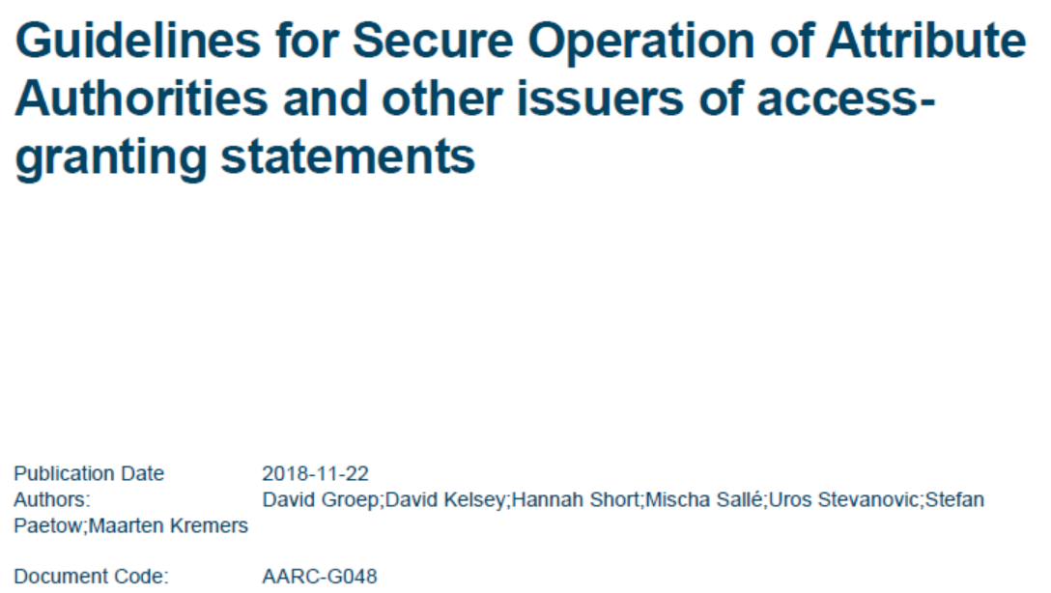
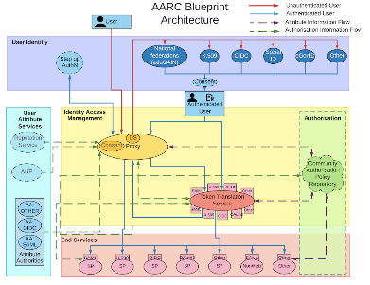
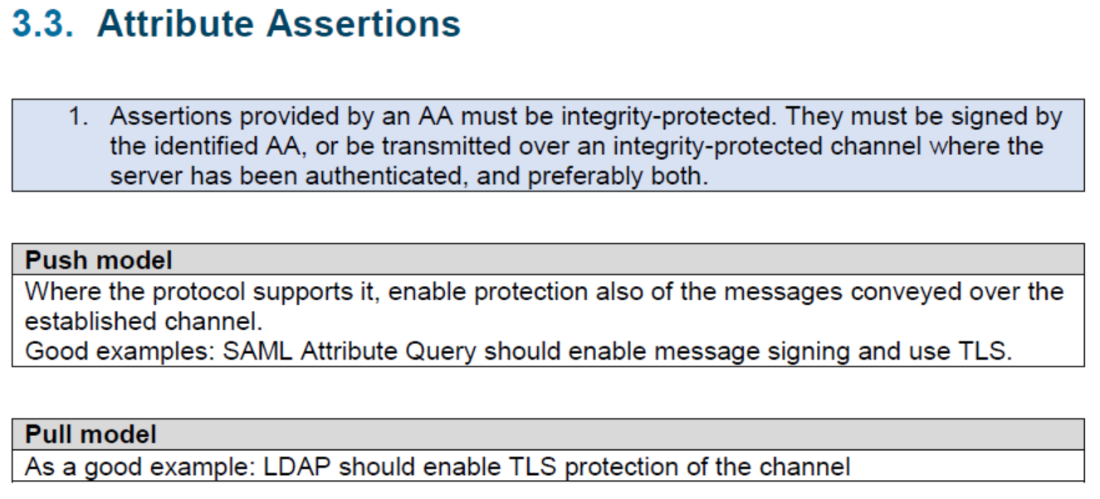
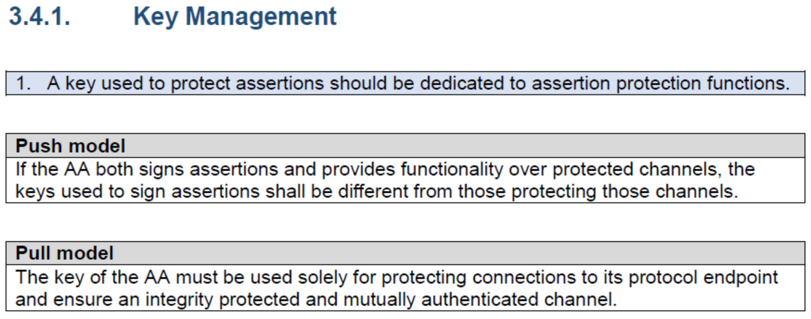
AARC-G048: keeping users & communities protected, moving across models
trusted delegation of response from communities to operators,
and from services to communities in recognizing their assertions
Structured around concept of “AA Operators”,
operating “Attribute Authorities” (technological entities),
on behalf of, one or more, Communities
`
https://www.igtf.net/guidelines/aaops/
https://aarc-community.org/guidelines/aarc-g048/
Notes:
And dwells also on naming since that is the unique hook for the service providers to actually track back persistently to the proper community as well as operator …

Slide 5
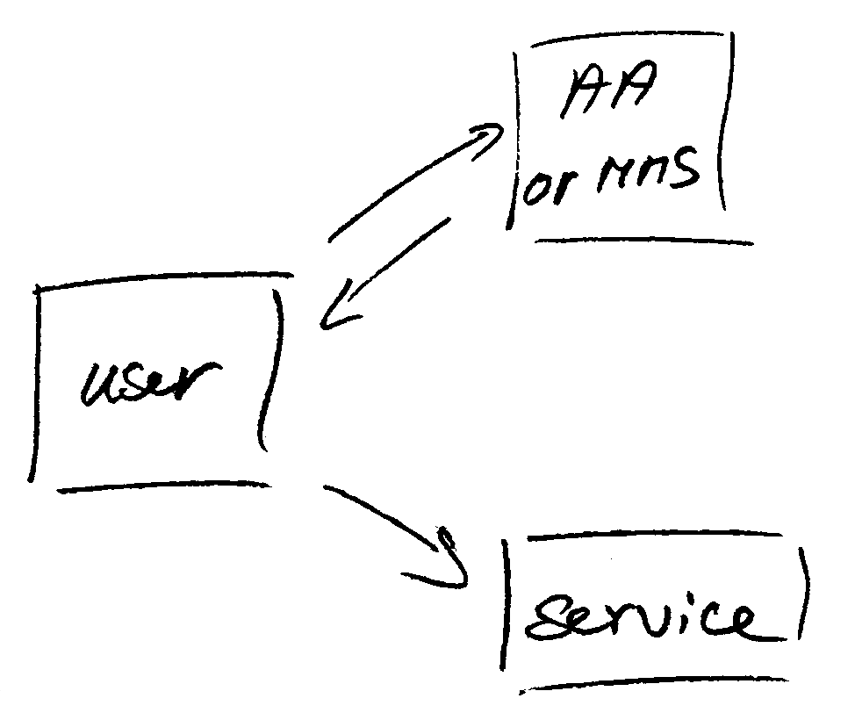
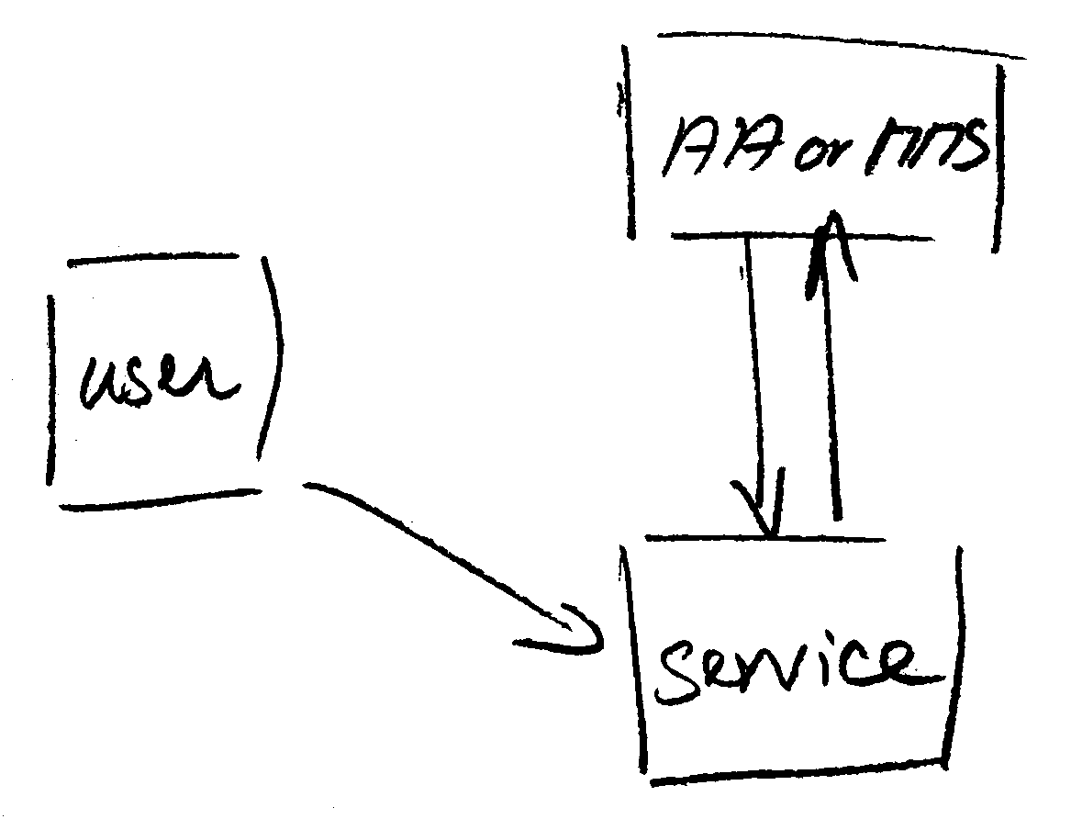
Protecting the community membership data and its proxy
Intentionally targeted broader than just BPA-style communities, since operational security spans data centres and infrastructures using other forms of AA membership management
PRACE: ‘pull model’ directory-based communities
BPA: encourages ‘push model’ attribute-carrying service requests
push model – the common BPA method
(e.g. SAML AttributeStatement, VOMS AC)
pull model – common when using directories
(e.g. LDAP in PRACE, GUMS in OSG)
push and pull model diagrams as per RFC2904 – the 3rd (agent) model is uncommon in research/collaboration scenarios except for provisioning

Slide 6
When the AA is in a managed (and in a data centre) …
Many of the recommendations are already implemented ‘implicitly’
because common software implements it: e.g. signing SAML assertions and JWTs
because a good data centre already has network monitoring and central logging in place
because you signed up to Sirtfi (didn’t you?) – so you collaborate in incident response
because you have trained IT operations personnel looking after the service
And some are intuitive best practice
like assigning a unique and lasting name to a group
because implemented controls follow ought to be those that have been documented

Slide 7
Forward looking and specific requirements
Some controls are specific to AA operations and protect against current and future threats:
minimum signing key length so that the community is not broken in the next few years (at least 112-bit symmetric, i.e. >=2048 bit RSA keys)
protect the key from data breaches, compromise, ransomware, and exfiltration by using HSM Hardware Security Modules or equivalent controls (and the HSMs you need are not that expensive, or you can even rent them in AWS…)
Or deal with commensurate incident response (you don’t want just a big red button):
re-issuance of attribute statement must be based on fresh data
release them only in accordance with the community’s policy and maximum life time
require appropriate client authentication before releasing attributes to prevent data breaches
for non-revocable tokens (like OAuth Access Tokens or PKIX 3820 proxies), limit life time <24hrs
(for OIDC, these are anyway typically 15 minutes)

Slide 8
G048 AA Ops guidelines and AA hosting
Guideline was written with both physical and virtual deployment in mind
“An AA may be run in a virtual environment that has security requirements the same or better than required for the AA, and for all services running in this environment, and it must not leave this security context. Any virtualization techniques employed (including the hosting environment) must not degrade the context as compared to any secured physical setup. Only AA Operator designated personnel should have control over the virtualisation and security context of the AA.”
if you can host it on-prem, the easiest solution is to host it on your security-service VM infrastructure (e.g. alongside your IdP, your AD, or your master LDAP servers) to limit guest compromise)
If you run it in a cloud provider, select a provider that offers proper security and network controls, implement account role separation, and deploy the offered protections. E.g. in AWS you have a lot of controls available to do so. But Azure &co hve the same. – and rent a netHSM

Slide 9
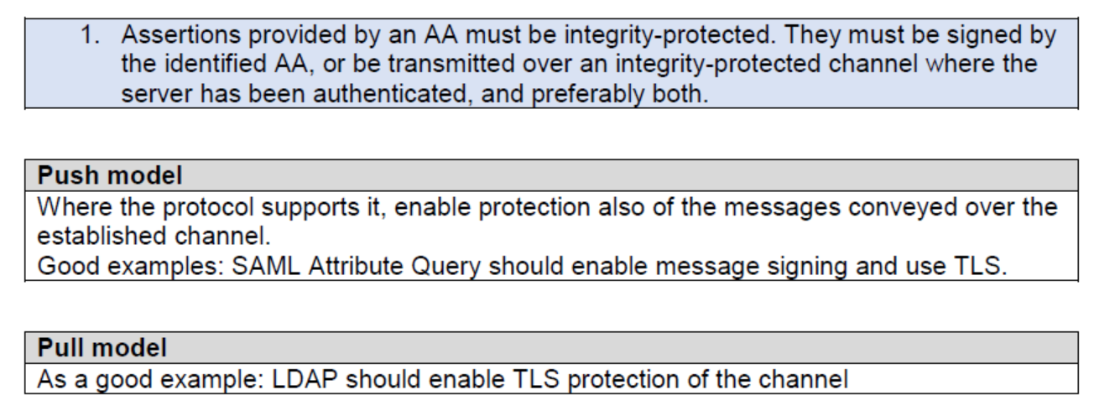
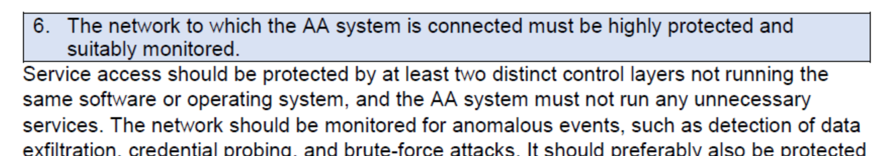
Deployment guidance included …

Slide 10
Implementation of AA Operations Security guidelines
review what is now in AAOPS G048 and comment
the comments will feed into an FAQ and additional guidance
evaluate feasibility by adopting AAOPS G048 – volunteer welcome!
It will then evolve and likely
be amended to include these lessons in FAQ or document
feel safe (or at least safer) when hosting attribute sources
and offering them to users and communities!
https://aarc-project.eu/guidelines/aarc-g048/

