Slide 1
The AARC ‘CILogon-like’ Pilot
using an IOTA CA and Credential Store for Europe
David Groep
AARC NA3 Activity Lead
Nikhef, Physics Data Processing Group
EUGridPMA 36 Bratislava meeting
18 January 2016

Slide 2
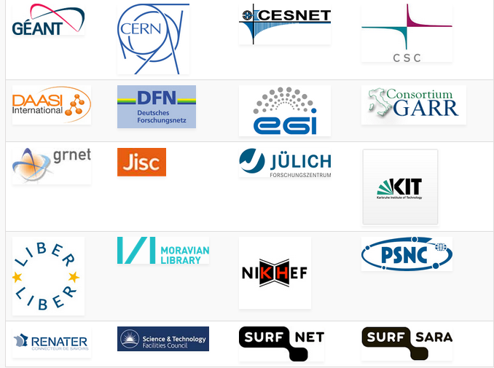
Some AARC Facts
Authentication and Authorisation
for Research and Collaboration
Two-year EC-funded project
20 partners
  NRENs, e-Infrastructure providers and Libraries as equal partners
About 3M euro budget
Starting date 1st May, 2015
https://aarc-project.eu/

Slide 3
AARC Vision and Objectives
Improve federated access by addressing current challenges
Integrate existing R&E AAIs to create a highway for identities
  Avoid the creation of project-specific AAIs by enabling researchers to use their existing credentials to access different resources
Harmonise policies among e-Infrastructures to ease service delivery
Define a training package for institutions and services to support federated access

Slide 4
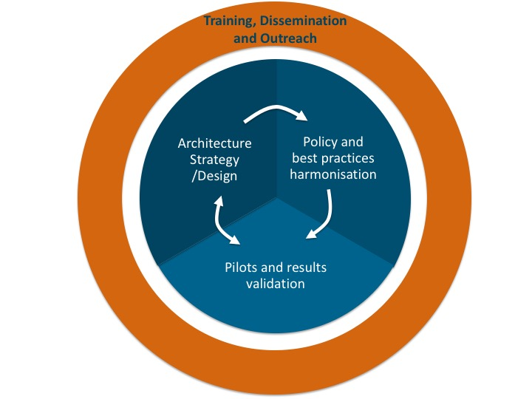
AARC Structure

Slide 5
AARC Pilots and the EGI AAI evolution
Most infrastructures move to completely hiding PKIX from the end-user
  “we’ve found all people in the world who understand PKI” (and they by now all got a certificate ;-)
  EEPKI + RFC3820 proxies do solve both the CLI and delegation use case rather nicely
Bridging and translation is the pragmatic approach
  Does not require major technical changes in existing R&E federations
  Allows for community-centric identities-of-last-resort (or first resort, for that matter!)
  Time line is more predictable, because fewer entities are involved –
  and those entities have a stake in and the benefits off the results
Emerging as a pattern in many Research Infrastructures that use CLI or brokerage
  ELIXIR, UMBRELLA, WLCG, INDIGO DC
  SAML->OIDC, SAML->X509, X509->OIDC, X509->SAML, OIDC->X509, …

Slide 6
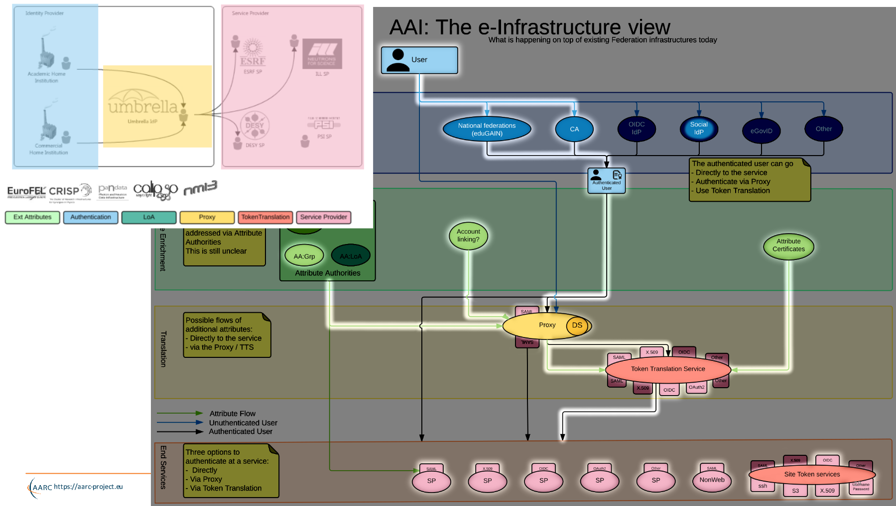
Example:
Umbrella
Marcus Hardt, KIT and AARC
https://aarc-project.eu/wp-content/uploads/2015/11/20151102-JRA1.2-Blueprint-Status-Hardt.pdf

Slide 7



Translation services – an overview
NCSA (IL,USA) operated service and project
InCommon backed MICS and IOTA
Generic ‘opaque’ certificate in Europe
Helps with PII data protection and integration with ESFRIs and e-Infrastructure
CERN wLCG IOTA CA
eduGAIN backed with added
CERN HR DB controls
GEANT Trusted Certificate Service TCS
could be turned into a translation service, when each subscriber would enable that since it has a subscriber-centric validation model

Slide 8
AARC engagement process: operational pilots
AARC will not operate any long-term services (that’s for GEANT, EGI, PRACE, EUDAT …)
But will pilot actual technology combinations that are useful to (research) communities
Proposal-identified pre-pilot: certificate-less access to existing services with “CILogon for Europe”
Driven by Mischa Sallé and Tamas Balogh (Nikhef)
Aligned with the EGI “JRA1” activity around the evolution of the AAI technology (ChristosK)
Using actual use cases from EGI competence centres and AARC communities
“It’s always a challenge to pilot something with a real community – the expectations are usually much higher than what can be provided in a pilot …”

Slide 9
AARC SA1 “CIlogon-like Pre-Pilot”
Establish a CILogon (like) service in Europe
Integrated closely with R&E federation landscape (with all of full-mesh, H&S, mixed-models)
Integration with user community services and attribute services
Close co-operation with the CILogon Project (Jim Basney et al.)
Pre-pilot work, so based on pre-AARC requirements gathering
FIM4R requests, alignment with known user communities (EGI evolution, ELIXIR)
Potential to support the EGI ENGAGE community ‘competence centre’ work
Leveraging existing components and services: CIlogon + ‘OAuth4MyProxy’ components, VOMS Attribute Certificate service, OIDC libraries, …
Try to fit first in the existing policy framework: Approved Robots (and “PUSPs”), Trusted Credential Stores, PKP Guidelines, IGTF ‘DOGWOOD’ – unless the pilot runs aground …

Slide 10
Desired features set
Certificate or proxy retrieval possible for federatively-authenticated end-user
inside a community (VO) portal or science gateway
Work with the existing (SAML2) R&E federations
Credential repository feature: manage credentials on behalf of the user
Provide – on the user’s request – delegated credentials to science gateways
Make end-user facing science gateways really light-weight: VOs should not need to know about protecting long-term secrets (and need a way to authenticate users)
Support both certificate and non-certificate science gateway use cases in the same way
Provide simple way for users to obtain ‘opaque’ CLI credentials (proxies) on their own system
Constraints:
No new software components (only limited glue)
Deployable in a scalable way – with a sustainability model behind it
As few CAs as possible (preferably: just one)

Slide 11
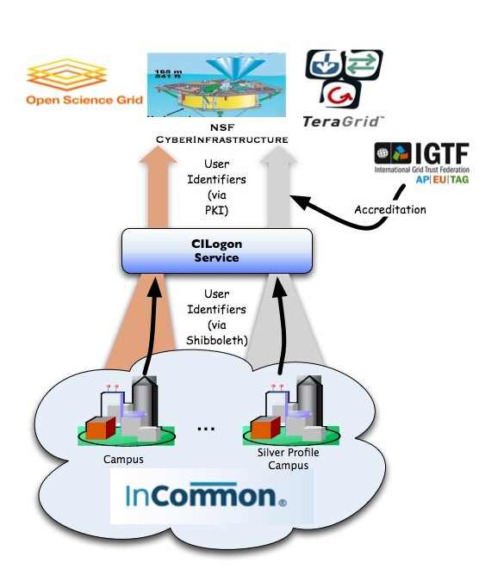
CILogon service and project (Jim Basney et al.)
Enable campus logon to CyberInfrastructure (CI)
  Use researchers’ existing security credentials at their home institution
  Ease credential management for researchers and CI providers
Multiple interfaces
SAML/OpenID Web Browser SSO
  PKCS12 certificate download
  Certificate issuance via OAuth
  OpenID Connect token issuance
  SAML ECP for CLI issuance
Slide content: Jim Basney, based on http://www.cilogon.org/docs/201106-cilogon-cern.pptx?attredirects=0&d=1
and http://www.cilogon.org/docs/20141030-basney-cilogon.pdf?attredirects=0&d=1

Slide 12
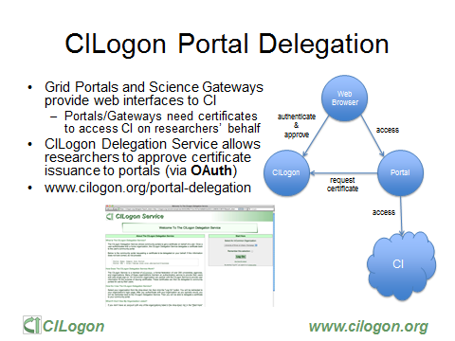
Slide: Jim Basney,
NCSA and CILogon

Slide 13
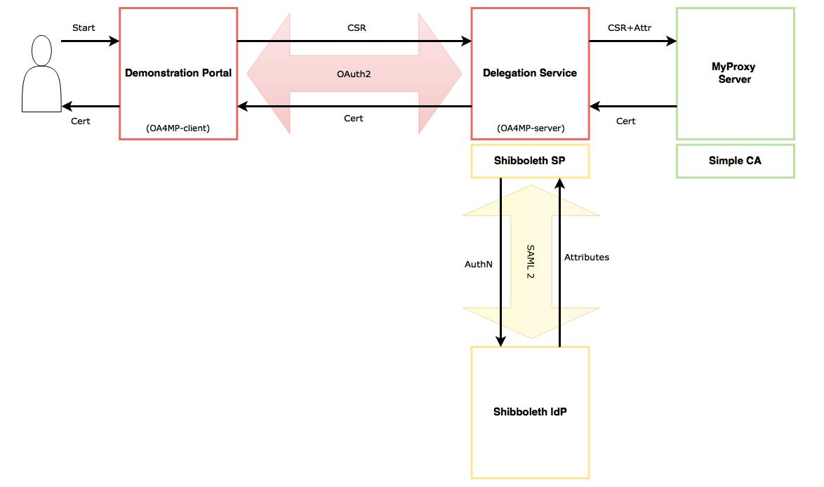
CILogon demo portal: Delegation of credentials using OAuth4MyProxy
OA4MP : using both the client and the server
components from the latest OAuth 2.0
implementation (3.1.1)
Shibboleth : using the latest Identity Provider (3.0),
and Service Provider (2.0)
MyProxy Server : using official releases from epel (6.1.13)
SimpleCA : using official release from epel (4.20)

Slide 14
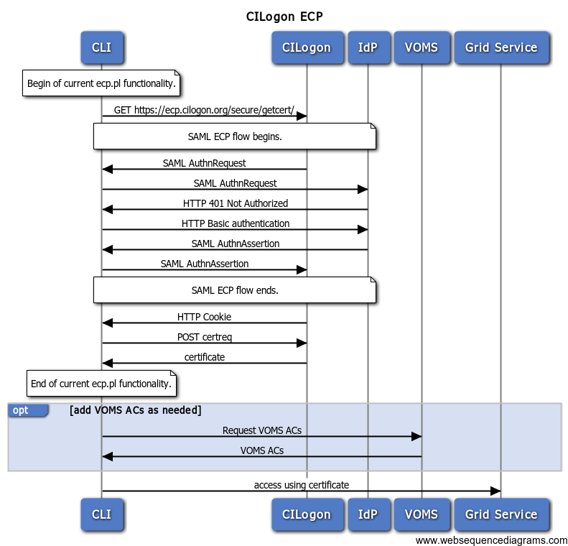
CILogon and SAML ECP
SAML federated login via ‘Enhanced Client’ (read: CLI)
or ‘Proxy’ (read: brokered access)
https://wiki.oasis-open.org/security/SAML2EnhancedClientProfile
A heavy (trusted) client sends credentials and
receives assertions from a specific IdP ECP end-point
Supports non-web
… if it were supported by the IdP
Most prominent use case: Office365
Limited update & support (only in Shib, and only v3+)
Unlikely to fly in Europe – but there many alternatives
like Moonshot, but also a move to OIDC, OAuth2, …
Flowchart: from CILogon

Slide 15
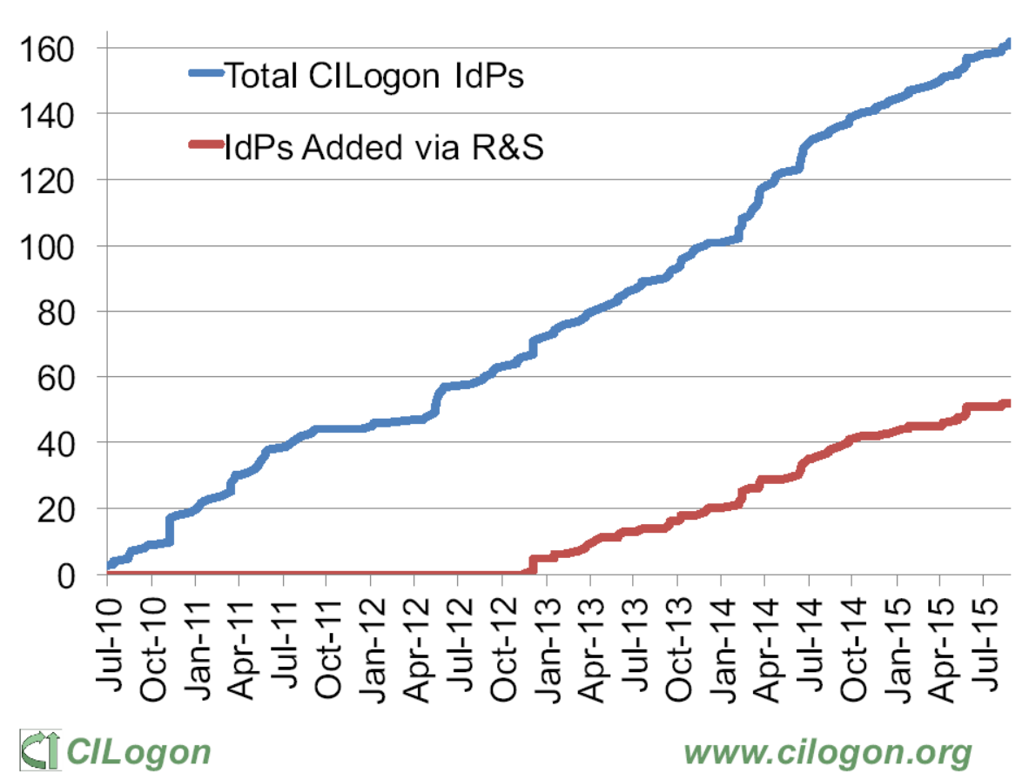
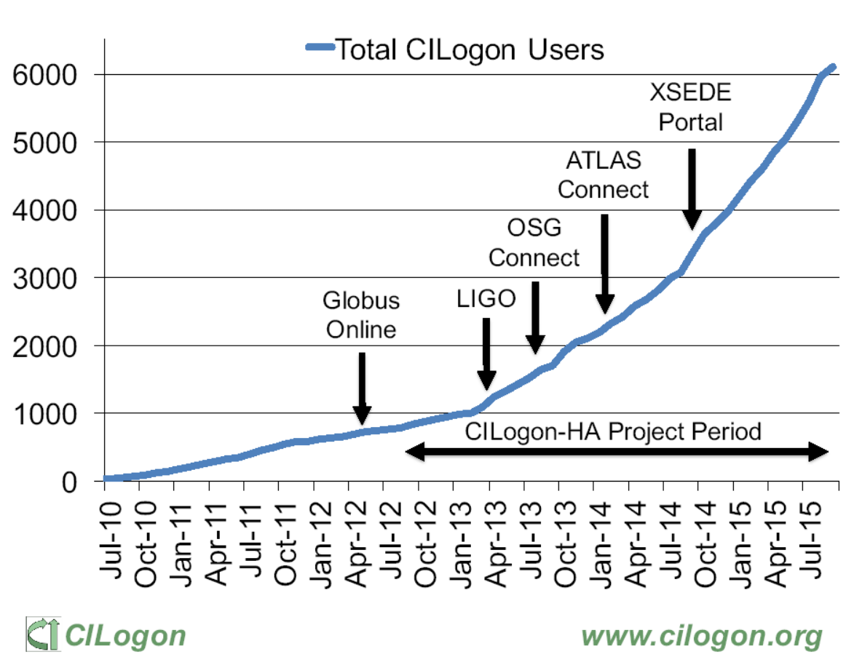
CILogon adoption in the US/InCommon
http://www.cilogon.org/docs/2015-09-cilogon-ha.pdf?attredirects=0&d=1

Slide 16
End-user credential hiding in the AARC CILogon-like Pilot
Do not assume any changes in the IdPs: no ECP, no new policies, no nothing (reality, sorry!)
Assume no major changes in the e-Infrastructures: interfaces remain a mix of Web and PKIX, policies remain mostly as-is
Should show results ‘fairly soon’ (i.e. in a few months work) for a broad audience
Leverage existing CILogon and MyProxy, thanks to the collaboration of AARC-CTSC/MyProxy
Beyond CILogon
CILogon assumes the e-Infrastructures (CIs) build the portals and interfaces
CILogon assumes that users in the end might retrieve certificates explicitly
Larger RIs and e-Infra in Europe could do it, but not the large number of small communities
So the AARC Pilots adds additional control elements: credential management, light-weight portal interfacing, (VOMS) attribute management, optional: opaque credential retrieval

Slide 17
Components
http://wiki.nikhef.nl/grid/CILogon_Pre-Pilot_Work

Slide 18
Authorization at the VO level
The VO light-weight portals (gateways) can re-use this system for both AuthN and AuthZ
Can be used besides a conventional (SAML) login to science gateway when a proxy is needed
Or even …
User ability to complete the OIDC login to the VO web portal (each time) does AuthN
Ability of the portal to successfully request VOMS attributes for an AuthZ/membership check
Successful authN and failed AuthZ? Suggest enrolment or auto-enrol members!
VO portal must be on a trusted list of the Master Portal
  Needs to be able to do OIDC in a trusted way
  Using a VO portal client ID + client secret (but there are server certs as well for the web site itself)
  User must be able to trust that the Master Portal will only relinquish user credentials to intended places
  OIDC consent mechanism informs the user of where the user credentials are sent

Slide 19
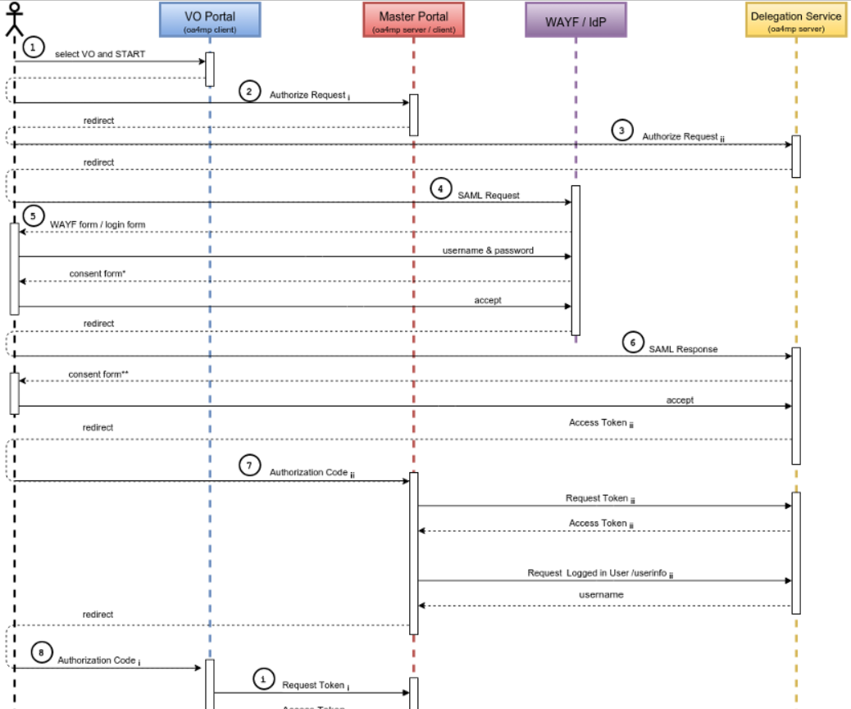
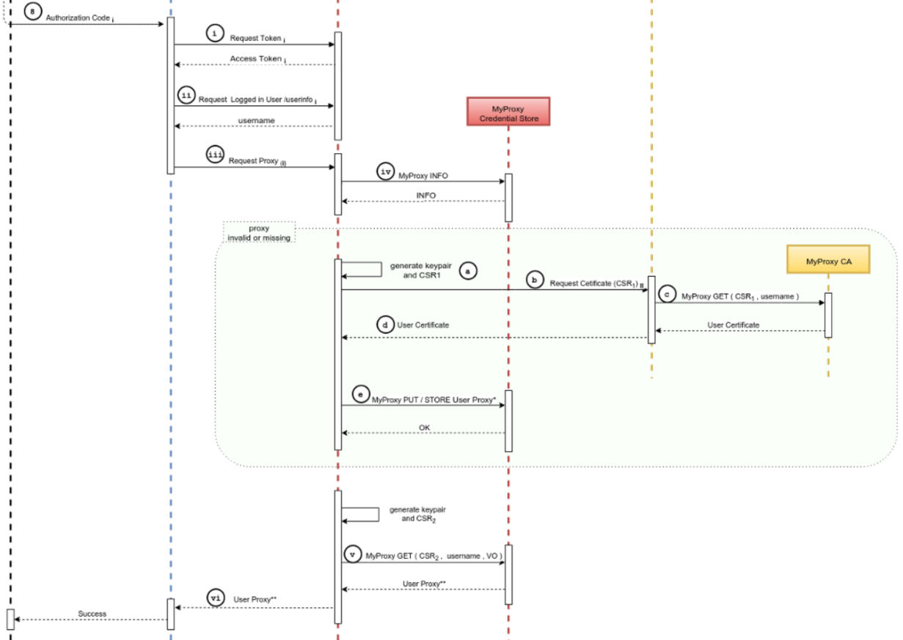
It’s a complex flow … because of a double OIDC + SAML + Online CA

Slide 20
X509 (proxy) certificates as opaque access tokens
VO or Master Portal can offer user to register user's SSH pubkey with Master Portal
Master Portal can store (uid, pubkey) pairs in a directory service (e.g. LDAP) associated with the MyProxy user identifier (username)
SSH Server runs cron job and creates authorized_keys file:
  Using a single special account, runs a myproxy-logon wrapper, similar to what SVN servers do*
SSH-agent forwarding: central login node, client UI, VDI server, laptop retrieves proxy
Any script wrapper to save proxy: looks similar to a Kerberos ticket
  No need for either extra password, ECP, Moonshot etc.
  Very similar to GitHub, SourceForge, etc.
* /usr/local/sbin/mkgroup-sshlpk \
-c 'command="svnserve -t -r /srv/svn --tunnel-user=@UID@", no-pty' \
-o ~svn/.ssh/authorized_keys --filter '(authorizedService=ndpfsvn)' nDPFSubversionUsers
... [gives] ...
command="svnserve -t -r /srv/svn --tunnel-user=tsuerink",no-pty ssh-rsa AAAAB3...2w== t@net

Slide 21
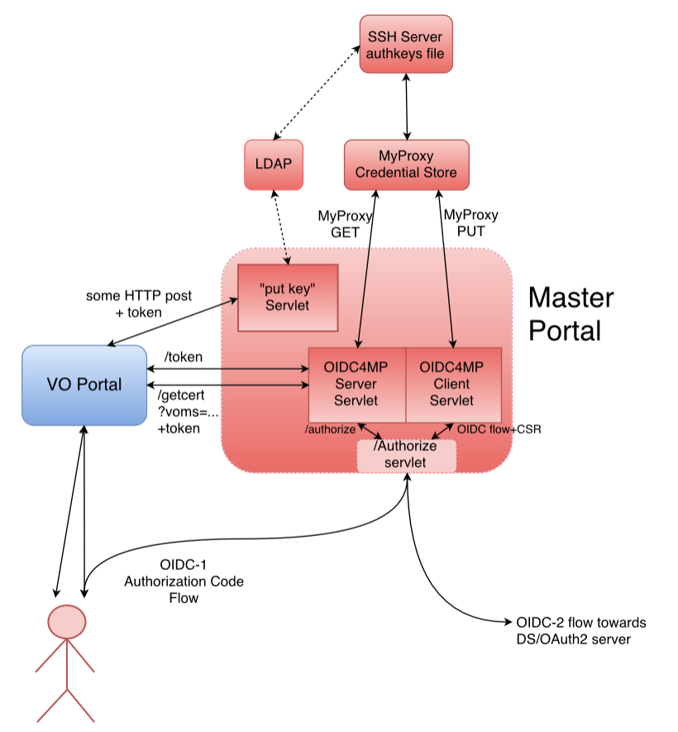
Master portal is a rather critical service
This is the component that – with a credential store and an (OIDC) authentication interface –takes care of the user credential management
The back-end CA provides
  Identifier uniqueness
  Revocation capability
but not much more!
It is a highly trusted component, of which there should not be many
But it may still be better then end-user managed keys – for authentication, that is …

Slide 22
Distribution of Roles in a Sustainable Model
VO Portal (Science GW)
One per application
Many deployed throughout
Reduced policy and compliance burden
Master Portal
One per country, ESFRI
Must be well-managed
Can be managed because there are few
CA and Delegation Service
As few as possible: just one!

Slide 23
Relevant (IGTF) policies
IOTA AP: LoA DOGWOOD and PKI Technology Guidelines
  https://www.igtf.net/ap/iota
  https://www.igtf.net/ap/loa
  https://wiki.eugridpma.org/Main/PKITechnologyGuidelines
PKP Guidelines
  https://www.eugridpma.org/guidelines/pkp
Guidelines on the Operation of Credential Stores (draft)
  https://www.eugridpma.org/guidelines/trustedstores/

Slide 24
Towards a CILogon CA for Europe
As a first phase, Jim may actually just open up the existing CILogon to ‘eduGAIN’
Once InCommon has also technically joined eduGAIN
For qualified entities in eduGAIN: R&S + SirTFi
Uniqueness enforced by the CILogon CA itself (as long as there’s no true ‘ePUniqueID’)
Aim for (a single) IOTA CA in Europe (EU/EEA) to back the Master Portals
This would be a generic IOTA CA, but it can be modeled closely on the existing ones
Model yet to be worked out (extend CERN’s IOTA CA? A new one?)
Support as many (European) eduGAIN IdP as feasible
Potentially including qualified IdPs of last resort operated by RI/e-Infrastructures, or qualified proxy services like the VOPaaS IdP gateway (with LoA support)
Having it issue only short-lived credentials would make things like DPCoCo compliance easier

Slide 25
Operating an generic European IOTA CA
It is a SPOF, so needs a high service level
Should be within the EU to ease transfer of personal data
Needs a sustainability model
Candidates to run this?
joint e-Infrastructure operation?
source it to a dedicated company under a strong SLA + PII protection?
‘Worst case’ would be to get one per country … and we still need a business model
In AARC DAASI is tasked to research possible sustainability & operating models

Slide 26
Protecting credentials, CS Operators
http://wiki.eugridpma.org/Main/CredStoreOperationsGuideline
data needed to activate and use credential material must not be held by the system on persistent storage, and must not be held by the system administrators. These must only be present in the system as a result of a user action, and only for as long as the user is using the system.
The activation data and any plain text private keys should be removed as soon as the user stops using the service, and should not be kept past 24 hours of inactivity exclusive use of confidential, integrity protected, and authenticated channels for the transfer of activation data and any private key material.
The keys used to protect the channel must have a strength equivalent to or better than an 2048 bit RSA key.
The keys must be suitably protected by the operating system or an HSM, and must only be accessible by the service and trained personnel with procedural controls.

Slide 27
PKP Guidelines
Section: Generation of private keys
A system SHOULD NOT persistently keep pass phrases or plain text private keys for longer than 24 hours, unless the key pair is used solely as a basis for Short Lived credentials, i.e. the certificate has a total validity of less than 1 Ms.
  “This text is written such that it allows for a portal to request a certificate on the user’s behalf (e.g. by redirecting the users to a, potentially federated, SLCS service) and keep the key material in the portal. To off-set the risk of keeping unencrypted private keys on disk for long periods of time, the mechanism as used by, e.g., the ssh-agent system is intended to be used for protection: The portal can itself encrypt it with some other pass phrase and store the key on disk, but keep the (portal-private) activation data to re-read the private key only in-memory (so that it becomes a lot harder to sniff in case the box is broken, in the same way that ssh-agent does it and for the same reasons).”

Slide 28
PKP Guidelines
But in the “Storage of key material” section …
Data needed to decrypt or use the private key MUST not be held by the system on persistent storage, and MUST not be held by the system administrators. It MUST only be present in the system as a result of a user action, and only for as long as the user is using the system. The activation data and any plain text private keys SHOULD be removed as soon as the user stops using the service, and MUST NOT be kept past 24 hours of inactivity.
  “This text specifically allows for long-running and multi-step work flows to continue in the absence of physical user presence at the portal. The word 'inactivity' should be interpreted as “if a user logs in and starts a long work flow at 3PM, leaves the portal and goes home at 5 PM, but the work flow completes only 48 hours after that, it is perfectly legitimate for this third-party system to hang on to the private key activation data in memory for 56 hours”. If we were to limit the caching of activation data to just 6 (or 24) hours after the user as stopped clicking on the portal (i.e. at 11PM), we would never get any real work done. But if the portal gets rebooted, the activation data is lost and the work flow will terminate once the pending proxies expire (after ~ 12-24 hrs). The 6 or 24-hour period is somewhat arbitrary, and should be synchronised to the characteristic ‘session expiration’ period for most portal applications.”

Slide 29
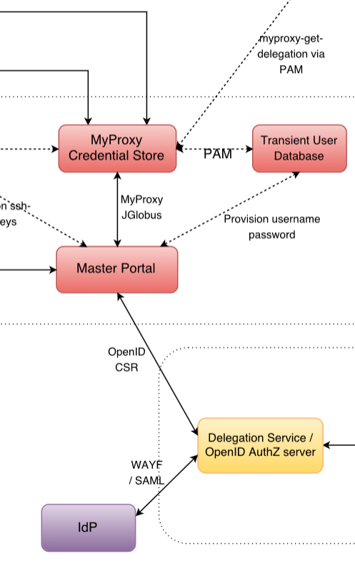
PKP Guidelines – the Challenge
The PKP Guidelines assume the user is present – somewhere in the
workflow – to provide a unique secret (activation data) with which
to protect the user’s credential
But:
in the entire federated workflow, there is no such secret to be found
the SAML assertion, the OIDC access tokens, the authorization codes:
all are generated by servers
the one unique user secret is hidden
– rightfully and only ever exposed to the federated IdP
the only place from which to get
a unique bit of private data close to the credential store
… is a single common place: the Master Portal ☹

Slide 30
Building the Pilot
The AARC CILogon-like Pilot works around this in the ‘trivial’ way
It requests a certificate when the user logs in via the portal (OIDC->OIDC->SAML/R&E)
Generates a unique key pair in the Master Portal memory, making a CSR on behalf of the user
OK, since “Key material MUST only be generated in the system as a result of a user action”
It then delegates a proxy to the Master Credential Store (a protected MyProxy)
And securely deletes the key pair in memory
By storing only a proxy in the Master Credential Repository it escapes the PKP and CS guidelines

Slide 31
Another alternative: replace the CA with a single Robot &
‘Per-User sub-proxies’ (PUSPs)
PUSPs are already used by the EGI “Long Tail of Science” gateways
RFC3820 proxy certificates generated from a single Approved Robot:
  embedded in the naming is a unique identifier
  the generator (portal) can associate the identifier with an individual Web User
This can also replace the CA it ‘just’ take the portal setup outside the PKP scope
but … is this the best way to do things??
"/C=IT/.../CN=Robot: Catania Science Gateway - Roberto Barbera/CN=user:jdoe" jdoe_localuser
"/C=IT/.../CN=Robot: Catania Science Gateway - Roberto Barbera/CN=*" .portal_users
https://wiki.egi.eu/wiki/Fedcloud-tf:WorkGroups:Federated_AAI:per-user_sub-proxy

Slide 32
What is the ‘right’ way of doing this? Considerations
Can the user – with duly informed consent – actually delegate credential management?
Pros
Good for usability and recoverability of user credentials (no separate passwords)
Custodianship is clearly identified (at the master portal operator)
Users are quite fed up with credential management and use any solution, so why not this?
Short life time can help limit the risks
Cons
Custodianship is clearly identified – who will want to run the master portal and take the risks?
Master portal operator can act as the user –
Short life time impairs the user for long-running jobs – automatic credential renewal is
non-trivial since you need the user in the loop every time
… and the master portal does not know the workflow

Slide 33
Short-lived credentials?
Use of credentials with a life time < 1Ms (11days) does allow unencrypted storage
So the master portal could ‘just’ hold them
But
Is that indeed better?
The work flow may run for longer than 11 days
master portal cannot renew the credential on behalf of the user (so needs to warn the user, and thus collect more PII than otherwise needed)
master portal does not know the workflow, so cannot ‘renew’ credentials in the VO portal
VO portal might renew, but then needs to be fully trusted to as to refresh based on existing (proxy) credential of the end-user at the master portal credential store

Slide 34
Thanks to all AARC folk whose slides and work I used in here –
esp. Mischa Sallé, Tamas Balogh, Jim Basney, Paul van Dijk
davidg@nikhef.nl

