Slide 1



The evolved role for policy and best practices for the AARC Community
Policy Development Kit
Consultancy role for communities & infrastructures
work items address policy aspects of the architecture & implementation, e.g.,
  AARC-G041 Assurance derived from social media
  AARC-G048 Secure Operation of Attribute Authorities …
address pilots in SA1, communities, or Infrastructures, e.g.
  AARC-G040 Policy Recommendations for the LS AAI (application to R&S and CoCo)
  AARC-I044 Implementers Guide to the WISE Baseline Acceptable Use Policy
You see the policy work ‘homed’ in your favourite forums: WISE, IGTF, REFEDS, FIM4R
joint work
with peers in

Slide 2
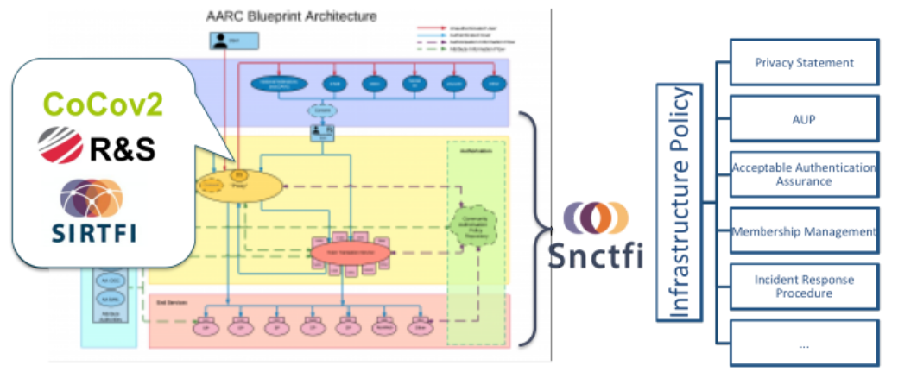
Making the proxy behave: infrastructure and community policy support
aarc-community.org/guidelines

Slide 3


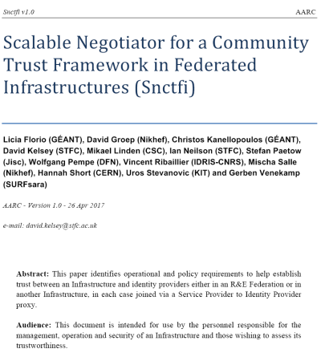

A policy framework for service providers groups and proxies in the BPA
Snctfi – the policy bridge between the BPA and the participants
Scalable Negotiator for a Community Trust Framework in Federated Infrastructures
derived from SCIv2: framework on Security for Collaboration in Infrastructures via WISE
reference policies supporting Snctfi fulfilment in the Policy Development Kit
graphic IdP-SP bridge: Lukas Hammerle and Ann Harding, SWITCH
https://igtf.net/snctfi

Slide 4
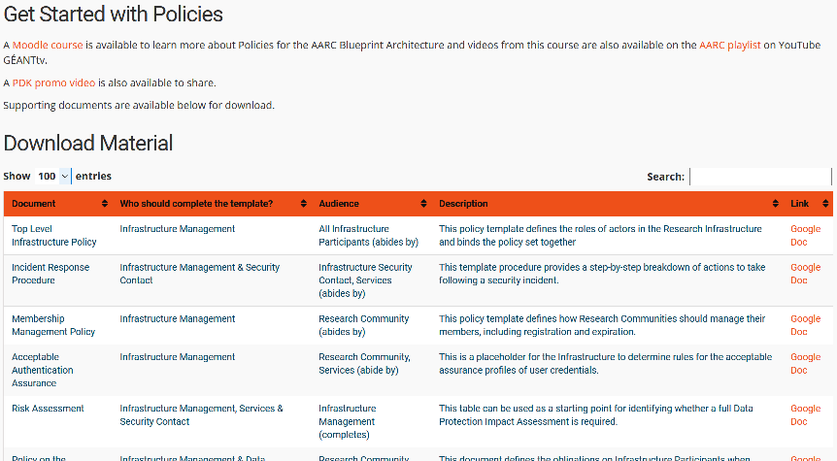
Policy Development Kit
introduction video – training – 9 reference templates – continued improvement
joint work
with peers in
https://aarc-project.eu/policies/policy-development-kit/

Slide 5
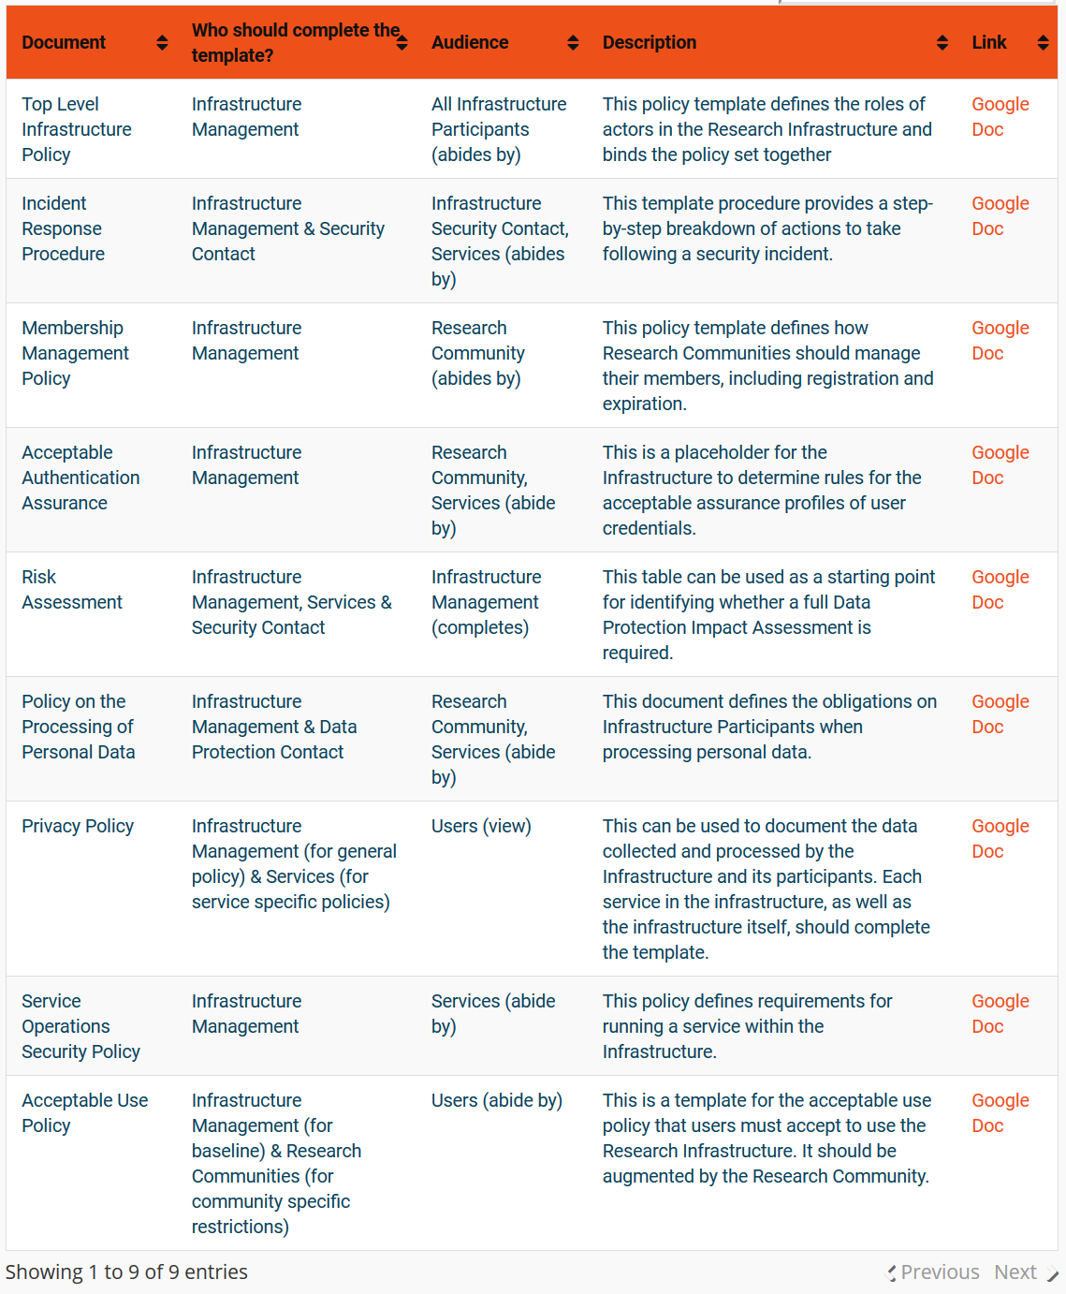
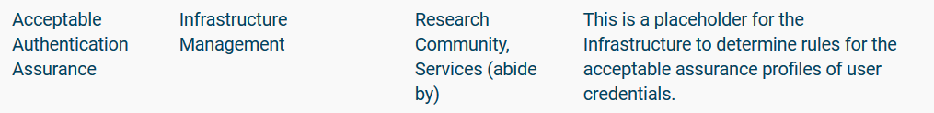

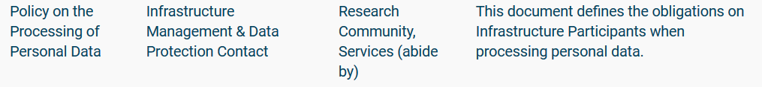
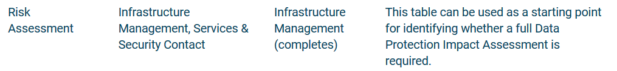
Supporting the Infrastructures get ‘Snctfied’
https://aarc-project.eu/policies/policy-development-kit/

Slide 6
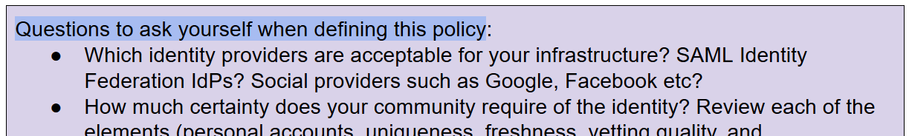
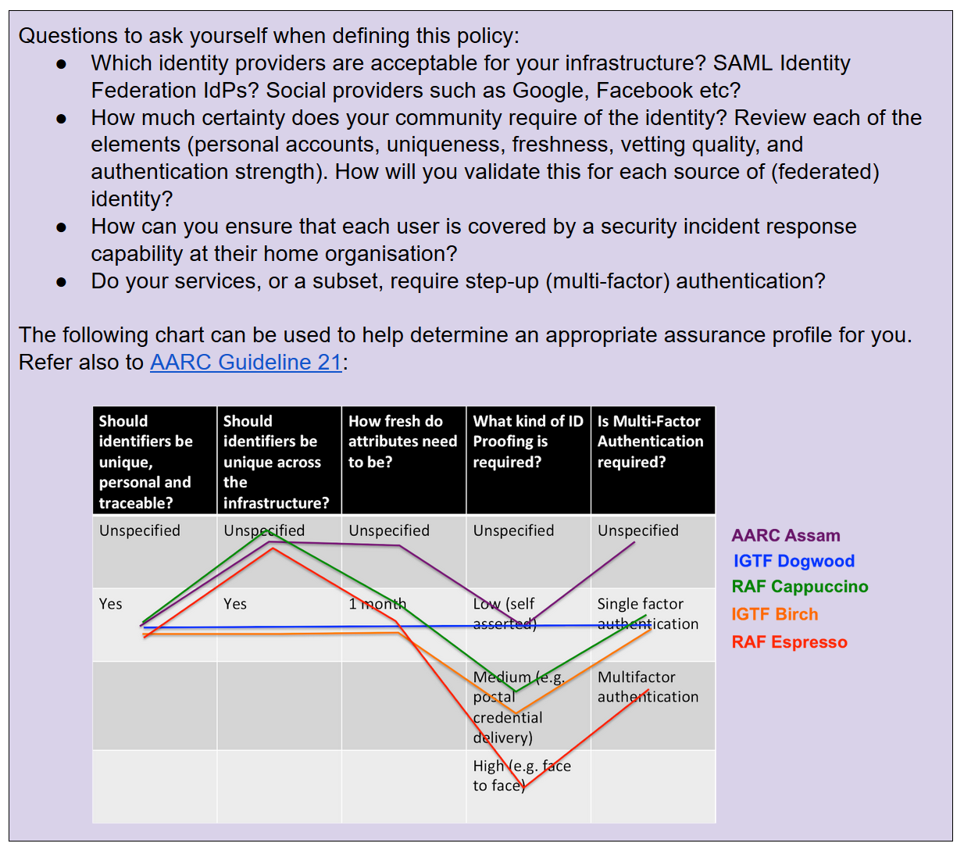
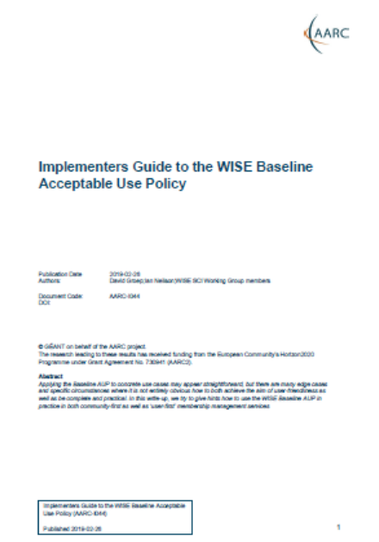
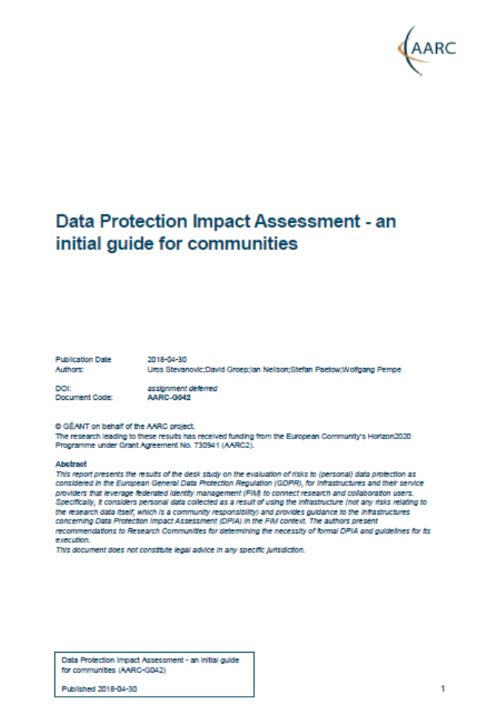
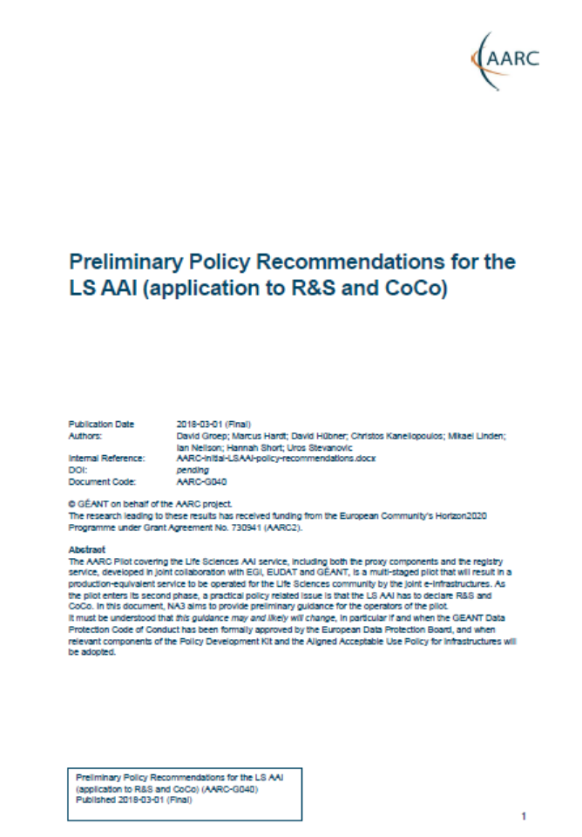
Templates and guidance on how to implement
…

Slide 7
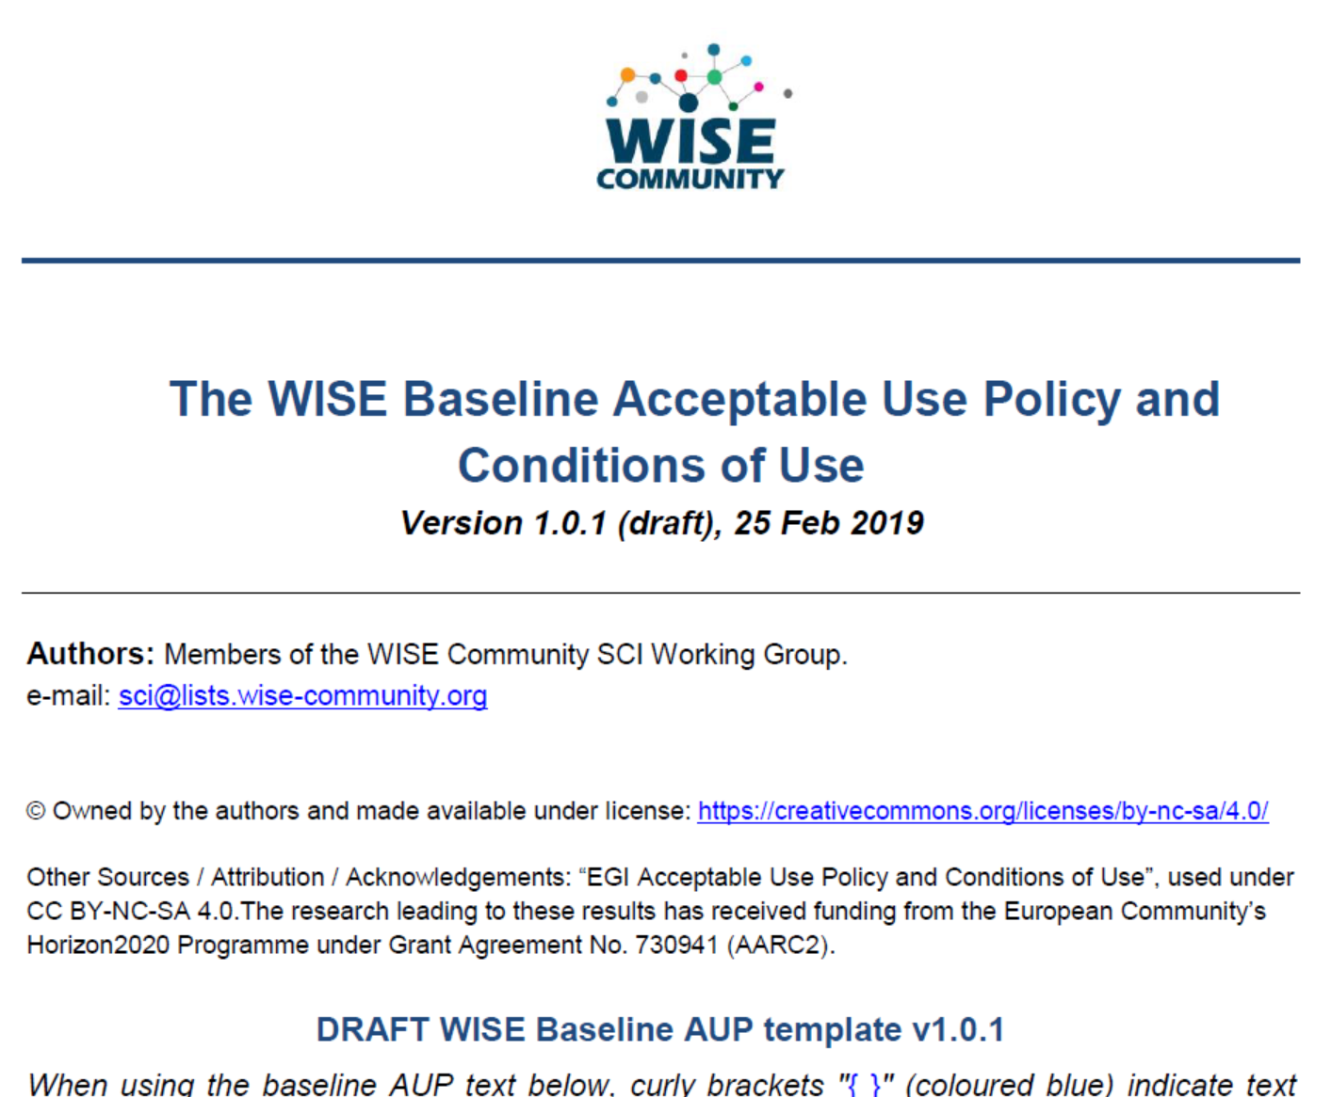
Baseline AUP at WISE SCI
shown only once to user during registration
information on expected behaviour and restrictions
can optionally be augmented with
additional community or infrastructure specific clauses
but numbered clauses should not be changed
registration point may be operated directly by research community or by third party on community's behalf
Other information shown to user during registration
Privacy Notice – information about processing & user rights
Service Level Agreements – information about what user
can expect from the service in terms of ‘quality’
Terms of Service – optional, with the ‘benefits’ to the user
https://wiki.geant.org/display/WISE/Baseline+Acceptable+Use+Policy+and+Conditions+of+Use

Slide 8
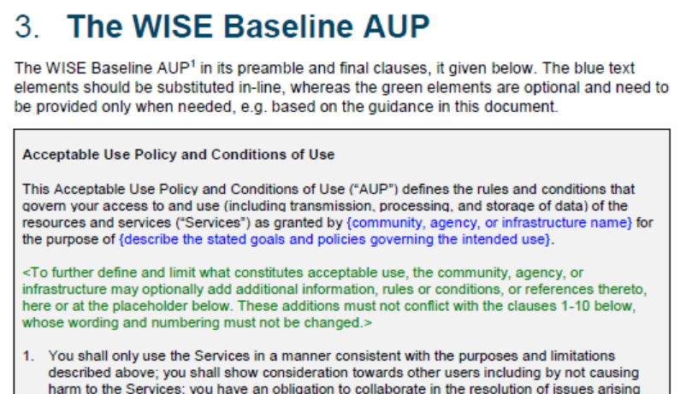
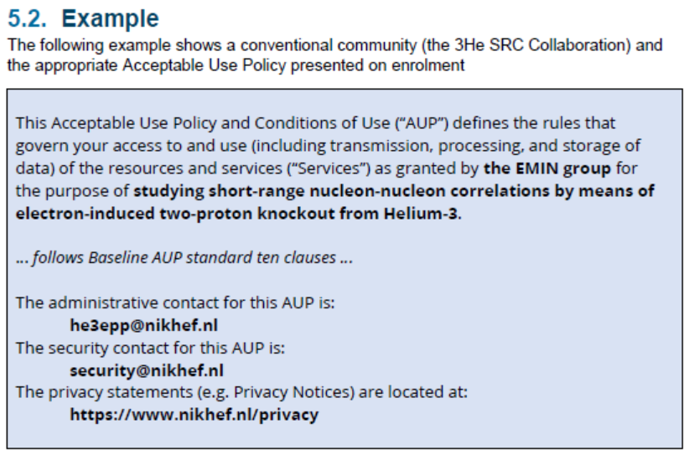
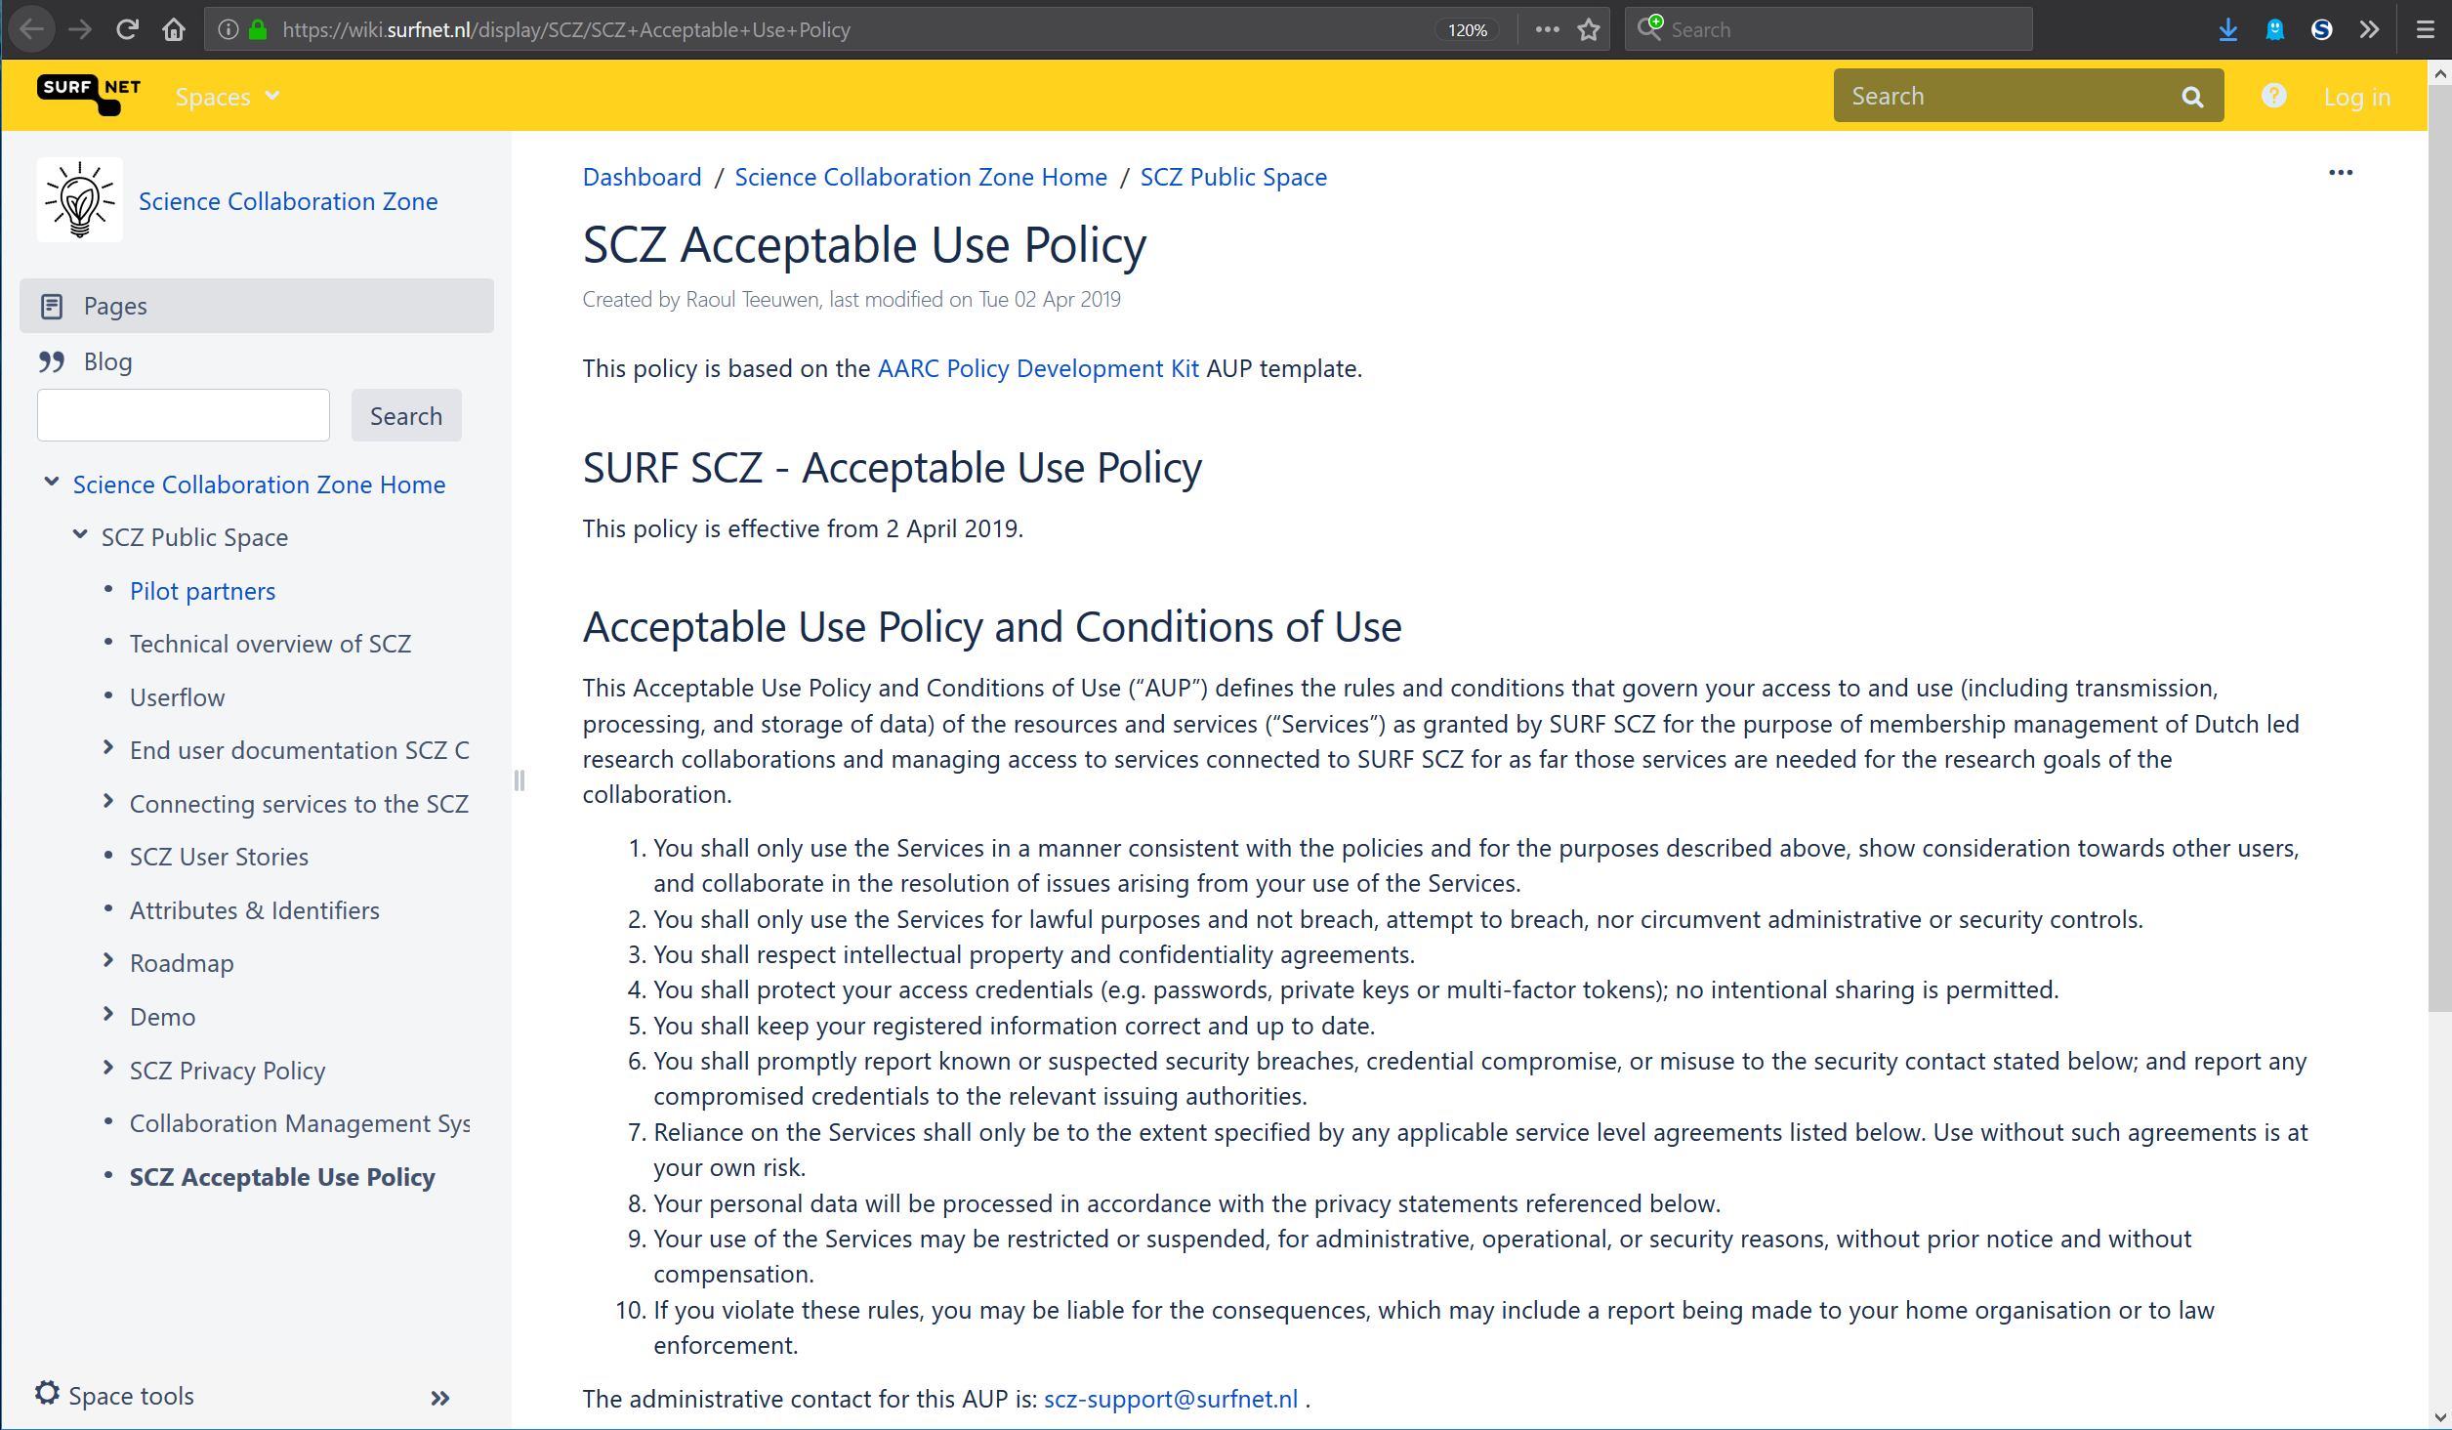
Example Guideline: implementing the interoperable WISE Baseline AUP
What is the benefit of the common AUP?
How to I present this to the user?
For both ‘community-first’ and ‘user-first’
membership management services
Examples to make it concrete
Rather quick take-up:
https://aarc-community.org/guidelines/aarc-i044/
https://wiki.geant.org/display/WISE/Baseline+Acceptable+Use+Policy+and+Conditions+of+Use

Slide 9
Operational security focus in the BPA: beyond just the IdPs
Community membership management directories and attribute authorities
integrity of membership
identification, naming and traceability
site and service security
protection on the network
assertion integrity
Store and manage ephemeral user credentials
trusted credential stores
protection at rest
IGTF Guidelines on
Trusted Credential Stores
(pre-existing)
Guidelines for Secure Operation of Attribute Authorities and other issuers of access-granting statements
(AARC-I048, in collaboration with IGTF AAOPS)

Slide 10
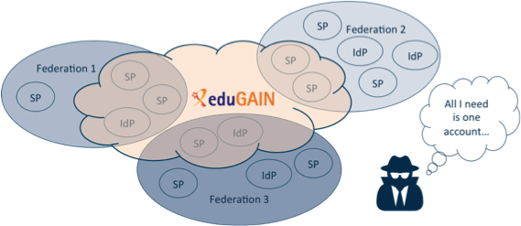
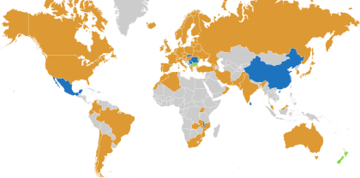














Security Incident Response in the Federated World
AARC-1 Refresher
many countries & economic regions with an R&E identity federation
full of valuable resources
(data, network, services)
Could we ensure that information is shared confidentially, and reputations protected?
Security Incident Response Trust Framework for Federated Identity
Sirtfi – based on Security for Collaborating Infrastructures (SCI) & FIM4R Recommendations

Slide 11
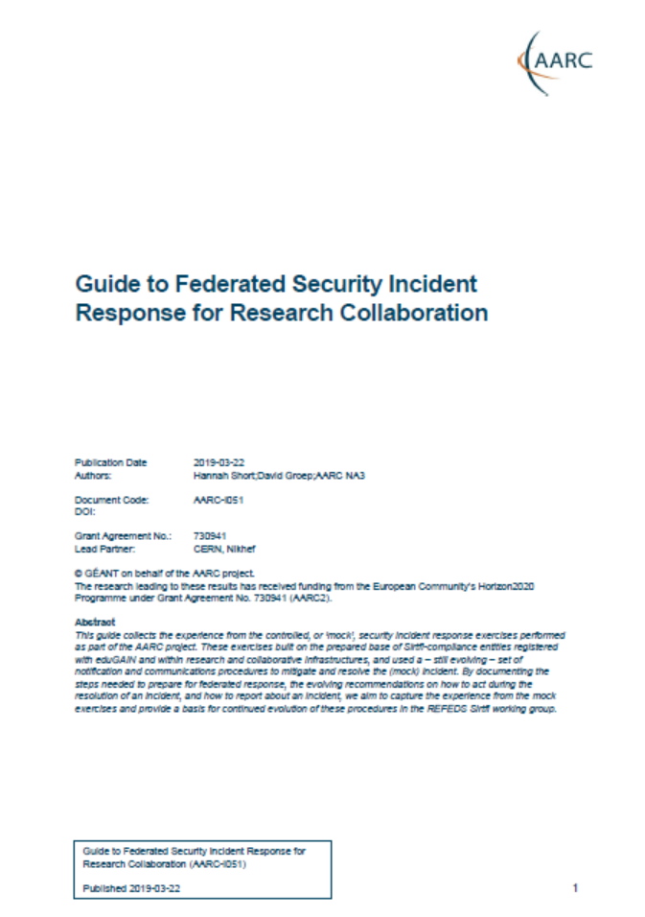
Preparing the ground for REFEDS Sirtfi procedures: AARC-I051
Acknowledging that only reviewers read deliverables, response process from DNA3.2 issued as …
AARC-I051 Guide to Federated Security Incident Response for Research Collaboration
Be Prepared
Federated Entities Should Support Sirtfi
Community Proxies Should Adopt Interoperable Policies & Procedures
Federations and Interfederations Should Adopt Common Procedures
Leverage Templated Emails
Establish Secure Communication Channels in Advance
Act
Scope
Goals
Responsibilities
Procedures: for IdPs & SPs, for coordinators, for eduGAIN
Report and Share
informational document and not a guideline since Sirtfi WG still needs
to get global endorsement, yet we need practical guidance right now!
https://aarc-project.eu/guidelines/aarc-i051/

