Slide 1
AARC Policy and Best Practice
supporting the FIM and e-Infra communities
David Groep
AARC AEGIS policy area coordinator
Nikhef
FIM4R Vienna
February 2020

Slide 2
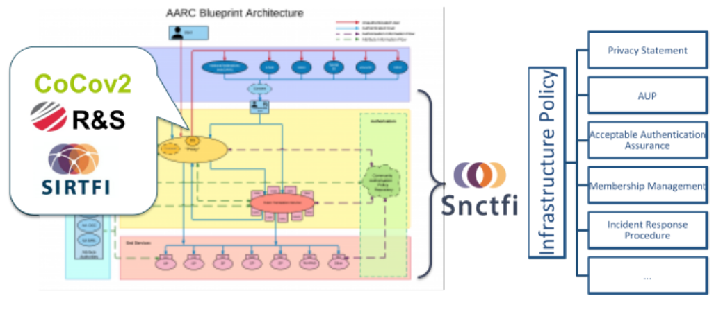
Making the proxy behave: infrastructure and community policy support
aarc-community.org/guidelines

Slide 3
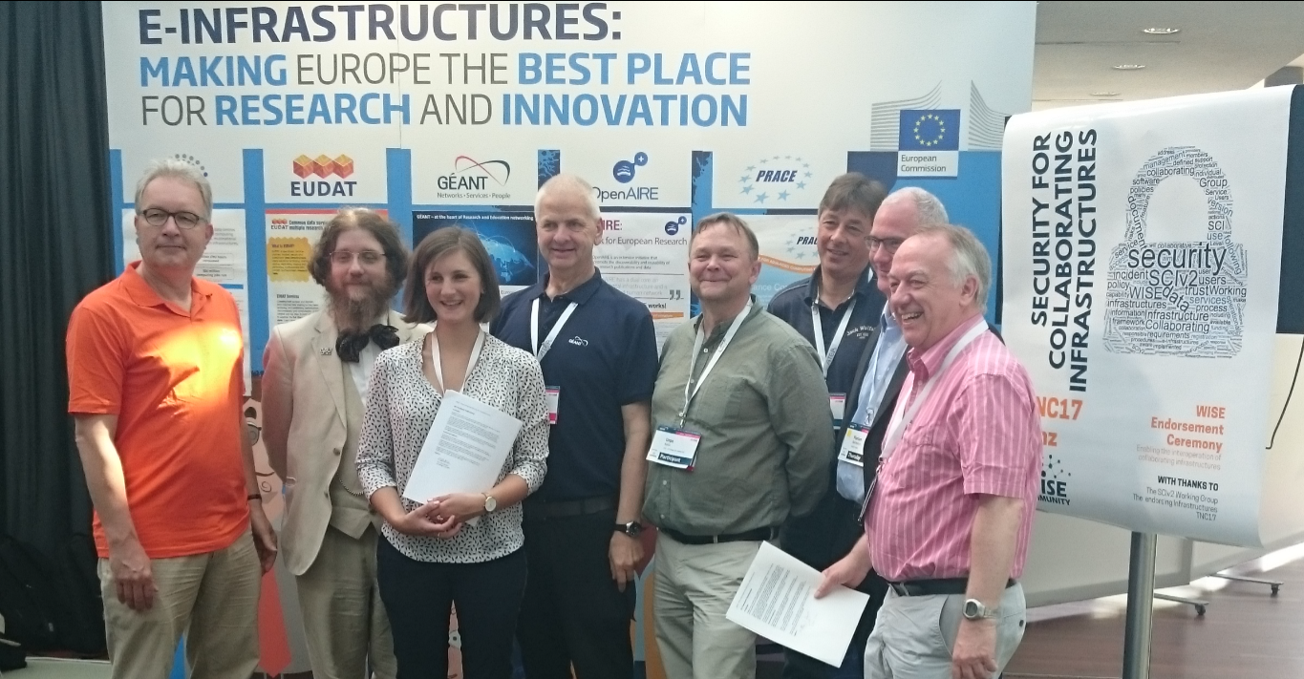

Trust and global policy
A single policy cannot apply
different risk scenarios for participants,
different risk appreciation,
distinct legal contexts, …
But one can ‘map’ policies and align policy structures
“enable interoperation of collaborating Infrastructures in managing cross-infrastructure operational security risks.”
which is the role of SCI - Security for Collaboration among Infrastructures

Slide 4
Determining interoperable risk profiles for collaborating infrastructures and services
concept in SCI context: Urpo Kaila

Slide 5
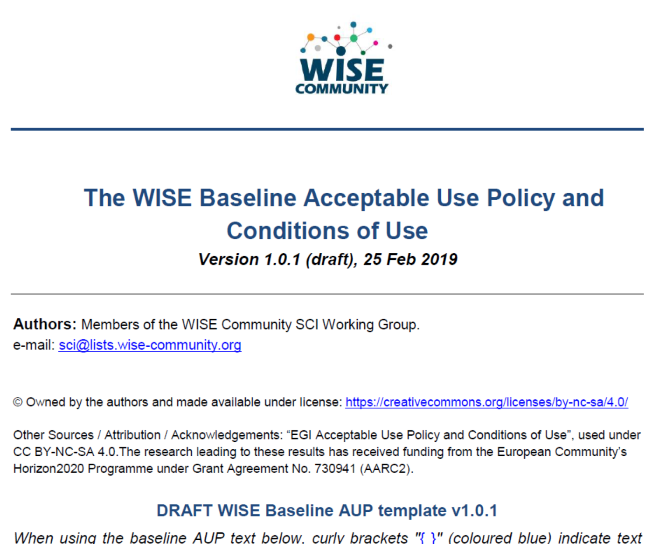
Baseline AUP at WISE SCI
shown only once to user during registration
information on expected behaviour and restrictions
can optionally be augmented with
additional community or infrastructure specific clauses
but numbered clauses should not be changed
registration point may be operated directly by research community or by third party on community's behalf
Other information shown to user during registration
Privacy Notice – information about processing & user rights
Service Level Agreements – information about what user
can expect from the service in terms of ‘quality’
Terms of Service – optional, with the ‘benefits’ to the user
https://wiki.geant.org/display/WISE/Baseline+Acceptable+Use+Policy+and+Conditions+of+Use

Slide 6
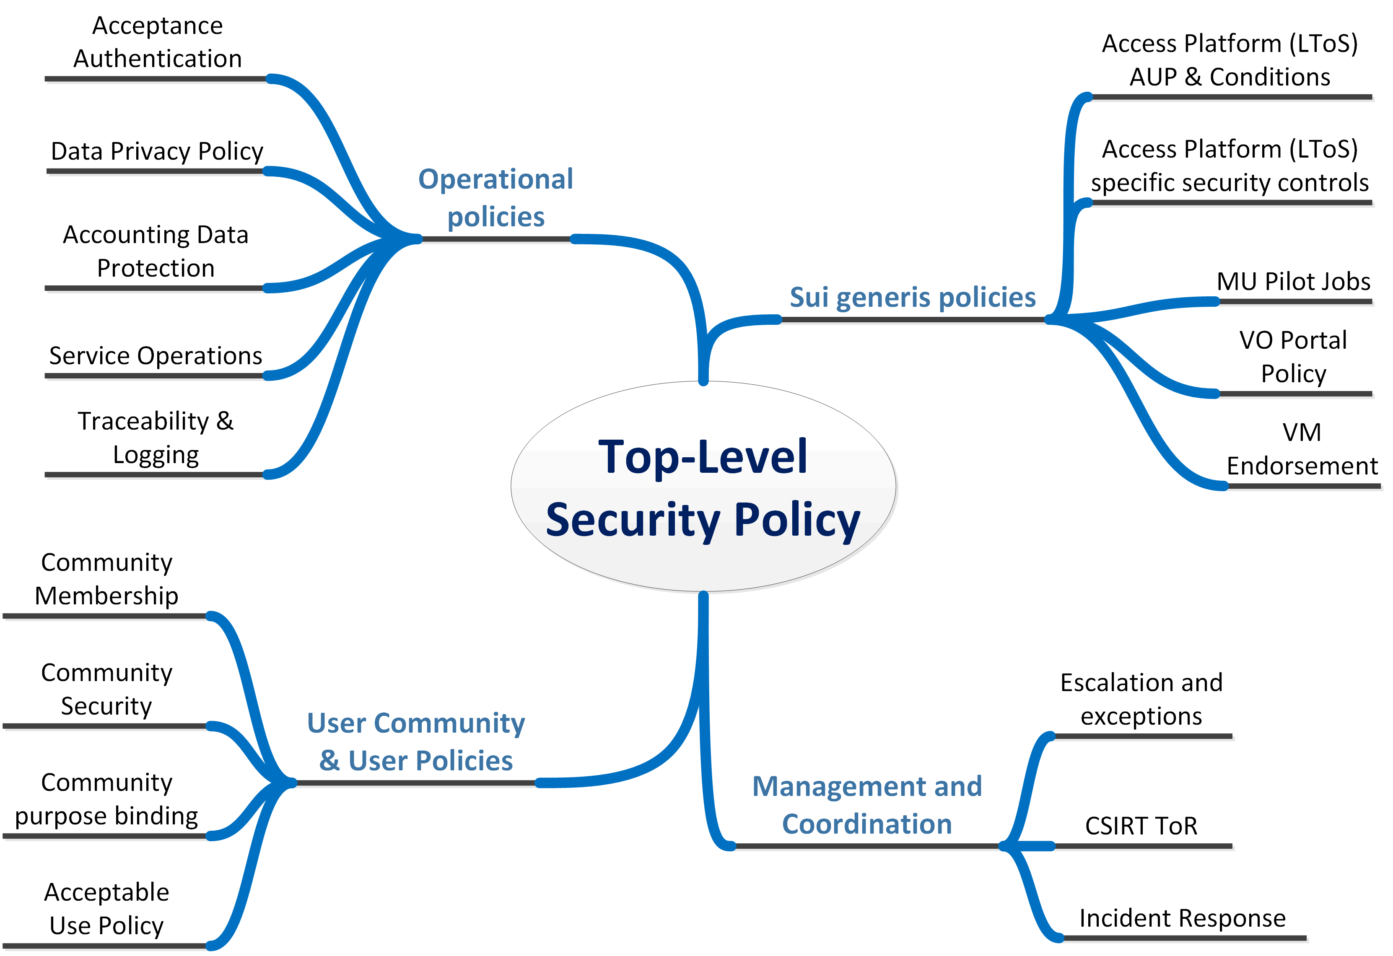

Evolving the policy development kit >>> Smplfy the structure
compact but comprehensive top-level policy
risk-classification driven policy requirements
supported by implementation measure that can be defined as needed

Slide 7
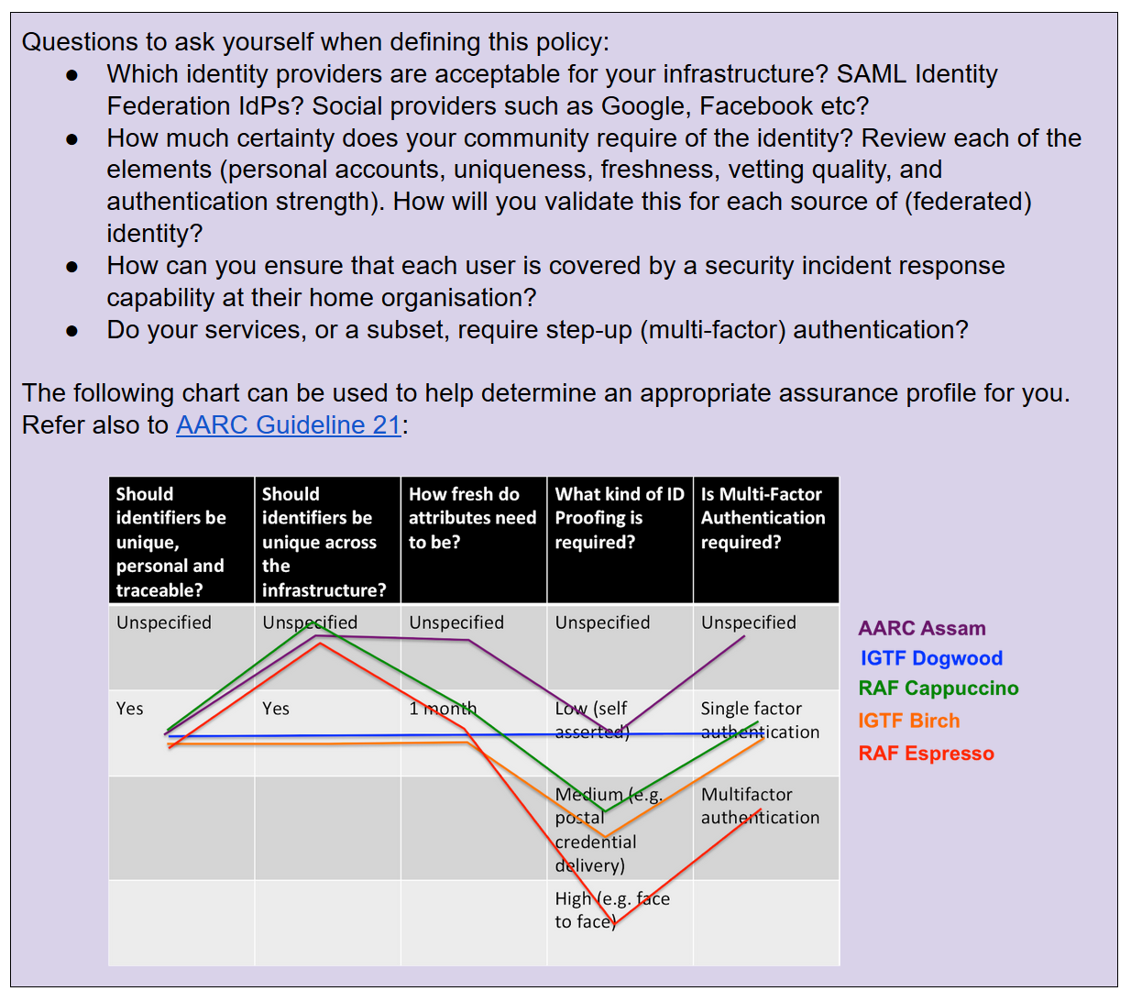
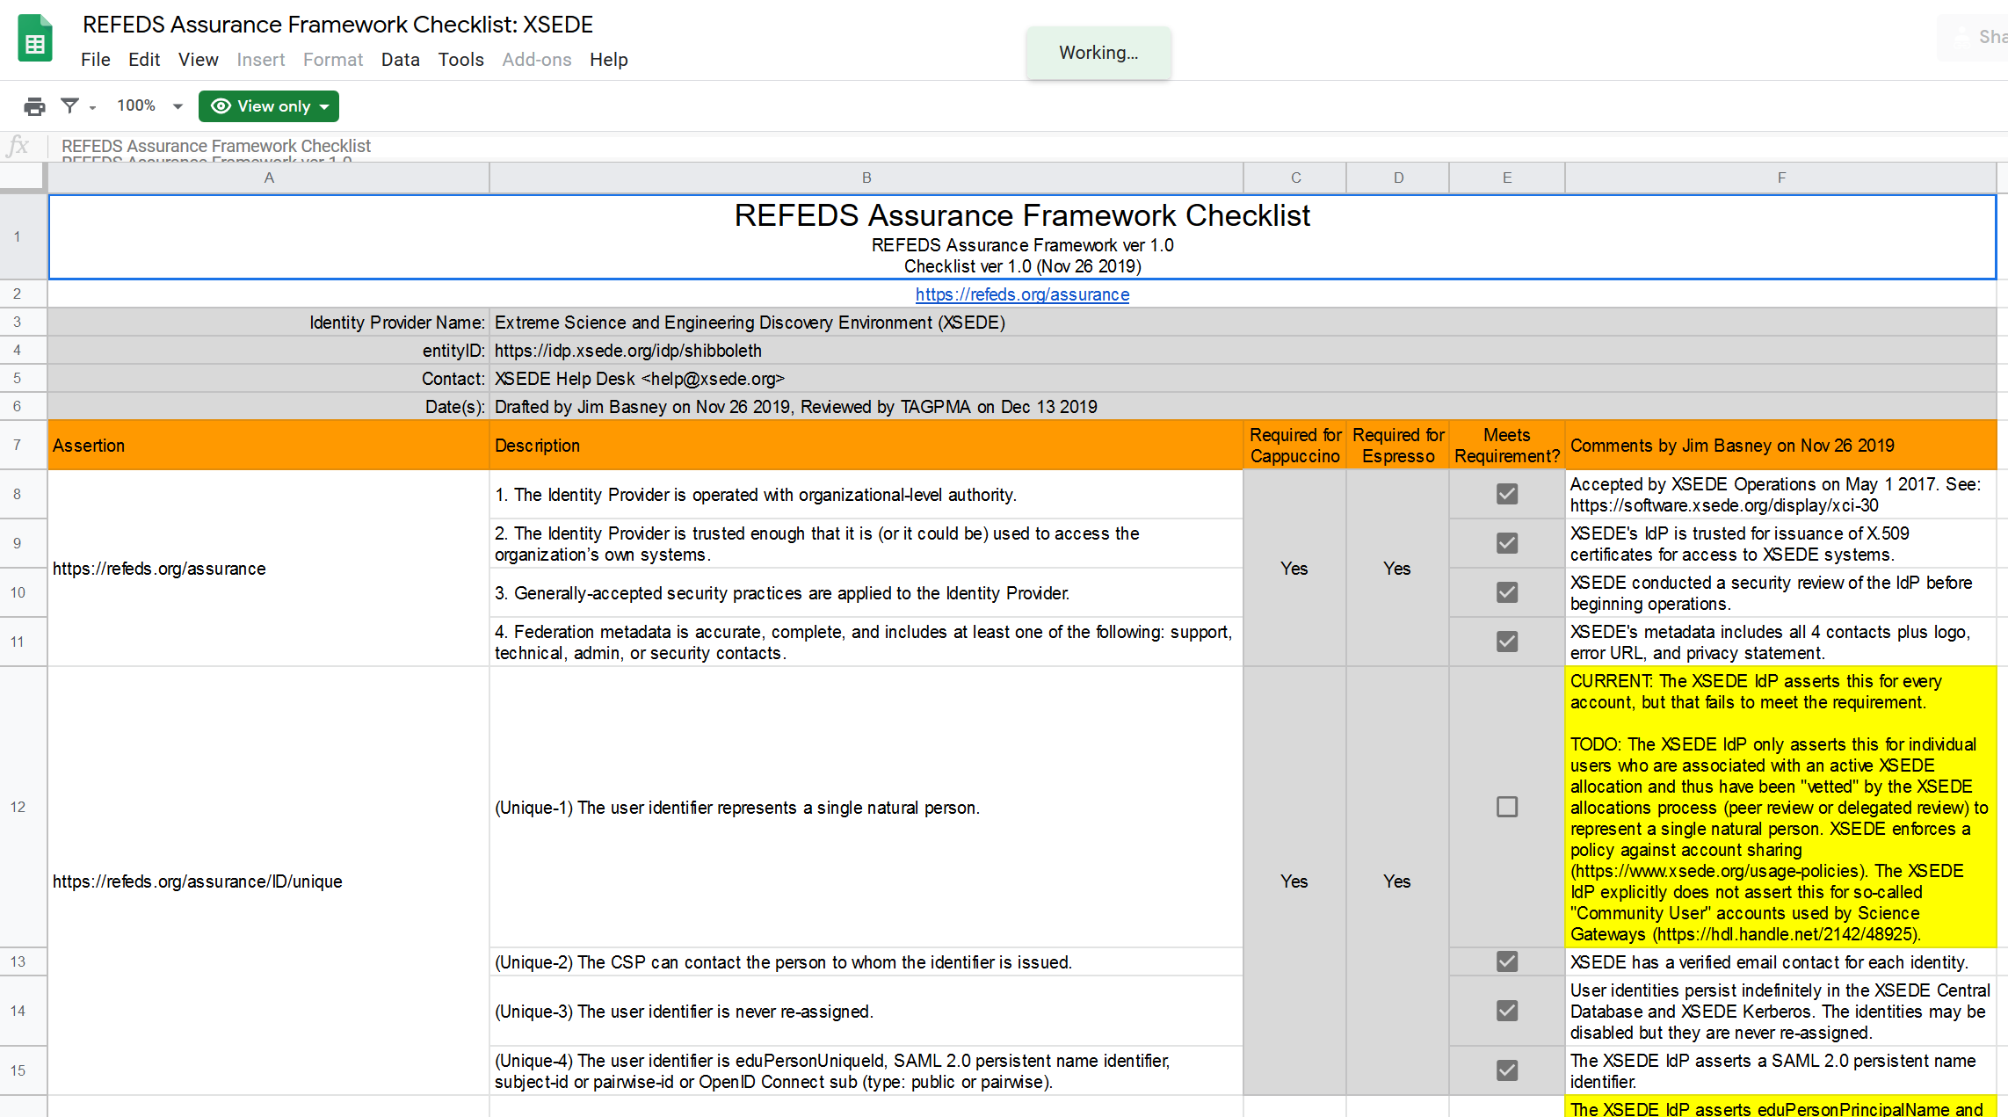
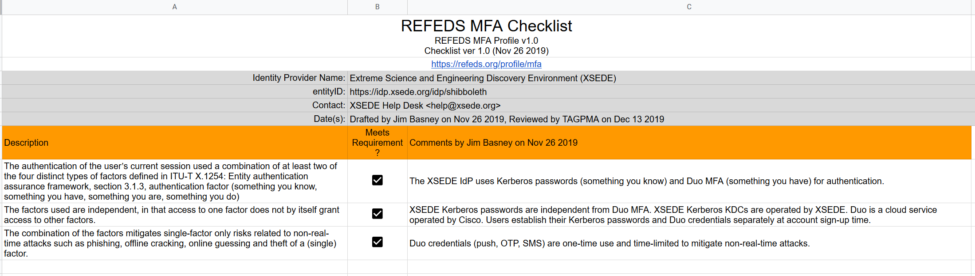
Conveying Assurance and Profiles in practice – at the IGTF: XSEDE & FNAL

Slide 8
Operational security focus in the BPA: beyond just the IdPs
Community membership management directories and attribute authorities
integrity of membership
identification, naming and traceability
site and service security
protection on the network
assertion integrity
Guidelines for Secure Operation of Attribute Authorities and other issuers of access-granting statements
(AARC-I048, in collaboration with IGTF AAOPS)

Slide 9
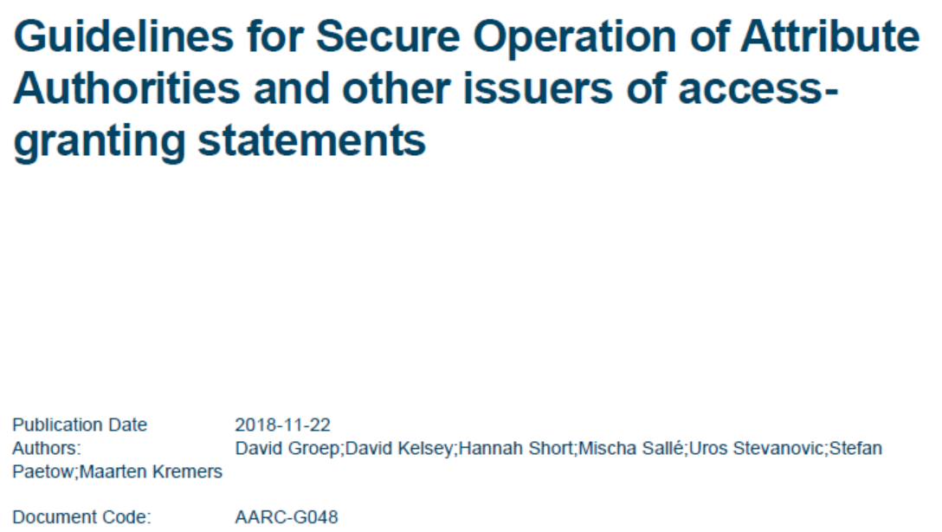
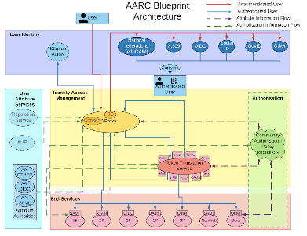
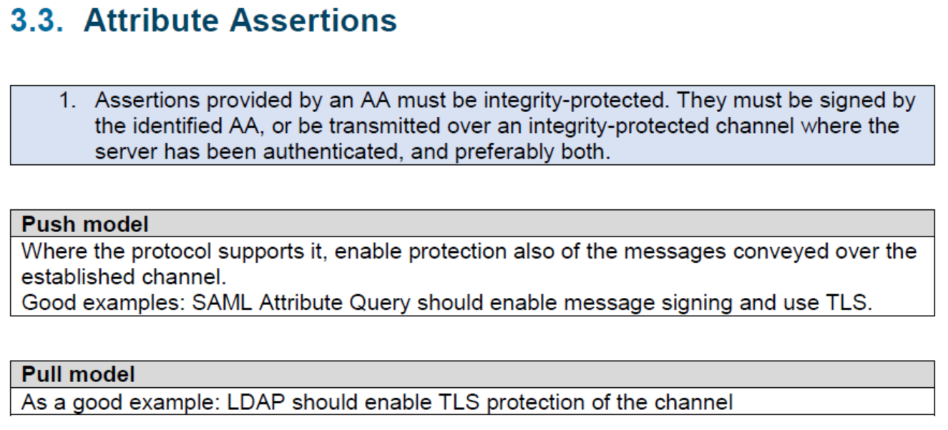
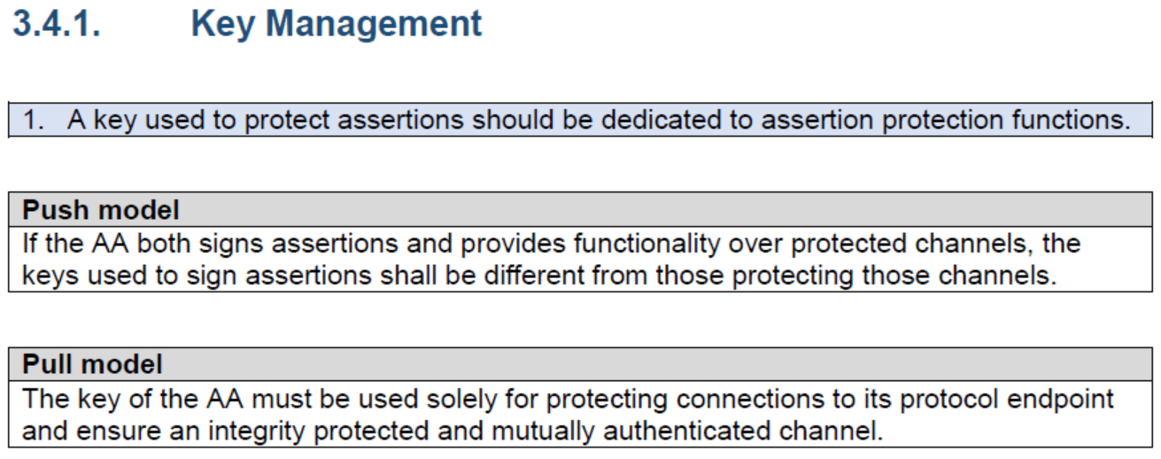
AARC-G048: keeping users & communities protected, moving across models
trusted delegation of response from communities to operators,
and from services to communities in recognizing their assertions
Structured around concept of “AA Operators”,
operating “Attribute Authorities” (technological entities),
on behalf of, one or more, Communities
`
contribute: validate it with current implementations
https://www.igtf.net/guidelines/aaops/
https://aarc-community.org/guidelines/aarc-g048/
Notes:
And dwells also on naming since that is the unique hook for the service providers to actually track back persistently to the proper community as well as operator …

Slide 10
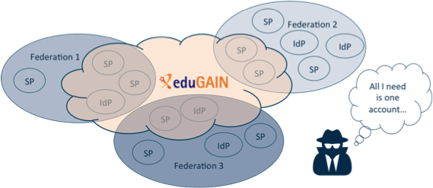
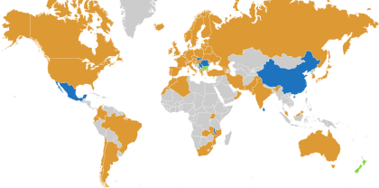














Security Incident Response in the Federated World
many countries & economic regions with an R&E identity federation
full of valuable resources
(data, network, services)
Could we ensure that information is shared confidentially, and reputations protected?
Security Incident Response Trust Framework for Federated Identity
Sirtfi – based on Security for Collaborating Infrastructures (SCI) & FIM4R Recommendations

Slide 11
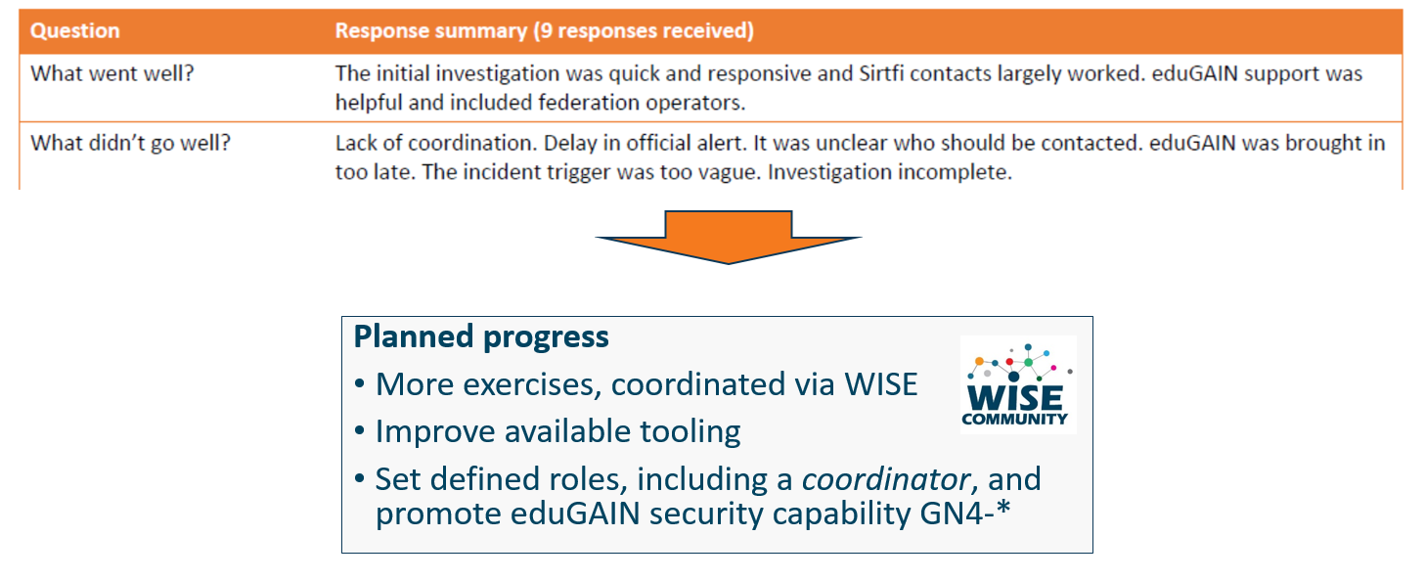
Communications Challenges
Based on Sirtfi incident role play of AARC in eduGAIN …
testing communications channels identified as high-priority target

Slide 12
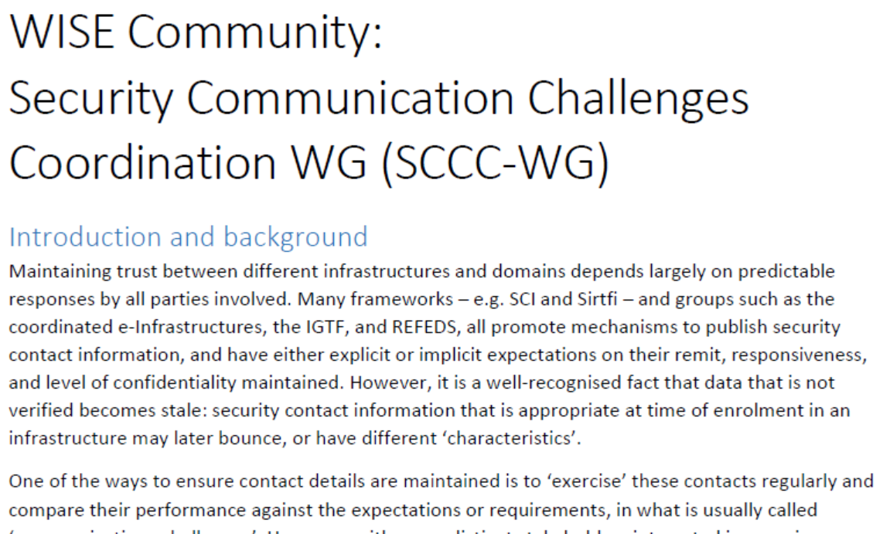
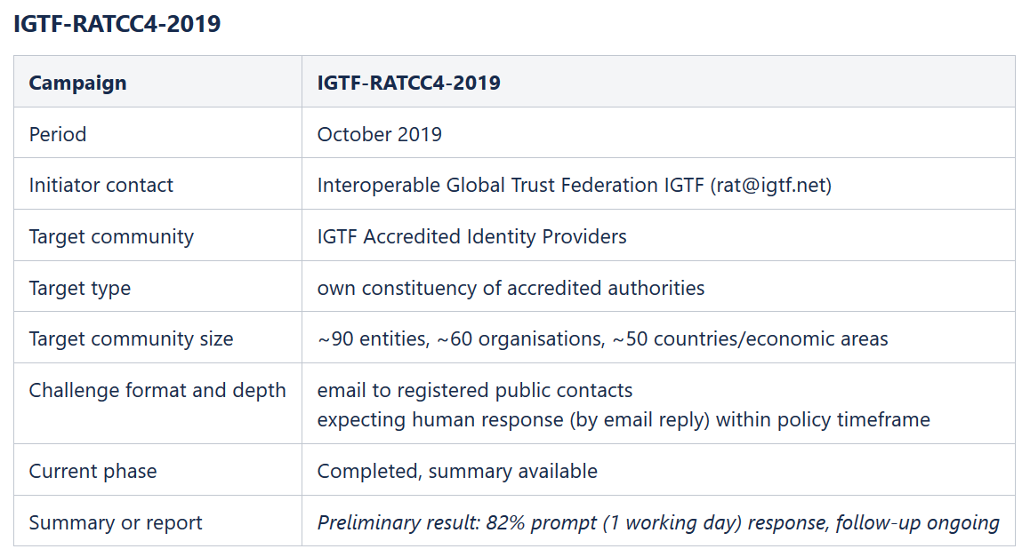
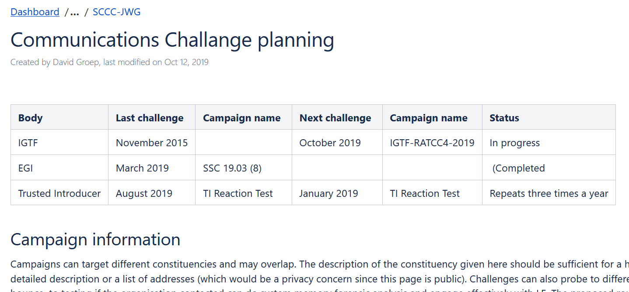
WISE SCCC-WG – participate!
WISE, SIGISM, REFEDS, TI joint working group
see wise-community.org and join!
https://wiki.geant.org/display/WISE/SCCC-JWG

Slide 13
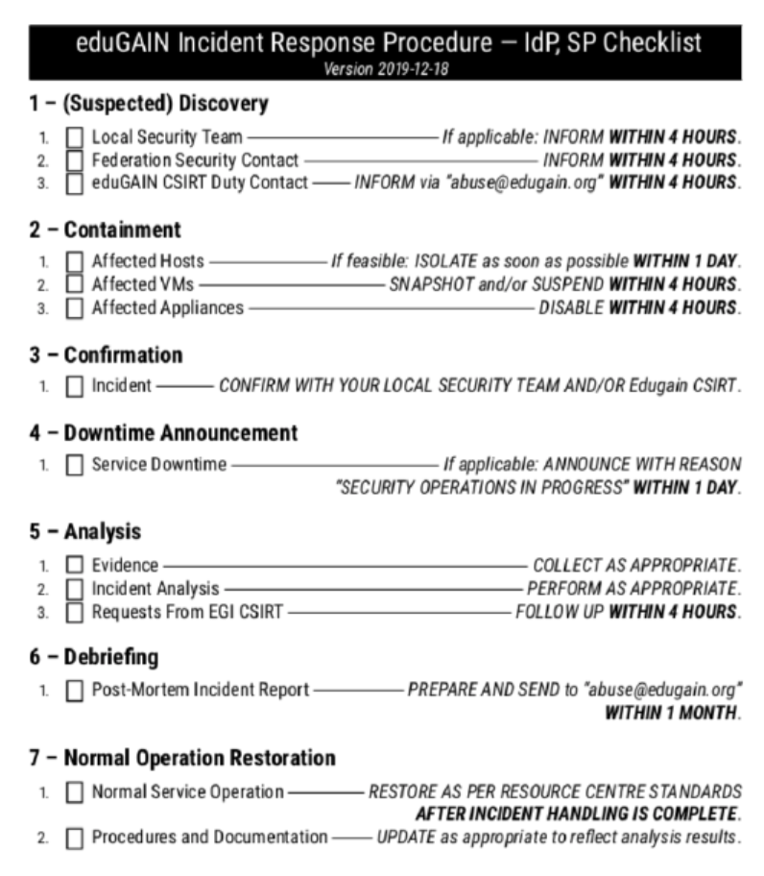
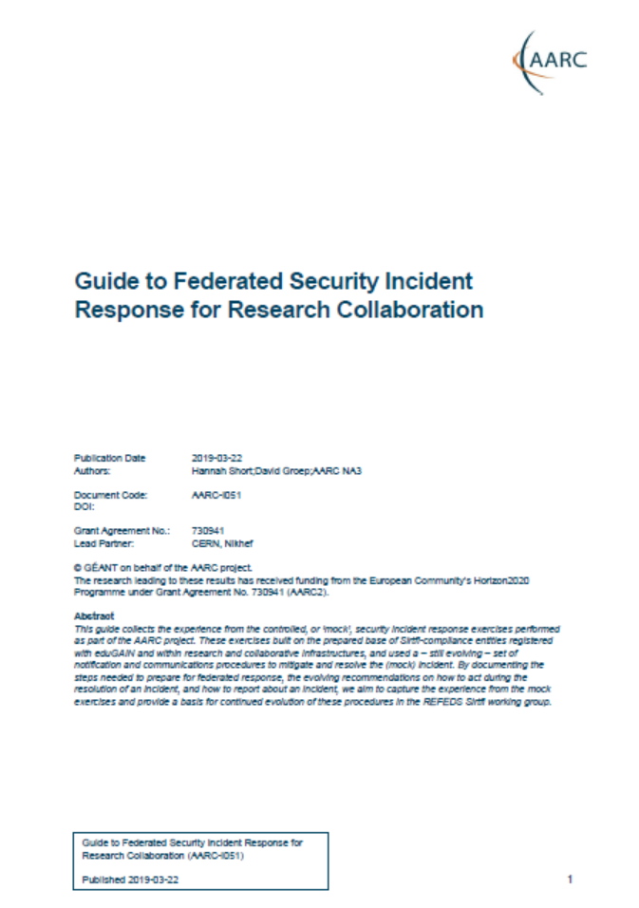
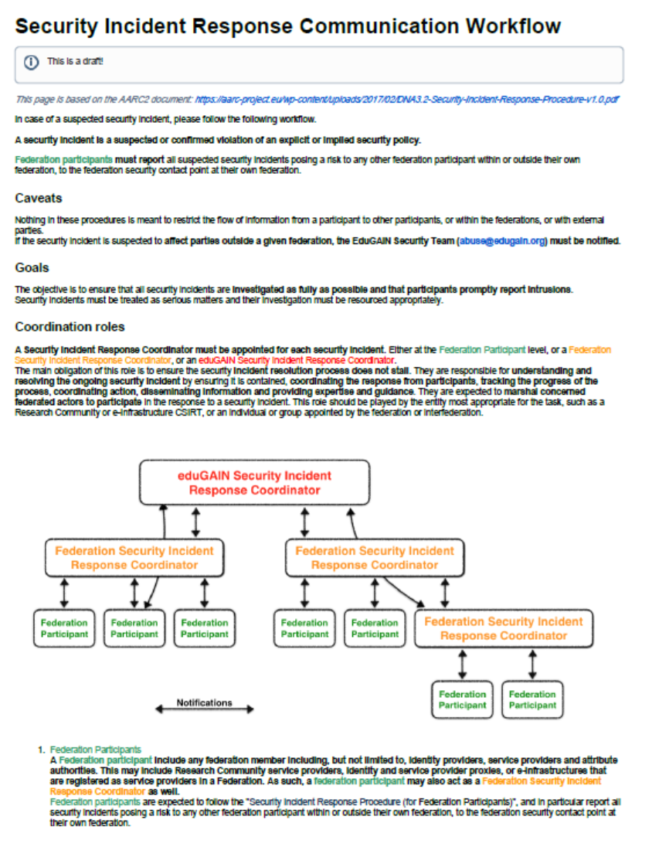
Evolving incident response: from I051 to eduGAIN Security
AARC-I051 Guide to Federated Security Incident Response for Research Collaboration
Be Prepared
Act
Report and Share
informational document and not a guideline since Sirtfi WG still needs
to get global endorsement, yet we need practical guidance right now!
https://aarc-project.eu/guidelines/aarc-i051/

Slide 14
See also https://g.nikhef.nl/pma48-summary
davidg@nikhef.nl
Project support by AARC2, GN4-3, and EOSChub

