Slide 1


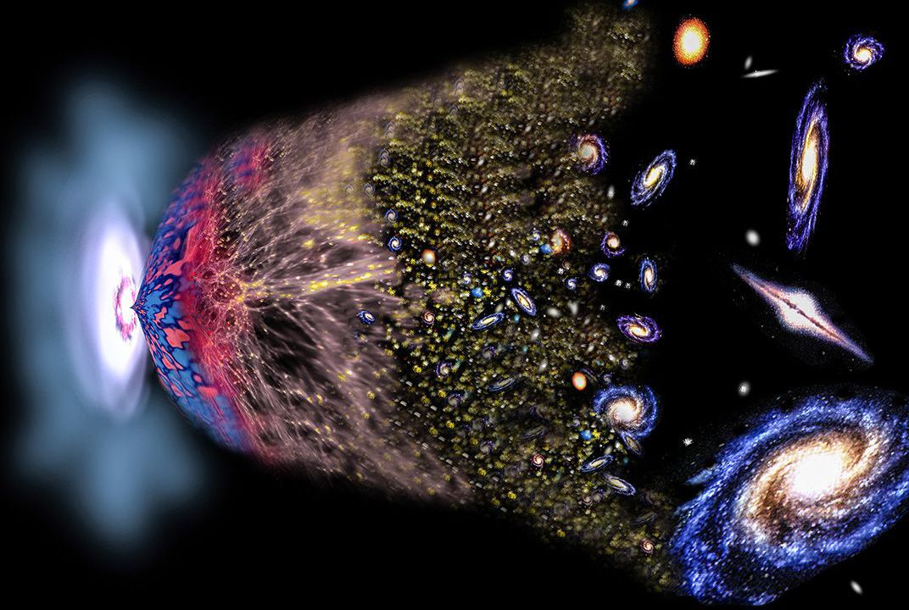

Slide 2

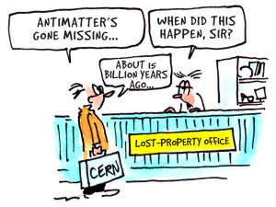

The mystery of the missing antimatter…
…and the number 3

Slide 3

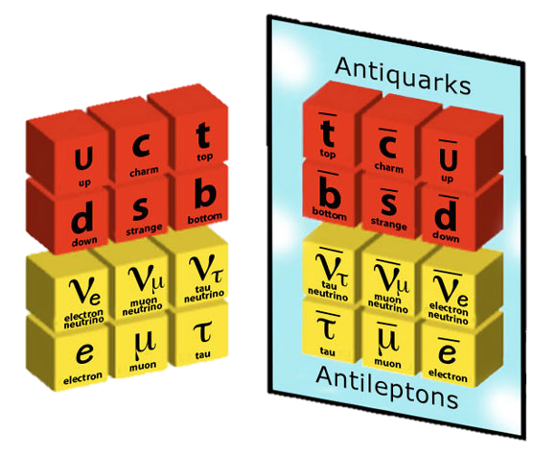
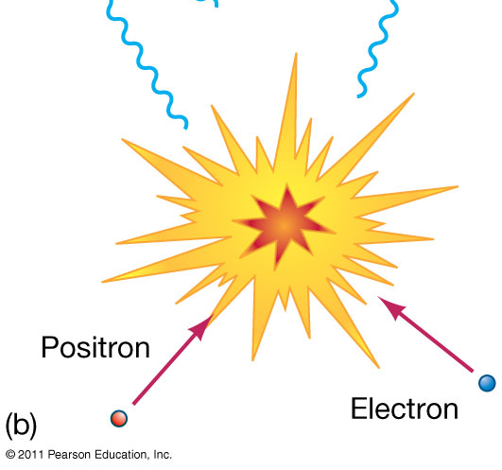
How did antimatter disappear in the Big Bang?
- What is the precise origin of the asymmetry
between matter and antimatter?
- Why are there three copies of particles?
Quarks
Leptons
50.000001%
49.999999%

Slide 4





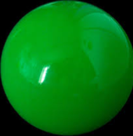

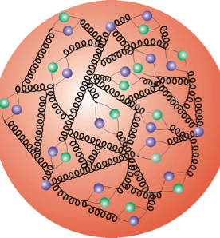

A world of matter and …
Atoo
m
Molecule
Electron
‘Quark’
Atom nucleus
Proton/Neutron

Slide 5
… a world of antimatter
Anti-Atom
Anti-Molecule
Anti-
Electron
Anti-Quark
Identical
anti-world
Anti-
Atom nucleus
Anti-Proton/anti-Neutron

Slide 6

… a world of antimatter
Anti-Atom
Anti-Molecule
Anti-
Electron
Anti-Quark
Identical
anti-world?
Anti-
Atom nucleus
Anti-Proton/anti-Neutron

Slide 7


CERN: the lab

Slide 8

CERN: the LHC collider

Slide 9
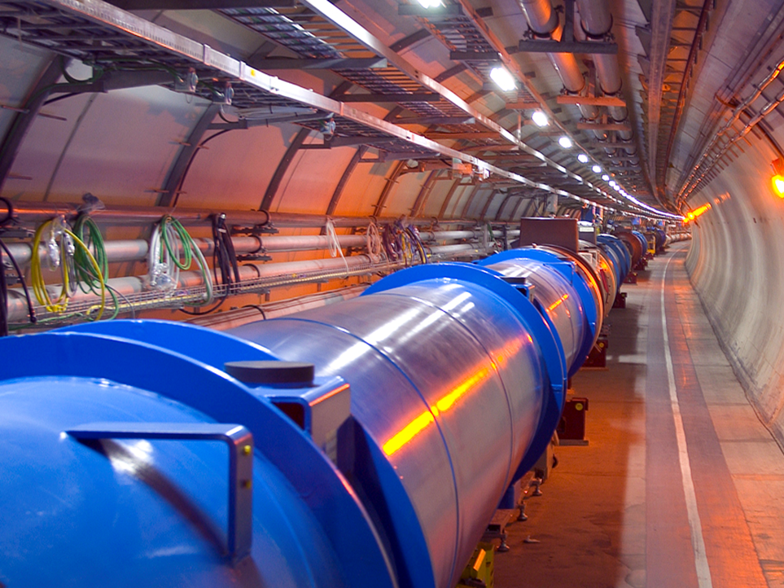
CERN: LHC accelerator
Proton beam 1
Proton beam 2

Slide 10

CERN: LHCb experiment
Notes:
Schematisch overzicht van de LHC versneller van 27 km lengte , 100 m diep onder de grond. In deze tunnel zijn in het verleden al experimenten gedaan (de LEP versneller) en hier is momenteel de LHC in bedrijf. Op vier plekken worden deeltjes met elkaar in botsing gebracht. De experimenten Atlas, CMS, LHCb en Alice.

Slide 11

LHCb detector
11

Slide 12
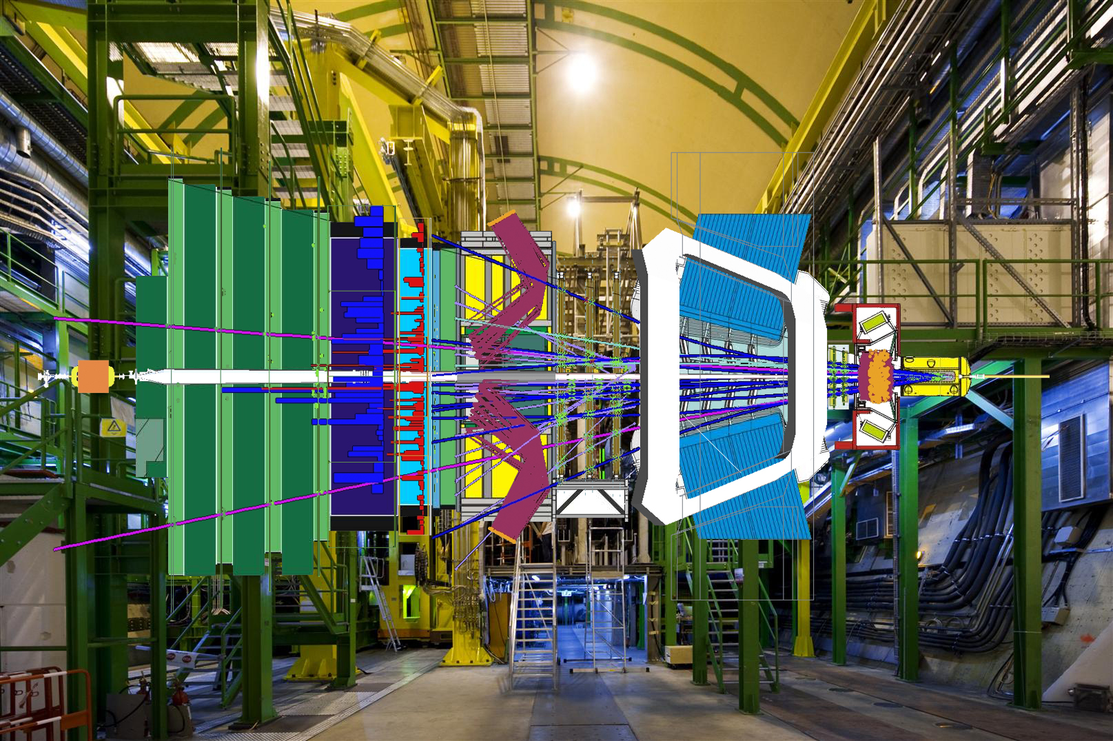
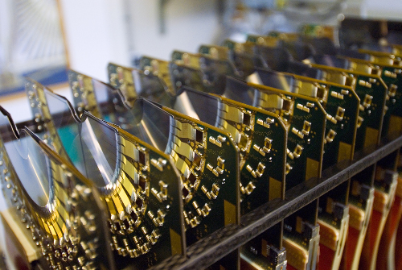

LHCb detector

Slide 13
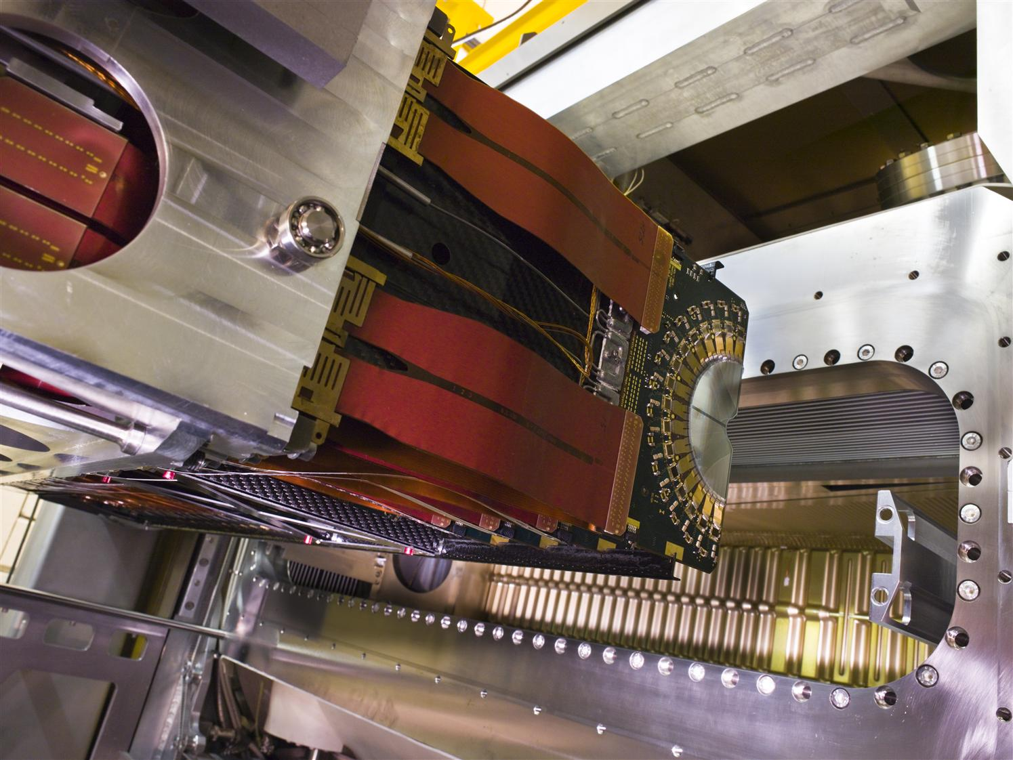
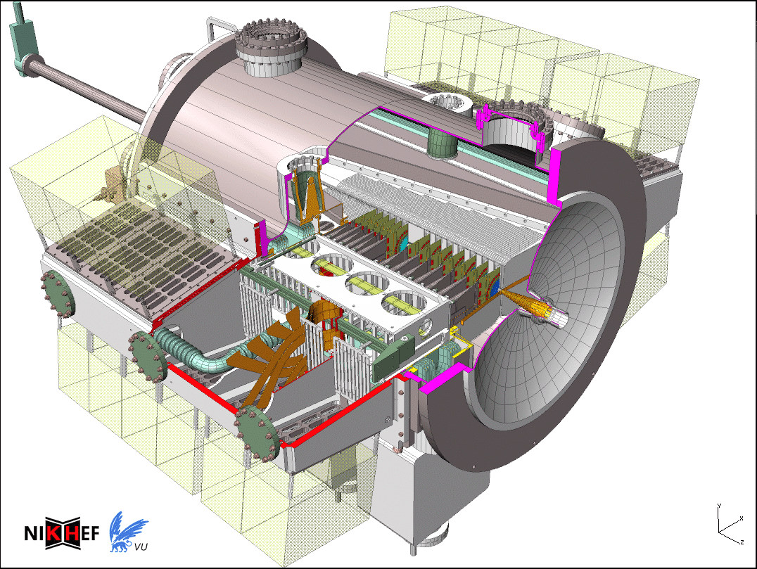
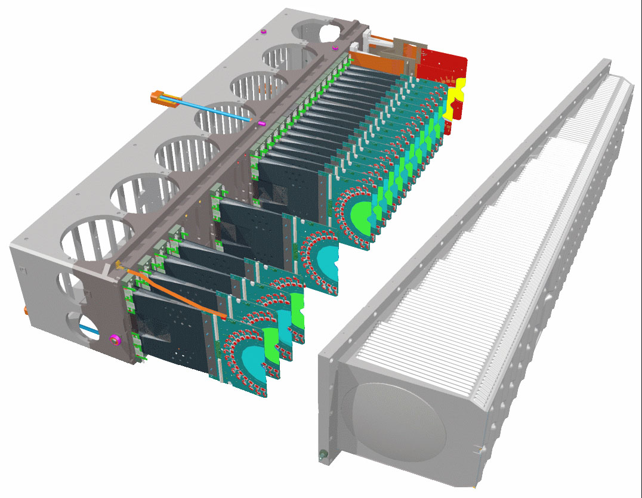
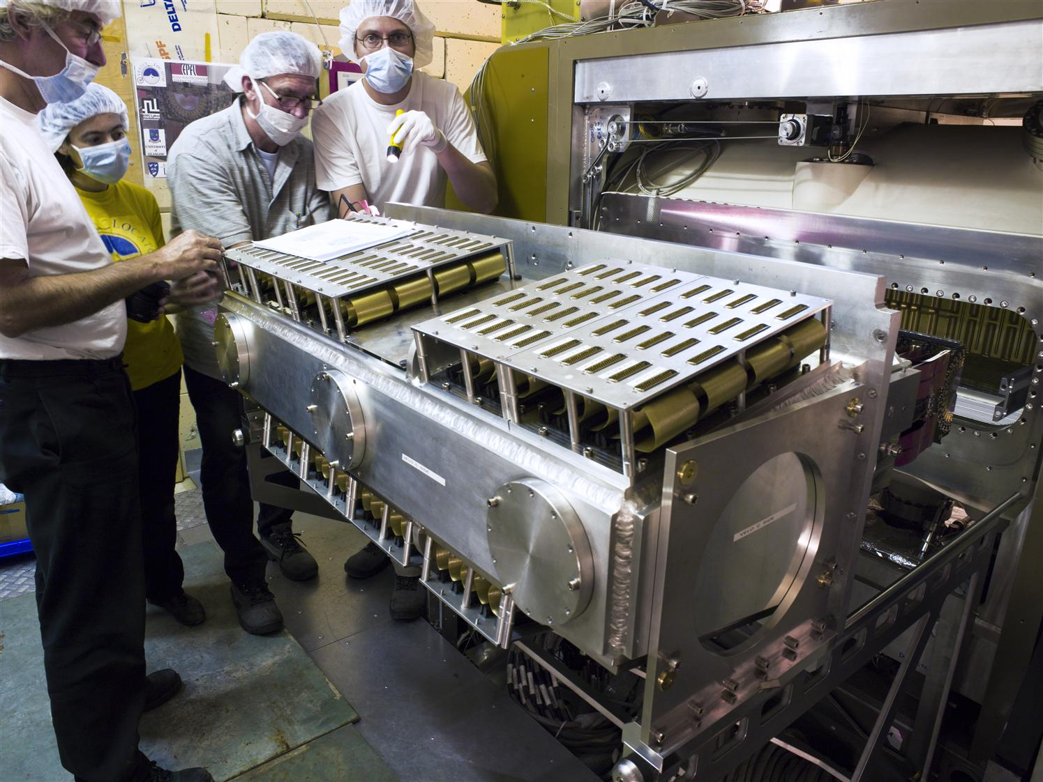
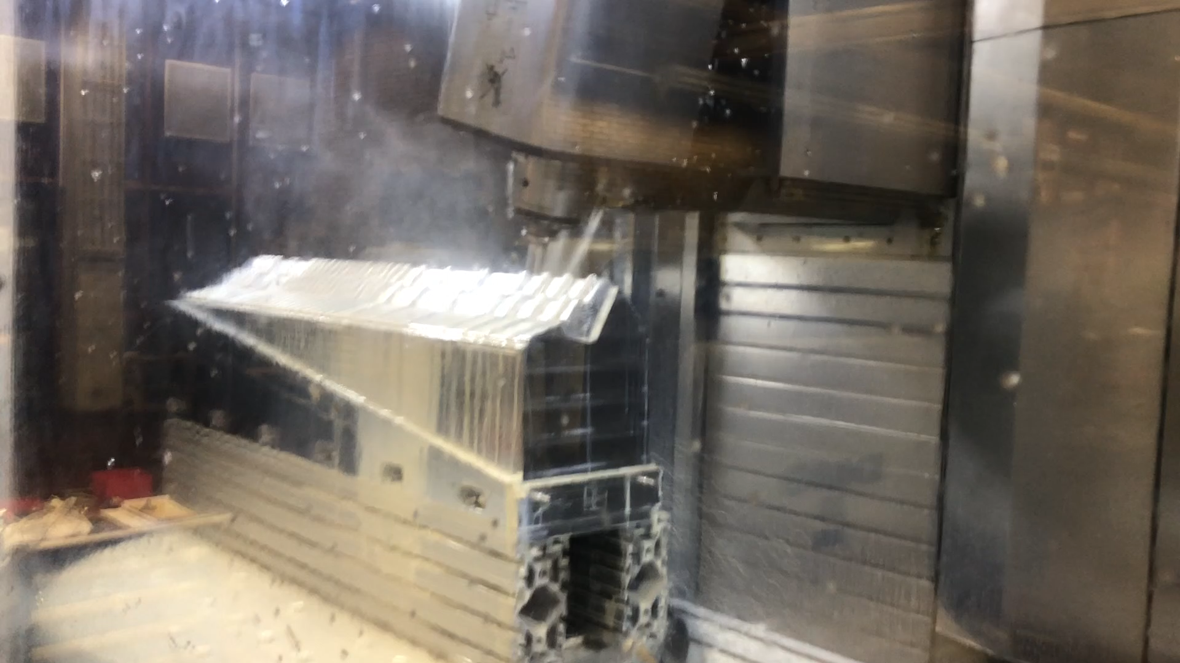
Nikhef contributions to Vertex Detector

Slide 14
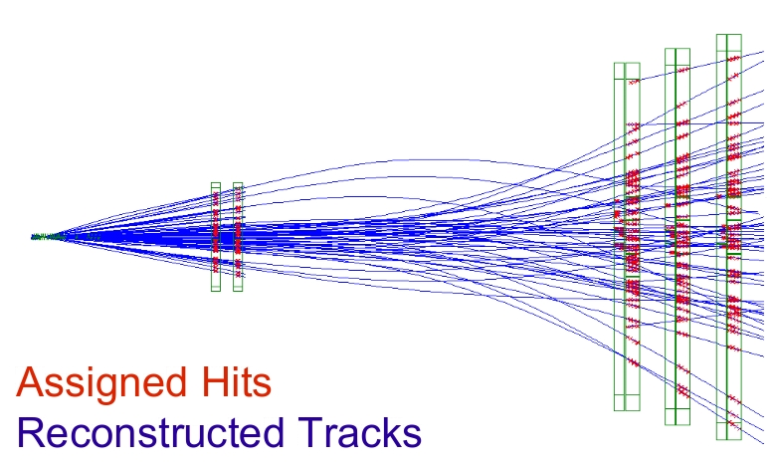
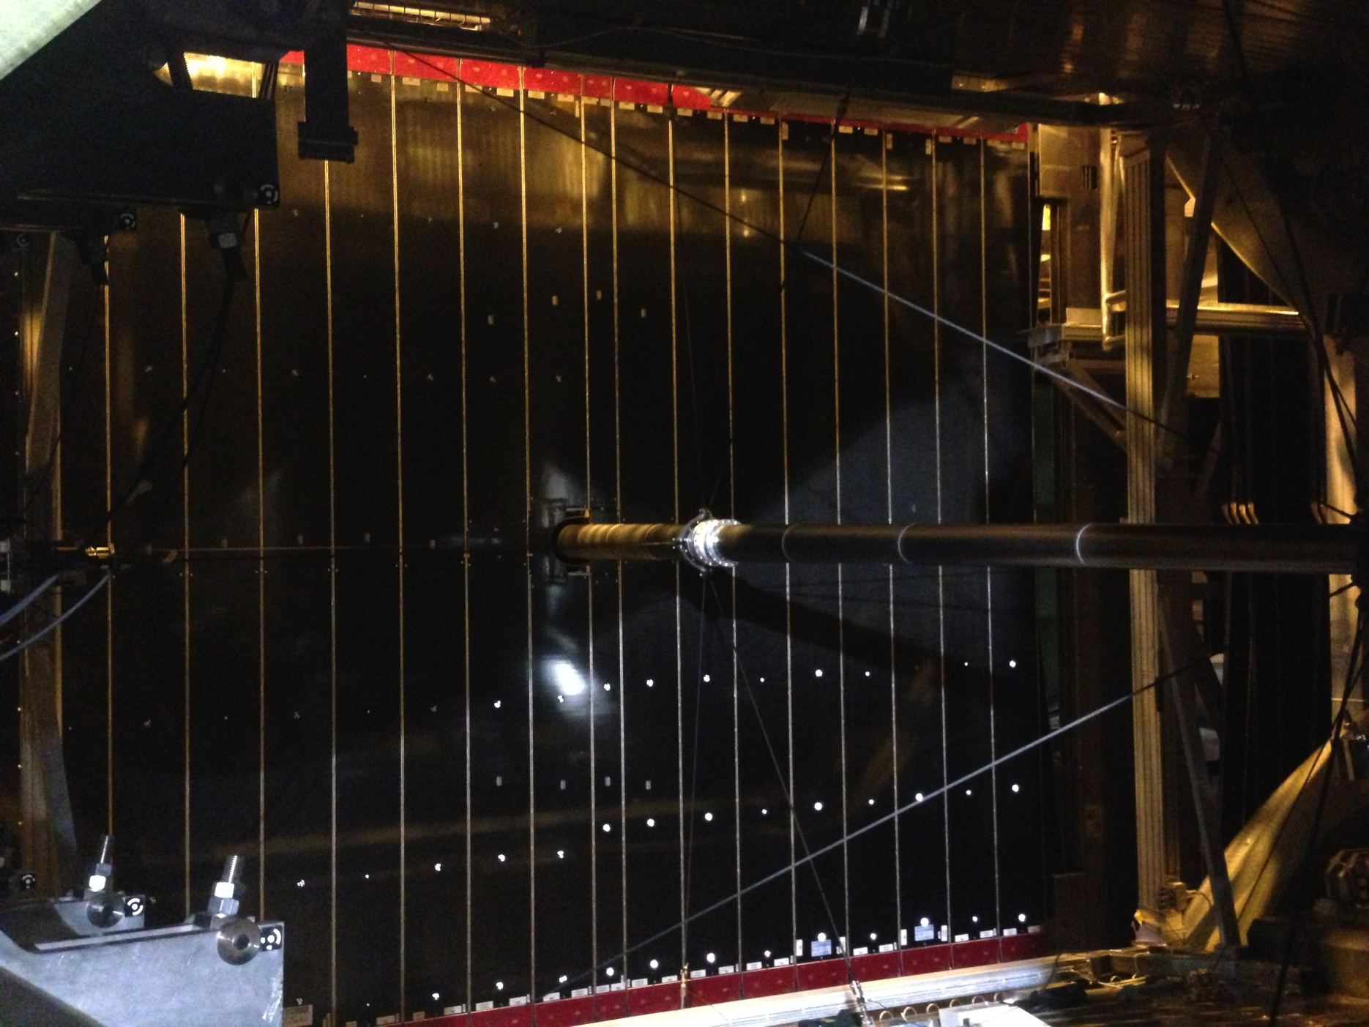
LHCb detector

Slide 15
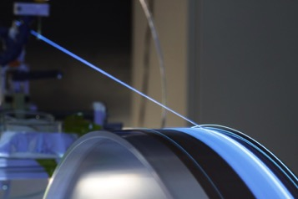
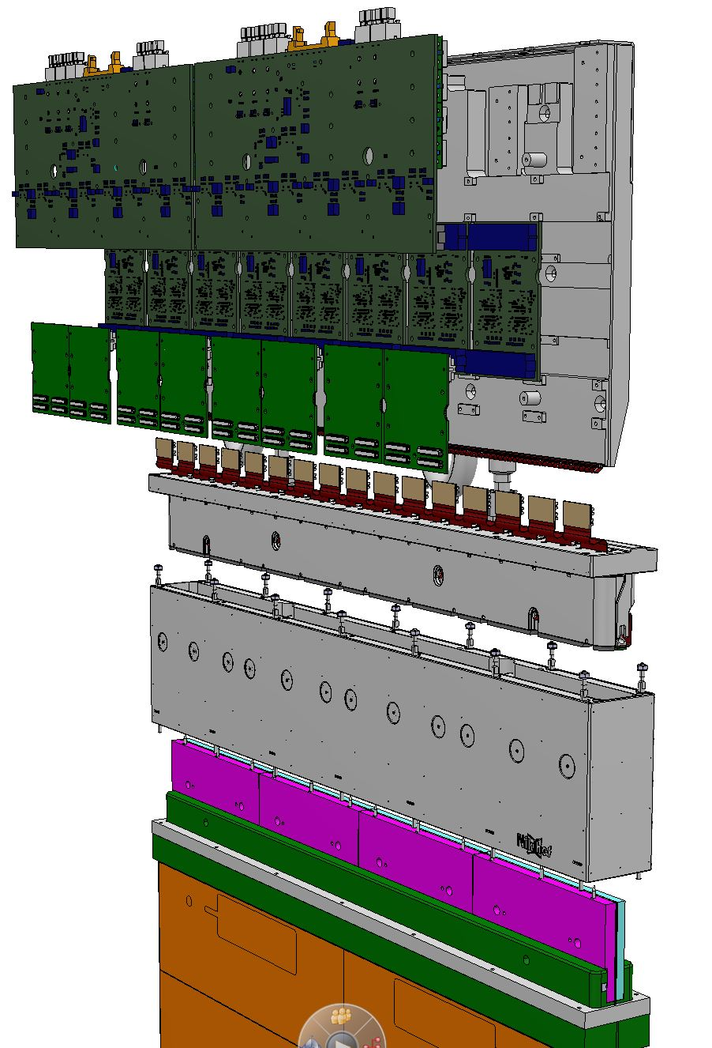
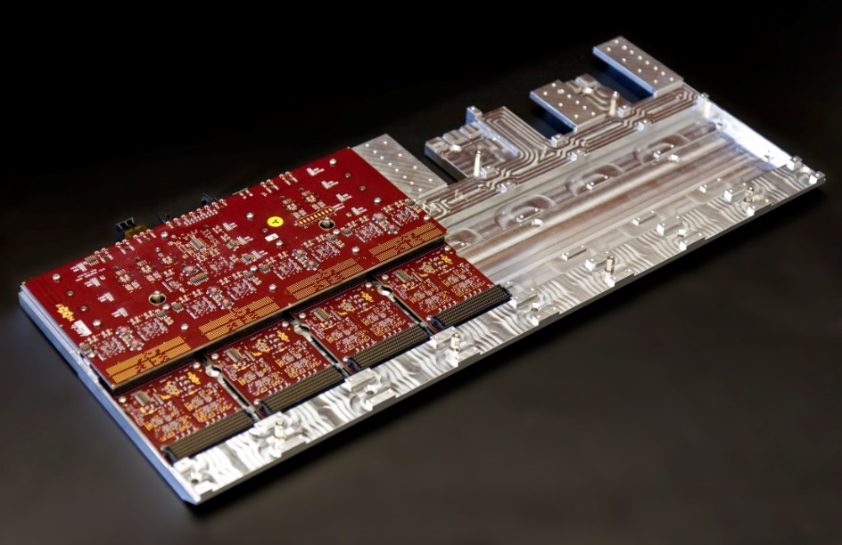
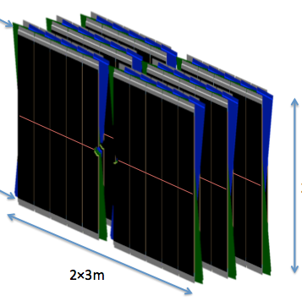
Nikhef contributions to Scintillating Fiber (“SciFi”) Tracker
1 Detector:
= 11.000 km fibres
= 128 modules
= 600 k SiPM channels
Module endpiece
Electronics
Master
Clusterization
Pacific
SiPM & Flex cables
Flex cables and SiPM
Cold box

Slide 16
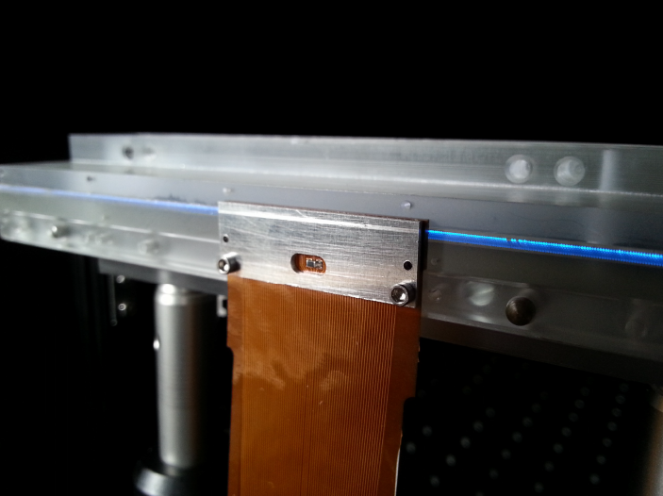
SciFi Detection Principle
fibre Ø = 250 µm
σ ~ 70 μm
6 staggered layers of 250 μm fibers
128 channel SiPM’s

Slide 17
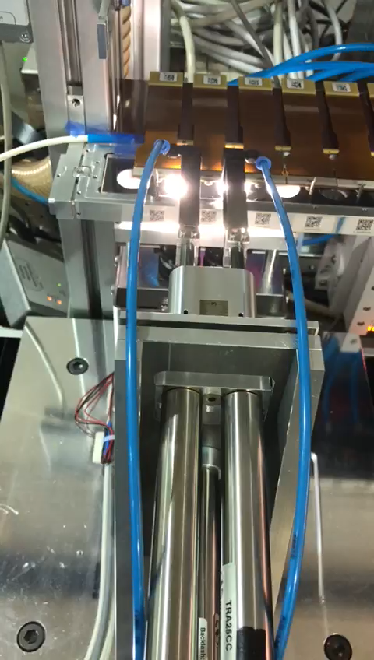
SciFi Detection Principle
fibre Ø = 250 µm
σ ~ 70 μm
6 staggered layers of 250 μm fibers
128 channel SiPM’s

Slide 18
LHCb detector

Slide 19
LHCb detector
Compare millions of matter as well as antimatter B-meson decays…
…And look for differences between matter and antimatter !

Slide 20


B-mesons: matter vs antimatter
B meson decays into
a K⁺ and a π⁻ particle
anti-B particle decays into
a K⁻ and a π⁺ particle
Matter process
Antimatter process
B⁰ → K⁺ π⁻
B⁰ → K⁻ π⁺
Left and right not at same rate!
Only occurs in rare cases where particles of all 3 generations are involved.

Slide 21
B-mesons: matter vs antimatter
B meson decays into
a K⁺ and a π⁻ particle
anti-B particle decays into
a K⁻ and a π⁺ particle
Matter process
Antimatter process
B⁰ → K⁺ π⁻
B⁰ → K⁻ π⁺
The laws of nature for matter and antimatter are clearly not 100% morror symmetric

Slide 22
How did antimatter disappear in the Big Bang?
Why are there three copies of particles?
Because it is the simplest possible universe?!
Quarks
Leptons
50.000001%
49.999999%

Slide 23

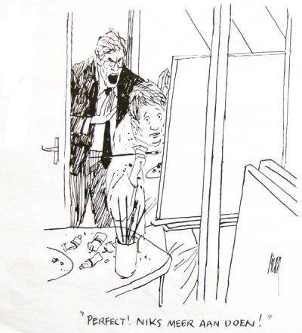
Are we now ready?

Slide 24
How did antimatter disappear in the Big Bang?
Standard Model explanation not enough !
Quarks
Leptons
50.000001%
49.999999%

Slide 25
How did antimatter disappear in the Big Bang?
New step in understanding Big Bang?
+ ???
Quarks
Leptons
50.000001%
49.999999%

Slide 26
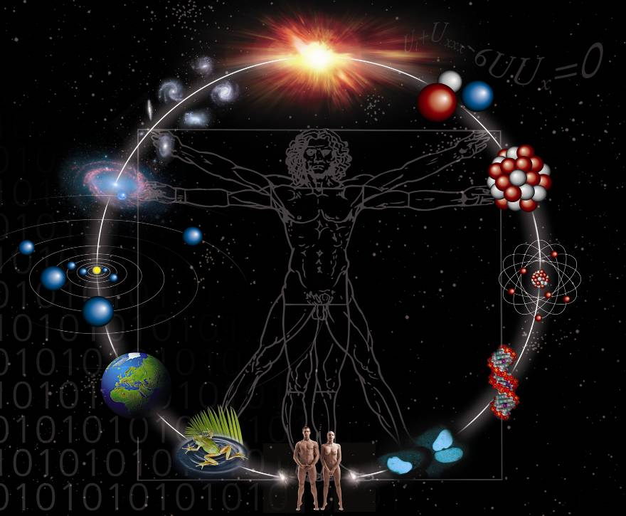
Astronomy
Particle-physics
Current Status:
Trying to understand the origin of elementary particles in Big Bang using the LHC
Higgs particle and origin of mass
Matter – antimatter asymmetrie
Is there another force in nature
Are three copies of fundamental particles a natural neccessity?

Slide 27
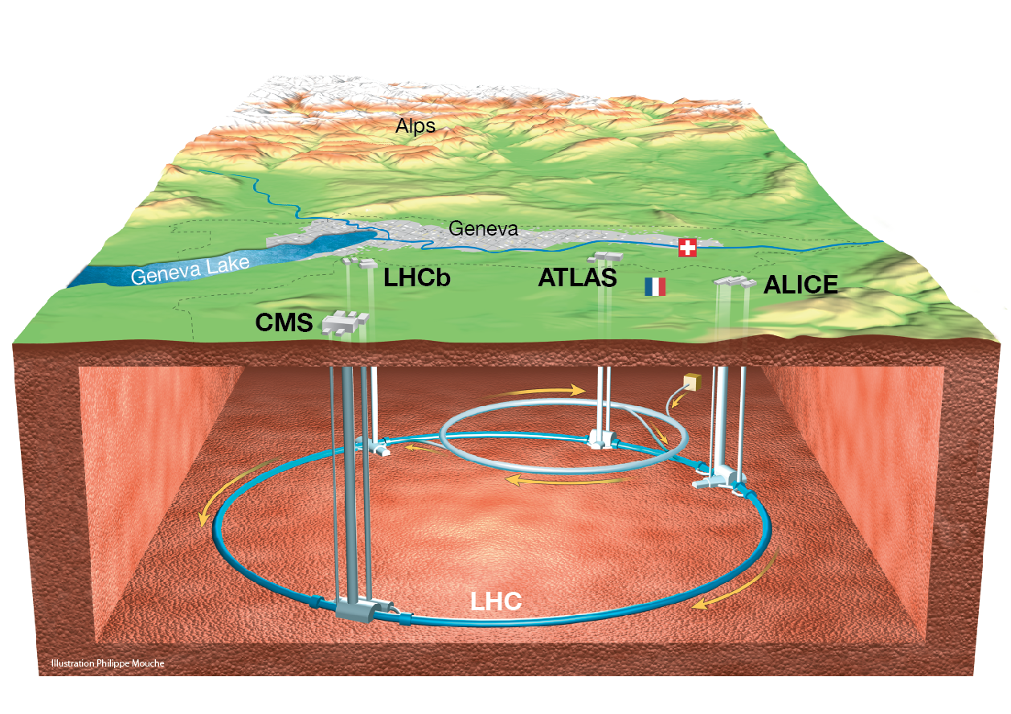
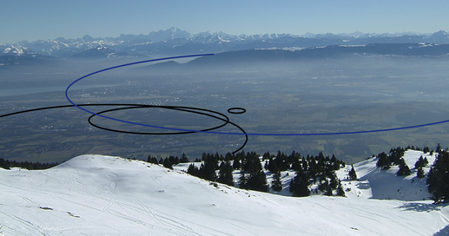
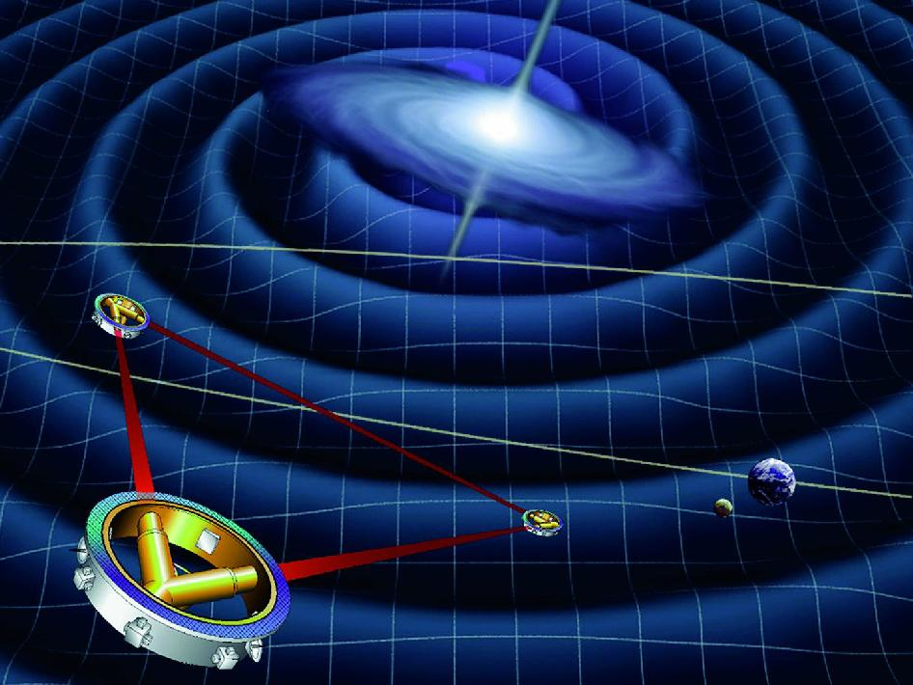
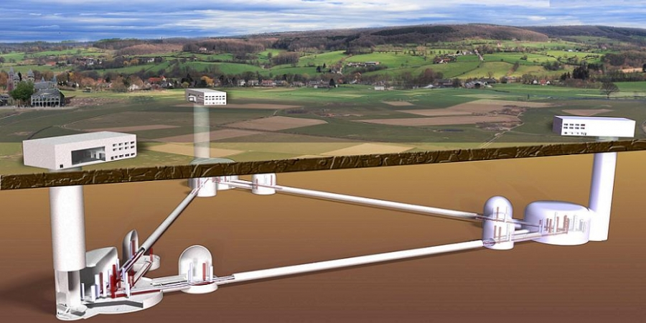
Future: “Circles and Triangles”
Particle accelerators: physics of the Big Bang…
Gravitation-detectors: listening to Big Bang…

Slide 28

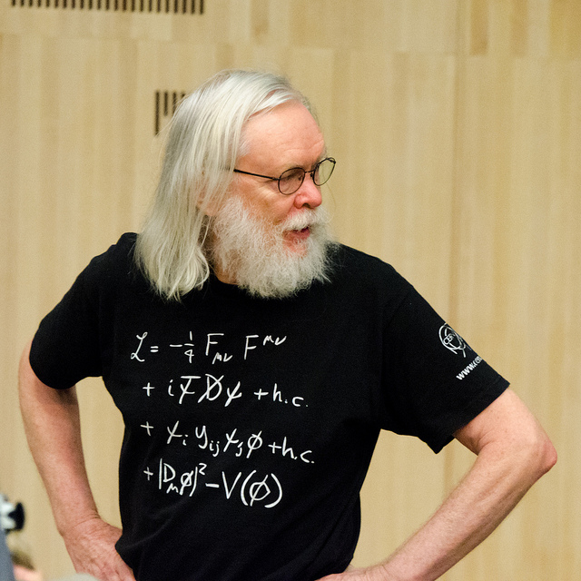
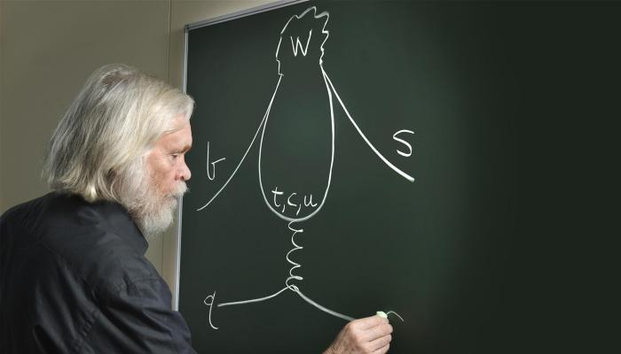
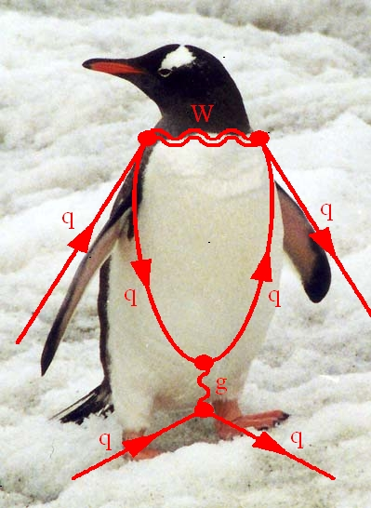

Enter Penguins
John Ellis loses a game of darts…
… from Melissa Franklin...
Notes:
Melissa Franklin

Slide 29
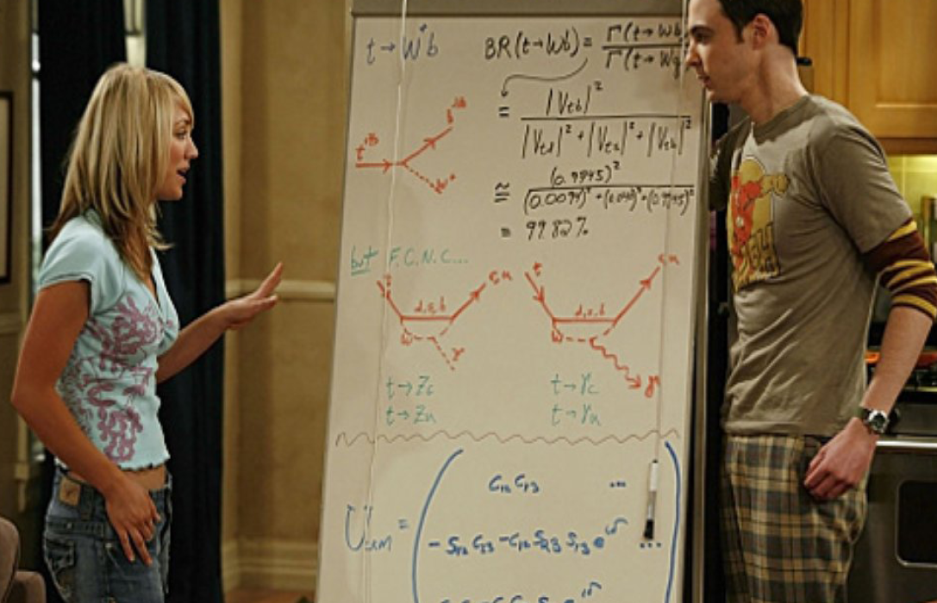
Penguins in de Big Bang theory…
Notes:
The Big Bang Theory: Sheldon and Penny

Slide 30

Penguins & Lepton Universality?
Are the three particle generations really completely identical?
The quantum penguin test:
μ⁺
e⁺
e–
μ–
?

Slide 31
Lepton Universality?
Measure the ratio:
= R
R = 1 ?
Recent result: R not precisely 1?
➔ Perhaps interaction not universal?!

Slide 32
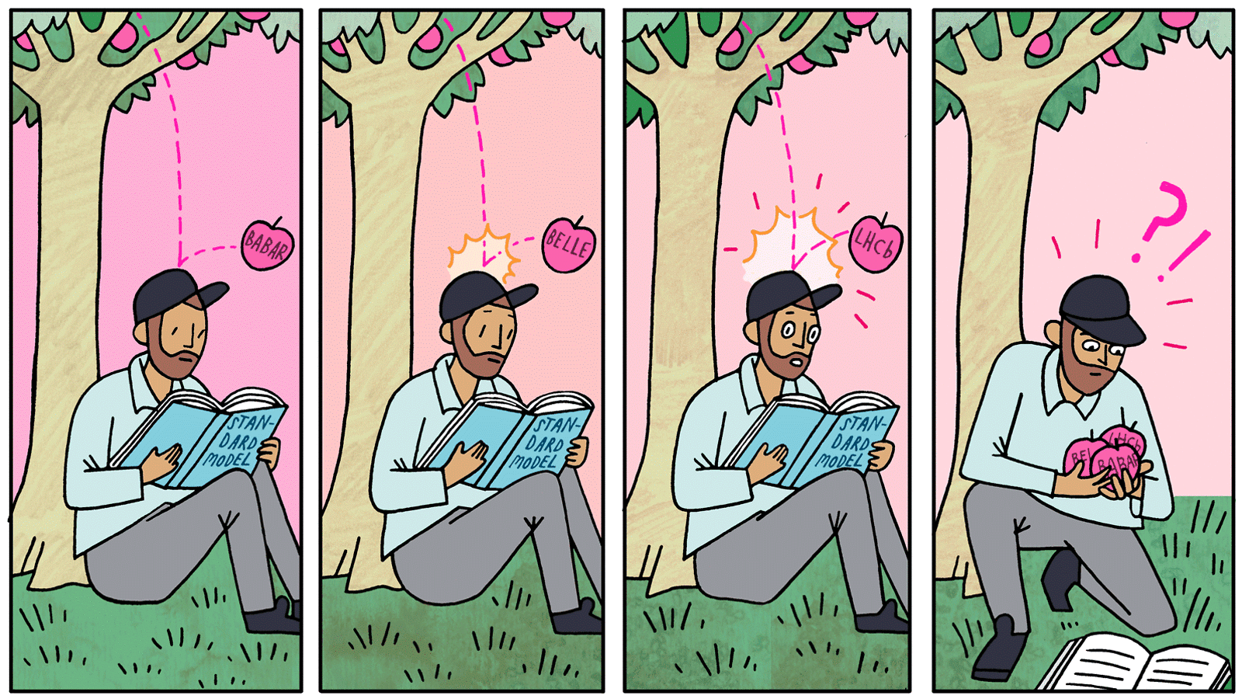
A new force in Nature?
+ ???
Three experiments see a small hint:
➔ New line in the fundamental theory?!
➔ More measurement results underway!

Slide 33
How did antimatter disappear in the Big Bang?
New step in understanding Big Bang?
+ ???
Quarks
Leptons
50.000001%
49.999999%

Slide 34
Astronomy
Particle-physics
Current Status:
Trying to understand the origin of elementary particles in Big Bang using the LHC
Higgs particle and origin of mass
Matter – antimatter asymmetrie
Is there another force in nature
Are three copies of fundamental particles a natural neccessity?

Slide 35
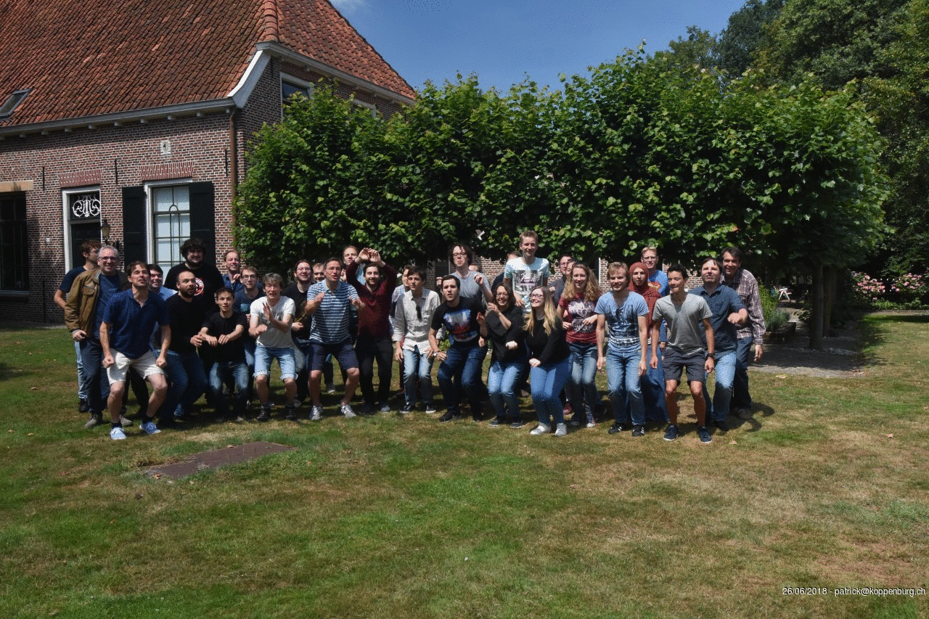
2
LHCb team of physicists
Notes:
Staff: Antonio, Niels, Gerhard, Wouter, Gerco, Kazu, Martin, Marcel Postdocs: Roman, Daniel, Jacco, Sevda, Carlos, Sean, Flavio,

Slide 36
Future: “Circles and Triangles”
Particle accelerators: physics of the Big Bang…
Gravitation-detectors: listening to Big Bang…

Slide 37
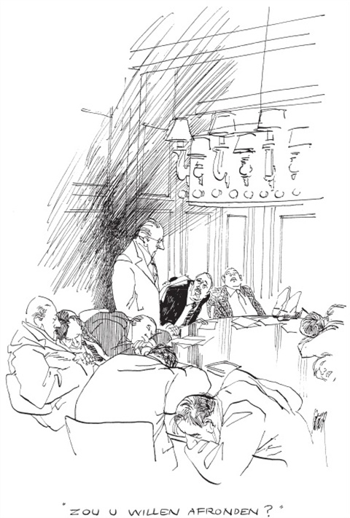

Slide 38
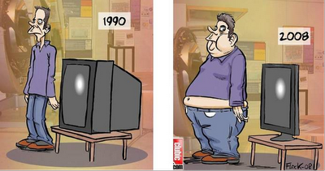
Valorization

Slide 39
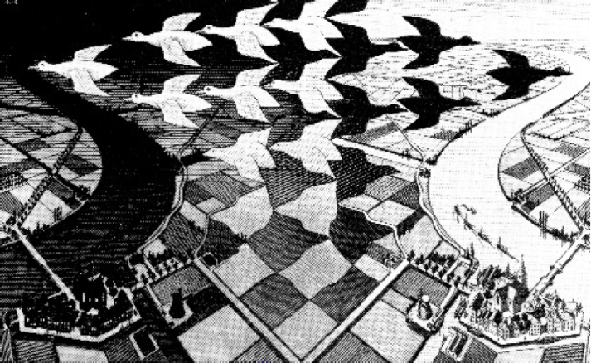
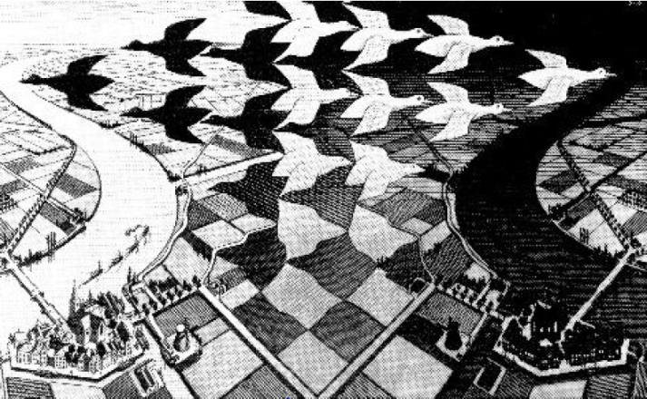
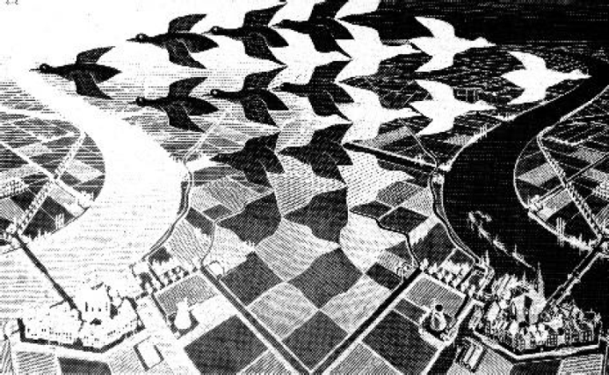
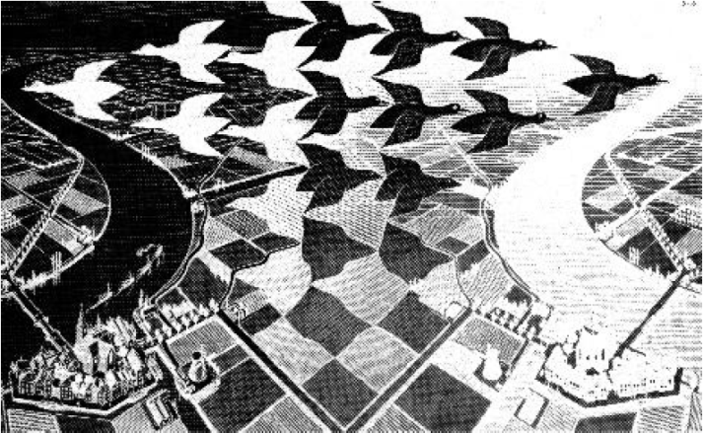
Escher’s impression on the matter vs antimatter asymmetry
matter
Color anticolor
antimatter
left right
Notes:
Tot slot wil ik eindigen met dezelfde transparant als waarmee ik begon: een impressie van Escher. Als U linksboven de kleuren zwart en wit verwisseld krijgt U het beeld linksonder. Als U dan dit beeld spiegelt door linke en rechts te verwisselen krijgt U het zelfde beeld weer terug.
Dit kunt U beschouwen als de anti-versie van linksboven. Maar als U nu goed kijkt ziet U dat ze niet helemaal identiek zijn. Blauw: bootje ontbreekt
In Groen staart omhoog/omlaag. De symmetrie is gebroken! Het feit dat een wereld van matere en een wereld van antimaterie er anders zouden uitzien is essentieel voor het onderzoek voor de eerste miljardste seconde in het heelal.

