Slide 1
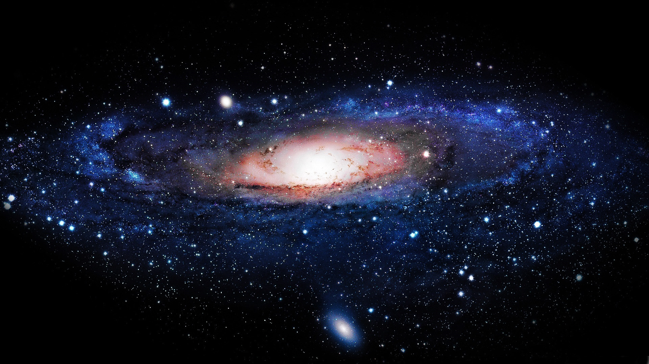


Higgs & Mystery of Missing Antimatter
Marcel Merk
VWO-NNV students
11 Sept 2015

Slide 2
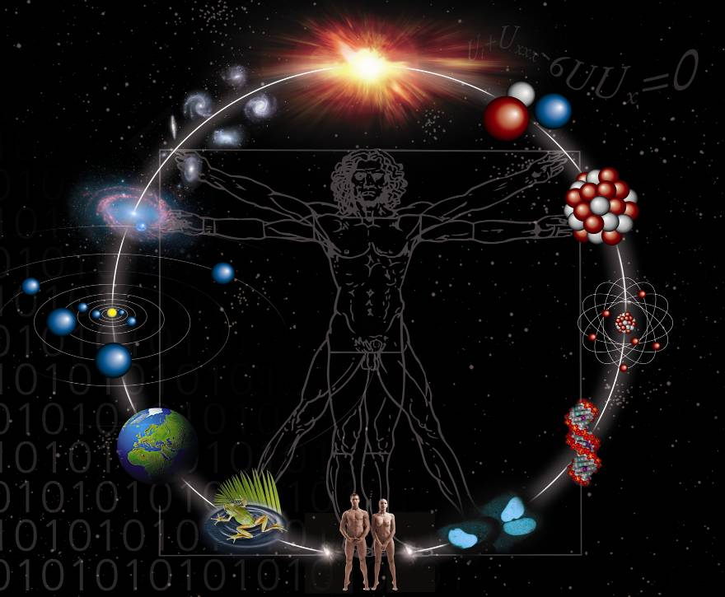
astronomy
particle-physics
“New Physics”
(Physics Beyond the Standard Model)

Slide 3







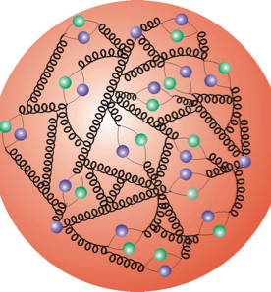

Building-blocks of Matter
Atom
Molecule
Electron
Quark
Atom
nucleus
Proton/Neutron

Slide 4
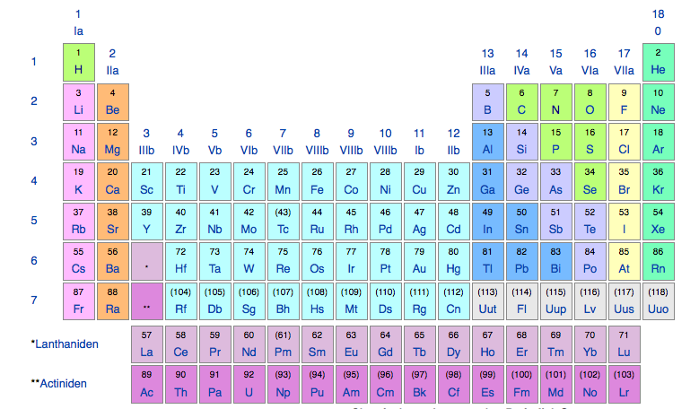
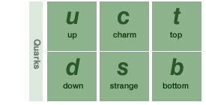
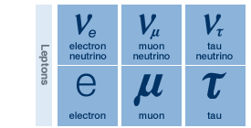
Building-blocks of Matter
Atom
Molecule
Electron
‘Quark’
Atom
nucleus
Proton/Neutron

Slide 5
Building-blocks of Matter
Atom
Molecule
Electron
‘Quark’
Atom
nucleus
Proton/Neutron

Slide 6




Fundamental forces of Nature
Gravitation
Strong nuclear force
Works on all particles with mass
Works
on all nuclear particles
Elektromagnetism
Weak nuclear force
Works on all
electrically charged particles
Works on
all particles

Slide 7

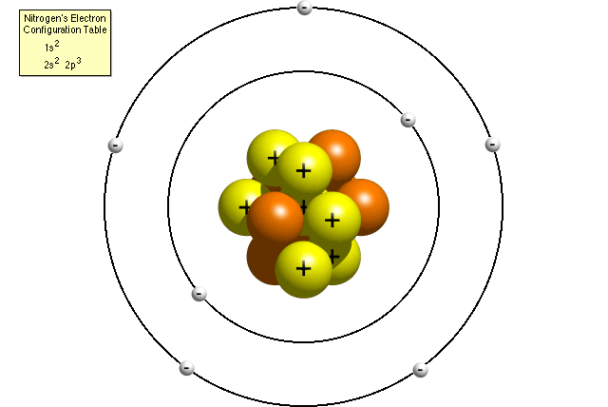

How does nature behave in extreme circumstances?
Small distances
‘Classical’
Kepler et. al. (1609)
Quantum mechanics
(Bohr et. al. 1930)
High energy
‘Special relativity’
(Einstein 1910)

Slide 8

How does nature behave in extreme circumstances?
Small distances
‘Classical’
Kepler et. al. (1609)
Small distances
and high energy
Quantum mechanics
(Bohr et. al. 1930)
High energy
‘Quantum field & gauge theory’
(Dirac, Pauli et al. 1950
Yang Mills Veltman ‘Hooft 1970 )
‘Special relativity’
(Einstein 1910)

Slide 9
How does nature behave in extreme circumstances?
Small distances
‘Classical’
Kepler et. al. (1609)
Small distances
and high energy
Quantum mechanics
(Bohr et. al. 1930)
Existance of anti-matter
Force = exchange of
messenger particles
Conversion of energy in matter and v.v.
High energy
‘Quantum field & gauge theory’
(Dirac, Pauli et al. 1950
Yang Mills Veltman ‘Hooft 1970 )
‘Special relativity’
(Einstein 1910)

Slide 10

The Standard Model of Elementary Particles
Works at very small distances
(Quantum Mechanics)
Works at very high energies
(Special Relativity)
(and also)
Describes all known matter
(except dark matter)
Describes all
forces of nature
except gravity
Not clear if SM is
Valid for Big Bang
20 unexplained parameters
(so not very predictief?)
Describes but does not explain many strinking aspecs of nature
+ New Physics ?!

Slide 11
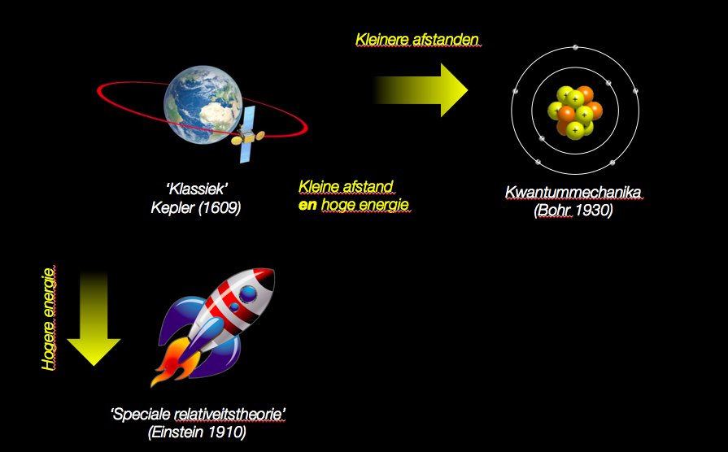

How does nature behave in extreme circumstances?
Experimentally tested
Domain of the Standard Model
Big Bang
But do we understand
physics here?

Slide 12
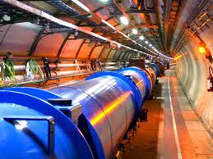
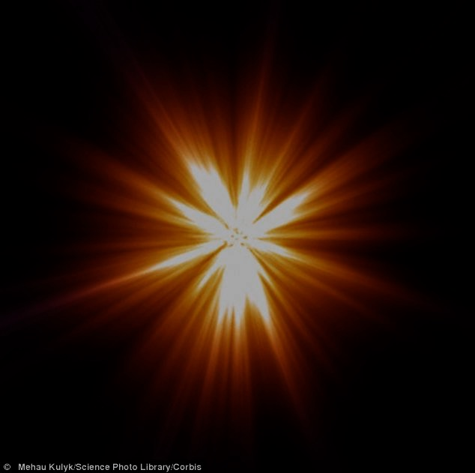
How does nature behave in extreme circumstances?
Experimentally tested
domain of the Standard Model
The Large Hadron Collider

Slide 13

The Standard Model – what is included?
“The formula”
“The building blocks nature”
Messenger
particles of
forces

Slide 14
The Standard Model – what is included?
“The formula”
“The building blocks nature”
Building blocks
of matter

Slide 15
The Standard Model – what is included?
“The formula”
“The building blocks nature”
The Higgs field
filling empty space
Note: The Standard Model predicts: empty space is not empty!

Slide 16
The Standard Model – what is included?
“The formula”
“The building blocks nature”
Interaction of Higgs with particles (“the origin of mass”)
→ Theory formulated 50 years before Higgs particle was seen! ←

Slide 17
July 4, 2012
Higgs dependence day July 4th

Slide 18


Higgs: Field and Particle
Higgs field is uniform, difficult to observe.
Higgs-boson particle is “wave” of the field.
Mass results from interaction of matter with the Higgs field.

Slide 19
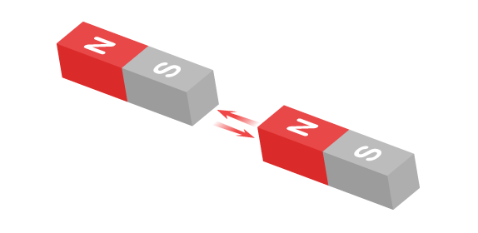
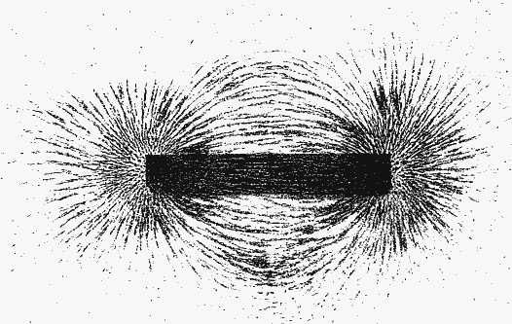


An Analogie: Magnetic Field
Notes:
De noordpool van de aarde is in feite een magnetische zuidpool.

Slide 20

Higgs Field and particle
Higgs particle
the “field-quantum”
Higgs field
Compare:
  A photon is an electro-magnetic quantum wave
  A Water wave

Slide 21
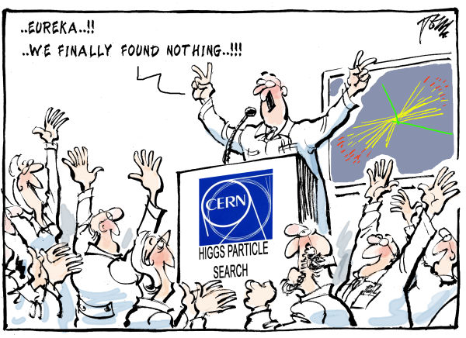
The Vacuum

Slide 22
Higgs mechanism:
mass is the resistance of a particle in the Higgs veld ϕ.
The Higgs field “sticks” to the particle
Compare: walking “through a swimming pool”.

Slide 23
The Higgs particle H:
a rumour passes as a wave through the field
The omnipresent Higgs field gives mass to all particles and to itself.

Slide 24
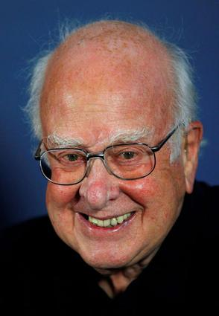
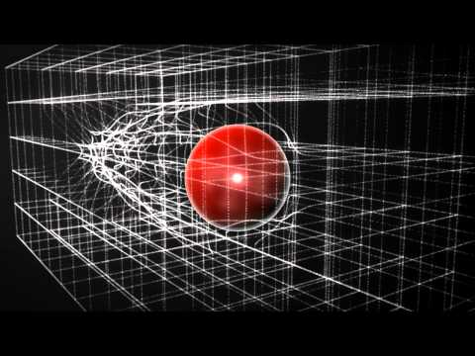
Electron in Higgs Field
e
e
1963
H

Slide 25


1897
1937
1975
τ
μ
e
Electron, e
Spin ½
Charge −1
Lifetime ∞
Massa .511 MeV
Muon, μ
Spin ½
Charge −1
Lifetime 2.2 μs
Mass 106 MeV
Tau, τ
Spin ½
Charge −1
Lifetime 290 fs
Mass 1777 MeV

Slide 26
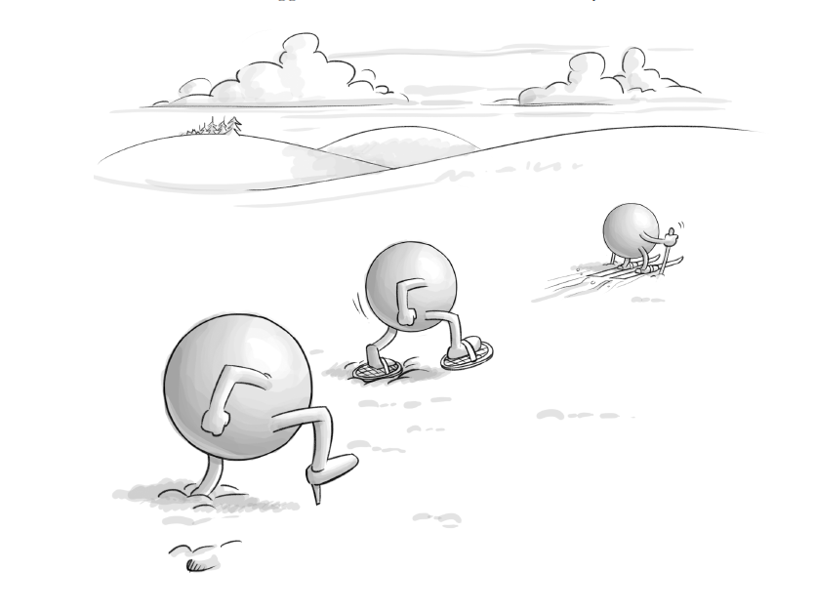
e
μ
τ
© Jean-Paul Keulen

Slide 27

CERN: the LHC collider

Slide 28
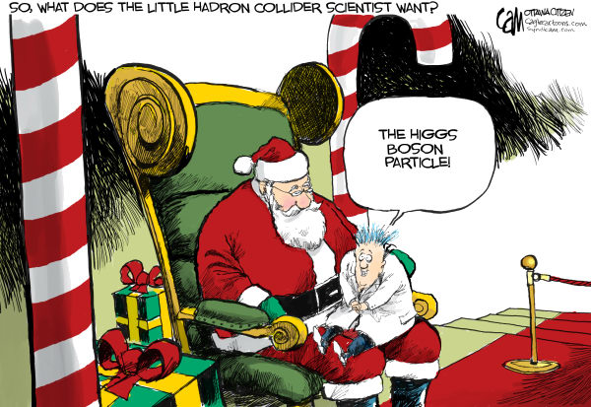

Slide 29
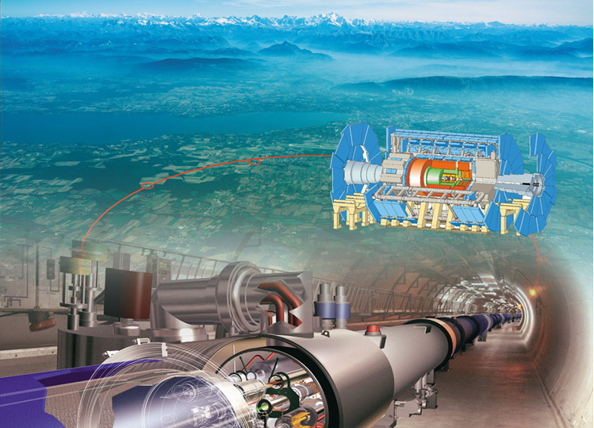
CERN: underground

Slide 30
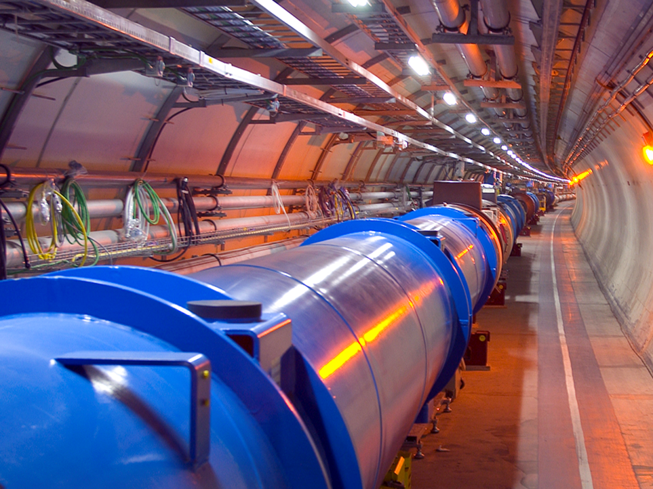
The LHC collider

Slide 31

CERN: The LHC
Tunnel of 27 km, 100 meter deep
Notes:
Schematisch overzicht van de LHC versneller van 27 km lengte , 100 m diep onder de grond. In deze tunnel zijn in het verleden al experimenten gedaan (de LEP versneller) en hier is momenteel de LHC in bedrijf. Op vier plekken worden deeltjes met elkaar in botsing gebracht. De experimenten Atlas, CMS, LHCb en Alice.

Slide 32

The Atlas Experiment
Notes:
De versneller loopt 100m diep onder het landschap van Zwitserland en Frankrijk, precies op de grens. In ondergrondse hallen zijn grote detector experimenten geinstalleerd waarin de deeltjes botsen. Hier het voorbeeld van Atlas.

Slide 33

The Atlas Experiment Schematic

Slide 34


The Atlas Experiment
The largest photocamera on earth: 45 m x 25 m, 2500 physicists
80 MegaPixel camera: 40.000.000 photos per second

Slide 35
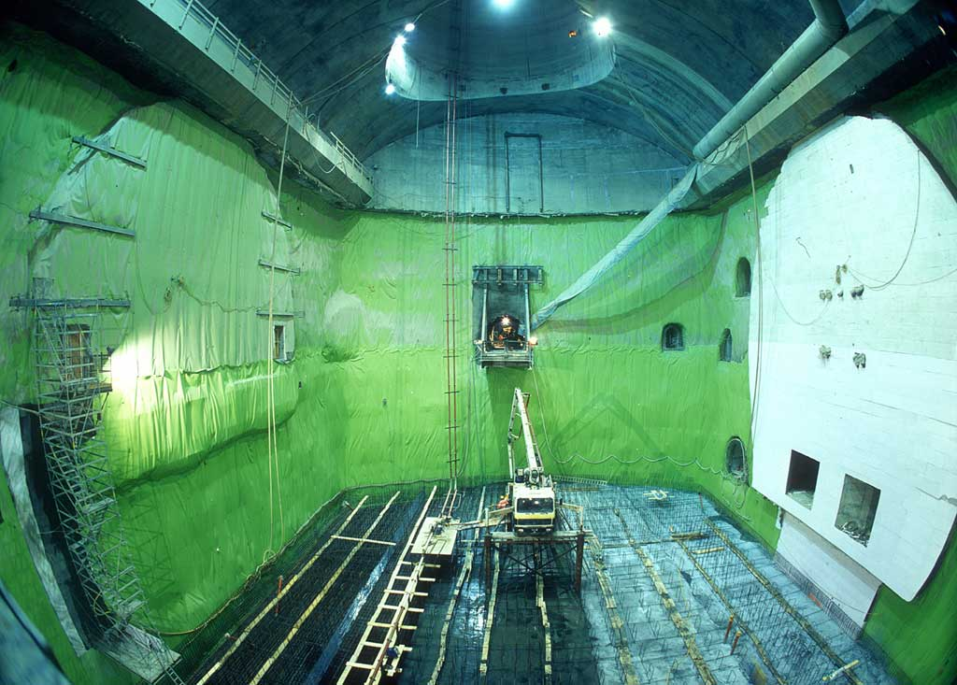
The Atlas Experiment under construction

Slide 36
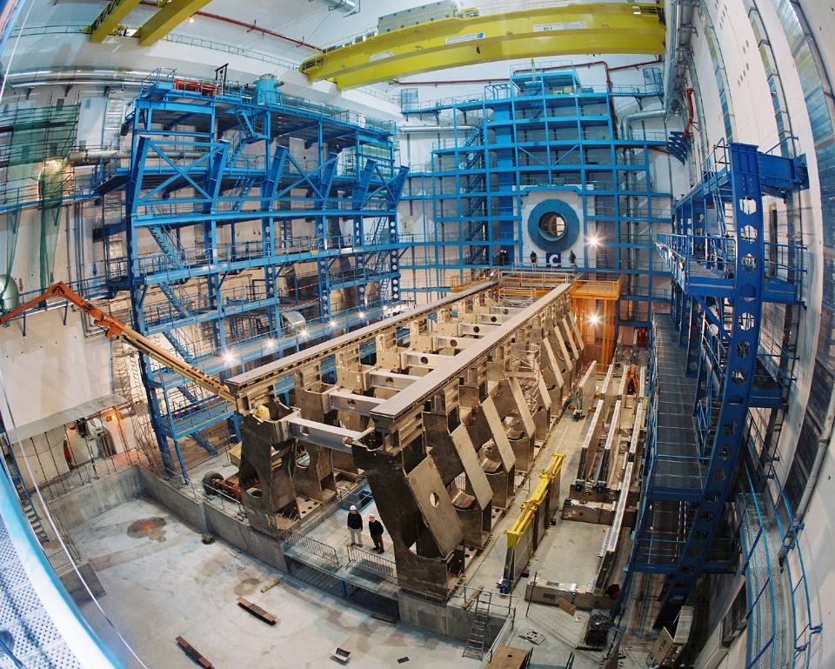

Slide 37

The Atlas muon detector

Slide 38
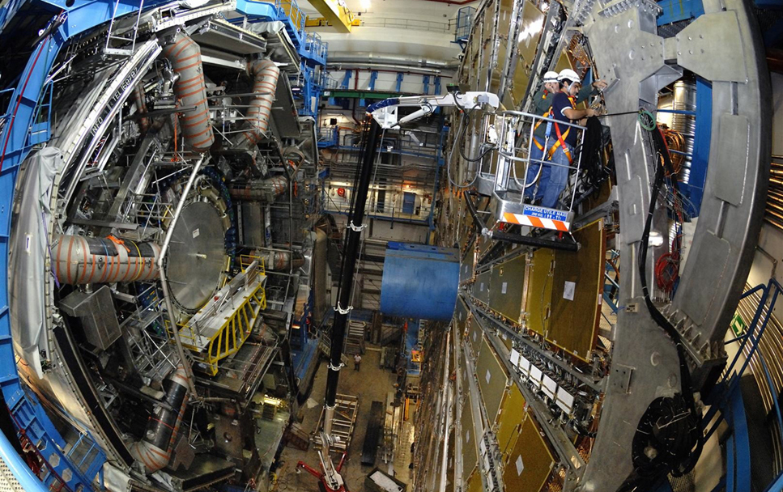
Atlas: side view

Slide 39

Atlas: front view

Slide 40
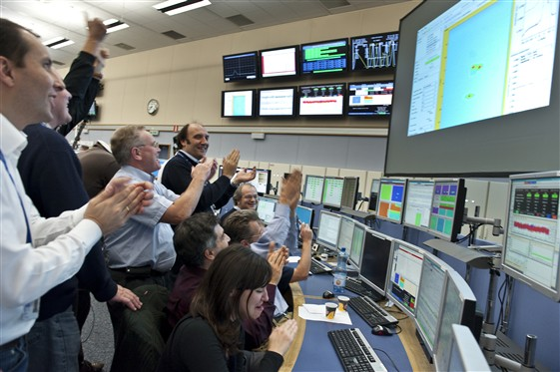
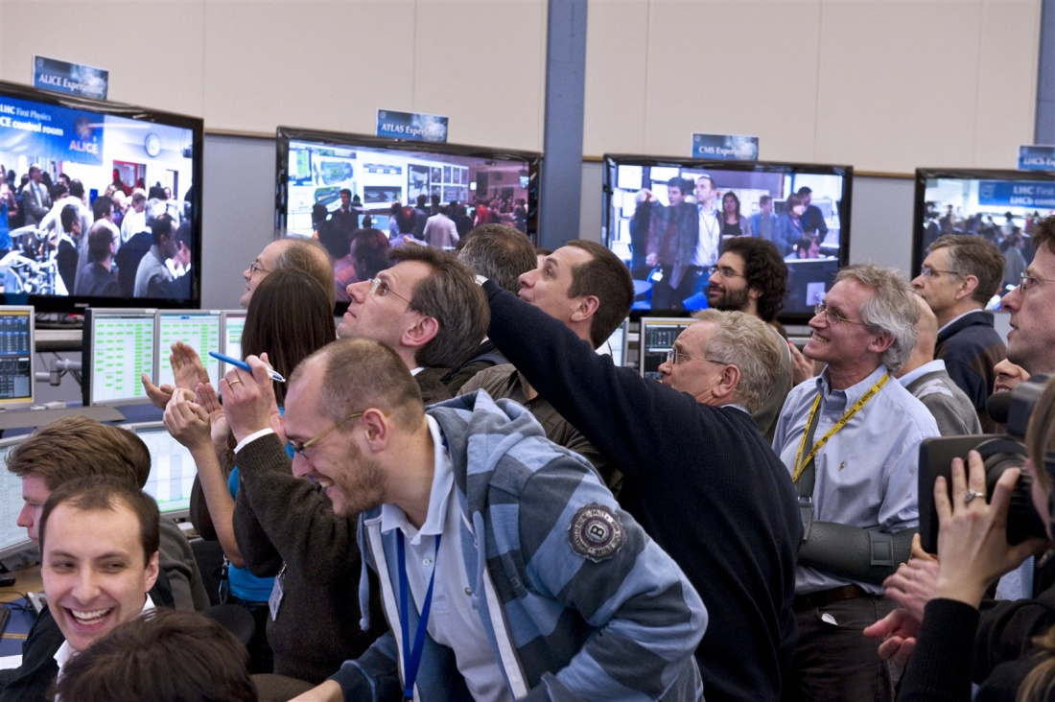

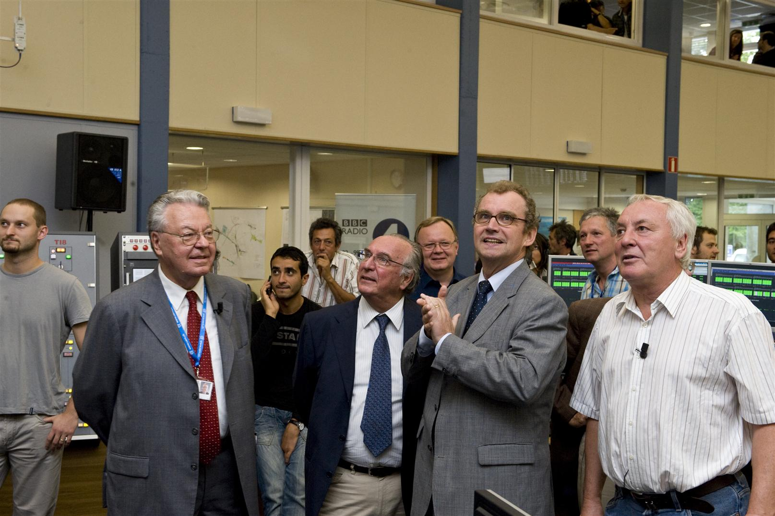
20 November 2009
Notes:
Jos Engelen: Wetenschappelijk directeur CERN. Jos->Nijmegen student.

Slide 41
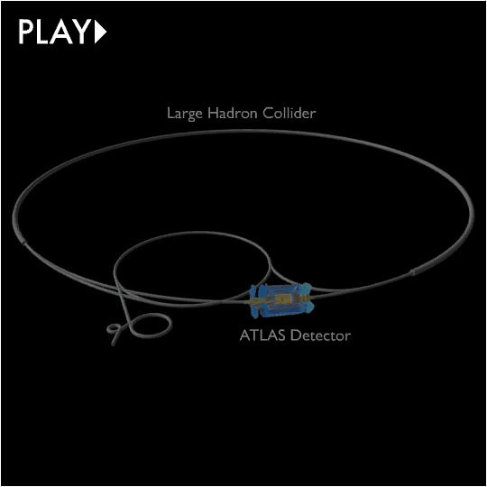
Collisions of Particles

Slide 42

All possible particles are created
Notes:
Een bekende natuurwet zegt dat in een botsing alle soorten deeltjes die geproduceerd kunnen worden ook daadwerkelijk geproduceerd worden.

Slide 43



Slide 44
Higgs→ZZ→μμμμ?
μ
μ
μ
μ
Atlas event

Slide 45
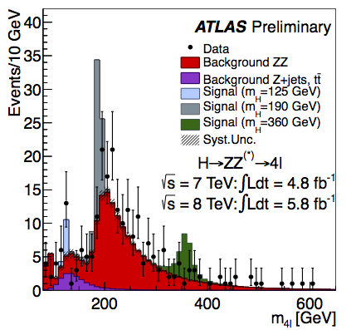
Higgs→ZZ→μμμμ?
Atlas:
CMS:

Slide 46
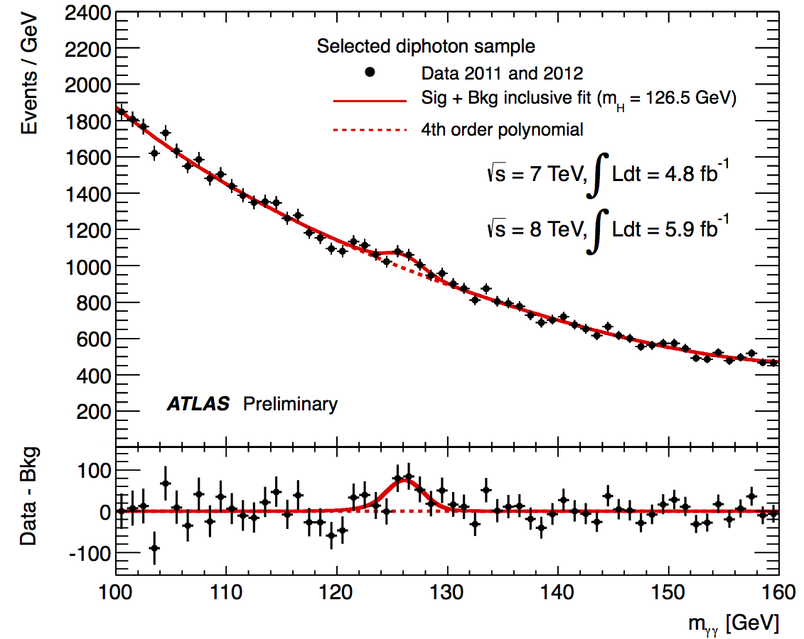
Higgs→γγ?
Atlas:
CMS:

Slide 47
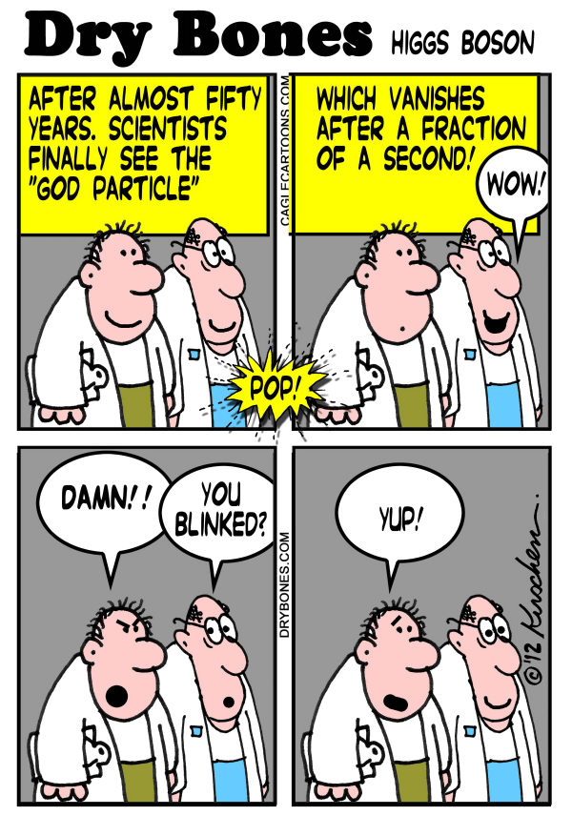

Slide 48
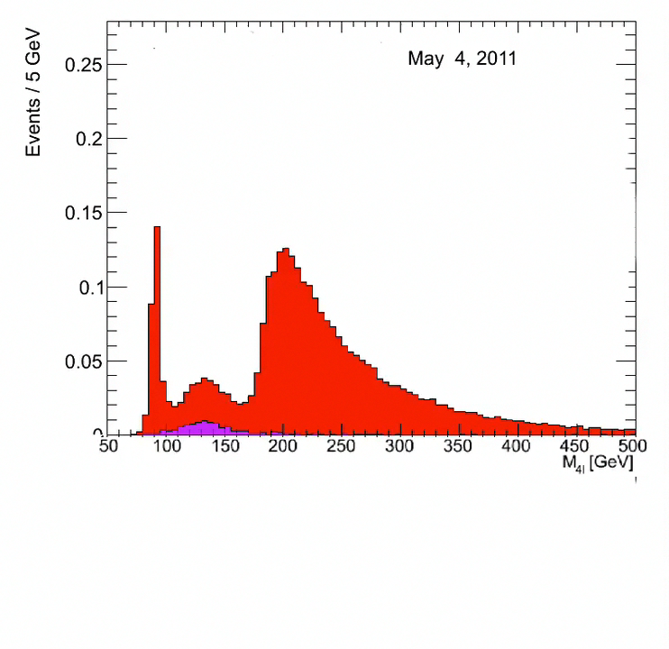

Slide 49
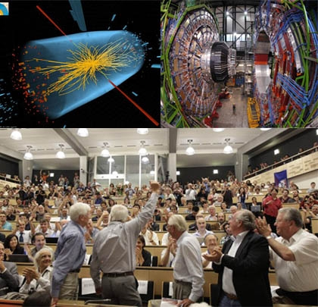
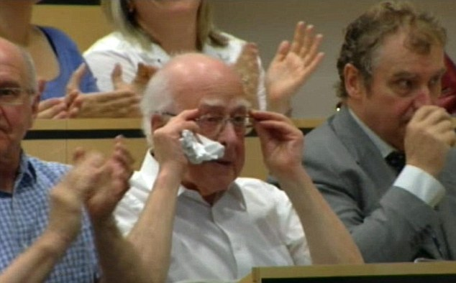
CERN Auditorium
4 juli 2012

Slide 50

So…

Slide 51


Slide 52
The Standard Model – what is included?
“The formula”
“The building blocks nature”
The Higgs field
filling empty space
Note: The Standard Model predicts: empty space is not empty!

Slide 53
The Standard Model – what is included?
“The formula”
“The building blocks nature”
Interaction of Higgs with particles (“the origin of mass”)
→ Theory formulated 50 years before Higgs particle was seen! ←

Slide 54
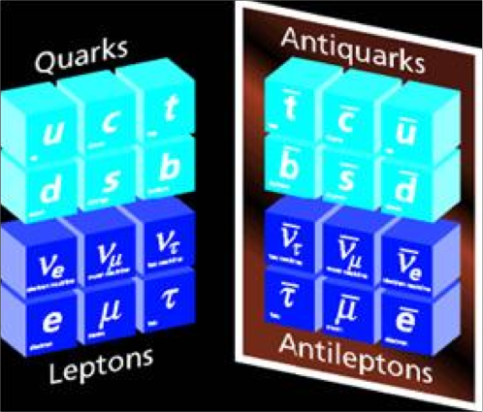
What is anti-matter and why is it not seen?
→ Anti-matter is part of the Standard Model
→ We can make it in the LHC
→ But why doesn’t is exist in the universe?

Slide 55
Building-blocks of Matter
Atom
Molecule
Electron
Quark
Atom
nucleus
Proton/Neutron

Slide 56
Building-blocks of Antimatter
Anti-Atom
Anti-Molecule
Anti-electron
Anti-quark
Anti-nucleus
Anti-proton/Anti-neutron

Slide 57


How did anti-matter disappear in the Big Bang?
Big Bang
Small surplus
Dominance
49.999999%
anti-matter
0.000001%
matter
50.000001%
matter
(+99.999999%
radiation)
Apparently anti-matter is not a
perfect mirror image of matter!

Slide 58
How did anti-matter disappear in the Big Bang?
Big Bang
Small surplus
Dominance
49.999999%
anti-matter
0.000001%
matter
50.000001%
matter
(+99.999999%
radiation)
One of the known causes is the Higgs-matter interaction.
But we know that it is not sufficient for the Big Bang.
Search for additional sources of matter/anti-matter asymmetry

Slide 59
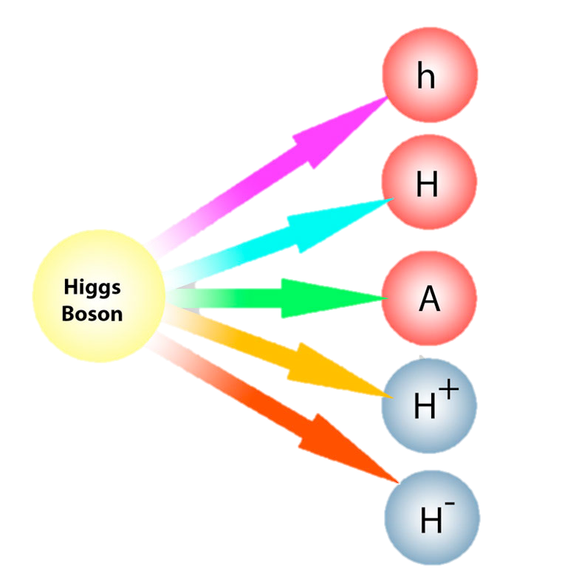
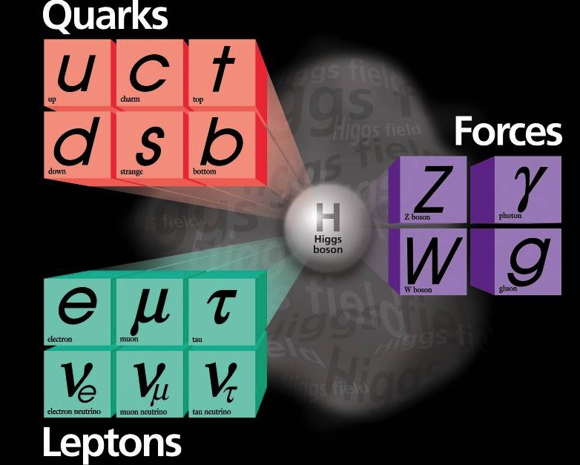
Maybe the Higgs sector is much more complex

Slide 60
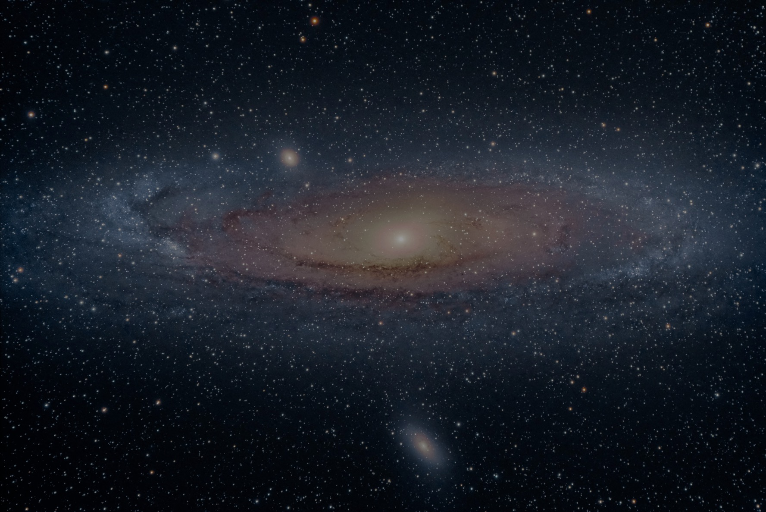
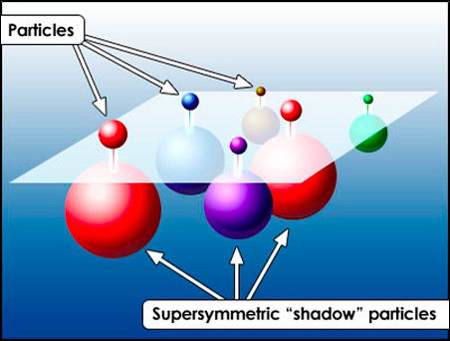
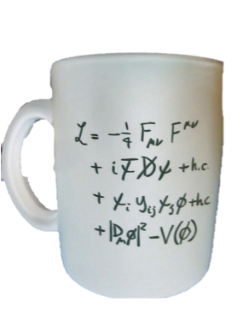
What is dark matter?
There is evidence in astronomy for ‘dark matter’
But what is it?
Perhaps ‘super-partners’ of existing particles?
Standard Model particles
Supersymmetry
Super-partner particles

Slide 61

Supersymmetry Particles

Slide 62
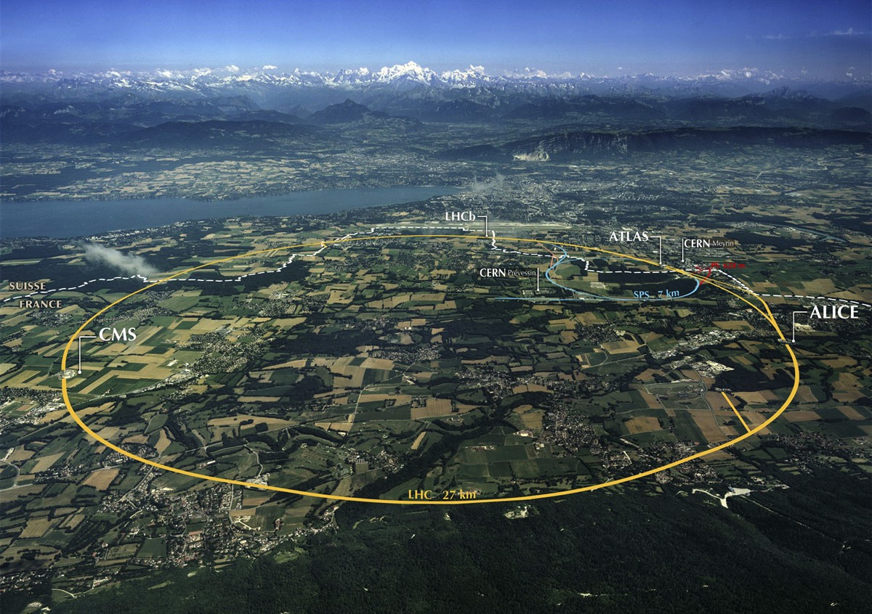

The Large Hadron Collider
LHCb
ATLAS
  One accelerator – four experiments Concept study in 1984
  First collisions 25 years later in 2009
  Maximal energy expected in 2015
  Maximal intensity expected in 2025
Alice
CMS
Antimatter: "We can make it in the LHC” → LHCb experiment

Slide 63

Study 3-rd generation quarks
Bs-mesons: particles containing a b- and s-quark

Slide 64
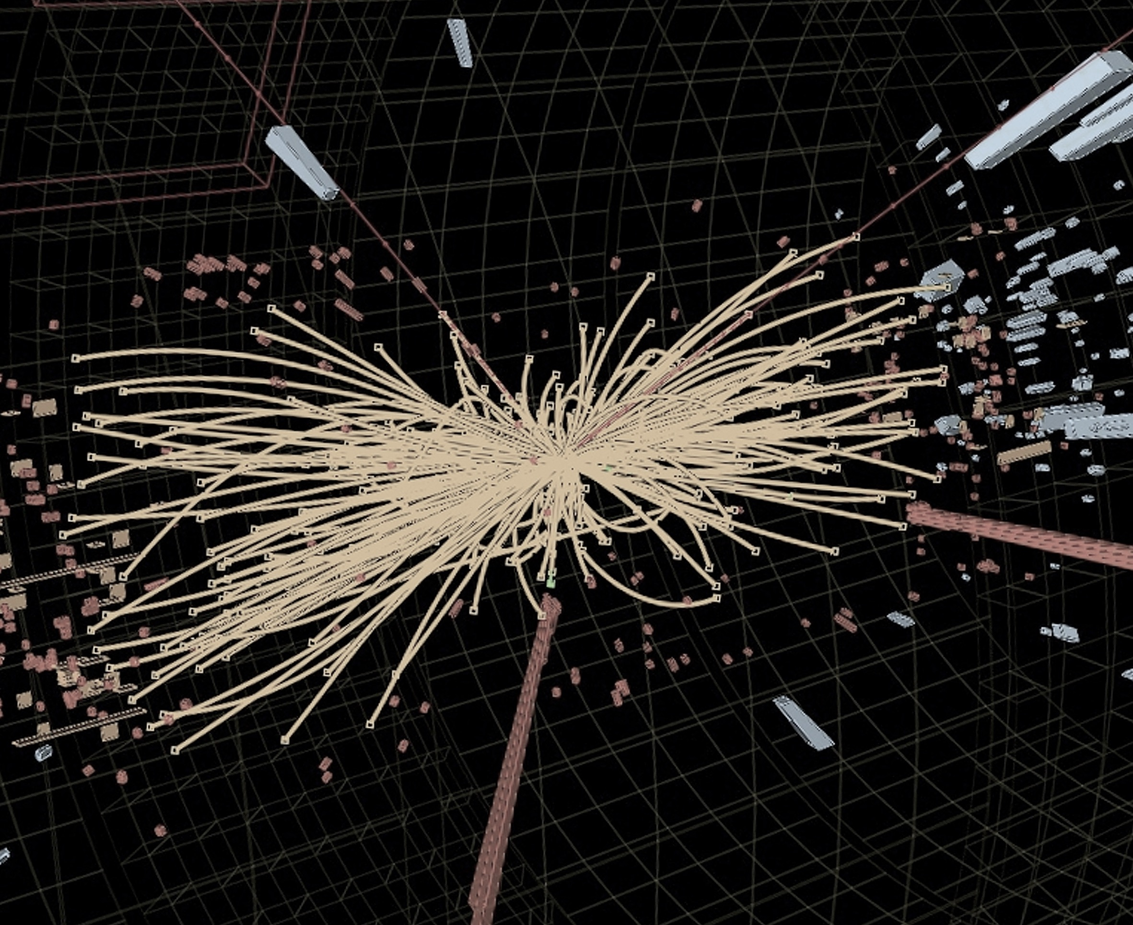
An LHC collision of two protons
→ Search exotic Bs meson particles that oscillate between matter and antimatter.
→ Produced mainly along the beam-line in LHC.
→ Requires dedicted detector.
B_{s} meson

Slide 65
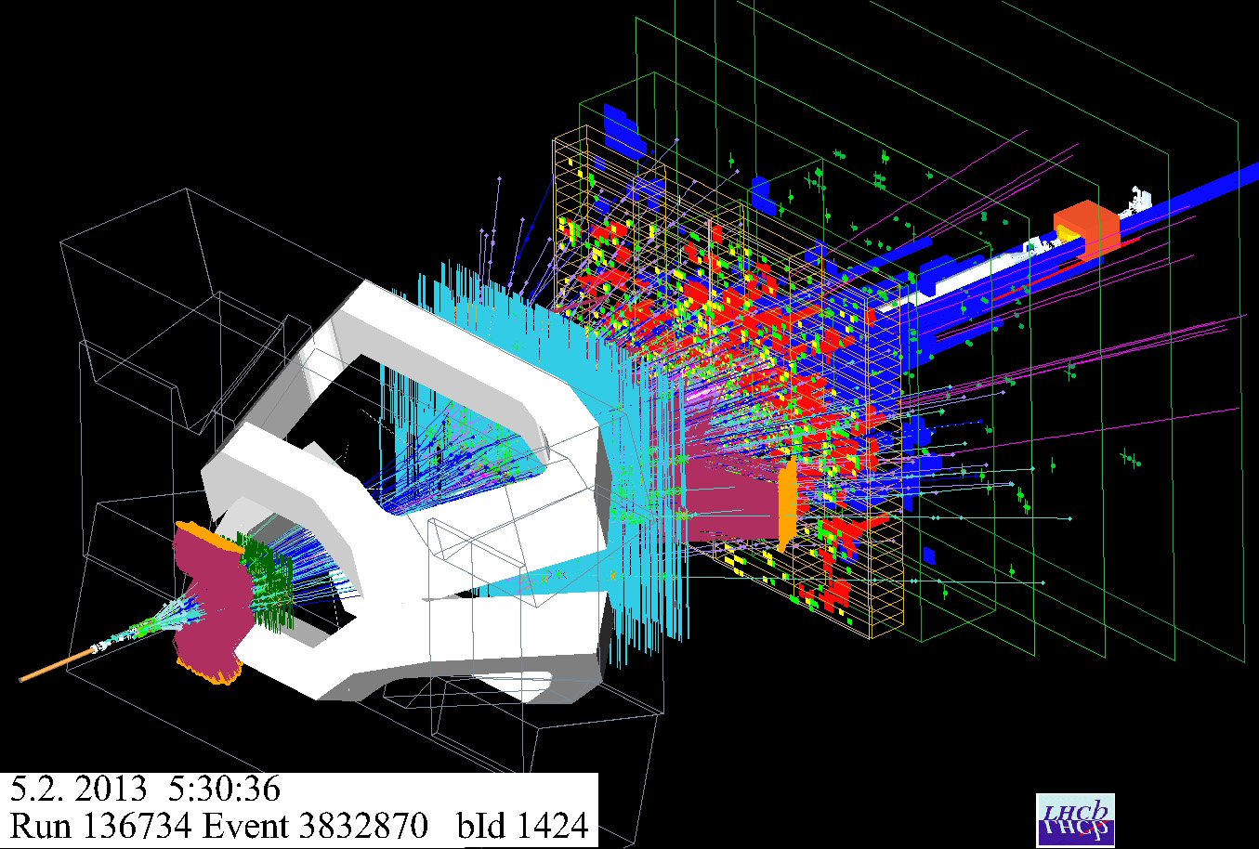
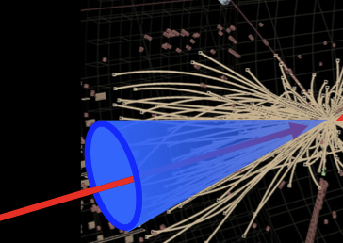
An LHC collision seen by the LHCb detector

Slide 66
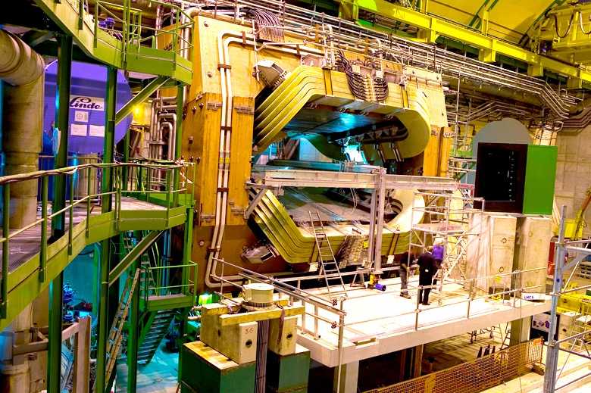
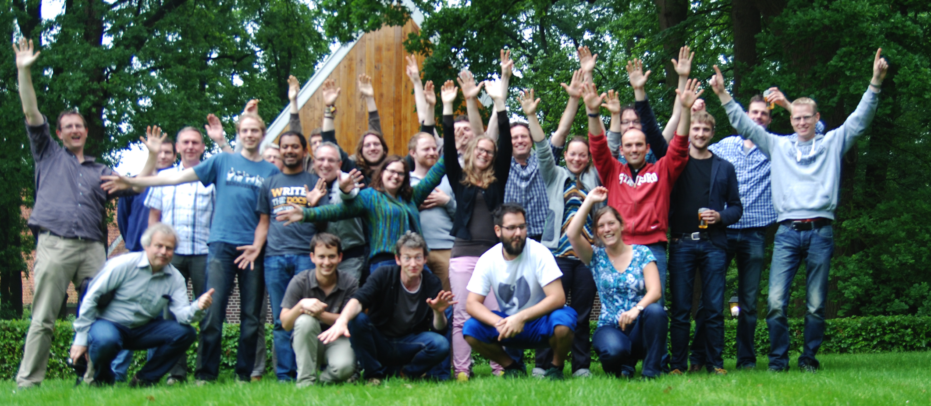
The LHCb experiment
LHC beam

Slide 67
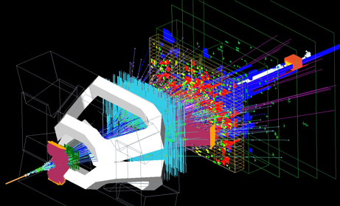
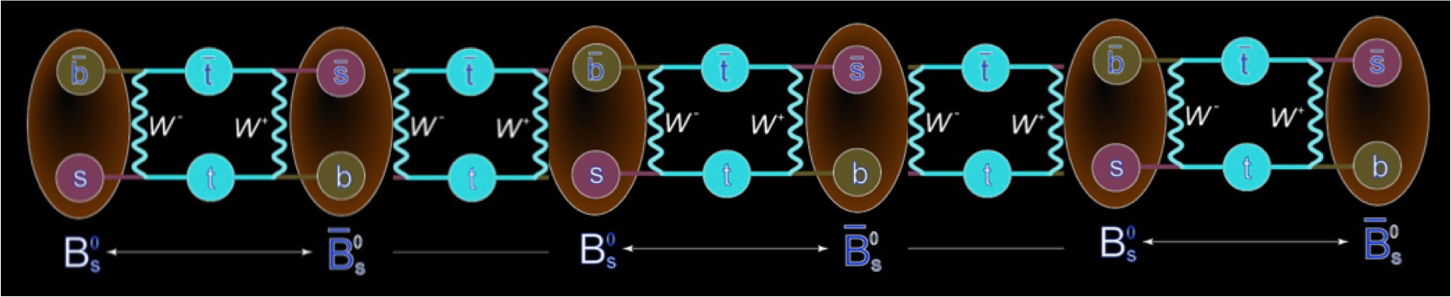
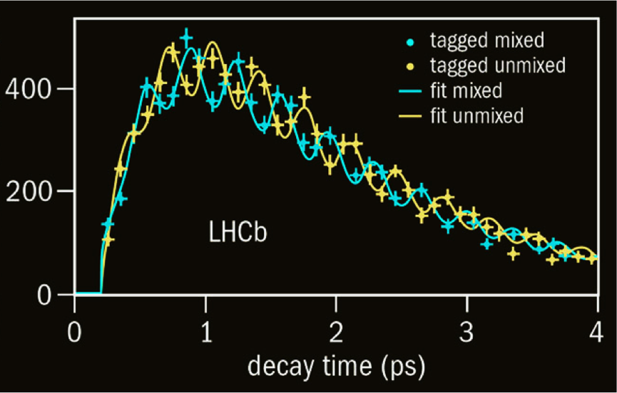
Matter-antimatter oscillations of B_{s} mesons
matter → anti-matter → matter → anti-matter ….
Oscillation signal of LHCb
Standard Model
0.0000000000002 second

Slide 68
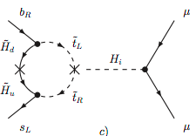
Matter-antimatter oscillations of B_{s} mesons
matter → anti-matter → matter → anti-matter ….
?
Oscillation signal of LHCb
New Physics
0.0000000000002 second

Slide 69

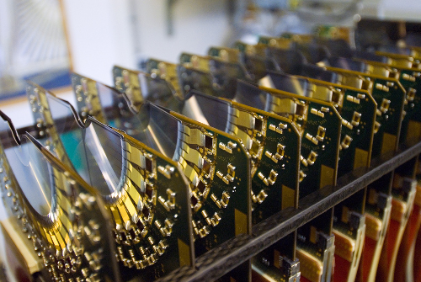



The LHCb Detector
Measure Matter – Antimatter oscillations:
- Detect collisions in which Bs mesons are produced.
- Check if they decay as Bs or as anti-Bs meson and measure the decay time.
- Plot the decay rate and measure the oscillation frequency.
- Compare to the Standard model predition.
23 sep 2010 19:49:24
Run 79646 Event 143858637
69

Slide 71
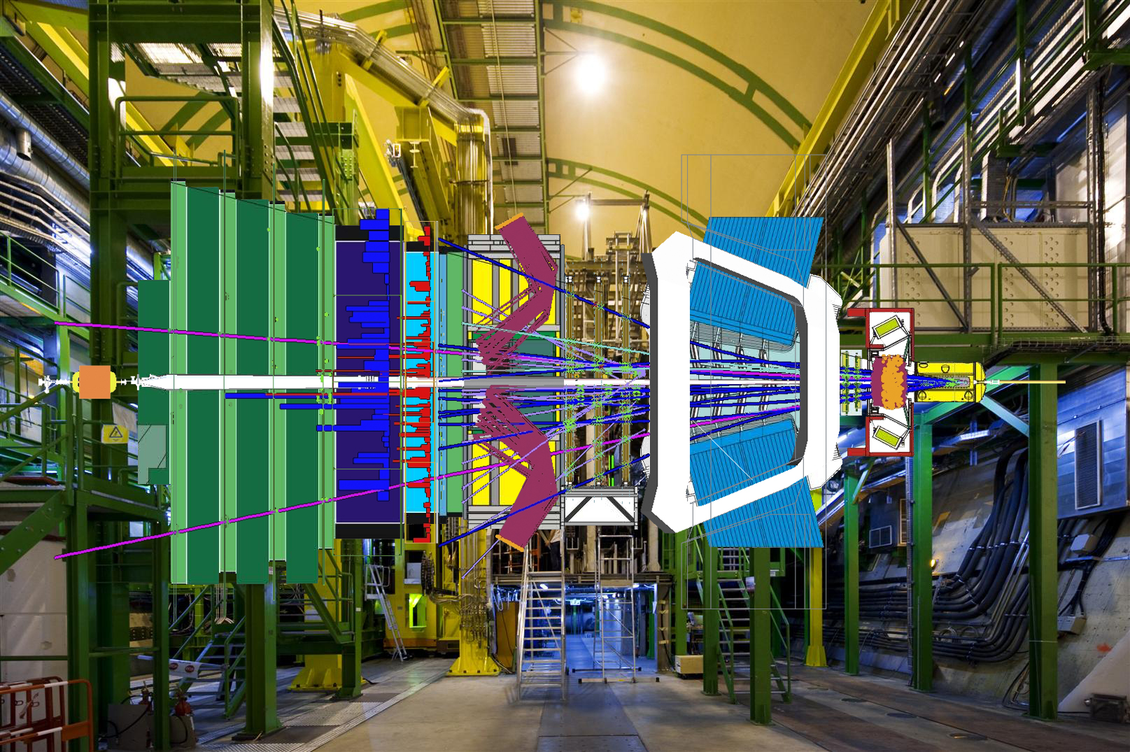
New Physics in rare decays?
B_{s,d}→μ⁺μ⁻

Slide 72

Standard Model or New Physics

Slide 73

A Di-muon Candidate

Slide 74

Very rare decays
B_{s}→μ⁺μ⁻
  Slightly less than expected
B_{d}→μ⁺μ⁻
  Slightly more than expected
?
A possibility
An exciting possibility??
Z’
Z’

