Slide 1
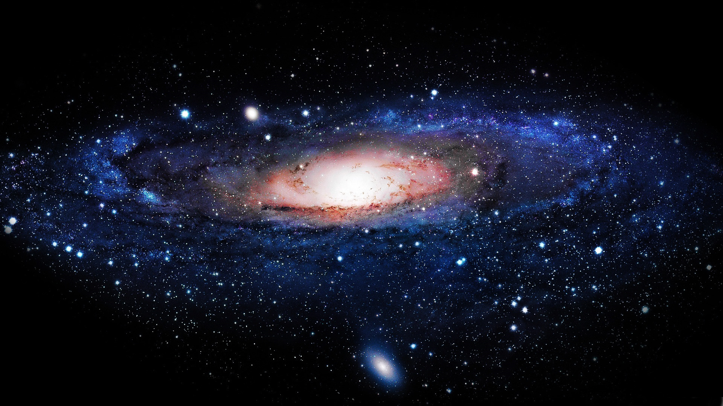

Mystery of missing antimatter
Lennaert Bel, Laurent Dufour, Marcel Merk, Jacco de Vries,
LHCb - Nikhef and VU
Masterclass New Physics Maastricht
9 March 2015

Slide 2
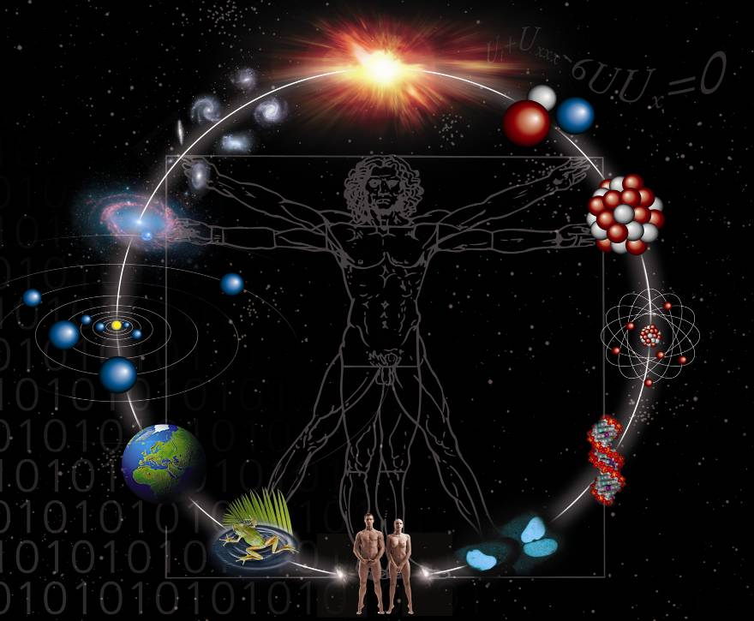
astronomy
particle-physics
“New Physics”
(Physics Beyond the Standard Model)

Slide 3







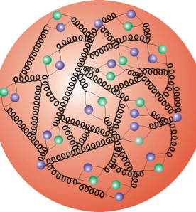

Building-blocks of Matter
Atom
Molecule
Electron
Quark
Atom
nucleus
Proton/Neutron

Slide 4
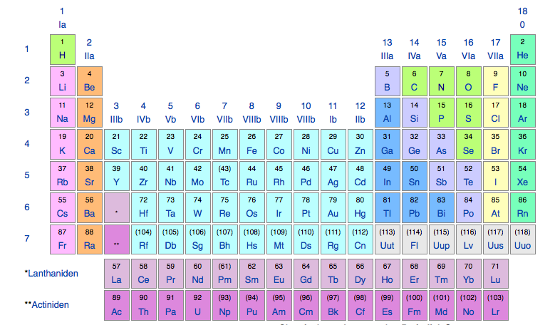
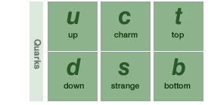
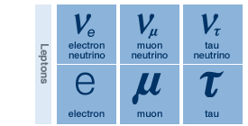
Building-blocks of Matter
Atom
Molecule
Electron
‘Quark’
Atom
nucleus
Proton/Neutron

Slide 5
Building-blocks of Matter
Atom
Molecule
Electron
‘Quark’
Atom
nucleus
Proton/Neutron

Slide 6




Fundamental forces of Nature
Gravitation
Strong nuclear force
Works on all particles with mass
Works
on all nuclear particles
Elektromagnetism
Weak nuclear force
Works on all
electrically charged particles
Works on
all particles

Slide 7

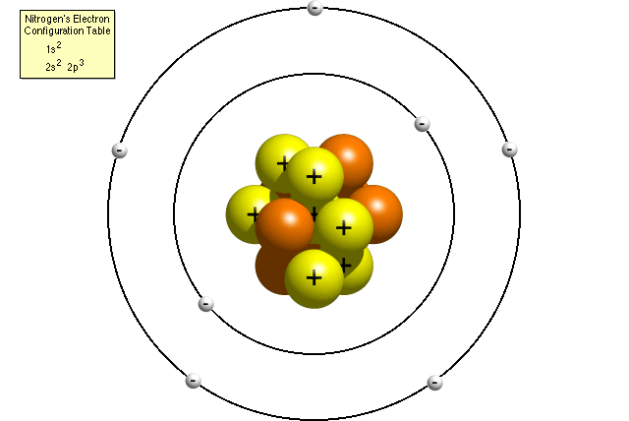

How does nature behave in extreme circumstances?
Small distances
‘Classical’
Kepler et. al. (1609)
Quantum mechanics
(Bohr et. al. 1930)
High energy
‘Special relativity’
(Einstein 1910)

Slide 8

How does nature behave in extreme circumstances?
Small distances
‘Classical’
Kepler et. al. (1609)
Small distances
and high energy
Quantum mechanics
(Bohr et. al. 1930)
High energy
‘Quantum field & gauge theory’
(Dirac, Pauli et al. 1950
Yang Mills Veltman ‘Hooft 1970 )
‘Special relativity’
(Einstein 1910)

Slide 9
How does nature behave in extreme circumstances?
Small distances
‘Classical’
Kepler et. al. (1609)
Small distances
and high energy
Quantum mechanics
(Bohr et. al. 1930)
Existance of anti-matter
Force = exchange of
messenger particles
Conversion of energy in matter and v.v.
High energy
‘Quantum field & gauge theory’
(Dirac, Pauli et al. 1950
Yang Mills Veltman ‘Hooft 1970 )
‘Special relativity’
(Einstein 1910)

Slide 10

The Standard Model of Elementary Particles
Works at very small distances
(Quantum Mechanics)
Works at very high energies
(Special Relativity)
(and also)
Describes all known matter
(except dark matter)
Describes all
forces of nature
except gravity
Not clear if SM is
Valid for Big Bang
20 unexplained parameters
(so not very predictief?)
Describes but does not explain many strinking aspecs of nature
+ New Physics ?!

Slide 11
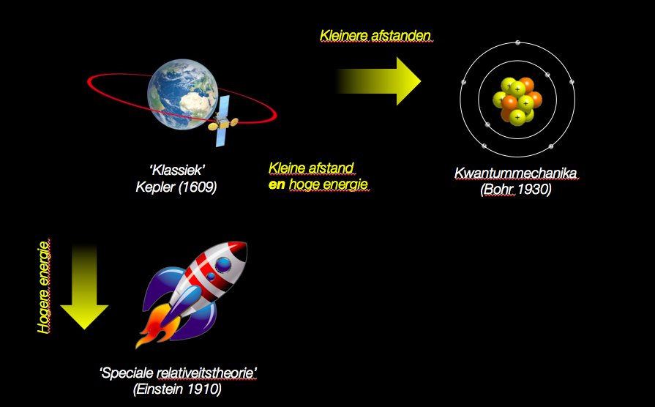

How does nature behave in extreme circumstances?
Experimentally tested
Domain of the Standard Model
Big Bang
But do we understand
physics here?

Slide 12
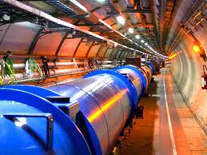

How does nature behave in extreme circumstances?
Experimentally tested
domain of the Standard Model
The Large Hadron Collider

Slide 13

The Standard Model – what is included?
“The formula”
“The building blocks nature”
Messenger
particles of
forces

Slide 14
The Standard Model – what is included?
“The formula”
“The building blocks nature”
Building blocks
of matter

Slide 15
The Standard Model – what is included?
“The formula”
“The building blocks nature”
The Higgs field
filling empty space
Note: The Standard Model predicts: empty space is not empty!

Slide 16
The Standard Model – what is included?
“The formula”
“The building blocks nature”
Interaction of Higgs with particles (“the origin of mass”)
→ Theory formulated 50 years before Higgs particle was seen! ←

Slide 17
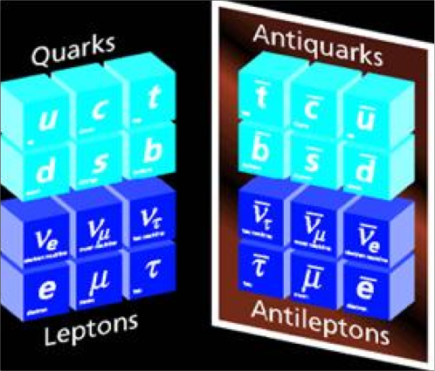
What is anti-matter and why is it not seen?
→ Anti-matter is part of the Standard Model
→ We can make it in the LHC
→ But why doesn’t is exist in the universe?

Slide 18
Building-blocks of Matter
Atom
Molecule
Electron
Quark
Atom
nucleus
Proton/Neutron

Slide 19
Building-blocks of Antimatter
Anti-Atom
Anti-Molecule
Anti-electron
Anti-quark
Anti-nucleus
Anti-proton/Anti-neutron

Slide 20


How did anti-matter disappear in the Big Bang?
Big Bang
Small surplus
Dominance
49.999999%
anti-matter
0.000001%
matter
50.000001%
matter
(+99.999999%
radiation)
Apparently anti-matter is not a
perfect mirror image of matter!

Slide 21
How did anti-matter disappear in the Big Bang?
Big Bang
Small surplus
Dominance
49.999999%
anti-matter
0.000001%
matter
50.000001%
matter
(+99.999999%
radiation)
One of the known causes is the Higgs-matter interaction.
But we know that it is not sufficient for the Big Bang.
Search for additional sources of matter/anti-matter asymmetry

Slide 22
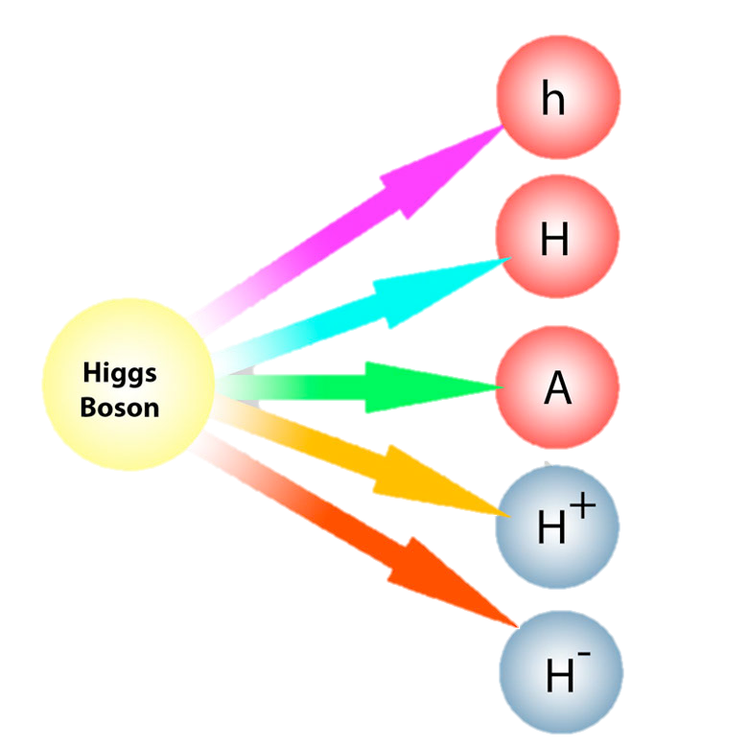
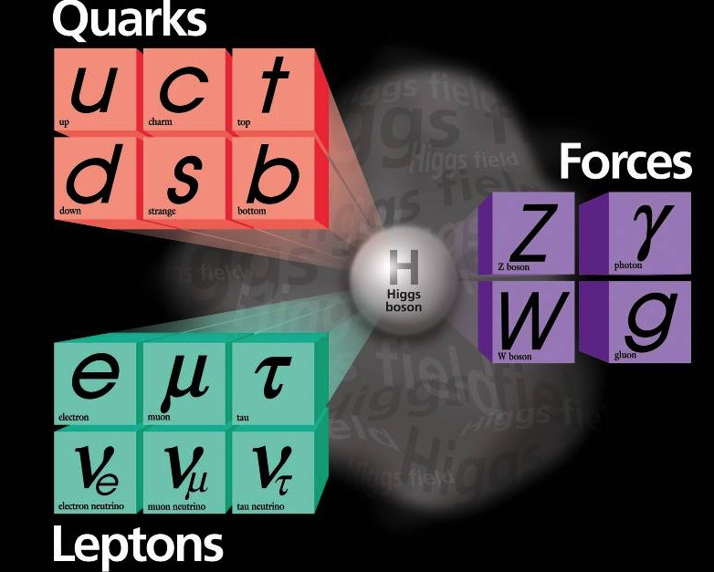
Maybe the Higgs sector is much more complex

Slide 23
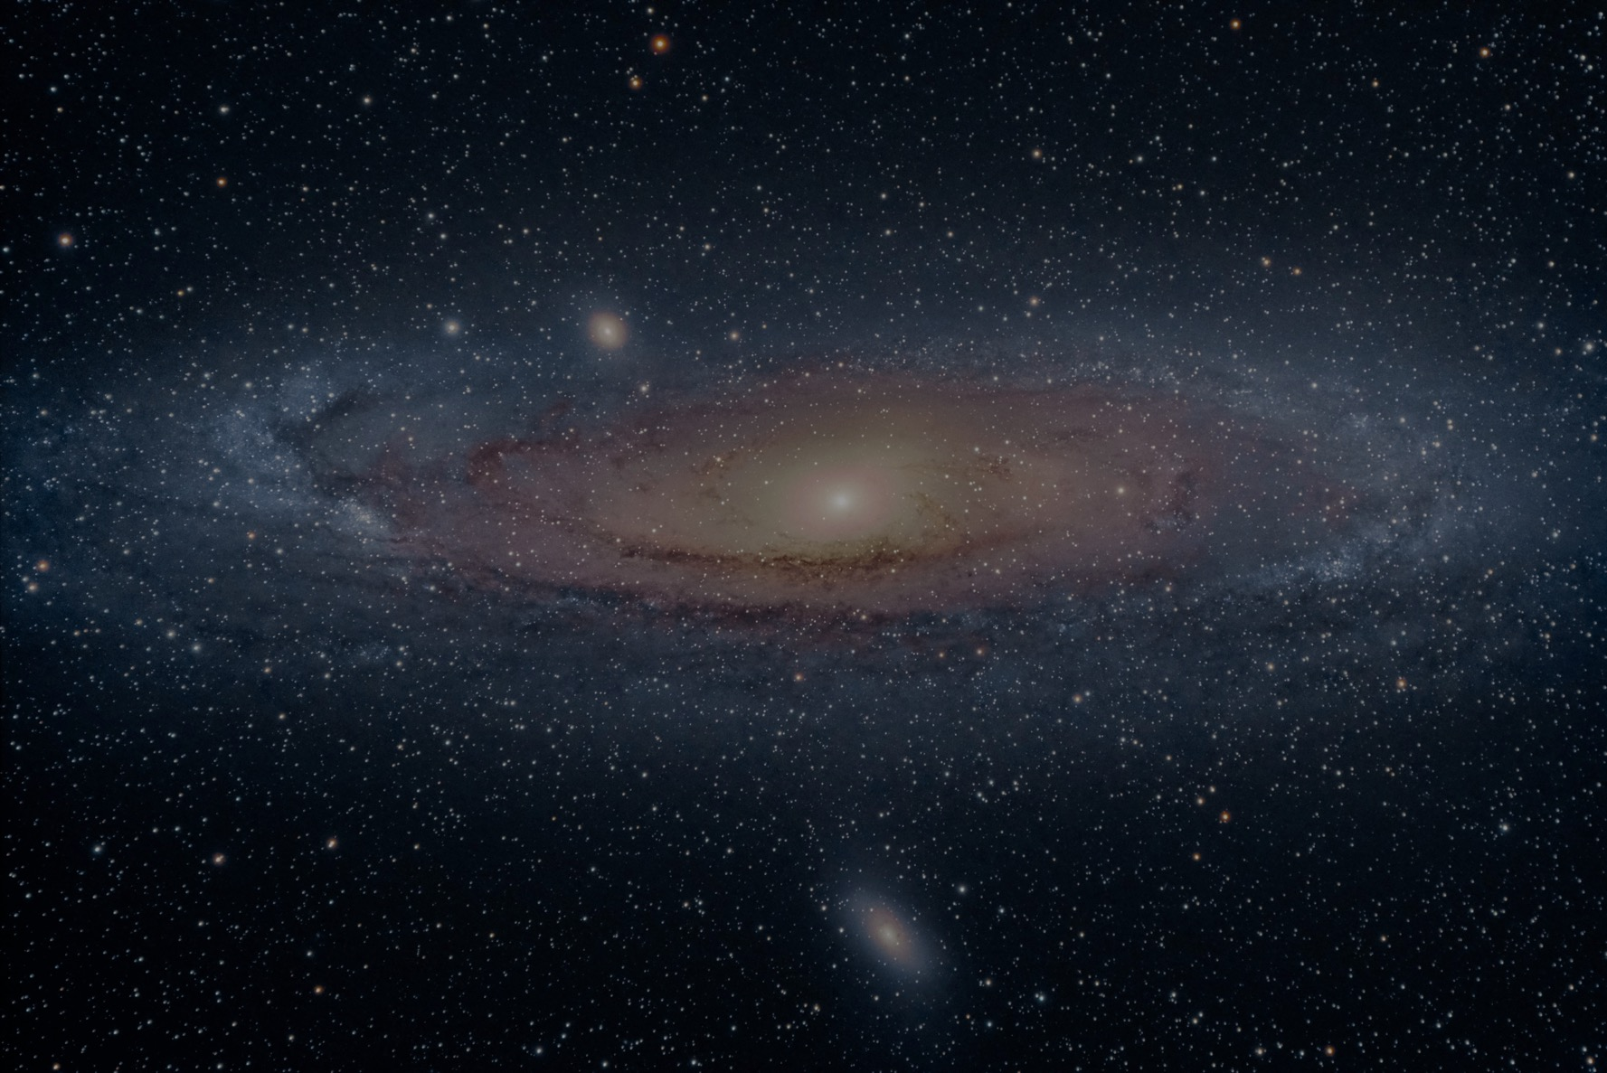
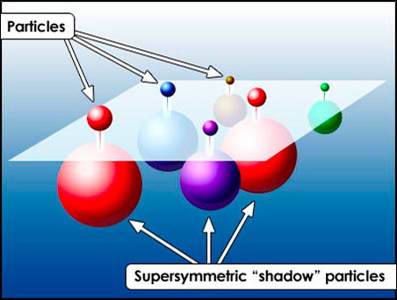
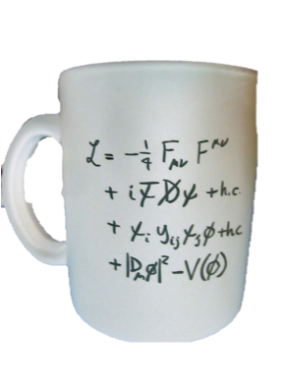
What is dark matter?
There is evidence in astronomy for ‘dark matter’
But what is it?
Perhaps ‘super-partners’ of existing particles?
Standard Model particles
Supersymmetry
Super-partner particles

Slide 24

Supersymmetry Particles

Slide 25
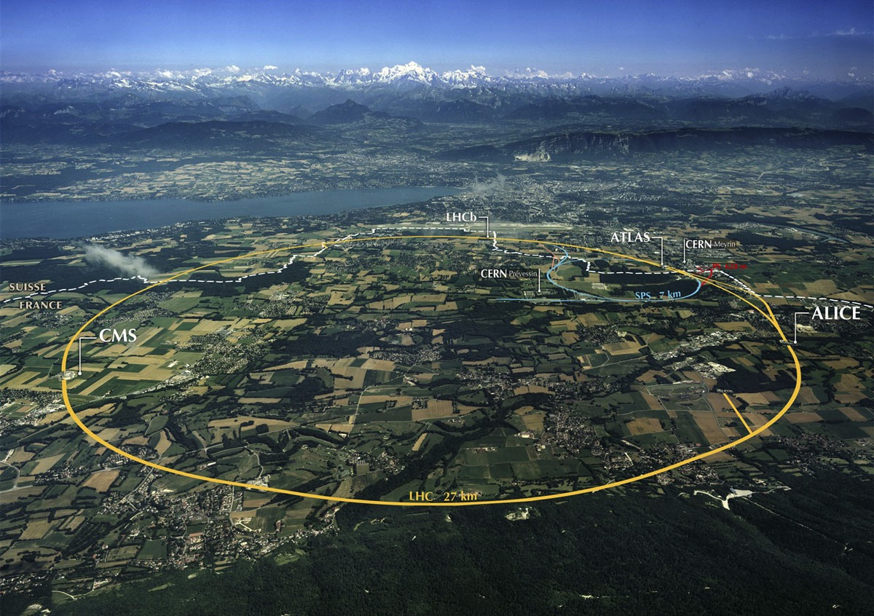

The Large Hadron Collider
LHCb
ATLAS
  One accelerator – four experiments Concept study in 1984
  First collisions 25 years later in 2009
  Maximal energy expected in 2015
  Maximal intensity expected in 2025
Alice
CMS
Antimatter: "We can make it in the LHC” → LHCb experiment

Slide 26

Study 3-rd generation quarks
Bs-mesons: particles containing a b- and s-quark

Slide 27
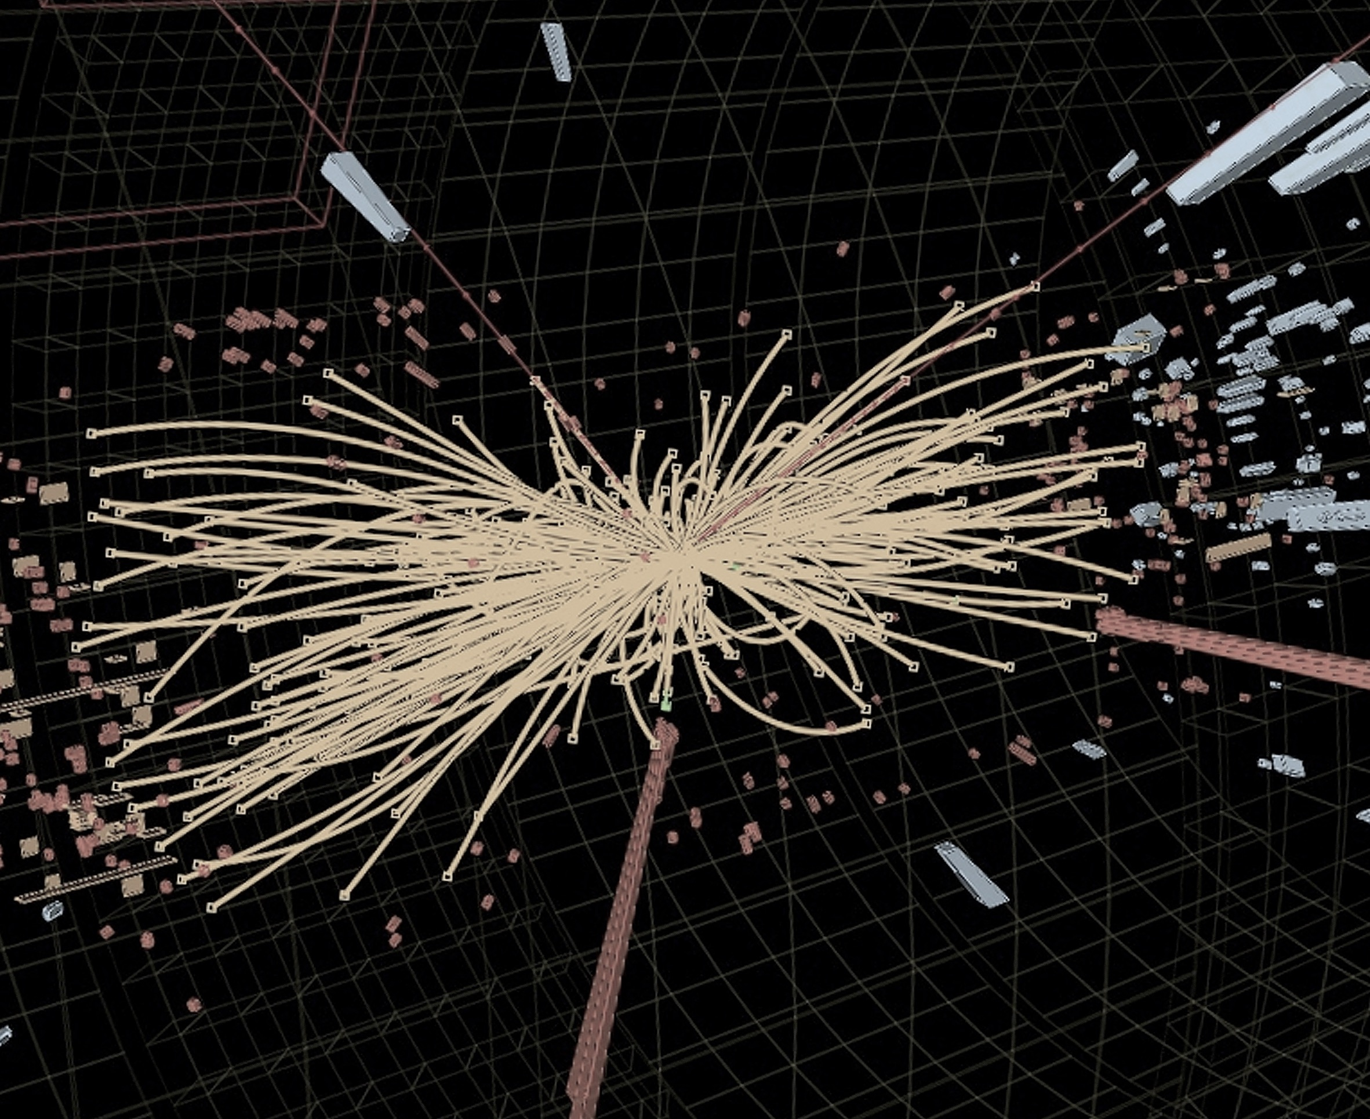
An LHC collision of two protons
→ Search exotic Bs meson particles that oscillate between matter and antimatter.
→ Produced mainly along the beam-line in LHC.
→ Requires dedicted detector.
B_{s} meson

Slide 28
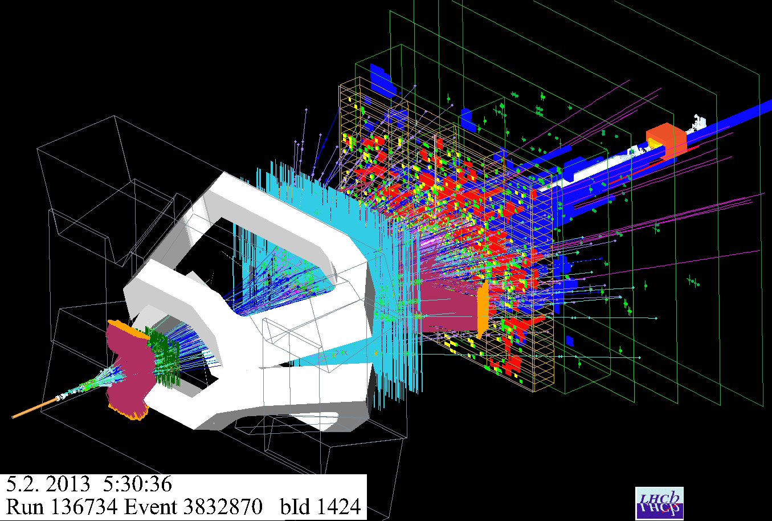
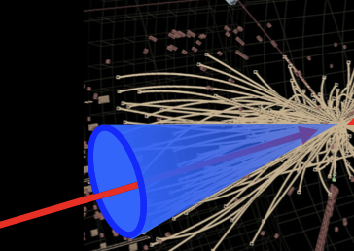
An LHC collision seen by the LHCb detector

Slide 29
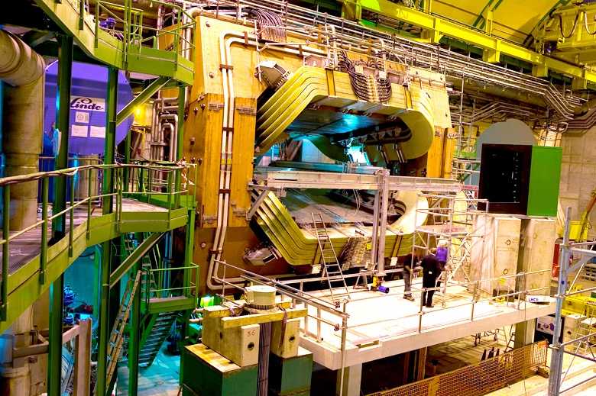
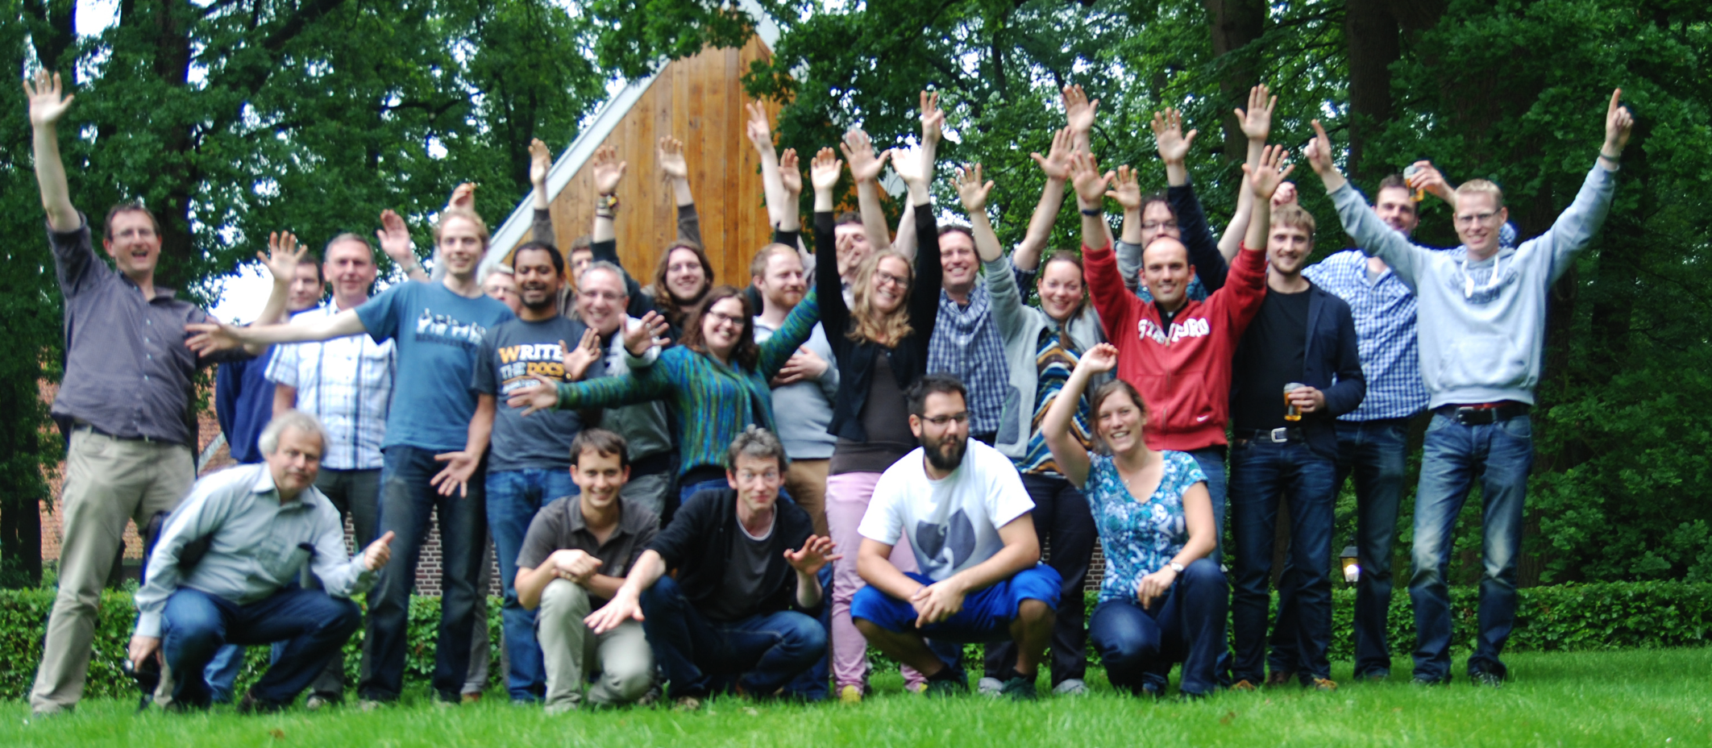
The LHCb experiment
LHC beam

Slide 30
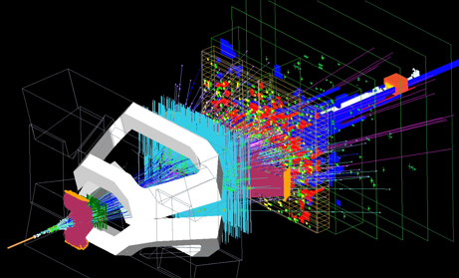
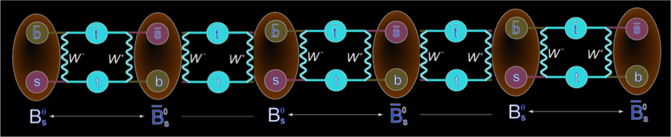
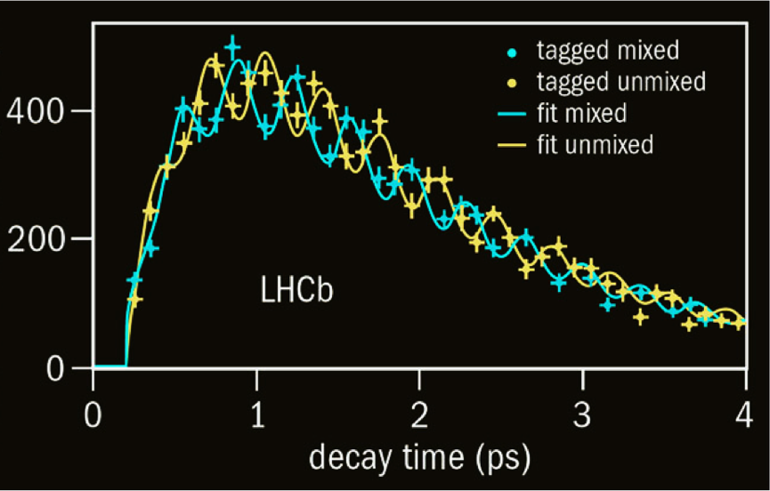
Matter-antimatter oscillations of B_{s} mesons
matter → anti-matter → matter → anti-matter ….
Oscillation signal of LHCb
Standard Model
0.0000000000002 second

Slide 31
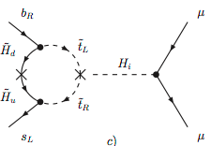
Matter-antimatter oscillations of B_{s} mesons
matter → anti-matter → matter → anti-matter ….
?
Oscillation signal of LHCb
New Physics
0.0000000000002 second

Slide 32

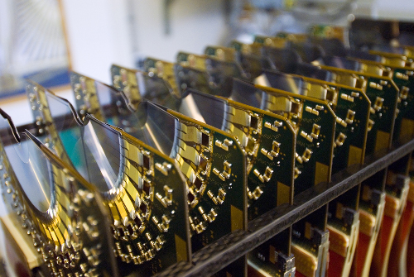



The LHCb Detector
Measure Matter – Antimatter oscillations:
- Detect collisions in which Bs mesons are produced.
- Check if they decay as Bs or as anti-Bs meson and measure the decay time.
- Plot the decay rate and measure the oscillation frequency.
- Compare to the Standard model predition.
23 sep 2010 19:49:24
Run 79646 Event 143858637
32

Slide 34
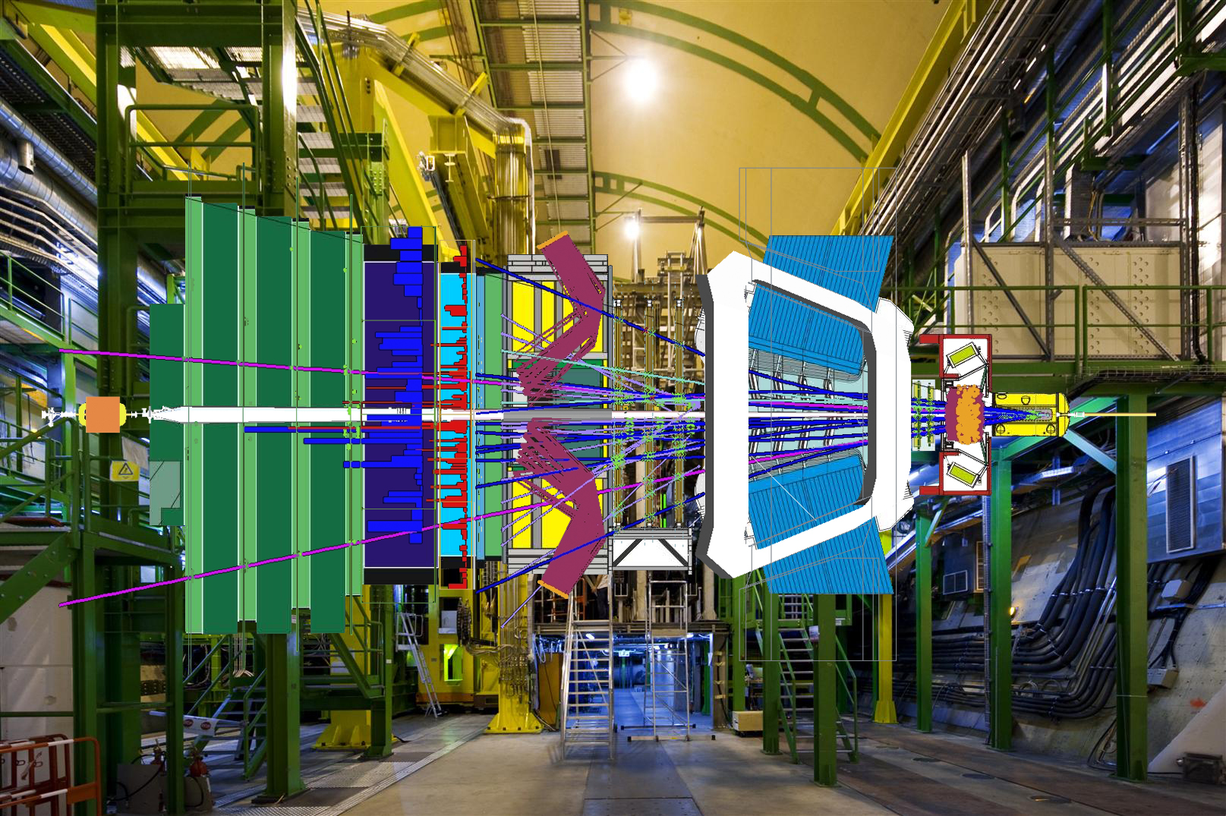
New Physics in rare decays?
B_{s,d}→μ⁺μ⁻

Slide 35
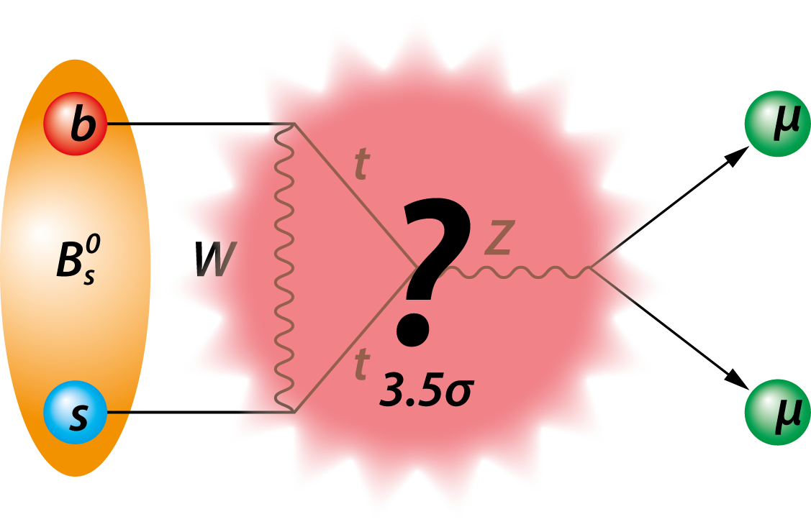
Standard Model or New Physics

Slide 36
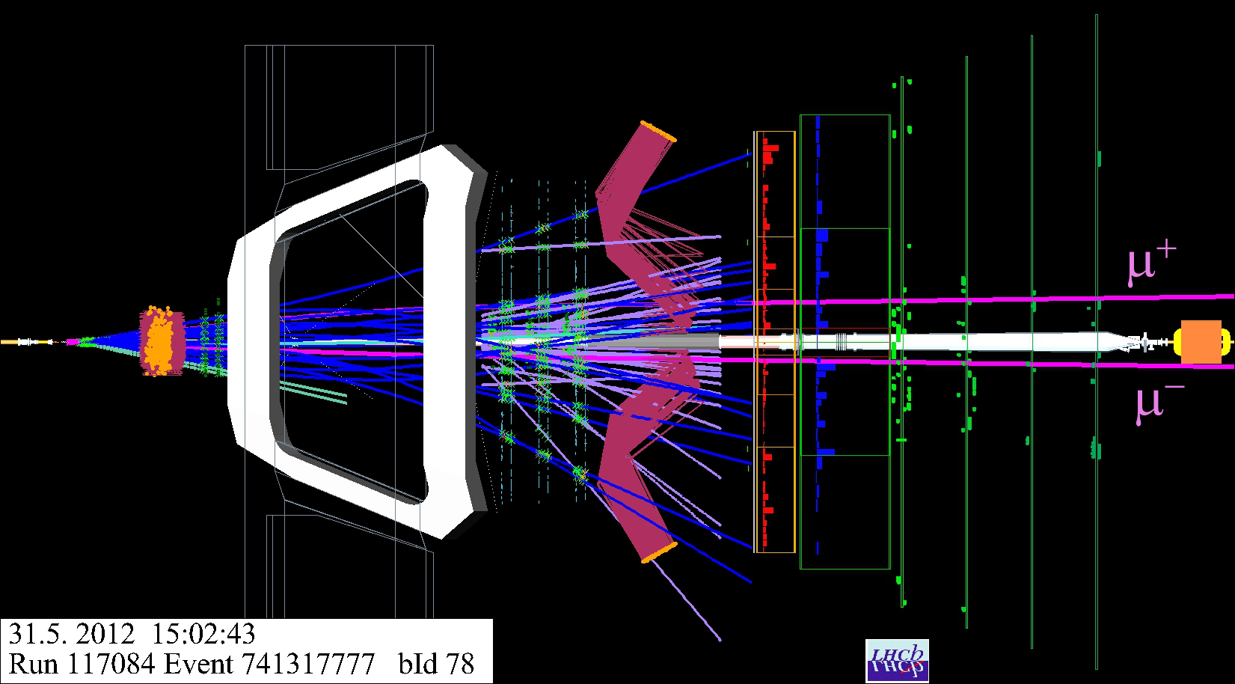
A Di-muon Candidate

Slide 37
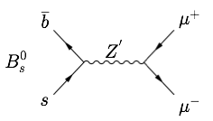
Very rare decays
B_{s}→μ⁺μ⁻
  Slightly less than expected
B_{d}→μ⁺μ⁻
  Slightly more than expected
?
A possibility
An exciting possibility??
Z’
Z’

