Slide 1
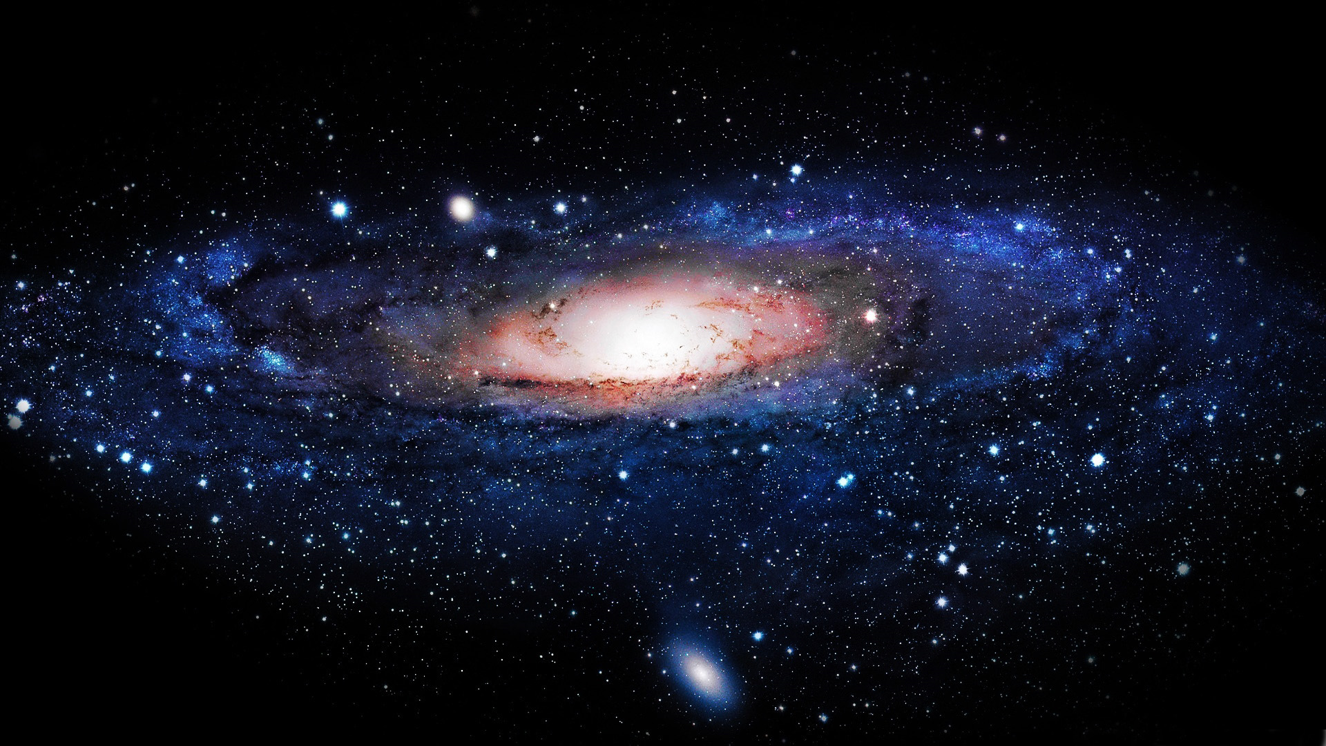

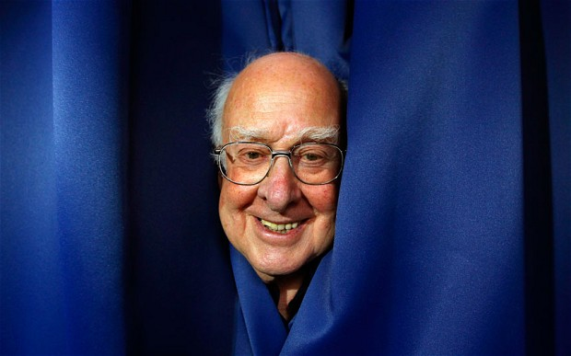
Higgs and the mystery of the missing antimatter
Marcel Merk
Aperture Lecture
Maastricht Science Programme
April 13, 2016

Slide 2
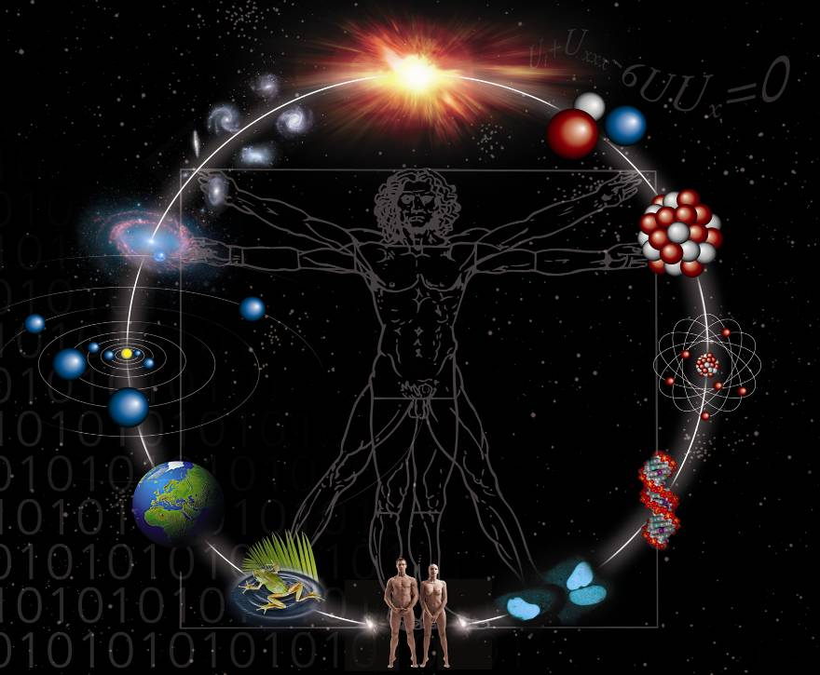

Astronomy
Particle
Physics

Slide 3
Astronomy
Particle
Physics
“New Physics”?
(Physics beyond the Standard Model)

Slide 4
Astronomy
Particle
Physics
Contents:
Building blocks of matter: the number 3
Antimatter and the Big Bang
Standard Model: particles, forces and Higgs
The quest for the Higgs boson
The antimatter – Higgs connection: again 3
Recent exciting developments…

Slide 5


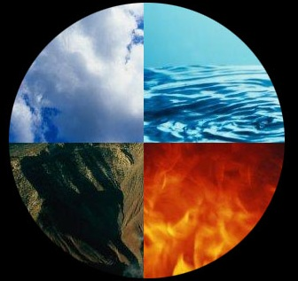
Elementary Particles and the number 3

Slide 6
Building blocks of matter
atom
quarks
electron
neutron
proton
Nucleus

Slide 7



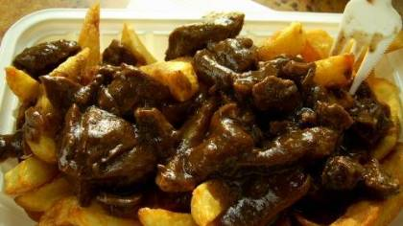
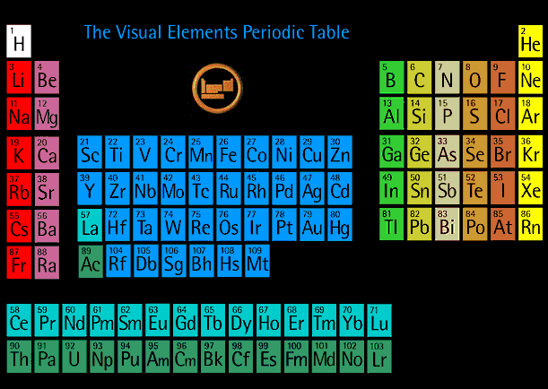
Matter on Earth
Even…
Periodic table of elements

Slide 8

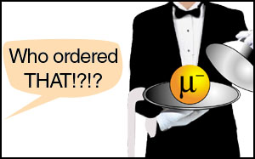
Cosmic Radiation
1936 Isidor Rabi:
the muon

Slide 9
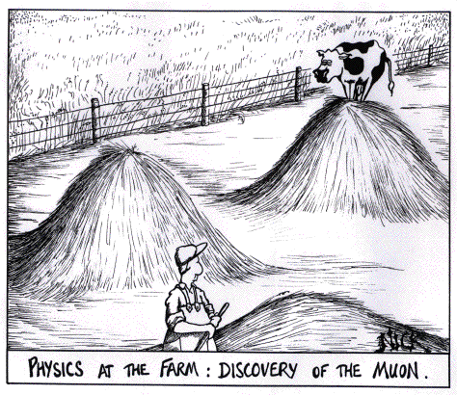

Slide 10


CERN: the laboratory

Slide 11
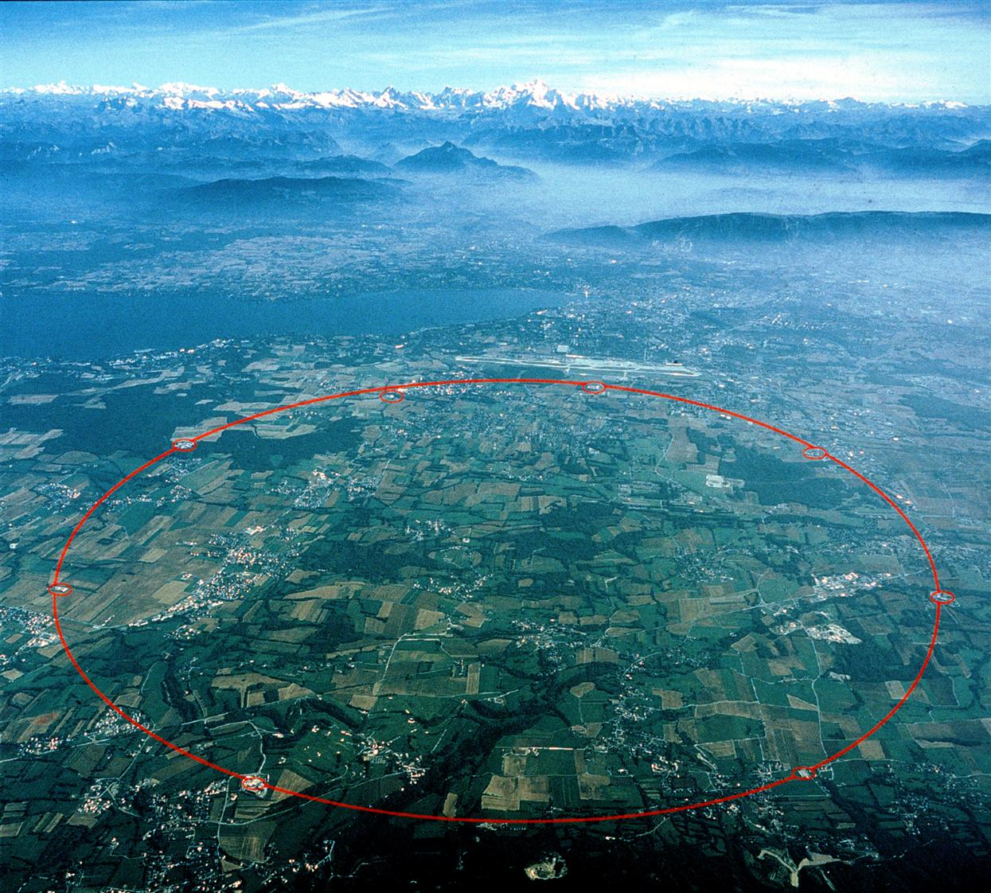
CERN: the LEP collider
Tunnel of 27 km, 100 m deep

Slide 12
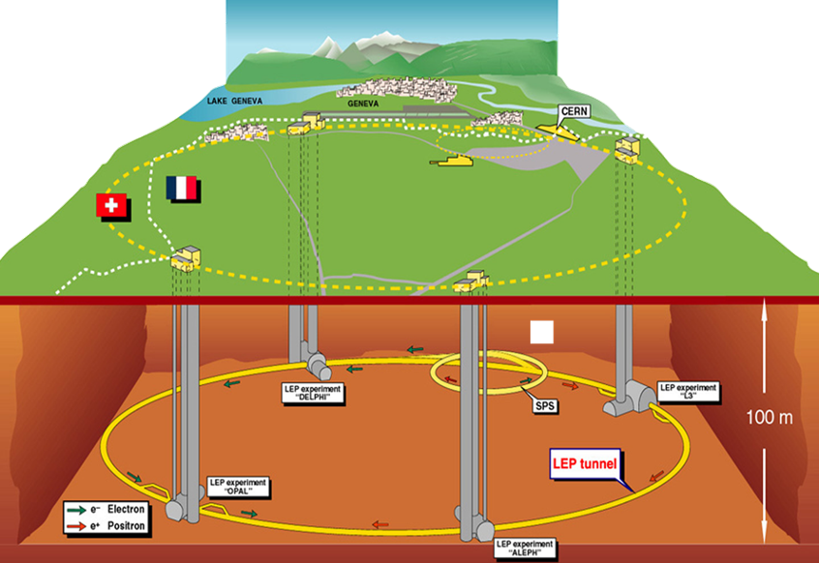
Large Electron Positron collider
LEP
1989-2000

Slide 13
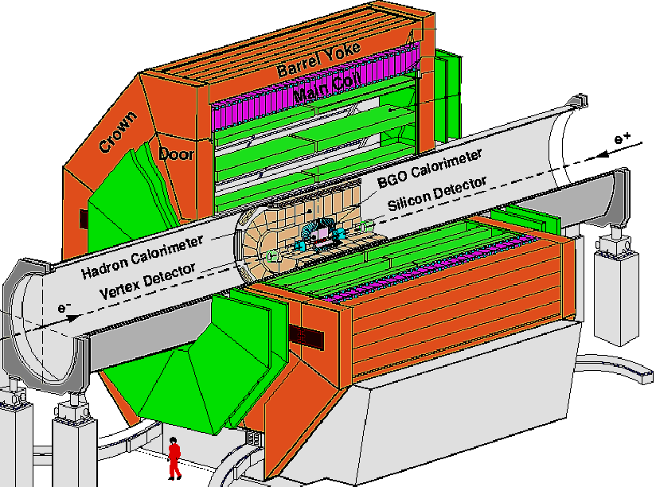
The L3 LEP Experiment
LEP
1989-2000

Slide 14
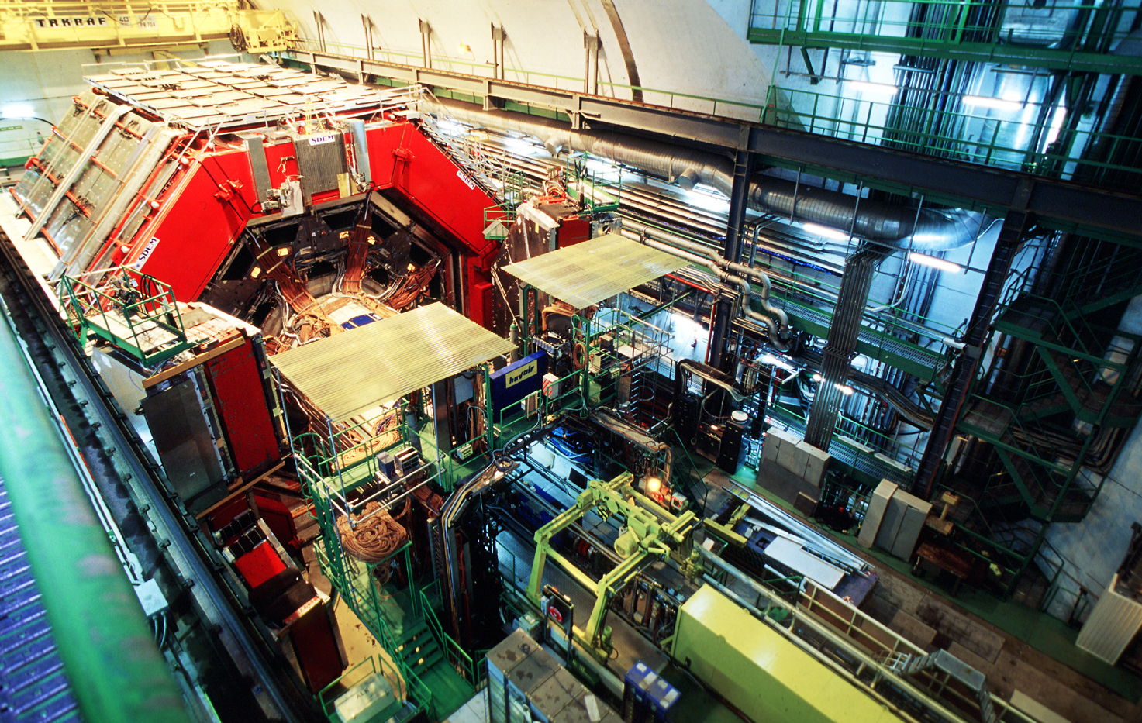
The L3 LEP Experiment

Slide 15
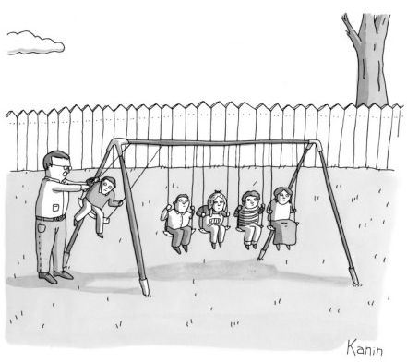
Scientific Experiments
If it moves, it’s biology.
If it smells, it’s chemistry.
If it doesn’t work, it’s physics..

Slide 16

All possible forms of matter are produced

Slide 17

All possible forms of matter are produced

Slide 18

The Elementary Particles
Generation:
I
II
III
Charge
u
c
t
+2/3 e
quarks
(1976)
(1995)
d
s
b
-1/3 e
(1947)
(1978)
e
μ
τ
-1 e
leptons
(1895)
(1936)
(1973)
ν_{e}
ν_{μ}
ν_{τ}
0 e
(1956)
(1963)
(2000)
Matter

Slide 19
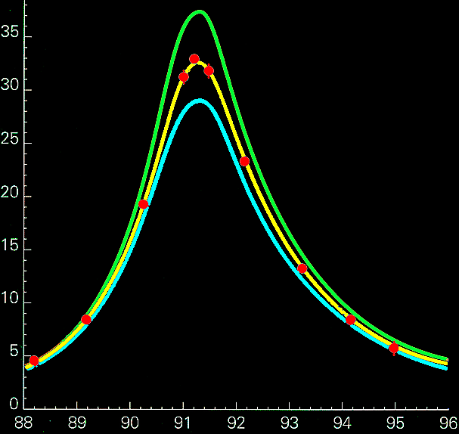
CERN 1993: There are exactly 3 generations!
Generation:
I
II
III
Charge
LEP
u
c
t
+2/3 e
quarks
(1976)
(1995)
4 neutrino’s
d
s
-1/3 e
b
The number of events
3 neutrino’s
(1947)
(1978)
2 neutrino’s
e
μ
τ
-1 e
leptons
(1895)
(1936)
(1973)
ν_{e}
ν_{μ}
ν_{τ}
0 e
(1956)
(1963)
(2000)
measurements
Matter
Collision Energy (GeV)

Slide 20
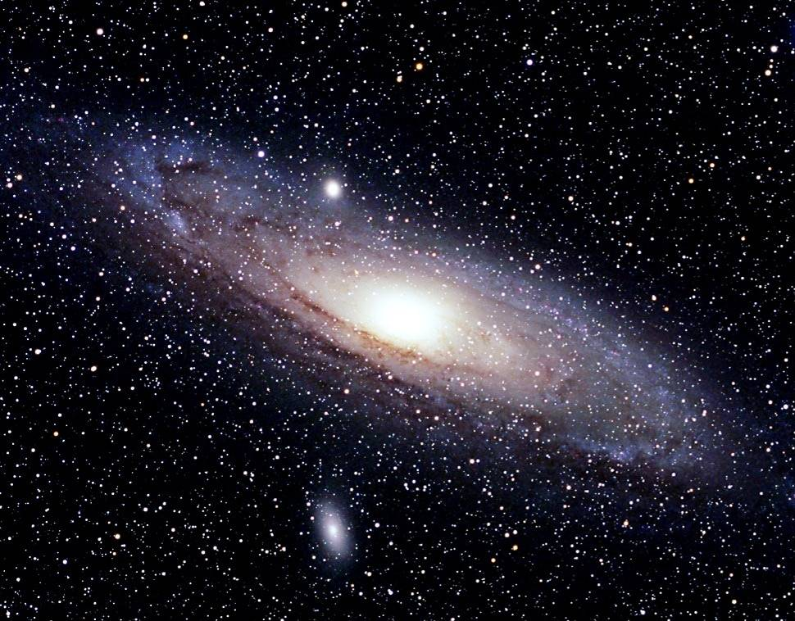
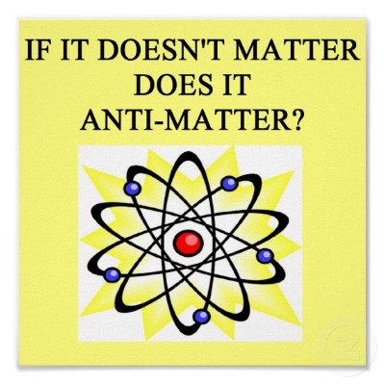
Is this all there is?
Generation:
I
II
III
Charge
u
c
t
+2/3 e
quarks
~3
1200
176300
d
s
b
-1/3 e
~7
120
4300
e
μ
τ
-1 e
leptons
0.511
106
1777
ν_{e}
ν_{μ}
ν_{τ}
0 e
~0
~0
~0
Matter
1 MeV = 1.8 x 10 ⁻³⁰ ⁻kg

Slide 21
Antimatter and the Big Bang

Slide 22
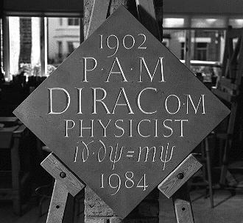
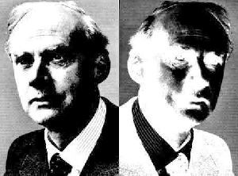

Physics of elementary particles
Revolutions early last century:
  Theory of Relativity
  Quantum Mechanics
Paul Dirac: relativistic
quantum theory!
(Westminster abbey)
Prediction Dirac 1928:
For each matter particle
there exists an antimatter
Particle!
Dirac
AntiDirac

Slide 23
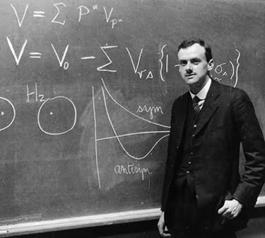
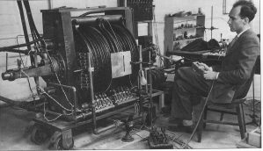

1928: Dirac predicts anti-particles
1932: Anderson discovers anti-electron
Anderson saw an electron with “wrong” charge : e⁺
Observed in a cloud chamber

Slide 24
The Elementary Particles
Generation:
I
II
III
Charge
u
c
t
+2/3 e
quarks
d
s
b
-1/3 e
e
μ
τ
-1 e
leptons
ν_{e}
ν_{μ}
ν_{τ}
0 e
Matter

Slide 25
The Elementary Particles
Generation:
I
II
III
Charge
Charge
I
II
III
u
c
t
+2/3 e
-2/3 e
u
c
t
quarks
d
s
b
-1/3 e
+1/3 e
d
s
b
e
μ
τ
-1 e
+1 e
e
μ
τ
leptons
ν_{e}
ν_{μ}
ν_{τ}
0 e
ν_{e}
ν_{μ}
ν_{τ}
0 e
Matter
Anti-matter

Slide 26
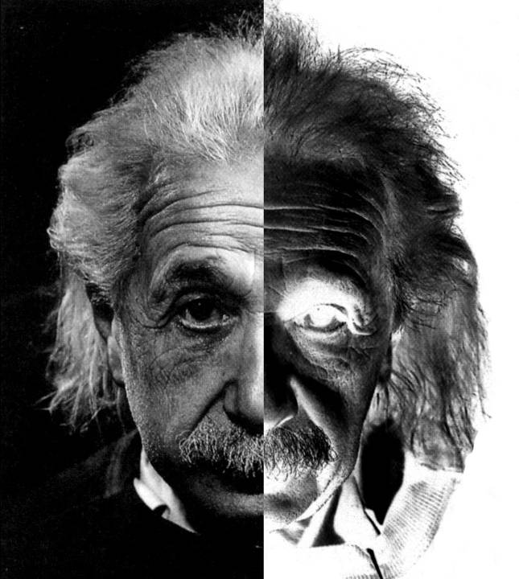
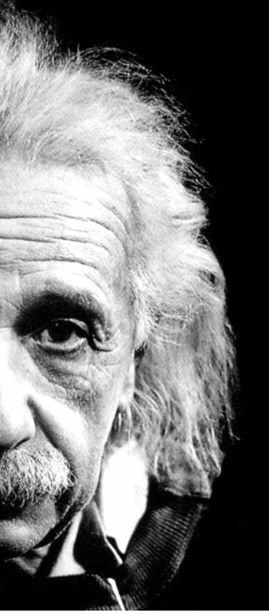
matter
anti-matter
positron
anti
elektron
electron
e
e
anti
quarks
quarks
u
u
Energy =
Matter + Antimatter
E=mc²
anti
up
up
d
d
anti
down
down

Slide 27
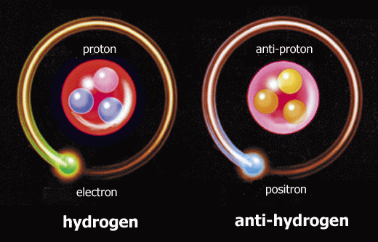
Antimatter
Hydrogen atom
Anti-hydrogen atom

Slide 28
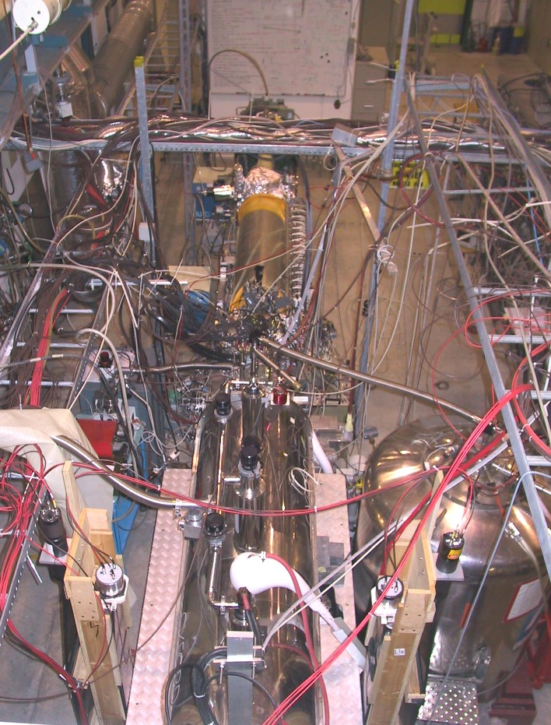
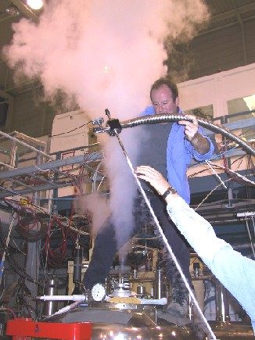
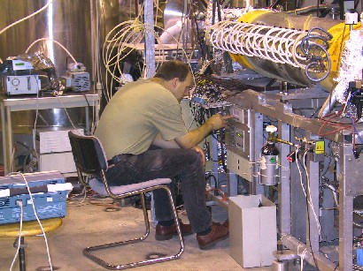
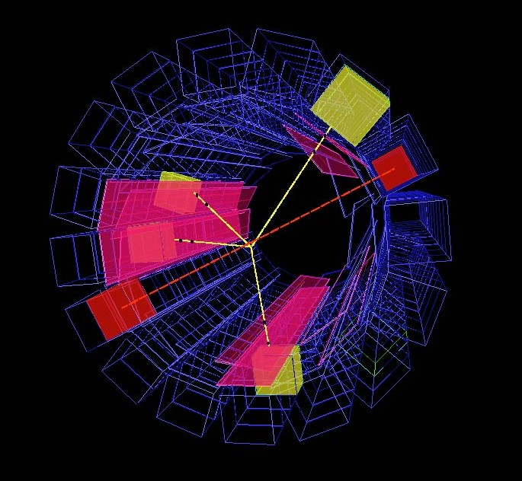
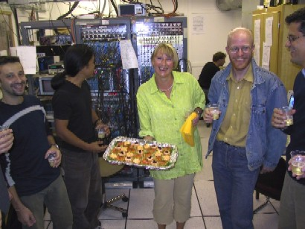
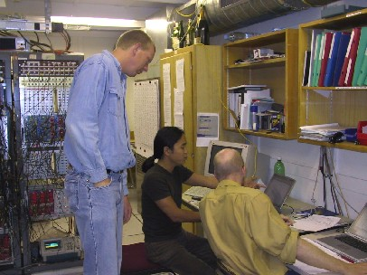
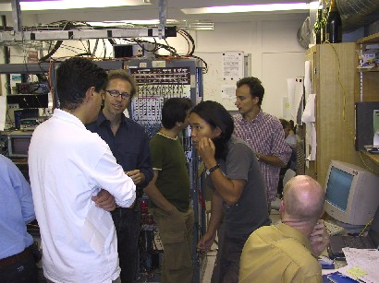
The ATHENA experiment at CERN
Antimatter really exists!
Notes:
p+ p- → pi+pi-pi+pi- (yellow) and e+e- →gamma gamma (red)

Slide 29
A world of matter…
atom
quarks
electron
neutron
proton
Nucleus

Slide 30
…and a world of antimatter?
Identical !
anti-plant
anti-atom
anti-quarks
anti-electron
anti-neutron
anti-proton
anti-nucleus

Slide 31
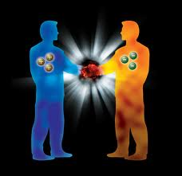
Is there antimatter in nature?
Does it exist on Earth?
No, we would immediately see it:
  “Annihilation”
e
e
+
-

Slide 32
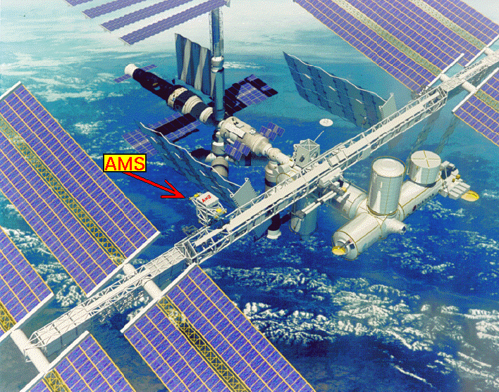

Is there antimatter in cosmic rays?
  The AMS experiment
The answer:
No!
Notes:
In March 2013 Sam Ting reported 400 000 positrons by AMS with a positron over electron ratio increasing between 10 GeV and 250 GeV, consistent with dark matter annihilation.

Slide 33
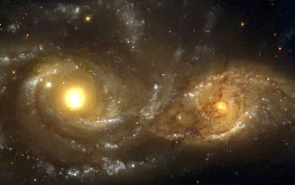
Are there antimatter galaxies?
No!
e
e
(matter + anti-matter = Intense gamma radiation)
+
-
Notes:
.

Slide 34
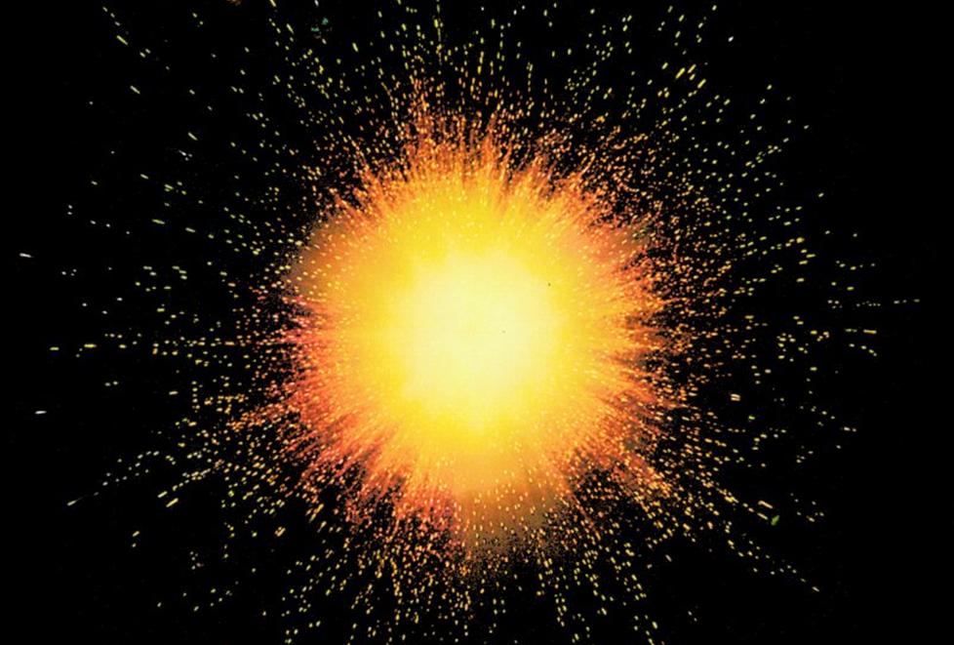
Back to the Big Bang
Assumption: matter and antimatter is produced!
Notes:
.

Slide 35
The early hot universe
Time=0.00000000001 second
Suppose:
matter:
1000000001
(E=mc²)
antimatter:
1000000000
light
So: “Teeny-weeny” more matter particles
than antimatter particles

Slide 36
The cooling (expanding) universe
Time ~1 second
matter
antimatter
light
After cooling
and
annihilate
What remains: lots of light and little matter
Ratio : 100000000 : 1
Our current universe….

Slide 37
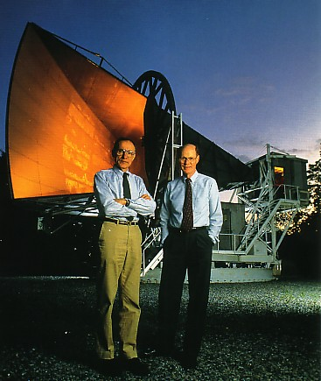
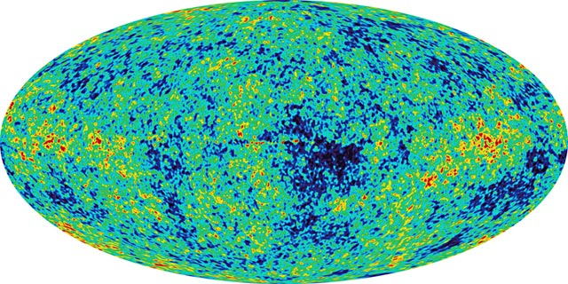
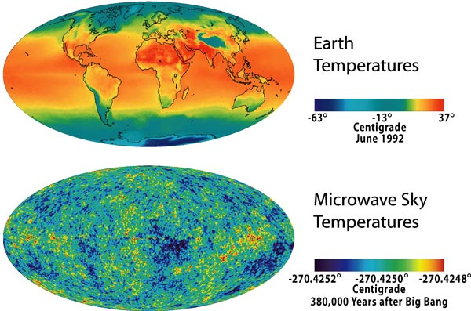
Cosmic background radiation
1964: Penzias en Wilson
discover: “background light”
(photons)
Remnant of the Big Bang
A temperature map …
of the universe!
-270⁰ C
For each matter particle there are a billion photons
2.7248K
2.7252K
Notes:
Penzias and Wilson were looking for weak radiosignals in universe. Their goal was to test it for communication sattelites. However they observed a very strong signal: background light from big-bang. (Initially suspected suspected noise due to bird-shit on the radiotelescope.) This is far(!) infrared light, invisible for the hunman eye. Compare it to radiation from microwave: 1mm waves. One of most important cosmological discoveries. It is sort of temperature radiation. Nobelprize in 1978. Mather and Smoot got the nobelprize in 2006 for Cobe satellite. Angular distribution. Amazing fact is that there are a factor billion more photons in the universe than matter particles.

Slide 38
The universe as we observe it today
Observed
background light:
“lots”
(1000000000)
+
Remaining matter:
“little”
( 1 )

Slide 39
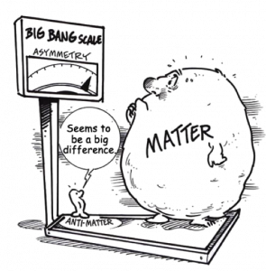
Big Bang: only matter, no antimatter?

Slide 40

The Standard Model
Particles, Forces and Higgs

Slide 41
The Elementary particles: 3 Generations
Generation:
I
II
III
Charge
u
c
t
+2/3 e
quarks
(1976)
(1995)
d
s
b
-1/3 e
(1947)
(1978)
e
μ
τ
-1 e
leptons
(1895)
(1936)
(1973)
ν_{e}
ν_{μ}
ν_{τ}
0 e
(1956)
(1963)
(2000)
Matter

Slide 42





Four fundamental Forces
Gravity :
Strong nuclear force:
Works on all particles with mass
Works on all quarks
Electromagnetism:
Weak nuclear force:
Works on all charged particles
Works on all particles

Slide 43

Force = particle exchange!!
The particle exchanged is called a “quantum” ➔ Quantum Mechanics
1) Electromagnetism: Photon γ 2) Strong nuclear force: gluon
3) Weak nuclear force: W⁺, W⁻, Z⁰ 4) Gravitation: graviton ??
The quantum of gravitation has never been observed.

Slide 44
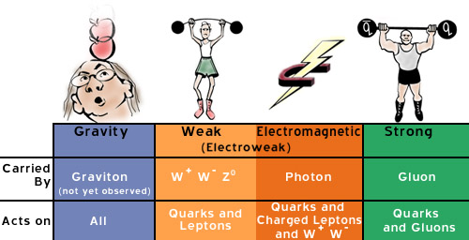
How strong are the forces?
Strength
0.00000000000000000000000000000000000000001
0.0001
1
60

Slide 45
The Standard Model

Slide 46
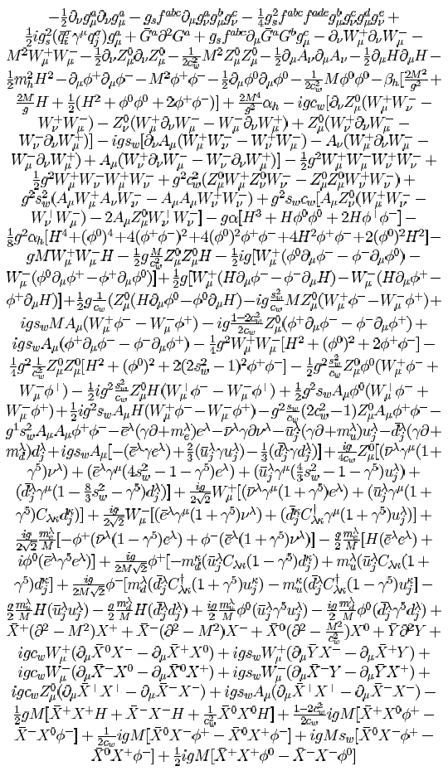
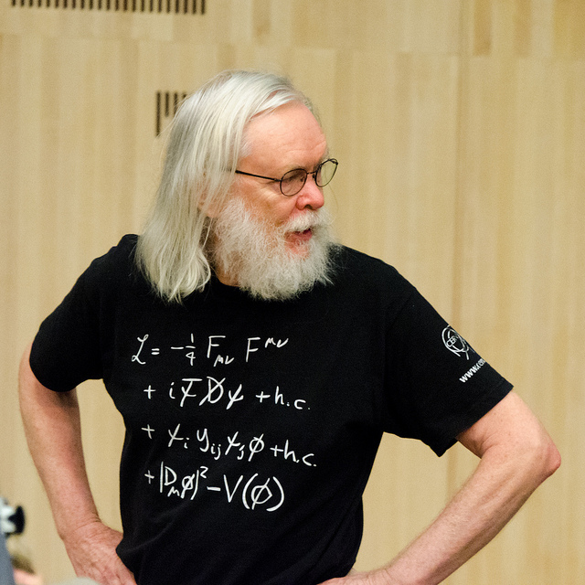
The Standard Model

Slide 47
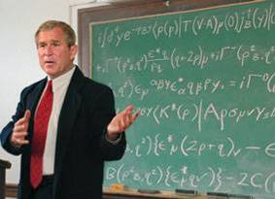
The Standard Model

Slide 48
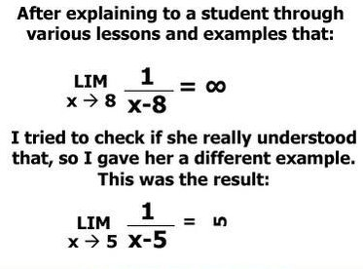

Slide 49

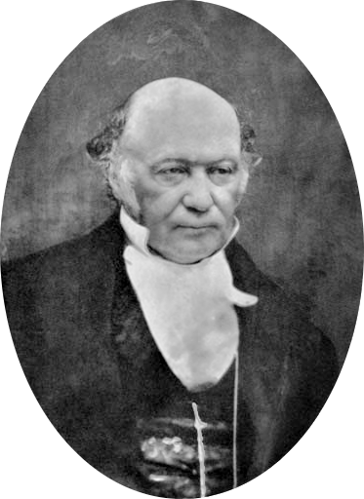
Quantum Field Theory
Particles and Forces are “fields”, think of a quantum wave function: ψ(x,t)
The fundamental object is the Lagrangian
(Classical mechanics: equation of motion follows)
L = T - V
T = Kinetic energy
V = Potential energy
Lagrange
1736 - 1813
Hamilton
1805 - 1865
Standard model of Quantum field theory (recipe for experts):
Write down the Lagrangian for all existing particles and forces
(Electromagnetism + Weak force + Strong force, forget gravity).
Require that the Lagrangian has certain mathematical symmetries.
The rest follows automatically: behaviour of particles and their interactions!

Slide 50
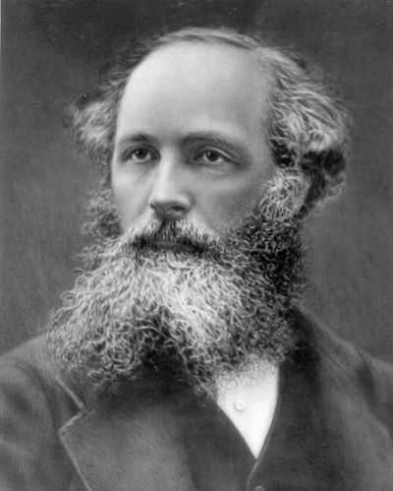
The Standard Model
Maxwell

Slide 51
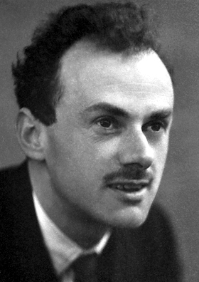
LagrangianL
The Standard Model
Maxwell
Dirac

Slide 52
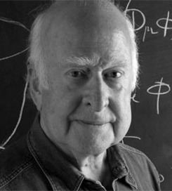
The Standard Model
Maxwell
Dirac
Higgs

Slide 53
The Standard Model
Force-fields
Coupling of forces
to matter-particles
Coupling of Higgs
to matter-particles
Higgs field

Slide 54
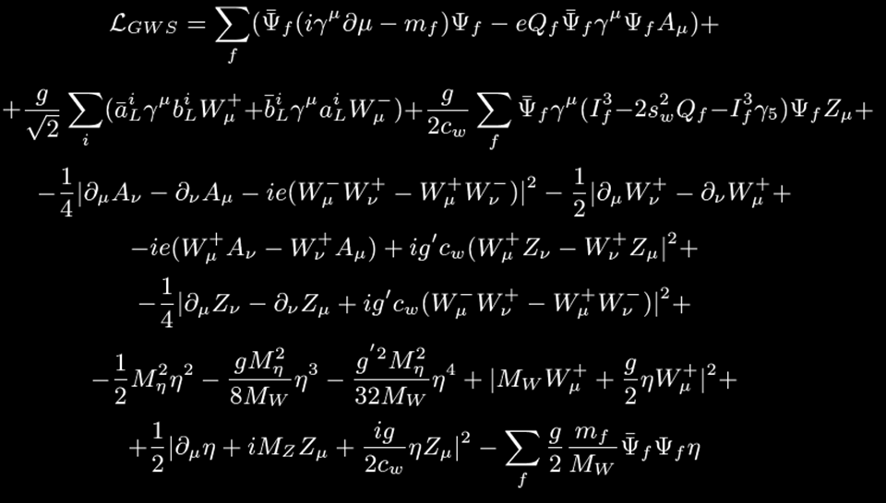
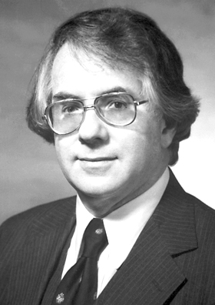
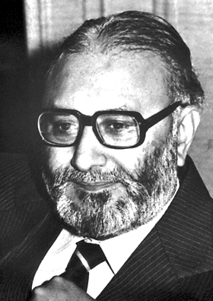

Standard
Model
Sheldon Glashow
Abdus Salam
Steven Weinberg

Slide 55


Slide 56


Slide 57


Slide 58
The Standard Model
Force-fields
Coupling of forces
to matter-particles
Coupling of Higgs
to matter-particles
Higgs field

Slide 59


Higgs Field and Particle
Higgs field is uniform, difficult to observe.
Higgs-boson particle is “wave” of the field.
Mass results from interaction of matter particles with the Higgs field.

Slide 60

The Standard Model
Higgs particle
a “field-quantum”
Higgs field
Compare:
  A photon is a quantum of electromagnetic field
  Waterwave

Slide 61
The Standard Model

Slide 62

LHC: Quest for
Higgs Boson

Slide 63


Slide 64

CERN: the LHC collider
Re-using the LEP tunnel
With new experiments.

Slide 65


The LHC accelerator
Total beam energy is equal to that of a TGV at high speed.
Proton beam 1
Proton beam 2

Slide 66

The Atlas Experiment

Slide 67



The Atlas Experiment
Largest photocamera on earth
45m x 25 m
2500 physicists
80 MegaPixel camera: 40.000.000 photos per second

Slide 68

The Atlas Experiment during construction
Largest man-made underground cavity on earth

Slide 69


Slide 70

The Atlas muon detector

Slide 71

Atlas: side-view

Slide 72

Atlas: front-view

Slide 73




20 November 2009

Slide 74

Particle collisions

Slide 75
All possible particles are created

Slide 76


Slide 77
pp→Higgs→ZZ→μμμμ?
μ
μ
μ
μ
Atlas event

Slide 78

Higgs→ZZ→μμμμ?
Atlas:
CMS:

Slide 79

Higgs→γγ?
Atlas:
CMS:

Slide 80


Slide 81


Slide 82

July 4, 2012
Higgs dependence day July 4th

Slide 83


CERN Auditorium
4 July 2012

Slide 84

Nobel prize in Physics 2013
Francois Englert
Peter Higgs

Slide 85


Slide 86




Slide 87

The Vacuum

Slide 88


Electron in Higgs field
e
e
1964
H

Slide 89


1897
1937
1975
τ
μ
e
Electron, e
Spin ½
Charge −1
Lifetime ∞
Mass .511 MeV
Muon, μ
Spin ½
Charge −1
Lifetime 2.2 μs
Mass 106 MeV
Tau, τ
Spin ½
Charge −1
Lifetime 290 fs
Mass 1777 MeV

Slide 90

e
μ
τ
© Jean-Paul Keulen

Slide 91

So…

Slide 92
Missing Antimatter and Higgs: again 3 ?!

Slide 93
The early hot universe
Time=0.00000000001 second
Suppose:
matter:
1000000001
anti-matter:
1000000000
light
So: “Teeny-weeny” more matter particles
than anti-matter particles

Slide 94




Escher’s impression on a world of matter and antimatter
matter
color anti-color
Anti-matter
left right

Slide 95
The Standard Model
Force-fields
Coupling of forces
to matter-particles
Coupling of Higgs
to matter-particles
Higgs field

Slide 96


Matter vs Antimatter
Makoto Kobayashi
Toshihide Maskawa
3 generations!
Nobelprize 2008
1972: Theory: with 3 generations of particles a difference in forces of matter and anti-matter is possible.
  This is caused by the Higgs field!

Slide 97
CERN 1993: There are exactly 3 generations!
Generation:
I
II
III
Charge
u
c
t
+2/3 e
quarks
(1976)
(1995)
d
s
b
-1/3 e
(1947)
(1978)
e
μ
τ
-1 e
leptons
(1895)
(1936)
(1973)
ν_{e}
ν_{μ}
ν_{τ}
0 e
(1956)
(1963)
(2000)
Matter

Slide 98
The Standard Model
B-mesons:
particles with a b-quark

Slide 99

The LHCb Experiment

Slide 100





The LHCb Detector
23 sep 2010 19:49:24
Run 79646 Event 143858637
Compare millions of particle and antiparticle decays…
…and look for differences between matter and antimatter!
100

Slide 101


Beauty particles: a difference between matter and anti-matter
B particle decays to a K⁺ and π⁻ particle
anti-B particles decays to a
K⁻ and π⁺ particle
Matter process
Antimatter process
B⁰ → K⁺ π⁻
B⁰ → K⁻ π⁺
But left and right not at the same rate!
This only occurs in rare decays in which particles of the 1st, 2nd and 3rd generation are involved.
This occurs exactly as predicted by the Higgs interaction!

Slide 102

Beauty particles: a difference between matter and anti-matter
B particle decays to a K⁺ and π⁻ particle
anti-B particles decays to a
K⁻ and π⁺ particlee
B⁰ → K⁺ π⁻
B⁰ → K⁻ π⁺
The laws of nature for matter and antimatter are clearly not 100% mirror-symmetric !

Slide 103
Escher’s impression on the difference between matter and anti-matter
matter
color anti-color
Anti-matter
left right

Slide 104

Are we done now?

Slide 105
The early hot universe
Time=0.00000000001 second
Suppose:
matter:
1000000001
anti-matter:
1000000000
light
So: “Teeny-weeny” more matter particles
than anti-matter particles

Slide 106
The early hot universe
Time=0.00000000001 second
Suppose:
matter:
The Standard Model explanation fails numerically. More
is needed than a Higgs particle!
1000000001
anti-matter:
1000000000
light
So: “Teeny-weeny” more matter particles
than anti-matter particles

Slide 107


Slide 108


Slide 109
Recent Excitement
X(750)?!

Slide 110
News from LHC high energy: 13 TeV
p p → ? → γ γ

Slide 111

Recent Excitement at the LHC!
Higgs discovery 2011-2012:
Atlas in Dec 2015 (!):
?
M_{Higgs} = 126 GeV
M_{X} = 750 GeV?
Statistical fluctuation?

Slide 112
Moriond conference 17-3-2016
Atlas:
CMS:
M_{X} = 750 GeV?
M_{X} = 750 GeV?
Either: statistical fluctuation, Or: revolution!

Slide 113


At the ICHEP conf (August 2016) we’ll know:
1936 Isidor Rabi:
?
the muon
M_{X} = 750 GeV?

Slide 114


Slide 115
X(750) ??
Higgs

Slide 116

Summary and Outlook
My personal fascination:
  Why are there three generations of fundamental particles?
Standard Model includes mathematical “accidents”.
Missing anti-matter is not explained.
Is there an answer with the leptons?
What is Dark Matter?
  New particles? X(750)? Standard Model→Supersymmetry?
  The LHC is searching for new particles…

Slide 117

Supersymmetry Particles ??

Slide 118

Thanks for your attention.
Beer?

